Slide 1

Adobe Spark Your Social Media to Enhance Your Communications
Notes:
Intro: Leah

Slide 2


Priddy Library
The Universities at Shady Grove
Rockville, Maryland
Emily Spangler - Library Services Specialist
espangl1@umd.edu
Leah Rufus - Graduate Assistant
lrufus@umd.edu
Notes:
Leah: Intro and USG info
Introduce ourselves and USG
Priddy Library is a UMD College Park branch library that serves the 9 institutions offering 80+ degree programs within the USMAI consortium
Not a traditional 4 year university, offers upper level courses and small class sizes in a convenient location (Montgomery County)
We are an academic library that is open to the public.
We have a wide range of degree options, and each program has a librarian that is their subject liaison

Slide 3
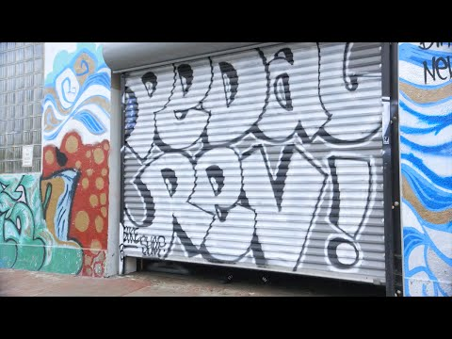
What is Adobe Spark?
Retrieved from Youtube, posted by Adobe
Notes:
Emily

Slide 4

What is Adobe Spark?
Page
Post
Video
Notes:
Emily
Adobe Spark is:
Posts - Create social media posts, ads, posters.
Videos - Create tutorials, how-tos, clips, video stories.
Pages - Create virtual resumes, blogs, galleries, web stories

Slide 5
Why Should You Use Adobe Spark?
Completely free
Adobe account allows you to login and sync onto multiple devices
Compatible with iPhone, iPad, and online computer (Android coming soon)
Allows you to create beautiful and professional-looking posts, videos, and web stories without having to be a graphic designer
Shareable, quick to make, and actually fun to use
Notes:
Emily
Easy to learn - by the end of this workshop you will be an Adobe Spark master

Slide 6
Where did we start?
Notes:
Leah

Slide 7
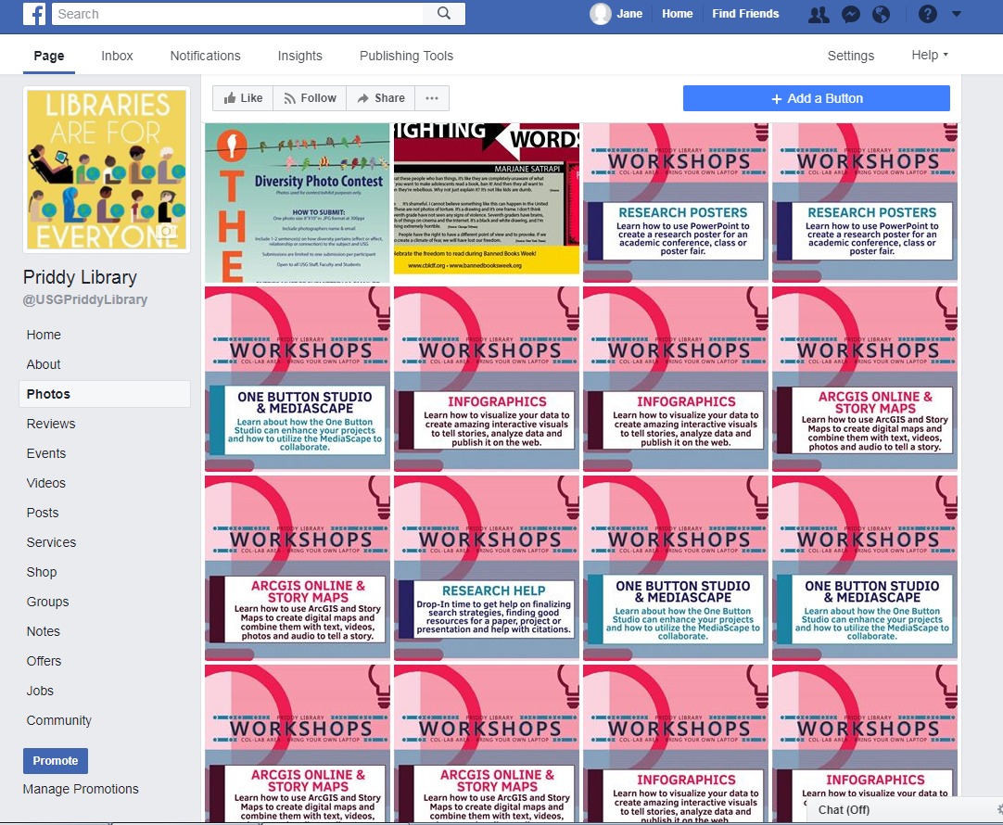
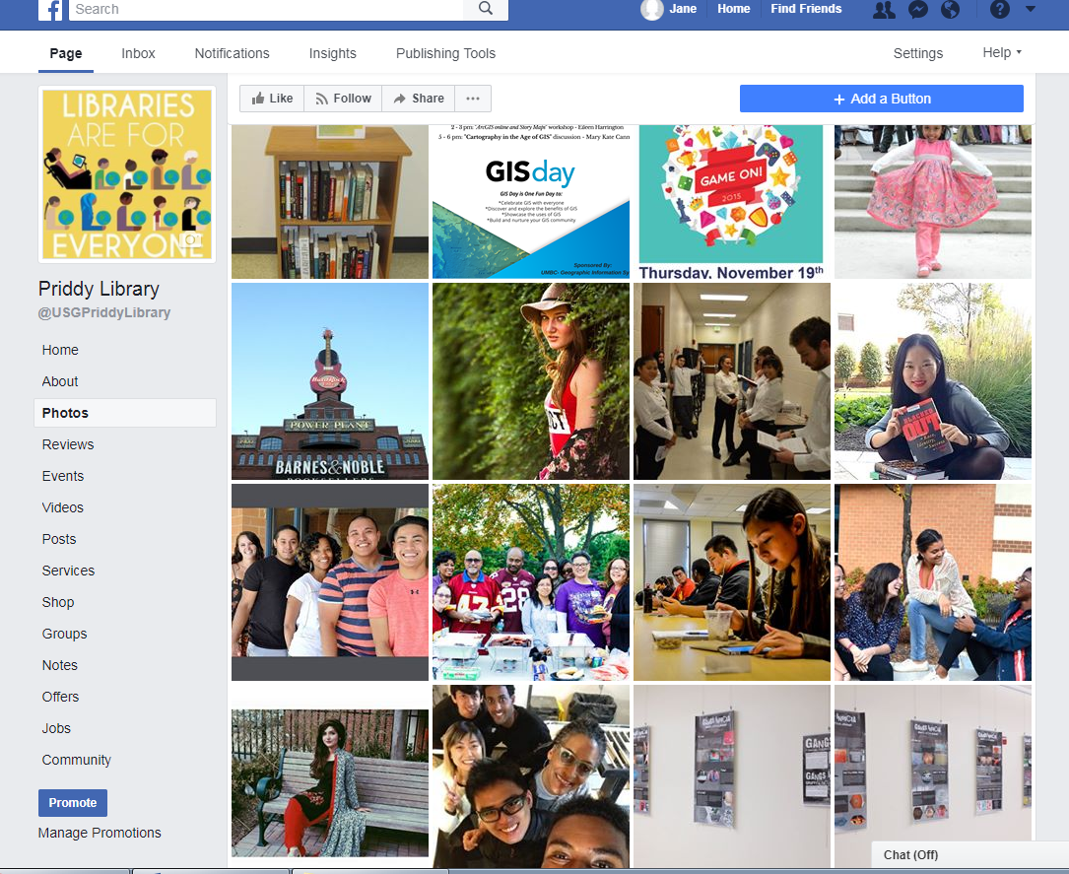
Before
Notes:
Leah

Slide 8
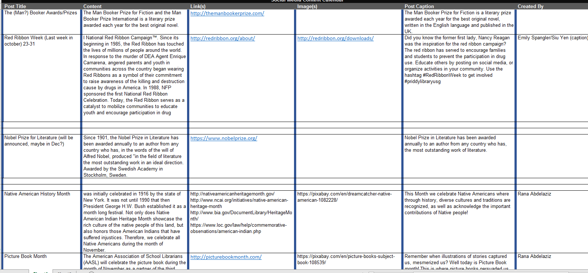
Greenposts
Posts that can be recycled every year without much effort
Notes:
Leah
Examples: Cultural month's, Library Card Sign-Up Month, American Archives Month, campus closings
These posts can range from serious (Suicide Prevention Week in September) to the fun (National Ice Cream Day in July)
Promote engagement and content in library social media

Slide 9
What changed?
Notes:
Emily

Slide 10

March 2017
Notes:
Emily
CIL fired us up to ramp up our social media
We observed that our social media wasn’t matching our patrons, primarily college students
As a result, we proposed creating an Instagram account for our library

Slide 11
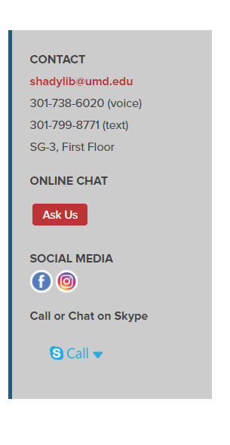
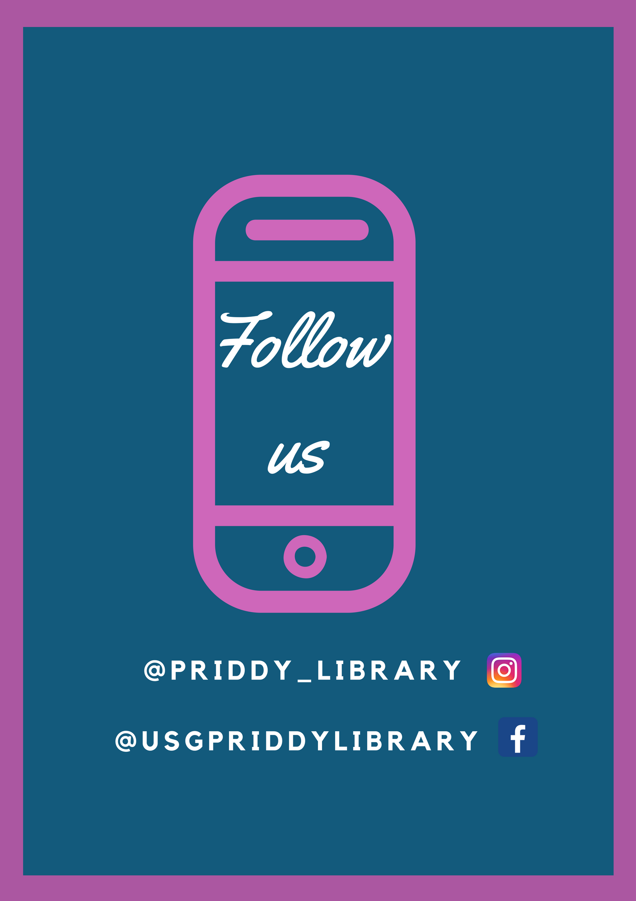
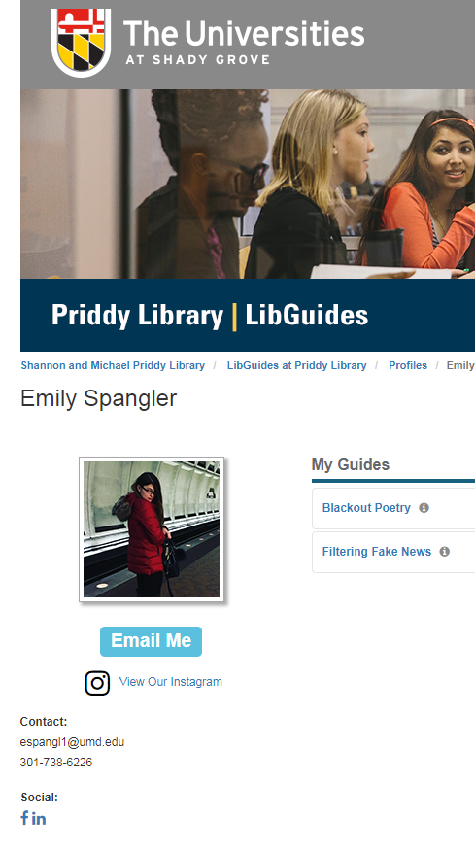
Priddy Library Social Media
Notes:
Emily
Our account created in April 2017
Consists of greenposts, posts promoting library services, events, staff spotlights, tutorials, etc.
We post anywhere from 3-4 times/week

Slide 12
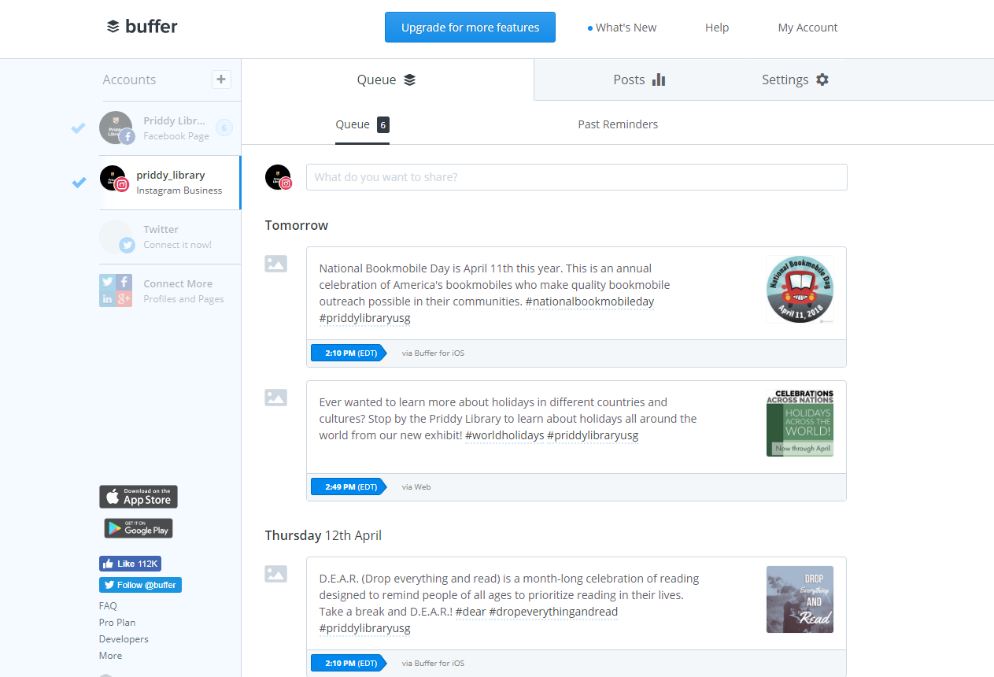
Scheduler - Buffer
Insert screenshot of Buffer
Notes:
Emily
With two social media accounts to manage, we needed a social media management system to effectively organize and push out posts
Buffer is free and easy to use
We can schedule, organize, and visualize posts that need to go out within the next week

Slide 13
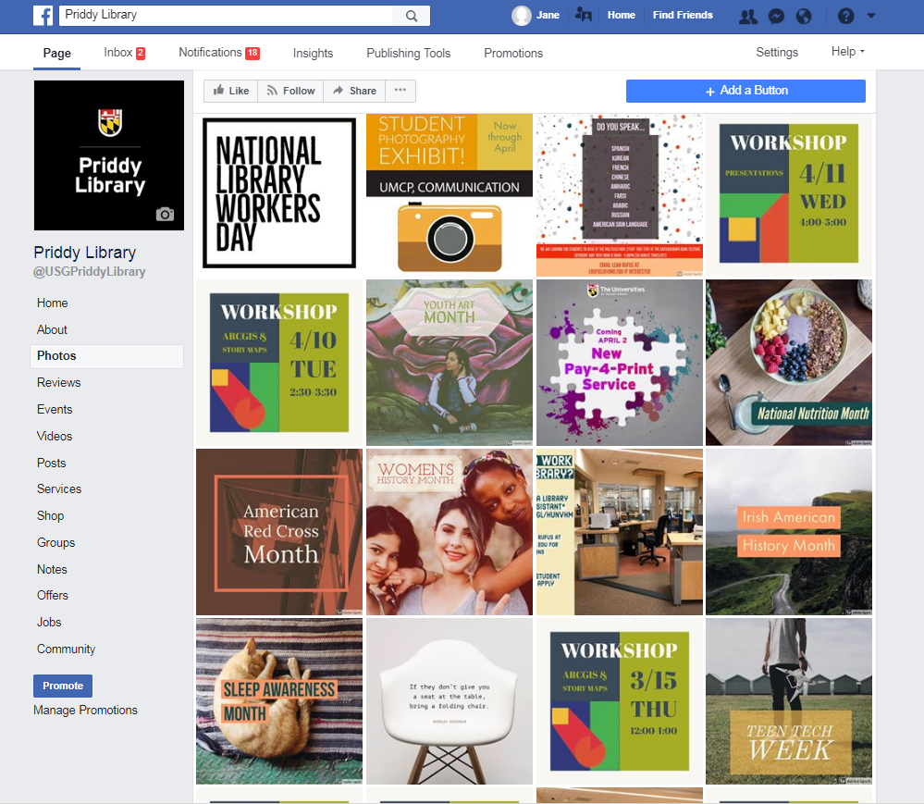
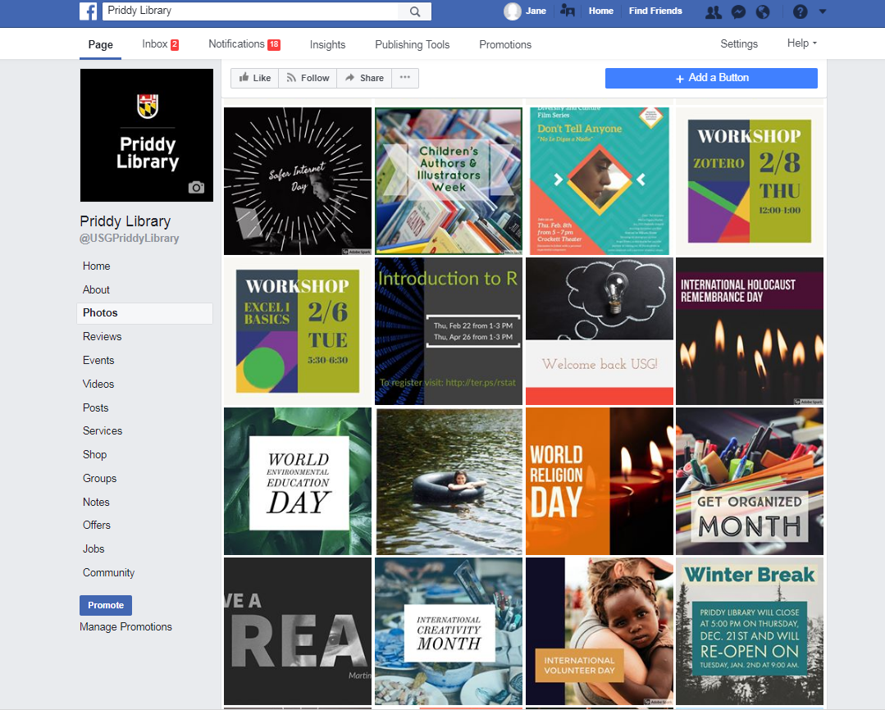
After
Notes:
Emily

Slide 14
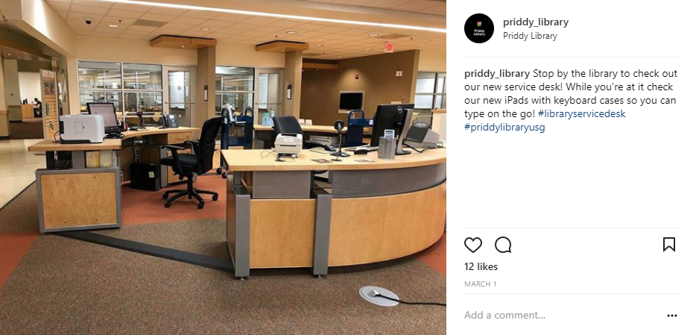
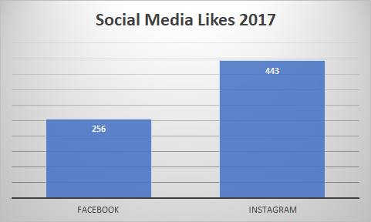
Analytics - 2017
Notes:
Emily

Slide 15
Teaching Adobe Spark
Notes:
Leah

Slide 16
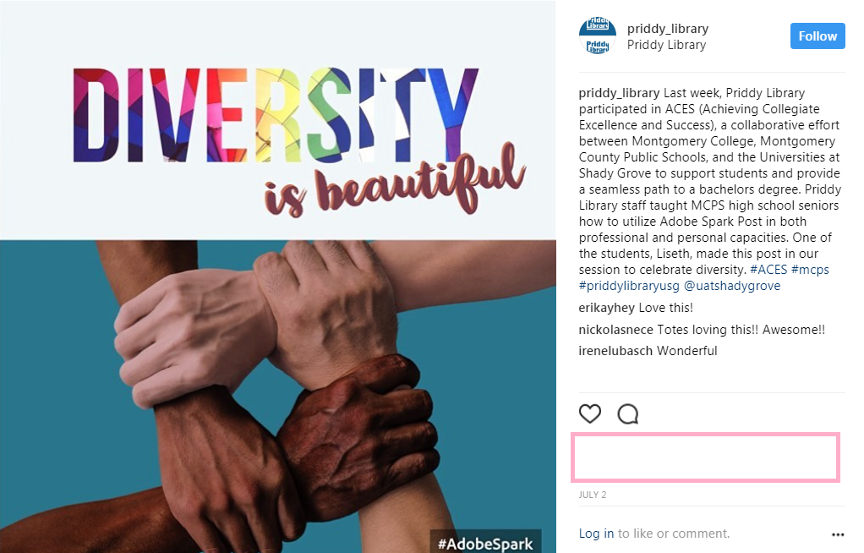
ACES Fair
Notes:
Leah
-Walkthrough of presentation
-Screengrab of student’s post

Slide 17
Summer R.I.S.E
Notes:
Leah
Summer Real Interesting Summer Experience

Slide 18
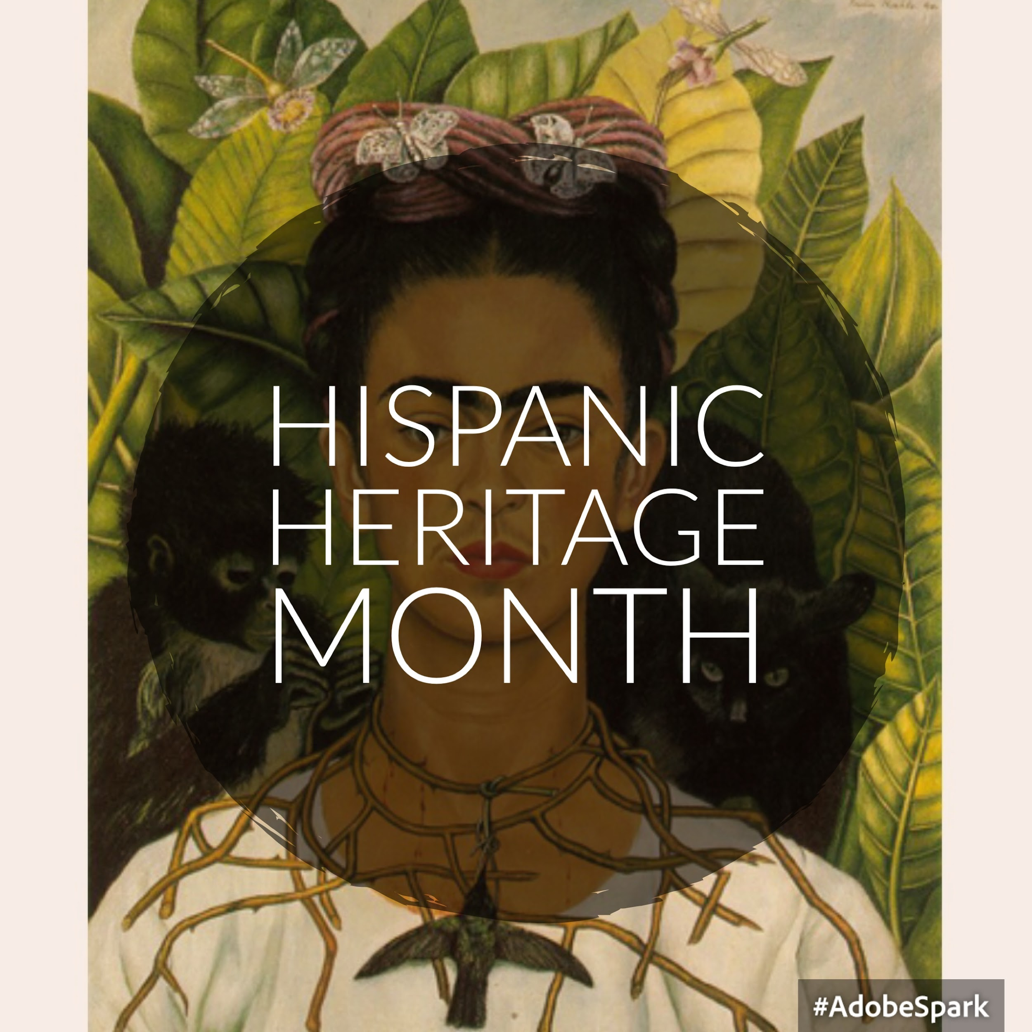
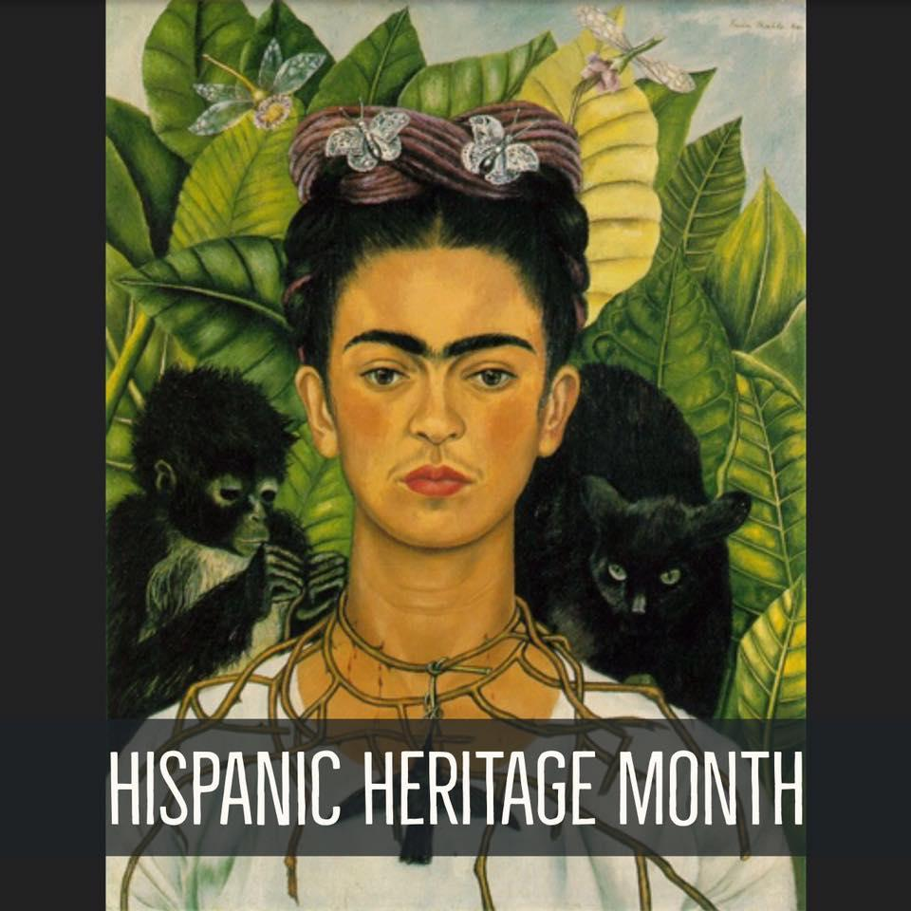
Lessons Learned
Notes:
Leah

Slide 19
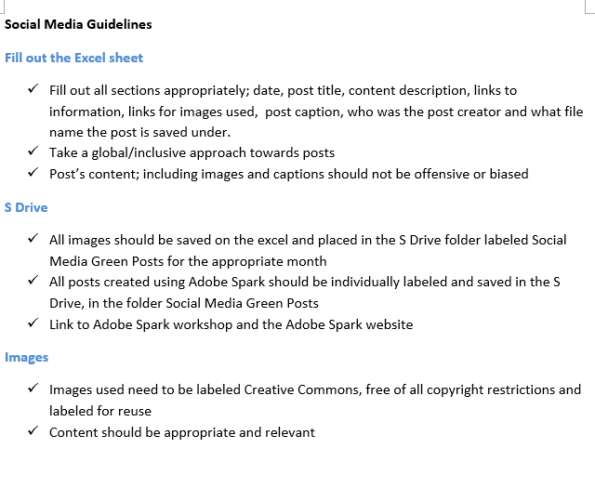
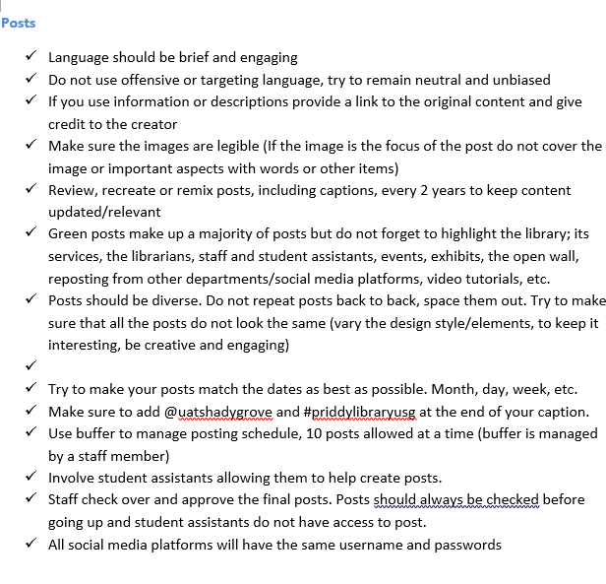
Social Media Guidelines
Notes:
Leah
Updated guidelines

Slide 20
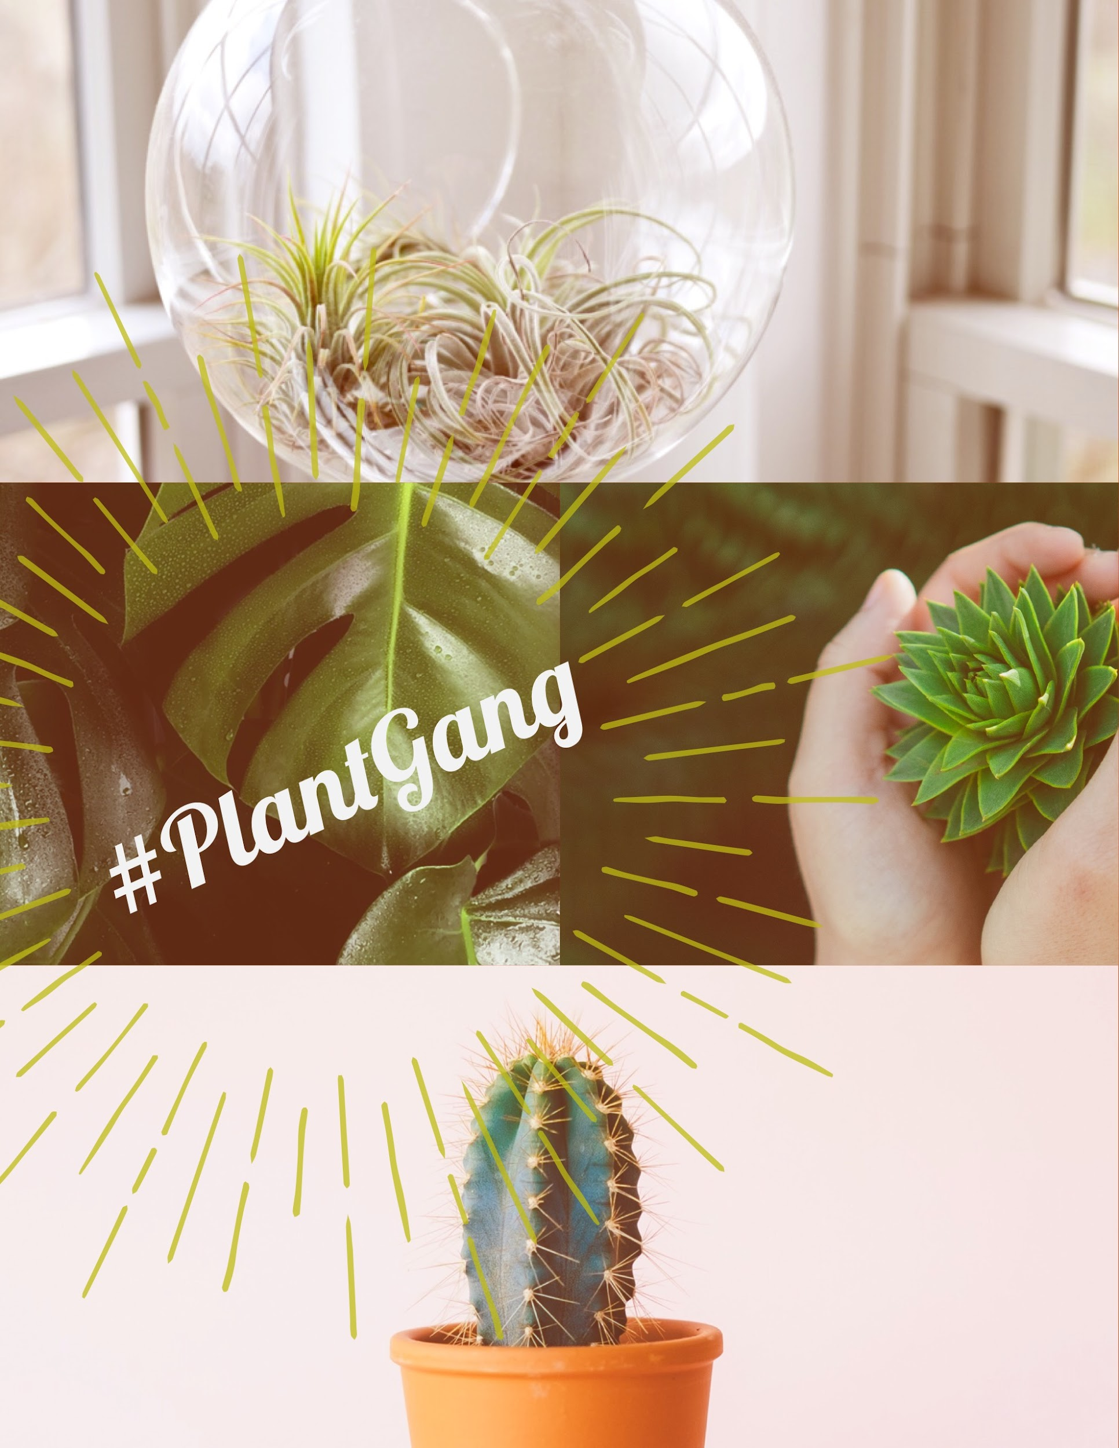
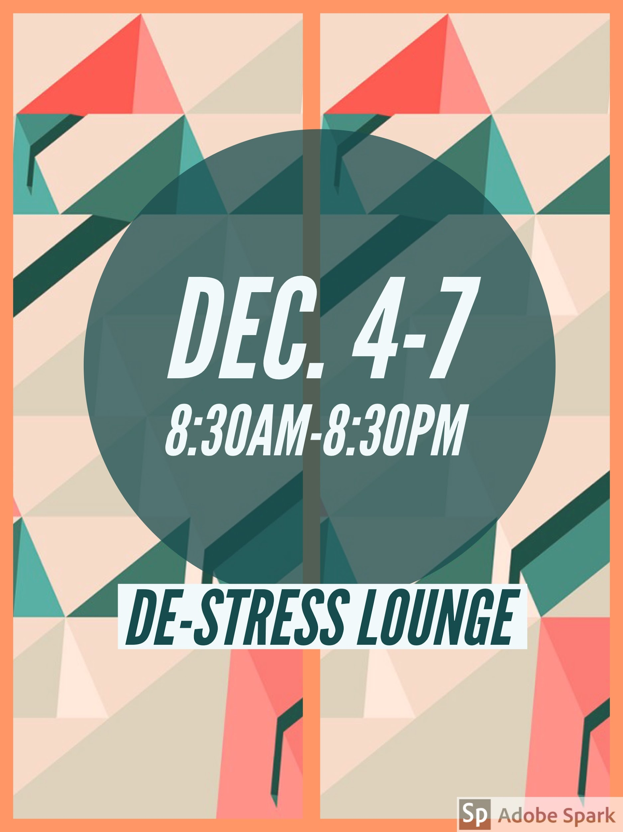
Library Workshop
Notes:
Leah

Slide 21
How We Use Adobe Spark
Notes:
Emily

Slide 22
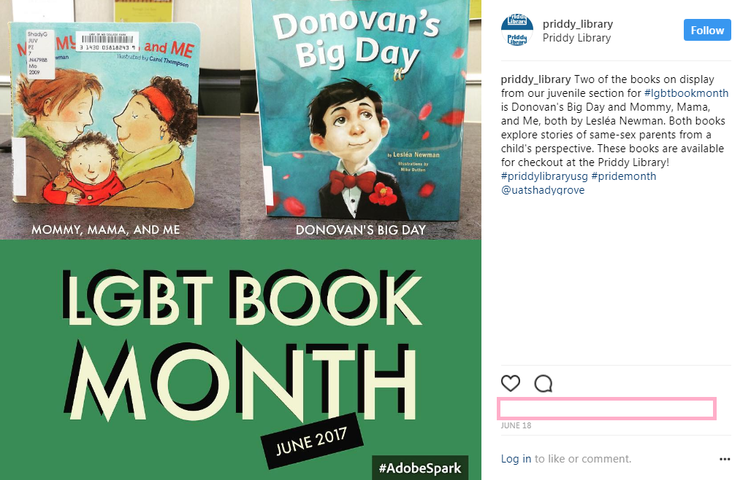
Exhibits
Notes:
Emily

Slide 23
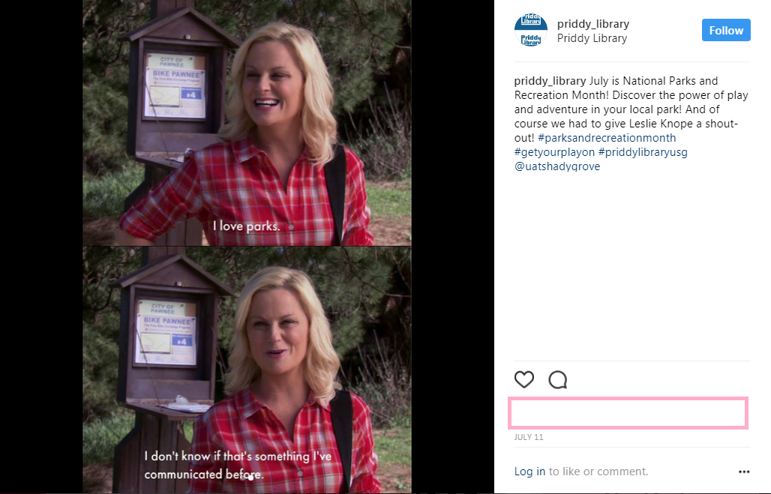
Memes
Notes:
Emily

Slide 24
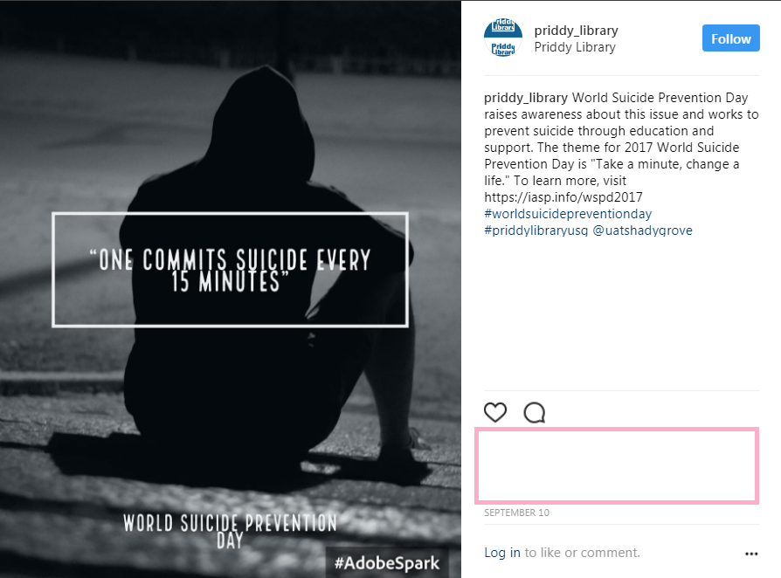
Greenposts
Notes:
Emily

Slide 25
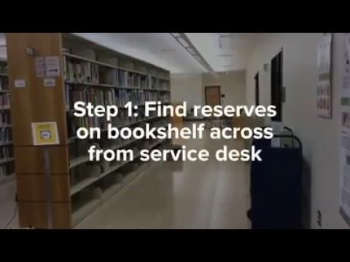
Library Service Tutorials
Insert Course reserves video
Notes:
Emily

Slide 26
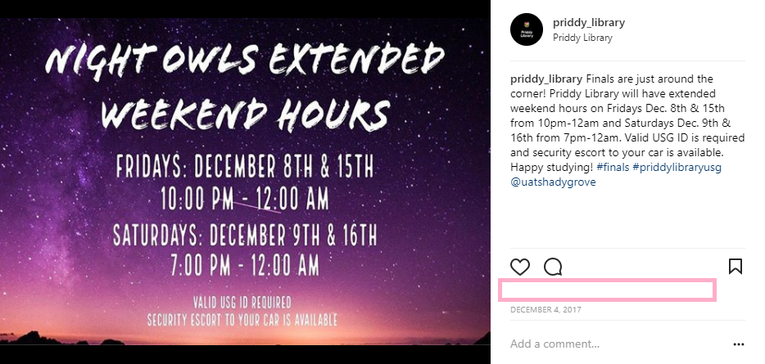
Promoting Library Services
Notes:
Emily

Slide 27
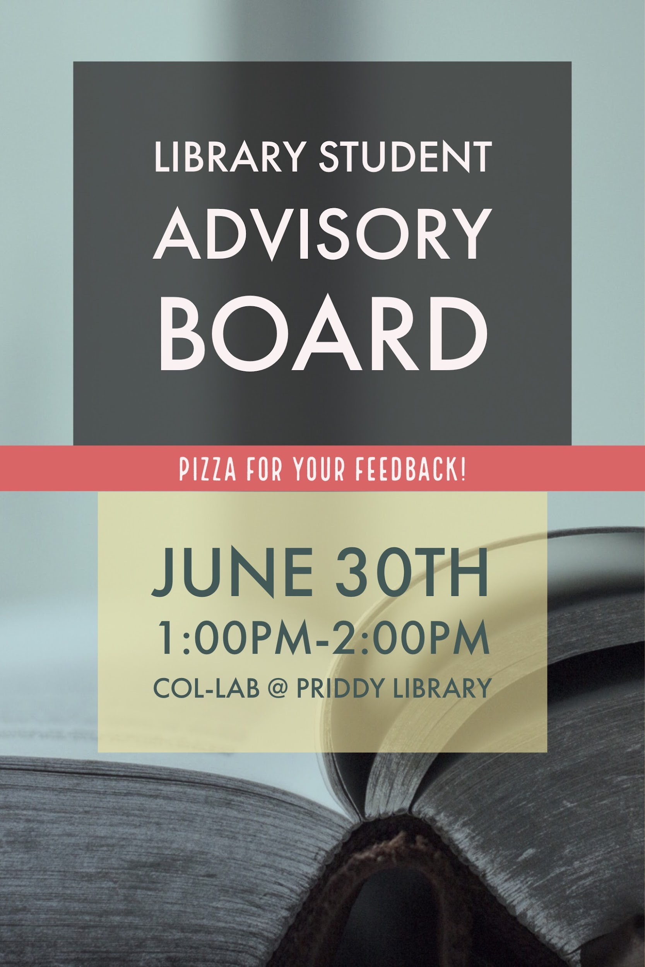

Library Promotional Materials
Notes:
Emily

Slide 28
Looking Ahead
Library service tutorials
Summer R.I.S.E. (Real Interesting Summer Experience)
Expand and re-visit Greenposts
Additional workshops on Pages and Videos
Explore additional social media platforms
Increase social media following and engagement
Notes:
Leah
Download Adobe Spark! Check it out!

Slide 29
Thank You!!
Interested in Adobe Spark and want more information?
Visit https://spark.adobe.com/

