Slide 1

Get Rid of It!: Eliminating Barriers to Improve Patron Services and Communication
Irene Münster and Emily Spangler
Priddy Library, The Universities at Shady Grove University of Maryland Libraries

Slide 2
Ideation & Design

Slide 3
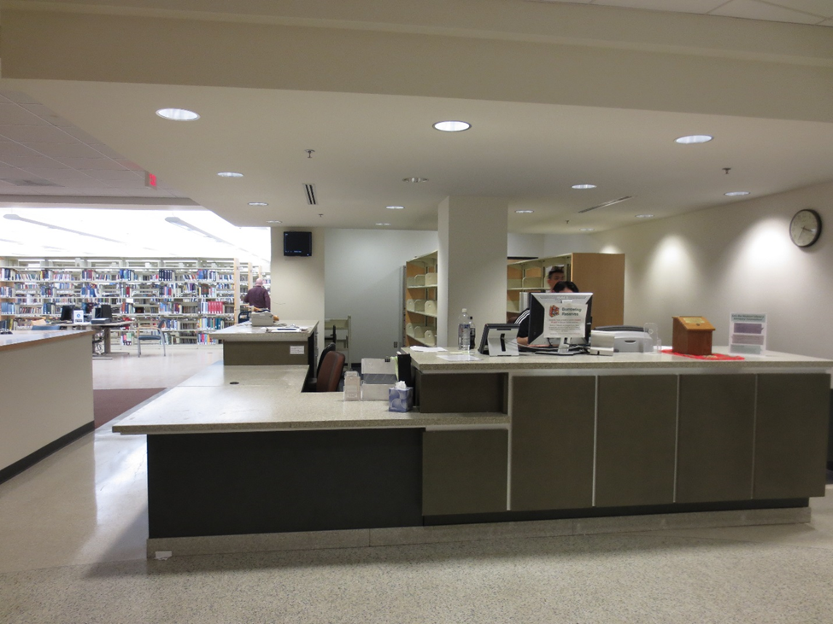

Slide 4
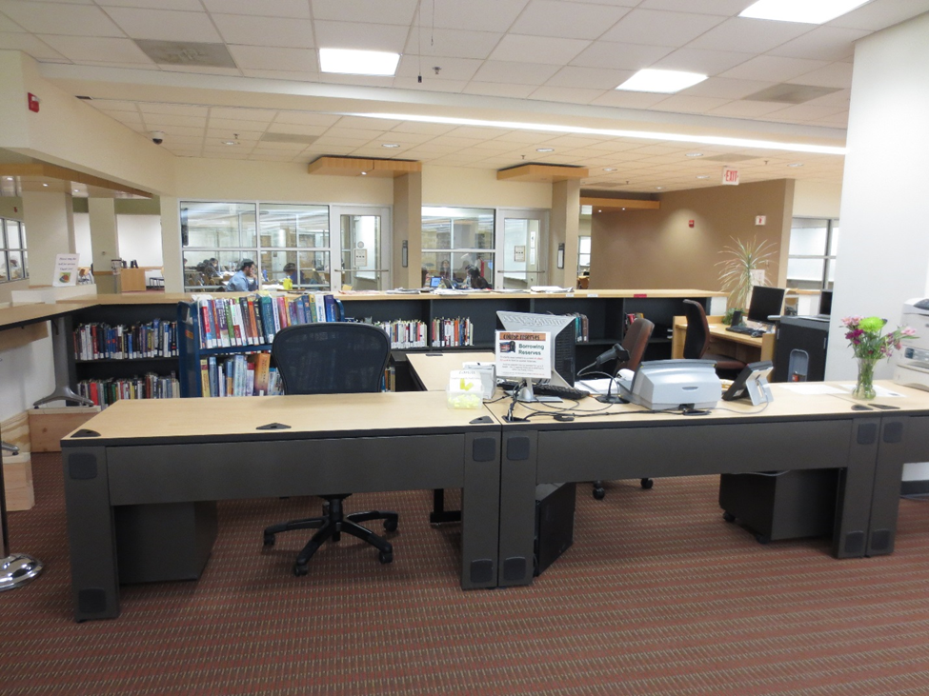

Slide 5
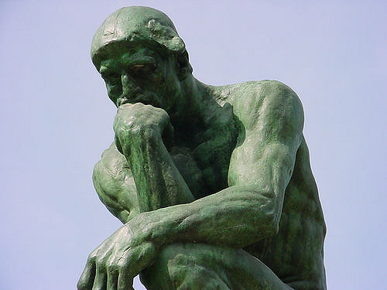
Source: https://www.flickr.com/photos/tmartin/32010732/

Slide 6




Slide 7
Implementation

Slide 8
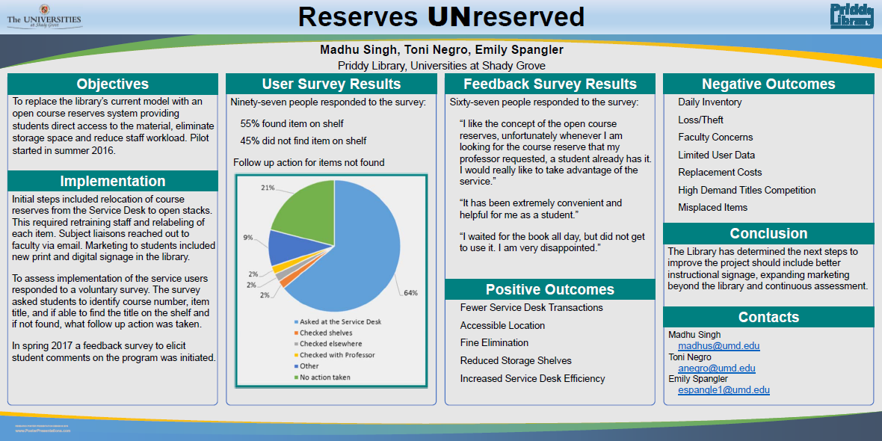

Slide 9
Get Rid of It!

Slide 10
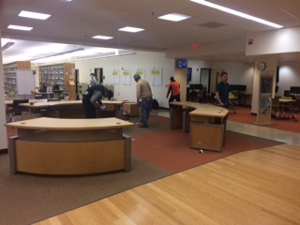

Slide 11
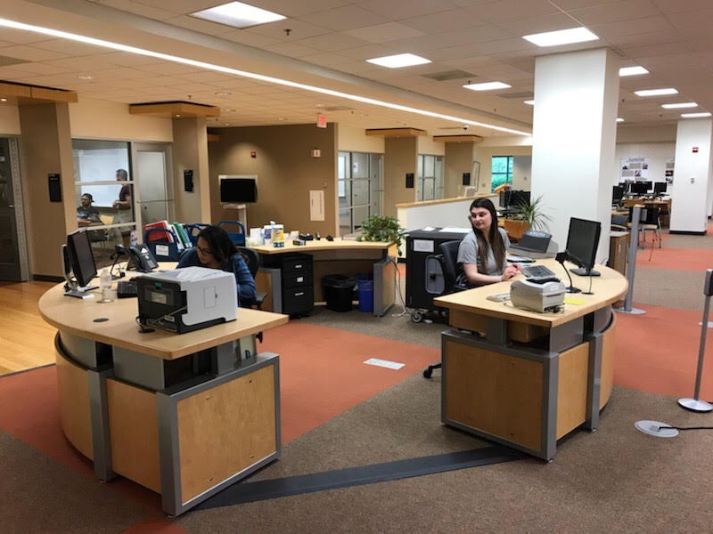

Slide 12
What Has Worked for Us
Central point in the library and better sightlines
Patrons and student assistants like the single-point Service Desk
Librarians have more time to devote to faculty and students
Opportunity for re-training student assistants in certain areas
Green library
Student assistants feel included and that they have a voice
Thank You!

