Slide 1
Our Stories in Numbers
Lulu Barnachea
Library Research and Innovation Practice Forum
McKeldin Library, June 8, 2017

Slide 2

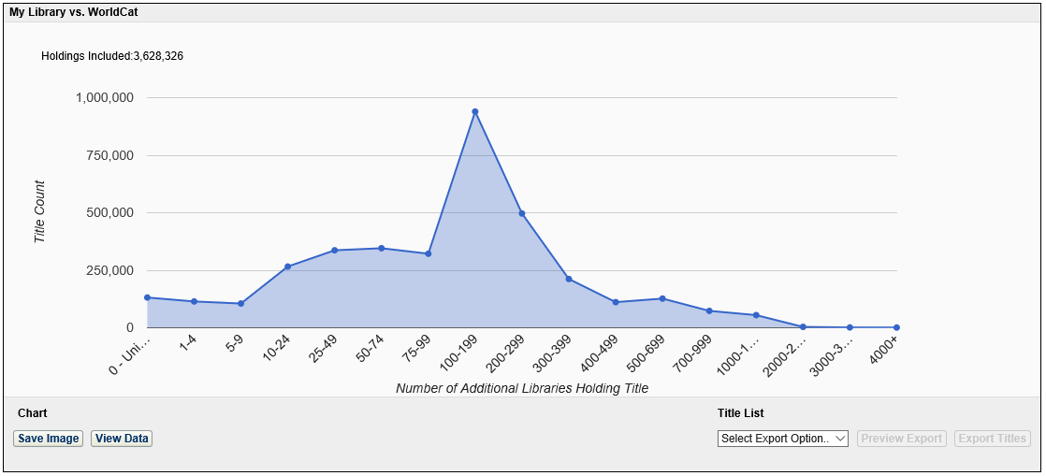
May 2017 unique holdings = 130,576
March 2013 unique holdings = 96,975
(3.7%)
Source: OCLC Worldshare Analytics, May 2017.

Slide 3
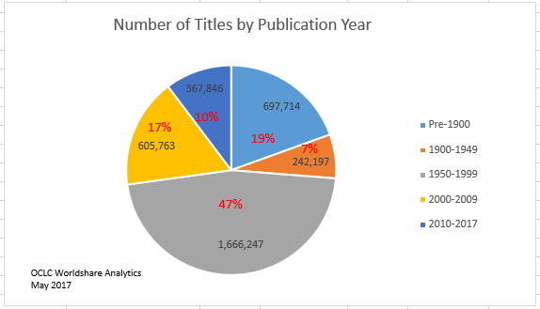

Slide 4
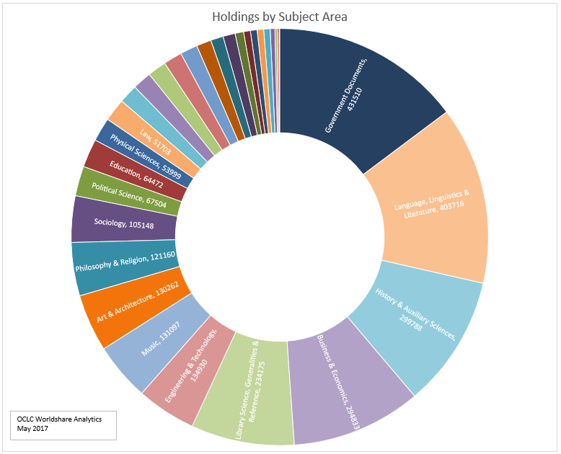

Slide 5
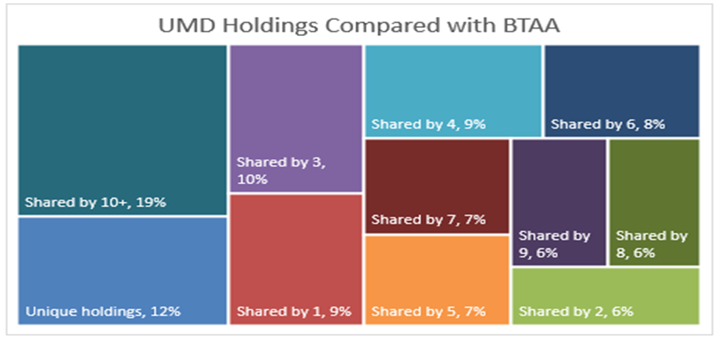

Slide 6
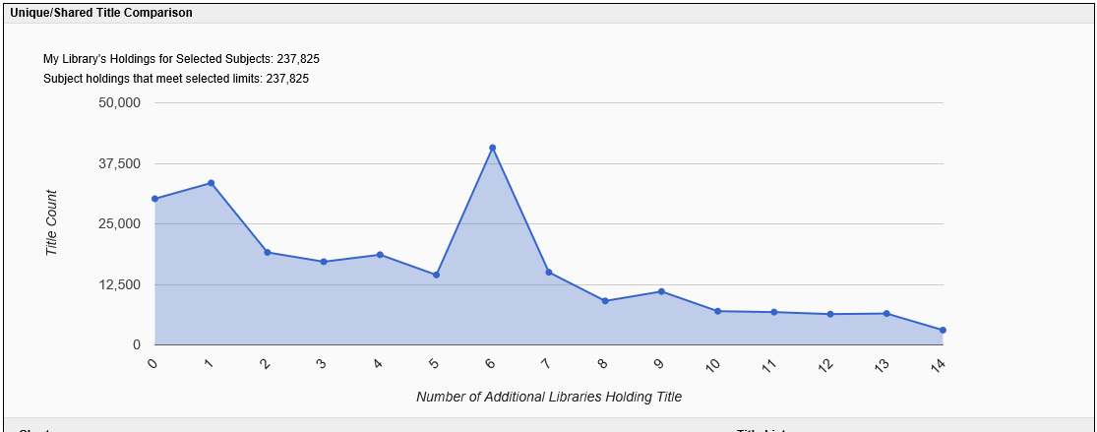
Music & Performing Arts holdings compared with BTAA

Slide 7
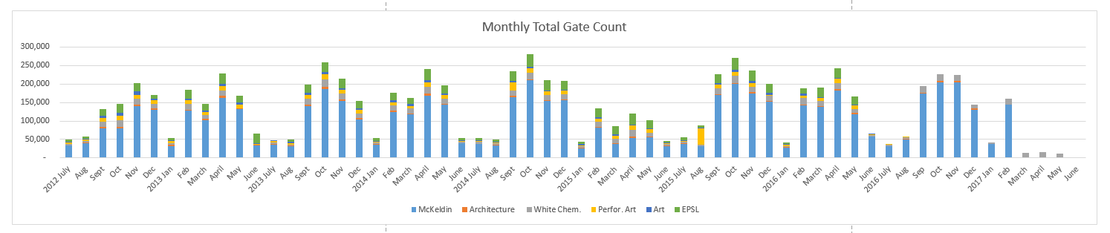
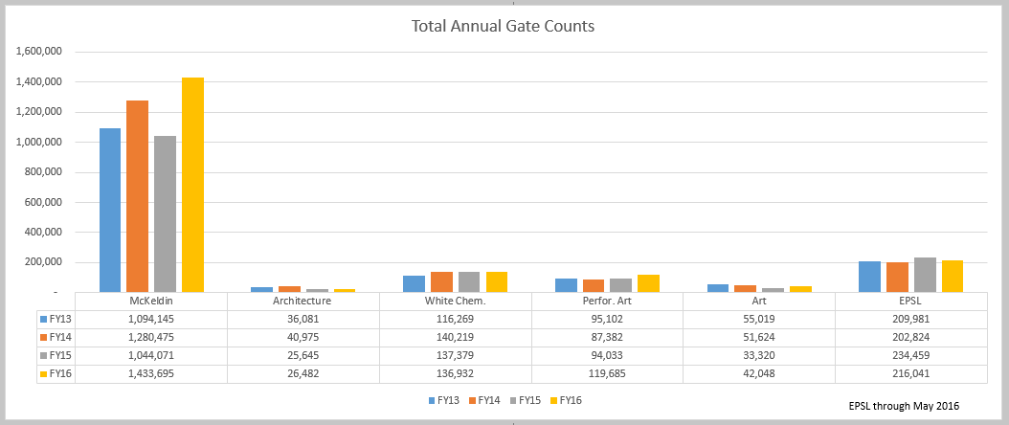

Slide 8
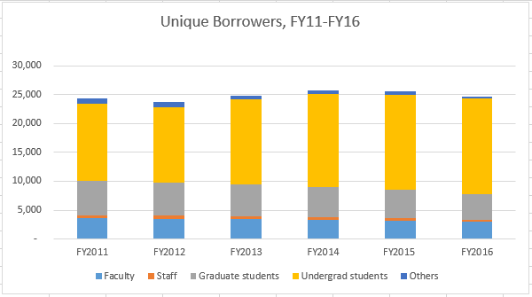
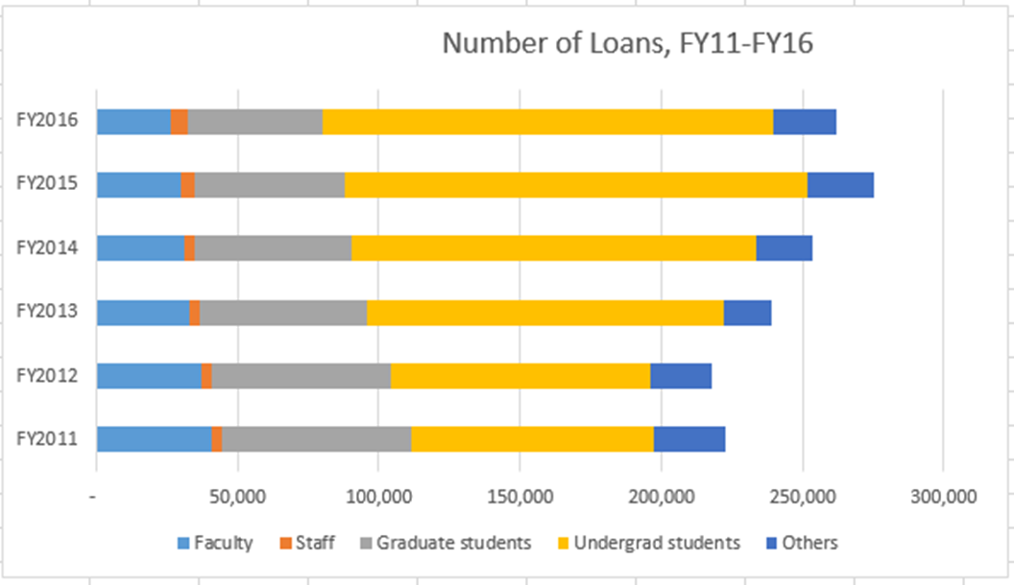
Number of unique borrowers (inc. USMAI)
 | FY2011 | FY2012 | FY2013 | FY2014 | FY2015 | FY2016
Faculty | 3,549 | 3,482 | 3,423 | 3,315 | 3,140 | 2,962
Staff | 604 | 547 | 506 | 500 | 480 | 408
Graduate students | 5,907 | 5,665 | 5,539 | 5,118 | 4,861 | 4,469
Undergrad students | 13,313 | 13,190 | 14,714 | 16,260 | 16,531 | 16,451
Others | 922 | 823 | 667 | 553 | 525 | 362
TOTAL | 24,295 | 23,707 | 24,849 | 25,746 | 25,537 | 24,652

Slide 9
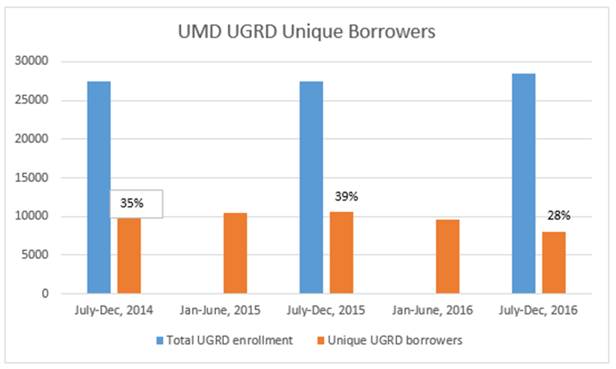
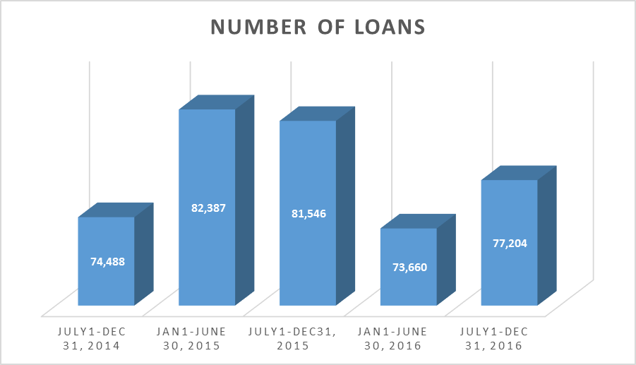
 | July-Dec, 2014 | Jan-June, 2015 | July-Dec, 2015 | Jan-June, 2016 | July-Dec, 2016
Total UGRD enrollment | 27,447 |  | 27,472 |  | 28,472
Unique UGRD borrowers | 9,680 | 10,417 | 10,628 | 9,594 | 8,008
% of total UGRD enrollment | 35% |  | 39% |  | 28%

Slide 10
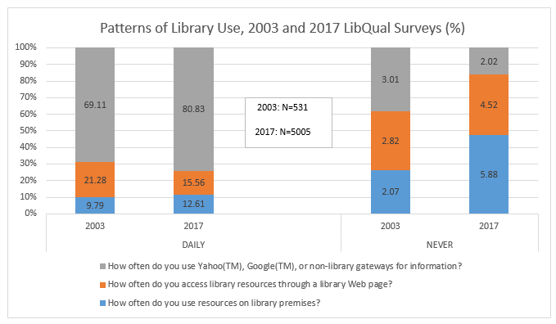

Slide 11
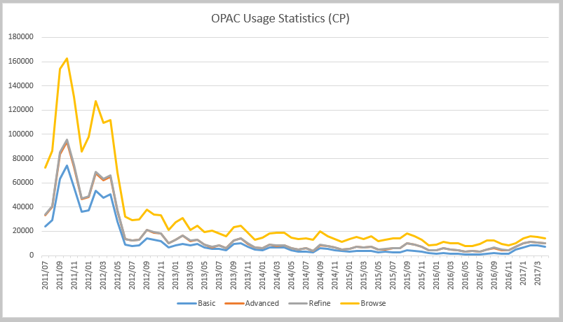

Slide 12
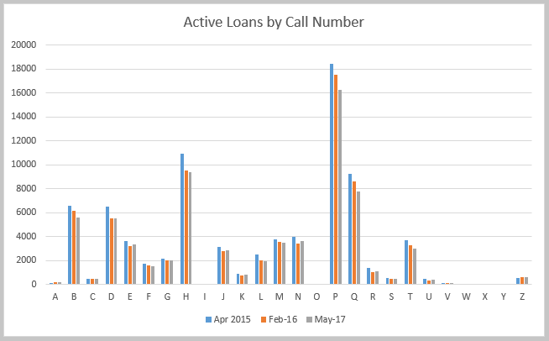
About 2% of total items are active loans

Slide 13
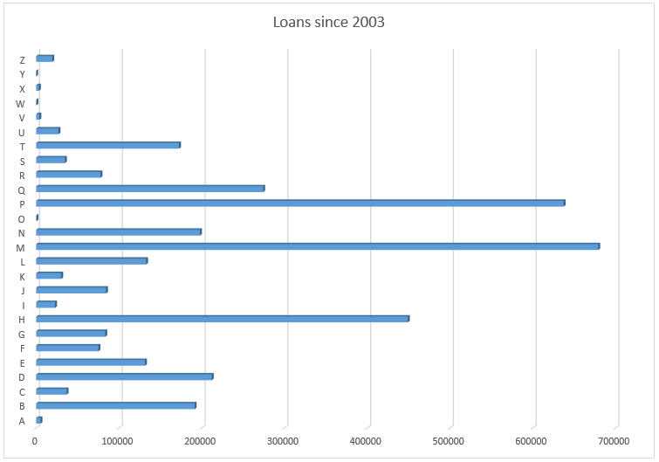
Aleph Report:
Call number range, April 2017

Slide 14
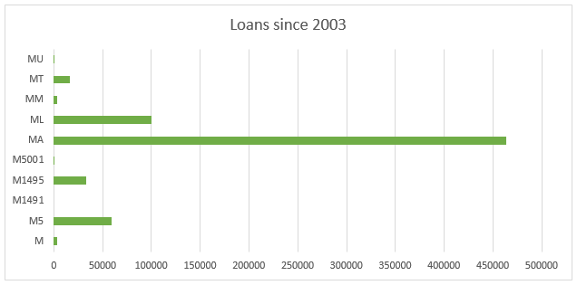
Class M - details
Aleph Report:
Call number range, April 2017

Slide 15
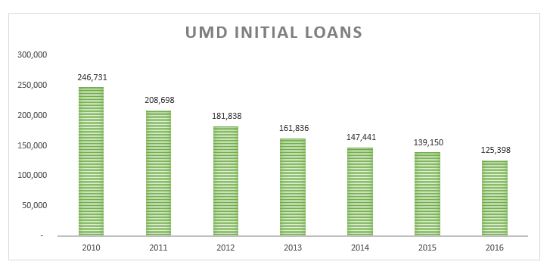

Slide 16
Books and periodicals with loan transactions, as of 8 March 2017
Aleph captured data since January 2003
 | CPARC | CPART | CPCHM | CPENG | CPMCK | CPPAL | CPOSS | TOTAL
BOOK Total
Bibs | 29274 | 69869 | 18801 | 136020 | 1186572 | 45757 | 359780
Hols | 29477 | 70003 | 18876 | 136377 | 1191226 | 45912 | 360264
Items | 33054 | 74579 | 21983 | 150684 | 1346727 | 50879 | 416197 | 2094103
BOOK w/ Loans
Bibs | 20274 | 43340 | 11558 | 95842 | 609050 | 28412 | 65857
Hols | 20328 | 43373 | 11585 | 95996 | 610197 | 28448 | 65885
Items | 22022 | 44830 | 12163 | 101832 | 652386 | 43598 | 69960 | 946791
% items loaned to total | 67% | 60% | 55% | 68% | 48% | 86% | 17% | 45%
ISSBD Total
Bibs | 536 | 1155 | 1369 | 3719 | 26517 | 492 | 10953
Hols | 545 | 1167 | 1383 | 3986 | 27609 | 514 | 11062
Items | 9782 | 10364 | 44559 | 91637 | 407846 | 4398 | 133517 | 702103
ISSBD w/ Loans
Bibs | 161 | 224 | 211 | 721 | 3595 | 104 | 1866
Hols | 162 | 225 | 217 | 730 | 3648 | 104 | 1866
Items | 459 | 479 | 1301 | 2344 | 9714 | 247 | 5124 | 19668
% items loaned to total | 5% | 5% | 3% | 3% | 2% | 6% | 4% | 3%
Total BOOK/ISSBD items | 42836 | 84943 | 66542 | 242321 | 1754573 | 55277 | 549714 | 2796206
Total BOOK/ISSBD items w/ at least one loan | 22481 | 45309 | 13464 | 104176 | 662100 | 43845 | 75084 | 966459
% items w/ loans | 52% | 53% | 20% | 43% | 38% | 79% | 14% | 35%

Slide 17
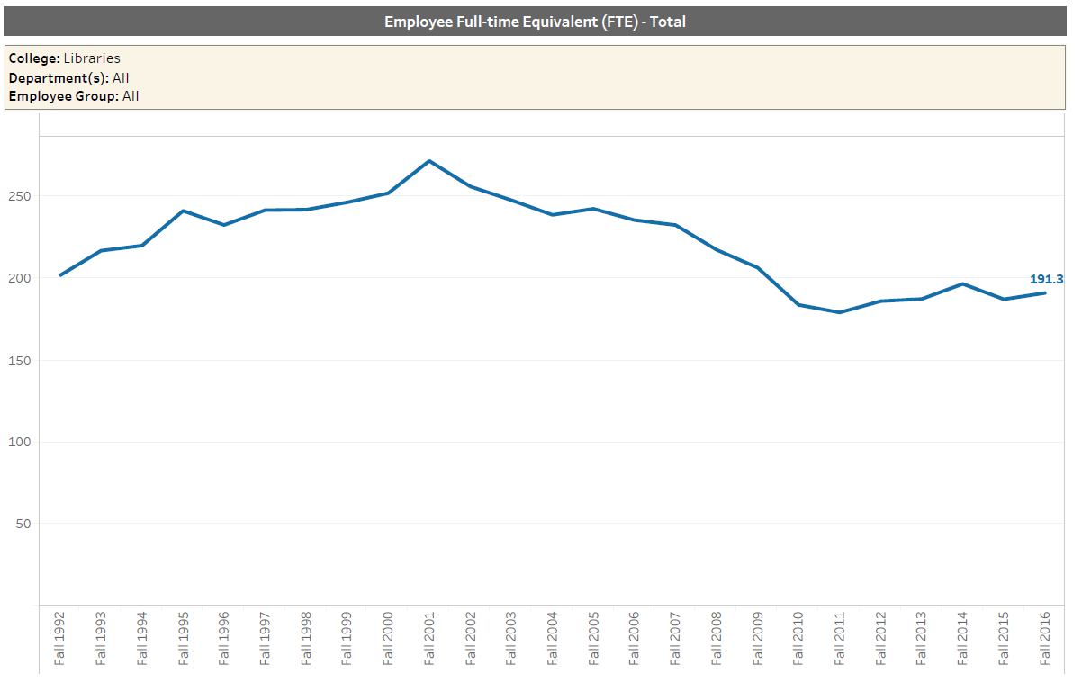

Slide 18
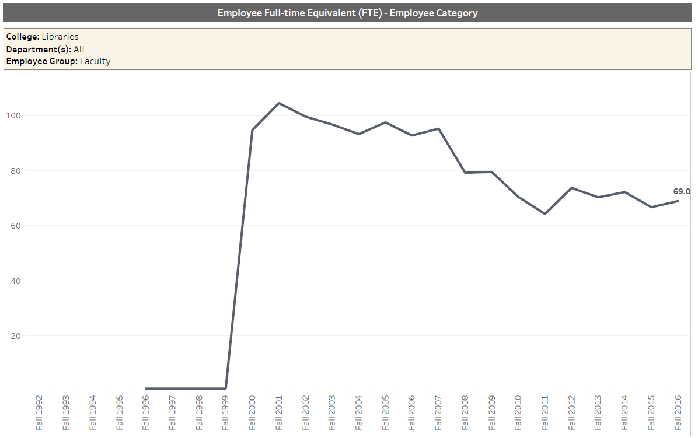
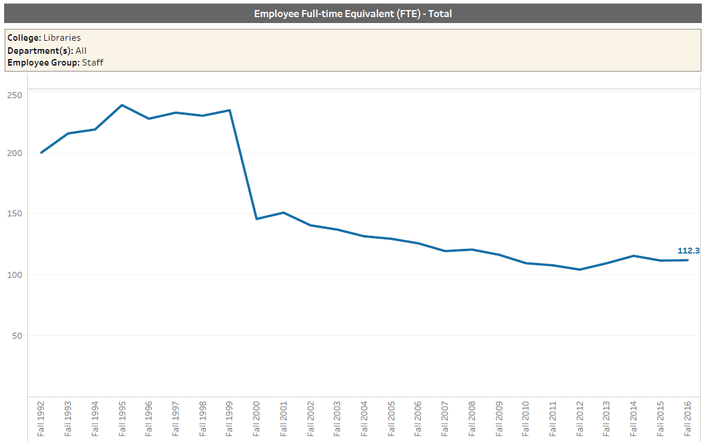

Slide 19
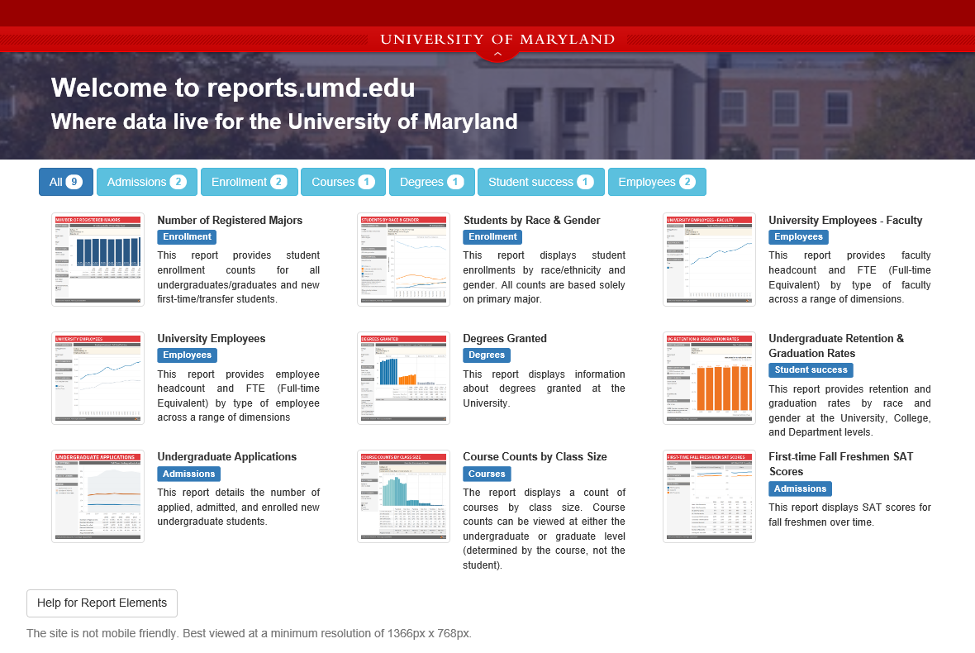
Campus repository

