Slide 1
Globalizing Librarianship:
A Study-Abroad Class in Russia
Yelena Luckert
University of Maryland
July 2, 2015

Slide 2
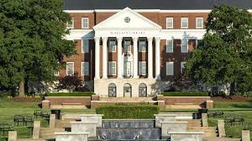

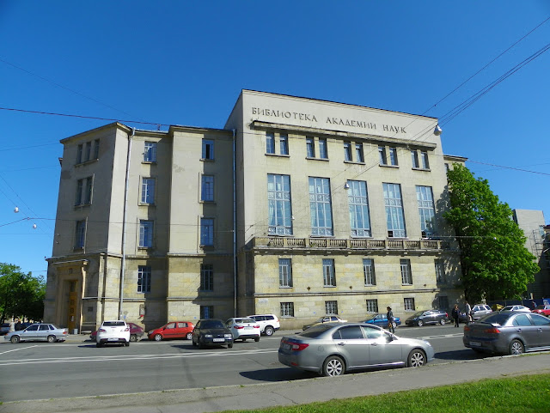

PARTNERS
University of Maryland Libraries
University of Maryland College of Information Science (iSchool)
Library of Russian Academy of Sciences (BAN)
Library and Information department of the St. Petersburg State University of Culture and Arts

Slide 3
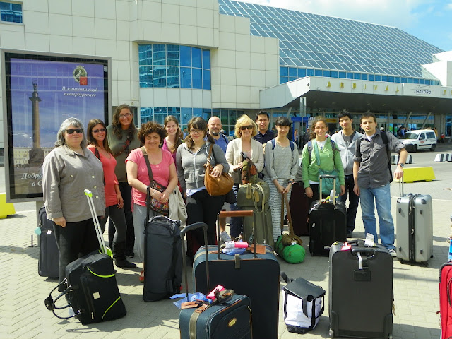
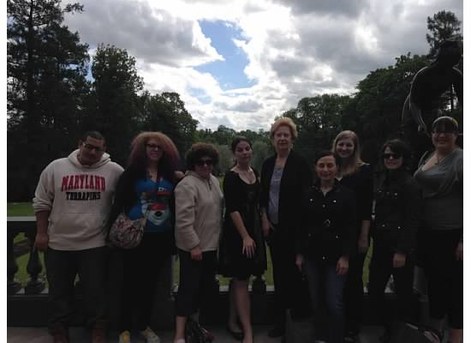
LBSC 729: International Opportunities in Information Studies; Libraries and Cultural Heritage Institutions of St. Petersburg, Russia
2012
2014

Slide 4
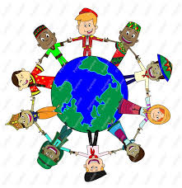


Why we need such courses?
Information travels with a speed of light across political and geographical boarders, religious strongholds and various prejudices.
Need for globally conscientious citizens, i.e. people who can function in the increasingly global environment.
Russia and US have very different information and library systems and lots of misunderstanding.

Slide 5
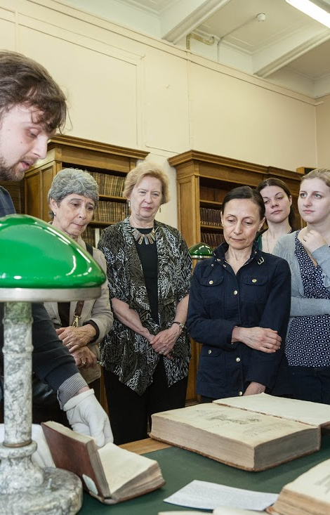
Goals for the course
To introduce our students of information sciences to libraries and cultural organizations in Russia on the example of St. Petersburg:
  how libraries work
  library treasures
  exchange and management of information
  network of library system,
  issues of readerships
  etc.

Slide 6
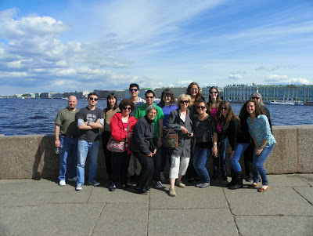
Why St. Petersburg?

Slide 7
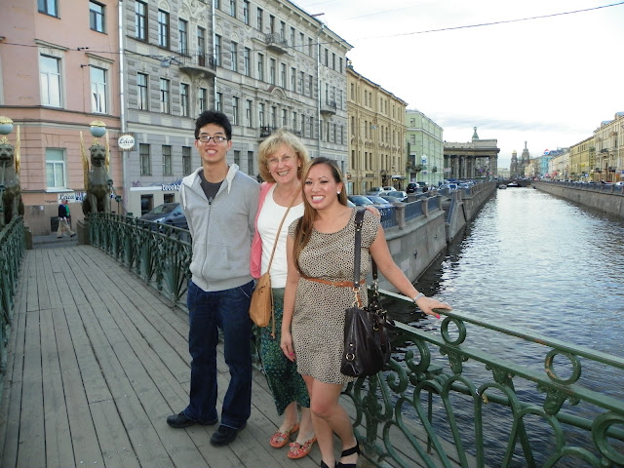
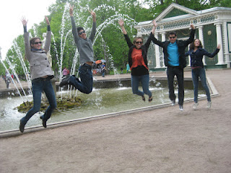
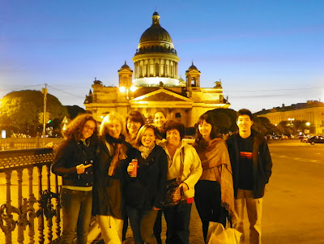
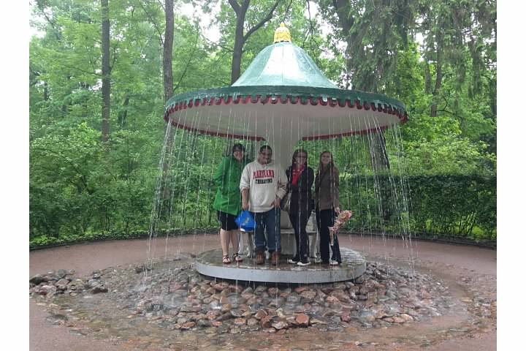
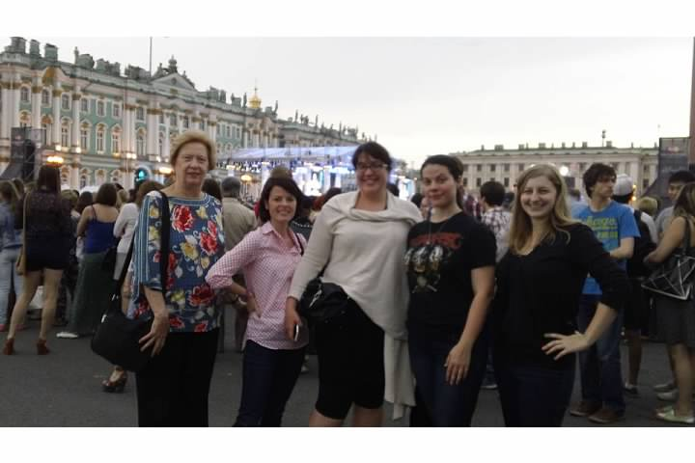
Why summer? easier to organize payments, include non-UM students, control length of the course, time of registration, number of students

Slide 8
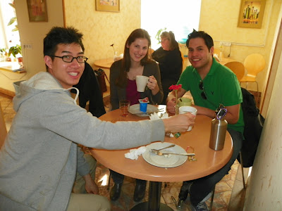
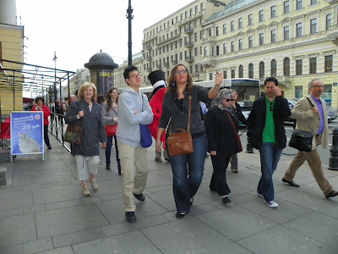
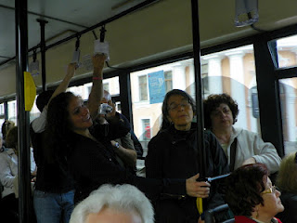
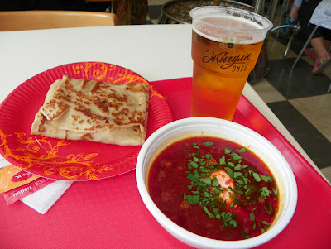
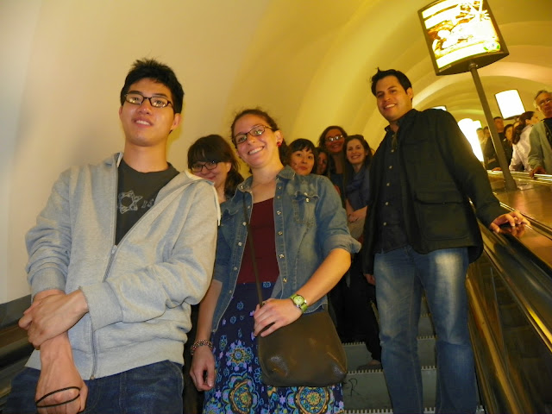
Logistics
Development of contacts
Resources
Visas
Language
Living there

Slide 9
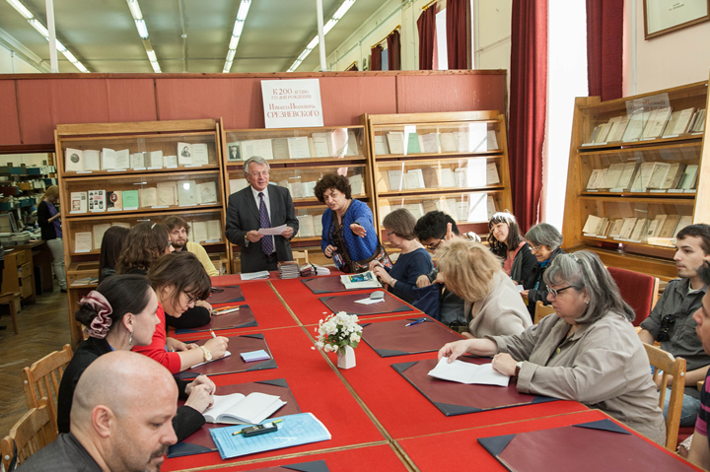
Curriculum
Pre-work reading
Two-day pre-trip preparation
In Russia:
  St. Petersburg University of Culture and Arts
  Visit to libraries of different types
  Touring

Slide 10
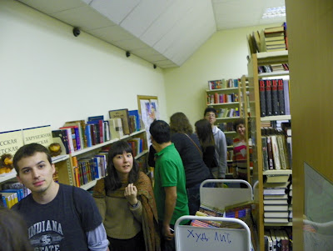
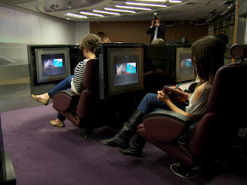
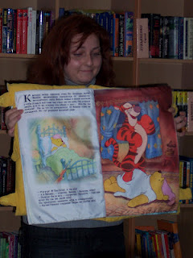
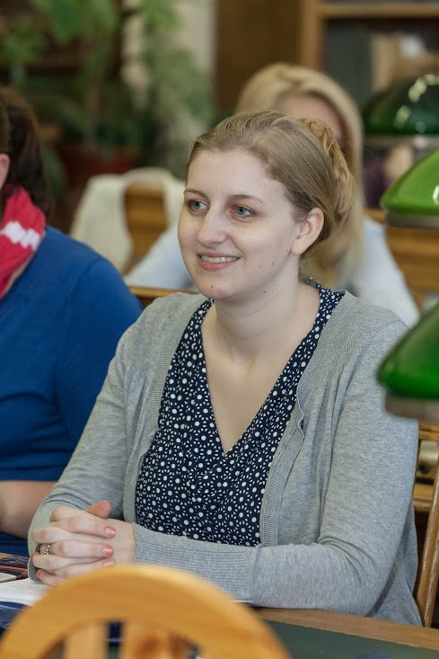
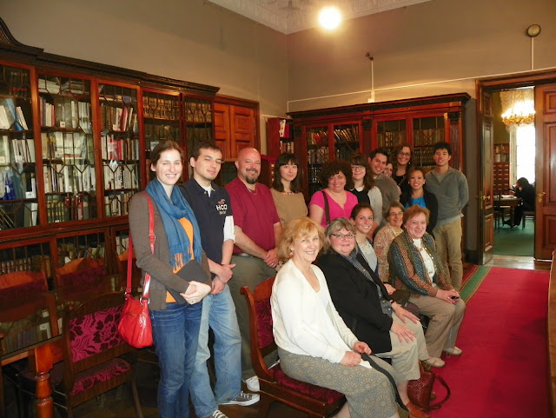
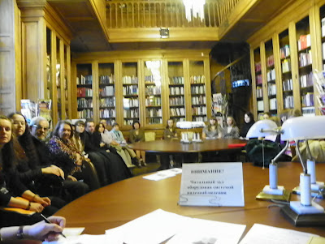
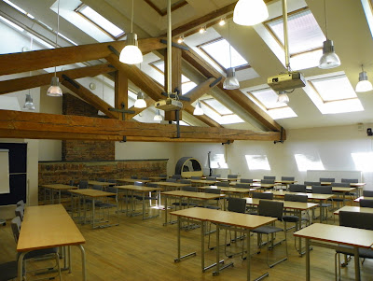
Library visits
Library of Russian Academy of Sciences (BAN)
National Library of Russia
Boris Yeltsin Presidential Library
Mayakovsky Central City Library
Pushkin City Children Library
St. Petersburg State University
St. Petersburg State University of Culture and Arts
Hermitage library
Pushkinskii Dom

Slide 11
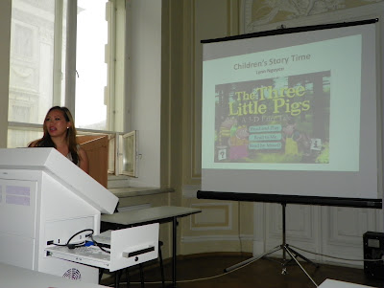
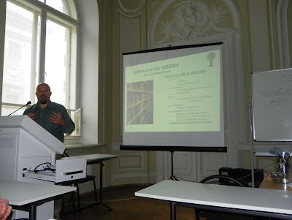
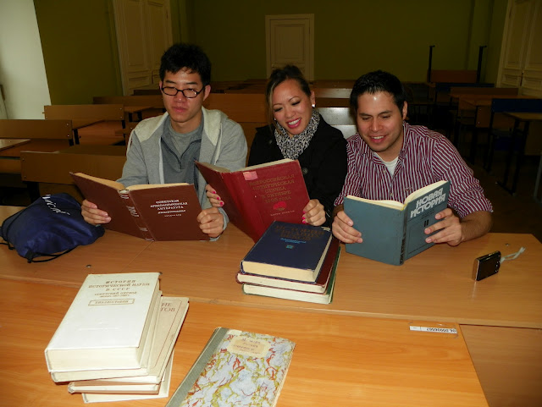
SPBGIK 2012
    No pre-work or coordination
    UM students prepared presentation
    Dean of Library School at SPGBIK gave a talk
    Interaction between two student bodies was missing

Slide 12
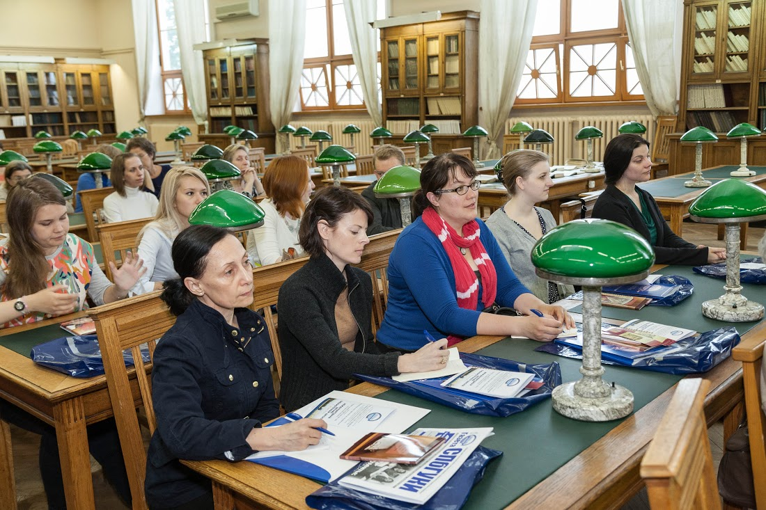
SPBGIK 2014: International Library School
    Discussions and program planning for the visit began in the Fall 2013.
    Reflector for students of both sides set up in March 2014.
    The visit in St Petersburg consisted of tours, lectures, presentations, discussions, joint program with BAN, Bibliofest, and even a concert. Students of both sides participated together.
    Some independent socializing between students occurred.

Slide 13
Saint Petersburg State University of Culture and Arts
Library and Information Science Department
Center for Additional Professional Education
Russian Academy of Sciences Library
With the support of the U.S. Consulate General in Saint Petersburg
International Summer Library School
May 5 – 28, 2014
May 28, 2014, Wednesday
Saint Petersburg State University of Culture and Arts
10.00 – 11.00 | Tour of the University and of the University Library: University Library as Research Center for Students; Traditional and Electronic Resources. Anastasia Kireeva, senior lecturer of the sub department of bibliology and information analysis Dvortsovaya Nab., 2
11.00 – 11.30 | Lecture: Traditions and Perspectives of Specialists Training for Library and Information Institutions at the Library and Information Science Department Valentina Brezhneva, Doctor of Pedagogical Sciences, Professor, Dean of LIS department Lecture room 211, Millionnaya ul.,7
11.30 – 12.00 | Presentation: Bibliofest as LIS Students Project Ekaterina Mokshanova, Candidate of Pedagogical Sciences, Deputy Dean of LIS department Linara Khabibulina, lecturer of the Information Management Department Lecture room 211, Millionnaya ul.,7
12.00 – 13.00 | Discussion: Library Profession in Russia and the USA Moderators: Ann Carlson Weeks, Professor and Associate Dean for Academic Programs, School of Information Studies, University of Maryland and Yelena Luckert, Head of Research Services University of Maryland Libraries Lecture room 211, Millionnaya ul.,7
13.00 – 14.00 | Lunch break University café, Millionnaya ul.,7
14.00 – 15.30 | Participation in Bibliofest Lecture room 211, Millionnaya ul.,7
15.30 – 16.00 | Certificates Presentation Ceremony Valentina Brezhneva, Doctor of Pedagogical Sciences, Professor, Dean of LIS department Ludmila Prokhorova, Candidate of Political Sciences, Director of the Center for Additional Professional Education Lecture room 211, Millionnaya ul.,7
16.00 – 16.30 | Concert of students of Russian songs art department Lecture room 211, Millionnaya ul.,7
May 27, 2014, Tuesday
Library of the Russian Academy of Sciences, Birzhevaia liniia, 1
10.00 – 10.10 | Greetings of Valerii Leonov, Doctor of Pedagogical Sciences, Professor, Director of the Russian Academy of Sciences Library Main Reading Room
10.10 – 10.20 | Greetings of the U.S. Consulate General in St. Petersburg Steven Labensky, Public Affairs Officer Main Reading Room
10.20 – 10.30 | Greetings of Yelena Luckert, Head of Research Services University of Maryland Libraries Main Reading Room
10.30 – 10.40 | Opening of International Summer Library School Ludmila Prokhorova, Candidate of Political Sciences, Director of the Center for Additional Professional Education Main Reading Room
10.45 – 12.00 | Tour of the Library (including Manuscript and Rare Books Departments) Exhibition: Materials about the U.S. in the Russian Academy of Sciences Library Main Reading Room

Slide 14
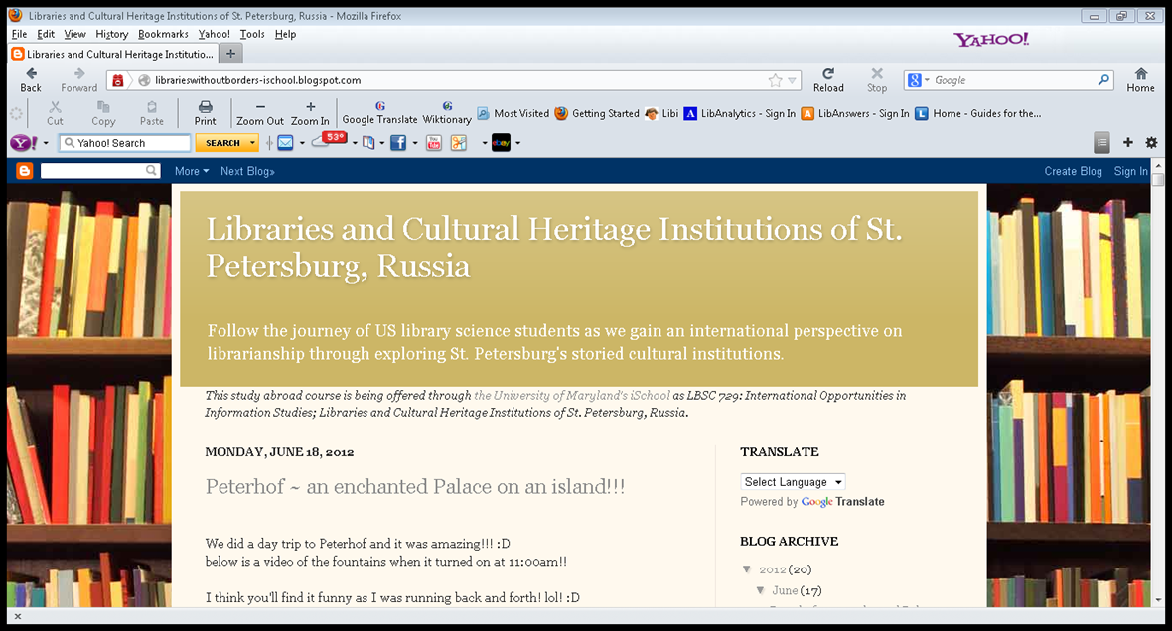
Class obligations
Literature review before the trip
Mandatory pre-trip preparation
Reflector, blog
Daily journal (which was graded)
Final paper.

Slide 15
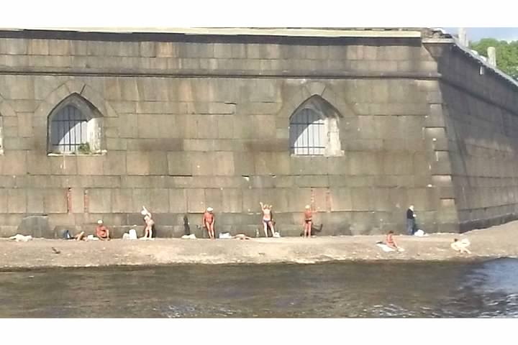
A life changing experience.
What was learned
Russian students have more fun
American students are less shy in classrooms
Russian librarians are very dedicated and work in difficult environment
Huge discrepancy on how libraries are funded, have and have not's
Russian libraries do a lot for their users, but there is still a need for better information sharing

Slide 16

Next steps
Another class possibly in 2016
Working on a grant
  Digitization project between BAN and University of Maryland
  Curriculum projects between iSchool and StPGUKI

Slide 17
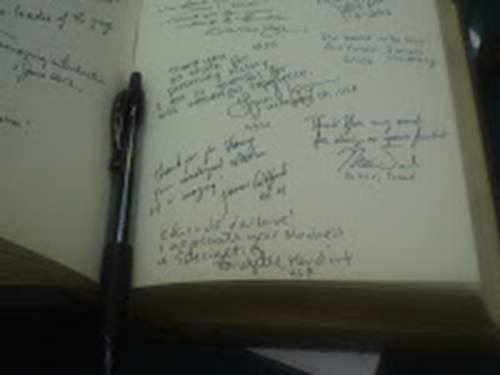
Thank you

