Slide 1
Welcome to the ScholComm Classroom

Slide 2
What is ScholComm?
The system through which research and other scholarly writings are created, evaluated for quality, disseminated to the scholarly community, and preserved for future use
- Association of College and Research Libraries
Scholary Communication, or ScholComm , is the ecosystem within which academics develop, share, discuss and save their research and publications. ScholComm includes traditional publication methods like academic journals but also the many other ways information is shared.
As a student, you are also part of ScholComm! These following modules will introduce you to ideas and concepts to consider with your own research and role in academia.

Slide 3
Navigation Tips
From the ScholComm Classroom homepage, click on the yellow squares to access each module. The modules can be explored in any order
Click Next to go to the next page of the module
Click Home to return to the ScholComm Classroom
NEXT
Copyright Basics
HOME

Slide 4
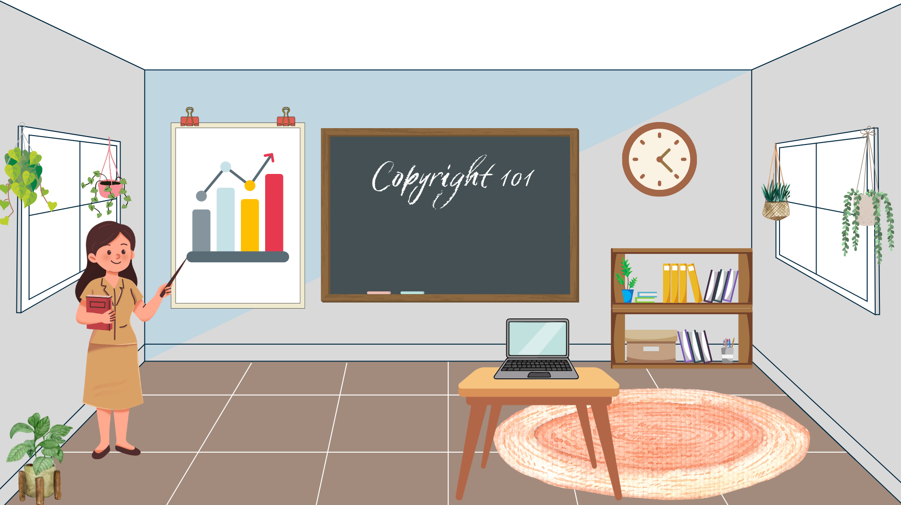
Share Your Research
Traditional Publishing
Copyright Basics
Work With Faculty
Digital Scholarship

Slide 5
Copyright Basics
HOME
Copyright protects the works of creators – which includes both the works you encounter in your research and what you produce!
In this module, learn about:
What is copyright
Your rights with your work
NEXT

Slide 6
HOME
Copyright law protects the rights of authors to their original intellectual property. Some important things to note about copyright are:
The copyright owner has the exclusive right to reproduce, adapt, distribute, publicly perform, and publicly display the work.
Copyrightable works include literary, dramatic, musical, and artistic works such as books, plays, music, lyrics, paintings, sculptures, video games, movies, sound recordings, and software.
Copyright protect applies onces a work is presented in a fixed medium – think written down, recorded or painted for example.
Note: a creator does NOT need to register a work for copyright in order to be protected, but there are some benefits.
Copyright can be transferred, sold, licensed or donated.
Copyright Law
Explore the federal statute
NEXT

Slide 7
What Does This Have to Do With Me?
HOME
Citations
Your Rights
We respect the copyright of others by properly citing works we reference in our research.
Different disciplines have different preferred citation styles. Talk with your professors if you are unsure which to use!
As an author, you hold the copyright for the works you create. This includes presentations and papers you develop for your coursework. You don’t need to register your work with the US Copyright Office, but for later works you might want to consider the benefits.

Slide 8
Traditional Publishing
HOME
When we talk about academic sources, we are typically referring to works published in academic journals.
In this module, learn about:
The peer review process
Common traits of academic journals
NEXT

Slide 9
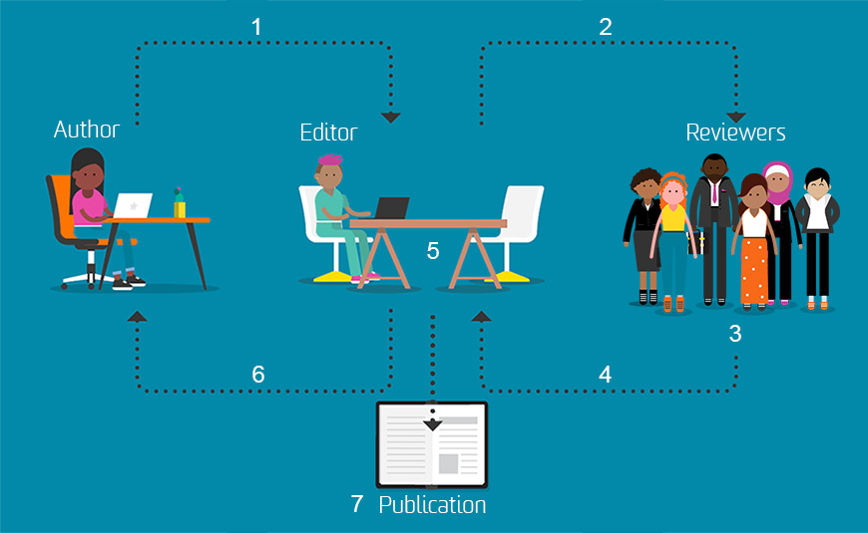
Peer Review Process
HOME
Your professor might ask you to use ACADEMIC 0r SCHOLARLY or PEER REVIEWED sources for your coursework. These are the same thing!
The peer review process is the way scholars provide feedback to eachother, and how academic journals determine what articles are ready for publication. It’s the seal of approval from experts in a particular field that the research is ready to be shared more broadly.
NEXT

Slide 10
Talk with your librarian about what journals your university subscribes to!
HOME
Academic Journals
Academic journals are the customary platform for scholarly publishing. Journals are collections of articles themed by a topic or discipline.
You can find academic journals in your university library’s catalog or through a database search. Journals might be subscription based – meaning you’ll likely need to access them through an institution log in like your university – or Open Access which means it is free for everyone to read. Both types are peer reviewed!
Open access is an interesting movement to make information more accessible. If you’re interested you can learn more by watching this video.
NEXT

Slide 11
Your turn!
HOME
Explore Academic Journals
Select an academic journal that interests you or is related to your field of study. Take a look at its website to learn more about its processes and standards.
What topics does this journal publish?
What organizations or institutions publish in this journal? Hint: browse the most recent edition?
How often is the journal published?
Are there any notable submission requirements? Is there a fee?

Slide 12
Digital Scholarship
HOME
Scholarship can take many forms when we incorporate new technologies!
In this module, learn about:
Different types of digital scholarship
Other forms to try with your own work
NEXT

Slide 13
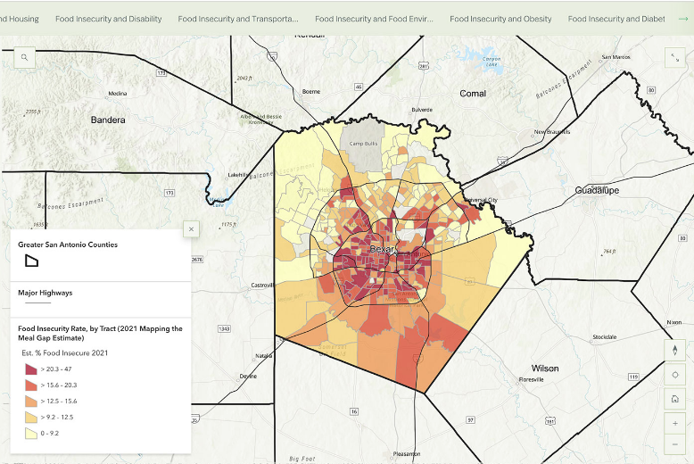
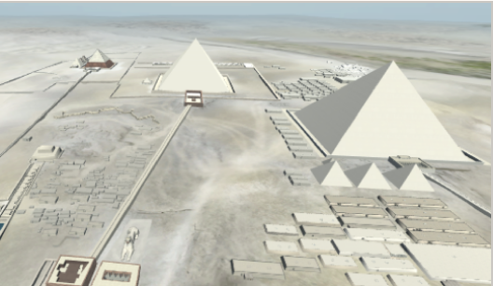

What is Digital Scholarship?
HOME
Digital Scholarship takes advantage of other technologies and tools to present research and data in innovative ways outside of the traditional academic journal. Explore these examples to see how different disciplines create digital scholarship
Understanding Food Insecurity in San Antonio, Texas
The Giza Project
I’m Still Surviving
NEXT

Slide 14
It Doesn’t Have to Be Complicated!
HOME
You don’t need to be a tech genius or build your own website to produce your own digital scholarship. Consider how you might use familiar technologies to showcase your work.
Podcast
Youtube Video
Blog Posts
NEXT

Slide 15
Your Turn!
HOME
Brainstorm a Digital Scholarship Idea
Think about a research topic your interested in or have worked on and consider the following to think about how you might ceate a digital scholarship piece about it:
What is the purpose of your research? To inform, advocate, persuade?
Who is your primary audience?
What multimedia might be engaging?
What digital tools do I have access to?
How might I visualize my data or otherwise share it?

Slide 16
Working With Faculty
HOME
There are lots of people at your university to support your research and help you navigate the world of scholarly communications.
In this module, learn about:
Questions to ask your professors
Questions to ask your librarian
NEXT

Slide 17
Talking With Your Professors
HOME
Your professors can offer a lot of expert advice, especially about scholarly communications and research in your fields of interest. Here are some ideas of what you might chat about during office hours:
What publications would they recommend keeping up with? The best writers are also readers. Staying up to date about what is happening in your field will help inspire your own interests.
What does digital scholarship look like in your field? Every discipline has new and creative ways of sharing their findings. See what catches your interest.
What research opportunities could I get involved in? If something interests you, see about getting involved. Lots of students learn about the research process and publishing through collaborating on projects.
NEXT

Slide 18
Talking With Your Librarians
HOME
There’s also help at the library! Librarians can offer other perspectives about scholarly communications.
Subject Specialist Librarians are the experts about conducting research in your discipline. They will have knowledge about top journals and other sources
University Libraries often have other specialists like a Scholarly Communications or Digital Scholarship librarian or other experts like a GIS Specialist that can help with particular technologies.
Take Action: Make an appointment with your subject specialist for your major or area of interest. They can talk with you about what resources the library has in that area

Slide 19
Share Your Research
HOME
You don’t need a PhD to begin sharing your work! There are many opportunities specifically for undergraduate students to network and publish their research.
In this module, learn about:
Developing a research poster
Exploring opportunities on campus and with undergraduate journals
NEXT

Slide 20
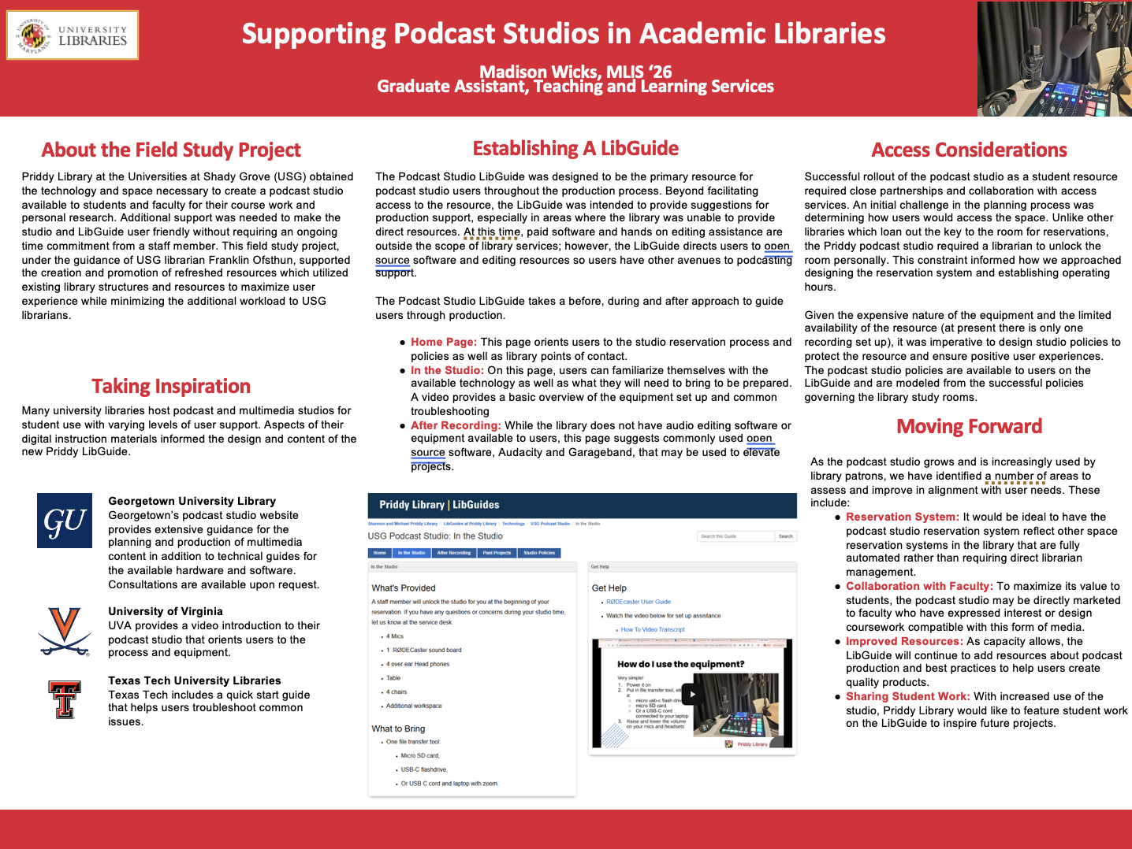
The Research Poster
HOME
Research posters are the classic way to present research. Whether it’s a longer research paper or perhaps an internship or other experience you’ve had, posters help summarize what you learned in an eye-catching way.
This LibGuide provides some design guidance and templates to get you started.
See if your library has poster printing services!
NEXT

Slide 21
Looking for Opportunities
HOME
Campus Opportunities
Undergraduate Journals
Lots of universities host events specifically to feature undergraduate research. These might be research days or presentation competitions. Look for ones both in your college of study and campus-wide!
Don’t know where to start? These events are great opportunities to see how students like you are conducting research.
Some academic journals publish exclusively undergraduate student work. If you have work you are especially proud of, consider submitting to one in your subject area. This is a great way to learn more about the peer review process.
The Council on Undergraduate Research maintains a list of undergraduate journals in a variety of disciplines.

