Slide 1

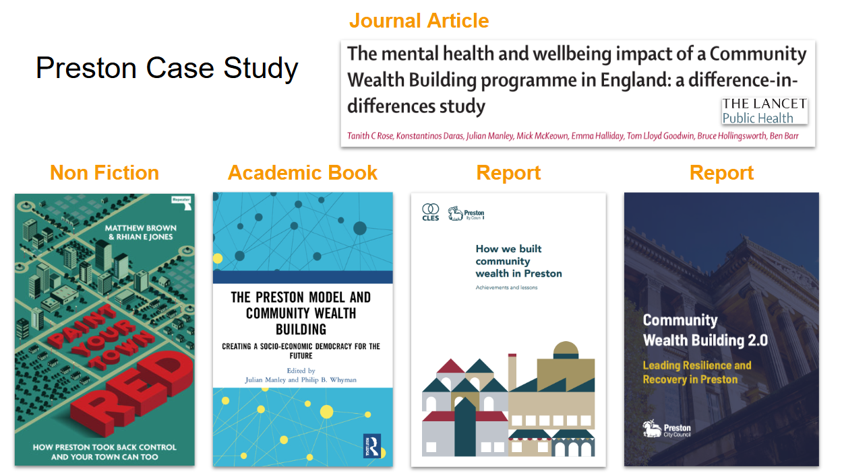
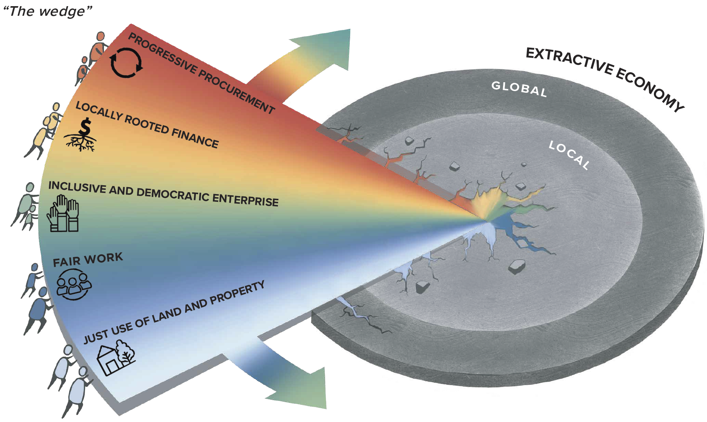
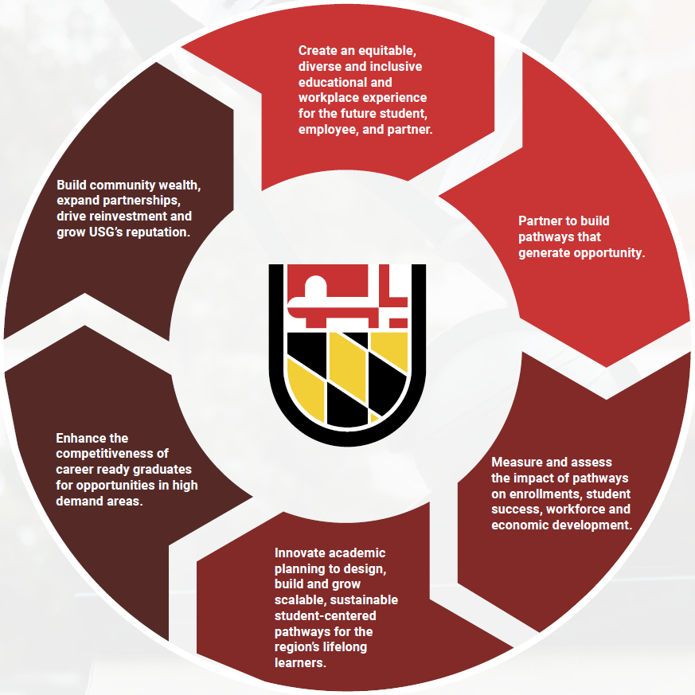
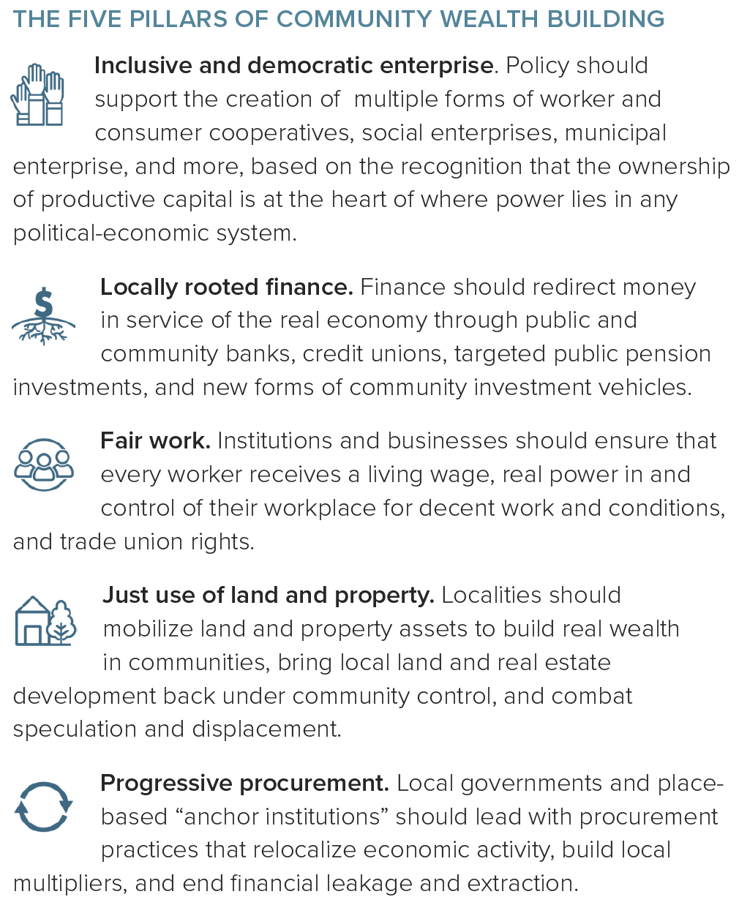
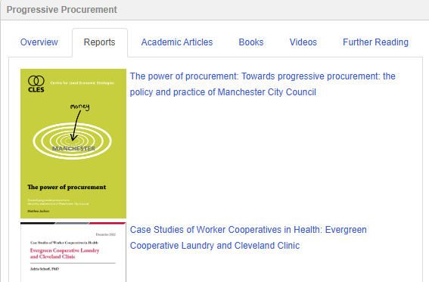
Supporting the Knowledge Needs of Community Wealth Building Initiatives with a Scoping Review and Subject Guide
Franklin Ofsthun,¹ Jaini Jain,² and Ralph P. Hall³
¹ Librarian I, Universities at Shady Grove, ² Graduate Student, University of Maryland, Baltimore,,
³ Professor, School of Public and International Affairs, Virginia Tech
Community Wealth Building
Community Wealth Building at USG
Previous Iterations
Community Wealth Building (CWB) is an economic development model that transforms local economies based on communities having direct ownership and control of their assets. It challenges the failing approaches that have been widely accepted in economic development for too long, and addresses wealth inequality at its core.
CWB emphasizes five pillars: inclusive and democratic enterprise, locally rooted finance, fair work, just use of land and property, and progressive procurement.
During the creation of USG’s first strategic plan, CWB was identified as an economic framework that intertwined with USG’s unique vision of “inspiring and leading educational transformation to serve all learners and to support a thriving, equitable economy.” As a higher education institution built to serve local needs, USG has a responsibility to lift up the students and communities it serves. By advocating and implementing CWB principles, USG can begin to realize its mission.
Two previous projects attempted to create versions of a Community Wealth Building (CWB) information repository. While both succeeded in conducting informal literature reviews on CWB, neither resulted in a usable subject guide. One contributing factor was the methodology used to locate relevant literature. In both cases, students approached the task as they would an academic paper—relying heavily on trial and error and subjective judgment. For a project of this scope, a more structured presentation of information was required, along with a systematic and replicable approach to the research process.
Current Project
Preview of Subject Guide Organizational Structure
The project goal is to develop a subject guide that catalogs existing CWB initiatives and academic literature, providing a central hub for the USG community and beyond. The guide will help users understand CWB concepts and participate in relevant projects. The project team includes:
Jaini Jain, a USG student intern,
Ralph Hall, a CWB subject expert, and
Franklin Ofsthun, a USG librarian.
Scoping Review
The key challenge is how to locate all necessary information for the subject guide in a systematic and replicable manner. To address this, the information discovery process was approached with the same level of rigor expected in a peer-reviewed journal publication. Guidance was drawn from librarians and experts experienced in systematic review methodologies.
A scoping review approach was selected, as it is well-suited for conducting broad, exploratory reviews in emerging fields. This method enables the identification and connection of fragmented literature across diverse sources. As part of the process, the team developed a research protocol, initially using an outline provided by the University of Maryland, Baltimore, and later adapting it to align with the PRISMA-ScR (Preferred Reporting Items for Systematic Reviews and Meta-Analyses extension for Scoping Reviews) protocol template.
Action guide for advancing Community Wealth Building in the United States, 2023, Democracy Collaborative.
Organization of Subject Guide
The CWB subject guide team has developed a new organizational structure for the guide. Information will be categorized in two primary ways. First, resources will be grouped according to the specific pillar of Community Wealth Building they address.
USG 2.0: Strategic Plan, The Universities at Shady Grove.
Future Work
Identifying the Information Need:
The next phases of the project will focused on finalizing the scoping review protocol, conducting the literature review, and developing a new version of the subject guide. In June, the team will begin the formal literature review that will include a consultation with The Democracy Collaborative to explore their archive and assess additional resource needs. In July, the focus will shift to reviewing selected articles and developing a categorization system to support the structure of the subject guide. By August, the project will move into the final phase with the construction of study guide, integrating the reviewed literature and organizational framework into a publicly accessible, well-structured resource.
After Community Wealth Building (CWB) was incorporated into the strategic plan, USG staff were tasked with implementing it. However, understanding and adopting a new economic model like CWB requires significant time and resources. For USG to fully embrace this paradigm, it became essential to clearly define what CWB entails and to present compelling evidence of its effectiveness. To support this need, a dedicated landing page was envisioned to explain the concept and offer informational resources. At this stage, Priddy Library joined the project.
Libraries specialize in information—identifying what users need, synthesizing it, and transforming it into accessible scholarship. One of the tools frequently used by librarians to accomplish this is the subject guide: a curated website designed as both a teaching resource and an informational hub. These guides may support a single course or address broader topics with global relevance.
The goal of this project is to develop a subject guide on Community Wealth Building that addresses local information needs while serving as a valuable resource for CWB scholars and practitioners worldwide.
Preview of Subject Guide Organizational Structure
Secondly, because CWB has been explored largely through local initiatives around the world, resources will be organized into place-based case studies. Sources may be referenced in multiple categories.
Acknowledgements
Action guide for advancing Community Wealth Building in the United States, 2023, Democracy Collaborative.
We would like to thank USG for providing the necessary financial resources to advance the CWB scoping review and subject guide.
We would also like to thank Nedelina Tchangalova, Public Health & Hearing and Speech Librarian at University of Maryland Libraries and Cozette Comer, Assistant Director, Evidence Synthesis Services at Virginia Tech University Libraries for their support and guidance in the scoping review process.

