Slide 1


Strategies to increase happiness and wellbeing among public health students, faculty and staff
Olivia Carter-Pokras, PhD
Professor Emeritus, Epidemiology & Biostatistics
University of Maryland School of Public Health
Nedelina Tchangalova, MS, MLS
Public Health Librarian
University of Maryland Libraries
Robin Puett, PhD
Professor, Applied Environmental Health
University of Maryland School of Public Health
ECPP 2022 The 10th European Conference on Positive Psychology
Reykjavik, 29 June-2 July, 2022
Notes:
Slide 1: Title page
Good afternoon. What I will be describing started several years ago…. before the current pandemic. As my School’s Diversity Officer and member of the University’s Senate Executive Committee I was dismayed to learn that one out of four undergraduate students at the University of Maryland College Park had diagnosed with depression and/or anxiety. The Counseling Center at that time had a waiting list to be seen of at least 2 months – this was pre-pandemic. Students and others were asking, shouldn’t we do more? I went on to complete a 7- month Certificate in Applied Positive Psychology, a 3-month resilience trainer training, and attended the International Positive Psychology Association meeting in Melbourne, Australia. I came back with lots of ideas and met with our Dean who asked for a proposal with a budget. Faced with limited resources, we were asked to focus on “low-hanging fruit” to get started – so we decided to take advantage of existing training such as Mental Health First Aid Training [1] and perform a literature review to find out what other schools and programs in public health were doing.
______________________________
[1] https://www.mentalhealthfirstaid.org/

Slide 2

Background
Prior to the pandemic, about one out of three undergraduate students suffered from depression and rates of depression and anxiety among graduate students were at least that high or even higher. A study of workplace stress found that psychological wellbeing amongst university faculty ranks amongst the lowest of all professions.
Public health schools equip students with skills to promote and protect health, however, little is known about what is provided to support physical, mental and social wellbeing in academic public health.
Aims
Perform literature review to identify programs, interventions, strategies and tools in medical and academic settings that could be applicable to supporting mental health and wellbeing of public health professional students, staff and faculty.
This Photo by Unknown Author is licensed under CC BY-NC
This Photo by Unknown Author is licensed under CC BY-ND
Notes:
Slide 2: Background & Aims
Prior to the pandemic, it was thought that as many as one out of three undergraduate students suffered from depression [2], and rates of depression and anxiety were at least that high or higher among graduate students [3]. Although public health schools equip students with skills to promote and protect health, little is known about what is provided to support the physical, mental and social wellbeing of students, faculty and staff in academic public health. Our aim was therefore to perform a literature review to find programs, interventions, strategies and tools that could be applied to public health students, staff and faculty.
____________________________
[2] Ibrahim AK, Kelly SJ, Adams CE, Glazebrook C. A systematic review of studies of depression prevalence in university students. J Psychiatr Res. 2013 Mar;47(3):391-400.
[3] https://www.insidehighered.com/news/2015/04/22/berkeley-study-finds-high-levels-depression-among-graduate-students; https://www.thecrimson.com/article/2018/11/30/huhs-depression-survey-grad-students/

Slide 3

Key Definitions
Wellness
Active pursuit of activities, choices and lifestyles that lead to a state of holistic health
(Global Wellness Institute)
Public health
Science of protecting and improving the health of people and their communities
(CDC Foundation)
Health
State of complete physical, mental and social well-being and not merely the absence of disease or infirmity
(World Health Organization)
Individual resilience
Behaviors, thoughts, and actions that promote personal wellbeing and mental health
(US Department of Health and Human Services)
Well-being
Judging life positively and feeling good
(Centers for Disease Control and Prevention)
This Photo by Unknown Author is licensed under CC BY-SA-NC
This Photo by Unknown Author is licensed under CC BY-ND
Notes:
Slide 3: Key Definitions
Positive psychology and mindfulness can contribute to the preparation of public health students to protect and improve the health of people and their communities, but also promote their own personal wellbeing and mental health. The World Health Organization defines health as complete physical, mental and social wellbeing and not merely the absence of disease and infirmity [4].
_________________________________
[4] https://www.who.int/about/governance/constitution

Slide 4
Methods
Inclusion criteria
⸱ Randomized controlled trials, group interventions to support mental health, curriculum, online tools, strategies, techniques and programs of mindfulness, anxiety, depression, stress/distress or burnout.
⸱ Studies were limited to English and from 1998 to January 3, 2022.
Databases
13 databases were searched:
PubMed, EBSCO databases (Academic Search Ultimate, APA PsycINFO, CINAHL Plus, Education Source, ERIC, Health Source: Nursing/Academic Edition, MEDLINE, Professional Development, Psychology and Behavioral Sciences Collection, SocINDEX), ProQuest Dissertations & Theses Global, and Web of Science.
Nov. 2019 (updated in Jan. 2022)
Records with title and abstract
screened N=12,775
Websites
For all 68 accredited Schools of Public Health in the United States
Annual Meeting Abstracts
From the American Public Health Association (2020-2021)
June 2022
Notes:
Slide 4: Methods
Our review of 13 databases was disappointing in 2019, and again in January of this year. Search terms were broad, and most records related to nurses or physicians. Although 194 articles focused on some aspect of public health, only 1 described evaluation results of an intervention in academic public health. So, we added two new pieces to our search: 1) review of websites for all 68 accredited Schools of Public Health in the United States [5], and 2) review of abstracts from the 2020 and 2021 American Public Health Association annual meetings.
____________________________
[5] See https://ceph.org/about/org-info/who-we-accredit/accredited/#programs for list of accredited Schools of Public Health

Slide 5
Example from our literature review
Practice-Based Teaching Model for Undergraduate Public Health Students: Partnership for Exercise Is Medicine on Campus Initiative. (Katzke et al 2020)
  Describes results from 4 years of the New Mexico State University undergraduate public health practice-based teaching (PBT) course project: Exercise Is Medicine on Campus (EIM-OC) initiative
  Two themes from student quotes
    Team performance and project management
    Team maintenance and relationships (e.g., “I was able to reach out to people without the fear of rejection.”)
Notes:
Slide 5: Example from our literature review
The one example from the literature review described 4 years of results from New Mexico State University’s undergraduate public health practice-based teaching course that was part of the Exercise in Medicine on campus [6]. Two themes were identified from student evaluations. Of particular interest was the 2nd theme—maintenance and relationships. One example quote: “I was able to reach out to people without the fear of rejection.” Learning how to build and maintain relationships is an important part of public health.
_______________________
[6] https://journals.sagepub.com/doi/full/10.1177/2373379920935460

Slide 6

Population | State of emotions/ theories | Program/therapy
health occupations | anxiety | awareness program
professional students | burnout | counseling
public health faculty | depression | education
public health professional | happiness | health center
public health staff | hope theory | intervention
public health students | kindness | meditation
public health workers | loneliness | program
Shool of Public Health | mental health | relaxation therapy
universities | mindfulness | social connection
 | occupational health | stress reduction
 | perceived stress | stress therapy
 | positive psychology | therapy
 | quality of life | training
 | resilience | welfare
 | social connections
 | stress
 | wellbeing
 | wellness
 | workplace/psychology
This Photo by Unknown Author is licensed under CC BY-SA-NC
Notes:
Slide 6: Key words searched
Shown on this slide are key words used for the per reviewed search. In bold are the words used for the search of School of Public Health websites. Wellness and mindfulness were the most commonly used terms for websites belonging to Schools of Public Health and their respective campuses.

Slide 7
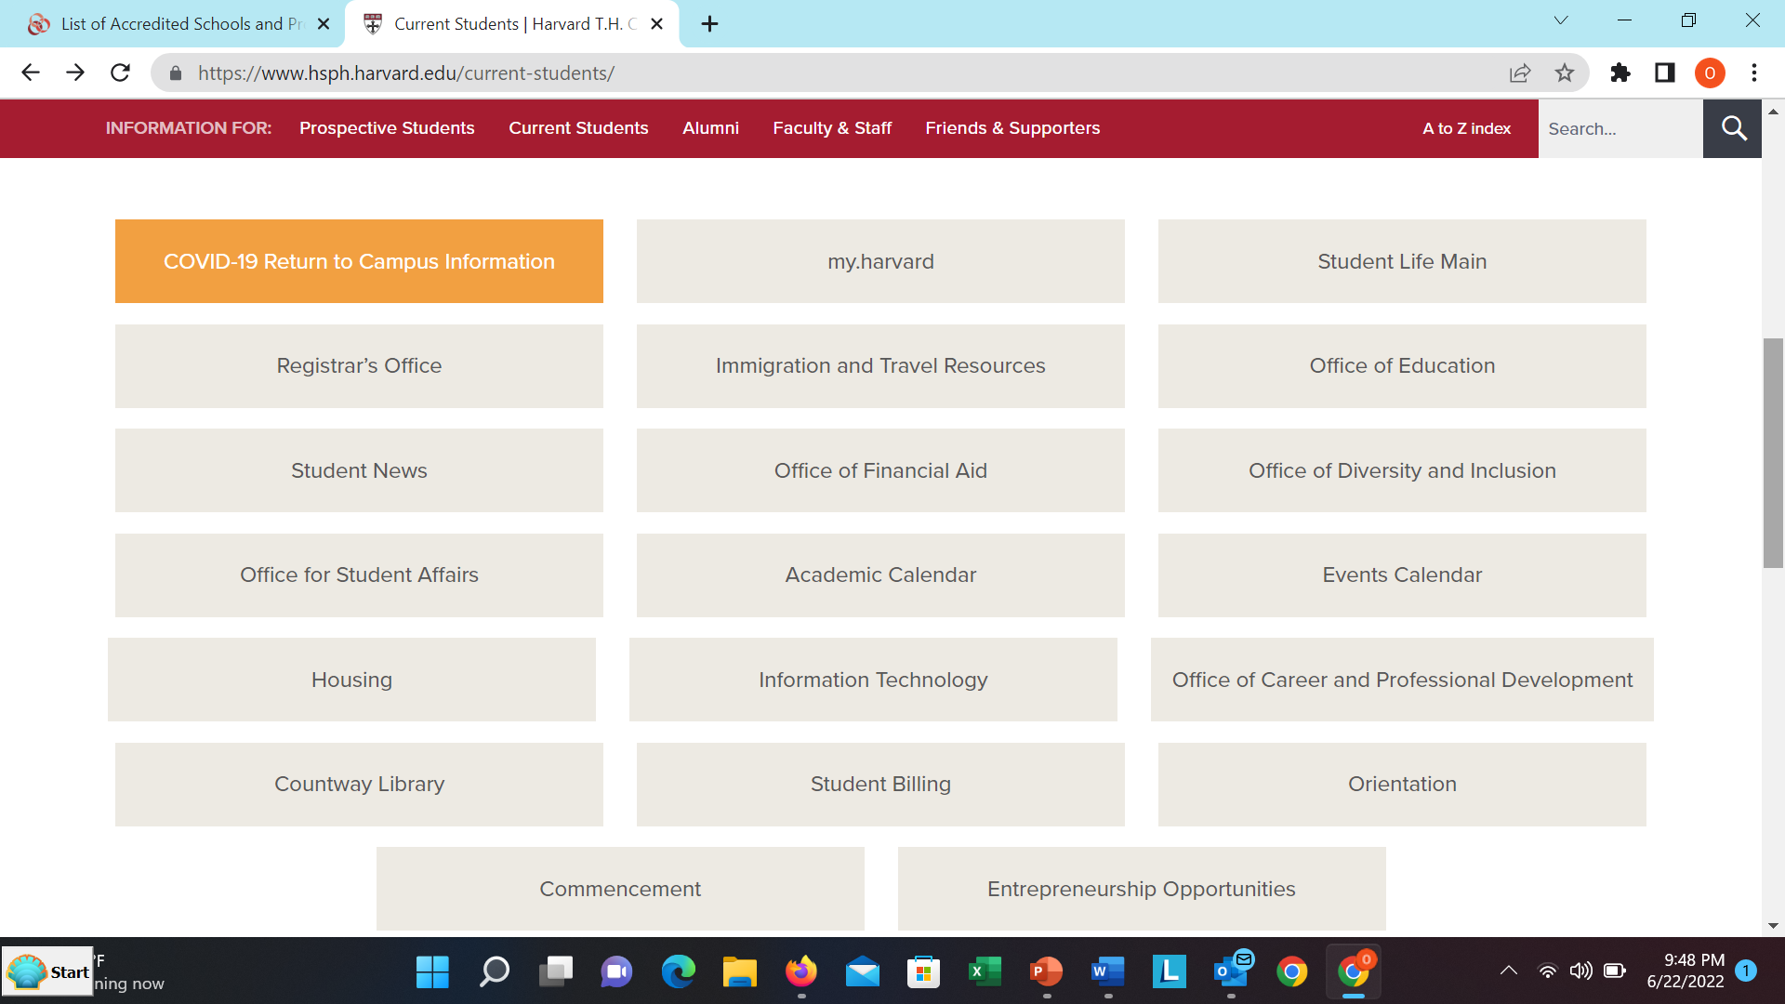
It is difficult to find information on School of Public Health websites
Notes:
Slide 7: Challenges during the search
A common theme when searching accredited School of Public health websites is that related academic programs, courses and other resources are not easy to find. Shown here is a screenshot of what current students would find at Harvard’s School of Public Health website – nowhere does Harvard’s Center for Health and Happiness appear.

Slide 8

Limited evaluation of activities to support wellbeing of public health professional students, staff, and/or faculty
  8-week Mindfulness-Based Stress Reduction (MBSR) for University of Pennsylvania undergraduate and graduate students - Significant increase in sleep quality, mindfulness, satisfaction with life, psychological distress, and perceived stress (APHA, 2021)
  6-week virtual Tai Chi and Qigong intervention among older university employees improved sleep quality at the University of Arizona (APHA, 2021)
This Photo by Unknown Author is licensed under CC BY-NC-ND
Notes:
Slide 8: Limited evaluation of activities to support wellbeing of public health professional students, staff, and/or faculty
Reviewing APHA abstracts for the years 2020 and 2021 uncovered 2 programs that had been evaluated: 1) an 8-week MBSR program at the University of Pennsylvania for undergraduate and graduate students [7] and a 6-week virtual Tai Chi and Qigong intervention for older university employees [8]. Both programs showed an improvement in sleep quality amongst participants. The MBSR program additionally showed significant improvements in mindfulness, satisfaction with life, psychological distress, and perceived stress.
__________________________________
[7] https://apha.confex.com/apha/2021/meetingapp.cgi/Paper/499902
[8] https://apha.confex.com/apha/2021/meetingapp.cgi/Paper/507605

Slide 9

Academic Programs & Course Examples
This Photo by Unknown Author is licensed under CC BY-SA-NC
BA degree & Minor in Wellness and Health Promotion Practice (University of Arizona)
MPH Concentration in Mindfulness (Brown University)
6-week Certificate in Mindfulness (University of Nebraska)
15-credit Certificate in Population Mental Health & Wellbeing (Colorado University)
Certificate in Mental Health (Emory University)
Courses on mindfulness, emotional well-being, building resilience, nontraditional and holistic health practices, happiness, mindful self-compassion (e.g., Brown University, Emory University, Harvard University, Johns Hopkins, University of Arizona, University of California Berkeley, University of California Los Angeles, University of Maryland, University of Minnesota, University of Washington)
Notes:
Slide 9: Academic Programs & Course Examples
Several academic programs and course examples were identified from reviewing the websites for the 68 accredited Schools of Public Health ranging from a BA degree and minor in wellness and health promotion practice, to a MPH concentration in mindfulness at Brown University to courses such as the one at the University of Maryland School of Public Health on nontraditional and holistic health practices taught by my coauthor, Dr. Puett since Spring 2020.

Slide 10

Examples of activities to support wellbeing of public health professional students, staff, and/or faculty
Free access to meditation apps
School wellness coordinator (Boston University, University of Illinois at Chicago)
4-week Koru mindfulness training (e.g. Kent State University, University of Arkansas, University of Illinois at Chicago, University of Iowa, University of Kentucky, University of Louisville, University of Massachusetts)
Mindfulness-Based Stress Reduction (MBSR) training (e.g., Brown University, Johns Hopkins University, University of Arkansas, University of Kentucky, University of Pennsylvania, University of Pittsburgh, University of Virginia)
This Photo by Unknown Author is licensed under CC BY-SA
Notes:
Slide 10: Examples of activities to support wellbeing of public health professional students, staff, and/or faculty
Most activities are housed outside Schools of Public Health, in campus health centers or wellness programs. Of particular interest is that Boston University and the University of Illinois at Chicago have hired wellness coordinators for their schools. It is important to note that what we identified can only be viewed as examples of relevant programs, courses, and activities at accredited Schools of Public Health since we did not survey the Schools.

Slide 11

Example quotes from correspondence with APHA abstract authors
  “Unfortunately, we have not been able to expand our program, as the two clinicians who were facilitating the MBSR program have left UPenn. We do continue to offer some mindfulness and mind-body workshops, and guided meditations, but no longer offer the 8-week MBSR training. To date, our programs have not focused specifically on the Public Health graduate students, although this is an avenue I'd like to explore.”
  “Although they are very popular amongst our MPH students, we have not been able to apply more broadly to UF students, faculty, or staff, but (we) are currently creating a third course - we hope the three courses can make up a graduate certificate in trauma-informed/resilience-based public health.”
Notes:
Slide 11: Example quotes from correspondence with APHA abstract authors
Many of the activities and programs that we identified are dependent upon champions – this is exciting since is a “bottoms up” approach but also makes them more vulnerable and limited in scope as to who they target – mainly students enrolled in specific classes or programs.

Slide 12

Positive Psychology Interventions (Boniwell, 2017)
Active – sports & physical activity (e.g., tai chi, yoga, walking together)
Calming – mindfulness & meditation
Thinking – working through & integrating past events (e.g., three good things, your best ever life experience, discussing beliefs)
Identity – personal strengths & one’s representation of oneself (e.g., strengths identification, best possible self, positive introduction)
Optimizing – actions that enable goal setting (e.g., coaching, resilience)
Nourishing – self-soothing, taking pleasure and care of oneself (e.g., self-compassion meditation, rest breaks at work, savoring, massage)
Social – establishing and maintaining positive relationships (e.g., grateful thoughts, kindness day, compassionate action, gift of time)
This Photo by Unknown Author is licensed under CC BY
Notes:
Slide 12: Positive Psychology Interventions
Using Dr. Boniwell’s ACTIONS acronym to organize positive psychology interventions [9], we see that activities and programs that were identified are also limited in scope in terms of what they cover. Most are targeted towards students and on mindfulness and meditation (addressing calming and perhaps nourishing). Going forward, perhaps emphasis should perhaps be given towards supporting the ways in which individuals view and engage with the world, and coping strategies. These factors have been identified by Shonkoff et al. (2021) [10] and the American Psychological Association [11] as key to promoting resilience, including in the face of interpersonal discrimination.
____________________________
[9] Chapter 8 – Positive Psychological Interventions. In: Boniwell I, Tunariu AD. Positive Psychology: Theory, Research And Applications (2nd ed). 2019
[10] https://www.annualreviews.org/doi/abs/10.1146/annurev-publhealth-090419-101940
[11] https://www.apa.org/topics/resilience

Slide 13
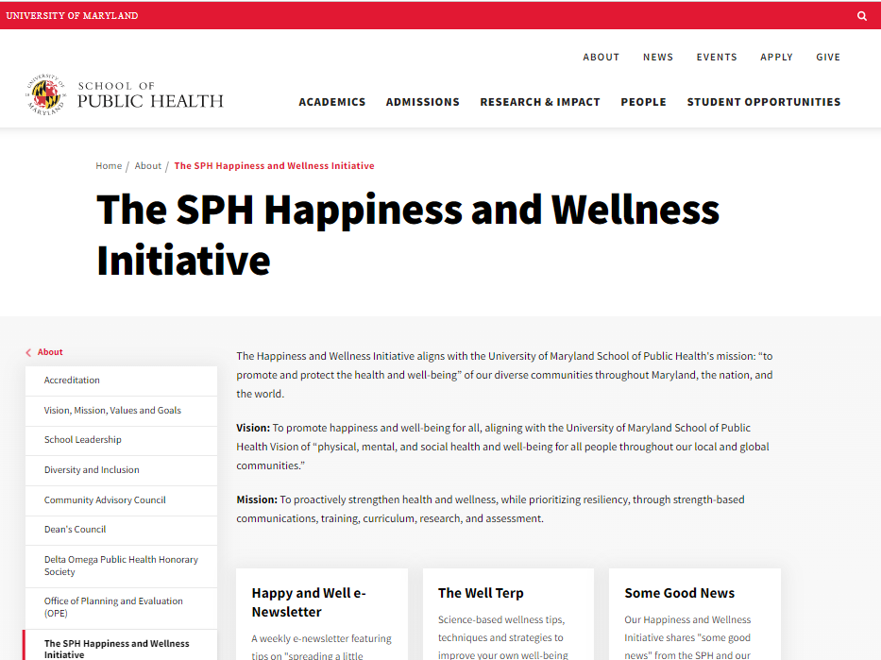
https://sph.umd.edu/about/sph-happiness-and-wellness-initiative
Notes:
Slide 13: The SPH Happiness and Wellness Initiative
At the University of Maryland School of Public Health, the School of Public Health Happiness and Wellness Initiative has evolved. Dr. Robin Puett’s course has been offered since Spring 2020 [12]. A webpage was created to share resources [13], and a regular newsletter sent out to thousands of subscribers since early 2020. The School offers weekly meditation, and a colleague sends regular wellness tips to graduate students. Campus offers wellness coaching, a 2-hour Clifton strengths program, stress management consultation, wellness coaching and daily online meditations.
_______________________________
[12] https://sph.umd.edu/news/happiness-effect
[13] https://sph.umd.edu/about/sph-happiness-and-wellness-initiative

Slide 14

Conclusions
The literature on strategies to increase happiness and wellbeing among public health students, faculty and staff is scarce
Efforts to support physical, mental and social wellbeing for this community should be evaluated, and findings shared.
This Photo by Unknown Author is licensed under CC BY-NC-ND
Notes:
Slide 14: Conclusions
In conclusion, strategies to increase happiness and wellbeing among public health students, faculty and staff are rarely published. Efforts to support physical, mental and social wellbeing for this community should be evaluated and findings shared.

Slide 15


Olivia Carter-Pokras, PhD
Professor Emeritus, Epidemiology & Biostatistics
University of Maryland School of Public Health
opokras@umd.edu
Nedelina Tchangalova, MS, MLS
Public Health Librarian
University of Maryland Libraries
nedelina@umd.edu
Robin Puett, PhD
Professor, Applied Environmental Health
University of Maryland School of Public Health
rpuett@umd.edu
Thank you!
This Photo by Unknown Author is licensed under CC BY-ND

