Slide 1
A CONTENT ANALYSIS OF ENGINEERING LIBGUIDES, RESEARCH IN PROGRESS
Leah DiCiesare, STEM & Open Science Librarian
Sarah Weiss, STEM & Open Science Librarian
Notes:
Outline document: STS Research Forum 2025

Slide 2
Background
We are interested in updating our engineering LibGuides but want to do it systematically
Interested in what content is most often found on engineering LibGuides
Interested in the pedagogy used when creating LibGuides (user centered vs. learner centered)

Slide 3
Content Analysis
A research tool that allows for the evaluation of text and unstructured data
Presents themes, meanings, and relationships
Only one done on Engineering LibGuides by Osorio in 2014
Limited scope - only Mechanical and Electrical Engineering LibGuides

Slide 4
Methodology - Sample
Chose the Top 20 R1 schools from the US News and World Report 2023-2024 Best Engineering Schools
Added a random sample of 30 of the rest of the R1 schools on the list
Total of 50 schools - only 49 of the chosen schools have engineering LibGuides

Slide 5
Methodology - Collection and Analysis
Collected PDFs of each LibGuide page
Imported pages to NVivo
Coded all LibGuide pages by engineering discipline first
Coded Home Pages of LibGuides
Coded each page’s content
Coded each page’s pedagogy
Used NVivo to analysis collected data
Looked at percentages of content coded to a certain code
Word analysis of specific resource types

Slide 6
Our Code
Content:
General Library Services
Resource Access (Databases, books, articles, websites, etc.)
Tools
Citation Management
Librarian Profile
Links
Tutorial & FAQ
Other
Pedagogy:
Learner Centered
User Centered

Slide 7
Pilot - Chemical Engineering Guides
Total of 29 guides
Included: chemical engineering only guides & multidisciplinary guides which include chemical engineering
Not included: general engineering guides

Slide 8
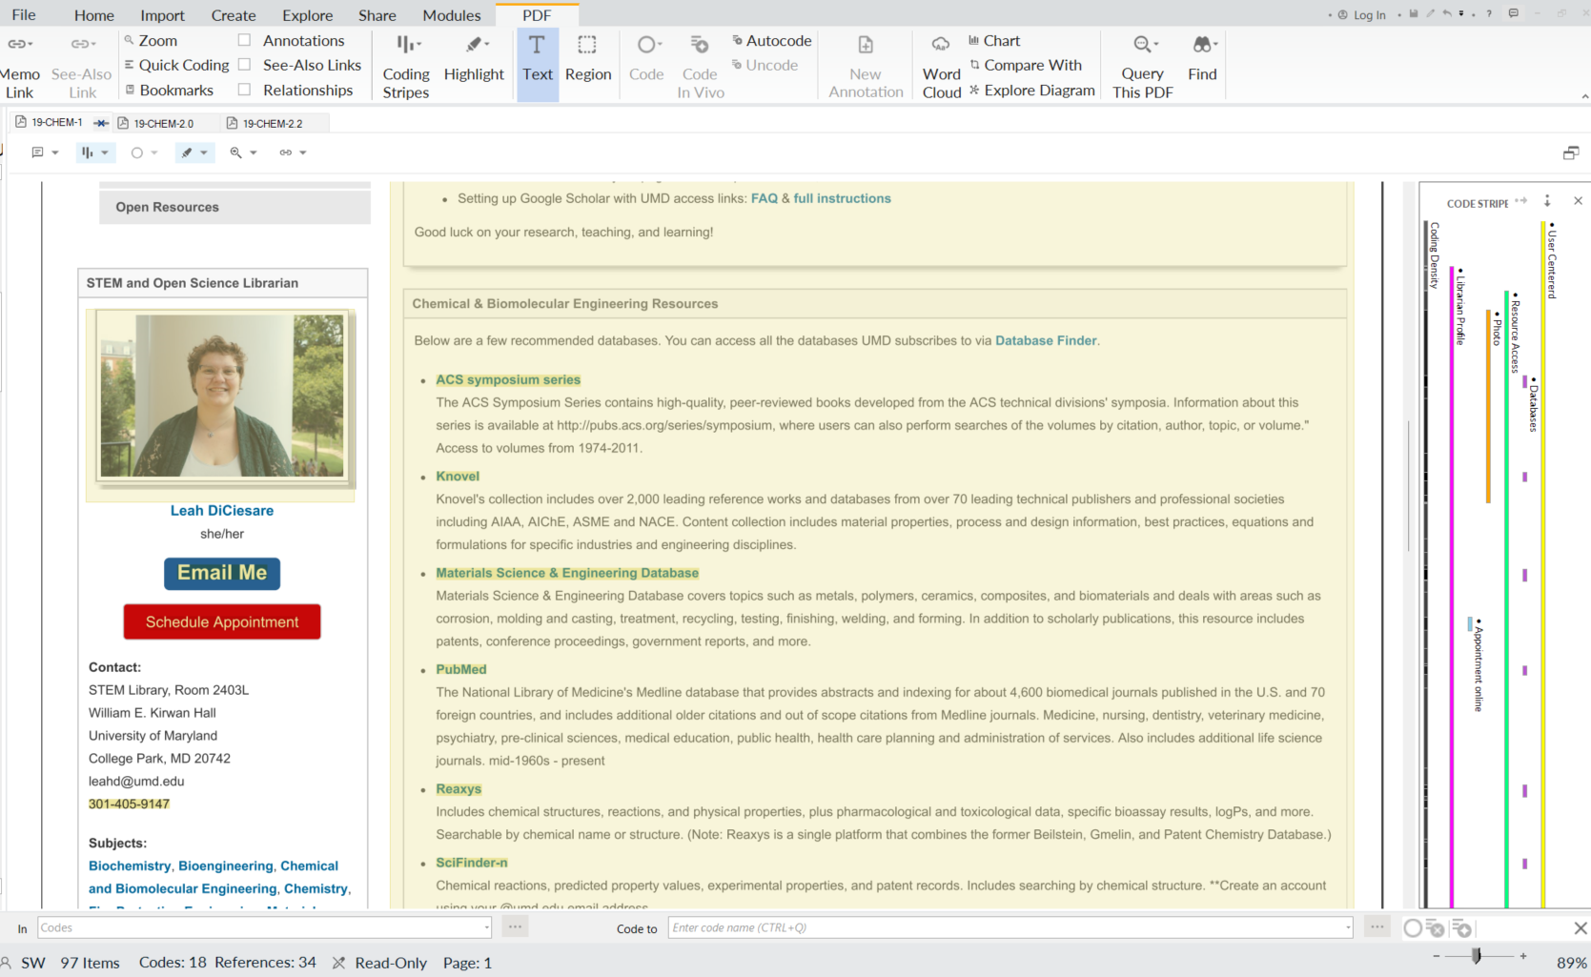
Screenshot of guide with code

Slide 9
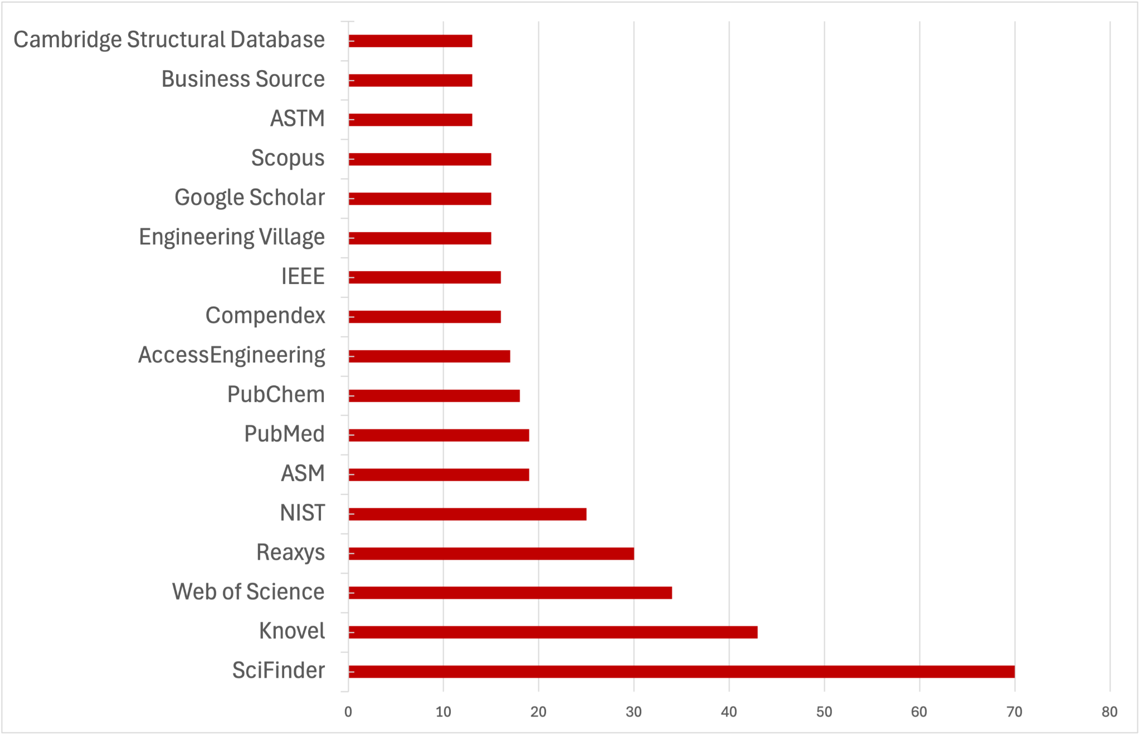
Chemical Engineering Databases

Slide 10
Current Challenges
Data analysis
Narrowing the scope
# of guides
Variables
Content to evaluate
Pedagogy
Resource Access
LibGuides subjects and tags
Librarian profile box content
Citation management
Publication Information
Other content

Slide 11
What’s Next
Assess project scope
Publish findings
2025 2026
Analysis of chemical engineering guides
Complete data collection & analysis based on revised scope

Slide 12
Thank you!
Leah DiCiesare leahd@umd.edu
Sarah Weiss srweiss@umd.edu

