Slide 1






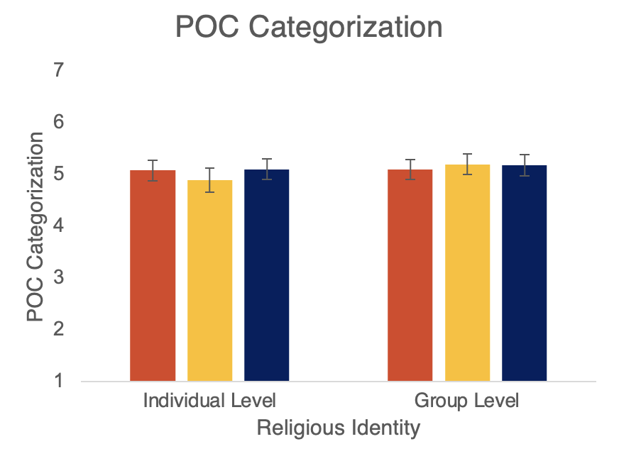
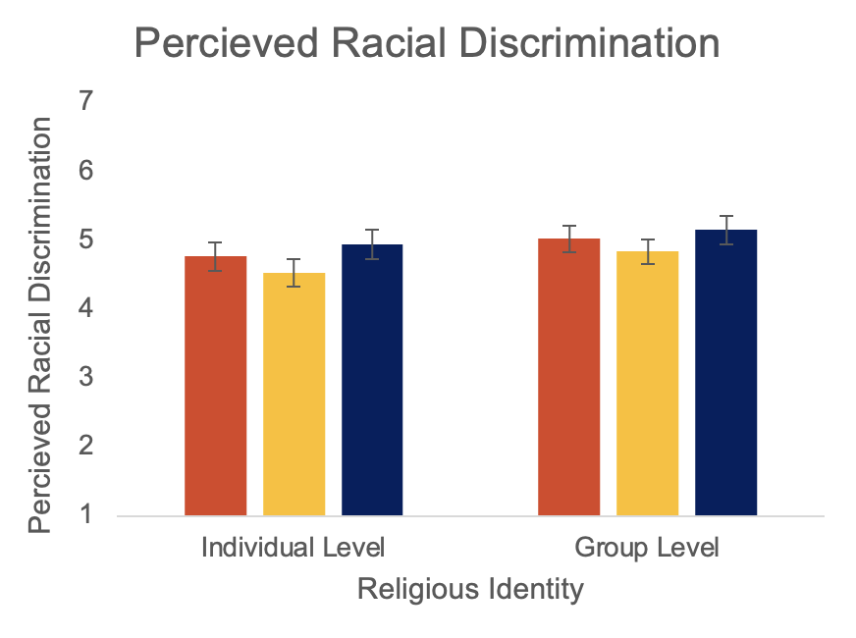
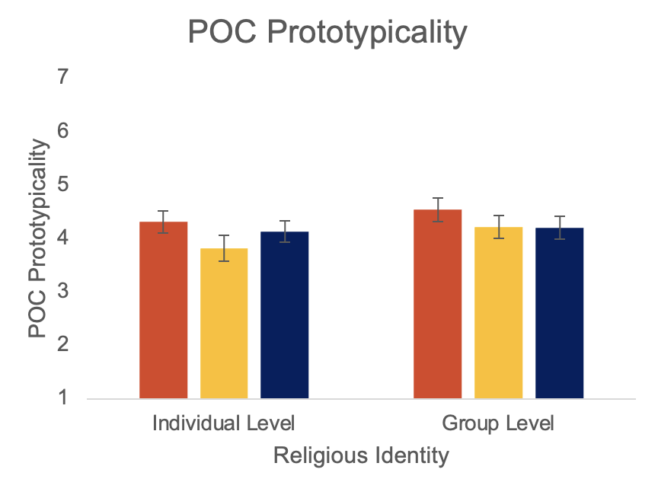
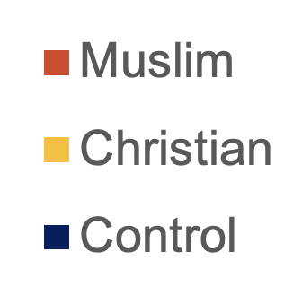
Does Religious Identity Influence the Racial Categorization of Middle Eastern and North African (MENA) Americans?
Sarah Moghaddam and Dr. Linda Zou
Introduction
Methods
Discussion
BACKGROUND
Despite Middle Eastern and North African (MENA) Americans experiencing marginalization due to their race and ethnicity² , the U.S. Census still classifies them as White.
There may also be ambiguity among other people of color (POC) as to how MENA Americans should be racially classified.
Previous research has found that Muslims MENA Americans are less likely to identify as White than Christian MENA Americans.^{1,3,4}
Could religious affiliation also impact how MENA Americans are viewed/classified by others?
HYPOTHESES
Muslim MENA Americans will be more likely to be categorized as people of color by participants of color than MENA Americans who are Christian or who have no religious affiliation.
We tested perceptions of racial discrimination and POC prototypicality as potential mediators.
IV: Religious Identity (Christian, Muslim, Control; between subjects)
PARTICIPANTS: 107 non-MENA POC (26 Asian American, 37 Black/African American, 18 Latino/Hispanic, 26 Multiracial; M_{age}= 35.05, 49.5% Male)
PROCEDURE: Participants were randomly assigned to view a set of six MENA American profiles.
SUMMARY
Christian and Muslim MENA Americans are viewed equally as People of Color (POC).
Religious identity did not have an affect on POC Prototypicality or Perceived Racial Discrimination of MENA Americans.
FUTURE DIRECTIONS
Limited sample size makes it difficult to identify patterns within the racial groups of the participants.
Future research may explore how White Americans racially categorize Christian and Muslim MENA Americans, as White Americans may be more impacted by religious information than POC when it comes to racial categorization.
Muslim Condition
Christian Condition
Control Condition
Participants then rated on a 1-7 Likert Scale (1 = Strongly Disagree, 7 = Strongly Agree) both the MENA American individuals in the profiles, and MENA Americans as whole, on the following measures.
POC Categorization: “I consider (these individuals/MENA Americans) to be people of color.” (3 items, α^{IL} = 0.83 , α^{GL} = 0.84)
Perceived Racial Discrimination: “(These individuals/MENA Americans) have experienced a lot of racial discrimination.” (3 items, α^{IL} = 0.92 , α^{GL} = 0.92)
POC Prototypicality: “(These individuals/MENA Americans) are similar to the average person of color.” (2 items, α^{IL} = 0.84 , α^{GL} = 0.84)
Results
References
Potential Mediator
Ajrouch, K. J., & Jamal, A. (2007). Assimilating to a white identity: The case of Arab Americans. International Migration Review, 41(4), 860-879.
Awad, G. H., Kia-Keating, M., & Amer, M. M. (2019). A model of cumulative racial–ethnic trauma among Americans of Middle Eastern and North African (MENA) descent. American Psychologist, 74(1), 76.
Beydoun, K. A. (2013). Between Muslim and white: The legal construction of Arab American identity. NYU Annual Survey of American Law, 69, 29.
Maghbouleh, N., Schachter, A., & Flores, R. D. (2022). Middle Eastern and North African Americans may not be perceived, nor perceive themselves, to be White. Proceedings of the National Academy of Sciences, 119(7), e2117940119.
Individual Level: F(2,104) = 0.31, p = 0.74, η² = 0.01
Group Level: F(2,104) = 0.07, p = 0.93, η² = 0.001
Individual Level: F(2,104) = 1.00, p = 0.37, η² = 0.02
Group Level: F(2,104) = 0.66, p = 0.52, η² = 0.01
Individual Level: F(2,104) = 1.31, p = 0.27, η² = 0.03
Group Level: F(2,104) = 0.74, p = 0.48, η² = 0.01

