Slide 1
The Duchamp Research Portal:
Moving an Idea to Proof of Concept
Susan K. Anderson
The Martha Hamilton Morris Archivist
Notes:
Good afternoon! I’m Susie Anderson, the Martha Hamilton Morris Archivist at the Philadelphia Museum of Art.

Slide 2
Session S-15 will include:
Brief presentations covering different aspects of project
Panel discussion about shared issues
Question and answer period
Notes:
Thank you for sticking around for the last session of the day. This is S-15, The Duchamp Research Portal: Moving an Idea to Proof of Concept, to make sure you’re in the right place.
My colleagues and I thought of doing this session because the past two years have been a bit of an odyssey.
It will be helpful for us – and possibly for you – to look back and see what we’ve done, note what worked and didn’t work, in the context of our NEH planning grant.
We will each be covering a different aspect of the project. We’ll start with brief presentations -- shift into a panel discussion -- and then finish with a question and answer period.
First of all, let me give you a *very* brief overview of the project.

Slide 3
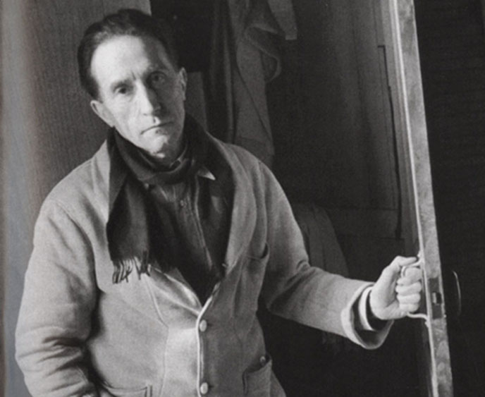
The idea for the Portal came in 2012
Applied to NEH in 2013 as part of the Humanities Collections and Reference Resources “Foundations” program
Received funding in 2014
Most of the project activities happened in 2015
White Paper submitted on March 31, 2016
Denise Bellon (French, 1902-1999), Marcel Duchamp opening the door to his Paris studio, 1938
Notes:
The idea for the portal came in 2012, when Dan Elliott, the former Library Director, and I were discussing possible grant projects with Museum Director and CEO, Timothy Rub.
We had a number of small collections in the Archives to process. Timothy suggested we approach the National Endowment for the Humanities, although we explained to him that a modest project wouldn’t be a good fit for this funder.
We needed something more ambitious, which drew on a major collection strength, and would be a real game changer for the profession.
I tossed out “Duchamp Research Portal” -- purely off the top of my head -- as an example of what it would take to get NEH’s attention.
And much to our amazement, Timothy said, “Okay, let’s go for it!”
So be careful of what you suggest to your Director – he might just take you up on it!

Slide 4
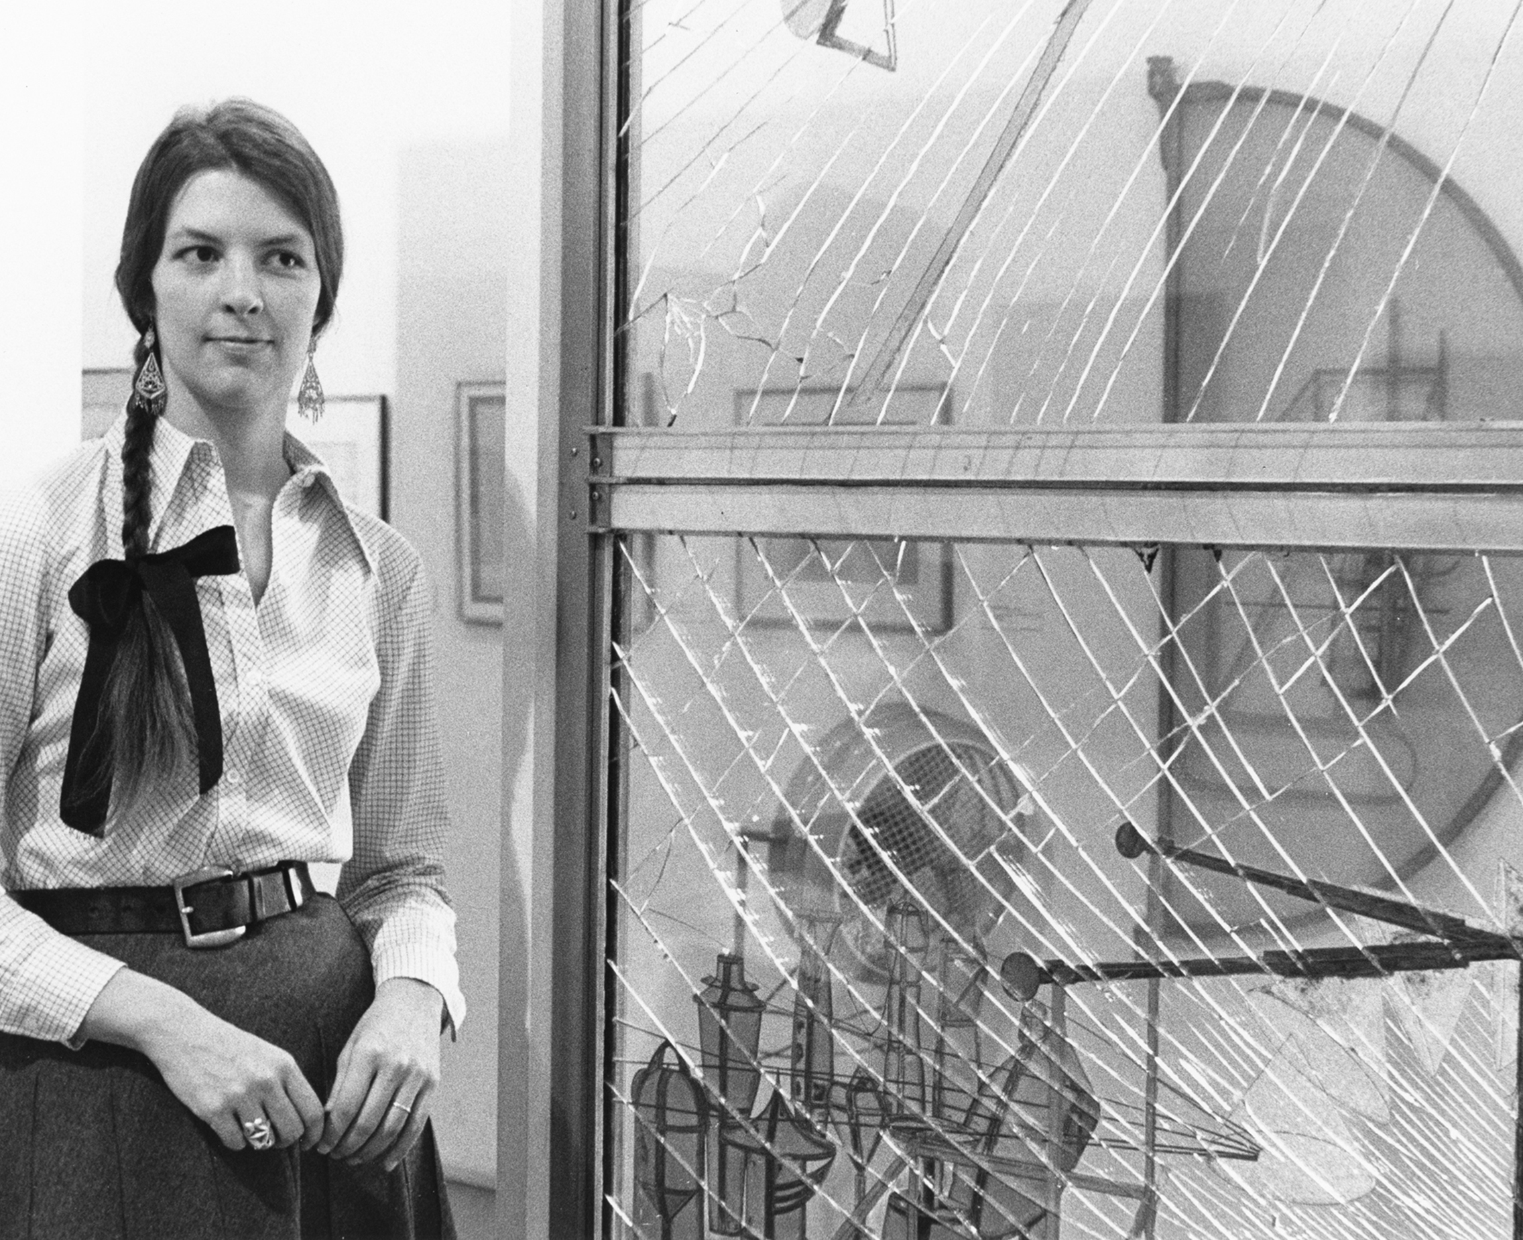
This project builds on previous efforts of Anne d’Harnoncourt and the Twentieth Century Art Department
The Museum Archives holds several collections related to Marcel Duchamp, making us a leader in this area of scholarship
Anne d’Harnoncourt with The Bride Stripped Bare by Her Bachelors, Even (The Large Glass), 1915-1923 by Marcel Duchamp, 1973.
Notes:
The project has some precedence, albeit in hardcopy. The groundwork was laid during Anne d’Harnoncourt’s tenure as curator of the Twentieth Century Art Department.
She and her staff, along with subsequent curators, gathered together primary and secondary source materials related to Marcel Duchamp, given the concentration of the artist’s work at the PMA.
What started out as curatorial research project eventually became a full-blown archive and was transferred to the Archives. These materials are now known as the Marcel Duchamp Research Collection.
It was processed by my department with major funding that Anne helped us obtain from the Andrew W. Mellon Foundation in the year 2000.
Other collections that benefitted from this initiative include the Arensberg Archives, the Alexina and Marcel Duchamp Papers, and the Marcel Duchamp Exhibition Records.
Taken together, these collections – along with the works of art themselves -- have made the Museum a leading site for Duchamp scholarship, so we are a logical choice to lead this initiative.
We’ve helped hundreds of researchers access these materials since they were transferred to my department in 2002.

Slide 5
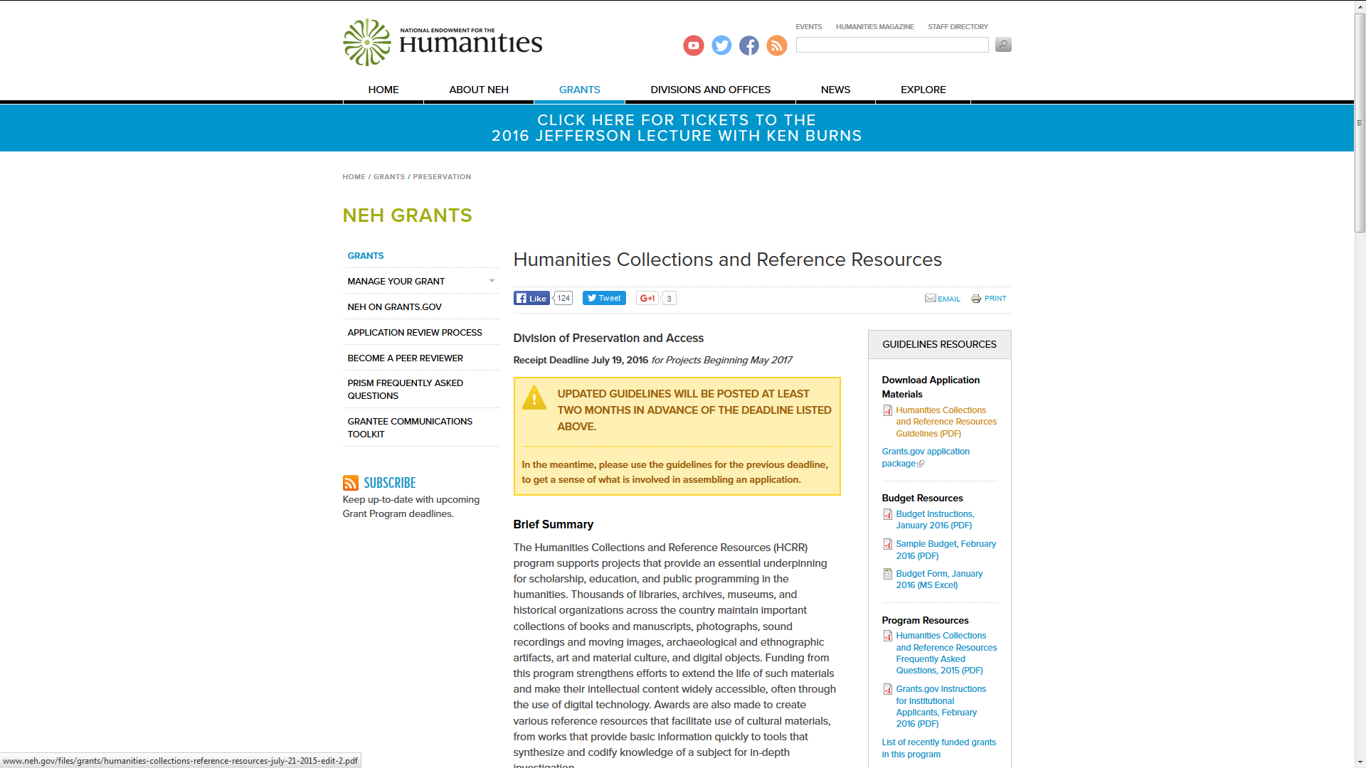
Notes:
Flash forward to 2013, when we followed our Director’s advice and applied to NEH, under the “Foundations” or planning grant category for Humanities Collections and Reference Resources.
I had heard stories about how you have to apply multiple times to NEH before you receive funding, so I warned our stakeholders that it may take awhile.
Then much to our surprise, we received a planning grant right off the bat in 2014.
Our proposal is on the NEH website, by the way, if you want to check it out, along with others, to get a sense of what is covered under the Foundations grant category.
The funding supported our planning efforts as we explored the possibility of Duchamp Research Portal, with a view towards eventually providing access to related collections from around the world.

Slide 6
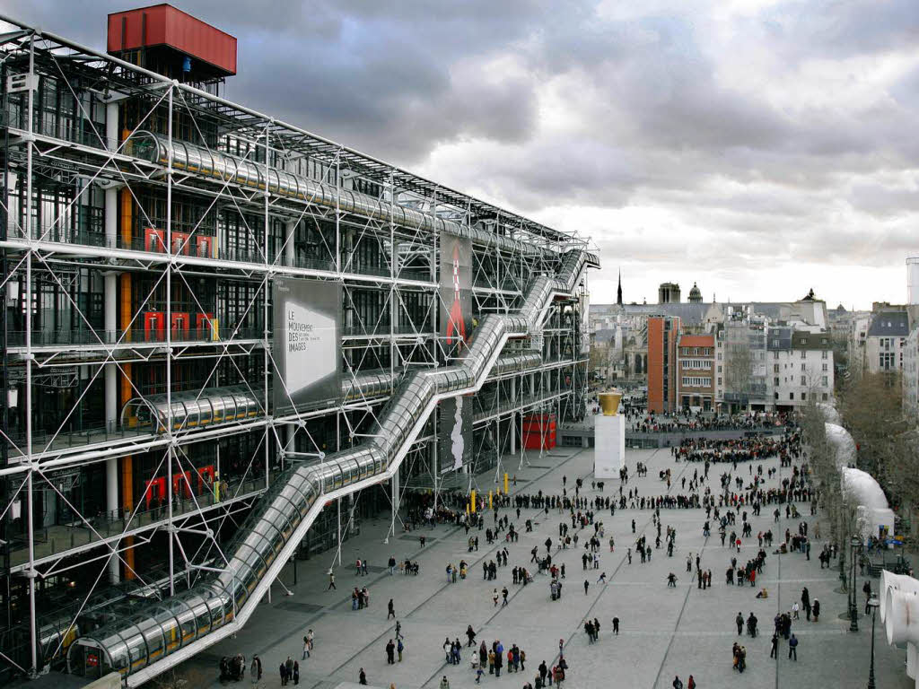
Centre Georges Pompidou
Notes:
Other organizations known for their Duchamp-related collections include the Musée National d’art Moderne and the Bibliotheque Kandinsky at the Centre Georges Pompidou,
And – not surprisingly -- the Association Marcel Duchamp, which represents the artist’s family.
During our planning grant project, we met with our French colleagues and explored the idea of a possible collaboration and building a shared online resource together.
Representatives from these organizations also served on our Advisory Board, along with my “dream team” of advisors, to whom I am immensely grateful:
Deborah Wythe from Digital Collections and Services at the Brooklyn Museum of Art,
Matt Shoemaker from the Digital Scholarship Center at Temple University,
and Christiana Dobrzynski-Grippe, the new college Archivist at Bryn Mawr.

Slide 7
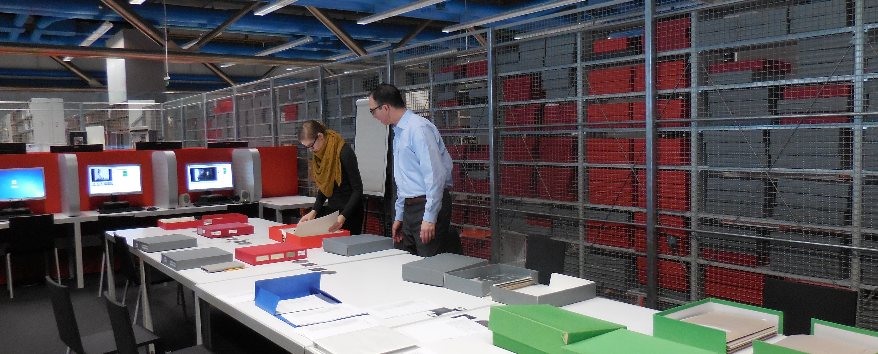
Christiana Dobryznski-Grippe and Matthew Affron examining Duchamp-related collections at the Bibliotheque Kandinsky
Notes:
Christiana and I visited Paris in 2015 for initial meetings and to survey collections for possible inclusion in the portal.
PMA Curator Matthew Affron also joined us, and you can see him here with Christiana, starting to dig into the Duchamp-related materials at the Bibliotheque Kandinsky.
The priority collections -- the ones that are unique or will complement what we have at the PMA -- will need preservation, cataloging, and digitization if they have not already received this attention.
And you’ll be hearing more about the survey process soon from Christiana.

Slide 8
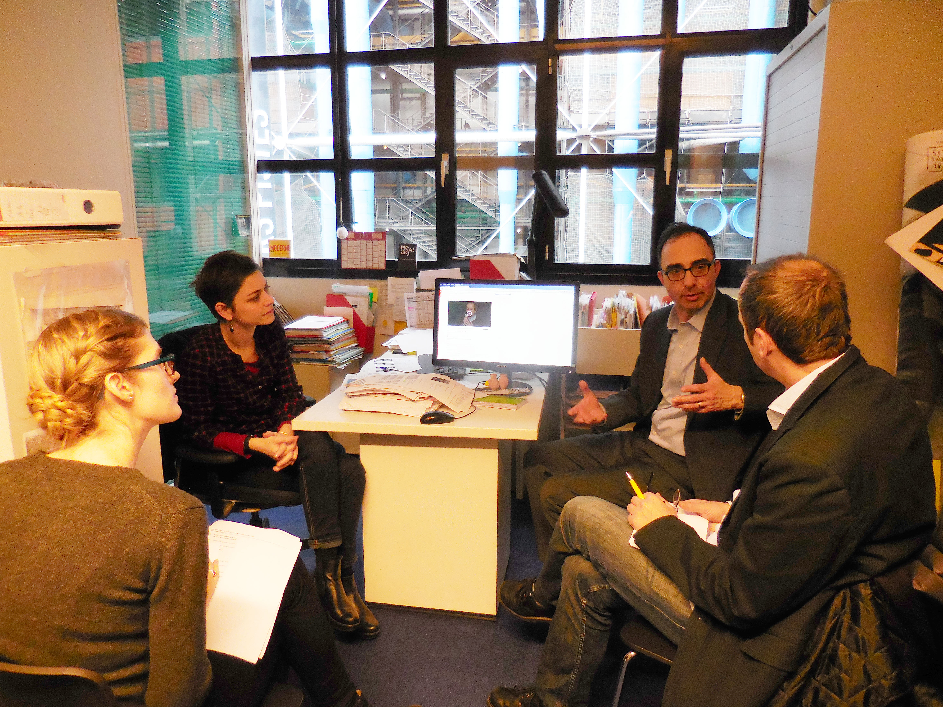
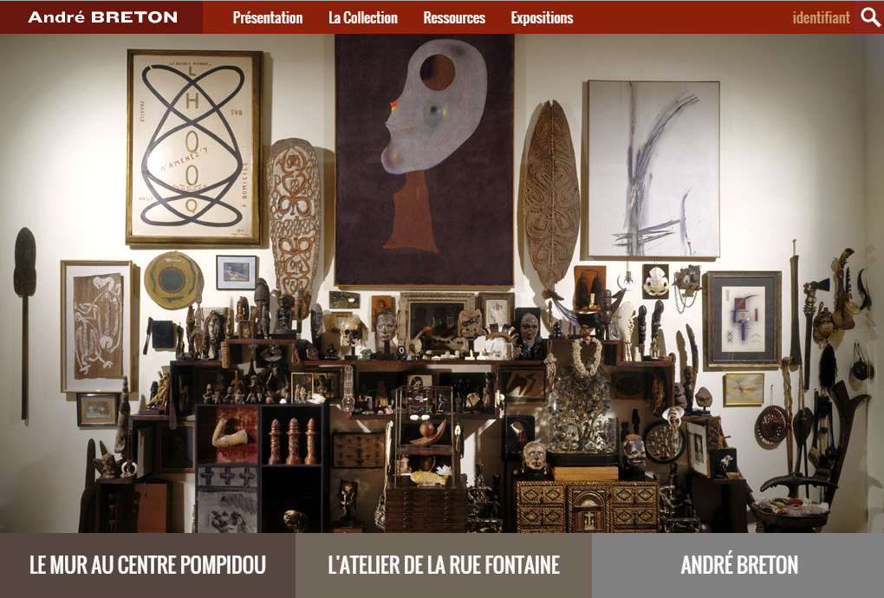
Left: project staff meet with Perrine Renaud and Bruno Gonthier. Right: home page for the Andre Breton research website
Notes:
We also met with the people working with digital collections at Centre Pompidou.
Fortunately for us, their staff has some experience with digital projects and recently collaborated with the Andre Breton estate to recreate his collection online. The homepage to this website is on the right.
The Pompidou uses descriptive standards similar to ours, in Unimarc and EAD, so we can conceivably create a crosswalk, along with emulating their work with aggregating collections online.

Slide 9
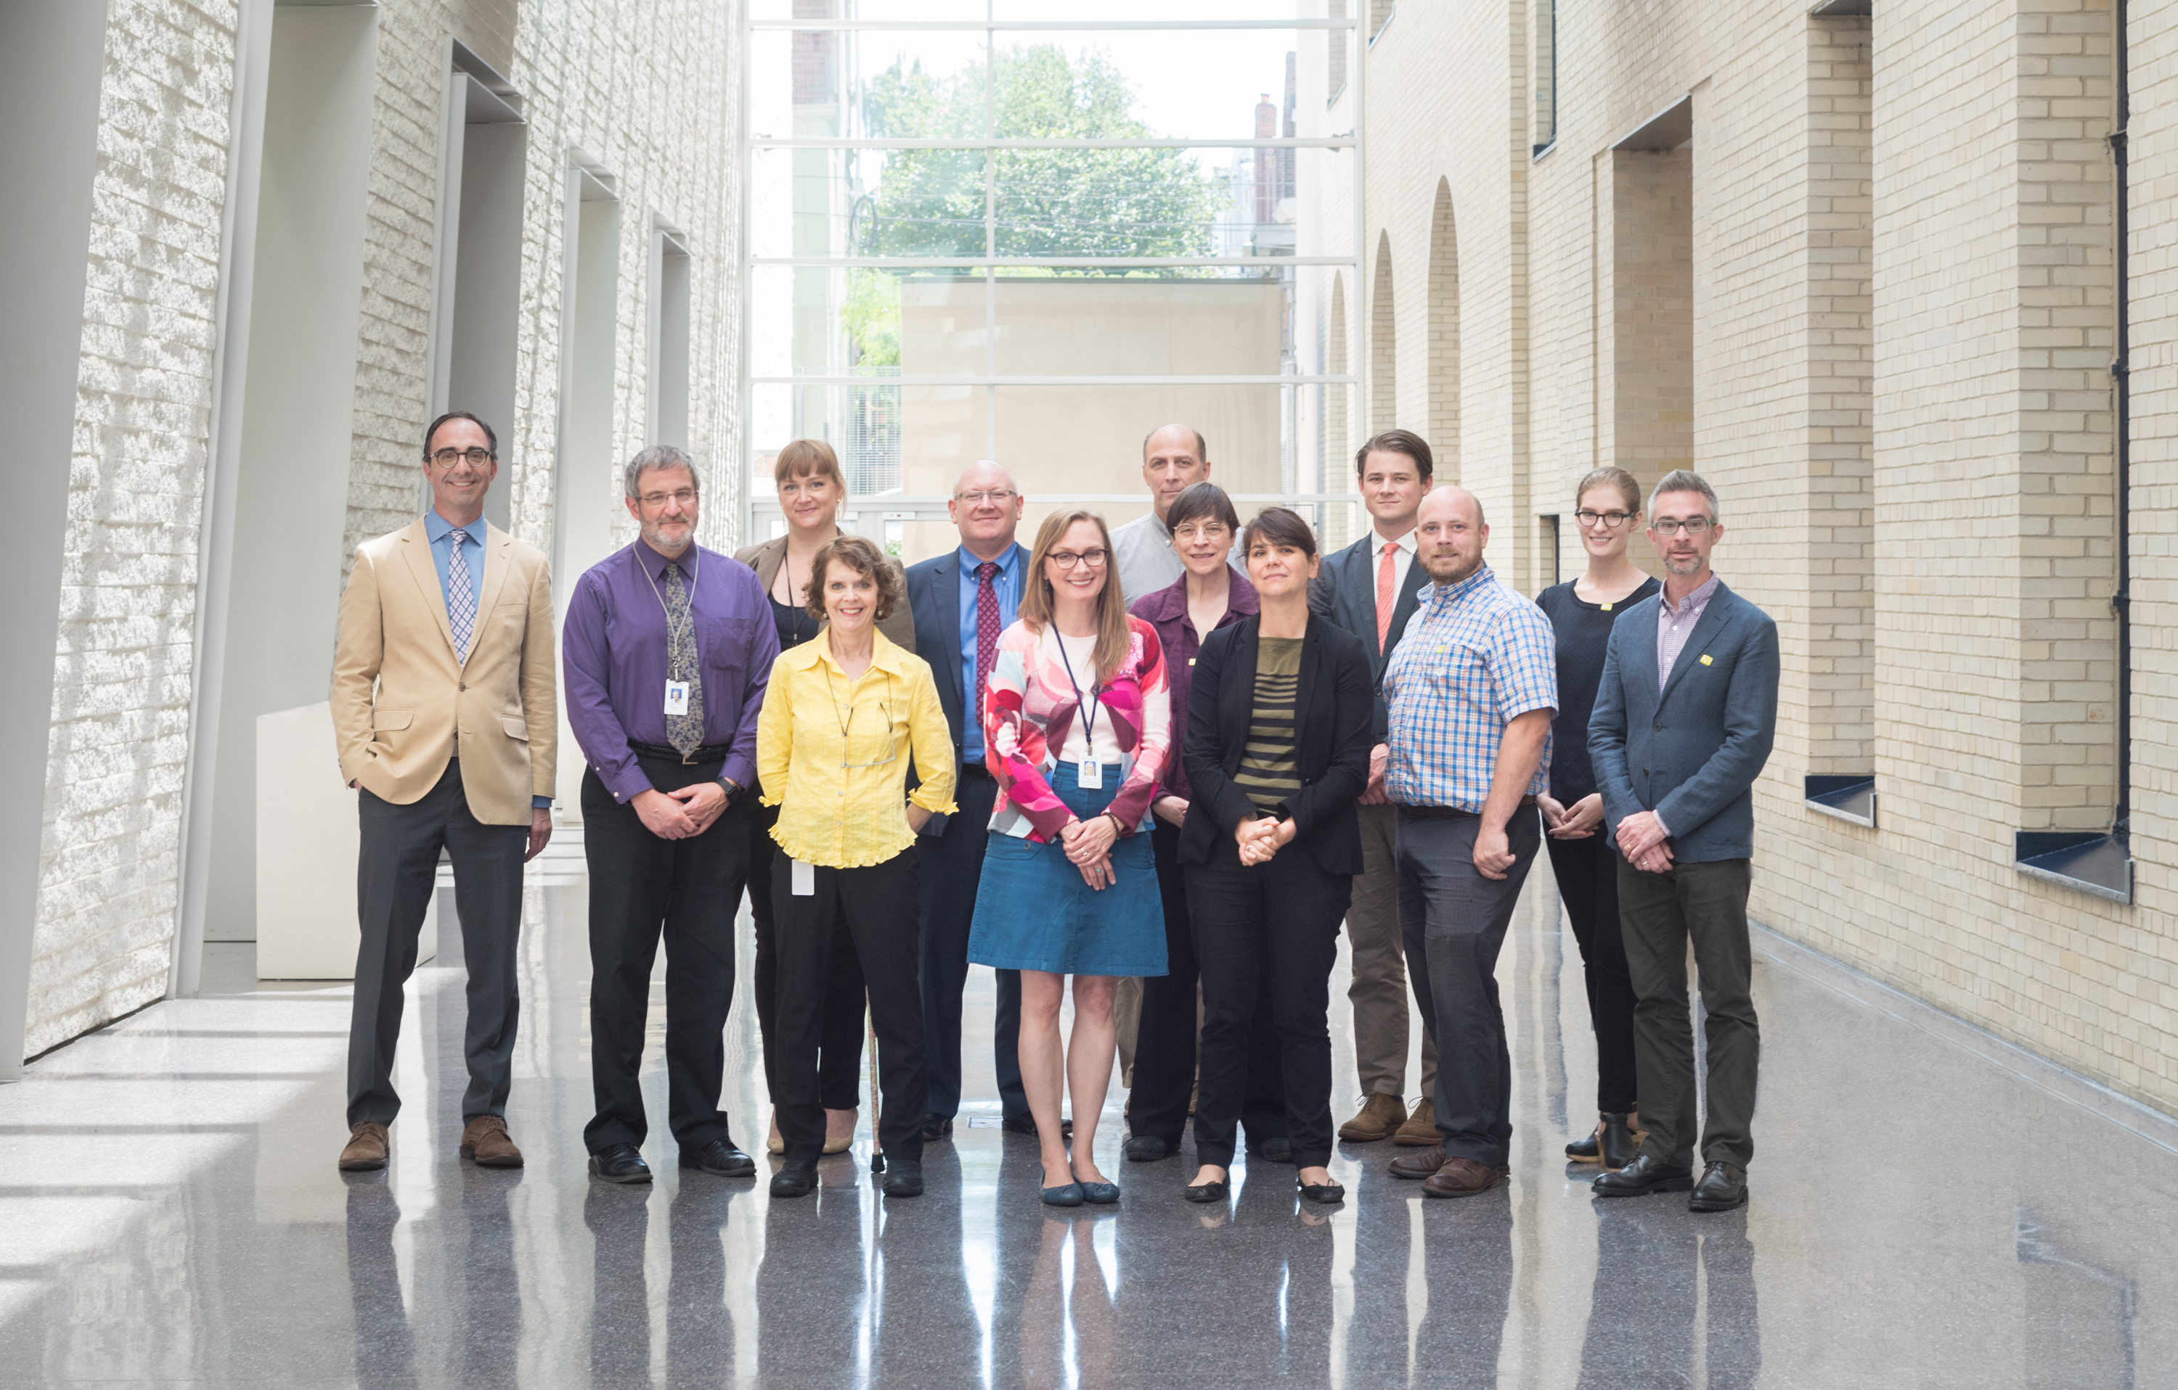
Duchamp Research Portal Advisory Board Meeting, May 27, 2015
Notes:
Upon our return, I surveyed Duchamp-related collections at the PMA, as well as conducting a user survey. We presented the results of this research at our advisory board meeting in late May 2015.
With our partners, we examined the findings and determined what kind of system would be appropriate for our purposes and how it could be adapted for user needs.
We also considered which collections to include from each site, as well as potential challenges, such as copyright and metadata issues, which you’ll be hearing from Deb about soon.
We have also been working with Matt over the past few months on a proof of concept model, with samples from each of the partner institutions, to demonstrate how a system could potentially work which you’ll be seeing shortly.

Slide 10
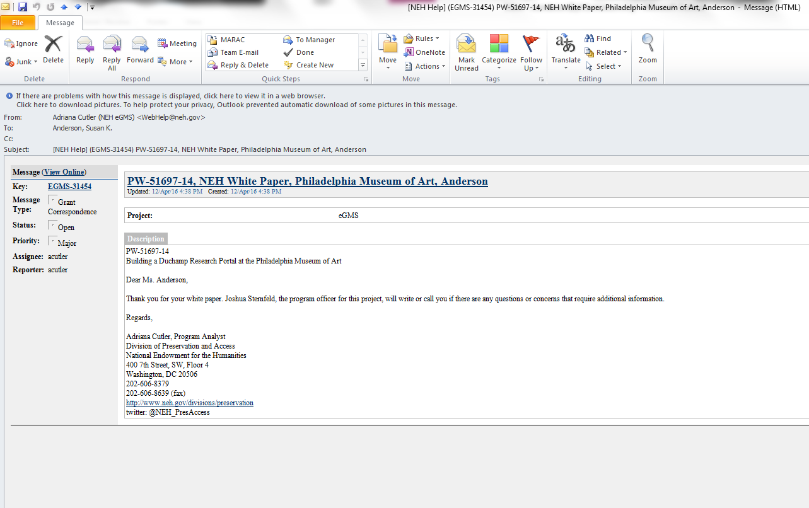
Notes:
The recommendations from this 18 month planning process resulted in a 277 page white paper, which we submitted to NEH on March 31st.
And ironically, I received this confirmation message from NEH as I was working on this slide!

Slide 11
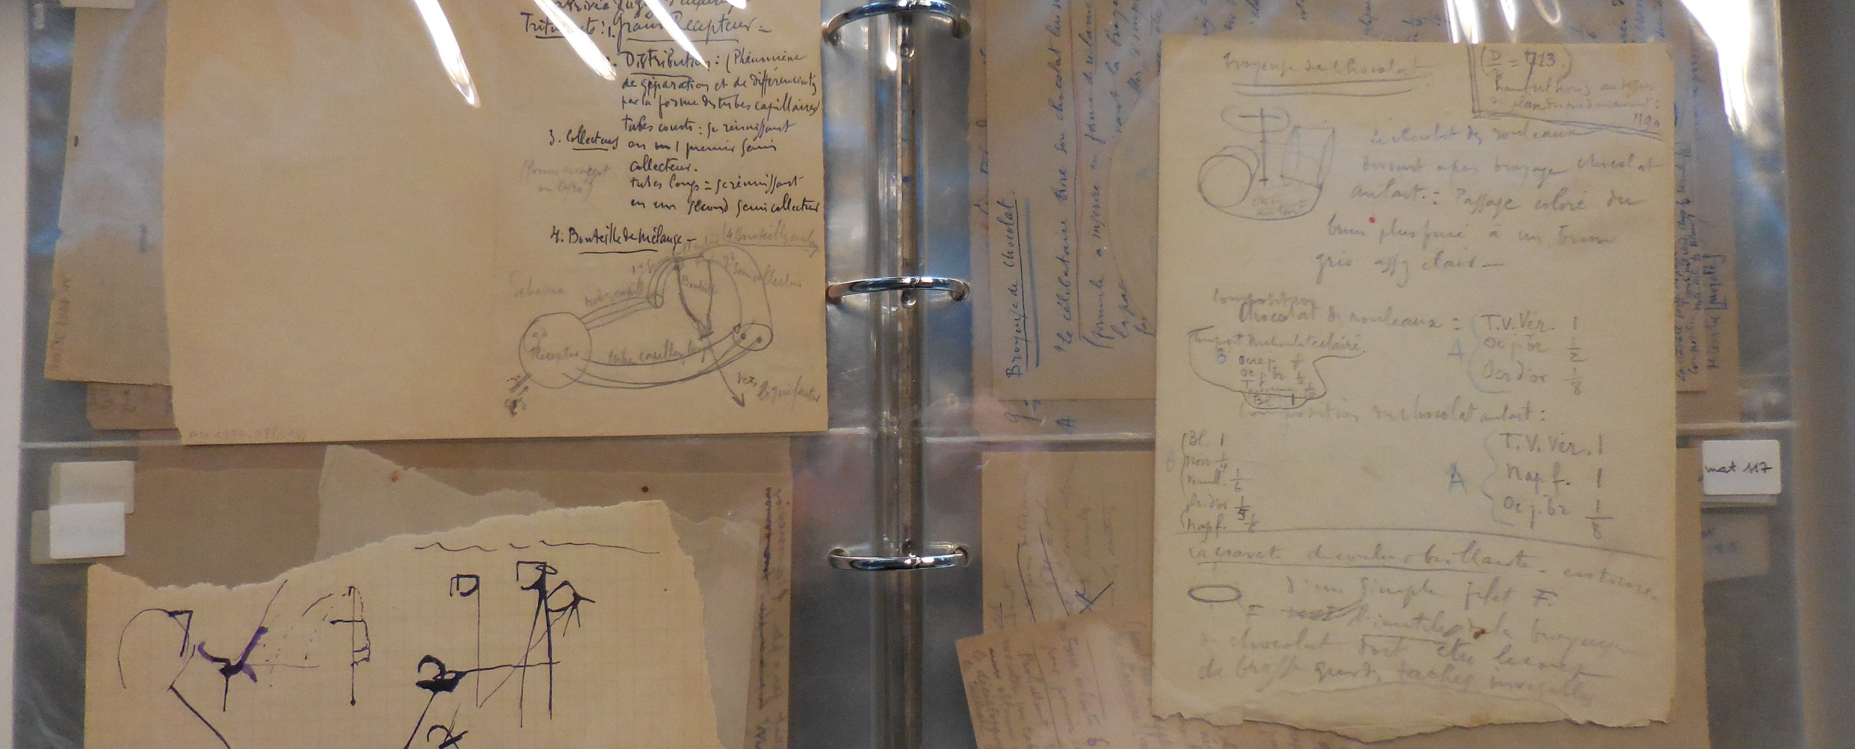
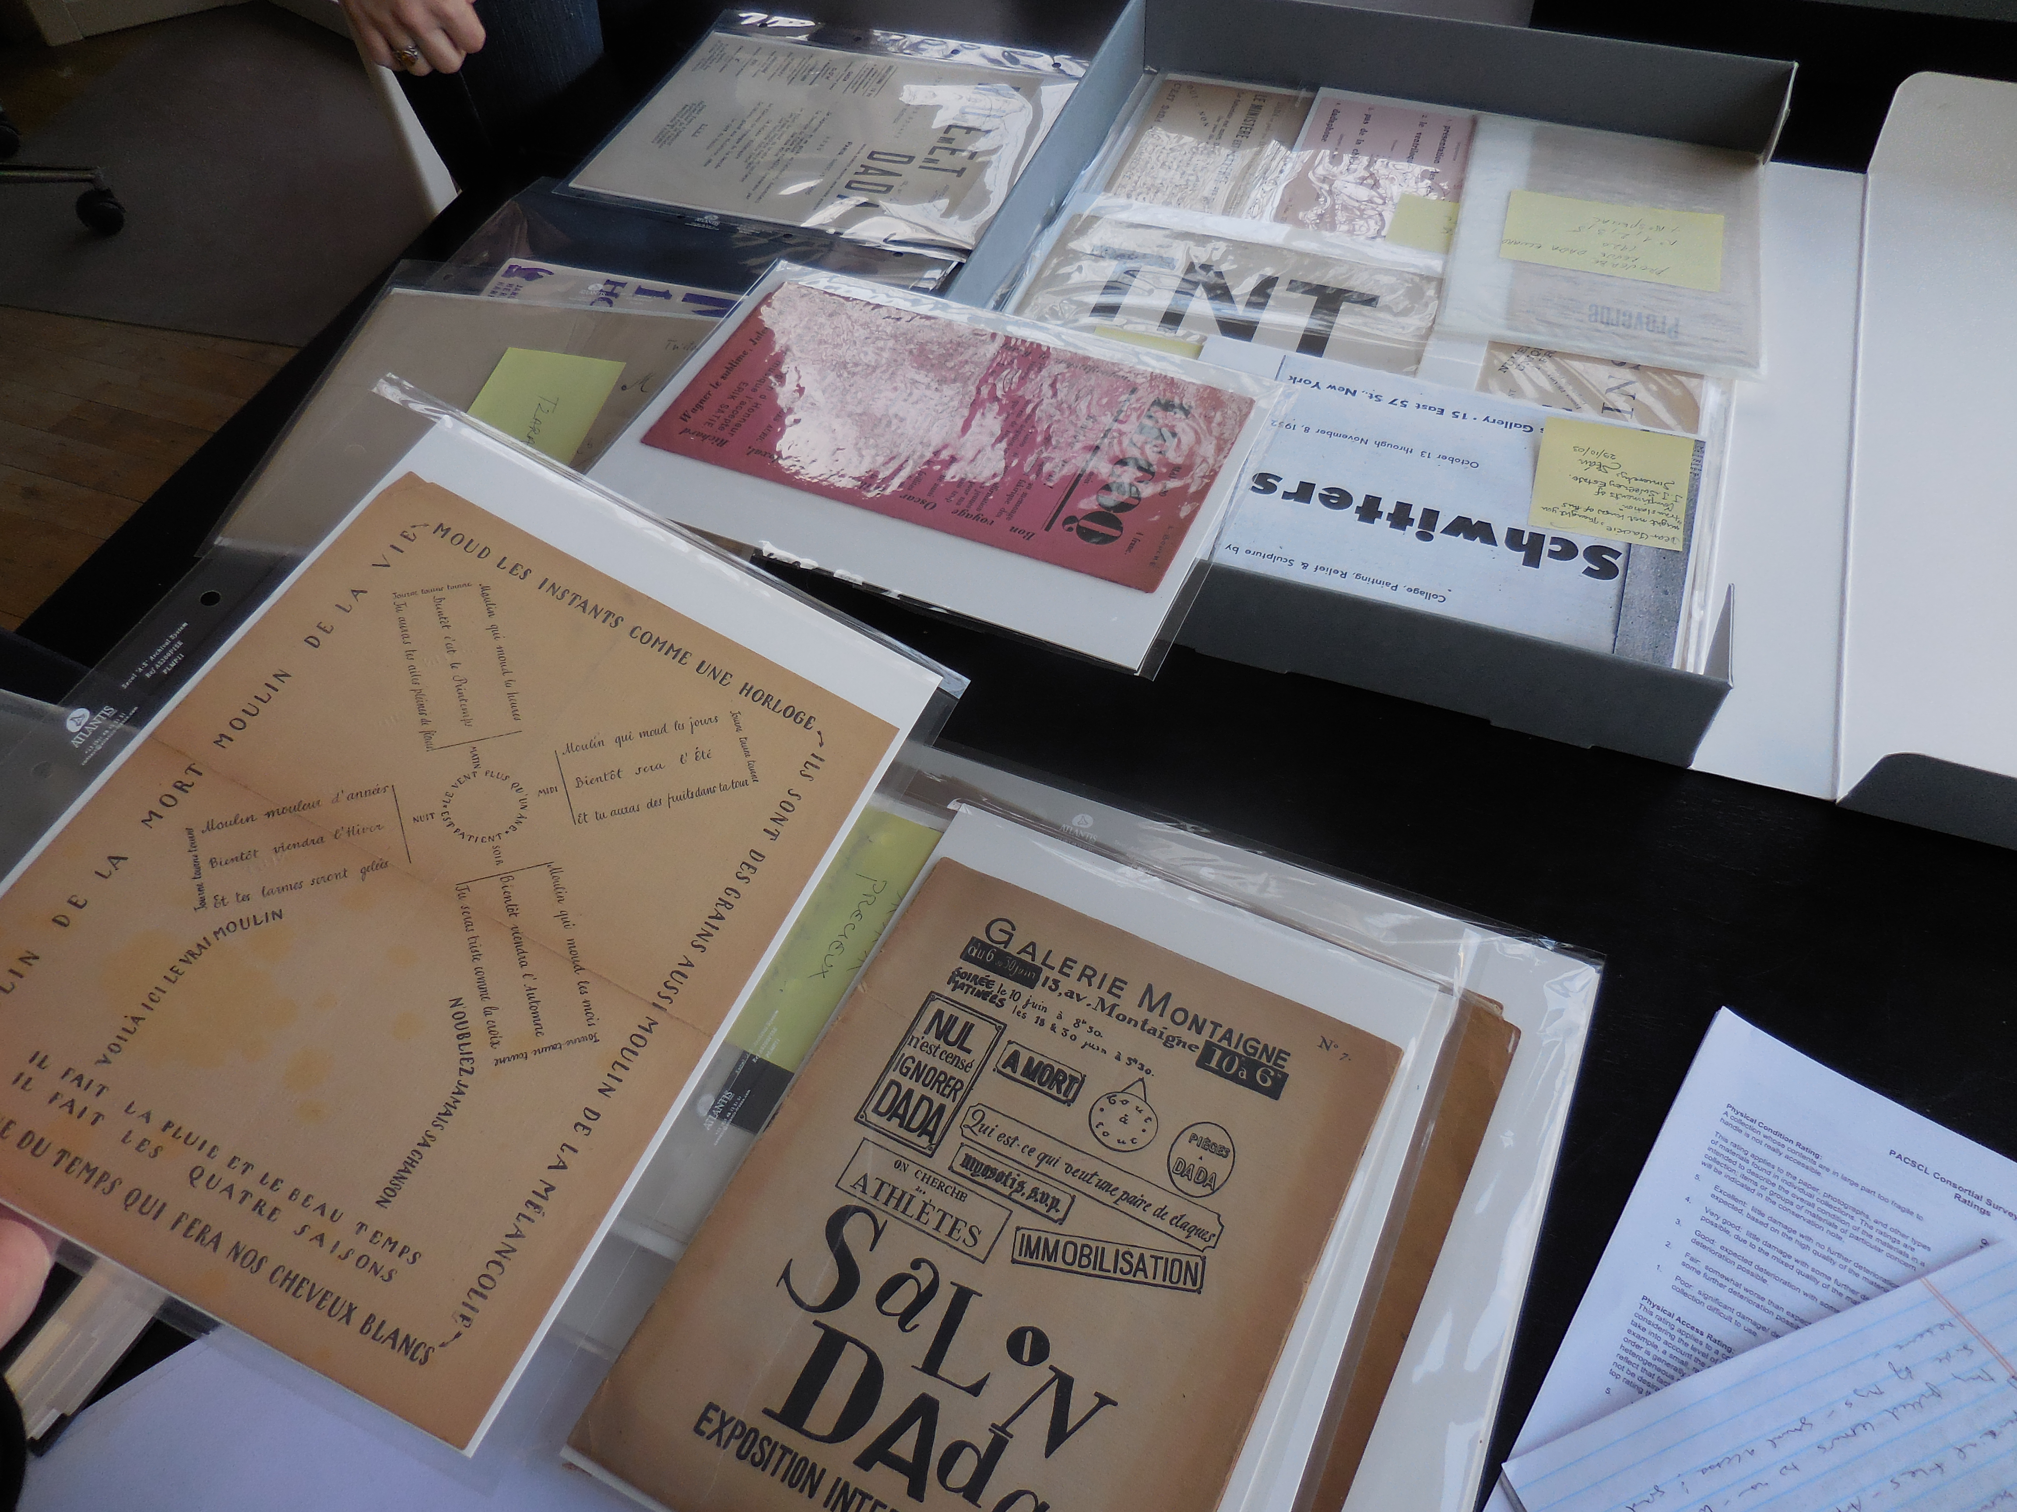
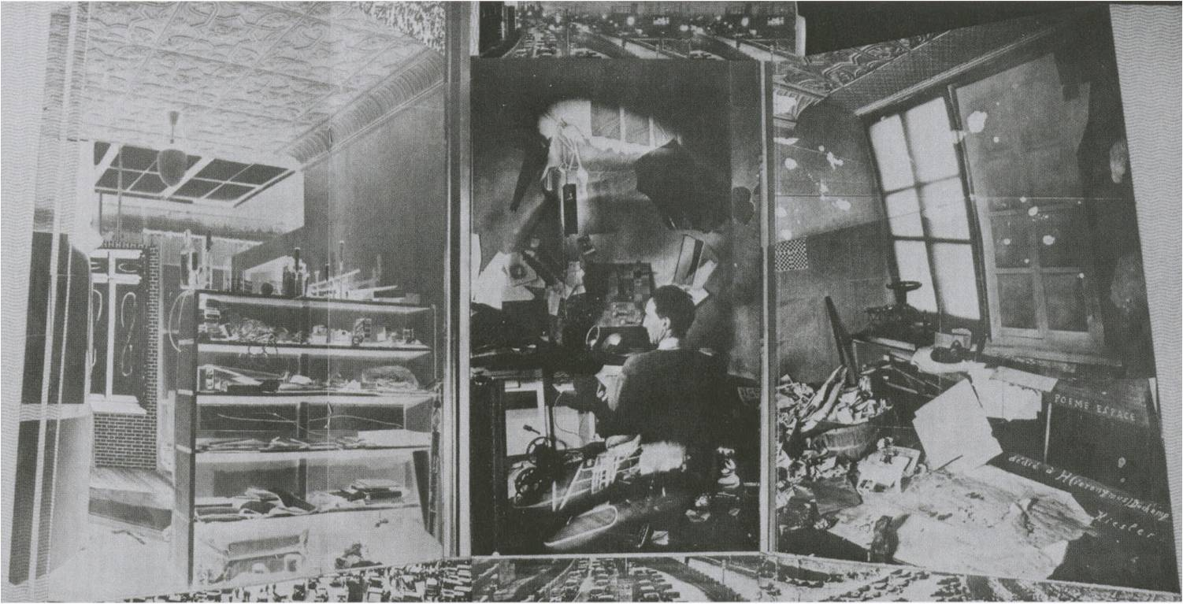
Upper right:, rare publications at AMD; upper left, original notes for the Green Box at CP; lower center, View magazine layout for Duchamp issue at PMA
Notes:
The next step in the process is writing an implementation grant to NEH, which I’m currently working on.
If we are able to obtain funding for this phase of the project, the Duchamp Research Portal will bring together archival materials from our three institutions and make them accessible in a way that has not been possible before.
We intend to create a scaleable model and ultimately invite other museums, libraries, and archives to contribute to this online resource.
Looking at the big picture, it will be a way for our Museum to collaborate internationally with related institutions and the digital humanities community.
It also promises to be a way of realizing several the PMA’s strategic goals, such as visitor engagement, activating the collections, and creative use of technology.

Slide 12
Applying for a grant
A grant is basically a business plan
Your job is to convince the funder you’re a good investment
Make a case for:
  The significance of your collection
  Impact on the scholarly community
  Benefit to the archives profession
Notes:
Okay, so now that we have a sense of what the project is about, I’ll cover some of the lessons learned from writing and administering grants, as well as conducting a user survey.
First, let me see where you all are coming from – have any of you applied for grant funding before? Okay, good. How about federal funding? Ah – it was a bit challenging, right?
While it can be, don’t let it intimidate you. I remember a former professor telling me that a grant is basically a business plan.
The more you can assure your funder that they’re making a good investment in your “product” -- be it a processed collection, finding aids, online resource, whatever – the better your chances are of getting funded.
Making a case for the significance of your project is important, as well as the impact on the scholarly community, and benefit to the archives profession if you plan to widely share the guidelines, workflows, and procedures you developed.

Slide 13
Identify your project and possible funder(s)
Work closely with colleagues in Development
Realize that you may have to wait your turn, or approach another agency altogether
Your funder’s priorities should be your priorities
One approach: brainstorming with a scribe
Allow a long window for developing the narrative
Notes:
Once you have the necessary buy-in and have considered all of the factors going into the project (and we’ll be sharing a checklist of these issues at the end of the session) be sure to meet with your Development colleagues.
I suspect that most of you – if you’re working for an educational institution or cultural non-profit – will have some kind of Development or fundraising department at your organization.
They can help you write the proposal, decipher the funder’s guidelines and requirements, as well as submitting it on your behalf (federal grants must be submitted through Grants.gov, a challenging interface to deal with).
Since Development departments coordinate grants for the whole institution, you never know who may want to approach the same funder and you’ll have to wait your turn, or they may know of a more appropriate foundation for your type of project.
Getting a good match between what you’re asking for and the organization who can provide it is key – your priorities should match their priorities.
As far as actual grant-writing is concerned, a couple of things I’ve found to be helpful are:
Brain storming with other staff who will be involved with the project. Assign someone to act as a scribe with a laptop, then you can pick and choose the best ideas to go into the grant narrative.
Also allow yourself a long window for the writing – I’ve learned this the hard way. Grant proposals are complex animals and require a long gestation period. It will evolve over time as you refine it.

Slide 14
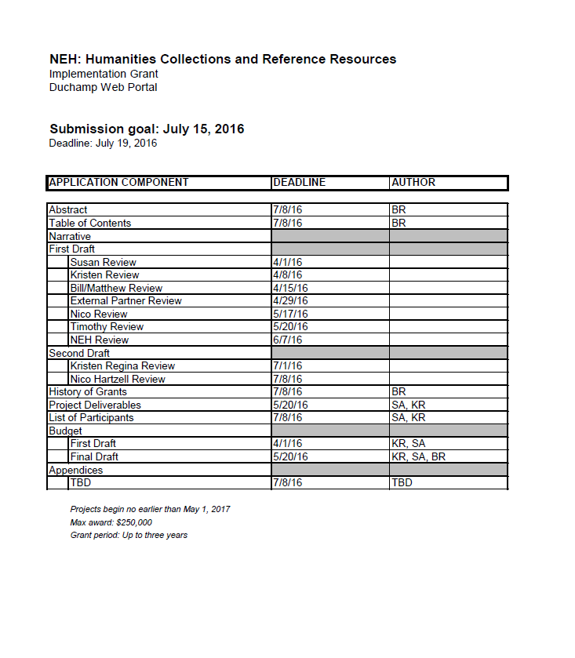
<= The deadline schedule for the NEH implementation grant
Identify stakeholders and build their review into the process
Notes:
If you will be collaborating with other people, identify all stakeholders. You will need their buy-in, as well as their review of the proposal, so leave plenty of time for their editing and feedback.
Creating a deadline schedule also helps with this process, so you can keep your proposal development on track. The slide shows the one we’re currently using for our NEH implementation grant.
Another way of tackling the writing, since staring at the blank screen is a bit intimidating, is copying the grant requirements from the funder’s website and have this serve as your outline for the narrative.
Speaking as someone who has reviewed grant proposals before for NEH and NHPRC, there are certain components I look for, and it helps to have the structure of your proposal emulate the requirements of the grant.

Slide 15
Ask a trusted colleague for feedback/fresh pair of eyes
Do your homework:
  Review successful grant proposals that did similar things
  Read up, take workshops, learn how to walk the talk
  Review standards, get policy framework in place
Request preliminary feedback from the potential funder
Notes:
Other things that have helped me in the past is asking for feedback on the proposal from a trusted colleague --
it’s helpful to have fresh eyes look at something that’s been labored over by multiple people, if you can stand one more opinion.
It’s also fruitful to look at successful grant proposals with a similar project or theme -- especially for their work plans -- if you’re starting a new initiative and wondering how long things will take, as well as specific procedures.
Depending on what you’re planning to do, you may have to do some preliminary work just to write the proposal, which will include training, having appropriate policies in place, and knowing which standards you need to invoke.
And don’t be afraid to request feedback from your funder. They will usually assign a grant manager to you, if not a chance to turn a draft in early for their initial reaction and input before the final submission.
You can be really frank with them -- ask what they’re looking for and how you can improve your chances of getting funding. It’s what they’re there for.

Slide 16
Grant management
Follow your work plan as closely as possible
Factor in contingency for unforeseen circumstances
Take note when interim and final reports are due
Know the terms and conditions of the grant, as well as process of changing them
If there is a matching component, see what your Finance department needs for documentation
Notes:
Another topic I can address is grant management. For starters, try to follow the work plan in your proposal as closely as possible to stay on track.
While there are various project management programs and apps out there, the most important thing to do is find one that works for you and stick to it.
Factor in some contingency for unforeseen circumstances and take special note of when interim and final reports are due. You should also know the process of changing the terms of the grant, such as asking for an extension.
We’re here in front of you, courtesy of the NEH, because we had some money left over, but we made sure to request it in writing first, because attending MARAC wasn’t part of our original proposal.
Also make sure you’re spending the grant funds in the correct way; we discovered this as we were planning a festive dinner after the advisory board meeting that we couldn’t use federal dollars on purchasing alcohol.
If there is a matching component, speak with your Finance or Accounting department early on to see what they need for reporting purposes (time sheets for staff contributed time, receipts for purchases, etc.) and follow up with them on a timely basis.
Even if you are collaborating, there needs to be one person in the role of primary investigator or grant manager, who is responsible for everything.
Realize this is going to be a part-time job on top of your regular job for the duration of the project. Do whatever is necessary to get the support you need to stay on top of your tasks.

Slide 17
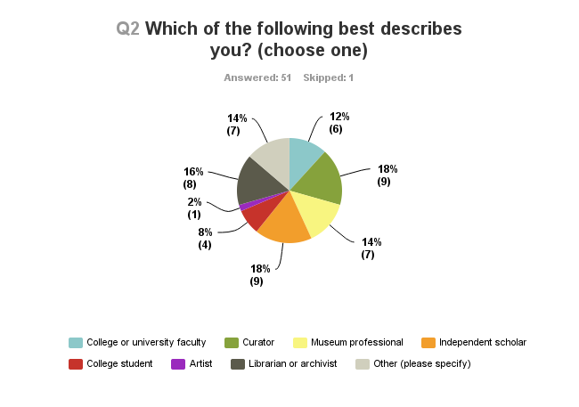
User survey
Question from the user survey distributed in March 2015
Notes:
Finally, as far as surveys are concerned:
We distributed our survey to approximately 300 people, including members of the advisory board, Museum staff, colleagues who have an interest in Duchamp, and researchers who have used our collections in the past.
For those who responded, you can see how the demographics played out above.
The survey had four sections: getting to know you, collection scope, search functionality, and other feedback.
The survey was a great opportunity to engage with the Duchamp research community and get direct feedback on what they would like from an online discovery tool.
It helped us establish priorities in developing the proof of concept, as well as helping us judge potential systems and other features.
A couple of suggestions would include: if your institution has a statistician in your visitor services department, speak with them first and get pointers.
Think carefully about the information you need to get from your users and how the data will help you move forward the product or services you’re developing.

Slide 18
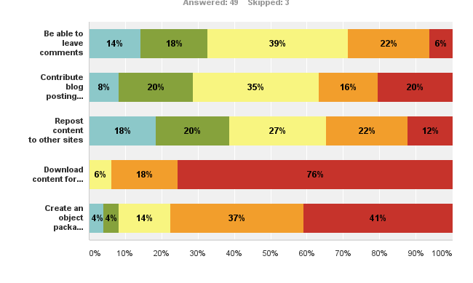
Question from the user survey distributed in March 2015
Notes:
While you don’t want to ask leading questions, if you’re trying to decide between a few viable options, have those options be your multiple choice questions, as clearly stated as possible.
You may even want to restate the question in a different way, just to make sure you get the feedback you need and the formatting of the question doesn’t skew the results.
While structured questions are easier to tabulate than open ended ones, having a few open text responses will allow feedback you weren’t expecting to enter into the mix. You can then tag those responses and tabulate from there.
If you end up using Survey Monkey, see if your institution has a corporate account before signing up for one yourself, like I almost did. Also, Survey Monkey Pro will let you save your data and export it.
Find the sweet spot between having too many questions and too few; you want to get the data you need to establish priorities, but you also don’t people to give up if it takes too long to finish the survey.
Have some friends test a draft of the survey before you make it live to get the bugs out. This will also help you estimate how long it will take to complete the survey, so you can include this info in your cover message.
Check the survey several times while it’s active; if you start to get wonky responses, you may want to rephrase a question or two.
Finally, make sure you have a set deadline and send reminders so your survey message doesn’t get lost in the bottom of someone’s inbox.

Slide 19
Thank you
Questions?
skanderson@philamuseum.org
(215) 684-7659
Notes:
Okay, that’s all for me -- thank you very much for your time!
Without further ado, please welcome Matt Shoemaker, who will tell you about the technical side of the Portal project.

