Slide 1
Our Stories, In Numbers
Best Practices
Lutgarda Barnachea
Library Research & Innovative Practice Forum
June 4, 2015

Slide 2
Goals
Measurable objectives
Metrics
Transparency
Group involvement
Common understanding – what, how to, where from, how often
Assigning responsibilities
Repository (individual vs group; print vs e)
Reporting
To whom
Frequency
Format
Who is doing
Assessment

Slide 3
Data sources
Internal – internal (production activities, services, library system)
External – OCLC (WMS for dashboards and institutional comparisons),
FirstSearch e-usage statistics
Future plans
Libraries’ central data repository (ongoing project)
Dashboard

Slide 4
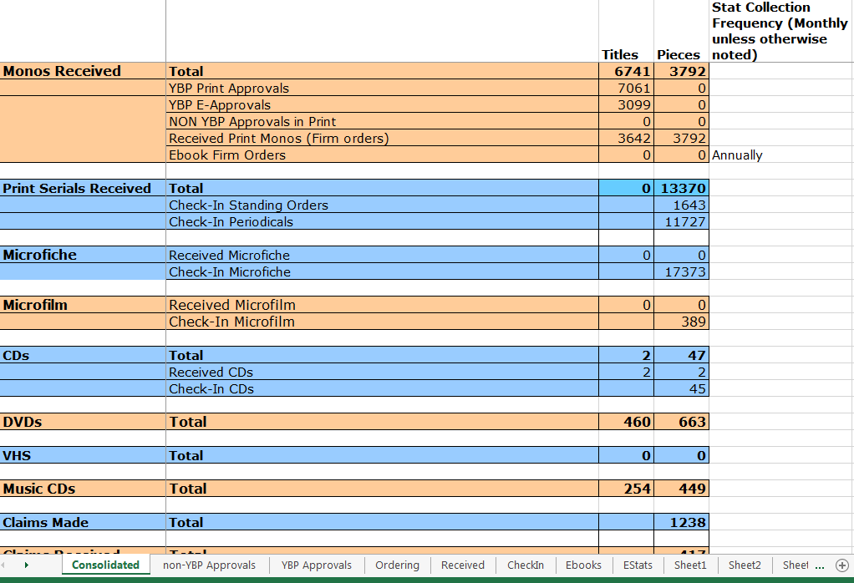
Example: central data repository

Slide 5
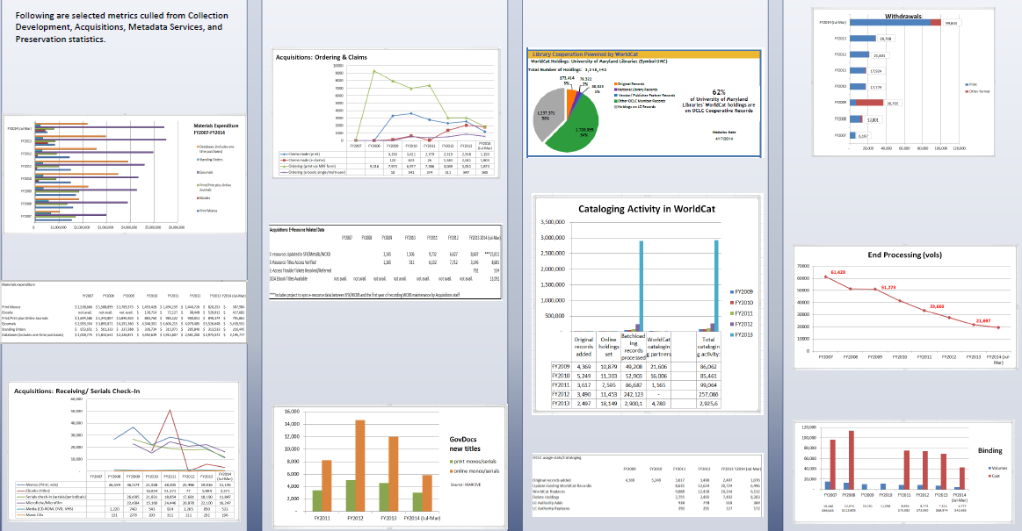

Slide 6
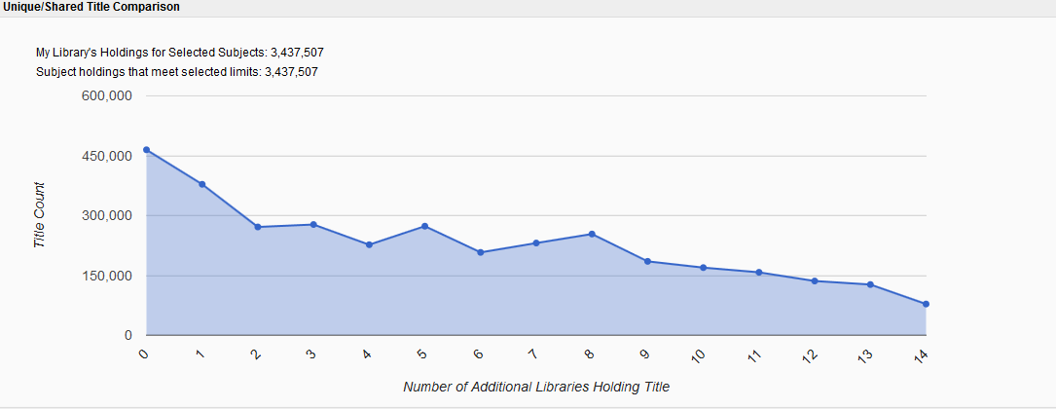
UMC vs CIC collections (OCLC WMS)

Slide 7
In the future….
DASHBOARD
- inform our public
- seek interaction
- current

