Slide 1
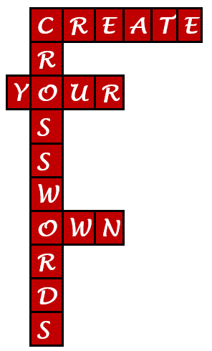

Crosswords
as fun, useful and engaging tools for library instruction, training and more
Judy Markowitz
Reference / Subject Librarian
judym@umd.edu
Nedelina Tchangalova
Public Health Librarian
nedelina@umd.edu
Presented at USMAI Reference & Instruction Forum • University of Maryland University College – Largo • May 5, 2017
Notes:
We introduce ourselves.

Slide 2
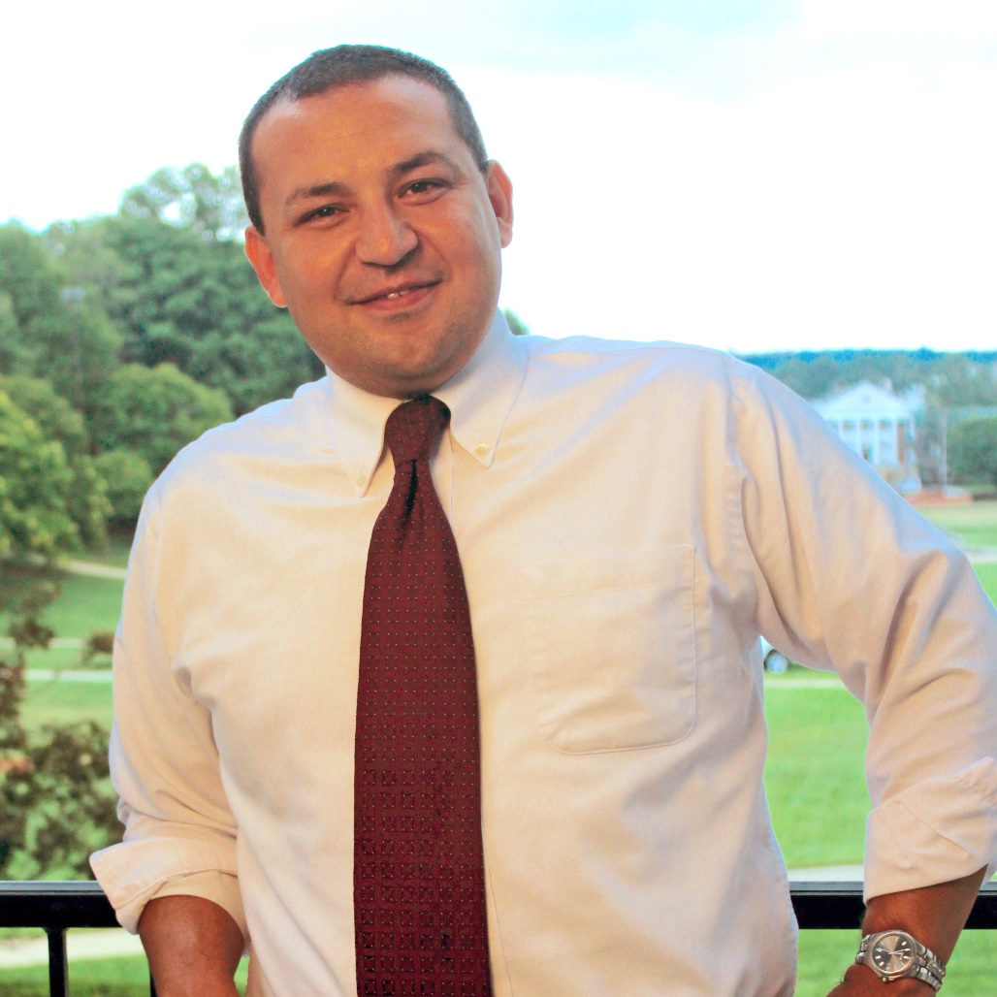

Background
Scott Roberts, PhD
Director of Instructional Excellence & Innovation
Teaching & Learning Transformation Center
University of Maryland, College Park
Notes:
Judy
We learned about using crosswords for instruction from Scott Roberts, a master teacher, psychology professor and director of Instructional Excellence & Innovation at the Teaching & Learning Transformation Center at the University of Maryland at College Park.
We had invited him to help us engage with students within our one-shot LI classes.
We started using crosswords in a formal and informal way.

Slide 3
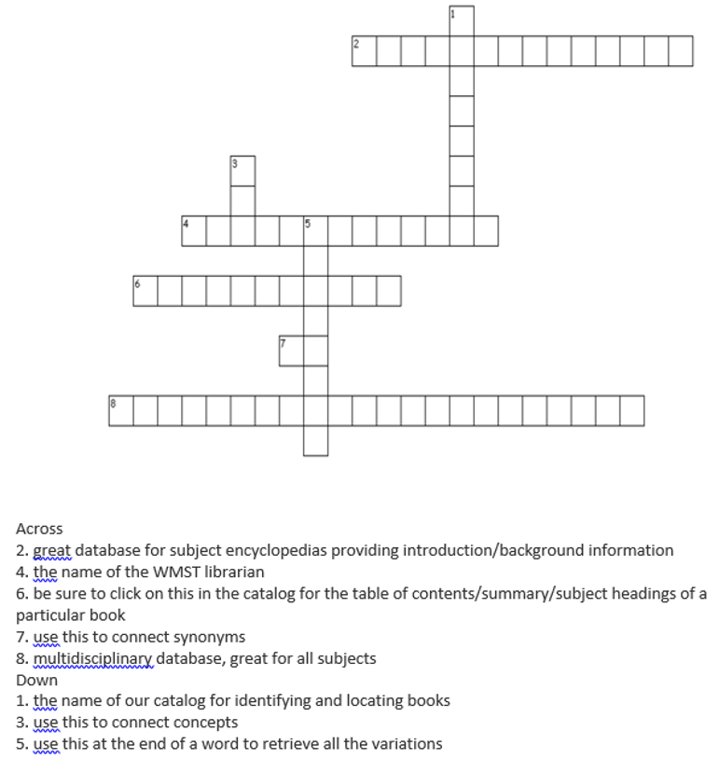
Example 1
Women Studies
General Crossword
Notes:
Judy

Slide 4
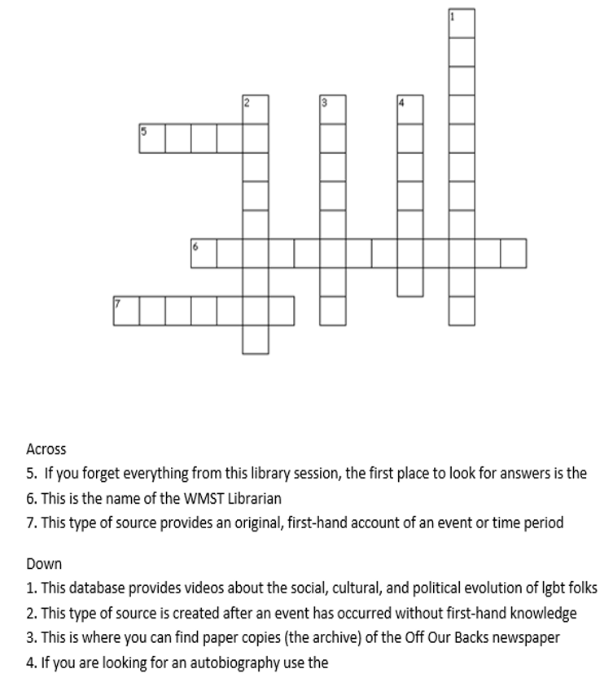
Example 2
Women Studies
Primary Sources Crossword
Notes:
Judy

Slide 5
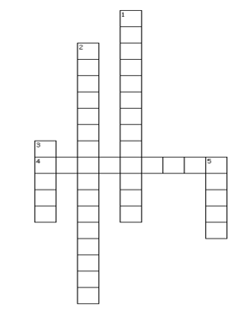
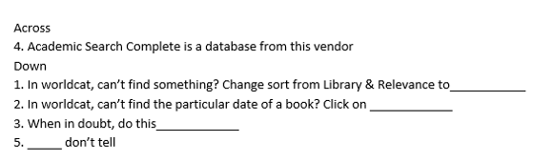
Example 3
Training Crossword
Notes:
Judy

Slide 6
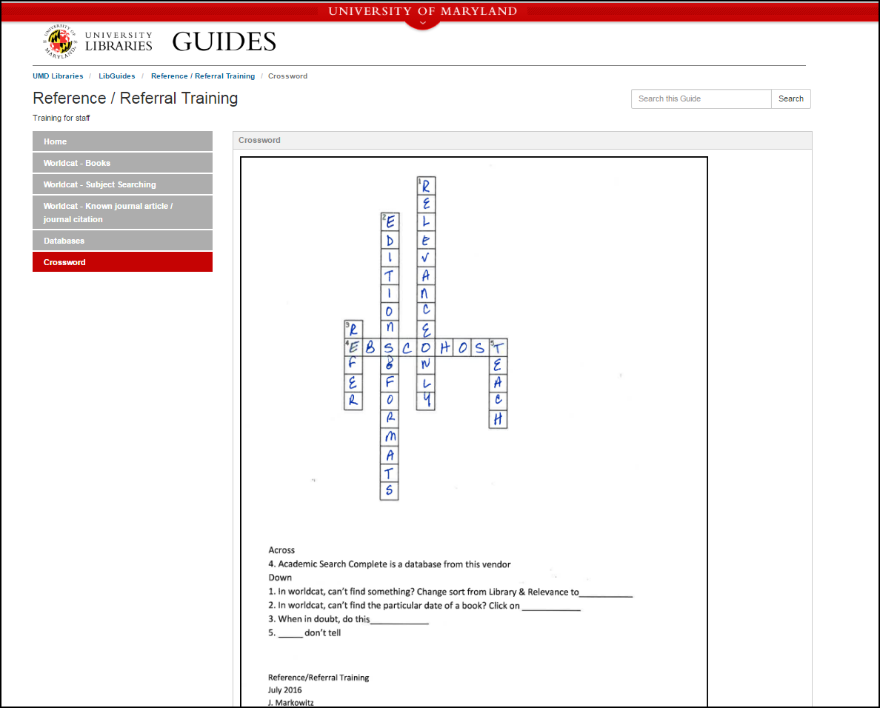
Example 3 (cont.)
Training Crossword
Answers posted on a LibGuide
Notes:
Judy

Slide 7
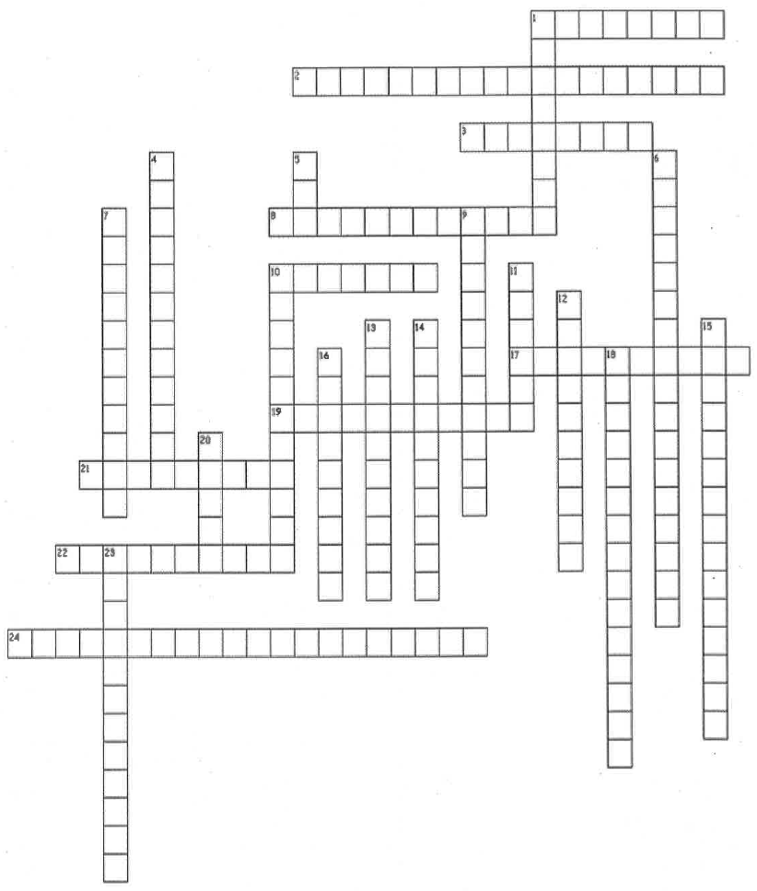
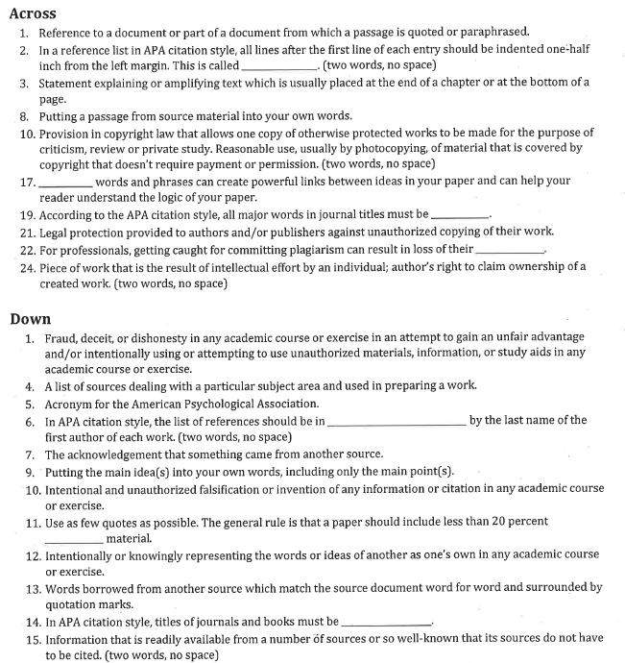
Example 4
Plagiarism Crossword
Notes:
Nedelina – I was invited to organize a workshop for graduate students on plagiarism and academic integrity. The lecture was recorded to be used by faculty who have online courses. To bring more interactivity in the session, I created a complex crossword for students to reinforce the concepts taught in class.

Slide 8
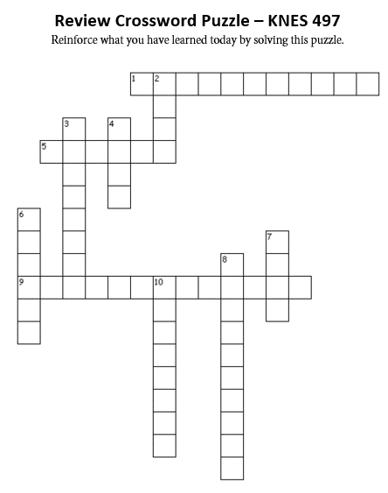
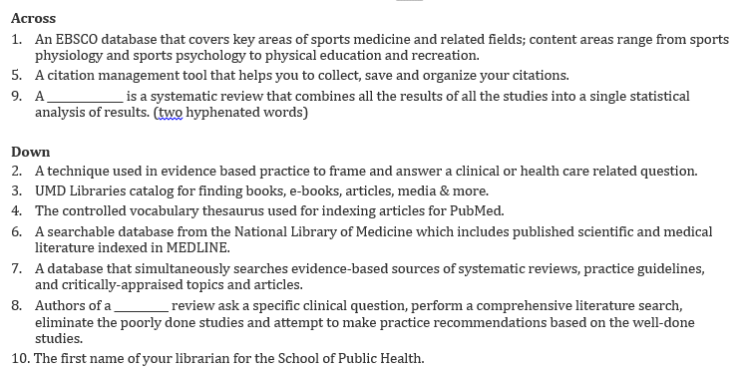
Example 5
Kinesiology Crossword
Please provide feedback on this activity (e.g. was it difficult or time consuming, did you enjoy it, did you consult with your friends, do you wish to have more activities like this one in other classes, etc.?)
Notes:
Nedelina – This is a history of sports class and I worked with a librarian from Special Collections to co-teach this class in 5 sessions. The professor mentioned that students have different levels of proficiency in searching databases. After completing an in-class activity searching various databases to find scholarly articles, some students have finished earlier than the others. Then, I gave them the crosswords to engage them in meaningful work while waiting others to complete their in-class assignments.
In other classes, with professor’s permission, I distributed the crosswords to students as a homework to assess their level of mastering the material taught in class and to make them consult the print handouts handed out in class.

Slide 9
More Ideas from the Literature
Accelerating learning vocabulary terms
Reviewing and reinforcing material
Library orientations
Checklist assignments and lengthy descriptive assignments
Assessment and feedback
Notes:
Nedelina will give a brief literature summary of other possible uses of crosswords. (see handout for further readings)

Slide 10

Crosswords Used in Other Subject Disciplines
Pharmacy
Sociology
Biology
Physiology
Image with modification from http://www.pptbackgrounds.org/notes-hanging-on-rope-backgrounds.html
Notes:
Nedelina will give a brief summary of how other subject disciplines have used crosswords in academia. (see handout for further readings)

Slide 11
Tips & Tricks
Make crosswords integral to the learning objectives.
Think of EDU-tainment as opposed to ENTER-tainment
Design short crosswords with no more than 5-6 clues (time for completion 2 minutes)
Post them on LibGuides, ELMS (Blackboard, Canvas, etc.)
Notes:
Nedelina

Slide 12

Y
E
Y
E
N
N
J
J
O
O
Notes:
How to make animations? https://www.youtube.com/watch?v=uhmAHFzsLxk

Slide 13
Let’s Create One
Search Google with “puzzlemaker” or go to the web site
http://puzzlemaker.discoveryeducation.com
Then click 2nd bullet: Criss-Cross
Some clues to begin with…
Smith The name of your librarian.
paraphrasing Putting a passage from source material into your own words.
database An online search engine to look for scholarly articles.
EBSCO Academic Search Complete is a database from this vendor.
Notes:
Judy

Slide 14
Questions?
We would love to hear back from you!
Judy Markowitz
Reference / Subject Librarian
judym@umd.edu
Nedelina Tchangalova
Public Health Librarian
nedelina@umd.edu

