Slide 1
What’s Wrong with You?
Hidden Disabilities and Diversity in the Library Workplace
Nedelina Tchangalova, nedelina@umd.edu
Aimee Babcock-Ellis, aimeebe@gmail.com
University of Maryland Libraries
National Diversity in Libraries Conference:
From Groundwork to Action
July 14-16, 2010
Notes:
NEDELINA:
Good morning and greetings to each of you! I want to thank you for coming to our session on hidden disabilities: “What’s Wrong with You? Hidden Disabilities and Diversity in the Library Workplace.” I’m Nedelina Tchangalova, from the University of Maryland Libraries, College Park, MD and this is… (Aimee introduces herself). We are truly excited that you have decided to join us this morning for our presentation.

Slide 2
Learning Outcomes
1.
Participants will recognize and understand hidden disabilities
2.
Participants will learn about potential accommodations
3.
Participants will learn how to advocate for people with hidden disabilities
Notes:
NEDELINA:
Now let’s get started and see what we would like to accomplish today. We developed some learning outcomes and at the end of this session, we hope that you:
Will be able to recognize and understand hidden disabilities
Learn about potential accommodations
Will know how to advocate for people with hidden disabilities

Slide 3
Outline
Hidden Disabilities
1.
The most common
3.
Definition
2. Demographic statistics
4.
Research findings
5.
Specific characteristics
6.
Accom-modations
7.
Advocacy
Notes:
NEDELINA:
What we hope to cover in this brief period of time is to:
Give you a sense of some most common hidden disabilities through visual and audio materials.
Provide you with some demographics statistics to understand how much disabilities affect our population.
Define what hidden disabilities are.
Share research completed on hidden disabilities in academic libraries in 2008; and our further investigation with the Disability Support Services at the University of Maryland.
Discuss some specific characteristics of hidden disabilities, and how to identify them.
Recommend accommodations to either assist yourselves, if you have a hidden disability, or to assist someone (a colleague or a library user) with a hidden disability.
How to advocate for people with hidden disabilities.

Slide 4
Notes:
NEDELINA:
Just sit back and relax while watching this short video which will list some disabilities that we consider hidden.
(2:33 min video)

Slide 5
Hidden disabilities are all around and inside us!
Notes:
NEDELINA:
Some people have hidden disabilities and don’t even realize they are disabled. Some others don’t have hidden disabilities and see the disability as a “blessing.” We will talk about this later. The purpose of this presentation is to bring into your life the hidden disabilities you might or might not have and to make you aware of the work environment in which you work and live.

Slide 6
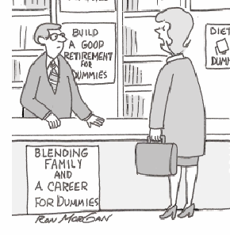
Whether you are helping a library user…
Do you have anything for people who aren’t dummies?
Source: http://www.CartoonStock.com
Notes:
NEDELINA:
As a library employee behind the information or circulation desk, you, as an individual might have a disability. You might work with special collection related to any aspect of human health, or you might encounter a library user with a hidden disability. You might not recognize that the user has a disability.

Slide 7
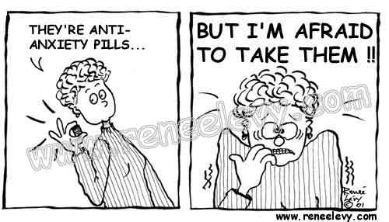
Or dealing with your own disability…
Notes:
NEDELINA:
Or you might not be aware of your own issue! So, hidden disabilities affect every single part of our lives and we all have to be aware of their existence. Sooner or later, anyone of us will develop some kind of disability. It could be in a mild form, or it could be in a severe form. But we all have to be prepared with every single situation and be successful. Can you give more examples of hidden disabilities other than those that were shown on the video? Anyone?... 1….2…3….4….5…6….7

Slide 8
The list goes on…
ADHD
Ageusia
Agoraphobia
AIDS
AIDS/HIV
Alcoholism
Allergy
Anosmia
Antisocial
Anxiety Disorders
Arachnoiditis
Arthritis
Asperger Syndrome
Asthma
Attention Deficit Disorder
Avoidant
Bipolar Disorder
Blurred Vision
Borderline
Brain Injuries
Cancer
Cataracts
Charcot-Marie-Tooth disease
Chronic Dizziness
Chronic Epstein-Barr Virus
Chronic Fatigue
Chronic Illness
Chronic Migraines
Chronic Musculoskeletal Pain
Chronic Pain
Notes:
NEDELINA:
Yes, the list goes on…

Slide 9
… and more
Circadian Rhythm Sleep Disorders
Coeliac Disease
Cognitive Disabilities
Color Blindness
Communication Disorder
Crohn's Disease
Deafness
Degenerative Disc Disease
Dementia
Depression
Diabetes
Drug Addiction
Dyscalula
Dysgraphia
Dyslexia
Emphysema
Epilepsy
Fibromyalgia
Food Allergies
Fructose Malabsorption
Gastrointestinal Disorders
Headaches
Hearing Impairment
Heart Conditions
Heart Disease
Hemophilia
Hepatitis
Hereditary Fructose Intolerance
Histrionic
Hyperhidrosis
Notes:
NEDELINA:
…and more.

Slide 10
…and even more
Hypertension
Hypoglycemia
Inflammatory Bowel Disease
Interstitial Cystitis
Irritable Bowel Syndrome
Kidney Failure
Klippel-Trenaunay Webber Syndrome
Lactose Intolerance
Learning Disabilities
Lung Disease
Lupus
Lyme Disease
Mental Retardation
Metabolic Syndrome
Migraine
Multiple Chemical Sensitivity
Multiple Sclerosis
Obsessive-Compulsive Disorder
Panic Disorder
Paranoid
Paraplegia
Prader Willi
Personality Disorders
Phobias (heights, water, dark, etc.)
Post-Traumatic Stress Disorder
Primary Immunodeficiency
Psychiatric Disabilities
Quadriplegia
Reflex Sympathetic Dystrophy
Renal failure
Notes:
NEDELINA:
And on….

Slide 11
The list is endless…
Repetitive stress injuries
Respiratory Disabilities
Rheumatoid arthritis
Schizoid
Schizophrenia
Schizotypal
Scleroderma
Seasonal Affective Disorder
Sickle Cell Disease
Sleep Disorders
Somatosensory Deficit
Speech impairment
Stress
Temporomandibular Joint Disorder
Thyroid Disorder
Tourette Syndrome
Transverse Myelitis
Traumatic Brain Injury
Ulcerative Colitis
Vertigo
Vision Problems
….
….
….
…
….
…
Reference:
Job Accommodation Network, Accommodation Information by Disability: A to Z
http://askjan.org/media/atoz.htm
Notes:
NEDELINA:
As you see the list is endless.

Slide 12
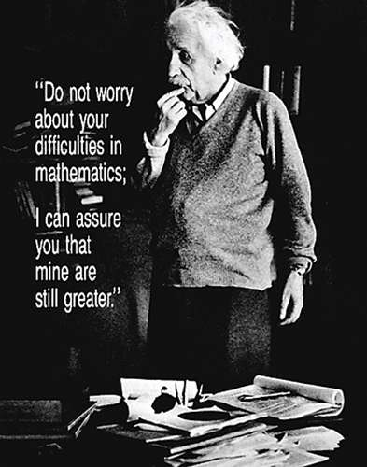
Source: http://www.picturesdepot.com
Notes:
NEDELINA:
A disability can happen to anyone at any point in their life. These many hidden disabilities affect many people, even the famous ones! Do you know how many famous people are like Einstein, the Mathematician/Physicist who had a learning disability and who did not speak until age 3?

Slide 13
Famous People with Disabilities
Abraham Lincoln
Agatha Christie
Albert Einstein
Alexander Graham Bell
Alexander the Great
Amy Ecklund
Andrea Bocelli
Ann Bancroft
Annette Funicello
Bill Clinton
Billy Barty
Billy Graham
Bob Jimenez
Bob Love
Bree Walker
Bruce Jenner
Carly Simon
Casey Martin
Chang and Eng
Charles Schwab
Cher Entertainer
Chris Burke
Chris Fonseca
Christopher Reeve
Chuck Close
Curtis Pride
Dale S. Brown
Daniel Inouye
Danny Glover
David Jones
Dr. Red Duke
Dwight Mackintosh
Edward Hallowell
Edward James
Ellie Hawkins
Eric Wynalda
Ernest Hemingway
Fanny Flagg
Florence Henderson
Frank Dunkle
Frank Wolf
Franklin Delano Roosevelt
Fred Curry
Gaston Caperton
George Burns
George Patton
Gheorghe Muresan
Greg Louganis
Gretchen Josephso
Gustave Flaubert
Hans Christian Andersen
Harriet Tubman
Harry Anderson
Harry Belafonte
Harvey Cushing
Heather Whitestone
Helen Keller
Henry Winkler
Itzhak Perlman
Jackie Stewart
James Brady
James Earl Jones
Janet Reno
Jerry Lewis
Jim Abbott
Jim Eisenreich
John Callahan
John Corcoran
John Hockenberry
John Horner
John Updike
Johnny Cash
Joseph Biden
Joseph Heller
Judith Heumann
Source: http://freedee.us/images/FamousPeopleDisabilities.pdf
Notes:
NEDELINA:
Check it yourselves!
Agatha Christie, is one of the most popular mystery writers of all time! She had a learning disability: some sources mention she had dyslexia, others – dysgraphia.
Franklin Roosevelt, had polio eleven years before being elected the president of the United States of America.
Harvey Cushing was an American neurosurgeon and a pioneer of surgery, who had spelling, and other language problems.

Slide 14
Famous People with Disabilities continued
Katherine Hepburn
Kirk Douglas
Kurt Vonnegut
Leonardo Da Vinci
Lewis Carroll
Linda Hunt
Lindsay Wagner
Ludwig von Beethoven
Magic Johnson
Mahmoud Abdul-Rauf
Marilyn Monroe
Marlee Matlin
Mary Verdi-Fletcher
Matt Luke
Michael J. Fox
Michael Wolff
Mike Wallace
Mikhael Gorbachev
Montel Williams
Muhammad Ali
Nancy L. Sonnabend
Nancy Mairs
Neil Bush
Nelson Rockefeller
Nola D. Chee
Nolan Ryan
Patricia Polacco
Patty Duke
Paul J. Orfalea
Paul Longmore
Pope John Paul II
Ray Charles
Richard Strauss
Richard Thomas
Rita Hayworth
Robert Dole
Robert Rauschenberg
Roger W. Wilkins
Ron Harper
Ron Kovic
Ronald Reagan
Russell White
Samuel Johnson
Stephen Bacque
Stephen Hawking
Stephen J. Cannell
Stevie Wonder
Sylvia Law
Terry Bowersock
Thomas Edison
Thomas H. Kean
Tom Cruise
Tom Smothers
Tom Thumb
Tomima Edmark
Tracey Gold
Ved Mehta
Victor Villasenor
Virginia Woolf
W.C. Fields
Walt Disney
Walter Cronkite
Whoopi Goldberg
William B. Yeats
William James
William Simmons
Winston Churchill
Wolfgang Amadeus Mozart
Woodrow Wilson
Source: http://freedee.us/images/FamousPeopleDisabilities.pdf
Notes:
NEDELINA:
Leonardo DaVinci who wrote his notes backwards.
Robert Dole, an attorney and retired United States Senator from Kansas "who did not have sense".
Walt Disney, an American filmmaker and businessman, who had dyslexia.
Having a disability brings a lot of stress in your life but it also teaches you how to be a stronger person. The missing piece of your “perfect” body, such as lost of hearing or vision, plays as a catalyst in your life experience. It stimulates the senses and makes them more sensitive to achieve new milestones despite your disability. People with hidden disabilities are able to bring on the top their Abilities with a capital A! They focus on their motivation for improvement whereas other individuals in a great health shape see the negative side of the issue. They see the disability FIRST, and this fact prevents them to see the Ability!

Slide 15
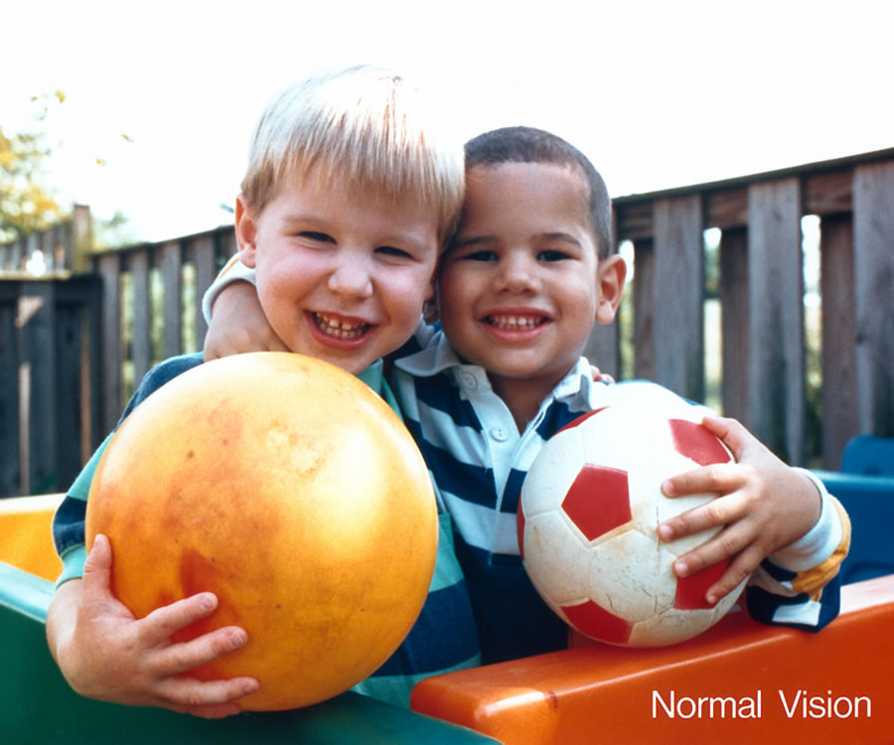
Let’s explore vision disabilities…
Source: National Eye Institute—National Institutes of Health, http://www.nei.nih.gov
Notes:
AIMEE:
Now let’s put ourselves in the shoes of a person with a hidden disability and start with the vision disabilities. We will see some eye disease simulations in the next few slides. This picture is seen by a person with a normal vision.

Slide 16
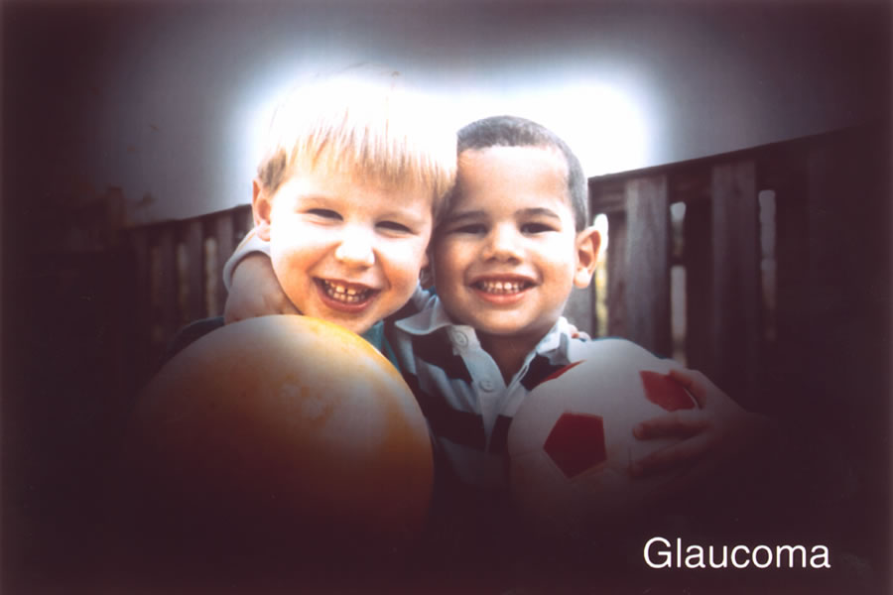
Source: National Eye Institute—National Institutes of Health, http://www.nei.nih.gov/health/glaucoma/
Notes:
AIMEE:
The same scene as viewed by a person with glaucoma. Glaucoma (pressure in the eye) can damage vision over time. This is the case when the normal fluid pressure inside the eyes slowly rises, resulting in low vision and even blindness.

Slide 17
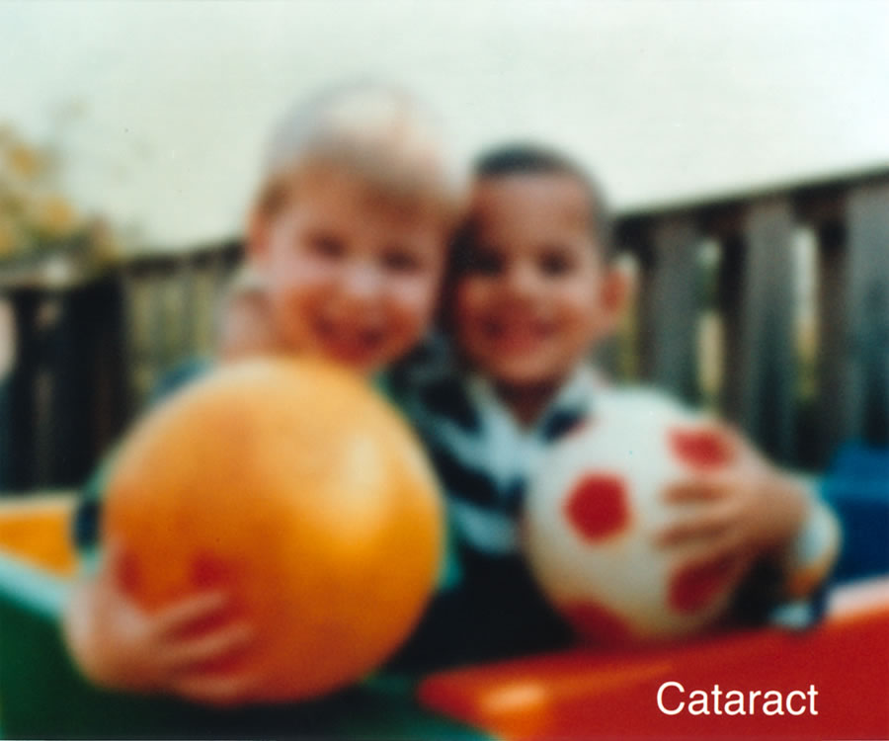
Source: National Eye Institute—National Institutes of Health, http://www.nei.nih.gov/health/cataract/
Notes:
AIMEE:
The same scene as viewed by a person with cataract. Cataracts cause blurry vision which is caused by the clouding of the lens in the eye. Cataracts are very common in older people and are related to aging.

Slide 18
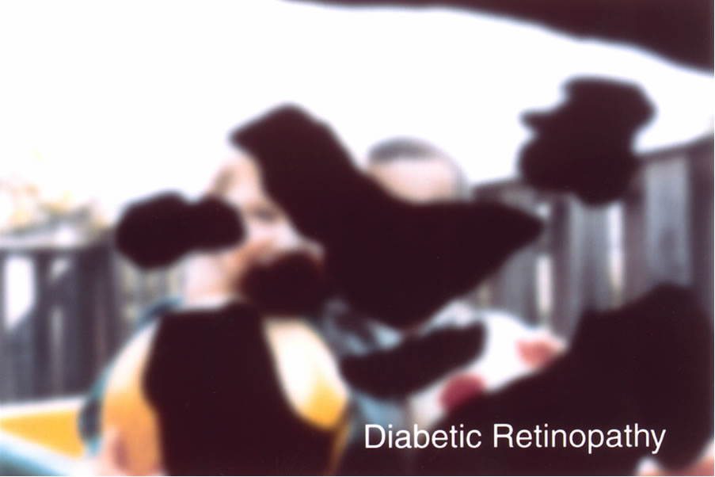
Source: National Eye Institute—National Institutes of Health, http://www.nei.nih.gov/health/diabetic/
Notes:
AIMEE:
The same scene as viewed by a person with diabetic retinopathy. Diabetic retinopathy can cause bleeding in the eye. This bleeding is caused by changes in the blood vessels of the retina.

Slide 19

Source: National Eye Institute—National Institutes of Health, http://www.nei.nih.gov/health/examples/#5
Notes:
AIMEE:
The same scene as viewed by a person with myopia. If you have myopia you can clearly see close objects, but distant objects are blurry. Myopia is caused by the eyeball being too long.

Slide 20
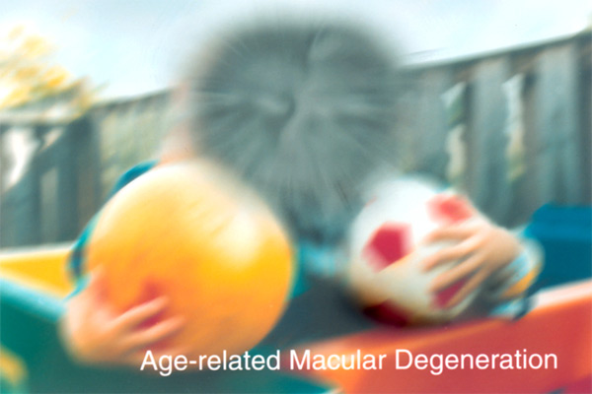
Source: National Eye Institute—National Institutes of Health, http://www.nei.nih.gov/health/maculardegen/index.asp
Notes:
AIMEE:
The same scene as viewed by a person with age-related macular degeneration. Age-related macular degeneration (AMD) is a disease that blurs the sharp, central vision you need for "straight-ahead" activities such as reading, sewing, and driving. AMD affects the macula, the part of the eye that allows you to see fine detail.

Slide 21
To sense a dyslexic's reading experience, read the following paragraph:
Appasiq or Addasibe, Aragic family bescengeb from Aqqas, the uncle of Muhawwad. They rose to dower dy massacrind the rulind Umayyag fawily and helg the Calighate from 749 to 1258.Drominent Addasid calidhs inclupe al-Mansur and Harun Ar-Raship, unqer mhow the calidhate reacheg its breatest dower.
Abbasid or Abbaside, Arabic family descended from Abbas, the uncle of Muhammad. They rose to power by massacring the ruling Umayyad family and held the Caliphate from 749 to 1258. Prominent Abbasid caliphs include al-Mansur and Harun Ar-Rashid, under whom the caliphate reached its greatest power.
Source: http://www.etni.org.il/etninews/inter2d.htm#ABBASID
Notes:
AIMEE:
Now, another example.
To sense a dyslexic's reading experience, read the following paragraph.
How did you feel, while reading it?
The dyslexic person read mirror-opposites: reads p instead of b, g instead of b. They mix up d for b, m and w.

Slide 22
Now, can you read this paragraph?
Link awoke one day to find himself deep in a strange forest. As he started to walk through the woods, he heard cries for help coming from just up ahead of him. Link hurried toward the voice, only to find a group of monsters surrounding the woman who was screaming. When the monsters saw Link, they immediately fled.
Source: http://www.dyslexiaaustralia.com/whattheysee.htm
Notes:
AIMEE:
Now, can you read this paragraph?

Slide 23
A person with a dyslexia sees this!
Link awoke one day to find himself deep in a strange forest. As he started to walk through the woods, he heard cries for help coming from just up ahead of him. Link hurried toward the voice, only to find a group of monsters surrounding the woman who was screaming. When the monsters saw Link, they immediately fled.
Source: http://www.dyslexiaaustralia.com/whattheysee.htm
Notes:
AIMEE:
However, some dyslexics assign images to words instead of sounds, and can’t read words that they can’t form an associated image of.

Slide 24
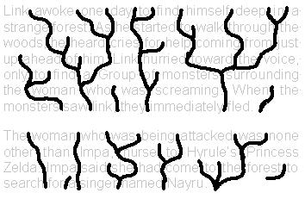
And this…
Source: http://www.dyslexiaaustralia.com/whattheysee.htm
Notes:
AIMEE:
Or words can appear in a river.

Slide 25
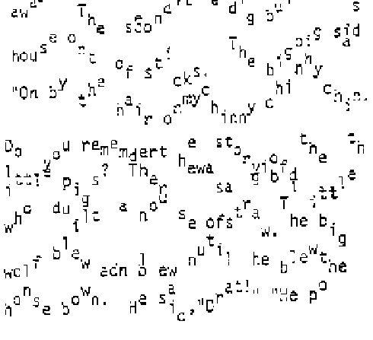
And this…
Source: Reading by the colors : overcoming dyslexia and other reading disabilities through the Irlen method by Helen Irlen
Notes:
AIMEE:
Some examples of how a dyslexic might see text from Helen Irlen's book Reading by the Colors.

Slide 26
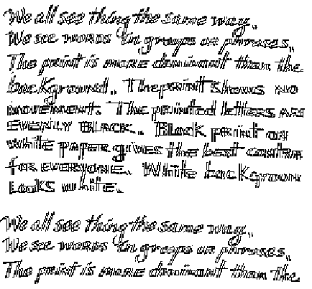
And this…
Source: Reading by the colors : overcoming dyslexia and other reading disabilities through the Irlen method by Helen Irlen
Notes:
AIMEE:
Another example from the same book.

Slide 27
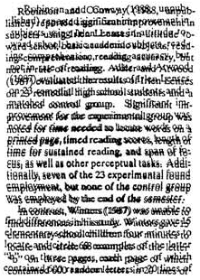
And this…
Source: http://www.dyslexia.com/library/information.htm#See
Notes:
AIMEE:
Or words can swirl in a circle.

Slide 28
Now, let’s explore hearing disabilities…
Public Service Announcement (PSA)
PSA on Social Issue: Disability (1 min)
http://www.youtube.com/watch?v=lXJgDigUWaA
Notes:
NEDELINA: (Switch to this video using ALT+TAB keys. Play the video with NO sound and NO captions).
Can you understand anything? Well, this is my everyday experience when I’m trying to attend online workshops, webinars, meetings. Even, ALA virtual conferences. The world would be more accessible for me, if there was not only sound but captions, as well. Isn’t it right?
(Play the video with sound and captions).

Slide 29

Demographics
National level
Notes:
NEDELINA:
According to the U.S. Bureau of Census, from 1991 to 2000, there were a growing number of workers who self-identified as having one or more disabilities. Since 2000, demographic changes prove this trend is continuing at an alarming rate. Now, the statistics from 2002 U.S. Census show that 18% of the population has disabilities. Just before coming to the conference, we found a more updated information from the Census 2005, that this percentage has increased from 18 to 19%. The statistics also show that older people were more likely than younger people to report having a disability.

Slide 30
Demographics cont.
Library professional level
Notes:
NEDELINA:
Back in 2008, our goal was to research what is the situation within our profession? How many library staff have hidden disabilities and we found out from the ALA Office for Research and Statistics 2006 that 4% of credentialed librarians have disabilities. This percentage would be higher, if we include library support staff that don’t have a library degree.

Slide 31
Demographics cont.
Local level
Washington DC area
(three institutions)
Notes:
NEDELINA:
With these statistics in mind, we dig up a little bit more to get to a local level, and sent out an electronic survey to three institutions who agreed to participate in this research. We discovered that 33% of the respondents from the three institutions we have surveyed have disabilities. We included a question in the survey to differentiate if they have physical or hidden disabilities, or both.
The results are very interesting:
Half of the respondents (who have disabilities), have hidden disabilities (46%) compared to those who have physical (8%) and who have both (46%).
As you see from the chart the distribution within the age group is highest in 51-60 years. The results are low in the age of 61 and older due to different reasons.

Slide 32
Who are the individuals
with hidden disabilities?
“I am a 54 years old African American female. My goal is to obtain my PhD. I am an over-achiever, so I work very hard to work around my disabilities.”
“I had inherited my grand-father’s motivation and thirst for knowledge.”
“I am finishing up a doctoral program in Audiology.”
Notes:
AIMEE:
This year, we contacted our campus Disability Services Office and asked them to send to their clientele our inquiry and share their life experience with having a hidden disabilities. The stories were heart-breaking.
Please read the comments from our respondents at your own peace.

Slide 33
Who are the individuals
with hidden disabilities?
“I am a 54 years old African American female. My goal is to obtain my PhD. I am an over-achiever, so I work very hard to work around my disabilities.”
“I had inherited my grand-father’s motivation and thirst for knowledge.”
“I am finishing up a doctoral program in Audiology.”
Notes:
AIMEE:
As you can see, our respondents who identified themselves, come from different ethnic groups, race, gender, and high degree of education. They are all hard working individuals motivated to succeed. They are not looking for empathy, nor for any privileges in the workplace. They are hard-working and motivated individuals.

Slide 34
Hidden Disabilities Defined
Psychological
Medical
Hidden disabilities
Impairment in functioning
Decrease in quality of life
Restricted lifestyle
Focus on pain
Feeling defensive
Stigma
Chronicity
Feeling misunderstood
Reference:
Taylor, S. “Living well with a hidden disability”,
Oakland, Calif. : New Harbinger , 1999
Notes:
NEDELINA:
The question that arises during every research we undertake, is what is considered a “hidden” disability? There are many definitions and the most wide and general definition we encountered is that hidden disabilities are those disabilities that cannot be directly identified through observation.
Some other researchers draw a line between visible and invisible disabilities, and divide invisible or hidden disabilities further into two categories:
Medical: Diabetes, lupus, heart disease, cancer, epilepsy, and so on.
Psychological: Acquired or neurological disorders that can cause impairment in daily functioning.
Both types of hidden disabilities, if substantiated, are covered under the Americans with Disabilities Act (ADA), but library employees are more apt to disclose a medical “hidden disability” than a psychological disability. Do you agree with this statement?
Now, I will mention a few criteria for a disorder to be considered a hidden disability:
Impairment in functioning. Your disability reduces your ability to function. For example, chronic migraine forces you to miss work or you can’t concentrate on work activities. You can’t work to your normal capacity.
Decrease in quality of life. Your quality of life seriously declines. You avoid social contacts, your world becomes smaller.
Restricted lifestyle . You’re challenged by your disability daily.
Focus on pain. You cope with pain, fatigue on a regular basis. Your life is focused on disability.
Feeling defensive. People don’t believe that you have a disability. You have to explain or defend your condition to others.
Stigma . There is a stigma associated with your condition. You feel blamed by others for developing a hidden disability.
Chronicity. The comfort level is decreasing over time and the hidden disability begins to have prevalence over individual’s every day life.
Feeling misunderstood

Slide 35
Attitudinal Barriers
Inferiority
Ignorance
Backlash
Pity
Spread effect
Denial
Hero worship
Stereotypes
Fear
Source: EmployAbility: A Resource Guide on Disability for Employers in Asia and the Pacific by Debra A. Perry, editor
Notes:
AIMEE:
People with hidden disabilities often do not feel like they belong within the Disability community because they are not considered to be “disabled enough” to fit into the group. People with hidden disabilities are caught between not being fully accepted as people without disabilities and not being recognized as having “real” disabilities. Take a look around. Is there someone in your personal life, in your class, on our campus that is just trying to fit in and wants to be accepted for who they are? Do we treat that person with the dignity and respect that they deserve? What can we do to make a difference in this person’s life? Imagine yourself in their shoes, how would you want to be treated?
This is an open discussion, so please share your thoughts! (2 minutes discussion)

Slide 36
Research Findings
Supervisors don’t know policies and procedures
Staff don’t know if Libraries have a policy
Relationship of supervisor and staff determine disclosure
Environment not welcoming
Personal beliefs
Lack of education on hidden disabilities
Notes:
NEDELINA:
What we discovered from our research is that people are more than concerned about these issues because they felt that the academic library work place is generally not interested in hearing about the concerns. The comments were freely given and we knew that respondents took the time to complete their answers. The comments covered a broad spectrum of concerns from personal lack of knowledge to others wanting to maintain their privacy.
Respondents said that many of their supervisors were not knowledgeable about policies and procedures, ADA, and University policy.
Some staff members were not even aware if the libraries had a policy that supported them. ---They knew that there was a campus resource but was not aware of what services they provided.
What determines self disclosure is the relationship one has with the supervisor.
They also stated that their environment was not welcoming and therefore chose to not disclose their personal hidden disabilities for fear of it being held against them.
Personal beliefs---Some expressed very adamantly that their personal health issues were their concern and they did not want their work to limit them. They wanted to work beyond their disabilities. Personal value of not letting their “disability” limit their “ability”.
Education of hidden disabilities is a major concern.

Slide 37
Recognizing the Hidden Disability
Frequent requests to have information repeated
Difficulty paying attention
Confusion
Difficulty following directions
Impulsive behavior
Sudden changes in mood
Shortness of breath
Significant fatigue
Difficulty sitting still or standing for long periods
Sudden weight loss or gain
Frequent medical appointments or treatments
Notes:
NEDELINA: It is very difficult to recognize hidden disabilities. If someone does not disclose that they have a disability, there may be some indicators that may signal a possible disability. These include:
• Frequent requests to have information repeated
• Difficulty paying attention
• Confusion
• Difficulty following directions
• Impulsive behavior
• Sudden changes in mood
• Shortness of breath
• Significant fatigue
• Difficulty sitting still or standing for long periods
• Sudden weight loss or gain
• Frequent medical appointments or treatments
Asking about a hidden disability can be a very delicate issue and should be handled with the utmost care and respect for the individual’s wishes, concerns, and decisions related to disclosing any information about their disability.

Slide 38
Accommodations
Workspace
Equipment
Materials
Work schedule
Job restructuring/sharing
Increased/modified supervision
Mentoring
Notes:
NEDELINA:
Hidden disabilities have a direct impact on employee retention, morale and productivity. Perhaps ironically, many libraries already have many services in place that can help these library employees, but our observance shows us that very low percentage of affected library employees access these services, most likely because of the perceived stigma associated with these disabilities. Because of the broad nature of hidden disabilities there are numerous workplace issues that may need accommodation. Not all people with hidden disabilities need accommodations. Keep in mind that all individuals and all disabilities are different.
Work space. Facilities modifications such as changes in the workspace (different lighting, ergonomic desk and chair, sitting away from distractions or dust, etc.). For individuals with functional deficit disorders: remove clutter, simplify environment. Place blinds on windows.
Equipment. Installation of accommodating equipment (different keyboard, different telephone, different monitor)
Materials . A person allergic to rubber and the type of paper that is used in the office. A possible accommodation is to provide that person with cotton gloves and switch to recycled, chlorine-free paper. For a person with respiratory difficulties: use air purifier near workstation, use non-toxic/low odor cleaners, and other supplies.
Work schedule. For example, a person who has difficulty to maintain her concentration can have her work schedule changed. The employee can work from home or have “off” times during the week where she can work without any interruptions. Part time schedule, flexible time schedule or telecommuting arrangements. Allow frequent rest breaks to a person with chronic fatigue or weakness.
Job restructuring/sharing. At meetings, it is often needed to write down minutes for sharing with the entire staff. A person with a hearing impairment can not assist with writing minutes but can participate in other meeting activities.
Increased/modified supervision. Increase the frequency of and the type of performance feedback and task assignments, such as written rather than verbal instructions, and monthly rather than yearly feedback.
Mentoring. Pair a sensitive successful colleague with the employee to help the employee master the job.

Slide 39

The X-Files (1993)
Season 3, Episode 22: Quagmire
Notes:
AIMEE:
(1:53 min)
This episode is from the American television series The X-Files and is about the disappearances of a Boy Scout leader and a biologist within weeks of each other. The fact of these missing people drew police officer Mulder's attention to Heuvelman's Lake in Georgia. Resident officials believed the case to be a joke, but Mulder hoped to find proof of the lake's long-rumored prehistoric monster, "Big Blue".

Slide 40
The X-Files: Quagmire
(Excerpts from the episode)
“No, I’m not being flippant. I mean, I’ve given this a lot of thought. If you have a peg leg or hooks for hands, you know, maybe it’s enough to simply carry on living – you know, bravely facing life with your disability. It’s heroic just to survive.
But without these things, you’re actually expected… to make something of your life – achieve something, earn a raise, wear a necktie… because if I did have a peg leg I’d quite possibly be more happy and more content… and not feel the need to chase after these creatures of the unknown…”
Notes:
AIMEE:
Here is an excerpt from the movie but let me try and play it as a video (use Alt+Tab to switch to the file).
In this episode, Scully discussed the Captain Ahab who has only one leg in the novel Moby-Dick. Have anyone read this novel? You just heard Agent Mulder who tells Scully he always wished he had a physical disability. What do you think of his reasoning? How do you feel when hearing his words?
Discussion: 5 min.
People with disabilities encounter many different forms of attitudinal barriers, as it is evident from our survey: (next slide)

Slide 41
Our survey respondents said…
“When I get my PhD in Education, I am going to fight for people, like myself, who are on disability, and are labeled or misunderstood because the rest of the world think disabled people have brains that can no longer function.”
“When I was in elementary school, I was considered a freak because of my ADD. When I got into college, I was considered a faker.”
Notes:
AIMEE:
Please read the quotes on your own.

Slide 42
Advocacy
Provide an environment conductive to self-disclosure
Learn more about hidden disabilities
Form a disability support group
Notes:
NEDELINA:
Now, how can we overcome these attitudinal barriers? The key to successfully managing this issue is to train human resources specialists and managers on how to identify and effectively manage library employees with hidden disabilities. My supervisor didn’t know about any existing policies and services on campus, she didn’t know how to communicate with me, either. We must educate ourselves, learn how to advocate and teach others to do the same.
Learn more about hidden disabilities. The more you know, the better advocate you will be.
Provide an environment conductive to self-disclosure. Listen to the person with the disability. Do not make assumptions about what that person can or cannot do. Support people in speaking up for themselves by actively listening and engaging in a collegial relationship. Assist people in their efforts to believe in themselves. Empower your colleagues!
Form a disability support group. Once a person has identified himself or herself as having a disability, an open and honest, confidential discussion can follow regarding the need for, and nature of, accommodations required. Ask questions that will help you provide appropriate accommodations.

Slide 43

Notes:
NEDELINA:
We have a few more minutes to wrap up with this adapted version of Infinity Love video (3:30 min).

