Slide 1
Implementing Project Management
Tools and Strategies
Robin Pike, Kelsey Corlett Rivera, Rachel Gammons,
and Hilary Thompson
Notes:
Many people are stretched thin at work because it's difficult to balance many competing priorities. In this panel, learn from four of your colleagues how they have implemented project management tools to stay organized, track projects and milestones, balance priorities, update stakeholders, delegate tasks, and more.

Slide 2
So many tools! What we’ve used:
Goal Setting | Asana | Basecamp | Google Keep | Google Apps (Other) | JIRA | Trello
 |  | Hilary |  | Hilary |  | Hilary
 |  | Kelsey | Kelsey
Rachel | Rachel | Rachel
 |  |  | Robin | Robin | Robin | Robin

Slide 3
Robin: Projects Use Multiple Tools
Trello
Google Apps
Vendor Digitization Projects
In-house Digitization Projects
In-house Digitization Projects
Personal Accountability
Complex, Time Sensitive, Cross-Departmental/Divisional
Time Sensitive, Cross-Departmental/Divisional, Personal
Organize multiple projects by milestone
Assign and set due dates
Communicate between stakeholders and team
People customize how to receive updates, don’t need to log in
Project history
Track current and upcoming projects and milestones
Assign functional team per sprint
Assign tasks per sprint
Communicate within team
Notes:
As a department manager, I manage other people’s work and cross-department/division projects.
I primarily use Trello to track digitization projects and milestones in a main dashboard containing all of my projects. I link important documents to each card, and can assign tasks and set due dates for phases. Trello allows for all project stakeholders to communicate on the card, and for my team to communicate with each other. Communication between my team and stakeholders is incredibly important for projects with a finite annual timeline. We share information about what we need from each other and any delays that may impact the set project timeline. This is also useful for people who are involved in multiple projects, such as our Preservation and Metadata units, because they can see all the projects and upcoming work at a glance. All Trello board members can customize how they receive communication and don’t need to log into Trello to receive them or communicate with me--the tool sends updates via email, meeting stakeholders where they usually want to receive their communication. Communicating via Trello also creates project history which we use for setting deadlines, invoicing, and more.
For in-house digitization projects, I use a combination of Trello and Google Apps to track current and upcoming projects for my staff. I’ve divided my staff into functional teams to meet on-demand requests for materials, perform quality control on files and metadata, and digitize projects. All assistants are assigned prioritized tasks per two-week sprints; they switch functional teams each two-week sprint so no one is fatigued by repetitive work and all students are cross-trained. We use these tools to communicate within our team more effectively, particularly because there is sometimes no overlap between students who are working on the same project.

Slide 4
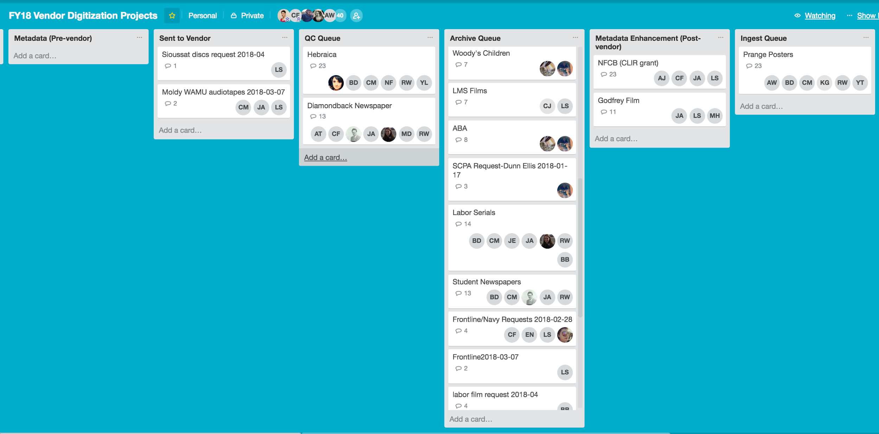
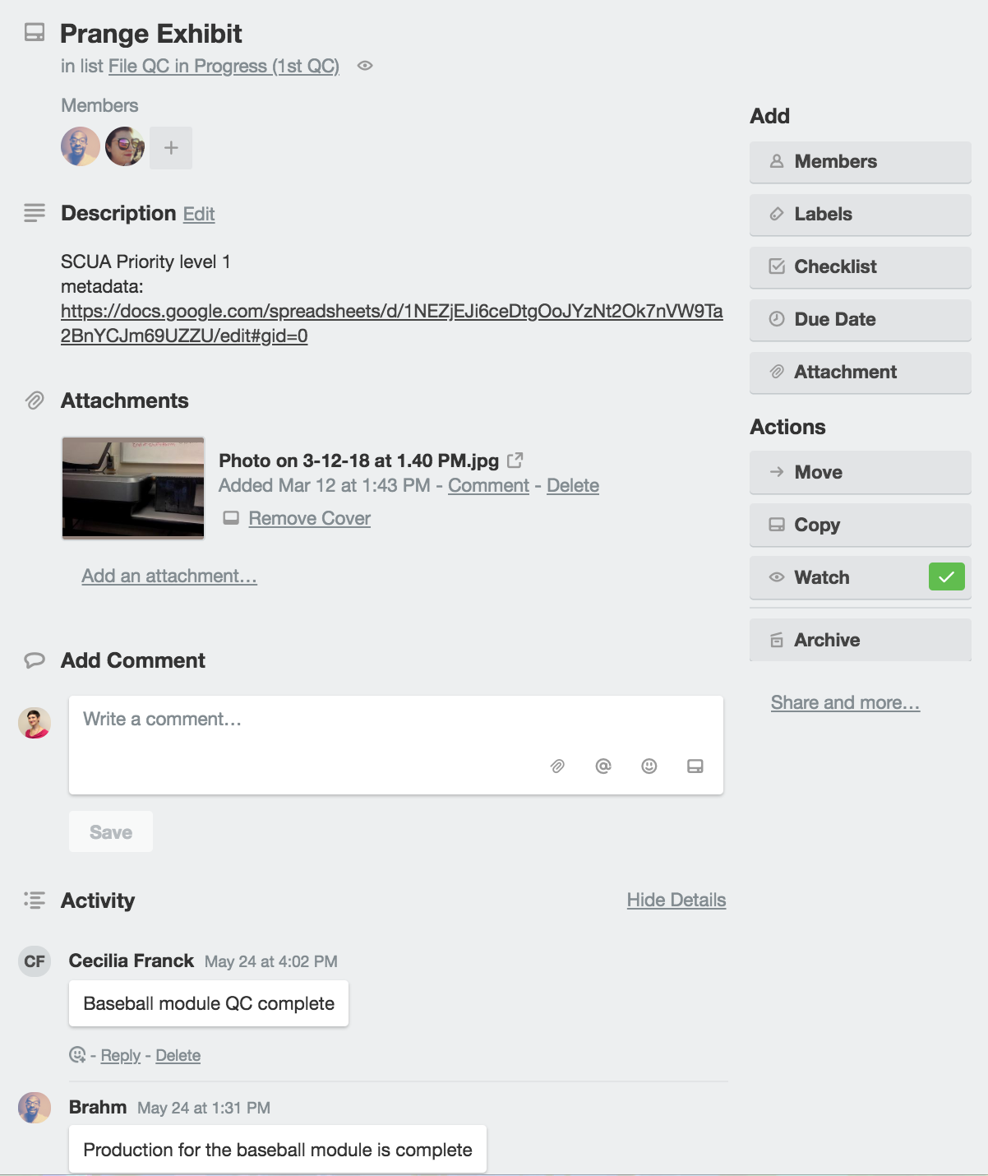
Robin: Projects Use Multiple Tools
Notes:
These screenshots show what we document and how we communicate on a single project card and a projects dashboard divided by milestones.

Slide 5
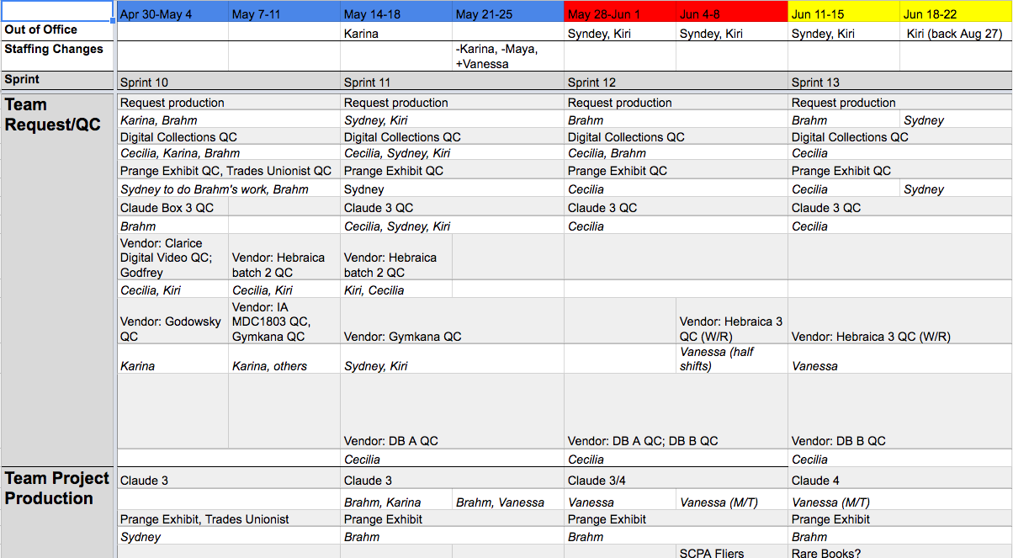
Robin: Projects Use Multiple Tools
Notes:
This screenshot demonstrates the functional teams of the Hornbake Digitization Center, as well as how I track current and upcoming tasks and priorities for assistants.

Slide 6
Robin: What Matters to Me
Communication, transparency, project continuity
Assigning tasks/projects
Time management
Notes:
These tools work for me because I can communicate with everyone and get them the same information, at the same time, saving me time. People receive information where they’re used to receiving it (email) without having to worry about logging into another application, which means they actually use the tool I’ve set up. This system is also useful for project continuity with departures, particularly with a workforce that relies heavily on student labor. My direct reports and project collaborators know at a glance where DCMR is with projects and what they should be working on and when, which is useful when I’m on leave or in meetings. These tools assist me with my personal time management and afford me extra time instead of communicating the same thing multiple times to different stakeholders on a project.

Slide 7
Hilary: One Tool Doesn’t Fit All
Basecamp
Google Apps
Top Textbooks on Reserve
NEVPC Committee Work
Resource Sharing & Reserves’
Recurring Tasks and Projects
Complex, Time Sensitive, Cross-Departmental
Less Complex, Time Sensitivity Varies, Internal
Organize tasks into to-do lists within a project
Assign tasks and set deadlines
Emails sent when tasks are assigned, modified, and due
Daily Recap emails
Notifications customizable for each participant
Shared Calendar: set reminders for recurring tasks
Shared Calendar: copy events to individual calendars
Team Drive: invite collaborators and set permissions once
Google Docs: use comments to assign tasks (+ email)
Boomerang: schedule emails to send or return in advance

Slide 8
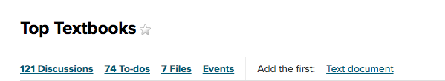
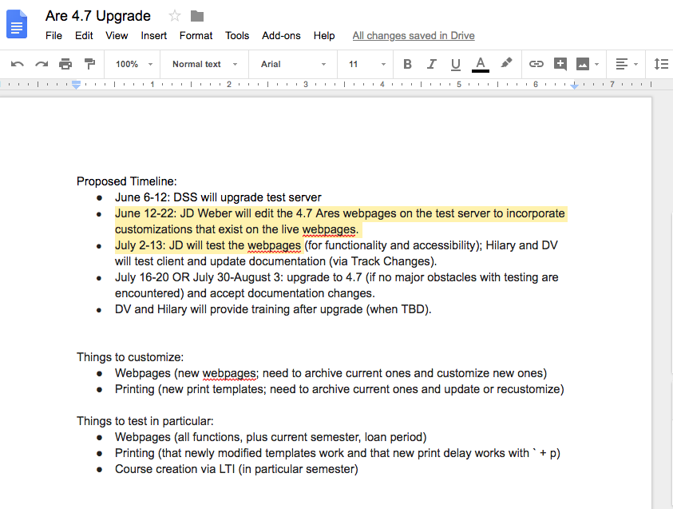
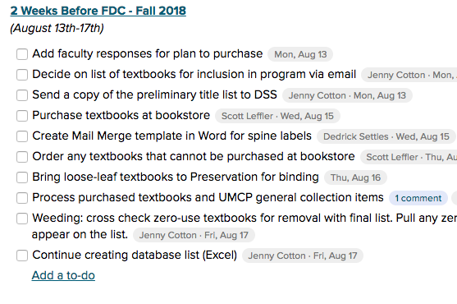
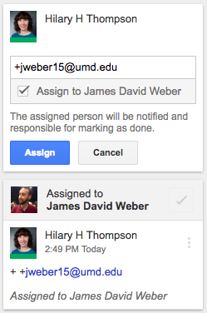
Hilary: One Tool Doesn’t Fit All

Slide 9
Hilary: What Matters to Me
Automated reminders
Integrated with my inbox and/or calendar
Transparency and sustainability

Slide 10
Kelsey: Don’t Overdo It
Basecamp
Google Keep
IRRoC Development Project
Small projects - i.e. RC webpage update
Keeping my life on track
Complex, Time Sensitive, Cross-Campus
Ongoing discussions, Internal/External
Easily include non-Libraries staff in project
Organize and assign tasks to individuals and set deadlines
Discussions are essentially archived email conversations
Includes a calendar for deadlines and meetings (agendas and minutes can be handled within Basecamp)
Easily share meeting notes with anyone
Syncs with phone
Facilitates reflection and preparation
Can color-code and add images
Built-In Checkboxes
Notes:
I’ve been involved in one too many projects where a 40-page project plan got drafted that took longer to put together than the project took to complete. It is very possible to over-do project management. At this point, much of my job is ongoing work for which I use project management strategies to stay on target, and a few small projects that tools like Basecamp and Keep can handle.
Basecamp has worked very well for the project I led to develop a cross-campus directory of funded research resources (IRRoC). This was time sensitive, and the project team was made up of people from DIT, Division of Research, and the Libraries. The project started before everyone was on Google, so it was important to find a central system that everyone could access, especially for communication and meeting notes/agendas. It has worked well over time too - the project hibernated for two whole years and we have just resurrected Basecamp to manage a round of updates/additions.
Google Keep handles most of what I need to have done on a regular basis. One example is updating the Research Commons Events webpages over the summer. Brittany is doing the majority of the work on that, so rather than set up something more elaborate, we have a shared to-do list in Google Keep. It doesn’t allow for task based deadlines, but that’s not necessary in this context. I also use it a lot to stay on track with work and reflect. At the end of each day I take a moment to see what I’ve crossed off my list and plan for the next day. I keep a running list for work that needs to be done, and then pull from that and my calendar to populate my list for each day. I include all my meetings and engagements (i.e. lunch). If I have 7 meetings on my list, I know I can’t plan to accomplish much other work or I will be sorely disappointed when I don’t finish it.

Slide 11
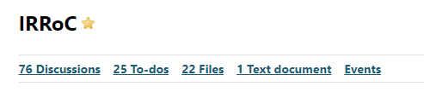
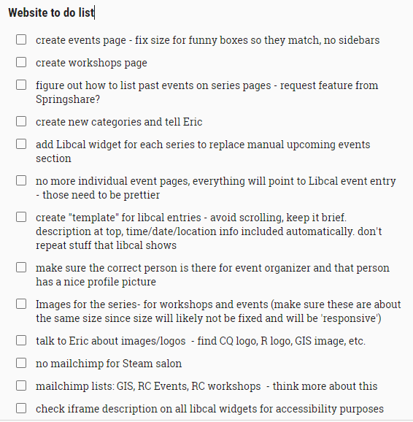
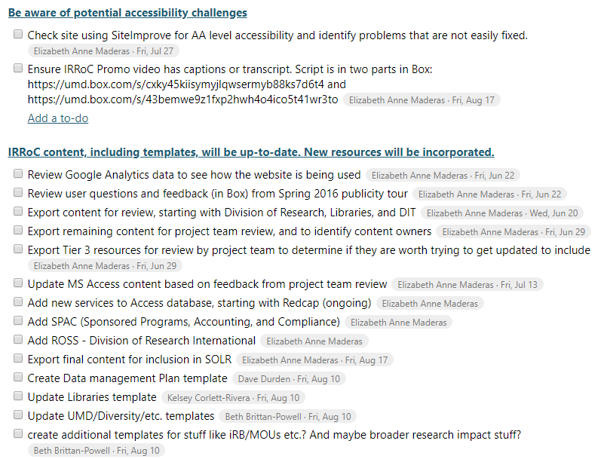
Kelsey: Don’t Overdo It
Notes:
On the left, the simple website to do list that Brittany and I have shared.
On the right, our IRRoC basecamp, which includes to-do lists based on summer project goals that have been assigned to the appropriate team member with deadlines.

Slide 12
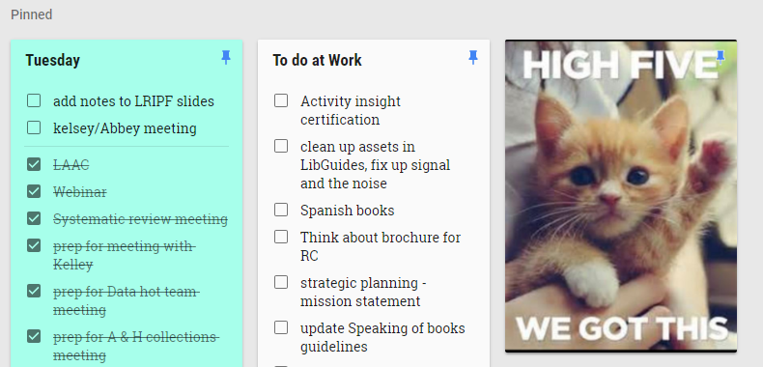
Kelsey: What Matters to Me
Customized notifications
Synced to phone/calendar
Fits into my workflow
Notes:
Unlike my co-presenters here, I hate receiving emails from these systems. I would prefer to have Keep/Basecamp open all the time and check what’s going on. I also don’t use calendar reminders, because I always have my calendar open. That’s why I appreciate being able to customize what notifications I receive
I always have my phone on me, and I have widgets on my homepage for both Keep and my Calendar. I love that Keep is synced there so I can add something to my list when I remember it or check what’s coming up on my schedule for that day.
Both of these things fit into how I already do work, so it means I actually use them.
Here you can see my daily list in Keep next to my ongoing list, with a little extra inspiration for moments when I’m considering throwing in the towel.

Slide 13
Rachel: Self-Accountability & Sustainability
Goal Setting
Asana
Individual scaffolded goals:
(1) annual, (2) quarterly, (3) monthly, (4) weekly
Managing unit-wide workflow
Complex, Time Sensitive, Cross-Campus
Annual: big project-based goals
Quarterly: specific phases or projects
Monthly: 3 to 4 focus goals for projects
  Weekly action items
Individual accounts + group workspace
Assign tasks to individuals
Attach multiple labels to a single task
View completed items
Notes:
As a unit head (and part-time Phd Student) I manage a large scale instruction program that includes librarians and a dozen graduate students. For myself, I have tried electronic project management system, but I always come back to print. I have found that the accountability and permanent of a print-planner keeps me in check. I also am a firm believer in religious goal setting. I have a goal setting funnel - so at the beginning of the year, I set large, broad goals that are based around projects. Then, each quarter, I move these goals forward by identifying benchmarks. They might be smaller components of a larger project, or related projects that advance my broader goal. Each month, I break down these quarterly goals into monthly goals. I always have three focus goals a month: two of them are tied back to a quarterly goal, and one of which is outside the scope of my normal work and might be related to scholarship or service. I then break down specific items for each of the three goals by week. This system keeps me accountable and helps to create space for passion projects.
For my unit, we have been using Asana. We have two levels of things: the first is just day to day tasks that we manage as a unit that need to get done, and need to have somebody responsible for them, and need to be collected in one place. This is, for example, updating room calendar,s checking links on websites, updating door codes, etc. We also have intensive periods, such as scheduling for English 101, where we are managing a lot of things in a short period of time. Asana allows each person to have an individual account, but contribute to a group workspace. This is great because folks can own their space while also participating in our unit work. The folks I manage can share individual workspaces with me, to keep me up to date on what they are doing. It has features like email reminders ands calendar notifications - but I let each person manage that on their own. For me, it's just important to know that it’s there, and that everything we do as a unit is kept in one place.

Slide 14
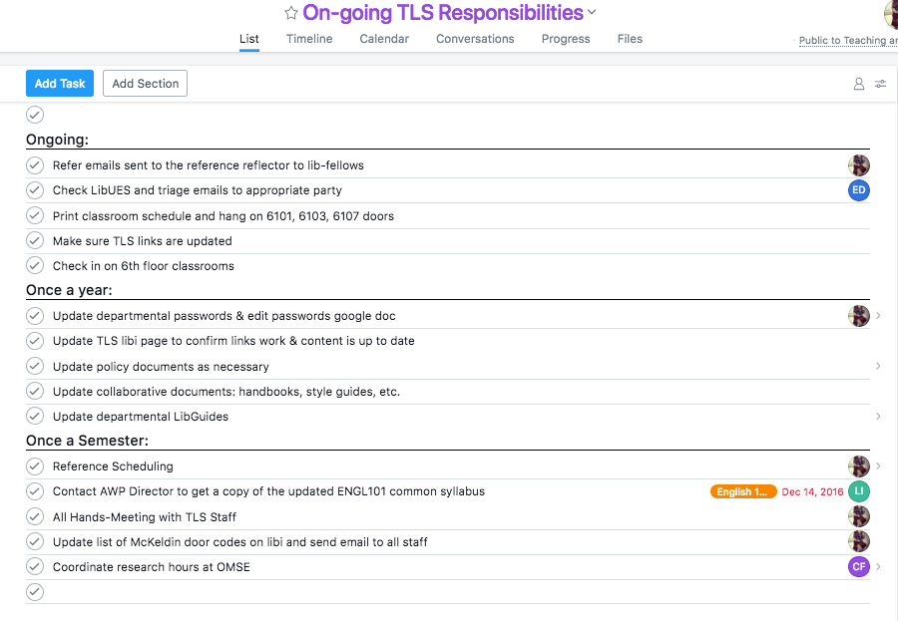

Slide 15
Rachel: What Matters to Me
Creating space to pursue passion projects
Ability to recycle tasks from semester to semester
Customized for individual staff needs

Slide 16
Questions? Ask us!

