Slide 1


‘Strategy-as-Practice’ by Personnel in Hospitals: A Scoping Review
UMD School of Public Health MPH-PHPP & MHA Students and Graduate Team
Presenters/Co-Authors: Brendan Jones, Elizabeth Millwee, Gabriela Irene Mulhall
Co-Authors: Damilola Ajayi, Nii Amon Amon-Kotei, Moboluwape Adeoti, Abdu Wakil Cyeef Din, Lyndsey Griffin, Maryam Aslam Hashmi, Brad E. Schwartz
Co-Authors UMD
Dr. Negin Fouladi, School of Public Health
Nedelina Tchangalova, STEM Library
Co-Authors UCD
Professor Kate Frazer, School of Nursing Midwifery & Health Systems
Professor Thilo Kroll, School of Nursing Midwifery & Health Systems
Carolyn Donohoe, Nursing and Midwifery Board of Ireland
Presentation at the 2nd International Research Conference, "Empowering Care: Innovations in Healthcare for a Sustainable Future,” Dublin, Ireland, August 23, 2024

Slide 2
Background
Globally, hospitals face growing demands with increasing patient acuity compounded by workforce challenges, balancing resources and responding to strategic developments.
As hospitals face growing demands for services and activities, strategic challenges include demonstrating effective resource management while responding to changing environments.
Strategizing in organizations, often known as Strategy-as-Practice, is an ongoing, dynamic process of sensing, planning, implementing, and evaluating strategy. It is a critical component for hospitals to effectively meet the growing and complex demands they face.
It is recognised that there is a disconnection between strategic planning and implementation and little is known about how organisational context influences the strategic process or how hospital personnel engage in strategic activities.
Notes:
Strategizing in organisations, often referred as Strategy-as-Practice, is an active process of sensing, planning, implementing and evaluating strategy.

Slide 3
Aim of Scoping Review
Examine literature related to strategizing practices among hospital employees with both professional and managerial backgrounds to determine the scope and prevalence of strategizing within hospital settings.
Objectives:
Map published literature to identify the number and types of studies, settings, and geographical distribution.
Discover theoretical frameworks or models being used in strategizing in hospital literature.
Explore what is known about strategizing and strategy implementation activities and strategic flexibility in hospitals.
Identify who engages in strategic planning and implementation in hospitals.
Identify what factors facilitate or hinder strategizing in hospitals.
Identify gaps in the literature to inform future research opportunities in this field.
Notes:
Strategizing in organisations is an active process of sensing, planning, implementing and evaluating strategy.
In essence, we wanted to map the extent and breadth of strategy-as-practice peer-reviewed literature relating to hospital personnel and establish how strategizing or ‘strategy-as-practice’ is described in hospital settings, how it is used and what gaps exist.
In this scoping review, we aimed to describe and summarize the literature on strategizing in hospitals and identify research gaps. As outlined in this scoping review protocol (Donohoe et al., 2023), the objectives were the following:
Map the published literature in terms of identifying the number and types of studies, settings, and geographical distribution.
Discover what theoretical frameworks or models are used in strategizing in hospital literature.
Explore what is known about hospital strategizing and strategy implementation activities in hospitals.
Identify who engages in strategic planning and implementation in hospitals.
Identify what factors facilitate or hinder strategizing in hospitals.
Explore what is known about strategic flexibility in hospitals.
Identify gaps in the literature to inform future research opportunities in this field.
The review question for this scoping review is “How do hospital personnel strategize from planning to implementation in hospitals?” The Population, Concept, and Context (PCC) framework as outlined by Peters et al. (2015) was used to structure the database searches.
Now that you're familiar with the aims of this review and the research question we set out to answer, let's move on to explore the methods that guided our review process.
.
The review focused on how hospital personnel within the patient care environment defined, implemented, and used strategies at operational levels. Personnel included were administrators, care teams, and support staff.

Slide 4
Concept | Inclusion criteria | Exclusion criteria
Population | Hospital personnel over 18 years, from frontline upwards, and any discipline or group within the hospital. This includes managers at the frontline, middle management, executive management, and also nursing, medicine, allied health professionals, administration, and corporate personnel. | Non-hospital personnel under 18 years of age
Concept | Strategizing, strategy to include the strategic planning process (strategic planning, assessment and development of the strategy for the organization, strategic implementation and communication, and review evaluation of the plan). | Descriptions of strategy processes, factors influencing strategic processes, and perceptions of strategies that lack any of the elements of planning, assessment, development, implementation, and evaluation.
Context | The setting was hospitals with adult populations in any country. | Pediatric hospitals or non-hospital settings
Species | Humans | Non-human and animals
Study type | Quantitative, qualitative, and mixed methods studies | Review studies (e.g. literature, systematic, scoping, etc.)
Language | English | Non-English
Publication year | January 2018 - June 2023 | Prior January 2018
Methods
The scoping review was guided by:
JBI Manual for Evidence Synthesis (Peters et al., 2020)
PRISMA Extension for Scoping Reviews (PISMA-ScR) checklist and explanation (Tricco et al., 2018).
Protocol developed and published in advance in HRB Open Research (Donohoe et al., 2021).
Notes:
Methods
-Four databases (Business Source Complete, CINAHL, PsycINFO through EBSCOhost, PubMed) were searched from January 1st, 2018, to June 27th, 2023. All study designs were included, language restricted to publications in English. Records were independently screened for eligibility, followed by full-text review. Reporting follows PRISMA-ScR guidelines.
-PCC framework (Population - Concept - Context) concepts, free key terms were expanded on using synonyms, related terms, and database-appropriate controlled vocabulary terms. Keywords for the search strings included hospital personnel (P), strategizing, strategy planning or implementation (C), and hospitals ©
-Patients, pediatric care facilities, and workers under 18 were excluded.

Slide 5
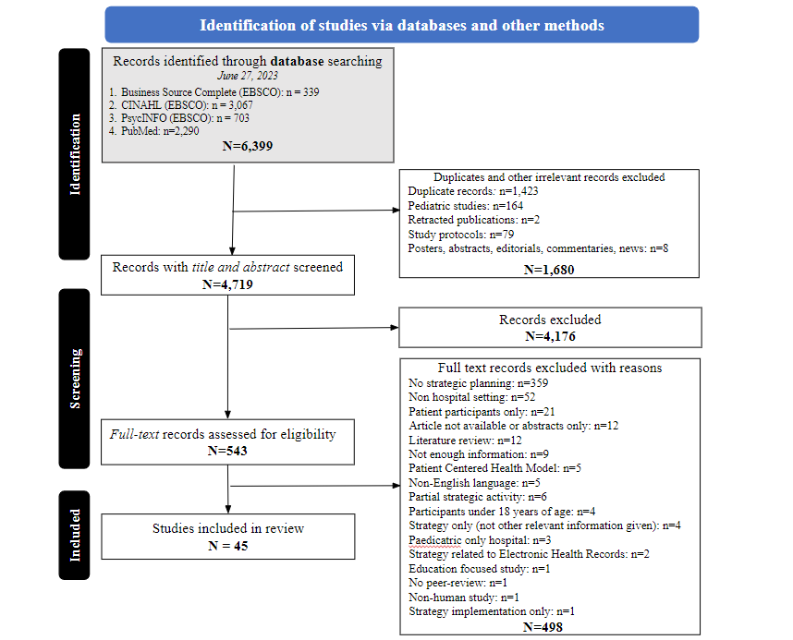
Results
Notes:
Results
4719 unique records were identified, and 45 full-text papers were included. Preliminary evidence from 17 countries is reported: 27.8% of studies (12/45) report evidence from the USA. All study designs are reported. Few studies (n=4) provided a specific definition of strategizing. 53.3% (24/45 studies) report multidisciplinary team perspectives, with only three studies including patients' perspectives. Flexible approaches are critical to adopting.
Include PRISMA
Logistcal Discusssion
Summary of Overall Results

Slide 6
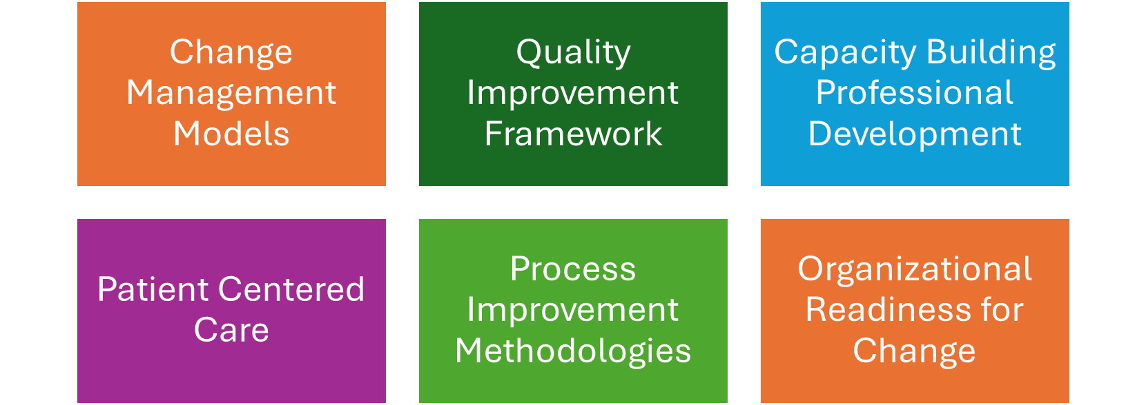
Results
Strategic Frameworks
Notes:
Results
Subsequently, the research identified six strategic frameworks in healthcare studies that are critical for managing change and optimizing outcomes.
Change Management Models, such as Kotter’s Change Model, provide guidance for implementation processes and evaluate their influence on organizational culture.
Quality Improvement Frameworks, including Lean Six Sigma and Failure Mode and Effect Analysis (FMEA), uphold high standards by directing improvement efforts and assessing outcomes.
Capacity Building Frameworks focus on enhancing professional competencies through structured training initiatives.
Patient-Centered Care Frameworks are designed to elevate patient engagement and ensure safety.
Process Improvement Methodologies, like Lean Management, are employed to streamline workflows and eliminate inefficiencies.
Organizational Readiness Frameworks evaluate an organization’s preparedness for transformation.
These frameworks are indispensable for addressing complex challenges within healthcare and advancing overall performance.

Slide 7
Results
Strategizing Activities, Flexibility, Engagement
Strategizing Activities
Utilization of structured frameworks Engagement of stakeholders and patients Integration of evidence based tools Evaluation and Continuous improvement
Engagement
Active engagement is critical to strategic planning Involves patients, physicians and executives and other ancillary team members Strategies of engagement include: consultation, committees and active efforts Engagement or lack there of impacts the success of strategy
Strategic Flexibility
Flexibility by staff on implementation, actions or incorporation of strategic plan into practice as it applies to themselves Flexibility by staff personnel on implementation, action or incorporation of strategic plan into practice as it applies to patient outcomes Enables organizations to handle uncertainty and change
Notes:
Hospital strategic planning and strategy implementation are essential activities aimed at maximizing organizational performance, improving patient care, and helping hospitals navigate complex healthcare systems. Our included articles indicates that hospital personnel strategize using a mix of formal approaches. Key processes include applying structured frameworks like Lean Management and Kotter's change model, engaging stakeholders and patients through collaboration and service redesign, integrating evidence-based tools like the Theoretical Domains Framework (TDF) and d the Joanna Briggs Institute Practical Application of Clinical Evidence System, as well as maintaining ongoing evaluation for continuous improvement.
When we examined engagement—a critical element of strategic planning—we found it occurs across all levels of the healthcare team, including physicians, educators, nurses, social workers, hospital executives, and patients. Strategies for engagement involve active efforts like consultations and committee formation. Effective engagement, or the lack thereof, significantly impacts the success of strategizing initiatives.
Strategic flexibility refers to an organization’s ability to handle uncertainty and change by creating adaptive options (Brozovic, 2018). Healthcare organizations that prioritize education, training, and data-driven feedback empower staff and patients to better adapt to change, leading to improved outcomes. Fostering a culture of adaptability enables healthcare organizations to navigate uncertainty, enhance patient care, and build more resilient systems.

Slide 8
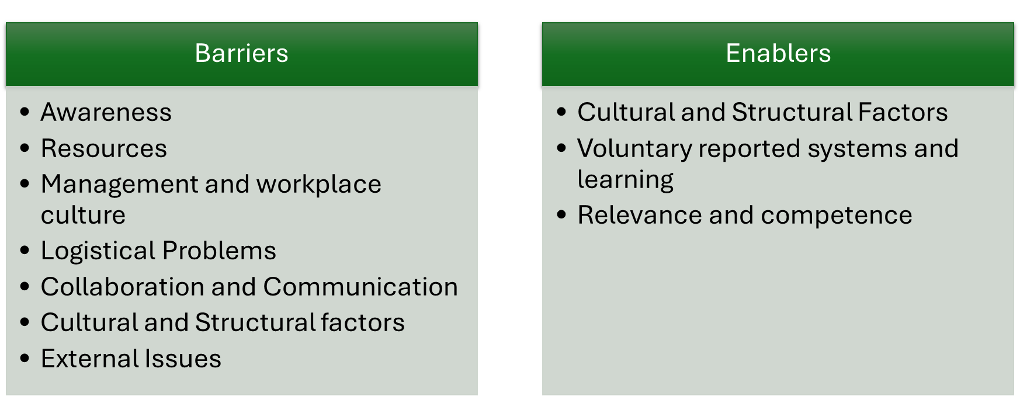
Results
Barriers and Enablers
Notes:
Results
Through the research, several significant barriers and enablers have influenced the implementation of healthcare initiatives. Key barriers included a lack of awareness, insufficient resources, and management and workplace culture challenges. Logistical constraints, coupled with suboptimal communication and collaboration, further impeded progress. Additionally, cultural and structural factors, both internal and external to the organization, were frequently cited as obstacles to successful implementation.
Conversely, the study highlighted several critical enablers. Supportive cultural and structural factors, voluntary reporting systems, and a focus on continuous learning were pivotal in facilitating positive outcomes. Ensuring the relevance of initiatives and enhancing staff competence through targeted training also emerged as essential components in overcoming implementation challenges.

Slide 9
Conclusion
Key implications for strategizing in hospitals and healthcare settings relate to defined strategies, quality frameworks, patient safety, technology integration, and leadership
Future Recommendations
  Emphasize strategic planning and continuous improvement.
  Focus on robust frameworks, leadership, training, and stakeholder engagement.
  Address barriers to effectively adopt new practices.
Notes:
Key implications for strategizing in hospitals and healthcare settings:
Only 24% of reviewed articles had clearly defined strategies; well-defined strategies enhance adaptability and success.
Adoption of EFQM and Lean Six Sigma frameworks are needed for systematic improvement.
Standardized safety protocols and a safety culture through regular training and effective communication are important
to have a skilled and motivated healthcare workforce, Investing in Staff Development is important. Continuous professional development and training programs are important
Integrating advanced technologies can significantly enhance efficiency and accuracy in healthcare delivery.
Developing strong leadership at all levels is crucial for driving strategic initiatives and fostering a culture of excellence.
Conclusion
Understanding and operationalizing strategy in a hospital setting is critical to maintaining organizational adaptability and improving performance and quality of care. Future research should focus on robust studies with longitudinal follow-up to understand the sustainability of strategizing in hospital settings and how it continues to meet the growing demands for services and activities.
Findings from the review will be of interest to hospital personnel and policymakers both locally and nationally. The review underscores that successful change management in healthcare relies on robust frameworks, strong leadership, comprehensive training, and stakeholder engagement, while addressing common barriers is crucial for the effective adoption of new practices. These findings highlight the importance of strategic planning and continuous improvement to enhance the overall efficacy of healthcare delivery.

Slide 10
References
Peters MDJ, Godfrey C, McInerney P, Munn Z, Tricco AC, Khalil, H. Scoping Reviews (2020). Aromataris E, Lockwood C, Porritt K, Pilla B, Jordan Z, editors. JBI Manual for Evidence Synthesis. JBI; 2024
Tricco AC, Lillie E, Zarin W, O'Brien KK, Colquhoun H, Levac D, et al. PRISMA Extension for Scoping Reviews (PRISMAScR): Checklist and Explanation. Ann Intern Med. 2018;169:467–473.
Donohoe C, Frazer K, Stokes D and Kroll T. 'Strategy-as-practice' by hospital personnel in hospitals: a scoping review protocol [version 1; peer review: 2 approved with reservations]. HRB Open Res 2021, 4:26

Slide 11
Thank you
Please contact Dr. Negin Fouladi, fouladi@umd.edu with questions

