Slide 1

Using Google Jamboard as an Interactive Group-work Platform
3/22/2022
Kana Jenkins
East Asian Studies Librarian &
Curator of the Gordon W. Prange Collection
University of Maryland Libraries

Slide 2
JAPN 402: Reading in Japanese Cultural Studies
Designed for students to challenge their Japanese language skill with various reading materials
Required a completion of JAPN 302 (=3 yrs of Japanese language classes) upon registration
Course theme: Relationship between technology and the human in contemporary Japan

Slide 3
Class Schedule
Early February
  Submit their research interest(s)
Mid February
  Library Day #1
  Concept Mapping Exercise
  Asahi Newspaper Database
  Select one article from Asahi Newspaper
Early March
  Presentation #1
  Presentation on the selected article
Late March
  Library Day #2
  Asahi Shinbun Kikuzo II Database - 1:1 Breakout room (zoom)
  Select additional article(s) from Asahi Newspaper
Mid April
  Presentation on the topic
  Presentation #2
  WordPress Blog entry
May

Slide 4

Final Project – WordPress Blog entry

Slide 5
What is Concept Mapping exercise?
Main concept
To expand/narrow down the research topic into a research question
To brainstorm keywords for the search

Slide 6
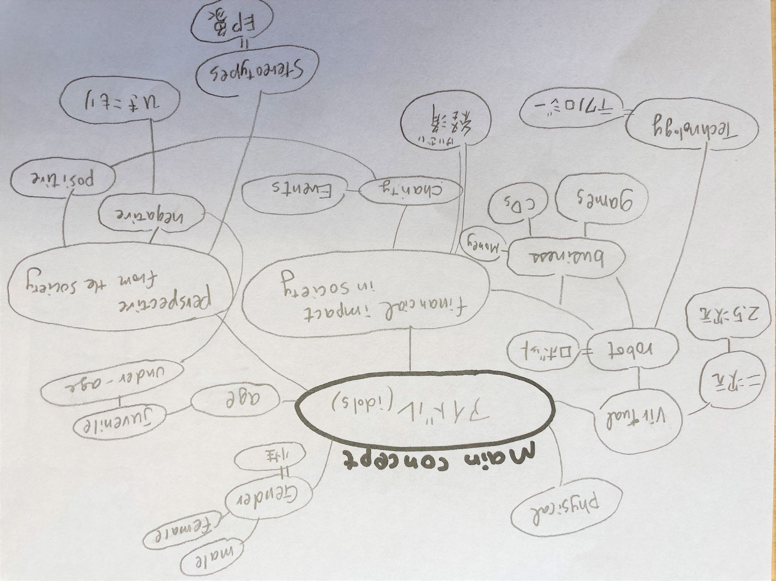
Concept Mapping Exercise – pre COVID time

Slide 7
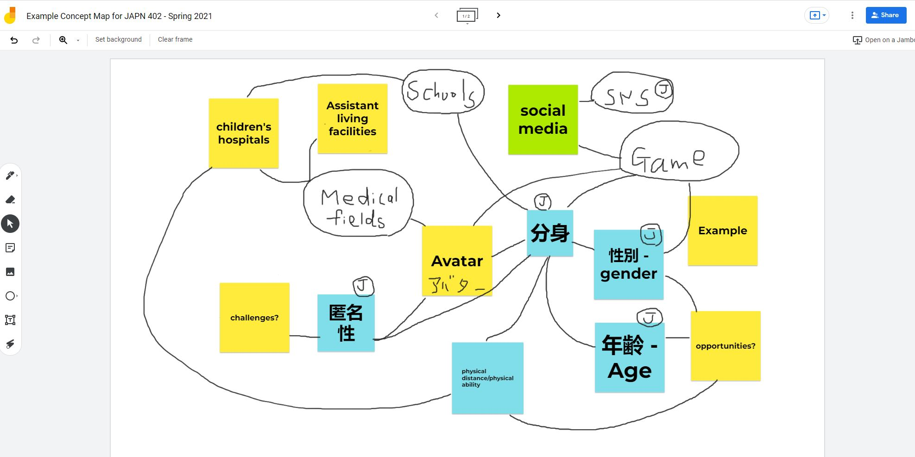
Google Jamboard – COVID time

Slide 8
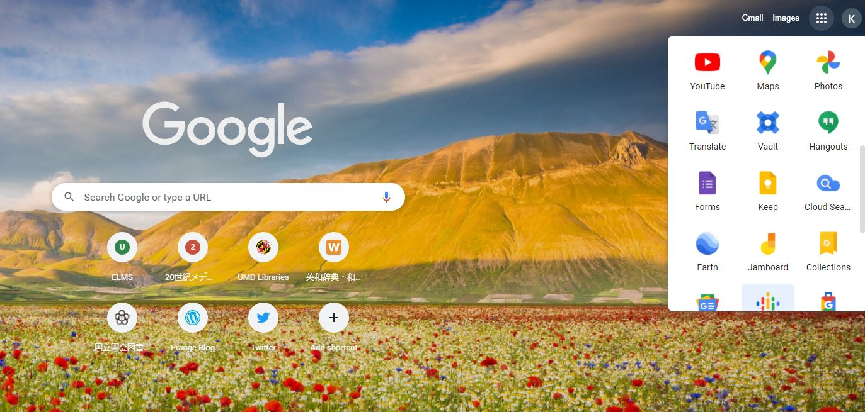
What is Google Jamboard?

Slide 9
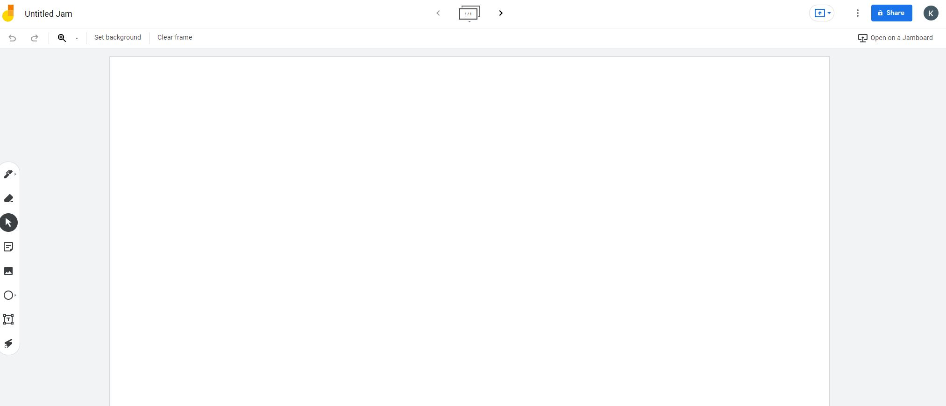
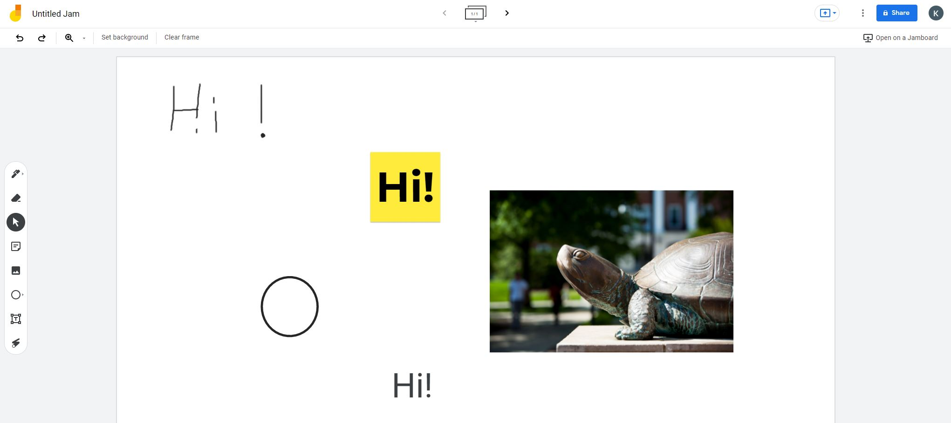
Google Jamboard
Pen
Eraser
Sticky note
Images
Shapes
Text box

Slide 10
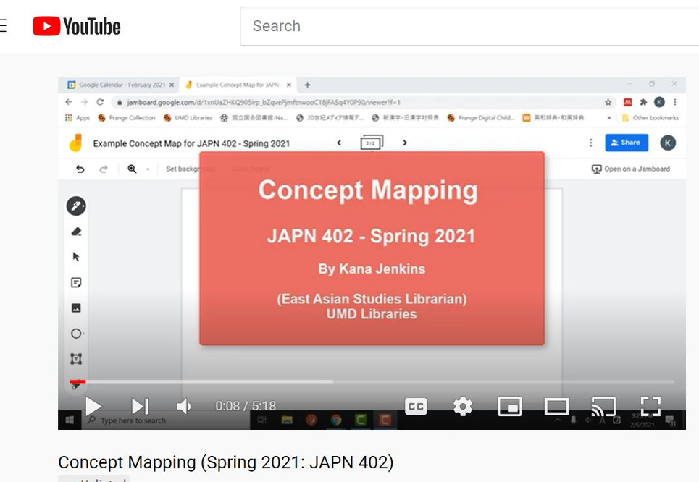
Prework

Slide 11
Synchronous session
Work on their own concept map
Divided to breakout rooms
Contribute to each other’s concept map

Slide 12
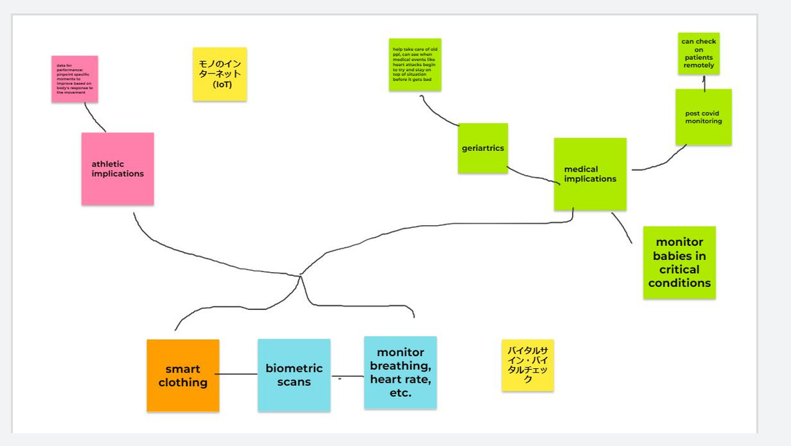
Example Concept Map #1

Slide 13
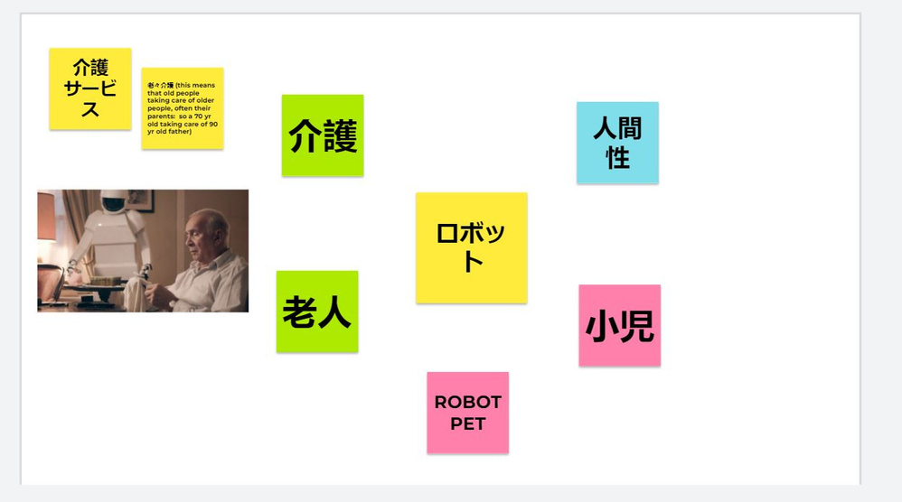
Example Concept Map #2

Slide 14
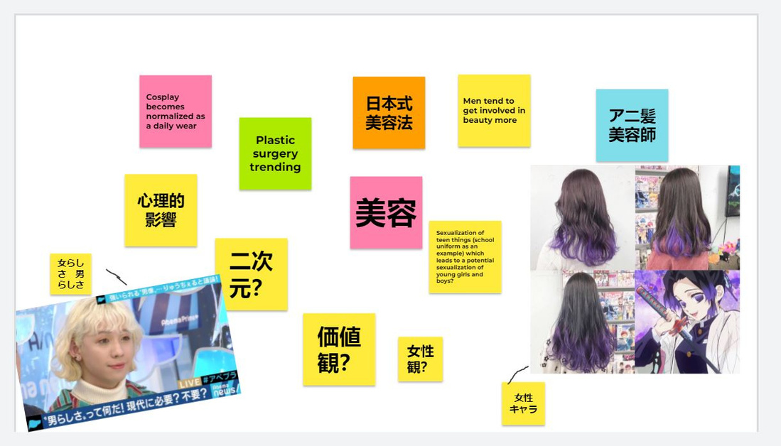
Example Concept Map #3

Slide 15
Assessment – what worked and what didn’t
Worked great on Google Jamboard:
Easy to master application
Casually add (and delete) the keywords
Easy to copy & paste Japanese keywords
Use images from the internet
Students found easy to communicate with virtually shared boards
Faculty & Librarian can monitor all boards

Slide 16
Assessment – what worked and what didn’t
Challenges on Google Jamboard:
(or on online teaching in general...)
Hard to see the students’ attention level
Differences among breakout rooms

Slide 17
So what are the keepers? – Plan for Post-COVID time
Pre-class video
Bilingual concept map
Concept mapping creation with classmates

Slide 18
