Slide 1
Ditch the Survey?
Lessons Learned From a Qualitative Research Study
Andy Horbal
Library Research & Innovative Practice Forum
University of Maryland
June 8, 2017
Notes:
This study was funded in part by a generous grant from the Library Research Fund. Thanks, LRF!

Slide 2
Background
“In particular, over-reliance on the survey method is limiting the types of questions we are asking, and thus, the answers we can obtain. This article is a call to arms: it is time to ditch the survey as our primary research method and think outside the checkbox. It is time to fully embrace evidence-based library and information practice and promote training in diverse research techniques.”
--Halpern, R., Eaker, C., Jackson, J. & Bouqin, D. (2015). #DitchTheSurvey: Expanding methodological diversity in LIS research. In the Library with the Lead Pipe. Retrieved from http://www.inthelibrarywiththeleadpipe.org/2015/ditchthesurvey- expanding-methodological-diversity-in-lis-research.
Notes:
The research project I’m talking about today was originally conceived of as a survey, not unlike the one our colleagues Kelsey Corlett-Rivera and Tim Hackman conducted to investigate ebook use in the humanities.
Decided to switch to a qualitative approach at the 2015 Institute for Research Design in Librarianship (IRDL).
As the authors of “#DitchTheSurvey” (who were all part of IRDL’s first cohort in 2014) note: “Qualitative data are generally text, sounds, and images, and typically answer questions such as, ‘What is the meaning of…?’ or ‘What is the experience of…?’ If the main objective of your research is to explore or investigate, choose a qualitative method. ”

Slide 3
Pros = Rich, Qualitative Data! Example #1:
“I no longer show films in their entirety in my classes. I feel like it’s bad pedagogy for the classes that I’m teaching. Not that I don’t think that it’s ever appropriate, but when I can give them the movie to watch outside of class and then spend the entire class period discussing it, it tends to let us cover more material instead of having to spend two class periods watching a movie and then talking about it.”
--Interview #10
Notes:
10/13 instructors who gave a reason why they assign the videos they use to their students as outside-of-class viewing explained that the limited amount of class time they have to work with was a major factor.

Slide 4
Rich, Qualitative Data! Example #2:
“One of the reasons why I prefer to use the library resources rather than going to YouTube or another online source is that I feel safe in the assumption that the library--that this is legal, that it is meant for use for a class to watch, for multiple viewing, and that those kind of legal issues are sort of taken care of by the fact that I'm using it through the library rather than online.”
--Interview #13
Notes:
10/18 instructors indicated that educational streaming video resources are superior to commercial alternatives in regards to terms of use/licensing terms. In almost every instance, the reason cited was the assumption that the library had already taken care of obtaining all necessary rights for them to do whatever they wanted to with the video

Slide 5
Rich, Qualitative Data! Example #3:
“I would use it, and this is something that I just was thinking about as I was talking to you. The reason why, and this is a really big reason, is to have a clean site medium. Let’s say I’m watching something on The Diary of Anne Frank, and it’s a school board hearing. On the right-hand side, especially depending upon what that student has been accessing, they’re going to have things like Holocaust denial videos, ‘Why Anne Frank Was a Liar,’ and other distracting things. It might be ads in the middle of this really serious talk about Anne Frank. Down below, you’re going to have the usual lunatic fringe making comments.”
--Interview #3
Notes:
15/18 instructors indicated that they wouldn’t knowingly use a non-library educational streaming video resource if the same title was available through the library, or that they would use both resources.

Slide 6
Cons = So. Much. Data.
Took approximately three months to schedule + conduct interviews.
19 interviews = 14 ½ audio hours = 386 pages of text containing 157,122 words.
Transcription took approximately three months to complete.
Iterative coding resulted in 57 total codes: 28 “structural” codes + 31 “content” codes.
Coding took at least 57 hours, which = at least seven full days of work.
Notes:
And I thought I was being clever by limiting the scope of my project to no more than 24 interviews!

Slide 7



Lessons Learned
Notes:
Each step of a qualitative research project requires either time or money: you can do it yourself, which will take time, or get someone else to do it for you, which will cost money.
Partners can help you get things done more quickly, but you’ll have to do things like test for inter-coder reliability, which take time. The tradeoff might be worth it, though!
Software costs money, but might make data analysis go much faster!
My interview script probably should have been half as long as it was, considering it was just me doing data analysis.

Slide 8
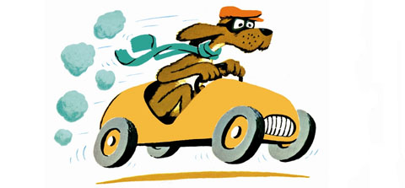
Lessons Learned
Illustration from Go, Dog. Go! by P.D. Eastman. Retrieved from http://www.cartoonbrew.com/books/p-d-eastman-book-website-26719.html.
Notes:
The most important thing = keep moving! My project got bogged down multiple times: between completion of the interview guide and the interviews themselves, between completion of transcription and coding, between the completion of coding and the beginning of writing, etc. It probably wouldn’t have if I wasn’t so intent on finishing one stage of the project before beginning the next one.
Pro tip: do data analysis as you go! Not only will it keep things moving, it will result in better interviews.

Slide 9
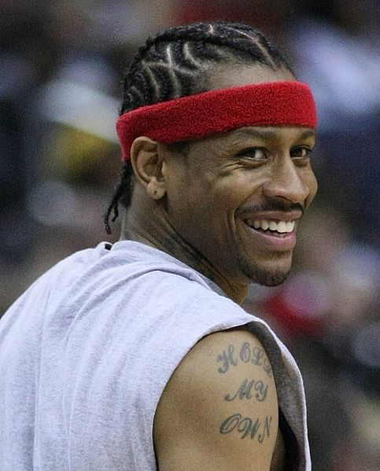
Lessons Learned
Photo of Allen Iverson by Keith Allison retrieved from https://commons.wikimedia.org/wiki/File:Allen_Iverson_headshot.jpg and used according to the terms of a Creative Commons Attribution-Share Alike 2.0 Generic license.
Notes:
There is no such thing as too much practice! I could have benefitted from additional practice interviewing. More specifically: I talked way too much and wasn’t focused enough on asking and getting answers to all of my questions, which would have made data analysis go *much* more smoothly.

Slide 10

Notes:
Questions?

