Slide 1

Using Statistics to Set Priorities
Robin C. Pike
UMD Libraries Research and Innovative Practice Forum
June 8, 2016

Slide 2
History of Digitization
Ad hoc
Boutique projects and requests
Small projects, mostly in-house
Mass-digitization for preservation and access
Notes:
Over the past 16 years, digitization in the UMD Libraries has morphed from ad hoc request-based digitization, to boutique projects and requests, to requests and small projects digitized in-house, to the current mix of in-house requests and small projects, and large-scale vendor-based digitization projects. Other than requests, projects were previously selected solely at the collection managers’ discretion.

Slide 3
Selection Process
Access need
  Patron/staff requests
  Formats are barrier to unmediated access
Preservation need
  Assessments
Institutional priorities
Notes:
The current selection process is based on patron and staff small to large requests, and the preservation and access needs of the collection. When formats are a barrier to access, such as oversize objects that are hard to handle or audiovisual formats for which we cannot maintain playback equipment or it would be a danger to play the media without causing damage, the solution is digitization for access. Preservation and Conservation have performed preservation assessments for some collections in Special Collections and University Archives. We also know that audiovisual materials are at a high risk for degradation and equipment obsolescence. This information is used digitization prioritization within departments. We also consider institutional priorities for digitization, such as when nearly 600 theses and dissertations from 1920-1953 were digitized in FY15 to support a weeding and consolidation project in the Libraries; these were recently ingested into DRUM.

Slide 4
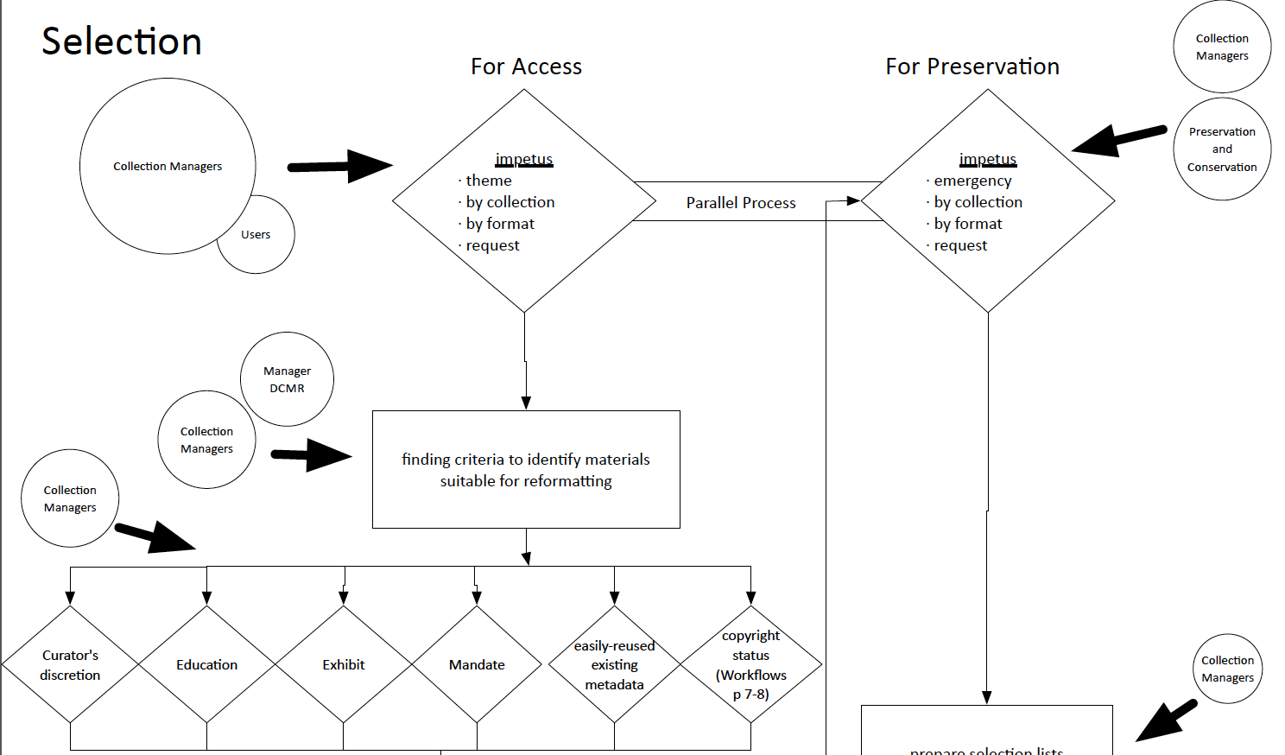
Notes:
This slide shows part of the current selection workflow, showing how collection managers and users or collection managers and Preservation and Conservation staff set the priorities for digitization, and some of the criteria used for project selection, such as requests, format, education, exhibits, a mandate or administrative priority, and the collection managers’ discretion.

Slide 5
Digitization Initiatives Committee (DIC)
In lieu of budget line
Scalable process
Cross-divisional expertise/interests
Cross-divisional collections priorities
Notes:
When the Digitization Initiatives Committee was established in 2014, its goal was to establish digitization priorities across the Libraries to support preservation and access needs, and to seek out and allocate funding for these projects in lieu of a dedicated budget line. Through the established project proposal process and the evaluation criteria, it evaluates projects based on the committee’s cross divisional expertise and interests, and priorities throughout the Libraries.

Slide 6
Funding Projects
Digitization Initiatives Committee
  Operations (state line)
  Gifts
  Endowments
  Foundation
  Fundraising
  Donors
Grants
Prioritizing limited resources:
  Prioritizing limited internal funding
  Prioritize staff time to work on projects
  Prioritizing staff time to pursue grants or fundraising
Notes:
Digitization projects are funded through a combination of operations budget, gifts, spendable endowments, foundation accounts, fundraising, and donations. Recently, we are also pursuing grants to support additional digitization projects.
By looking at all the possible digitization projects across the Libraries we are able to prioritize limited internal funding and staff time to work on the projects, and time to pursue grants or other fundraising opportunities.

Slide 7
DIC Criteria
Area | Considerations | Weight | Score
Relation to Teaching and Research Priorities | Intellectual value, collection assessment score (if available), previous use of material, etc. | 1 | High=3 Moderate=2 Low=1 None=0
Relation to Library Administration Priorities | Political, space (disposition or sending to offsite storage), development, public relations, etc. | 1 | High=3 Moderate=2 Low=1 None=0
Department/Unit Prioritization | When a department/unit submits more than one project, DIC will contact you to request prioritization information. | 2 | High=3 Moderate=2 Low=1 None=0
Continuation from Previous FY | Multi-year proposal. | 2 | Yes=1 No=0
Preservation Need | Preservation assessment score; consult with Preservation & Conservation. | 2 | High=3 Moderate=2 Low=1 None=0
Project Readiness | Available description for metadata; status of preservation work; material selection; other resources needed; plans for prep work or prep work completed. People should have spoken to MSD or P&C and prep work should be on work plans. | 2 | High=3 Moderate=2 Low=1 None=0
Available Funding | Gifts, endowments, donors, partners, grants, etc. | 2 | Full=2 Some=1 None=0
Partnerships | Campus, grants, CIC, etc. Relationships or funding. | 3 | Yes=1 No=0
Copyright status | On-campus access only will not be a limiting factor to digitization. | 4 | Public=2 On-campus=1 Dark archive=0
Notes:
The DIC Criteria was established for analyzing the FY16 projects in 2015. It was used again in 2016 to analyze the FY17 projects. The committee uses these criteria to rank project proposals in the importance to the university, Libraries, and department, balancing the preservation needs and access needs or restrictions with the project readiness and political implications.
I am most interested in gaining more evidence of the relation to teaching and research priorities ( such as use in classes and researcher requests), how departments and units prioritize collections for digitization, and the preservation needs of the collection, since some collections are degrading quickly. While SCUA and SCPA track usage statistics in Aeon, their collection retrieval system, other units don’t use the same system or have access to similar statistics for patron requests. To my knowledge, these statistics are also not yet used, at least in an obvious way, in determining priorities for digitization. Even if they are used, because digitization project proposals come from across the Libraries, we need a uniform way of measuring and tracking usage for determining priorities.
In the future, I would like to explore having additional preservation assessments performed on collections to provide additional data for prioritization.

Slide 8
Tracking Usage
Better representation across collection areas
Google Analytics
Web scraper used for Internet Archive
Asked for statistics from Chronicling America
Notes:
One way we could track usage across all digitized collections is by exploring web analytics statistics for UMD Digital Collections and other repositories where our data is stored, such as the Internet Archive, DRUM, HathiTrust, and Chronicling America.
In late 2015 and early 2016, I had my Graduate Assistant David Durden explore Google Analytics usage statistics in UMD Digital Collections and our collections in the Internet Archive via a web scraper. We did ask for additional statistics from Chronicling America, but have not yet received them.
By using data collected automatically by applications and repositories, we are able to track at a minimum how many people are accessing content in different collection areas. In UMD Digital Collections, we’re able to track much more information about the user, such as how they come to the site, how long they stay on the site, and where they’re located. This information can not only provide helpful information about collection usage, but it can also provide more information about how we should be making our collections accessible.

Slide 9
Usage Trends 2013-2015
Region
  70-80% Non-Metro
  80-90% Non-College Park
60-80% New Users (though each College Park public computer session is tracked as new)
Languages of highest use
  English (US), Japanese, European languages (various)
3-4 pages visited, on average
As social media referrals increase
  60-70% Leave after arriving on initial page
  Average session decreasing from 3-4 minutes to 2-3 minutes
Pageview trends ranking by semester: Fall, Spring, Summer, Winter
Increasing mobile users
Notes:
Between 2013-2015, the date range Google Analytics was fully implemented in UMD Digital Collections, David Durden analyzed the usage data by semester and noticed the following trends (see above).

Slide 10
Content Trends 2013-2015
Most frequent landing page is “digital collections home page”
Users follow search-result-search pattern
Popular digital exhibits/collection landing pages
  Appear to be consistent interest among semesters, inferring classes, though not necessarily from UMDCP
Most popular:
  Baroness Elsa von Fretag-Loringhoven Digital Library (Dada movement, poems and papers)
  Films at UM (educational licensed film content)
  University AlbUM (UMD photos from various collections)
  Prange Collection (censored publications from US Occupation of Japan)
  Jim Henson Collection (licensed videos)
Notes:
In tracking statistics by content type, we discovered the following trends (see above).

Slide 11
Plans for Data Use
Repository development
  Access restrictions due to copyright
  Need to be more friendly for mobile users (Zoomify image viewer uses flash)
Outreach to collection areas
  Project planning
Fundraising/grants for collection areas
Integrate into DIC process, prioritization rubric
Notes:
These statistics allow us to infer that we need to make our collections more accessible to off-campus users from the general community and to other colleges and universities; access restrictions due to copyright or relationships are impeding research in some collections. We should also work to make the next version of our repository more mobile-friendly for our growing mobile user contingent; Zoomify, the application used to display and allow zooming on images is flash-based and not mobile friendly for all devices.
In looking at the five most popular digital collections spanning diverse collection areas—Baroness Elsa von Fretag-Loringhoven, Films at UM, University AlbUM, the Prange book collection, and the Jim Henson Collection—we should explore the following questions with collection managers in determining future project planning priorities: How can we explore outreach for these collections and expand these digital collections? Do we have other related materials we can digitize and promote in similar ways to the same user communities? Would setting up some of the same type of visibility these collections have, such as landing pages or exhibits, increase usage of non-related collections? The answers to these questions could be used for planning future digitization projects or future promotion and outreach, or website and exhibit development in collection areas.
Usage statistics can also be used to set fundraising goals for collection areas, or be used as the catalyst for collaborative digitization grants between myself as Manager, DCMR and the collection managers.
I would like have further discussions about collection usage with collection managers before the fall FY18 DIC digitization project proposal process and eventually integrate usage statistics of the collection or related collections into the DIC prioritization rubric.
For more information on the statistics gathered during the UMD Digital Collections Google Analytics report, please talk to David Durden, who will be presenting his findings on a poster at this afternoon’s session.

