Slide 1
Supervising Student Assistants During COVID-19
By Emily Spangler and Joanna Wiley
Notes:
Emily

Slide 2
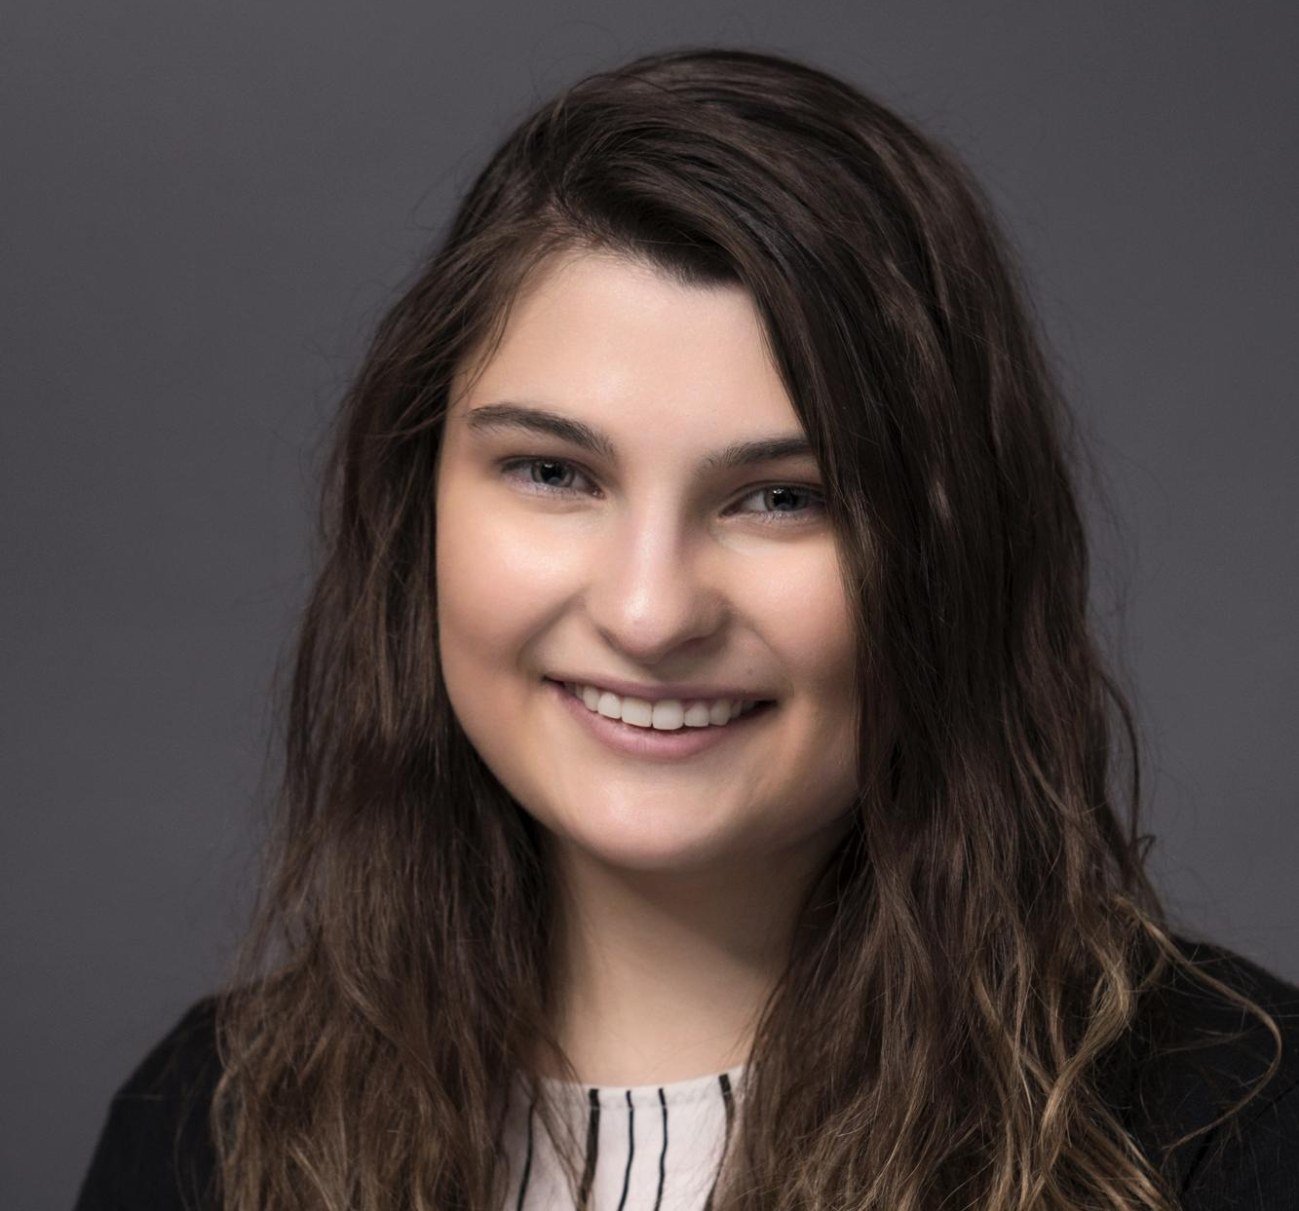
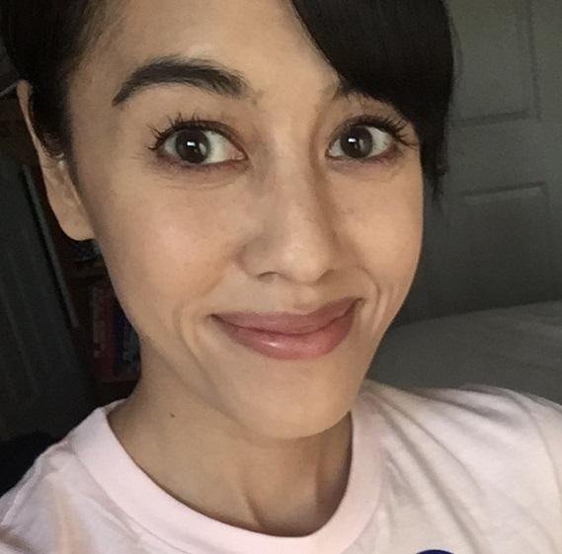
Emily Spangler
Library Services Supervisor
McKeldin Library
Joanna Wiley
Lead Student Supervisor- User Services
McKeldin Library
Notes:
Emily/Joanna

Slide 3

University of Maryland, College Park
About UMD College Park
Flagship university for the state of Maryland
Member of the Big 10 Conference since 2014
30, 511 undergraduate students
10, 232 graduate students
14, 505 employees (faculty, staff, and GAs)
UMD Libraries
Consists of 7 branches
Nearly 4 million titles in our collection

Slide 4
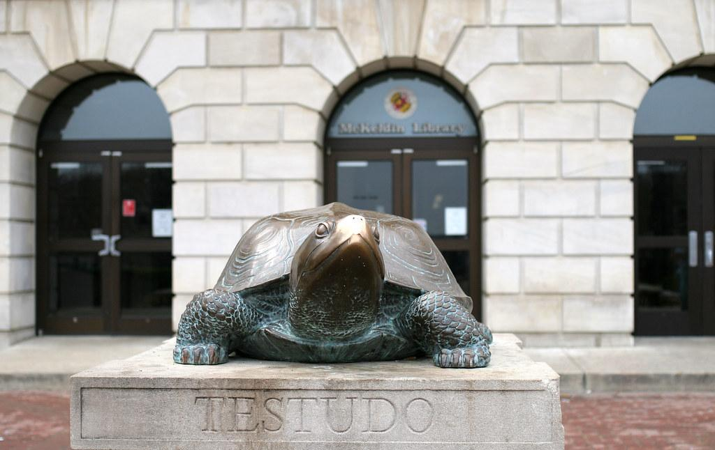
University of Maryland, College Park
McKeldin Library (User Services & Resource Sharing)
Student pool currently consists of 29 student assistants scheduled across 3 units
Collections Maintenance & Retrieval
Logistics & Periodicals
Library Services Desk
5 Student Supervisors
Jasmine Johnson
Amy Kim
Brandon Magby
Emily Spangler
Joanna Wiley

Slide 5
COVID-19 Timeline
March 10: UMCP moves to an online environment until April 10th
March 12: Student assistants are permitted to telework
March 17: UMCP Libraries are closed until March 29th
March 19: UMCP goes online for the entire Spring semester
March 23: Gov. Hogan announces stay-at-home order and all library services go remote until further notice
Notes:
Emily

Slide 6
Start of the Pandemic
Lots of uncertainty, confusion, and lack of information
Students were terrified of losing their jobs
Student supervisors insisted on letting the students telework at least until the end of the Spring semester, then reassess
Main priority became coming up with telework projects to keep students employed
Notes:
Emily

Slide 7
Initial Concerns
Final Decisions
Would students want to work remotely?
If so, how many?
Student schedules - would they have a set hours like onsite work or could they set their own hours?
How many hours could each student work?
How would students log their hours?
Out of 40 students, 31 confirmed interest in remote work.
Set Their Own Hours: Students were permitted to log hours anytime they wished
Students hours were limited to their originally scheduled number of hours per week
Students were granted access to their timesheets to log individual hours.
Notes:
Joanna #3

Slide 8
Initial Concerns
Final Decisions
Supervision- Should the student pool report to all supervisors or one primary supervisor?
Communication- How do we check in with students to ensure everything is going smoothly?
Students were assigned a primary supervisor. Primary supervisors were responsible for assigning projects, approving timesheets, and dealing with individual student issues.
Communication strategies varied, but common methods were weekly check ins via email or Zoom. Continuous regular communication was emphasised as imperative to the continuation of remote work the start of the transition to remote work.
Notes:
Joanna #4

Slide 9
Initial Concerns
Final Decisions
Can students use Sick Leave?
*Students working 12hr/week earn 1hr of sick leave for every 30hr worked
Can students decide to stop teleworking if they find it’s not a good fit for them?
Yes- As with full time staff, sick leave can be used if available to cover everything under UMD’s Sick & Safe Leave Policy.
Yes- Emphasised that telework was volunteer only. During this time of heightened stress and transition, if telework was not working for them, they could stop at anytime.
Notes:
Joanna #5

Slide 10
What does Student Assistant Remote Work Look Like?
UMD Libraries came together and volunteered projects that student assistants could perform
Telework for students ranged from departmental projects, to LinkedIn Learning courses, to watching webinars and reflecting on them, and much more.
We used Google Forms for students to reflect on certain projects
For more complex projects, supervisors trained students via Zoom
Notes:
Emily

Slide 11
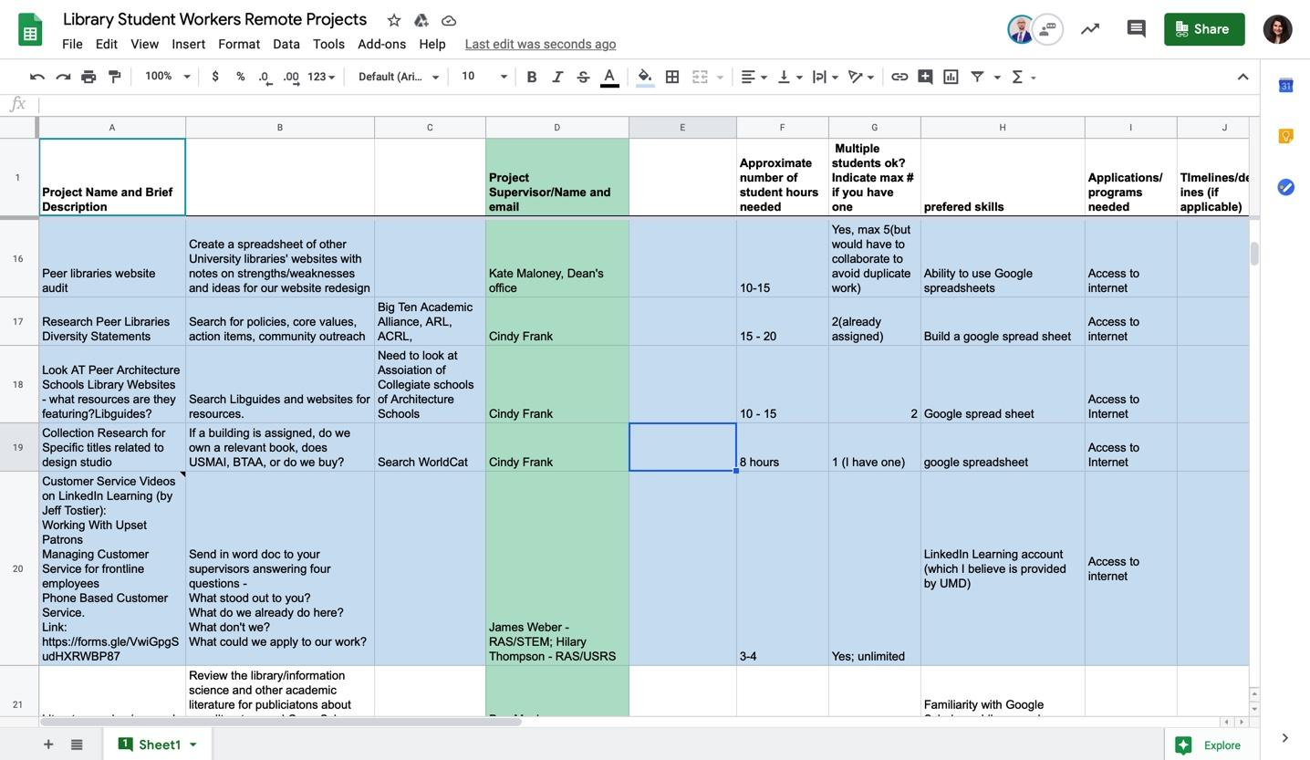
SLIDE TO SHOW TELEWORK PROJECT LIST
Notes:
Emily

Slide 12
Major Challenges
Students and supervisors adapting to telework in such a short span of time
Creating enough projects to keep students going
Keeping track of which students were doing which projects
Not being able to fully rely on our normal guidelines and procedures of student supervision
Notes:
Emily

Slide 13
Trends We Noticed
The majority of teleworking students logged far fewer hours per pay period than they typically did on-site
Avg # Hrs Worked Per Pay Period On-Site: 514.5
Avg # Hrs Worked Per Pay Period Remote: 208
Students tended to underestimate the effect of losing the regular structure of their day
Students reported feeling stressed, depressed, lack of motivation but felt telework helped offset that a little
Notes:
Joanna #6

Slide 14
Unexpected Successes
Weekly supervisor meeting
Celebrating our graduating students in virtual environments, such as a send off video and e-cards
Being able to support our students in times of crisis
Teaching our students topics they would not have learned in their normal routine
New ideas i.e. Student Assistant Professional Development program
Notes:
Emily

Slide 15
Lessons Learned
Structure is key to maintaining success:
Consider setting scheduled work hours
Set a minimum number of hours per week to keep students engaged with work
Schedule regular F2F check-ins (do not just rely on email communications) Checking in with students using communication software, about both their personal and work lives, should be prioritized. Face to face time is imperative to maintaining a strong working relationship.
Notes:
Joanna #7

Slide 16
Lessons Learned
Use specific dates for responses in email communication whenever possible (Ex. Please respond by 5pm Friday)
Not every student is able to adapt to telework, and that is okay. After the first few weeks of telework, we had 2 students ask to stop teleworking.
Screen project content before assigning them to students
Notes:
Joanna #8

Slide 17
Student Survey
Linear scale of 1 (strongly disagree) to 5 (strongly agree) for 2 questions, and then a space for any comments or anecdotes
10 responses
80% of students who responded strongly agreed with the statement “Communication between my primary supervisor and I during the Spring 2020 semester was consistent.”
60% of students who responded strongly agreed with the statement “The quality of projects I was assigned during the Spring 2020 semester helped me grow professionally or taught me more about libraries.”
Notes:
Emily

Slide 18
Student Survey (Qualitative Data)
“At the end of the semester when we were notified that only 7 students were staying over the summer, I wish we had been given some information as to why only those students were able to continue teleworking.”
“Working from home was very difficult since I was unable to balance home responsibilities and schoolwork. The videos from Linked-In were very dry and involved information that I already knew and I struggled to finish them. One of my favourite things about working at the library was patron interaction and helping them problem solve. Perhaps incorporating more elements of that or doing activities or ‘work’ with other students at the same time may provide some sense of normalcy or community.”
“The biggest struggle I found was self-motivating to work from home on my own schedule.”
Notes:
Emily

Slide 19
Student Survey (Qualitative Data)
“I appreciated both the library staff's and the University of Maryland's efforts in allowing UMD student workers the opportunity to still work for pay. The projects assigned helped me when I was applying for jobs and going to interviews.”
“I learned a lot about the infrastructure of the libraries, as well as customer service skills through the Linkedin Learning videos. I cannot think of anything that would have made the experience better, aside from perhaps being at the library!”
“The staff did a wonderful job coming up with relevant projects that allowed students to be able to work! I heard from my supervisor every week at least once and, she was always available and understanding.”

Slide 20
Where Are We Now?
6 students were selected to telework during the summer, with the expectation of resuming some onsite work as we begin to slowly reopen
Students are required to log 5hrs min per week or they will no longer be eligible to continue telework
Students are required to email their primary supervisor after each “shift” to summarize what they worked on that day
A new series of projects were created to take them through the Summer
We are maintaining contact with the rest of the student pool via email.
Notes:
Joanna #9

Slide 21
Looking Forward
Will we have the budget or workload to bring all of our student assistants back on in the Fall?
Will all of our students be returning to campus? Will they want to work on site?
How do we prepare students for the numerous changes implemented in the library in response to the pandemic?
Notes:
Joanna #10

Slide 22
Looking Forward
How do we adjust student schedules and tasks to reflect a new work environment that includes social distancing, PPE, and less staff?
If there is a second wave of Covid-19 cases, will we resume this telework model if UMD moves to a 100% remote model again this Fall?
Notes:
Joanna #11

Slide 23
Questions?
Emily Spangler - espangl1@umd.edu
Joanna Wiley - jwiley13@umd.edu
Notes:
Emily

