Slide 1
Museum Institutional Records: Stewardship and Advocacy, Challenges and Rewards
Celia Hartmann, The Metropolitan Museum of Art
Sarah Demb, Harvard University
Patricia Kervick, Peabody Museum, Harvard University
Shana McKenna, Isabella Stewart Gardner Museum
Meghan Petersen, Currier Museum of Art
Marianne Martin, Colonial Williamsburg Foundation
Notes:
Thank you everyone. This is session C3: Museum Institutional Records: Stewardship and Advocacy, Challenges and Rewards. So if you were planning to attend another session, this would be a good time to get up and go find that other room. And for those of you live tweeting the sessions, the hashtag for this one is: TBD
I’m not going to do long introductions of our panel discussers today except to introduce them as – [individually by name] – My name is Celia Hartmann, and I am senior associate for archival processing in the archives at the Metropolitan Museum of Art in New York.

Slide 2
Museum Institutional Records: Stewardship and Advocacy, Challenges and Rewards
Questions and issues, not answers
Varied experiences over time and at different institutions
Value of the records
Challenges common to all institutional records:
  Stewardship
  Advocacy
Challenges specific to museum records:
  Objects vs. collection
  Privacy and confidentiality: donors and purchase prices, lender agreements, object conservation
YOUR questions, challenges, hesitations
Notes:
For our format today, we are not going to do formal how-to, or what-we’ve-done presentations. Instead, we’re hoping to foment discussion with you all in the audience, as well as among ourselves, following a short presentation of a salient issue from each of us. We all bring very different points of view, from different institutions with varying issues. But we share some commonalities. Underlying all of this is the value of our records, both to internal users and to external researchers, which fuels our work. We also share the same challenges of all institutional records, including stewardship, the need for advocacy, concerns about privacy and confidentiality. We are also usually facing a combination of diminished resources and increased demand, whether internal or external, often driven by the perceived value of digitization and a movement to greater information sharing in general.
We also face challenges specific to Museum records: issues like is it an object or part of the archives? How are and should visual materials be handled in our records? And specific subsets of privacy and confidentiality stemming from the business practices of museums: the purchase and loan of works of art, object conservation, and long-term relationships with donors, dealers, auction houses, and our sister organizations. We hope that our comments and observations will stimulate your own thoughts on this, and that you’ll be formulating questions, providing us with answers or more questions and generally increasing the communication among us all, in our community of shared interest.

Slide 3
Expanding Access at
The Metropolitan Museum of Art Archives
Celia Hartmann
Senior Associate for Archival Processing
The Metropolitan Museum of Art Archives
MARAC/NEA joint conference, Boston, MA, March 2015
Notes:
I’m going to speak briefly about the work that went on in the Metropolitan Museum Archives prior to my tenure, which made possible the 27 month project I’m currently completing: a grant-funded initiative to process and open to researchers, for the first time, fourteen collections of the records of Museum directors, curators, and programs, plus the complete departmental records of the Costume Institute.

Slide 4
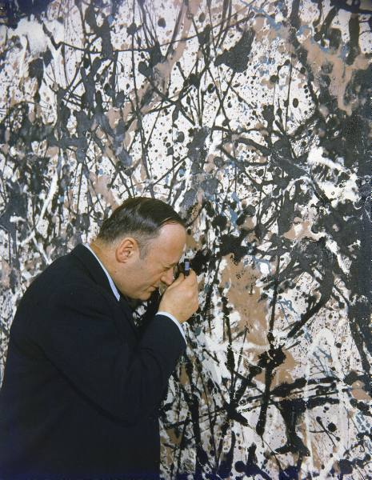
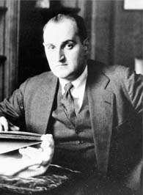
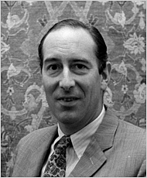
Expanding Access at
The Metropolitan Museum of Art Archives
New Access Policy for Director’s Records
Tom Hoving
Director, 1966-77
James Rorimer
Director, 1955-66
Francis Henry Taylor
Director, 1940-55
Notes:
Most problematic from the onset was access to Directors’ papers, which had been unprocessed and therefore closed to outside researchers. Before any work could be done on making records available publicly, the Museum Archives department needed to define an access policy, and secure approval of that policy from institutional leaders and the Museum’s Board of Trustees. Because directors’ papers document institutional decision-making at the highest level, issues to do with privacy and confidentiality drove much of the discussion about access to them. And you may have similar concerns and be having similar conversations at your institution as you look at these kinds of records in your custody.

Slide 5
Expanding Access at
The Metropolitan Museum of Art Archives
Convinced Museum leadership of need for a clear access policy
Conducted peer institution review
Visited peer institutions with Counsel to consult open collections of Directors records
Drafted policy recommendations and secured support of Counsel, Director, President
Presented to Trustee Legal Committee
Presented to Trustee Executive Committee
Approved by full Board of Trustees
Notes:
Here is a condensed version of the decision-making process, as it progressed at the Met. First, our Museum Archivist Jim Moske convinced his managers and Museum leaders of the need to provide research access to this material, and that a clearly defined policy would be the way to promote this. He examined the policies of peer institutions to see how they were tackling this issue, for comparison and guidance. Next, he visited some of those collections, together with Chief Counsel. He worked to define a policy that balances reasonable access with protection of sensitive information, and won the support of our current Director for that policy. It was then run through key Trustee committees, which led to full approval by the Museum’s Board of Trustees.

Slide 6
Expanding Access at
The Metropolitan Museum of Art Archives
Policy on Access to the Records of Former Museum Directors
Unprocessed records of former Metropolitan Museum of Art Directors and Presidents are closed to non-staff; they are accessible only to staff of the Museum Archives, the Office of the Senior Vice President, Secretary and General Counsel, the creating office, and those approved by the Director or President.
Processed records of former Metropolitan Museum of Art Directors and Presidents are closed to non-staff for 35 years, determined by the date of the latest document contained in a file.
Some records may be permanently closed to non-staff at the discretion of the staff of the Museum Archives, the Office of the Senior Vice President, Secretary and General Counsel or the creating office.
Notes:
His research showed that museums impose restrictions on recently created records, varying from fifteen to fifty years in length, to allow confidential information to become less sensitive; in addition, some particularly sensitive records are closed to non-staff indefinitely. The Met created a policy that, in simplified terms, makes unprocessed records closed, opens processed Directors’ and Presidents’ records after 35 years, and allows for permanent closure or restriction of specific items based on defined and stated policies.

Slide 7
Expanding Access at
The Metropolitan Museum of Art Archives
It can be done!
Clear goals, visible benefits
Working through decision makers, and levels of approval
Customizing arrangement, description, access to effect policy
Balancing open access with institutional concerns
Notes:
Putting those restriction policies into effect is a large part of my responsibilities as lead archivist on this project. And we continue to hone our arrangement, description, and physical access procedures to put this into practice, and to flesh out our processing manual to reflect this. We continue to balance the proprietary needs of the institution with the movement to greater public access. And to balance the higher risk aversion of our legal department with the generally more open approach held by archivists as information professionals.
The message that I’ve taken from this process is: restrictions are part of what we deal with in museum records, and perhaps what is daunting as you consider dealing with yours and discussing those issues with your institution’s leadership. Forming a clear policy that both advocates the value of records in your institutions and guides their availability to the public was key in our experience. Based on our experience, it can be done! So I’ll leave you with that as one specific example of having worked through these issues, and hope that you’ll have questions and comments on it later, based on your experiences and concerns.
Each of the panelists will now present some of the issues they are tackling as they confront their records. We will have lots of time for discussion when Marianne is finished, and we look forward to the conversation with you afterwards.

