Slide 1
It’s All in the Archives: Describing and Discovering Archival Material
2013 Association of Recorded Sound Collections Pre-conference workshop
Discovery Access Methods for SounD Recording Collections
May 15, 2013
Joanne Archer
Special Collections Librarian
University of Maryland Libraries

Slide 2
Outline
Introduction
Archival Principles and Practices
Arrangement and Description of Archival Material
  Exercise: common arrangement schemes
Access and Discovery of Archival Material
  Standards and Best Practices
  Discovery Tools and Methods

Slide 3
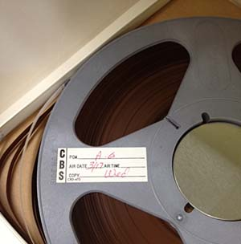
Introduction: The Most Hidden of Collections
Unprocessed/Uncataloged
Collections (1998 ARL Survey)
Print Collections (15%)
Manuscript Collections (27%)
University Archives (31%)
Video Holdings (35%)
Graphics Materials (36%)
Audio Materials (37%)
Artifactual Materials (46%)
Born digital materials (71%: 2010 survey)

Slide 4
Introduction: More Product, Less Process (MPLP)
Mark Greene and Dennis Meissner “More Product, Less Process: Revamping Traditional Archival Processing” (American Archivist, 2005)
  Collection Level records
  Minimal Finding Aids
  Change the definition of processing to privilege users and flexibility, “describe everything in general before describing anything in detail”
  Goal is to do just enough arrangement and description so that user can successfully locate and use material.

Slide 5
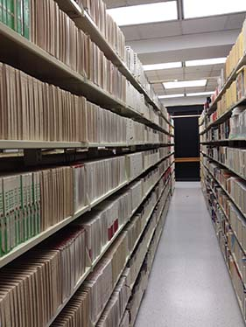
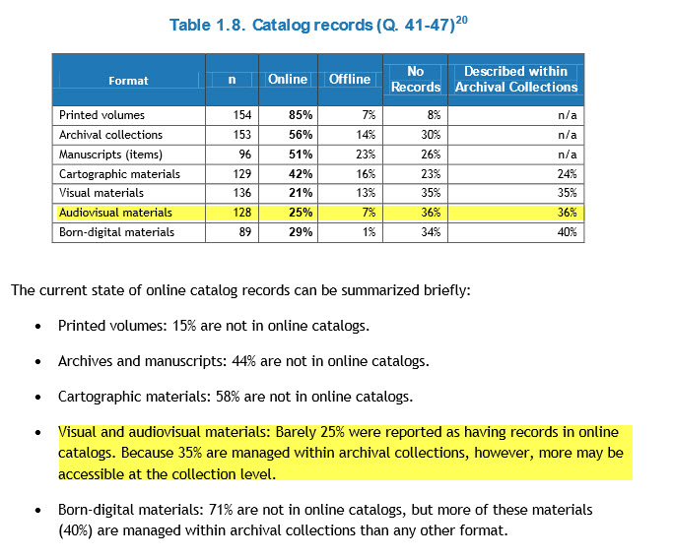
Introduction: The Most Hidden of Collections
Source: Taking Our Pulse, The OCLC Research Survey of Special Collections And Archives

Slide 6
Introduction: The Most Hidden of Collections
Why are audio visual materials most overlooked in archival collections?
  Many archivists not equipped to deal with materials
  Doesn’t fit neatly into standards and practices developed for paper based materials
  Format and lack of easily accessible descriptive information make materials particularly challenging for non specialists

Slide 7
Outline
Introduction
Archival Principles and Practices
Arrangement and Description of Archival Material
  Exercise: common arrangement schemes
Access and Discovery of Archival Material
  Standards and Best Practices
  Discovery Tools and Methods

Slide 8
Archival Principles
Provenance
  “Information regarding the origins, custody, and ownership of an item or collection.”
Original Order
  “The organization and sequence of records established by the creator of the records.”
All definitions take from the Society of American Archivists, Glossary of Archival and Records Terminology

Slide 9
Archival Principles: Provenance
Discourages the mixing of collection materials
Refers to the creator rather then the donor if the two are different
Benefits:
  Accepts the creator or source as the system of organization which makes work much simpler
  Preserves key information about the collection as a whole
Drawbacks
  No uniformity of arrangement across collections
  Can be more difficult for users unaware of this practice

Slide 10
Archival Principles: Original Order
The order in which materials were kept when in active use
Original order is preserved unless use is impossible.
Time saving measure—rearrangement is time consuming and subjective

Slide 11
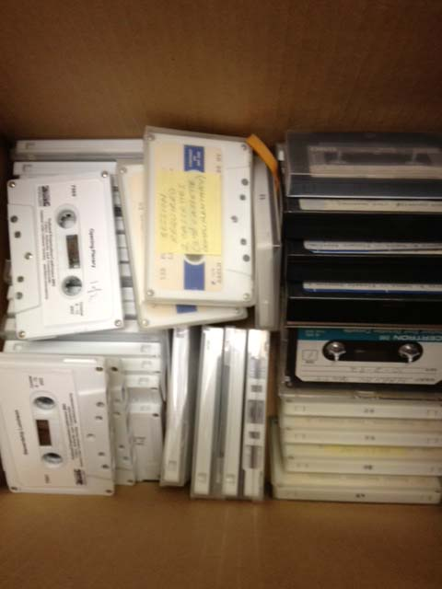
Archival Principles: Original Order
DOES NOT mean:
Respect for Original Chaos

Slide 12
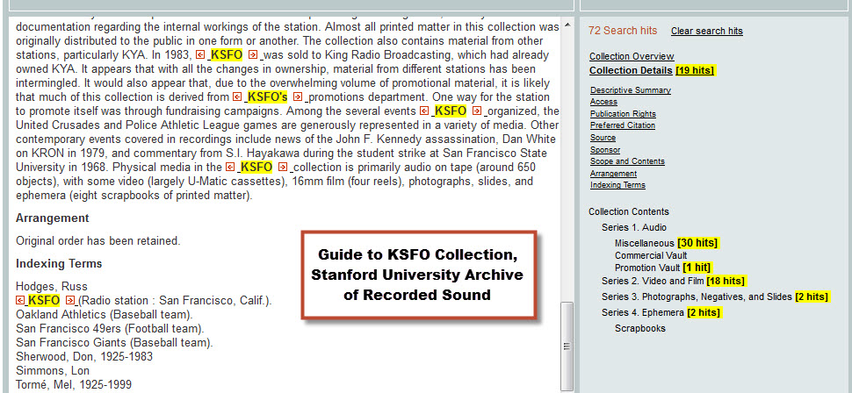
Archival Principles: Original Order & Provenance
Live site: http://www.oac.cdlib.org/findaid/ark:/13030/kt458035s1/

Slide 13
Outline
Introduction
Archival Principles and Practices
Arrangement and Description of Archival Material
  Exercise: common arrangement schemes
Access and Discovery of Archival Material
  Standards and Best Practices
  Discovery Tools and Methods

Slide 14
Arrangement and Description
Goals of archival arrangement and description:
To know what we have and where it is
To make material accessible to users
To explain the context of the creation and use of records
“Good Descriptive Practices Facilitate Good End- User Access”
Prom and Frusciano, Archival Arrangement and Description

Slide 15
Arrangement: Levels of Control
Arrangement is the process of intellectually and physically organizing materials taking into consideration
their provenance and original order
Collection
Series
Subseries
Files
Item

Slide 16
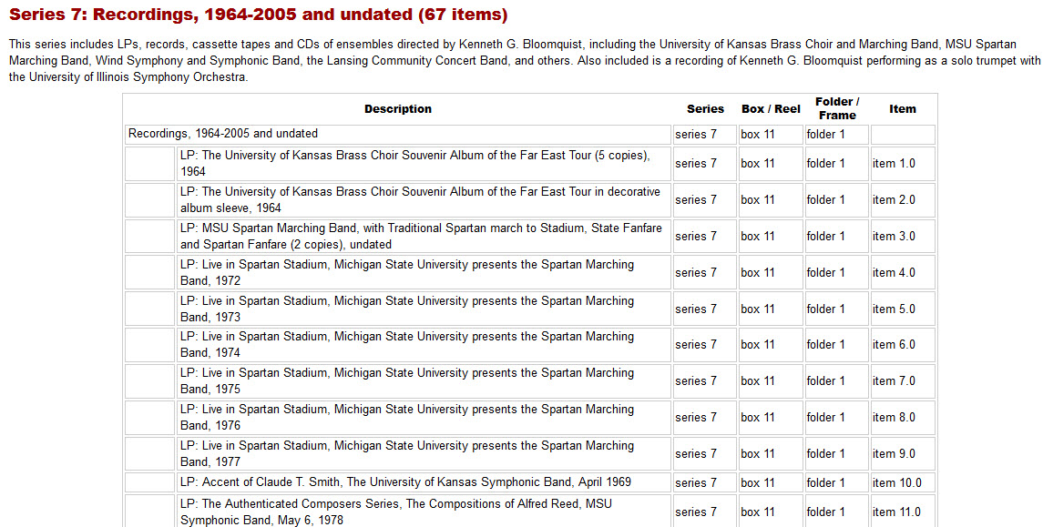
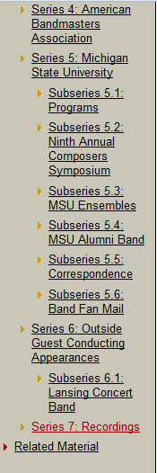
Arrangement: Audio
Live site: http://hdl.handle.net/1903.1/19184

Slide 17
Arrangement: Common Schemes
Series
Document Type
Chronological
Below the Series
Chronological
Alphabetical
Alphabetical
Topical/Subject
Function/Activity
Significance

Slide 18
Arrangement Exercise: Part 1
What series would you propose?
What factors did you take into consideration?
How do you imagine you would arrange material within the series?
Link to arrangement exercise
Link to WAMU finding aid: jpeg /live

Slide 19
Arrangement Exercise: Part 2
How would you arrange this material within an audio series?
What factors would you consider in determining this arrangement?
What are the benefits and drawbacks to your arrangement scheme?
Link to arrangement spreadsheet
Link to final version of inventory

Slide 20
Description
Archival description is:
“The process of analyzing, organizing, and recording details about the formal elements of a record or collection of records, such as creator, title, dates, extent, and contents, to facilitate the work's identification, management, and understanding”
From the Society of American Archivist’s Glossary of Archival and Records Terminology

Slide 21
Description
Library
Item level
Single level of description
Archives
Collection level
Multiple levels of description

Slide 22
Description: Finding Aids
Finding aids are indexes to archival and manuscript collections. A finding aid can be as simple as a listing of folders (often called an inventory or preliminary inventory), but it can also be a complex document that places materials in context by consolidating information about the collection, such as a history or biographical note and a description of the arrangement of the collection.
Finding aid example: jpeg / live

Slide 23
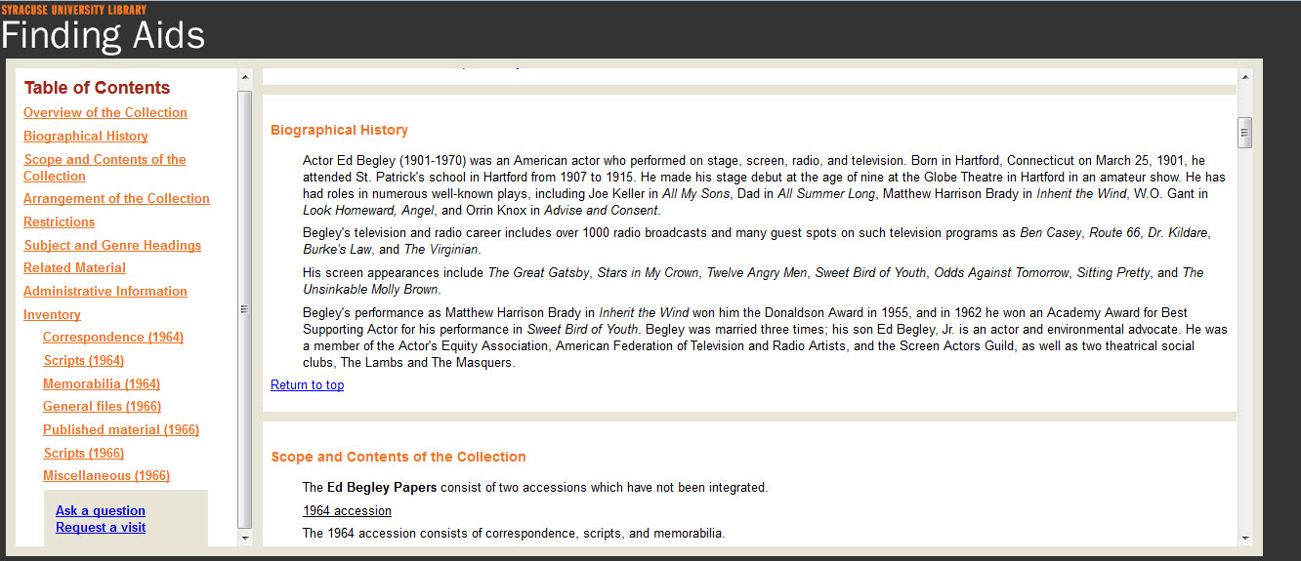
Description: Finding Aids

Slide 24
Outline
Introduction
Archival Principles and Practices
Arrangement and Description of Archival Material
  Exercise: common arrangement schemes
Access and Discovery of Archival Material
  Standards and Best Practices
  Discovery Tools and Methods

Slide 25
Standards: Who cares?
Enable efficient production, description, and use of objects and information
Break down description into a set of common elements
Helps with consistency and helps users know what to expect
Increases discoverability by creating structured data that can be shared across systems

Slide 26
Standards
Data Structure Standards
  MARC, EAD, EAC-CPF
Data Content Standards
  DACS, AACR2, RDA, APPM, IASA
Data Value Standards
  Library of Congress Name Authority Files (LCNAF), Library of Congress Subject Headings (LCSH),
Metadata/companion standards
  Main standards are Dublin Core (often used at the item level), MODS, and METS (structural metadata), and PREMIS (administrative metadata)

Slide 27
Standards: Data Structure Standards
MARC (Machine Readable Cataloging)
  Designed for print materials with data elements such as title, author, date, and subject
  Not flexible or detailed enough for describing context of archival materials but allowed users to find print, archival, and other materials in one system.
  Large number of tools available for creating and managing MARC and for converting to other formats

Slide 28
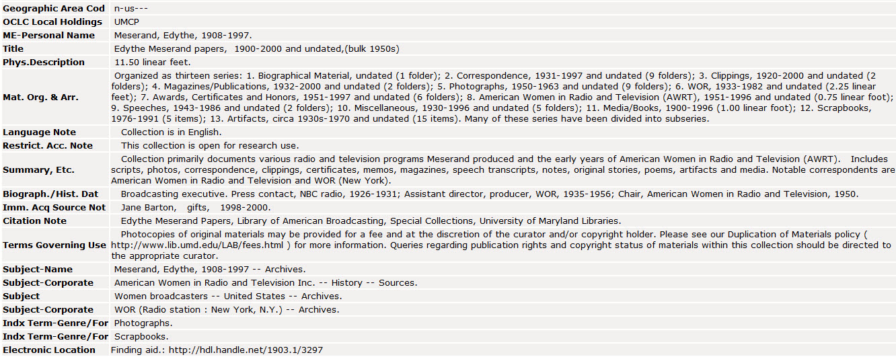
Standards: MARC
Link to jpeg/ live

Slide 29
Standards: Data Structure
Encoded Archival Description (EAD)
  1st data structure standard created by the archival community (1997); current version last updated in 2002
  XML-based data structure standard for encoding archival finding aids
Benefits of EAD
  EAD was designed to put archival finding aids online; preserves the hierarchical structure of collections
  Flexible; as long as a document includes required elements is it valid. This allows institutions to choose appropriate levels of description for their institution
  Allows standardized search across and within finding aids

Slide 30
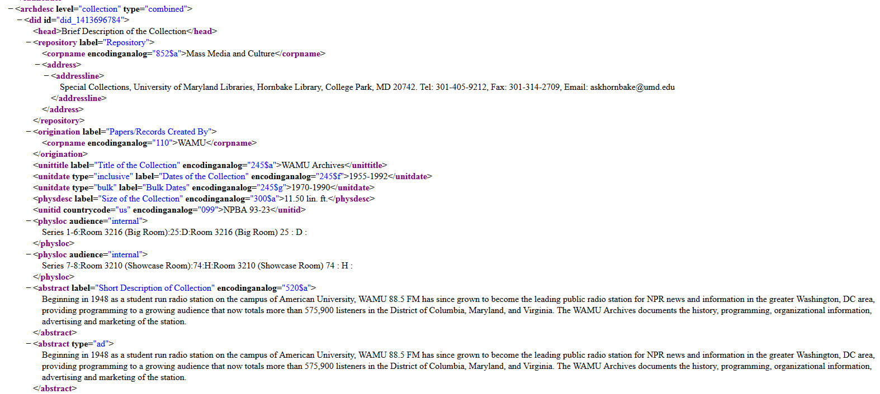
Standards: EAD

Slide 31
Standards: EAD
Drawbacks to EAD: a 2008 survey found that nearly 50% or respondents have not adopted EAD. Barriers to adoption include:
  Lack of funding/resources
  Lack of technical skills/support
Tools exist to support this work:
  Regional consortia that host EAD repositories and can even help with encoding etc.
  Open sources tools such as Archivist’s Toolkit that export/create EAD
  Templates/EAD Cookbook (for style sheets)

Slide 32
Standards: Data Content
Describing Archives: A Content Standard (DACS)
  Adopted in 2004 (revision expected in 2013)
  Provides detailed instruction on how content should be formulated with specific descriptive elements. (25 elements total)
  Can be used at any level of description
  Designed to be compatible with data structure standards such as MARC and EAD

Slide 33
Standards: DACS
Reference Code (2.1)
Name and Location of Repository (2.2)
Title (2.3)
Date(s) (2.4)
Extent (2.5)
Names of Creator(s) (2.6)
Scope and Content (3.1)
Conditions Governing Access (4.1)
Language and Scripts of the Material (4.5)

Slide 34
Standards: DACS
Title Element (2.3)
  Example: Thirteen/WNET Arthur Godfrey Collection (original)
  DACS:
  Arthur Godfrey papers
  Questions to ask:
  Who is primarily responsible for the creation, assembly, accumulation of the material?
  Is the material a function of an individual’s activity or was it intentionally assembled?

Slide 35
DACS and Sound Recordings
DACS does not specify rules based on format and instead points to companion standard when format specific information is needed.
For sound recordings see:
  RDA
  IASA Cataloging Rules
  Example: Extent (DACS 2.5) use IASA
  12 audio cassettes (DACS)
  12 sound cassettes (IASA)

Slide 36
Outline
Introduction
Archival Principles and Practices
Arrangement and Description of Archival Material
  Exercise: common arrangement schemes
Access and Discovery of Archival Material
  Standards and Best Practices
  Discovery Tools and Methods

Slide 37
Discovery & Access or Where Can I Find Archival Material?
Library Catalogs
EAD delivery systems
Databases
Websites
Digital Collections
“Use is the end of all archival effort”
Theodore Schellenberg

Slide 38
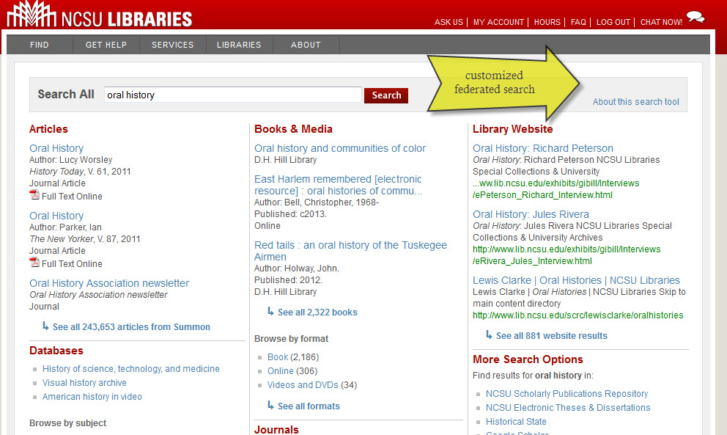
Discovery: Library Catalogs

Slide 39
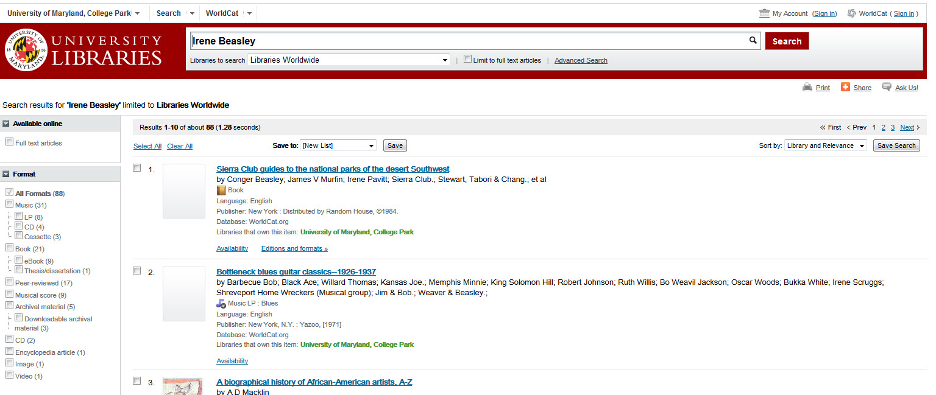
Discovery: Library Catalogs

Slide 40
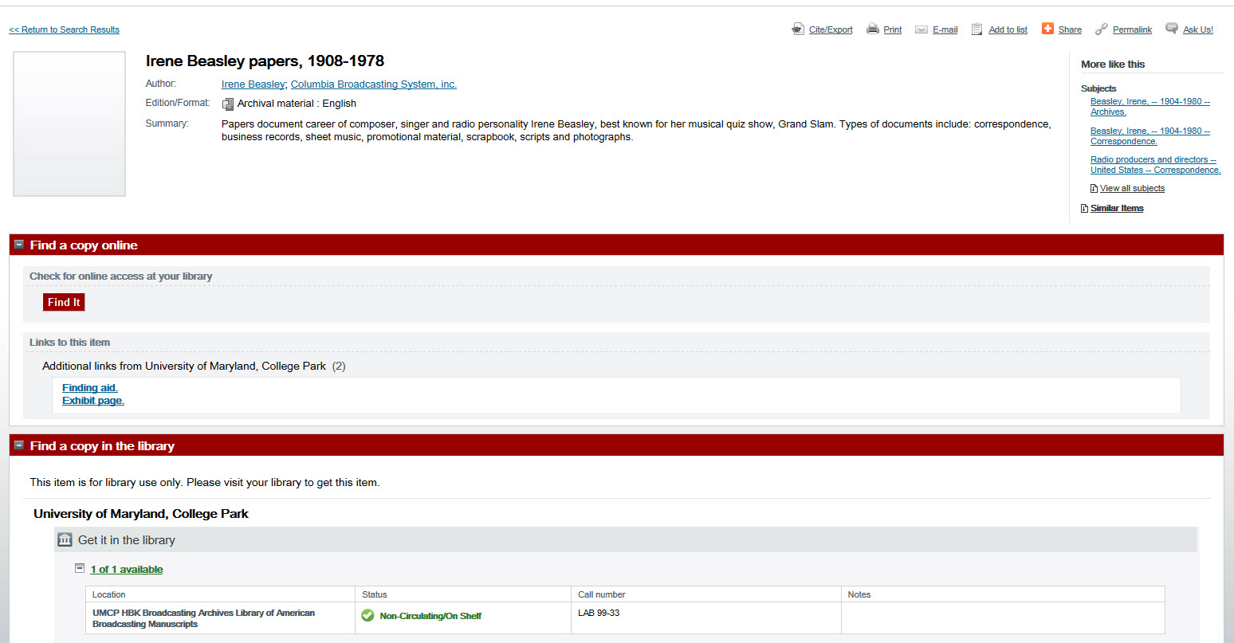
Discovery: Library Catalogs

Slide 41
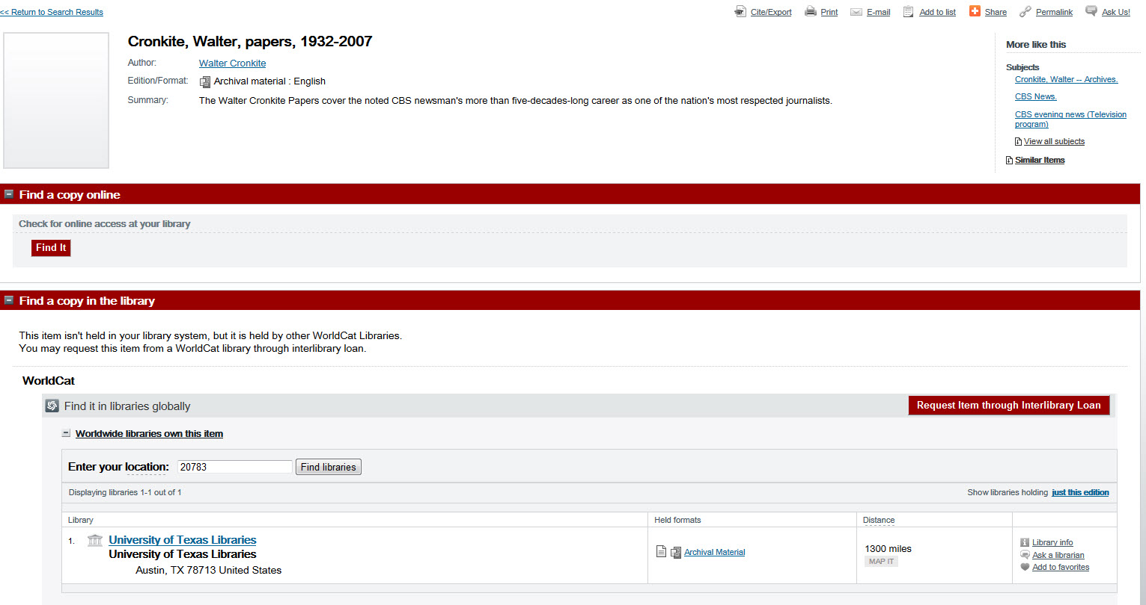
Discovery: Library Catalogs

Slide 42
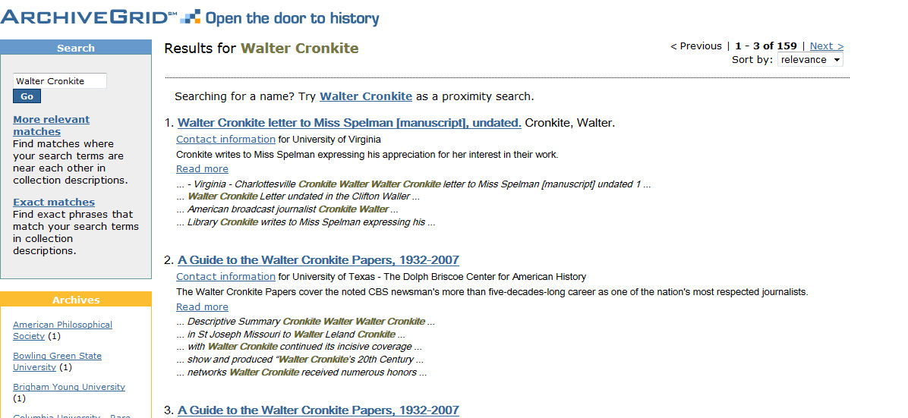
Discovery: Archive Grid

Slide 43
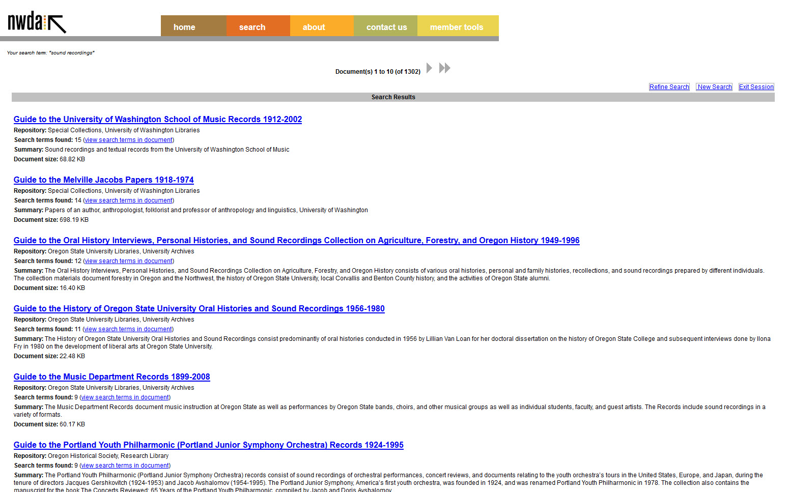
Discovery: EAD Delivery Systems

Slide 44
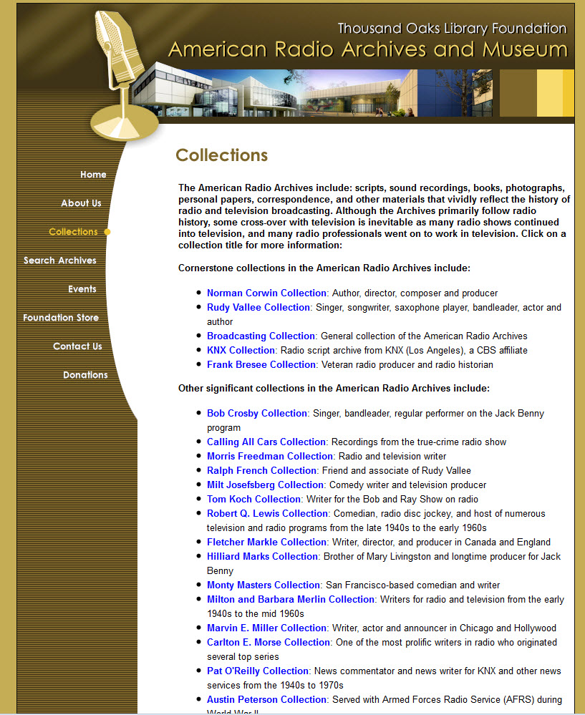
Discovery Beyond the Catalog: Websites

Slide 45
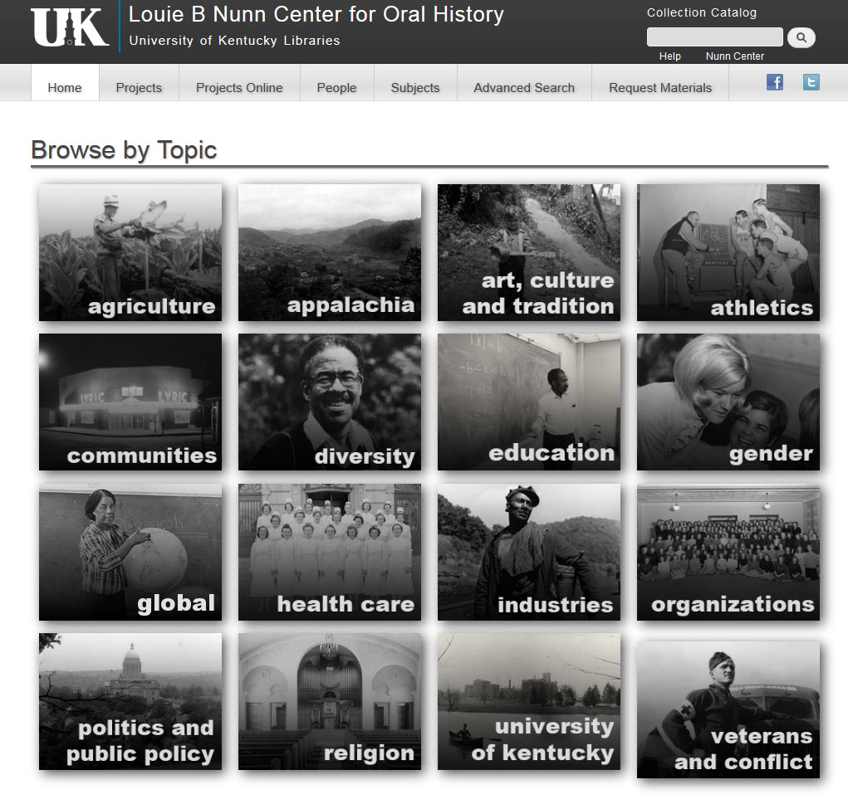
Beyond the Catalog: Databases

Slide 46
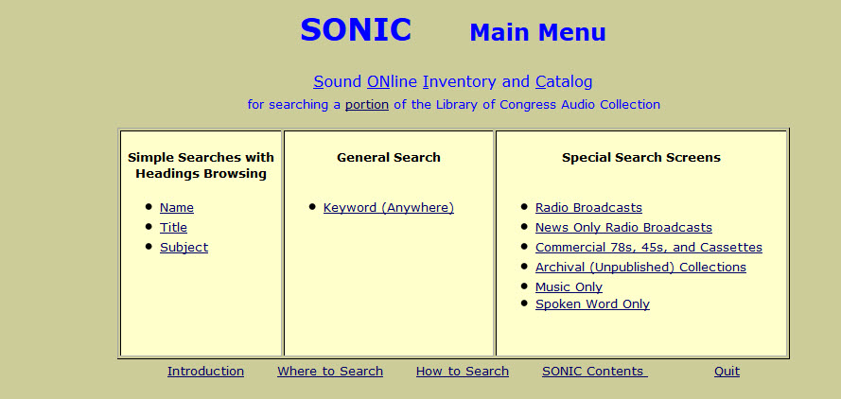
Beyond the Catalog: Databases

Slide 47

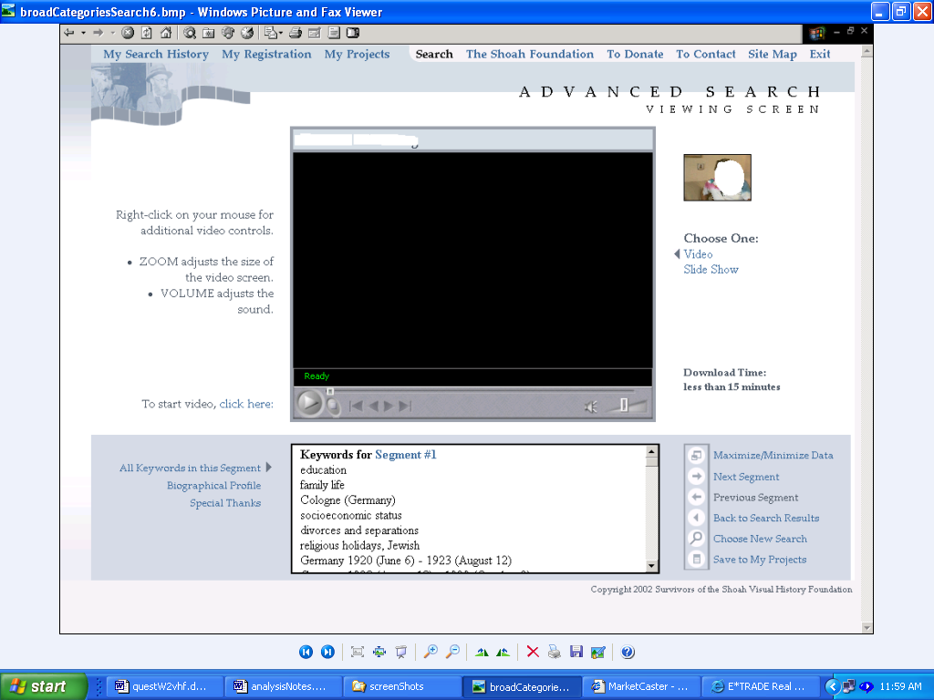

Beyond the Catalog: Databases

Slide 48
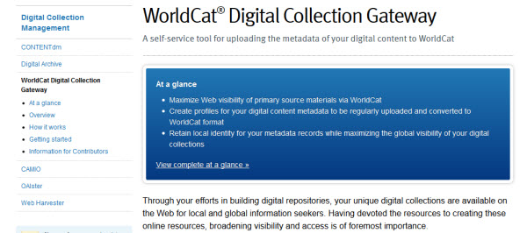
Discovery: Digitization
Digital Repositories
  ContentDm
  Fedora/DSpace
  Internet Archive
Digitization often requires item level description for many formats

Slide 49
Conclusion
Backlogs are with us for the long-term
Determine priorities for processing based on research value and needs of collection
Decide policy on descriptive levels and standards
  Processing manuals: University of Maryland; Yale University; Wright State University
Develop criteria for when further processing is needed

Slide 50
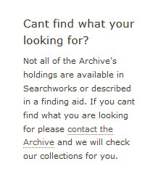
Conclusion: It’s all in the archives but where?
Words to Live By……..
From Stanford University Libraries, Archive of Record Sound Website

