Slide 1
Framework for Small Crack Propagation and Detection Joint Modeling Using Gaussian Process Regression
Dissertation Defense
August 22nd, 2017
PhD Candidate:
Reuel Smith
Dissertation Advisor:
Professor Mohammad Modarres
Committee Members:
Professor Enrique López Droguett
Professor Aris Christou
Professor Monifa Vaughn-Cooke
Dean’s Representative:
Professor Sung Lee

Slide 2
Overview
Introduction to Crack Propagation and Detection Research
Collection and Pre-processing of Data
Crack Propagation and Detection Methodology Description
Discussion of Results
Conclusions

Slide 3
Introduction

Slide 4
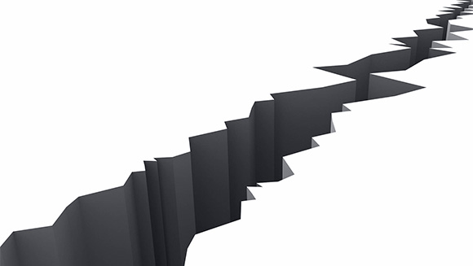
Background of Crack Propagation and Detection Research
The study of Crack Propagation and Detection (CPD) is over 60 years old and produced many models
Crack Propagation (CP) models:
  Paris, Forman, Walker
  Exponential (log-linear)
  Acoustic Emission
Crack Detection or Probability of Detection (POD) models:
  Binomial
  Lognormal
  Logistic
  Log-logistic
Mostly Empirical
Picture © ACOEM http://metravib.acoemgroup.com/dma/crack-propagation-tests

Slide 5
Background of Crack Propagation and Detection Research
Empirical Crack Propagation and Detection can be problematic. Why?
Data Uncertainty
Various detection methods, all subject to:
  Missing small cracks
  Detecting different measures of the same crack
2. Physical Variability Uncertainty
Loading and material properties that affect crack shape are variable
  Example: A test frequency of 5 Hz may actually range +/- 0.1 Hz
3. Model Uncertainty/Error
All models subject to error: No exceptions
  Some models have more error than others
“Is the model true?” If “truth” is to be the “whole truth” the answer must be “No.” The only question of interest is “Is the model illuminating and useful?”
George Box, 1979
Notes:
Three uncertainties
Data Uncertainty
Comes from failings in different detection methods which include missing really small flaws and detecting a different flaw size with a different method
Physical Variability Uncertainty
Crack shaping factors are not static in real life
Loading and material properties that effect the crack shape can vary
Model Uncertainty/Error
All models will have error, but some will have more error than others

Slide 6
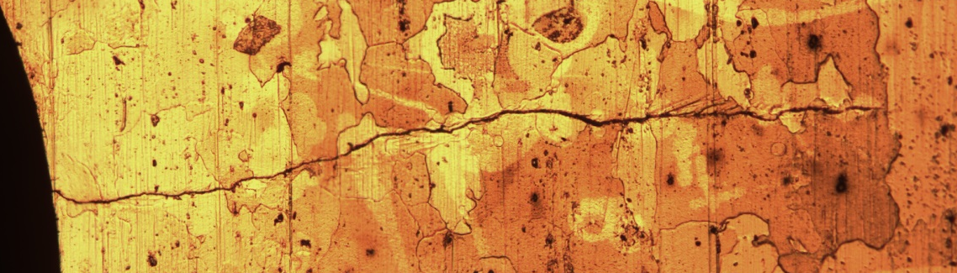
Accounting for Uncertainties
Apply measurement error correction to the CP data
Select a CP model that accounts for as many shaping properties that contribute to the crack shape
  The Gaussian Process Regression (GPR) CP model depicts this relation between the crack shape and multiple Crack Shaping Factors (CSF)
  Definition: Loading and/or material based input properties that have direct bearing on the shape, length, and propagation of the crack
Represent the variation of CSFs as distributions
Force,
Load Ratio,
and Load Frequency
Grain size
Inclusion size
Crack length a
Notes:
Application of measurement error of CP data
Representing the variation of CSFs as distributions
A CP that accounts for all input properties contributing to crack shape
Define CSFs
Bring up the GPR CP model which

Slide 7
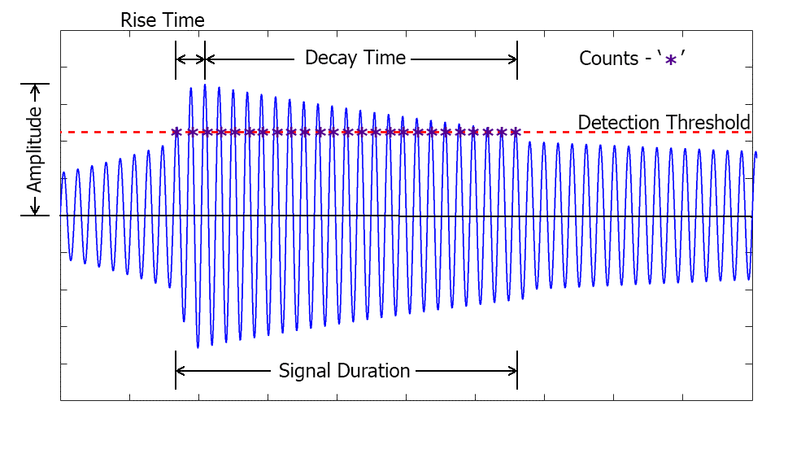
Previous Research
Fatigue testing research has been conducted by several of our own students from the
Center of Risk and Reliability at the University of Maryland. Much of the CP research included application of Acoustic Emission (AE) signals.
Acoustic Emission Testing
  Definition: A non-destructive testing (NDT) technique that detects generated energy within a material
  Has been shown to detect and monitor the growth of cracks by way of certain AE signals:
    Cumulative Counts (C)
    Cumulative Amplitude (A)

Slide 8
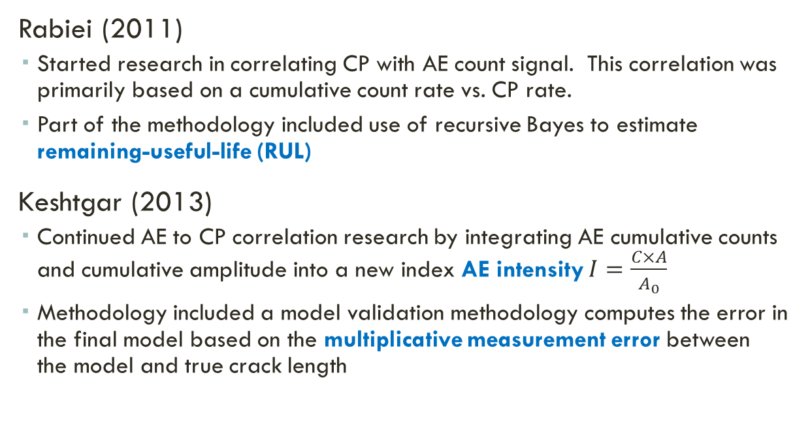

Previous Research
Rabiei (2011)
  Started research in correlating CP with AE count signal. This correlation was primarily based on a cumulative count rate vs. CP rate.
  Part of the methodology included use of recursive Bayes to estimate remaining-useful-life (RUL)
Keshtgar (2013)
  Continued AE to CP correlation research by integrating AE cumulative counts and cumulative amplitude into a new index AE intensity $I=\frac{C×A}{A_{0}}$
  Methodology included a model validation methodology computes the error in the final model based on the multiplicative measurement error between the model and true crack length
$$a\left(N\right)=αI\left(N\right)+β$$

Slide 9
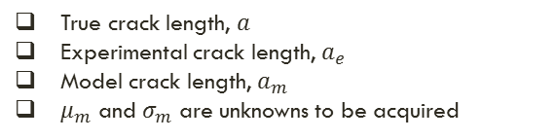
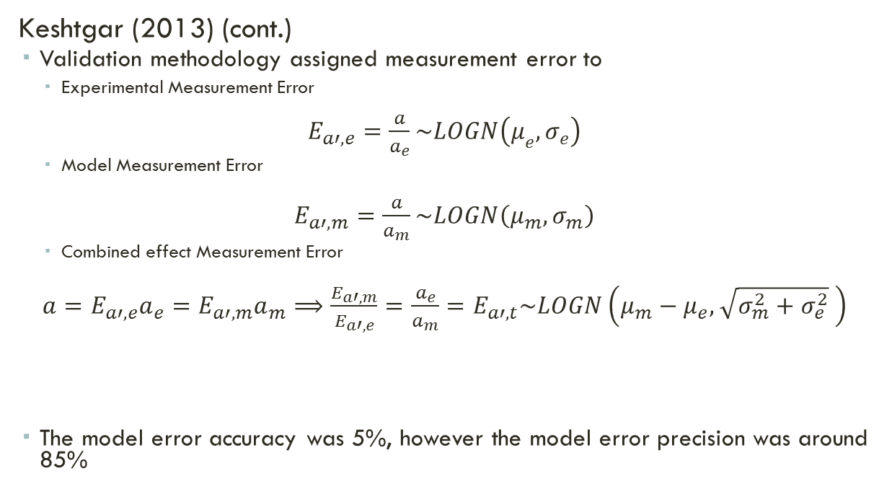
Previous Research
Keshtgar (2013) (cont.)
  Validation methodology assigned measurement error to
    Experimental Measurement Error
$E_{a′,e}=\frac{a}{a_{e}}\sim LOGN\left(μ_{e},σ_{e}\right)$
    Model Measurement Error
$E_{a′,m}=\frac{a}{a_{m}}\sim LOGN\left(μ_{m},σ_{m}\right)$
    Combined effect Measurement Error
$a=E_{a′,e}a_{e}=E_{a′,m}a_{m}⟹\frac{E_{a′,m}}{E_{a′,e}}=\frac{a_{e}}{a_{m}}=E_{a′,t}\sim LOGN\left(μ_{m}−μ_{e},\sqrt{σ_{m}^{2}+σ_{e}^{2}} \right)$
  The model error accuracy was 5%, however the model error precision was around 85%
$$a\left(N\right)=αI\left(N\right)+β$$
True crack length, $a$
Experimental crack length, $a_{e}$
Model crack length, $a_{m}$
$μ_{m}$ and $σ_{m}$ are unknowns to be acquired

Slide 10
Research Objectives
Design a methodology that can determine the level of realism that is present in CPD models
  Consider the relation between the CP and POD model and treat as a jointly integrated model
  Account for the uncertainties associated with all the CPD models
Compile and assess a list of relevant CSFs that contribute to CPD
  An extensive list, but only a few CSFs were examined for this research
Establish a relationship between CSFs and CPD parameters and the CPD model
Demonstrate the relationship between CSFs to the remaining-useful-life (RUL)
  From the CSF-to-CPD relationship, this demonstrates the potential for the methodology in predicting CPD behavior based on a unique set of CSFs

Slide 11
Data Collection and Pre-Processing

Slide 12
Fatigue Testing
Data collected:
  In-test photos of crack propagation area
  Post-test photo of crack propagation area
  (high magnification)
  AE data
  CSFs
    Load Conditions: Frequency, Force, and Load Ratio
    Material Properties: Mean Grain and Inclusion Diameters
Dog-bone specimens for fatigue testing
  Made of Al 7075-T6
  Geometries based on ASTM standards
Photo © of Azadeh Keshtgar, 2015
Notes:
Not necessary to include specimen dimensions, but may be necessary to include the loading condition ranges
Pass out specimen samples at this point and describe the MTS process

Slide 13
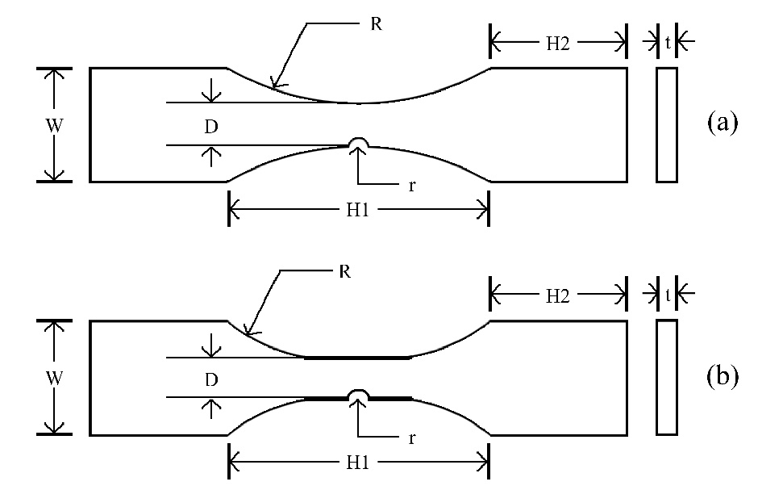
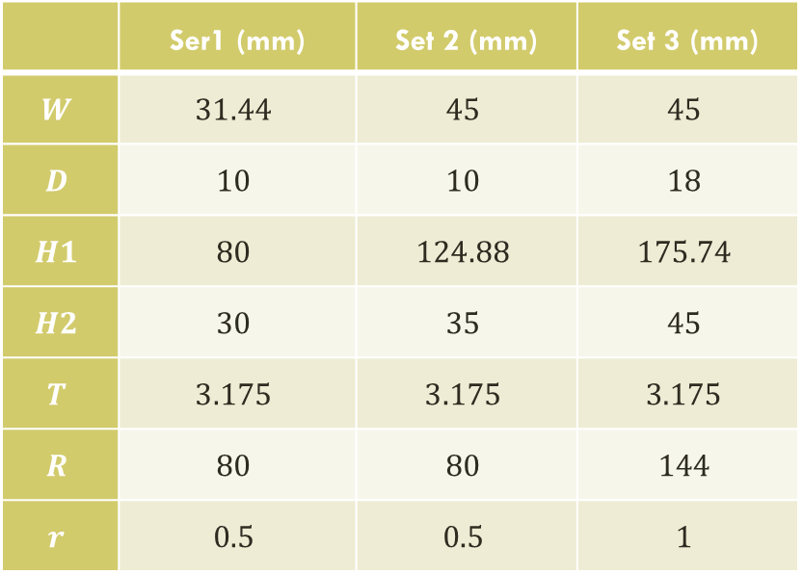
Fatigue testing
Set 1: DB3, DB4, DB5, DB6, DB7, DB15 (6)
Set 2: 1A2, 1B3 (2)
Set 3: 5A2, 5A3, 5A4, 5A6, 5A8, 5A9, 5A10, 5A20, 5A21, 5A22, 5A23, 5A24, 5A25, 5A26 (14)
Dog bone Specimen Geometries
 | Ser1 (mm) | Set 2 (mm) | Set 3 (mm)
$$W$$ | $$31.44$$ | $$45$$ | $$45$$
$$D$$ | $$10$$ | $$10$$ | $$18$$
$$H1$$ | $$80$$ | $$124.88$$ | $$175.74$$
$$H2$$ | $$30$$ | $$35$$ | $$45$$
$$T$$ | $$3.175$$ | $$3.175$$ | $$3.175$$
$$R$$ | $$80$$ | $$80$$ | $$144$$
$$r$$ | $$0.5$$ | $$0.5$$ | $$1$$
Set1
Sets 2 & 3
Notes:
6, 2, and 13 respectively

Slide 14
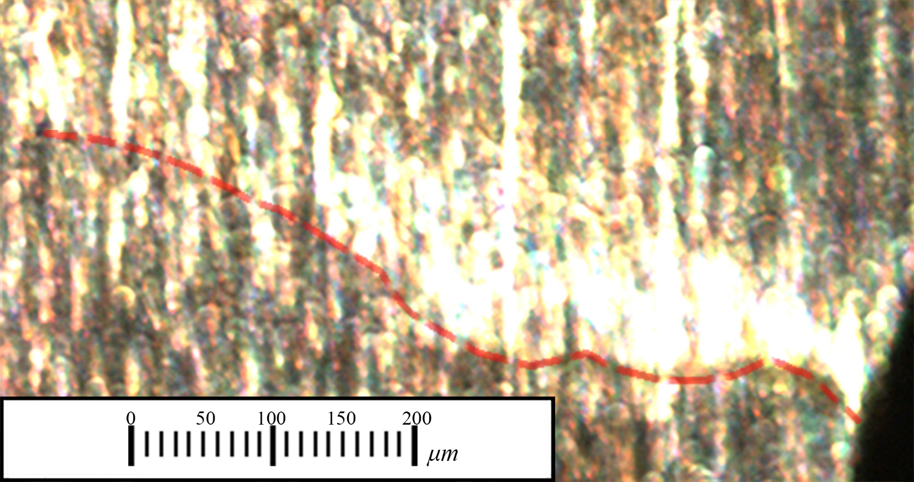
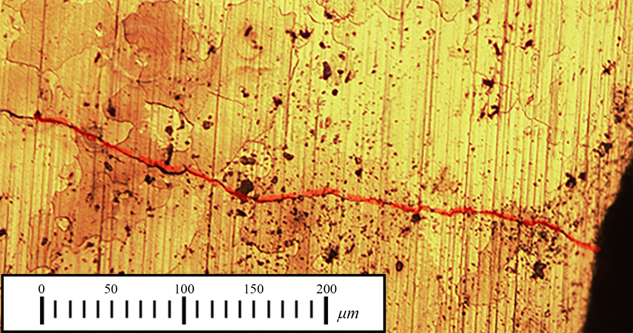
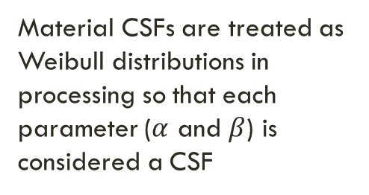
Fatigue Testing
That’s 335 photos average!
Mean Grain Diameter
Mean Inclusion Diameter
Crack Length (True and Measured)
Material CSFs are treated as Weibull distributions in processing so that each parameter ($α$ and $β$) is considered a CSF
Notes:
Detail the crack length, grain diameter, and the inclusions on this slide too through an animation

Slide 15
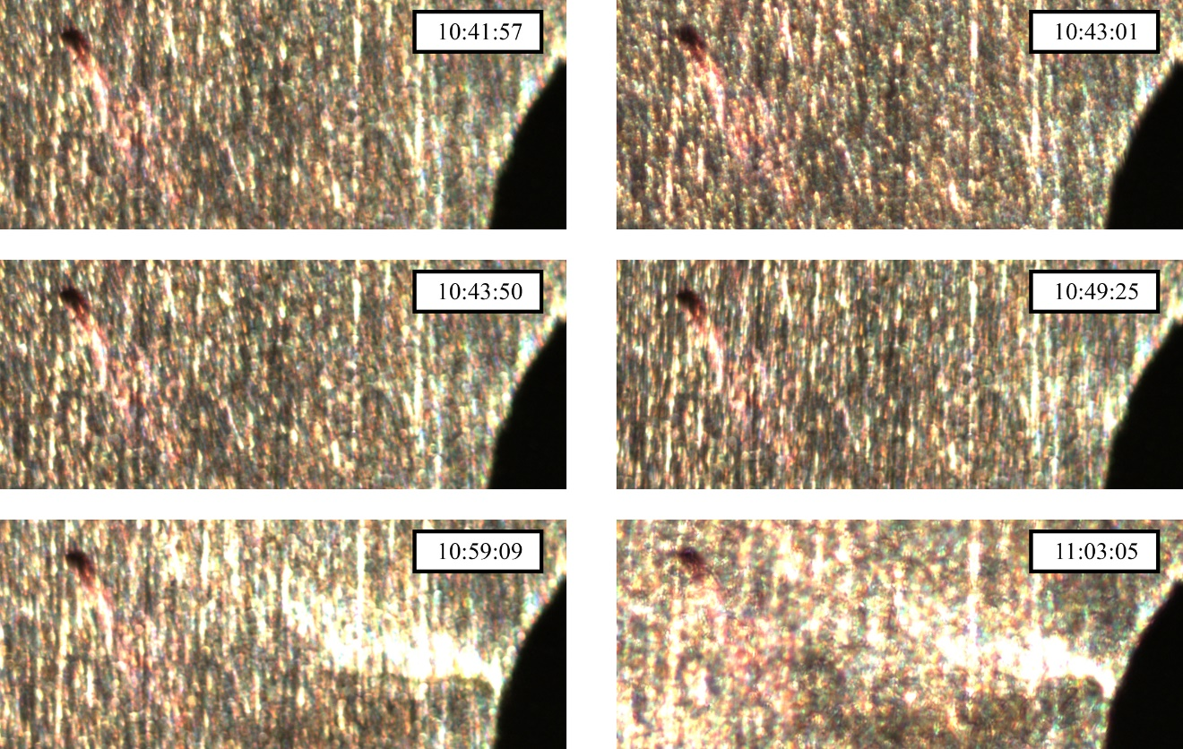
Fatigue Testing
Example of Time Lapse Crack Detection

Slide 16
Crack Propagation and Detection Methodology

Slide 17
Methodology Flowchart
Loading Conditions
Crack Propagation (CP) Model
Material Properties
Log-linear CP Parameter Distribution
AE CP Parameter Distribution
GPR CP Parameter Distribution
PFGPR CP Parameter Distribution
False Detection Probability
Distribution
Updated CPD Parameter Distribution
Measurement Error
Bayesian Inference of Integrated CPD Model
Crack Propagation Data
CSF-to-CPD Correlation
Lognormal POD Parameter Distribution
Log-logistic POD Parameter Distribution
Logistic POD Parameter Distribution
Weibull POD Parameter Distribution
Acoustic Emission Signals
Model Error
CSF-to-CPD Model Parameters
Crack Detection (POD) Model
Validation CSFs
Estimated RUL

Slide 18
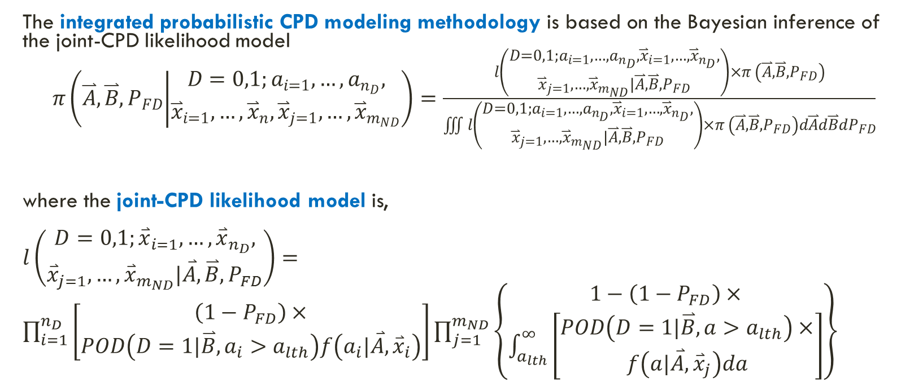
Bayesian Inference of Joint-CPD Model
The integrated probabilistic CPD modeling methodology is based on the Bayesian inference of the joint-CPD likelihood model
$π\left(\overset{⃑}{A},\overset{⃑}{B},P_{FD} | \begin{aligned}D=0,1;a_{i=1},…,a_{n_{D}}, \\ {\overset{⃑}{x}}_{i=1},…,{\overset{⃑}{x}}_{n},{\overset{⃑}{x}}_{j=1},…,{\overset{⃑}{x}}_{m_{ND}}\end{aligned}\right)=\frac{l\left(\begin{aligned}D=0,1;a_{i=1},…,a_{n_{D}},{\overset{⃑}{x}}_{i=1},…,{\overset{⃑}{x}}_{n_{D}}, \\ {\overset{⃑}{x}}_{j=1},…,{\overset{⃑}{x}}_{m_{ND}}|\overset{⃑}{A},\overset{⃑}{B},P_{FD}\end{aligned}\right)×π \left(\overset{⃑}{A},\overset{⃑}{B},P_{FD}\right)}{\iiint{l\left(\begin{aligned}D=0,1;a_{i=1},…,a_{n_{D}},{\overset{⃑}{x}}_{i=1},…,{\overset{⃑}{x}}_{n_{D}}, \\ {\overset{⃑}{x}}_{j=1},…,{\overset{⃑}{x}}_{m_{ND}}|\overset{⃑}{A},\overset{⃑}{B},P_{FD}\end{aligned}\right)×π \left(\overset{⃑}{A},\overset{⃑}{B},P_{FD}\right)d\overset{⃑}{A}d\overset{⃑}{B}dP_{FD}}}$
where the joint-CPD likelihood model is,
$l\left(\begin{aligned}D=0,1;{\overset{⃑}{x}}_{i=1},…,{\overset{⃑}{x}}_{n_{D}}, \\ {\overset{⃑}{x}}_{j=1},…,{\overset{⃑}{x}}_{m_{ND}}|\overset{⃑}{A},\overset{⃑}{B},P_{FD}\end{aligned}\right)=\prod_{i=1}^{n_{D}}{\left[\begin{aligned}\left(1−P_{FD}\right)× \\ POD\left(D=1|\overset{⃑}{B},a_{i}>a_{lth}\right)f\left(a_{i}|\overset{⃑}{A},{\overset{⃑}{x}}_{i}\right)\end{aligned}\right]}\prod_{j=1}^{m_{ND}}{\left\{\begin{aligned}1−\left(1−P_{FD}\right)× \\ \int_{a_{lth}}^{∞}{\left[\begin{aligned}POD\left(D=1|\overset{⃑}{B},a>a_{lth}\right)× \\ f\left(a|\overset{⃑}{A},{\overset{⃑}{x}}_{j}\right)da\end{aligned}\right]}\end{aligned}\right\}}$

Slide 19
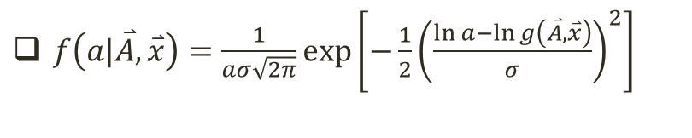
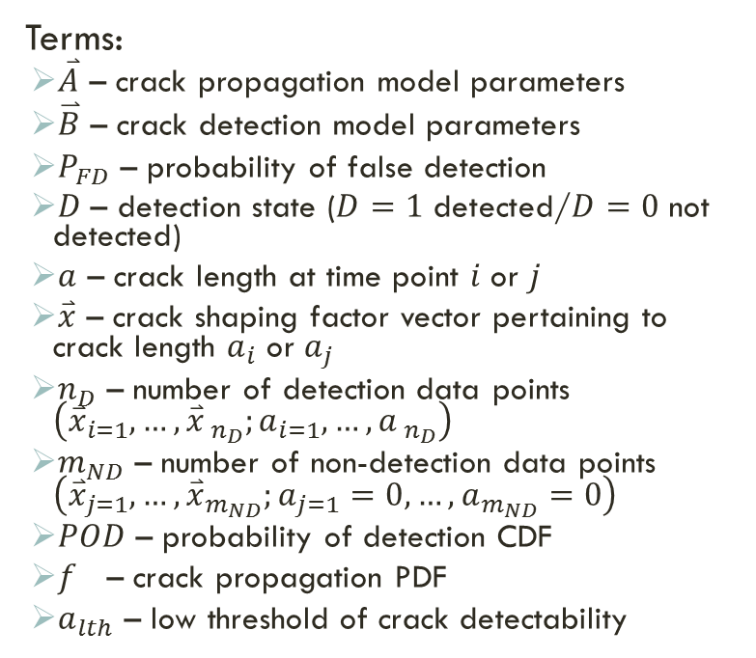

Bayesian Inference of Joint-CPD Model
Terms:
  $\overset{⃑}{A}$ – crack propagation model parameters
  $\overset{⃑}{B}$ – crack detection model parameters
  $P_{FD}$ – probability of false detection
  $D\text{ – }\text{detection} \text{state}\text{ (}D=1 \text{detected}\text{/}D=0 \text{not} \text{detected}\text{)}$
  $a$ – crack length at time point $i$ or $j$
  $\overset{⃑}{x}$ – crack shaping factor vector pertaining to crack length $a_{i}$ or $a_{j}$
  $n_{D}$ – number of detection data points $\left({\overset{⃑}{x}}_{i=1},…,{\overset{⃑}{x}}_{ n_{D}};a_{i=1},…,a_{ n_{D}}\right)$
  $m_{ND}$ – number of non-detection data points $\left({\overset{⃑}{x}}_{j=1},…,{\overset{⃑}{x}}_{m_{ND}};a_{j=1}=0,…,a_{m_{ND}}=0\right)$
  $POD$ – probability of detection CDF
  $f$ – crack propagation PDF
  $a_{lth}$ – low threshold of crack detectability
$\overset{⃑}{Θ}={\left[\overset{⃑}{A},\overset{⃑}{B},P_{FD}\right]}^{T}$
Target parameter set for Bayesian updating
$f\left(a|\overset{⃑}{A},\overset{⃑}{x}\right)=\frac{1}{aσ\sqrt{2π}}\exp\left[−\frac{1}{2}{\left(\frac{\ln{a}−\ln{g\left(\overset{⃑}{A},\overset{⃑}{x}\right)}}{σ}\right)}^{2}\right]$
where $g\left(\overset{⃑}{A},\overset{⃑}{x}\right)$ is the CP model and $σ$ is the standard deviation

Slide 20

Crack Propagation Model Choices
Gaussian Process Regression CP Model
  $a=g\left(\overset{⃑}{x}\right)=g\left(\left[\begin{matrix}{CSF}_{1} & {CSF}_{2} & ⋯ & {CSF}_{Q}\end{matrix}\right]\right)$
Crack Length (μm) |  | Growth Model Parameters | Fatigue Cycles | Min Load(N) | Max Load (N) | Load Ratio | Frequency (Hz) | Mean Grain Diameter α (μm) | Mean Grain Diameter β | Mean Inclusion Diameter α (μm) | Mean Inclusion Diameter β
Output:
Crack Length (μm)
Input:
Loading and Material CSFs
Model Parameters

Slide 21

Crack Propagation Model Choices
The Kernel Function for the GPR and PF/GPR CPD Analyses
$k\left({\overset{⃑}{x}}_{i},{\overset{⃑}{x}}_{j},\overset{⃑}{A}\right)=g_{1}+\sum_{q=1}^{9}{g_{q+1}{\overset{⃑}{x}}_{i,q}{\overset{⃑}{x}}_{j,q}}+g_{20}\exp\left[−\sum_{q=1}^{9}{g_{q+10}{\left({\overset{⃑}{x}}_{i,q}−{\overset{⃑}{x}}_{j,q}\right)}^{2}}\right]+g_{22}\sin^{−1}{\frac{g_{21}\sum_{q=1}^{9}{x_{i,q}x_{j,q}}}{\sqrt{{\left(1+g_{21}\sum_{q=1}^{9}{x_{i,q}x_{j,q}}\right)}^{2}}}}+g_{23}δ_{i,j}$
  where $\overset{⃑}{A}$ is a twenty-three-parameter model parameter set vector $\left[g_{1},g_{2},…,g_{23}\right]$
Constant bias or offset component
Linear component
Squared Exponential component
Neural Network component
Noise component
Notes:
A kernel is a function that is designed to correlate the input and the output data in a GPR model

Slide 22







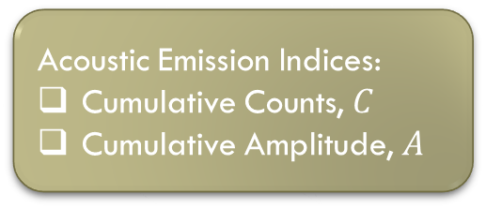
Crack Propagation Model Choices
Particle Filtering (PF) GPR CP Model
  $a=g\left(\overset{⃑}{x}\right)=g\left(\left[\begin{matrix}{CSF}_{1} & {CSF}_{2} & ⋯ & {CSF}_{Q}\end{matrix}\right]\right)$
Acoustic Emission Indices:
Cumulative Counts, $C$
Cumulative Amplitude, $A$
$$A_{r−1},$$
$$C_{r−1}$$
$$A_{r},$$
$$C_{r}$$
Observed values
$$a_{r−1}$$
$$a_{r}$$
$$a_{r+1}$$
Unobserved value
Unobserved Crack Lengths
Time-step, $r$
Notes:
The final CP model based on particle filtering (PF), a recursive Bayesian estimation technique that is suited for non-linear processes
Recursive Bayes estimation is a probabilistic inference method in which a set of unobserved values are estimated based on a set of observed values
The dynamic state-space representation of the particle filtering propagation model where $r$ is a time-step

Slide 23
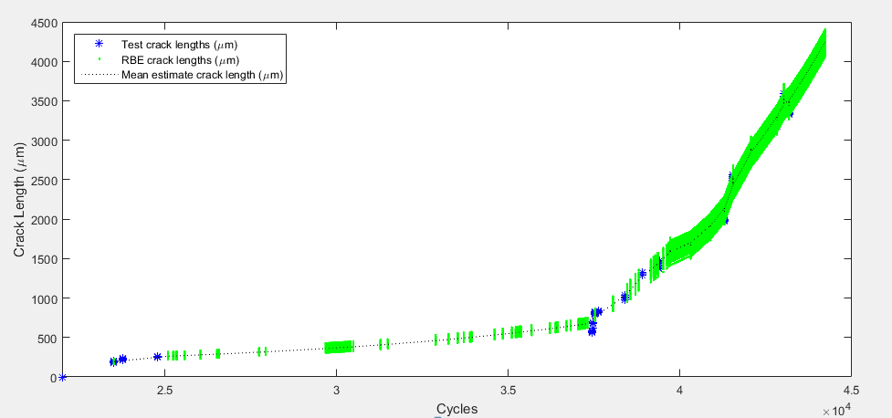
Crack Propagation Model Choices
Example of PF output
The PF output for each specimen is used in the PF/GPR model
Notes:
Add animation of plots (superimpose over the State-Space model)

Slide 24
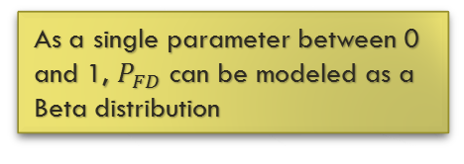
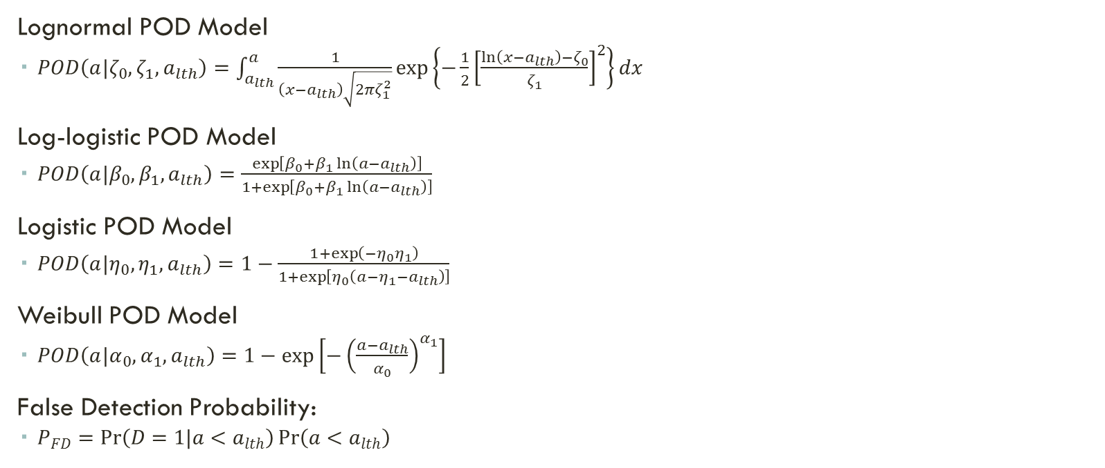
Crack Detection Model Choices
Lognormal POD Model
  $POD\left(a|ζ_{0},ζ_{1},a_{lth}\right)=\int_{a_{lth}}^{a}{\frac{1}{\left(x−a_{lth}\right)\sqrt{2πζ_{1}^{2}}}\exp\left\{−\frac{1}{2}{\left[\frac{\ln\left(x−a_{lth}\right)−ζ_{0}}{ζ_{1}}\right]}^{2}\right\}dx}$
Log-logistic POD Model
  $POD\left(a|β_{0},β_{1},a_{lth}\right)=\frac{\exp\left[β_{0}+β_{1}\ln\left(a−a_{lth}\right)\right]}{1+\exp\left[β_{0}+β_{1}\ln\left(a−a_{lth}\right)\right]}$
Logistic POD Model
  $POD\left(a|η_{0},η_{1},a_{lth}\right)=1−\frac{1+\exp\left(−η_{0}η_{1}\right)}{1+\exp\left[η_{0}\left(a−η_{1}−a_{lth}\right)\right]}$
Weibull POD Model
  $POD\left(a|α_{0},α_{1},a_{lth}\right)=1−\exp\left[−{\left(\frac{a−a_{lth}}{α_{0}}\right)}^{α_{1}}\right]$
False Detection Probability:
  $P_{FD}=\operatorname{Pr}\left(D=1|a<a_{lth}\right)\operatorname{Pr}\left(a<a_{lth}\right)$
POD Models
As a single parameter between 0 and 1, $P_{FD}$ can be modeled as a Beta distribution

Slide 25
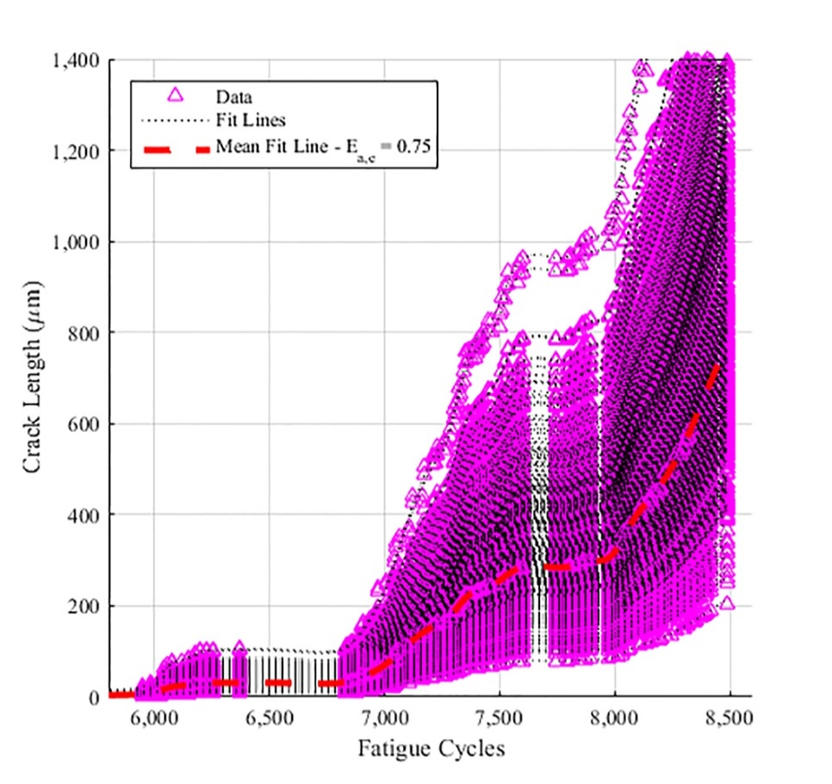
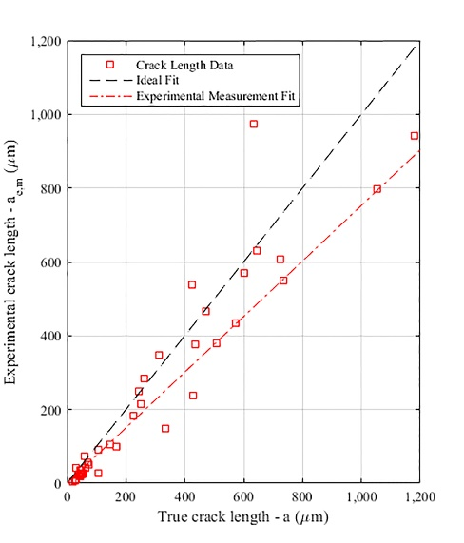

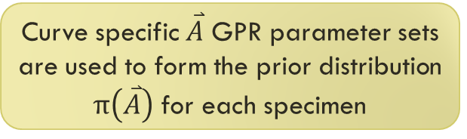
Building the Priors
Curve specific $\overset{⃑}{A}$ GPR parameter sets are used to form the prior distribution $π\left(\overset{⃑}{A}\right)$ for each specimen
Prior CP parameter set $\overset{⃑}{A}$
Raw CP Data
Measurement Error
Notes:
A prior obtained from ME and CP
B prior obtained from SR POD and AE
If asked, the stray SR POD is because of the separate treatment of the specimens (provide example inbonus slides)

Slide 26
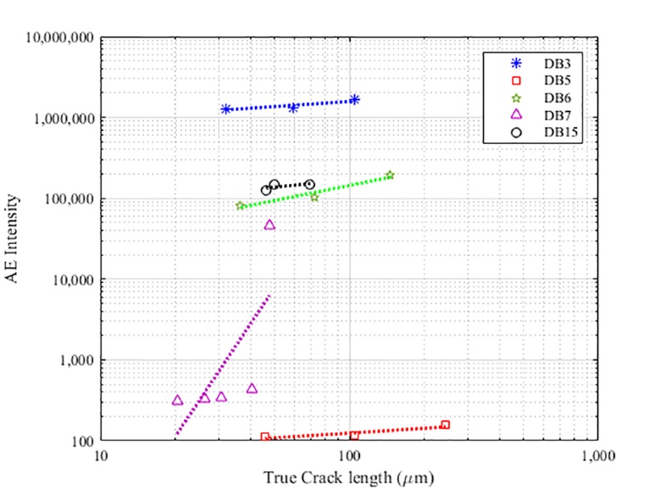

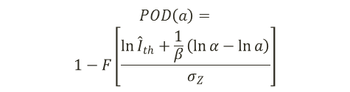
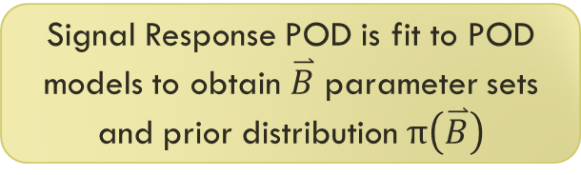

Building the Priors
Signal Response POD is fit to POD models to obtain $\overset{⃑}{B}$ parameter sets and prior distribution $π\left(\overset{⃑}{B}\right)$
Prior POD parameter set $\overset{⃑}{B}$
Acoustic Emission Data
Signal Response POD Relation
$$POD\left(a\right)=$$
$$1−F\left[\frac{\ln{{\hat{I}}_{th}}+\frac{1}{β}\left(\ln{α}−\ln{a}\right)}{σ_{Z}}\right]$$
$$I=\frac{C×A}{A_{0}}$$
Notes:
A prior obtained from ME and CP
B prior obtained from SR POD and AE
If asked, the stray SR POD is because of the separate treatment of the specimens (provide example inbonus slides)

Slide 27

Measuring the Uncertainties
$\overset{⃑}{A}=f_{\overset{⃑}{A}}\left(CSFs\right)$
$\overset{⃑}{B}=f_{\overset{⃑}{B}}\left(CSFs\right)$
$P_{FC,α}=f_{P_{FC,α}}\left(CSFs\right)$
$P_{FC,β}=f_{P_{FC,β}}\left(CSFs\right)$
CSFs:
Min/Max Force
Load ratio
Test frequency
Mean grain diameter distribution
Mean inclusion diameter distribution
Model parameters:
Crack propagation
POD
False detection probability
CSF-to-CPD Correlation:
  This procedure is reserved for a larger training set of posteriors to predict the CP and POD of a unique set of specimens
  A main part of this methodology is the validation procedure, which is done by correlation of the CSFs to each CPD posterior parameter

Slide 28
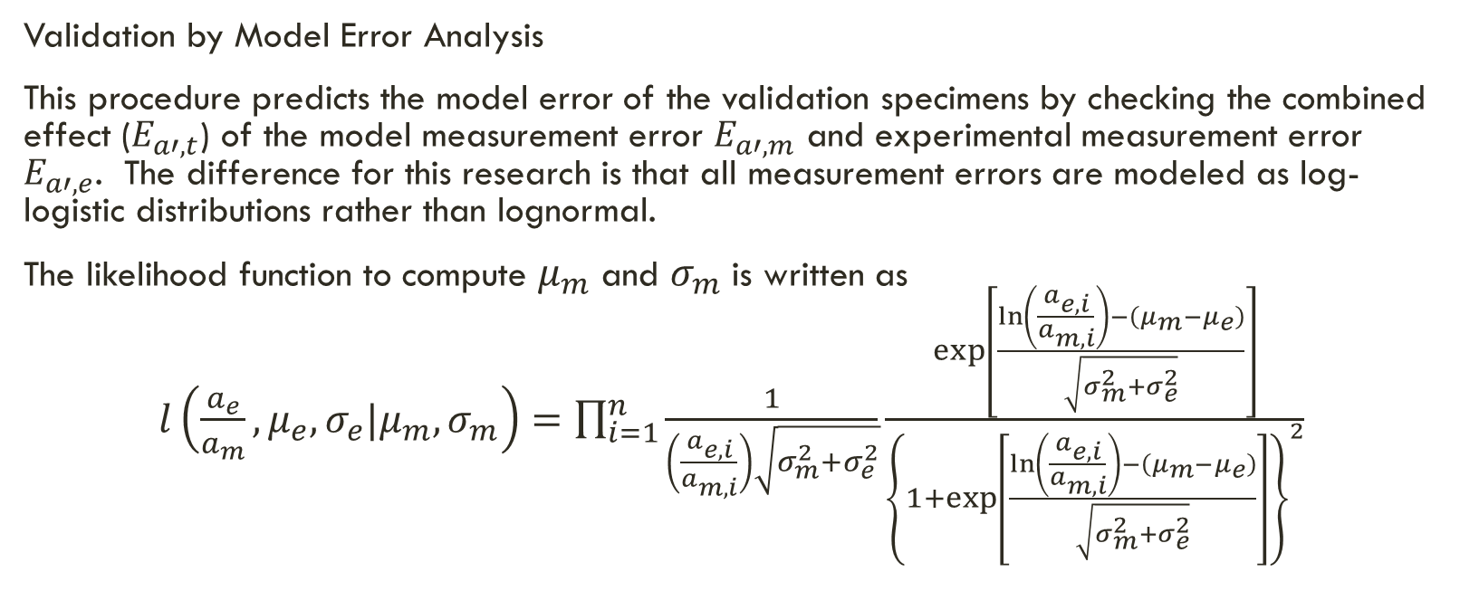
Measuring the Uncertainties
Validation by Model Error Analysis
This procedure predicts the model error of the validation specimens by checking the combined effect ($E_{a′,t}$) of the model measurement error $E_{a′,m}$ and experimental measurement error $E_{a′,e}$. The difference for this research is that all measurement errors are modeled as log-logistic distributions rather than lognormal.
The likelihood function to compute $μ_{m}$ and $σ_{m}$ is written as
$l\left(\frac{a_{e}}{a_{m}},μ_{e},σ_{e}|μ_{m},σ_{m}\right)=\prod_{i=1}^{n}{\frac{1}{\left(\frac{a_{e,i}}{a_{m,i}}\right)\sqrt{σ_{m}^{2}+σ_{e}^{2}}}\frac{\exp\left[\frac{\ln\left(\frac{a_{e,i}}{a_{m,i}}\right)−\left(μ_{m}−μ_{e}\right)}{\sqrt{σ_{m}^{2}+σ_{e}^{2}}}\right]}{{\left\{1+\exp\left[\frac{\ln\left(\frac{a_{e,i}}{a_{m,i}}\right)−\left(μ_{m}−μ_{e}\right)}{\sqrt{σ_{m}^{2}+σ_{e}^{2}}}\right]\right\}}^{2}}}$

Slide 29
Results

Slide 30
Bayesian Analysis
The Bayesian inference of this methodology was performed by a MATLAB routine that made use of two primary codes
  Metropolis Hastings command
  GPML software package
The MATLAB routine is executed for each CPD model pair under study for each of the training specimens.
The posterior results from specimen sets 1 and 2 were mainly used as priors for specimen set 3, where four of those specimens were reserved for the validation step of the methodology.

Slide 31
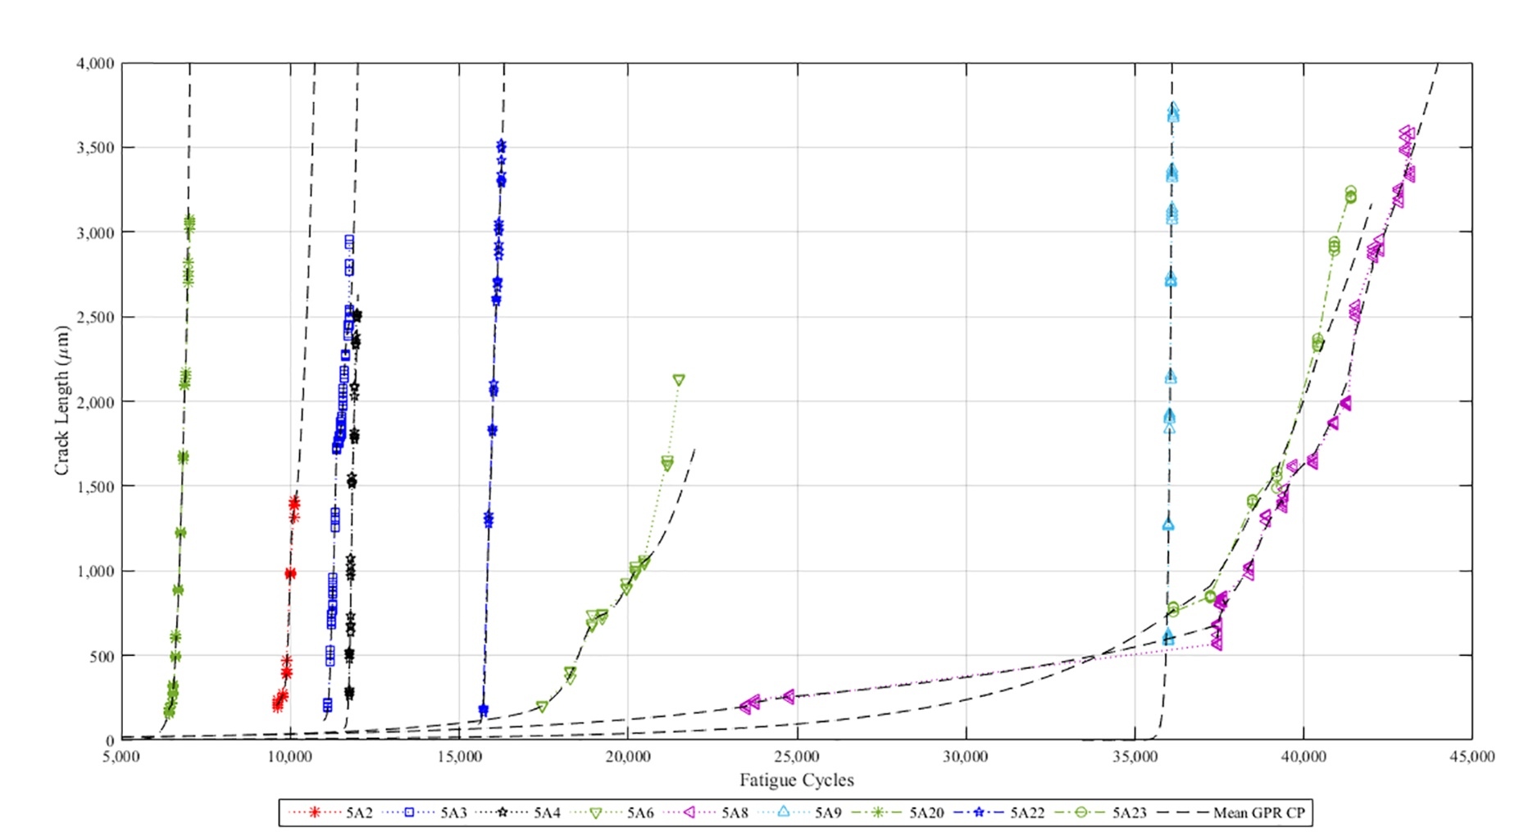
Bayesian analysis
This is an example of the posterior results for the GPR CP models

Slide 32
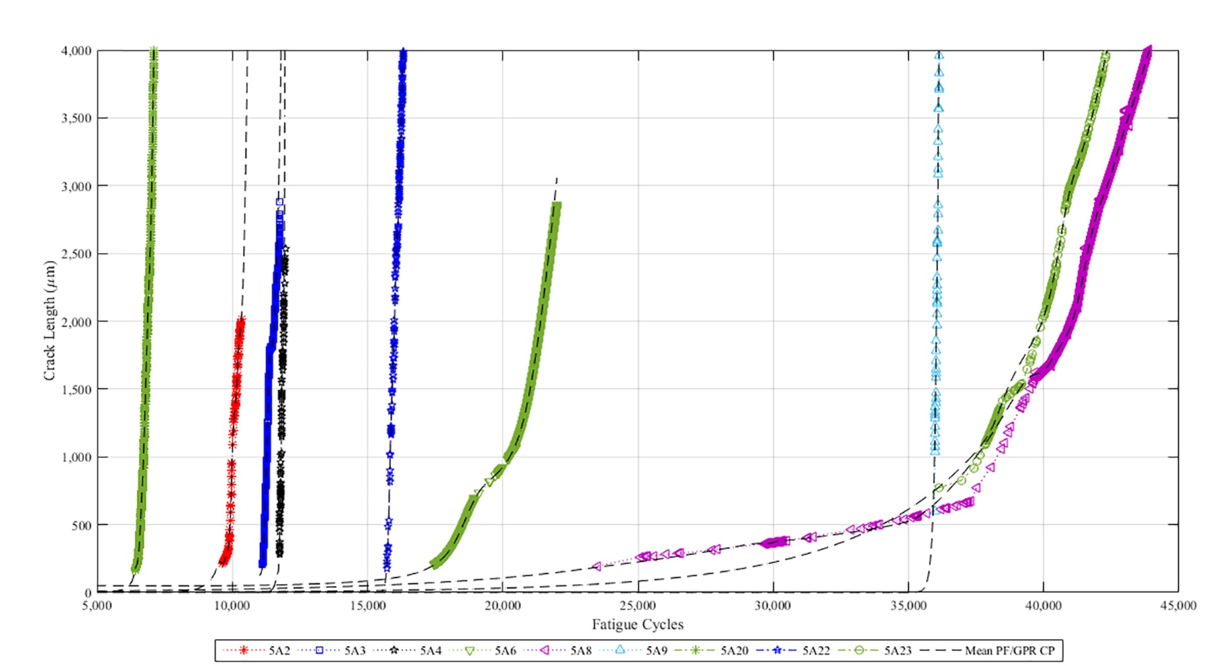
Bayesian analysis
Note that for the PF/GPR CP posteriors, the mean line is smoother because of the increase in data
  The posterior CP models were put through the CSF-to-CPD correlation method to estimate the CP models of the validation specimens: 5A10, 5A20, 5A24, and 5A26
Notes:
The stronger fit is due to the higher amount of input data that the PF/GPR model has vs. the GPR method.

Slide 33
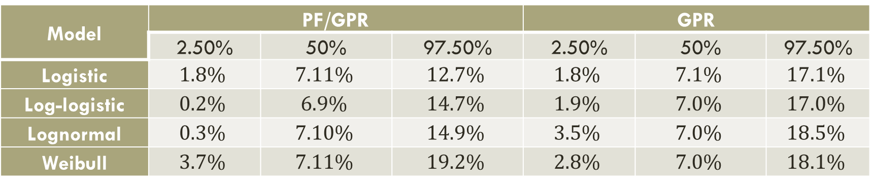
Crack Propagation Model Error and Validation
Model | PF/GPR |  |  | GPR
 | 2.50% | 50% | 97.50% | 2.50% | 50% | 97.50%
Logistic | $$1.8\%$$ | $$7.11\%$$ | $$12.7\%$$ | $$1.8\%$$ | $$7.1\%$$ | $$17.1\%$$
Log-logistic | $$0.2\%$$ | $$6.9\%$$ | $$14.7\%$$ | $$1.9\%$$ | $$7.0\%$$ | $$17.0\%$$
Lognormal | $$0.3\%$$ | $$7.10\%$$ | $$14.9\%$$ | $$3.5\%$$ | $$7.0\%$$ | $$18.5\%$$
Weibull | $$3.7\%$$ | $$7.11\%$$ | $$19.2\%$$ | $$2.8\%$$ | $$7.0\%$$ | $$18.1\%$$
The validation analysis method tests the model error associated with the CP model estimates and accounts for the associated model uncertainty
The primary findings for this step:
  Significant advantage in model error accuracy and precision
    GPR: 7.0% accuracy and 15.0-15.4% precision
    PF/GPR: 7.1% accuracy and 10.9-15.4% precision
  Addition of AE data to the GPR model improved the model error precision of the PF/GPR model
Notes:
This further validates the other finding from the previous study which is that model input directly correlates to model error precision and CP realism
The PF/GPR CP model takes advantage of much more input/output data due to the abundance of AE data that is gathered for the second set of tests
Finally, the CPD model pair with the smallest model error precision range is the PF/GPR/logistic model pair whereas the pair with the smallest model error average is the PF/GPR/log-logistic pair

Slide 34
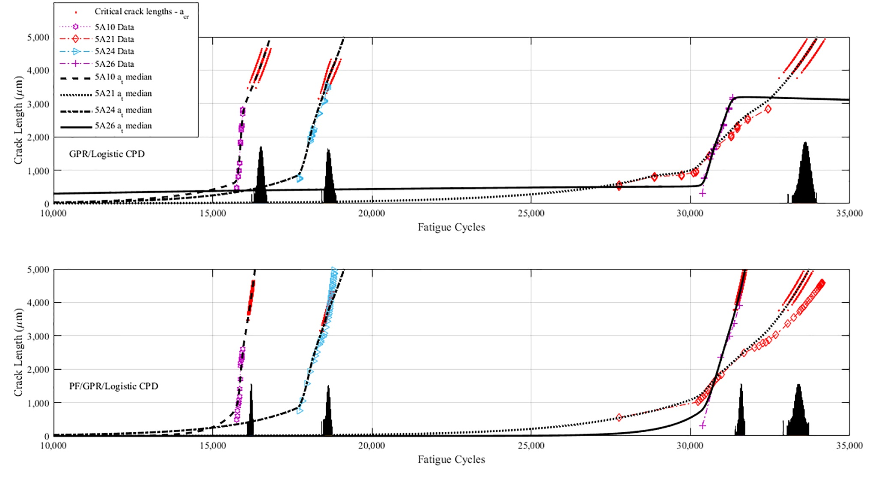
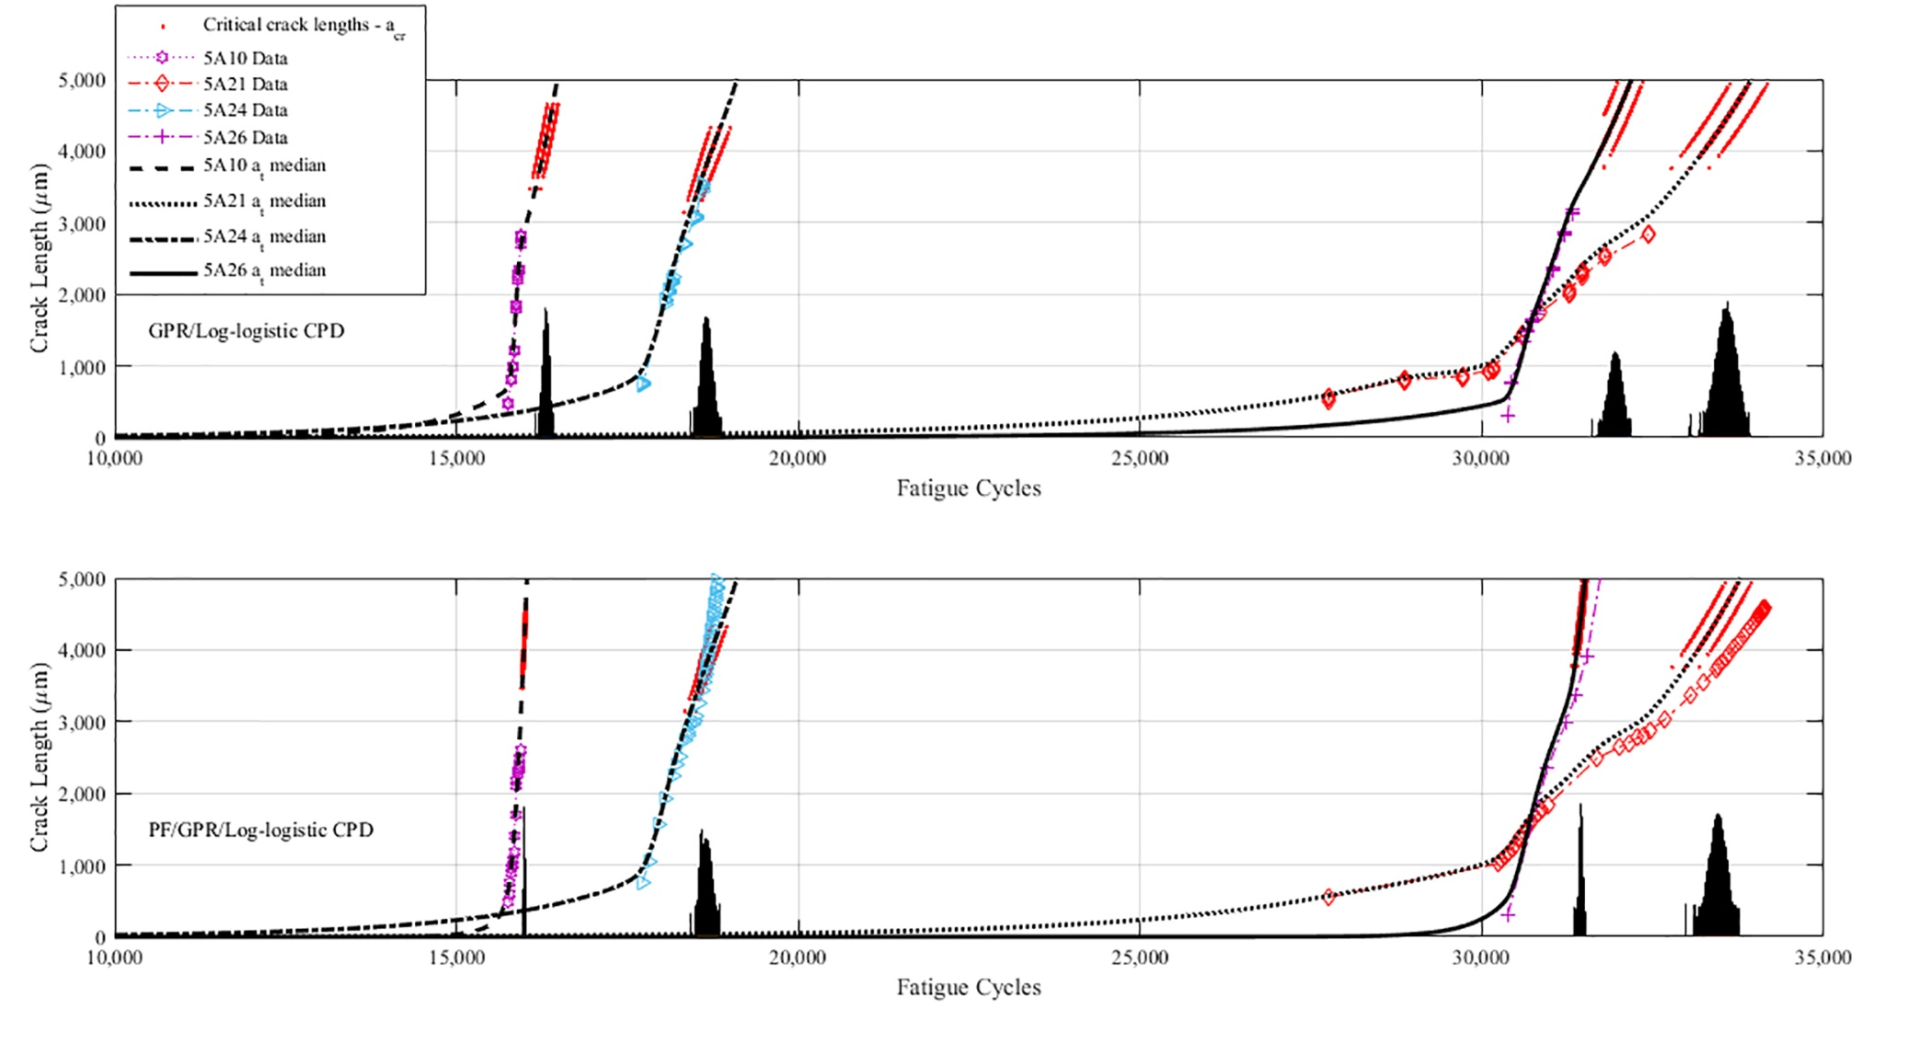
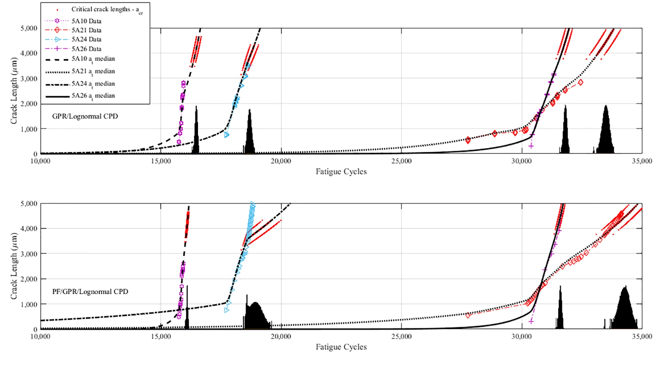
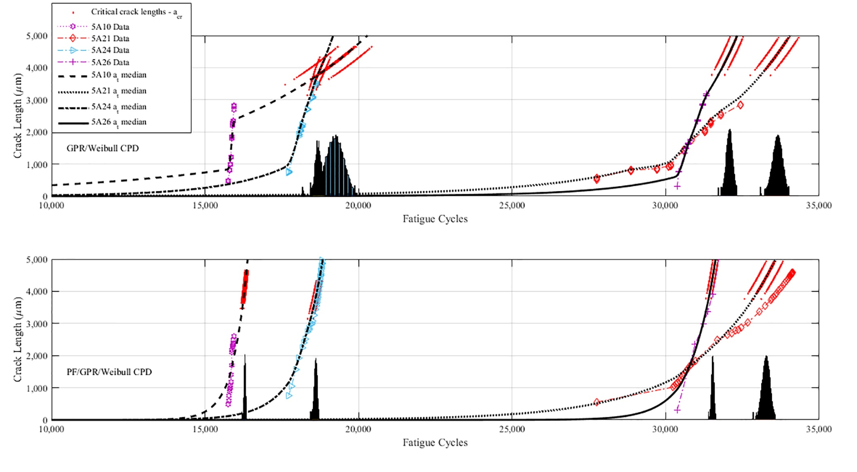
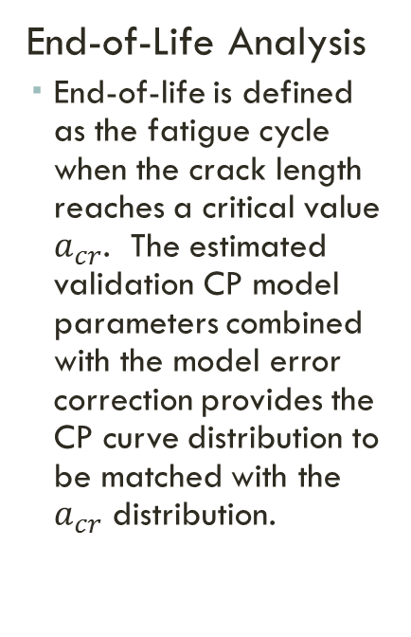
Crack Propagation Model Error and Validation
End-of-Life Analysis
  End-of-life is defined as the fatigue cycle when the crack length reaches a critical value $a_{cr}$. The estimated validation CP model parameters combined with the model error correction provides the CP curve distribution to be matched with the $a_{cr}$ distribution.

Slide 35
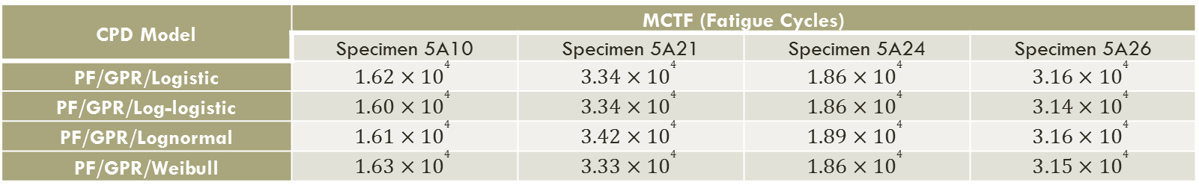
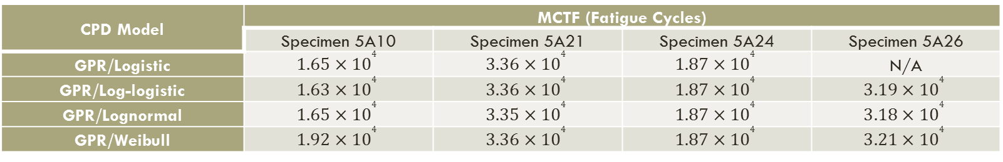
Crack Propagation Model Error and Validation
End-of-Life Analysis: Mean-cycles-to-failure (MCTF)
CPD Model | MCTF (Fatigue Cycles)
 | Specimen 5A10 | Specimen 5A21 | Specimen 5A24 | Specimen 5A26
GPR/Logistic | $$1.65×{10}^{4}$$ | $$3.36×{10}^{4}$$ | $$1.87×{10}^{4}$$ | N/A
GPR/Log-logistic | $$1.63×{10}^{4}$$ | $$3.36×{10}^{4}$$ | $$1.87×{10}^{4}$$ | $$3.19×{10}^{4}$$
GPR/Lognormal | $$1.65×{10}^{4}$$ | $$3.35×{10}^{4}$$ | $$1.87×{10}^{4}$$ | $$3.18×{10}^{4}$$
GPR/Weibull | $$1.92×{10}^{4}$$ | $$3.36×{10}^{4}$$ | $$1.87×{10}^{4}$$ | $$3.21×{10}^{4}$$
CPD Model | MCTF (Fatigue Cycles)
 | Specimen 5A10 | Specimen 5A21 | Specimen 5A24 | Specimen 5A26
PF/GPR/Logistic | $$1.62×{10}^{4}$$ | $$3.34×{10}^{4}$$ | $$1.86×{10}^{4}$$ | $$3.16×{10}^{4}$$
PF/GPR/Log-logistic | $$1.60×{10}^{4}$$ | $$3.34×{10}^{4}$$ | $$1.86×{10}^{4}$$ | $$3.14×{10}^{4}$$
PF/GPR/Lognormal | $$1.61×{10}^{4}$$ | $$3.42×{10}^{4}$$ | $$1.89×{10}^{4}$$ | $$3.16×{10}^{4}$$
PF/GPR/Weibull | $$1.63×{10}^{4}$$ | $$3.33×{10}^{4}$$ | $$1.86×{10}^{4}$$ | $$3.15×{10}^{4}$$
 | Specimen 5A10 | Specimen 5A21 | Specimen 5A24 | Specimen 5A26
Observed CTF (Fatigue Cycles) | $$1.59×{10}^{4}$$ | $$3.41×{10}^{4}$$ | $$1.95×{10}^{4}$$ | $$3.24×{10}^{4}$$

Slide 36
Crack Propagation Model Error and Validation
The proximity of the estimates to the observed CTF is overall confirmation that the CPD methodology is effective
  The few deviations in the GPR CP model show that the validation methodology is more effective when there is more data, thus validating the addition of AE data for the PF/GPR model
  The GPR CP model in this case was limited by the small number of detections made, whereas the PF/GPR CP model has many data from the AE signals
  In general, the MCTF estimate is more conservative when under the PF/GPR CPD model

Slide 37
Final Thoughts

Slide 38
Research Contributions
A new approach was proposed which groups models (crack propagation and detection) into a single integrated model for a singular Bayesian analysis
  The effect of the POD of sensor data on the CP mode was considered, resulting in the need for a joint-CPD model
An improved application of the GPR CP model was designed in which a path-wise CP model captures the true crack path and fits it to a large set of CSFs
A new CP model was developed that combines elements of GPR CP modeling based on CSF-to-CP relation and PF techniques in which AE indices were utilized for the modeling
A set of correlations was developed between CPD model uncertainty and CSFs that can be used to assess CP and predict the CP, POD, and RUL of specimens with a unique CSF set
It was discovered that with regard to a validation methodology, the modeling of measurement error is not specifically restricted to one distribution

Slide 39
Conclusions
The rigorous Bayesian analysis methodology described in this defense further validates the usefulness and effectiveness of a Bayesian analysis methodology performed on a joint-CPD model that is composed of a CP and a POD model
The example of this methodology successfully reduced model uncertainty and predicted the CP, POD, and RUL based on a CSF/CPD parameter correlation methodology and a validation methodology based on measurement and model error
  The overabundance of data through PF analysis produced a posterior model with reduced uncertainty
  It has two limitations however: (1) There is an lower and upper limit to how much data can be analyzed and (2) the methodology for GPR-based CPD models can be computationally expensive
The onset of this new methodology opens up the possibilities of combining this methodology with other Bayesian methodologies in order to produce a more effective Bayesian analysis of RUL estimation

Slide 40
Future Work
Address more CSF variability: This example only assumed the variability of the material CSFs, but for the future the variability of the loading CSFs should be addressed as well
Seek methods and updates to the existing routine to make it less expensive computationally:
  Review the MATLAB routine in an effort to minimize the processing time
  Consider making the methodology available in other programming languages such as OpenBUGS, R, and C++ as an alternative
Consider the effect of additional CSFs
  Examples: Temperature, pressure, entropy
  Follow-up with a sensitivity analysis

Slide 41
Publications
Modarres, M., Smith, R., & Montemerlo, M. (2010). Strain Energy-Based Probabilistic Life Assessment of Dynamic Structures. Conference: Proceedings of the ASME 2010 International Mechanical Engineering Congress & Exposition, At Vancouver, British Columbia, Canada.
Smith, R., Ontiveros, V., Paradee, G., Modarres, M., & Hoffman, P. (2011). Probabilistic Strain Energy Life Assessment Model. Procedia Engineering 10, 613–618
Zhu, S., Huang, H., Smith, R., Ontiveros, V., He, L., & Modarres, M. (2013). A Probabilistic Framework for Low Cycle Fatigue Life Prediction and Uncertainty Modeling of Turbine Disk Alloys. Probabilistic Engineering Mechanics 34:114–122
Smith, R., & Modarres, M. (2016). Small Crack Fatigue Growth and Detection Modeling with Uncertainty and Acoustic Emission Application. Conference: International Work-Conference on Time Series (ITISE 2016), At Granada, Spain

Slide 42
Publications
Smith, R., & Modarres, M. (2016). Tools for Analysis of Accelerated Life and Degradation Test Data. Conference: 2016 IEEE Accelerated Stress Testing & Reliability Conference (ASTR), At Pensacola Beach, Florida.
Smith, R., & Modarres, M. (2017). Small Crack Fatigue Growth and Detection Modeling with Uncertainty and Acoustic Emission Application. Contributions to Statistics, [In publication].
Smith, R., Modarres, M., & Droguett, E. L. (2017). Small Crack Fatigue Propagation Detection Modeling with Applications to Recursive Bayesian Estimation. International Journal of Prognostics and Health Management, (in review).
Barrett, A., Smith, R., & Modarres, M. (2017). A Multivariable Model of the Probability of Detection and Sizing of Small Cracks. Structural Health Management, (in final preparation).

Slide 43
Acknowledgements
My Lord and my family
My advisor and friend Prof. Mohammad Modarres
Prof. Enrique Droguett, Dr. Azadeh Keshtgar, Christine Saurbrunn, Huisung Yun, Dr. Kaushik Chatterjee, Dr. Martin Wayne, Mohamad Nuhi, Dr. Elaheh Rabiei, and friends past and present
Ms. Rosemary Parker and the staff at the Center for Minorities in Science and Engineering

Slide 44
Questions?
Thank you for participating!

Slide 45
End

Slide 46
Extra Slides

Slide 47
PF/GPR Crack Propagation Sub-block Flowchart
Acoustic Emission Signals Cumulative Count and Amplitude
Measurement Error
Crack Propagation Data
Particle Filtering Crack Propagation Data
GPR State Process Model
Particle Filtering Routine
Loading Conditions
Posterior Distribution of PF/GPR Crack Propagation Model Parameters
GPR Crack Propagation Model
Material Properties

Slide 48
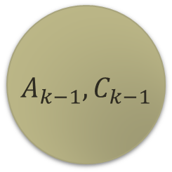

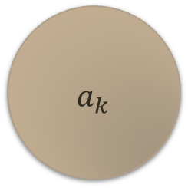
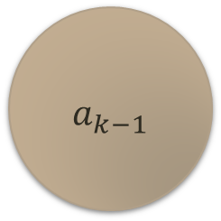

Particle Filtering Technique
$A_{k−1},C_{k−1}$
$A_{k},C_{k}$
Observed values: Cumulative amplitude and cumulative count
$$a_{k−1}$$
$$a_{k}$$
$$a_{k+1}$$
Unobserved value: True crack length
Recursive Bayes estimation by particle filtering will address the following:
  Low amount of true crack length data
  Further correlation of AE readings to crack growth
Notes:
Recursive Bayesian Estimation will be the final step in modeling of crack growth and detection. Previous results showed that both the GPR and the AE crack growth models have minimal model error. Since Recursive Bayes estimation is based on modeling an unobserved set of output based on an observed set of output, we can address some lack of growth data by its implementation.
The unobserved set of data is the true crack length while the observed set of data is the AE readings (cumulative amplitude and count) and/or the measured crack lengths. Due to a lack of measured crack length data for the newer samples, just the AE readings will be used as our observed set for that group.
Guidance from Dr. Droguett proved to be most useful during the Australia program. I had looked at the problem in May based off of his notes alone, but going through them with him proved to be more helpful in understanding. As such I developed a particle filtering routine in MATLAB based on the algorithm he went over.

Slide 49

Particle Filtering Technique
STEP 1: Sample $N$ particles from the first cycle
  The initial set of particles is based on a lognormal distribution of initial crack length estimates,
  That is,
  $$a_{0}=LOGNRND\left(N,μ,σ\right)$$
STEP 2: Propagate each particle
  Each particle has to be updated based on an assumption of how the crack grows (e.g. Gaussian based or Paris Law based)
  I am assuming Gaussian based growth based on the present model
  Propagation takes place on each particle $i$as follows
  $$a_{r}^{i}=a_{r−1}^{i}+∆a_{r−1}×\exp\left[NORRND\left(1,0,σ_{noise}\right)\right]$$

Slide 50

Particle Filtering Technique
STEP 3: Compute weight and distribution for each particle
  The updated distribution is based on the AE outputs as,
$π\left(C_{r},A_{r}|a_{r}\right)=\frac{1}{A_{r}C_{r}σ_{v}\sqrt{2π}}×\exp\left\{−\frac{1}{2}{\left[\frac{\ln\left(\frac{A_{r}C_{r}}{A_{0}}\right)−μ_{r}}{σ_{v}}\right]}^{2}\right\}$
  where,
$\ln\left(\frac{A_{r}C_{r}}{A_{0}}\right)=\frac{1}{β}\ln\left(a_{r}\right)−\frac{1}{β}\ln\left(α\right)+NOR\left(0,σ_{v}\right)$
  This mean value is based on the power relation of AE intensity
  The weight is updated as,
$w_{r}^{i}∝w_{r−1}^{i}×π\left(C_{r},A_{r}|a_{r}\right)$

Slide 51

Particle Filtering Technique
STEP 4: Resampling (generate new $N$ samples based on calculated weight)
  Resampling is done to address the regeneracy problem that is common in particle filtering
  Each loop checks to see if $\operatorname{Pr}\left(x_{r}^{i∗}=x_{r}^{j}\right)$. If it does then the weight of that step is reset to $1/N$.
  Finally the weights are normalized ${\overset{⃑}{w}}_{r}={\overset{⃑}{w}}_{r}/\sum{{\overset{⃑}{w}}_{r}}$ so that the sum of weights is $1$
STEP 5: Repeat STEP 2 for next time step i

Slide 52
Particle Filtering Technique
Example of PF output
The PF output for each specimen is used in the GPR analysis

Slide 53

CSF-to-CPD Correlation
This is the kernel function that was designed for correlation between CSFs and crack growth and detection parameters:
$k\left({\overset{⃑}{x}}_{i},{\overset{⃑}{x}}_{j},\overset{⃑}{V}\right)=\sum_{q=1}^{8}{v_{q}{\overset{⃑}{x}}_{i,q}{\overset{⃑}{x}}_{j,q}}+v_{17}\exp\left[−\sum_{q=1}^{8}{v_{q+9}{\left({\overset{⃑}{x}}_{i,q}−{\overset{⃑}{x}}_{j,q}\right)}^{2}}\right]+v_{19}\sin^{−1}{\frac{v_{18}\sum_{q=1}^{8}{x_{i,q}x_{j,q}}}{\sqrt{{\left(1+v_{18}\sum_{q=1}^{8}{x_{i,q}x_{j,q}}\right)}^{2}}}}+v_{20}δ_{i,j}$
  where $\overset{⃑}{V}$ is a twenty-parameter model parameter set vector $\left[v_{1},v_{2},…,v_{20}\right]$

Slide 54

Bayesian Analysis
The Posterior POD curves for Set 3

Slide 55

Model Error and Validation
Validation
CPD Model | ME Parameter | PF/GPR |  | GPR
 |  | Mean | SD | Mean | SD
Logistic | $$μ_{m}$$ | $$0.069$$ | $$0.014$$ | $$0.069$$ | $$0.022$$
 | $$σ_{m}$$ | $$4.56×{10}^{−4}$$ | $$4.58×{10}^{−4}$$ | $$1.37×{10}^{−3}$$ | $$1.38×{10}^{−3}$$
 | $$E_{a′,t}$$ | $$1.071$$ | $$0.027$$ | $$1.072$$ | $$0.046$$
Log-logistic | $$μ_{m}$$ | $$0.067$$ | $$0.019$$ | $$0.069$$ | $$0.022$$
 | $$σ_{m}$$ | $$7.83×{10}^{−4}$$ | $$7.95×{10}^{−4}$$ | $$1.35×{10}^{−3}$$ | $$1.36×{10}^{−3}$$
 | $$E_{a′,t}$$ | $$1.070$$ | $$0.037$$ | $$1.071$$ | $$0.046$$
Lognormal | $$μ_{m}$$ | $$0.069$$ | $$0.019$$ | $$0.068$$ | $$0.023$$
 | $$σ_{m}$$ | $$8.54×{10}^{−4}$$ | $$8.64×{10}^{−4}$$ | $$1.94×{10}^{−3}$$ | $$1.94×{10}^{−3}$$
 | $$E_{a′,t}$$ | $$1.071$$ | $$0.037$$ | $$1.071$$ | $$0.053$$
Weibull | $$μ_{m}$$ | $$0.068$$ | $$0.019$$ | $$0.068$$ | $$0.023$$
 | $$σ_{m}$$ | $$2.34×{10}^{−3}$$ | $$2.29×{10}^{−4}$$ | $$1.76×{10}^{−3}$$ | $$1.78×{10}^{−3}$$
 | $$E_{a′,t}$$ | $$1.072$$ | $$0.056$$ | $$1.072$$ | $$0.051$$

Slide 56
Validation POD Curves
The validation POD model curves

