Slide 1
Leveraging Literary Classics to Energize the Campus Community
A Case Study at the University of Maryland (UMD) Libraries
Notes:
Welcome, and thank you for joining us in our presentation. First I have a few questions for you:
How many of you read any of William Shakespeare’s plays?
Not surprisingly, studying Shakespeare is required in the US High School Common Core English Language Arts standards.
Any idea which plays are most often read in high schools? Romeo and Juliet was the top play, followed by Hamlet, Macbeth, A Midsummer Night’s Dream, Othello, and Julius Caesar.
How many of you have read Mary Shelley’s Frankenstein in High School or College? How many know the story of Frankenstein?
Frankenstein is the most frequently taught work of literature in college English courses and the fifth most frequently taught book in college courses in all disciplines.
So, it makes sense that widely studied and loved literary classics are a great way to energize the campus community. And academic libraries are perfectly situated to organize and lead events that celebrate such works.
In my presentation I will discuss how our library developed and led efforts to energize the intellectual life of the campus community by joining the international celebrations of William Shakespeare and Mary Shelley. I hope what I share with you today will serve as a model that you can adapt to your specific library and campus.

Slide 2
Goals
Energize intellectual life of the campus
Foster partnerships across library units and among campus departments
Bring together students, staff, librarians, and faculty by celebrating the timeless influence of literary classics
Showcase the Libraries’ collections and services
Build a marketing campaign around our beloved mascot Testudo
Notes:
In developing these programs we had several overarching goals.
We wanted to position the libraries as a central player in energizing the intellectual life of the campus
We wanted to partner with multiple library units and campus departments and bring together teaching faculty, librarians, staff, and students through these celebrations, while at the same time, showcasing the Libraries’ collections and services.
With the Libraries’ Communications Office and the English Department our goal was to build a marketing campaign using our beloved mascot, Testudo, as the centerpiece and unifying image for the events.
My presentation will focus on three things: 1. The Shakespeare Celebration 2. The Frankenstein Celebration and 3. The marketing program we developed

Slide 3

The Wonder of Will:
400 Years of Shakespeare
Notes:
Our first series of programs and events took place In 2016 when we joined the The Wonder of Will celebration, spearheaded by the Folger Shakespeare Library. This was a year-long celebration of William Shakespeare, on the 400th anniversary of his death in 1616.
The commemoration included exhibitions, performances, lectures and more, held at the Folger Library, across the United States and abroad. Our campus participated by hosting a series of events which I will highlight.

Slide 4
Campus Partners
Libraries
Architecture, McKeldin , Perfroming Arts, and
STEM Libraries
Special Collections
John & Stella Graves Makerspace
Communications Office
English Department and Center for Literary & Comparative Studies
School of Theatre, Dance, & Performance Studies
Clarice Smith Performing Arts Center
Palestrina Choir
Maryland Shakespeare Players
The UMD Dairy
College of Arts & Humanities
UMD Pepsi Enhancement Fund
Organizing Committee Members
Libraries:
Eric Bartheld, Director of Communications, Libraries
Felicity Brown, Theatre, Dance, & Performance Studies Librarian
Laura Cleary, Special Collections and University Archives
Aaron Ginoza, Social Media Coordinator, Libraries
Steve Henry, Head, Michelle Smith Performing Arts Library
Patricia Herron, English Librarian
Eric Lindquist, History Librarian
Vin Novara, Curator, Special Collections in Performing Arts
Rebecca Wilson, Graphic Designer, Libraries
English Department & Center for Literary & Comparative Studies (CLCS)
Karen Nelson, Associate Directory of CLCS
KaraPleasants, Graduate Student and Director of Maryland Palestrina Choir
Clarice Smith Performing Arts Center
Jane Hirshberg, Campus & Community Engagement Manager
School of Theatre, Dance, & Performance Studies
Frank Hildy, Professor
Notes:
Here is a list of all the campus departments and groups with which we partnered
The Libraries and the English Department took the lead in organizing these events. As you can see we brought a number of other groups.
The School of Theatre, Dance & Performance Studies and The Clarice Performing Arts Center were natural partners
as were two campus student groups, the Palestrina Choir, a music ensemble devoted to exploring the music of the Medieval and Renaissance periods,
and the Maryland Shakespeare Players whose mission is to “Bring the bard to the University of Maryland community” by staging Shakespeare productions.
We also brought in the University of Maryland Dairy to design special flavored ice cream for both celebrations.
This is a list of our organizing committee,, which included librarians, faculty, staff and students, from the Libraries and other campus departments, centers, and groups.
I will talk about some of the major events that took place

Slide 5
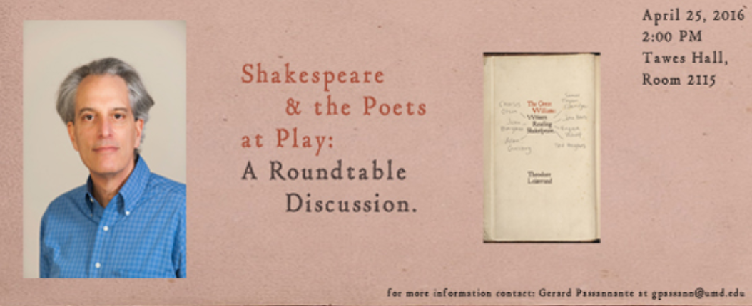
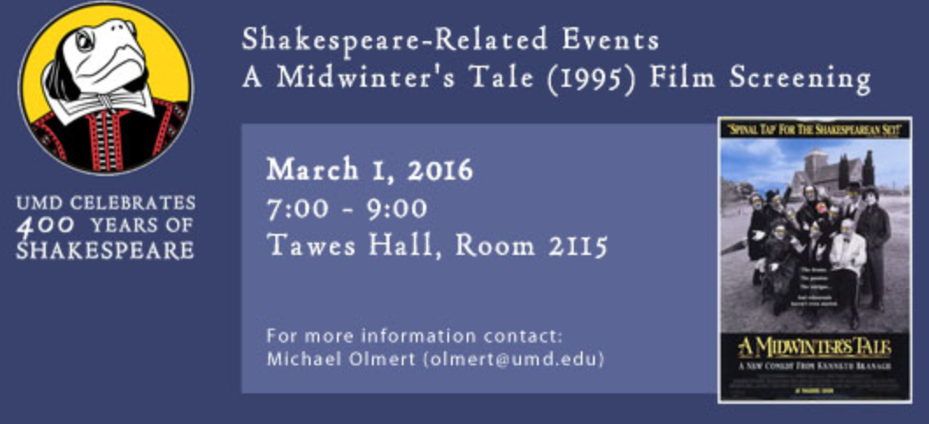
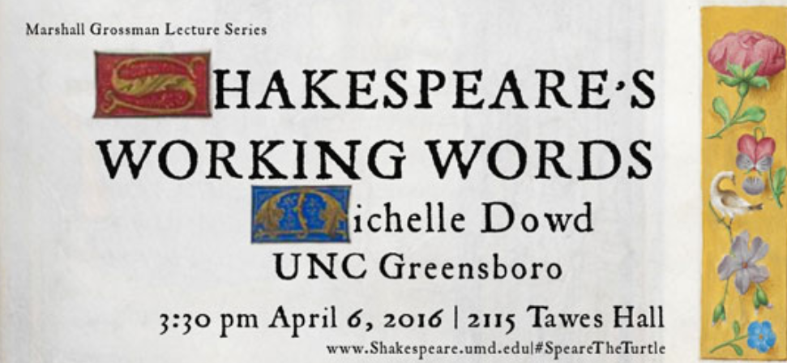
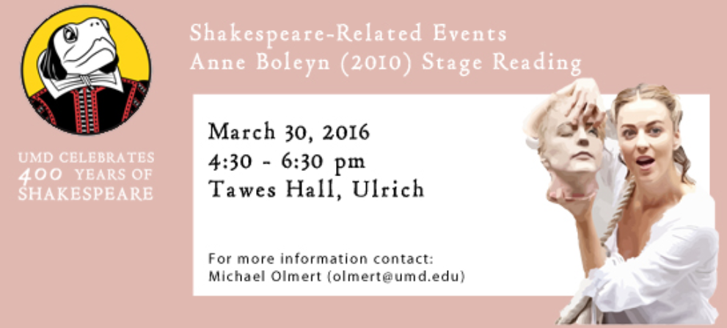
Roundtable
English Department
Film Screenings
Marshall Grossman Lecture
Staged Readings
Notes:
The English Department organized:
Feature film showings
AND Rehearsed staged readings of Shakespeare related plays.
Scholarly Events included:
A Rountable Discussion: Shakespeare and the Poets at Play
AND a lecture entitled: Shakespeare's Working Words.

Slide 6
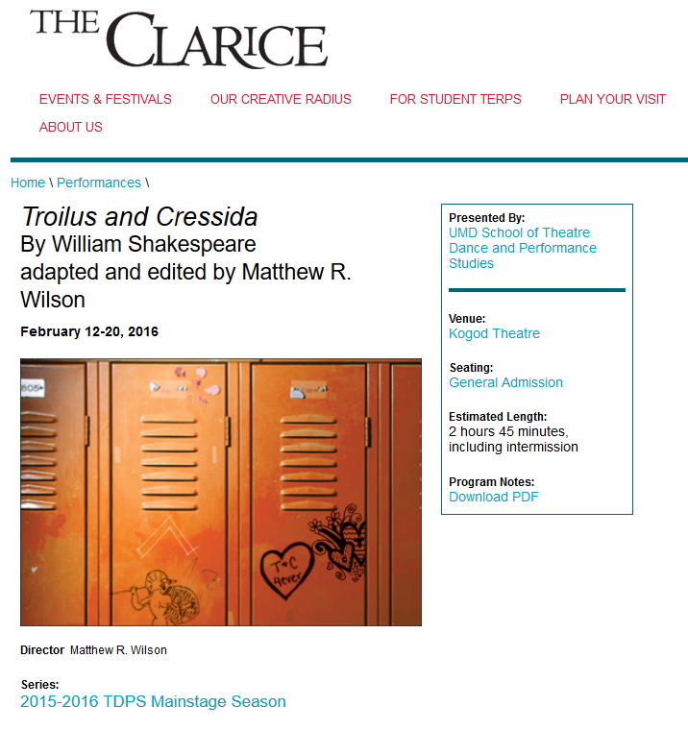
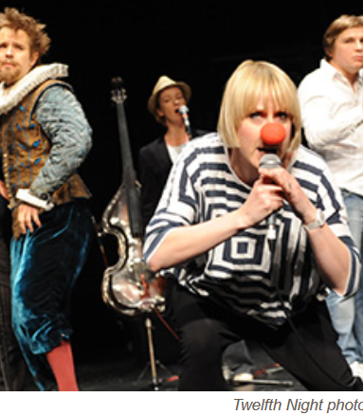
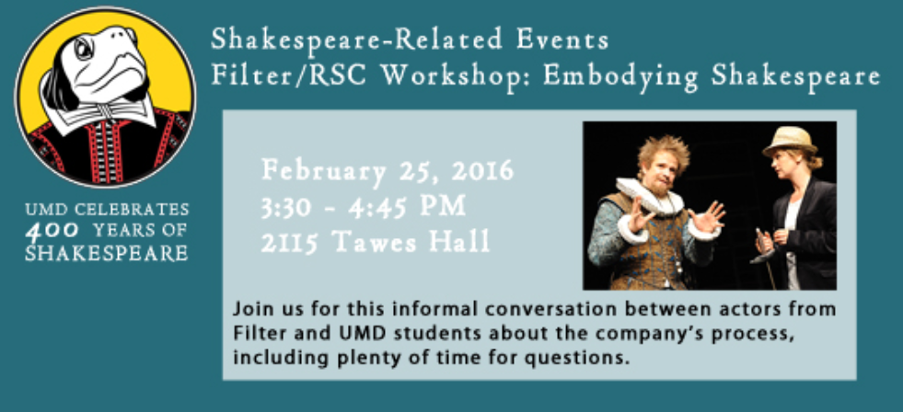
Clarice Smith Performing Arts Center
Performances
Filter / Royal Shakespeare Company Workshops
Notes:
Clarice Performing Arts Center offered two Shakespeare productions: Troilus and Cressida and Twelfth Night
The Clarice also brought in Filter, a British theatre company known for its groundbreaking use of sound and unconventional adaptions of classic texts. They offered two workshops for students:
Embodying Shakespeare - a practical, hands-on workshop about the company’s process in the staging of Shakespeare’s plays.
Introduction to Filter, Shakespeare and Sound Design –a workshop that explored the way sound supports their productions.

Slide 7
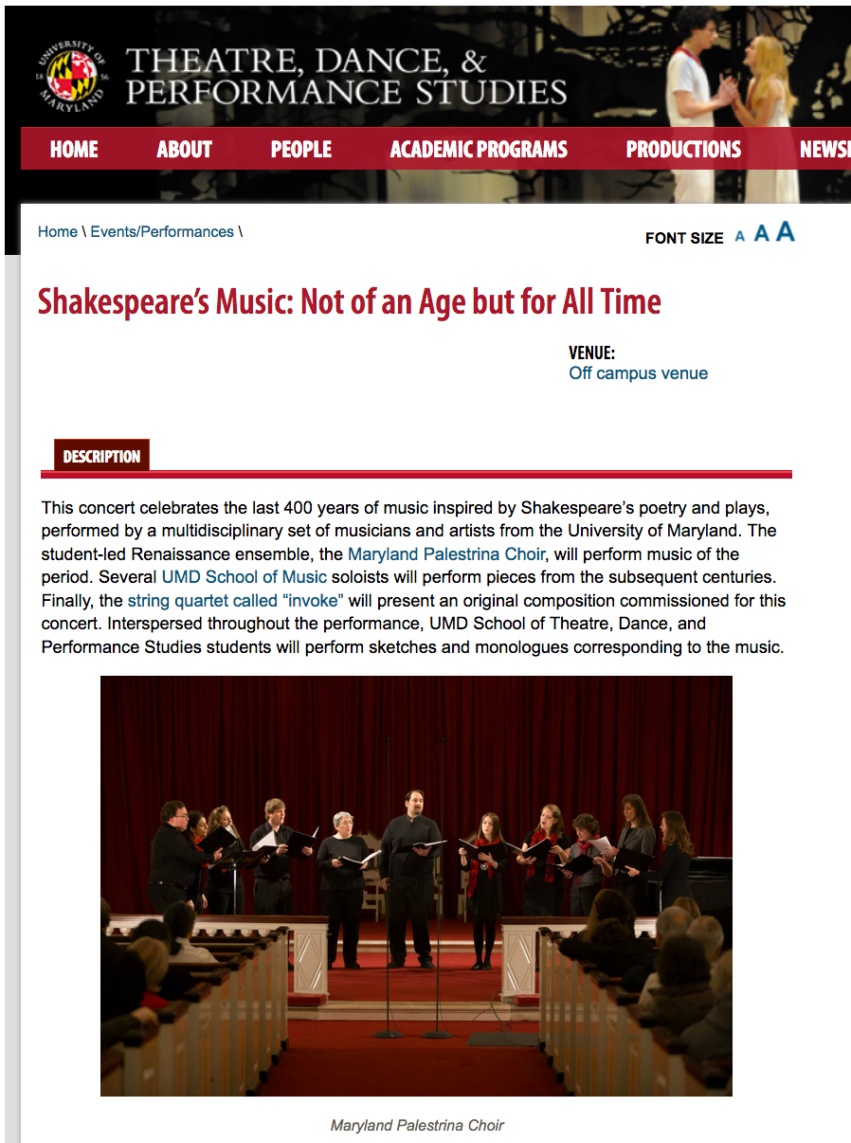
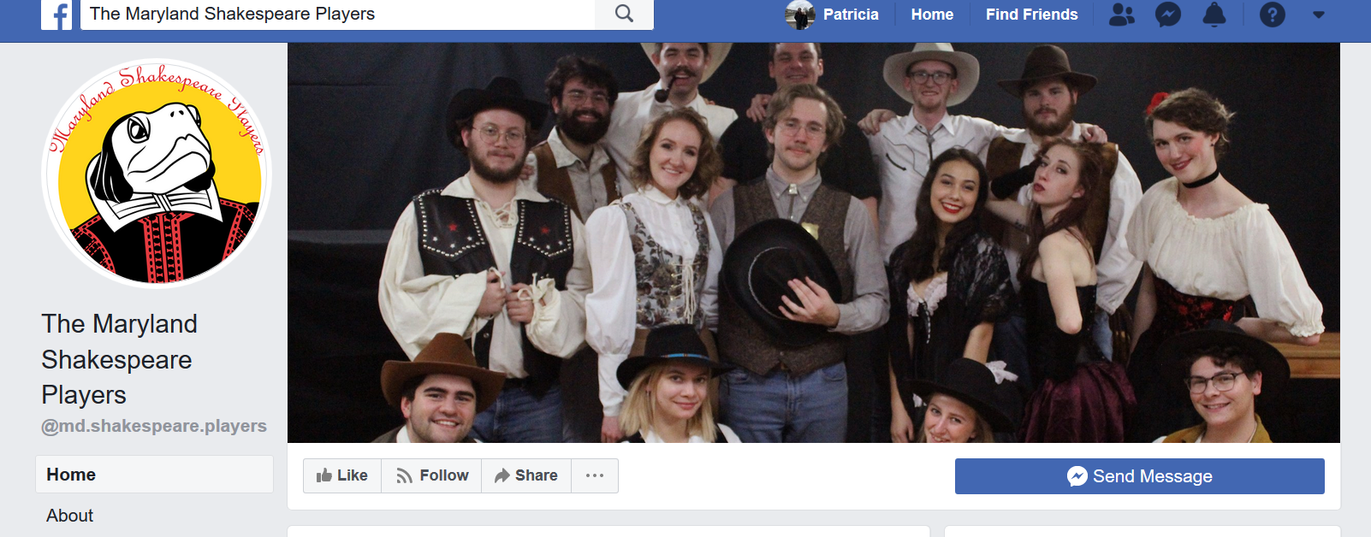
Maryland Palestrina Choir
Maryland Shakespeare Players
Notes:
The Maryland Palestrina choir prepared and performed a program of music entitled: Shakespeare’s Music: Not of an Age but for All Time.
The Maryland Shakespeare Players performed the play, Much Ado About Nothing at several venues during the Spring semester.

Slide 8
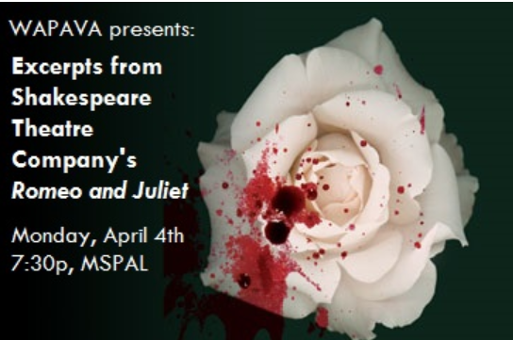
Washington Area Performing Arts Video Archive (WAPAVA)
Notes:
WAPAVA is The Washington Area Performing Arts Video Archive, a non-profit organization dedicated to documenting theatre and performing arts in the DC-region. Materials from this collection are available on site in the Michelle Smith Performing Arts Library.
Librarians and curators at the Performing Arts Library, sponsored an event which profiled excerpts of WAPAVA’s video recording of the 2008 Shakespeare Theatre Company's all-male performance of Romeo & Juliet.
It included a discussion led by Shakespeare scholar and University of Maryland Professor of Theatre Dr. Franklin Hildy. Hildy is an internationally recognized authority on Shakespeare, and the Globe Theatre.

Slide 9
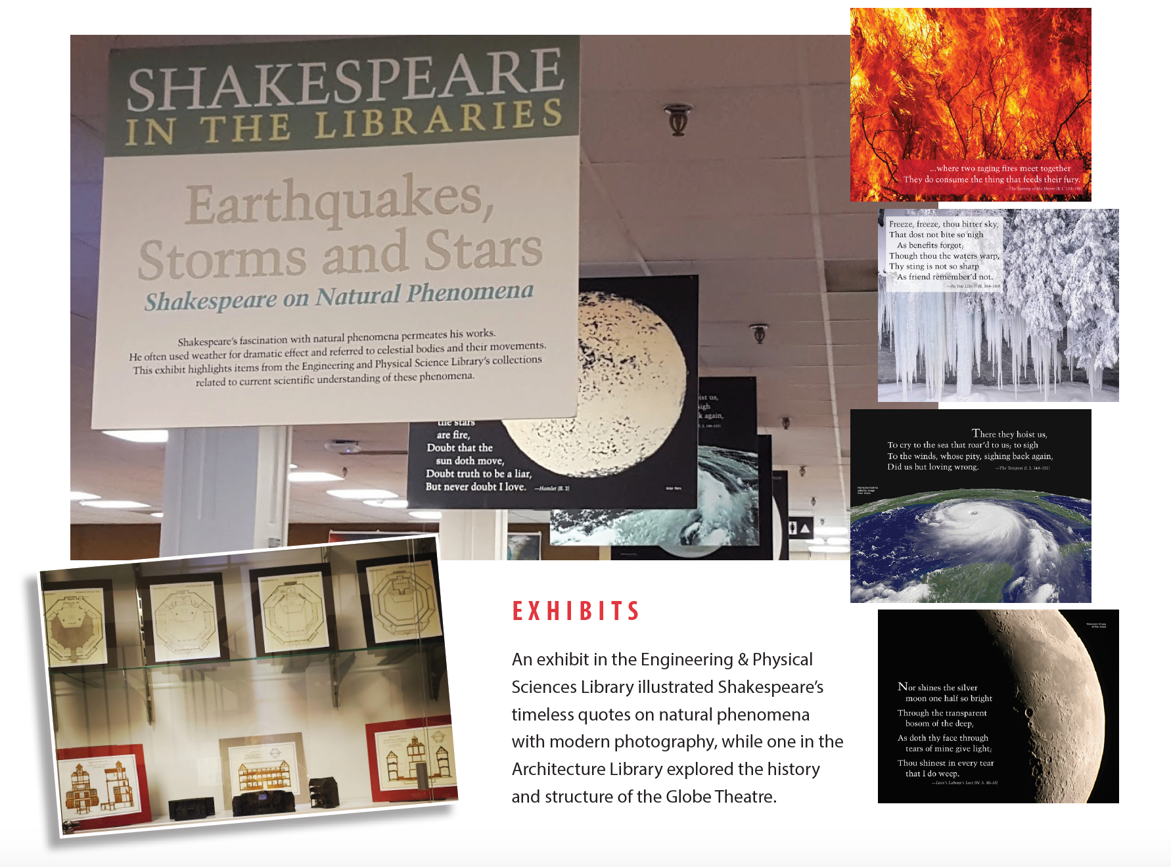
Library Exhibits:
Architecture and STEM Libraries
Notes:
Two branch libraries created Shakespeare related exhibits.
The STEM Library mounted an exhibit which illustrated Shakespeare’s quotes related to natural phenomena, alongside modern photographic images.
The Architecture Library exhibit explored the history and structure of the Globe Theatre

Slide 10
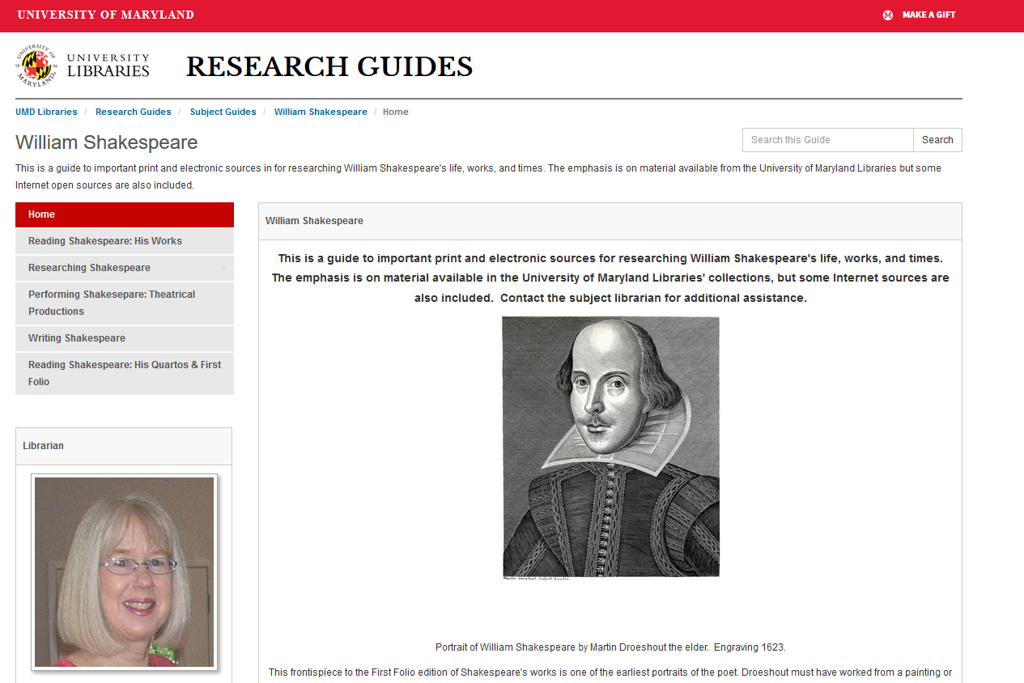
Notes:
To assist with the many Shakespeare coursed offered on campus I created a libguide for the students.

Slide 11
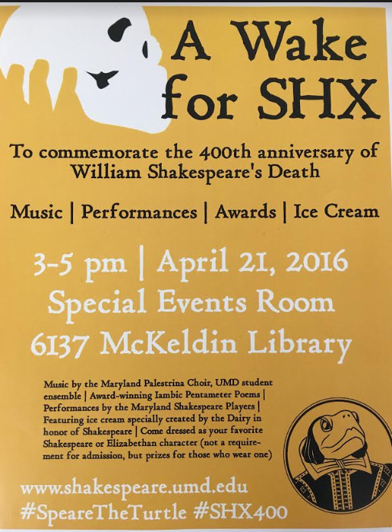
Shakespeare Gala: A Wake for SHX
Notes:
The events culminated with a party in McKeldin Library A Wake for SHX on April 21st, which included a number of fun activities:
We invited people to come dressed in Shakespearean or Elizabethan characters or clothing and we awarded prizes for the best costumes.
With the English Department during the semester we sponsored an Iambic Pentameter Couplet Twitter Competition and we announced and gave out awards to the winners at the party
We served a special flavor of ice cream created by the UMD Diary featuring mulled wine and cardamom cake, both ingredients available during Shakespeare’s time

Slide 12
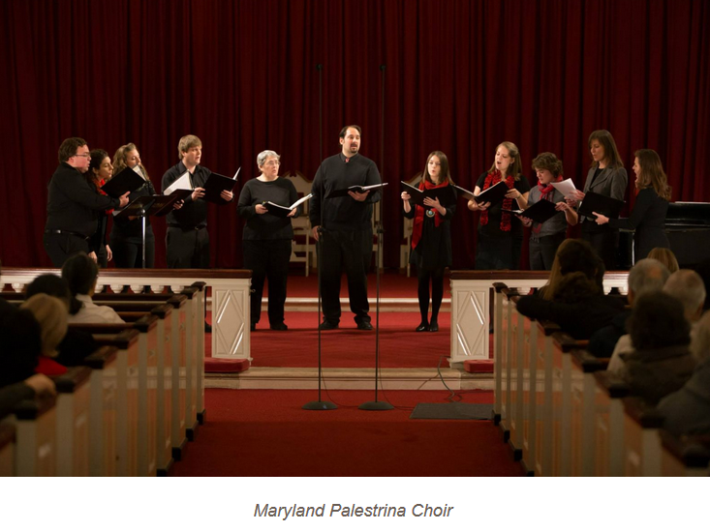
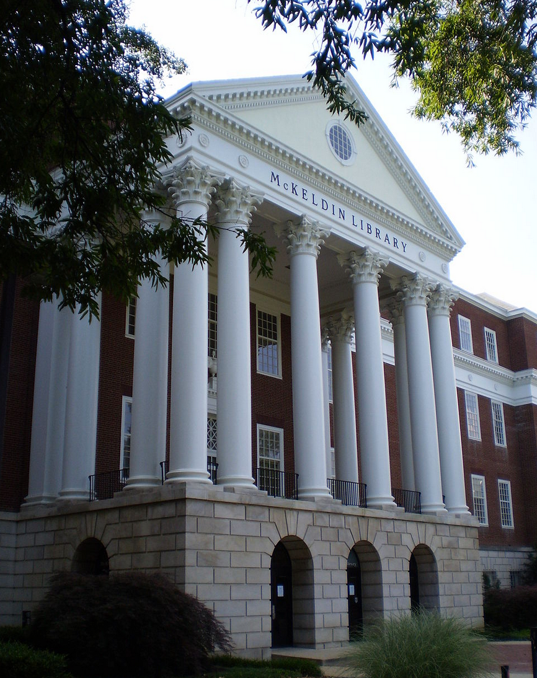
Shakespeare Gala: A Wake for SHX
Peformance by the Palestrina Choir https://youtu.be/UcHJ6SuviL0
Maryland Shakespeare Players – The balcony scene and a scene from Much Ado about Nothing https://youtu.be/UcHJ6SuviL0?t=353
Notes:
In addition:
The Palestrina Choir performed one of their musical selections.
AND We invited the Maryland Shakespeare Players to join us. Just before the party they performed the balcony scene from Romeo and Juliet on the balcony outside of McKeldin They also performed a scene from Much Ado about Nothing, at the party,
They have since, with our permission, adopted our Shakespeare inspired ‘Speare the turtle image, which was developed by our Communications Office graphic arts staff.

Slide 13

Frankenreads
200th anniversary of Mary Shelley's Frankenstein
Notes:
Our second series of programs occurred in 2018 when we joined the international celebration of the 200th anniversary of the publication of Mary Shelley’s novel Frankenstein.
Frankenreads, as it was called, was organized by the Keats-Shelley Association of America with funding from the National Endowment for the Humanities.
Like the Wonders of Will, this project invited participants to organize events such as exhibits, lectures, discussions, film viewings and more, related to the novel and its enduring themes.

Slide 14
Organizing Committee
English Department & Center for Literary & Comparative Studies (CLCS)
Karen Nelson, Associate Directory of CLCS
Edlie Wong, Professor and Director of the Center for Literary and Comparative Studies
Libraries:
Eric Bartheld, Director of Communications, Libraries
Aaron Ginoza, Social Media Coordinator, Libraries
Patricia Herron, English Librarian
Eric Lindquist, History Librarian
Amber Kohl Special Collections and University Archives
Rebecca Wilson, Graphic Designer, Libraries
Notes:
For this event the Libraries partnered primarily with the English Department with help from several other campus units.
We had a much smaller organizing committee and the Libraries played a more significant role in the overall celebration and the marketing of the events.

Slide 15
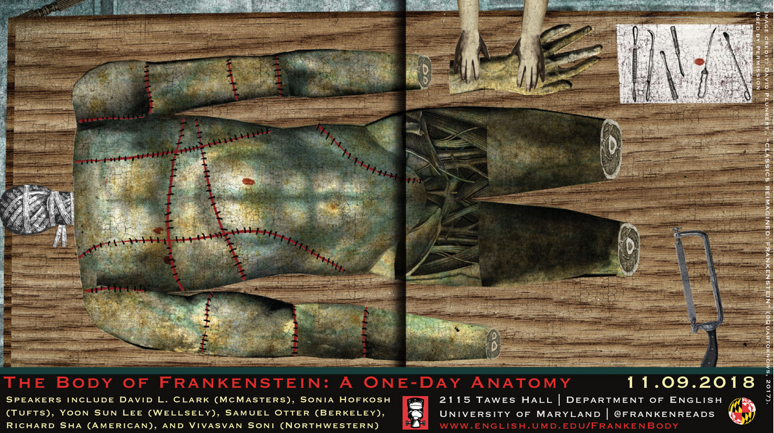
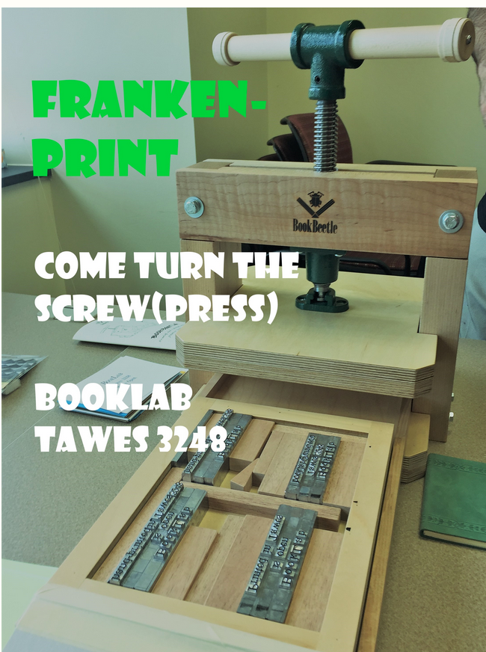
English Department:
Symposium: The Body of Frankenstein: A One Day Anatomy
BookLab: FrankenTerps Community Print
Notes:
The English Department held several events:
A Scholarly Symposium entitled: The Body of Frankenstein: A One Day Anatomy
BookLab a new space in the English Department which houses a small tabletop hand-press hosted a FrankenTerps Community Print day, where students and faculty were encouraged to stop by to “print quotes from Mary Shelley's 1818 edition of Frankenstein.

Slide 16
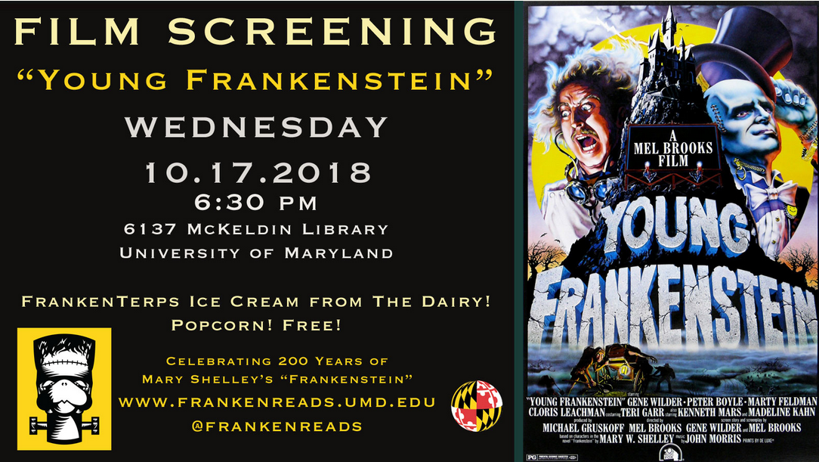
English Department and Libraries
Film Screening: Young Frankenstein
Notes:
English Department and the Libraries sponsored a film screening of Mel Brooks’ Young Frankenstein In McKeldin Library. We had about 50 attendees, mostly students, and we served the Dairy’s specially created FrankenTerp ice cream AND popcorn.

Slide 17
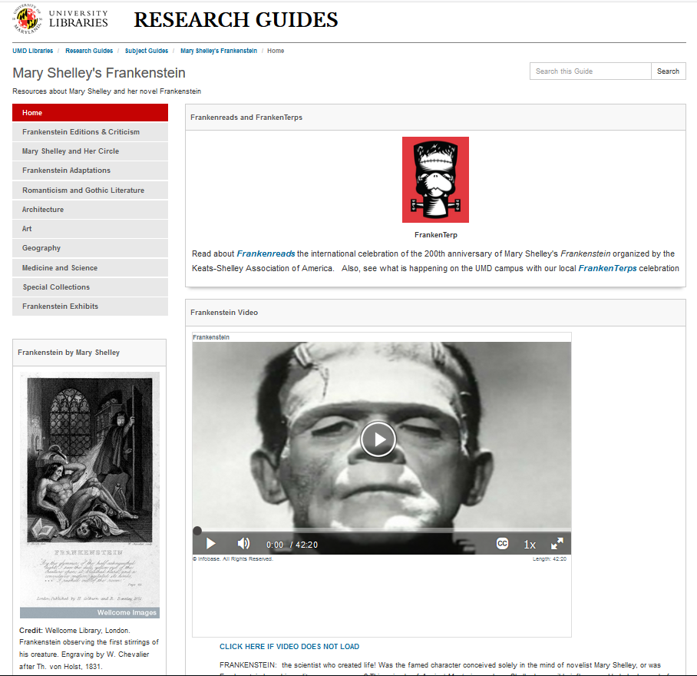
Libguide http://lib.guides.umd.edu/frankenstein
Architecture, Art, McKeldin, Performing Arts, STEM Libraries and Special Collections
Notes:
During Fall of 2018, the English Department offered 18 courses that engaged in some way with Shelley's novel or texts inspired by it
To support these courses, librarians in McKeldin, the Architecture, Art, Performing Arts, STEM Libraries and Special Collections created an interdisciplinary guide which included resources related to
Frankenstein,
Mary Shelley
Gothic and romantic literature, art, and architecture
Science in the 19th century

Slide 18
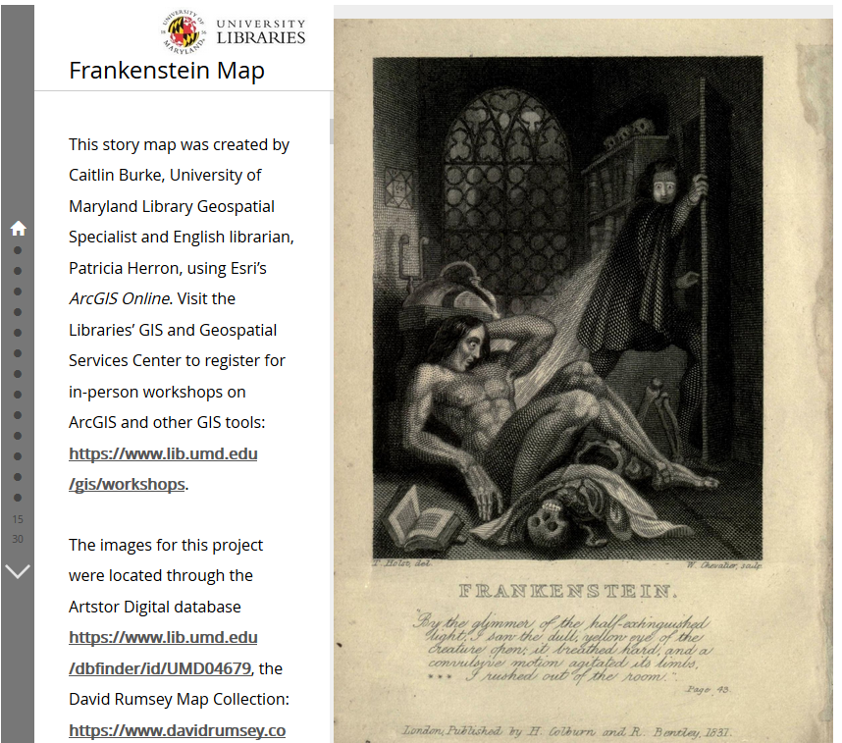
Frankenstein GIS Story Map https://www.arcgis.com/apps/MapJournal/index.html?appid=85b227b2ee964cb9b6279ed0dc3411ac
Notes:
Caitlin Burke our GIS Specialist created an Arc GIS Story Map using images from various databases including ArtStor, I supplied the textual commentary and quotes from the novel. ‘
Geography plays an important part in Frankenstein.
The characters in Frankenstein travel throughout Europe, Great Britain, and the Arctic region. This Story Map identifies and illustrates many of these locations with maps, images of 19th century paintings, and contextual quotes from the novel.
Created: Jul 5, 2018 - View Count: 4,307
https://www.arcgis.com/home/item.html?id=85b227b2ee964cb9b6279ed0dc3411ac

Slide 19
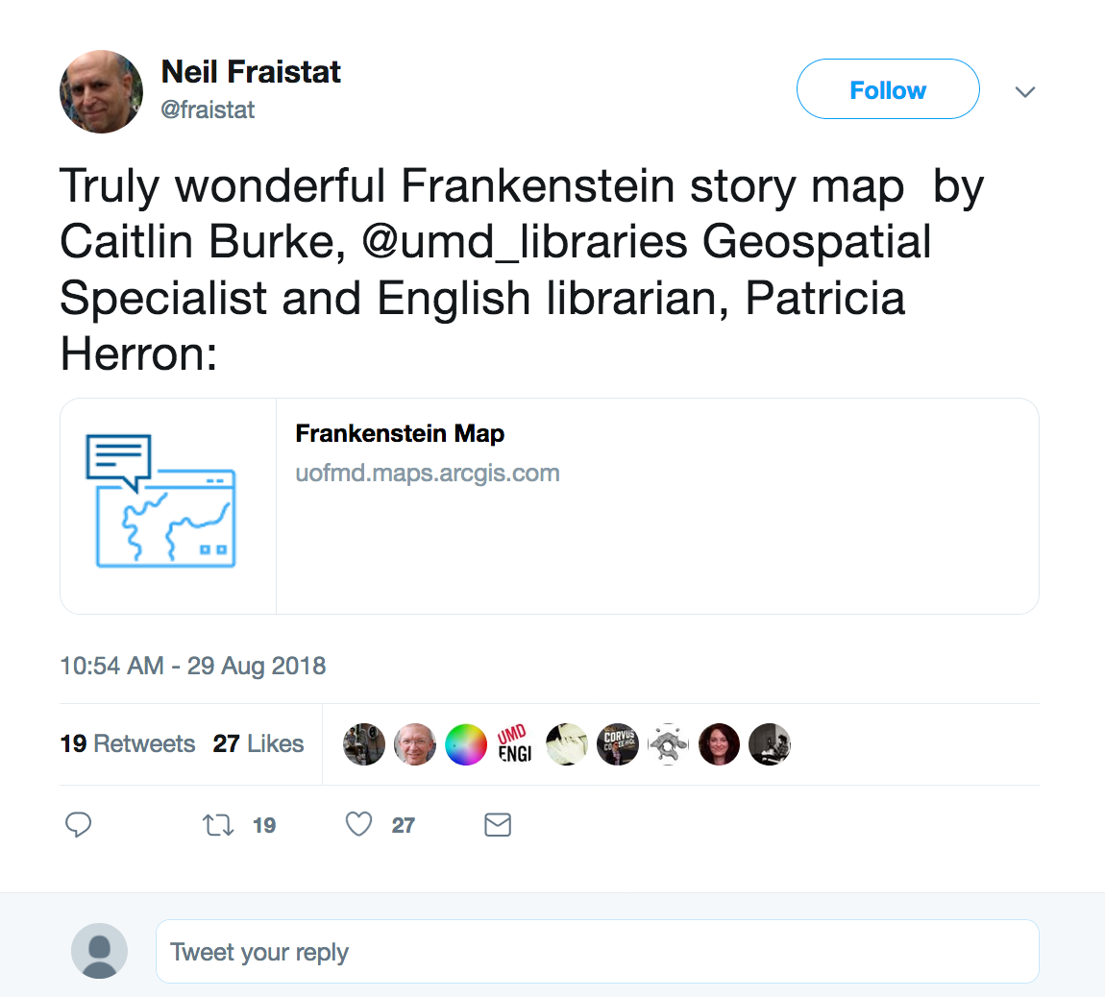
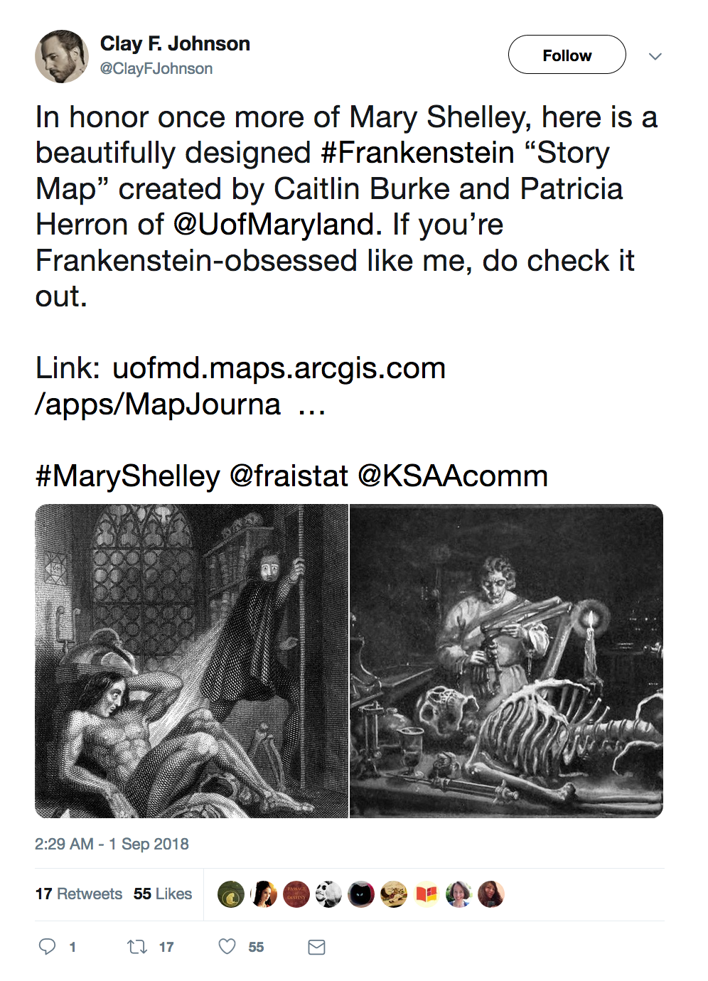
Tweets
Notes:
Our Story Map received national and international attention through social media and was tweeted and retweeted numerous times by academics and lovers of romantic literature.
Created: Jul 5, 2018 Updated: Oct 1, 2018 View Count: 4,307
https://www.arcgis.com/home/item.html?id=85b227b2ee964cb9b6279ed0dc3411ac

Slide 20
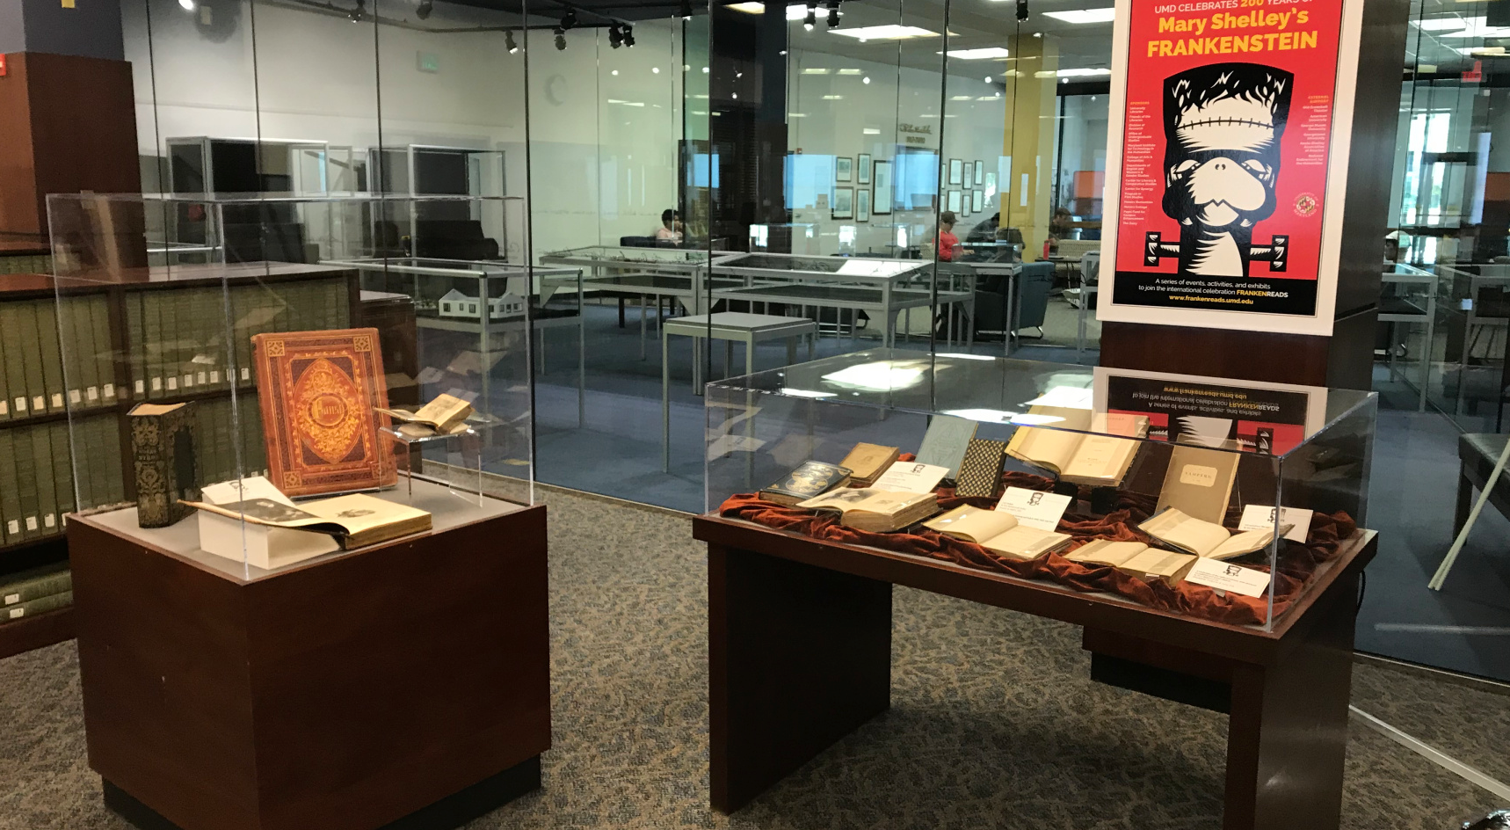
Special Collections Exhibit
Mary Shelley and the Romantics https://hornbakelibrary.wordpress.com/2018/10/02/special-collections-celebrates-frankenreads/
Notes:
All of the College Park campus Libraries and Special Collections created Frankenstein related exhibits. While each dealt with very different themes, they all included a FrankenTerp events poster, which served to unify them.
Amber Kohl, our Head of Literature & Rare Books at Hornbake Special Collections mounted the “Mary Shelley and the Romantics” exhibition, which included both modern and 19th century editions of romantic writers’ works.
As news got out about the Hornbake Special Collections exhibit, Amber was asked (and graciously agreed) to lead tours for several English classes.

Slide 21
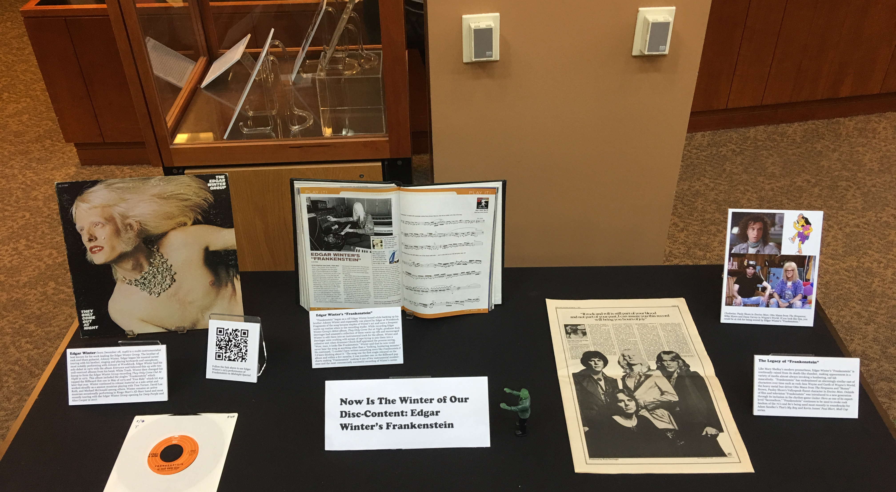
Performing Arts Library Exhibit
Now is the Winter of our Disc-Content
Notes:
Benjamin Jackson (PhD student in ethnomusicology) with Vin Novara, curator at the Performing Arts Library mounted an inventive exhibit entitled: “Now is the Winter of our Disc-Content.”
The exhibit profiled an instrumental song by the American blues rock group The Edgar Winter Group called "Frankenstein" which topped the US Billoard Hot 100 chart in May of 1973.

Slide 22
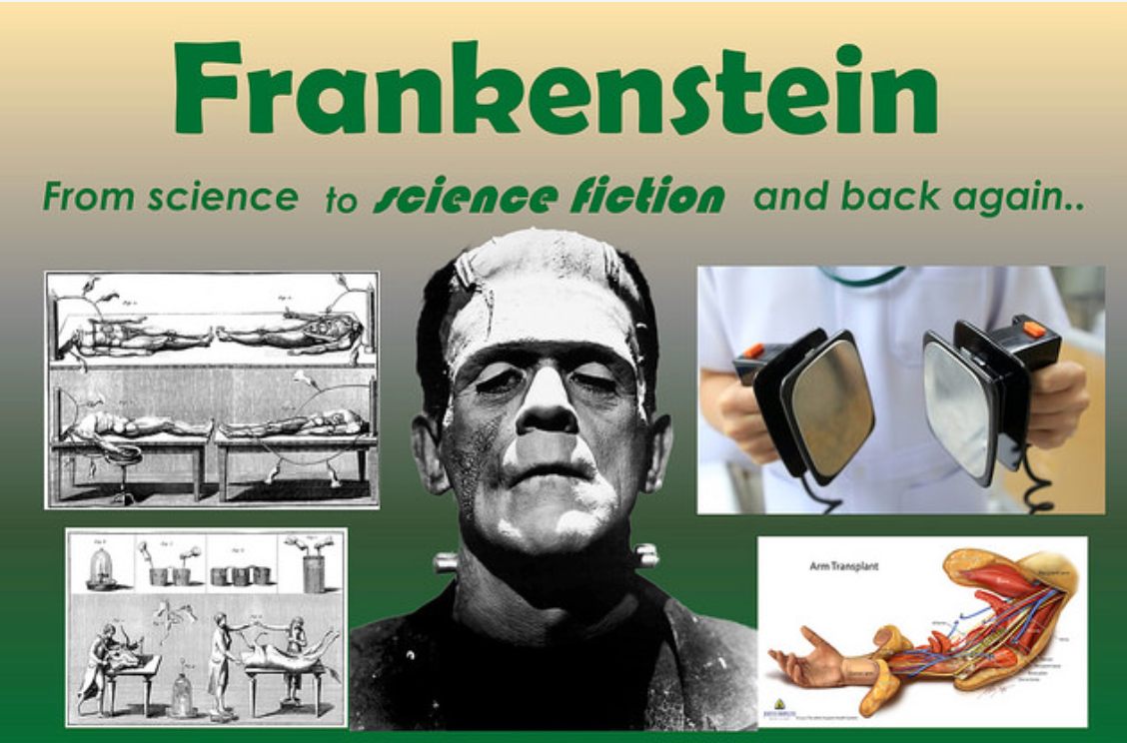
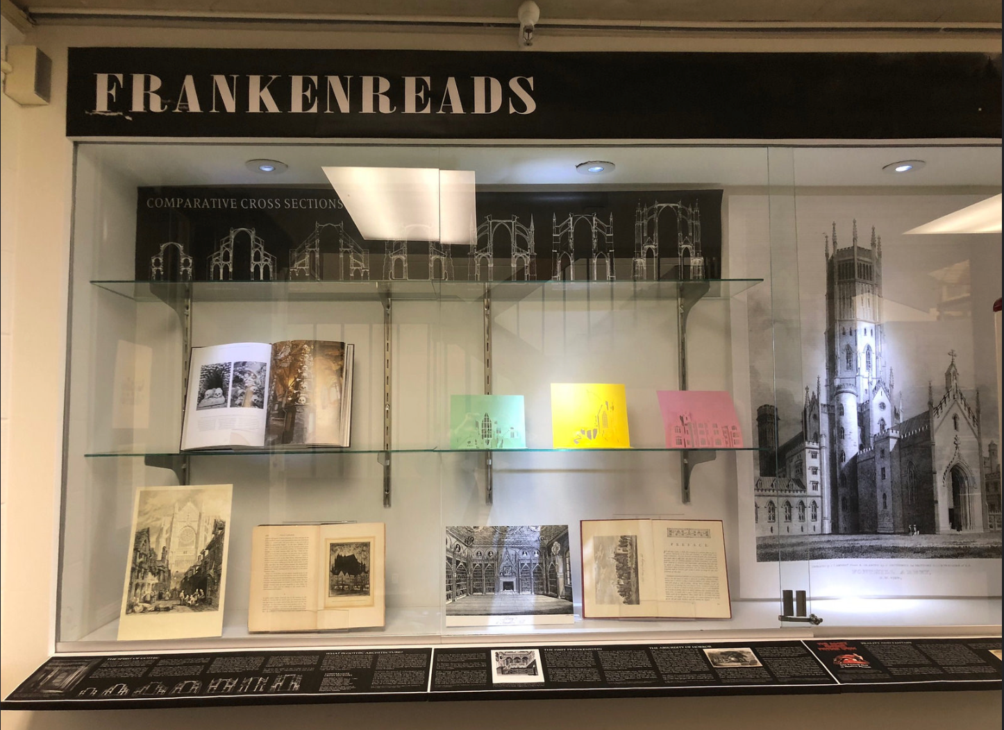
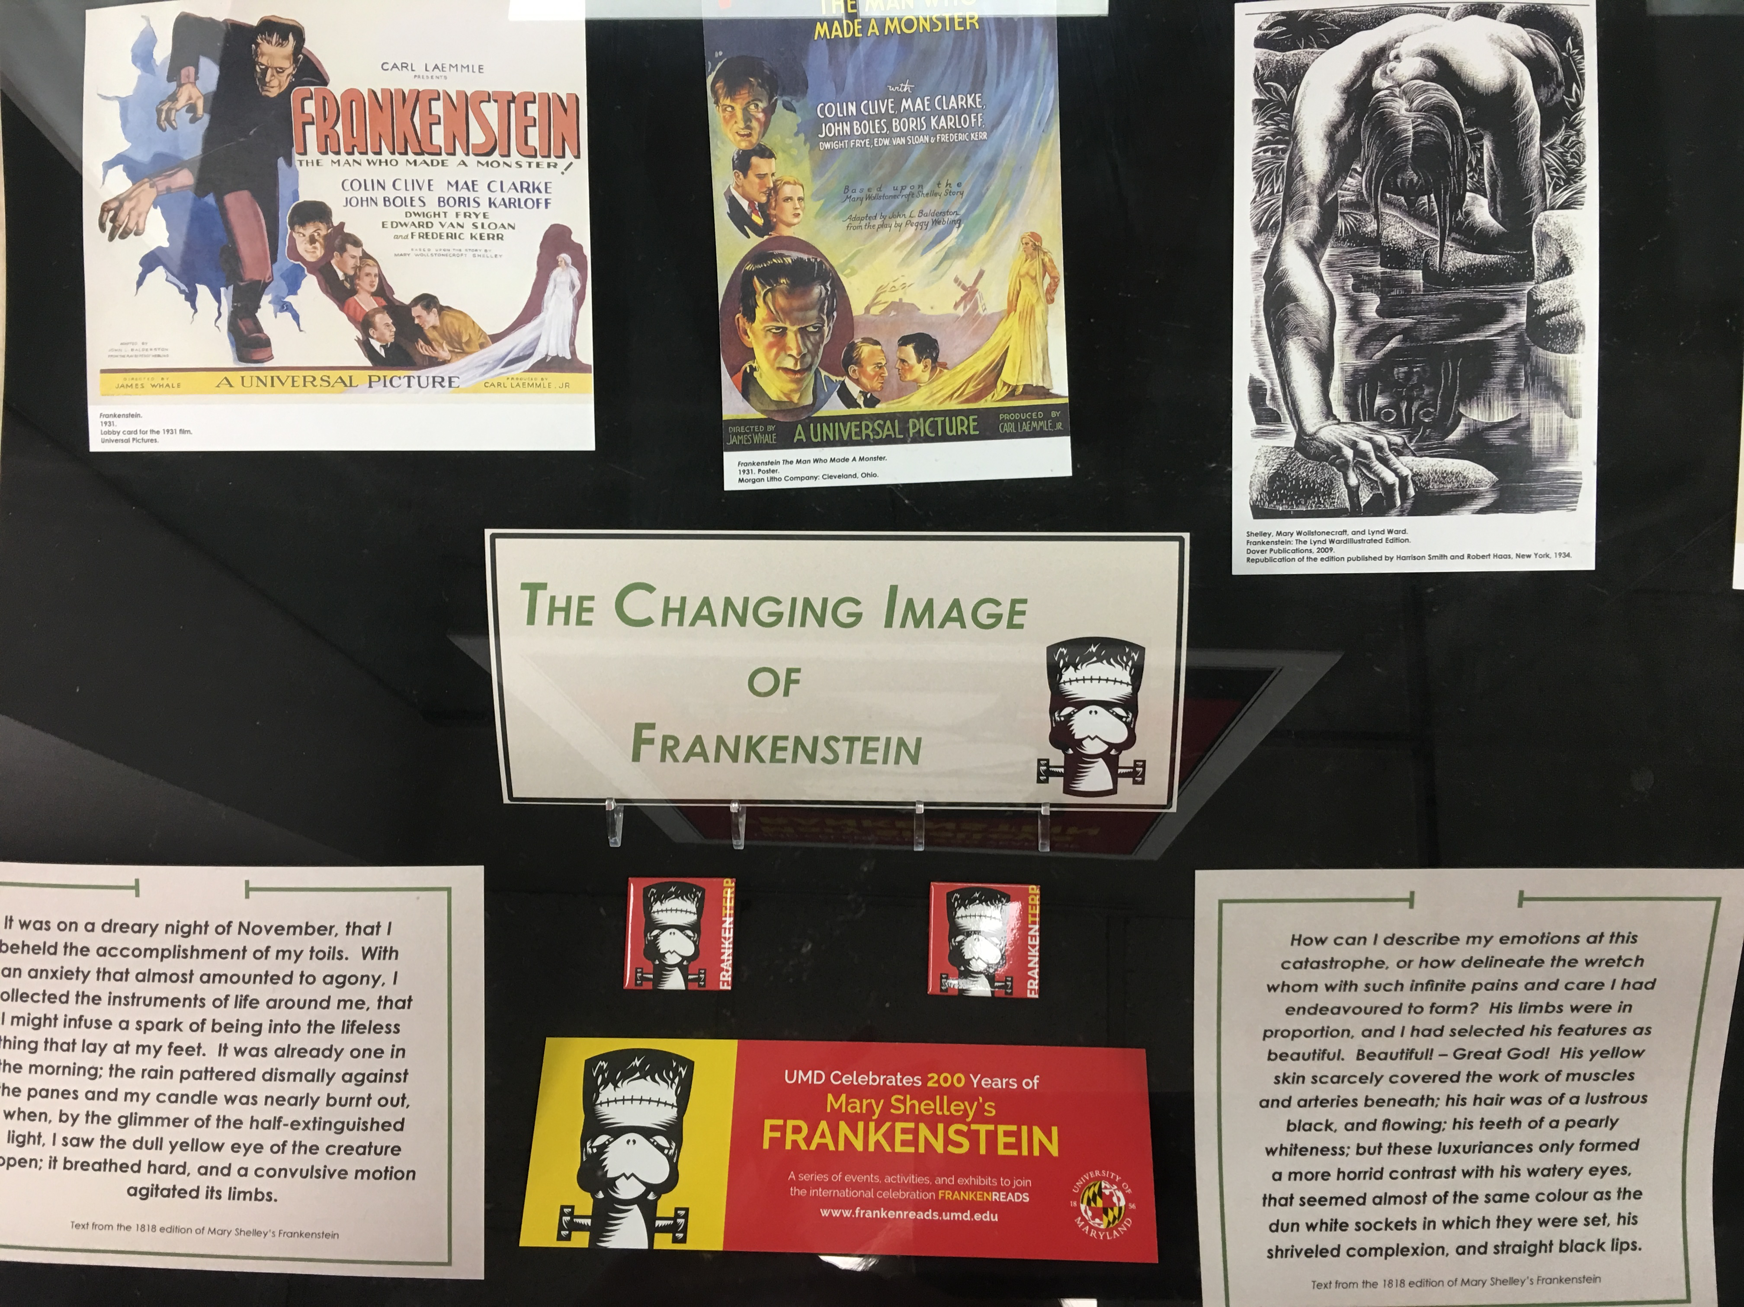
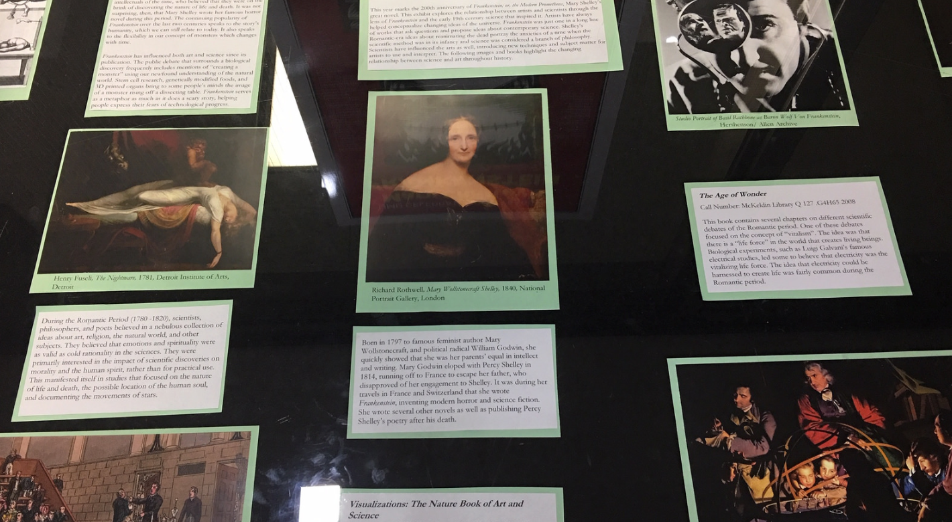
Library Exhibits
STEM: From Science to Science Fiction and Back Again Pinar Beygo
Architecture: Gothic Architecture Wil Combs and with Cindy Frank
Art: Frankenstein: At the Crossroads of Science and Art John Rogers, Sophia Lee, and Patti Cossard
McKeldin: The Changing Image of Frankenstein Pat Herron and Amber Kohl
Notes:
Librarians, library staff, and students from the STEM, Architecture, Art, and McKeldin Libraries partnered together to mount Frankentstein related exhibits.
Each focused on different themes and topics within the novel.

Slide 23
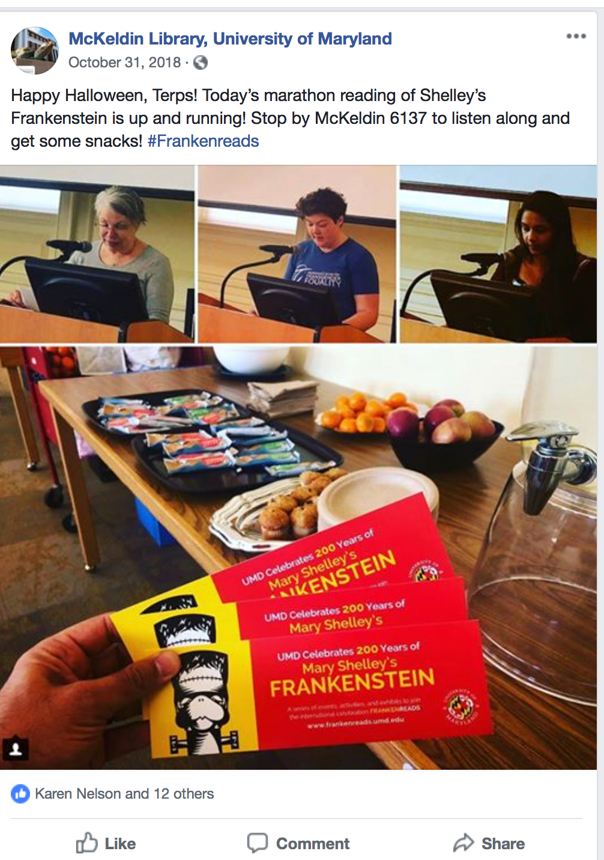
Notes:
On Halloween, in Mckeldin Library, we joined libraries worldwide in FrankenReads, a marathon reading of the entire novel. We began at 9 am and successfully completed reading the novel by 6 pm.
Readers included students, faculty, librarians and library staff.

Slide 24
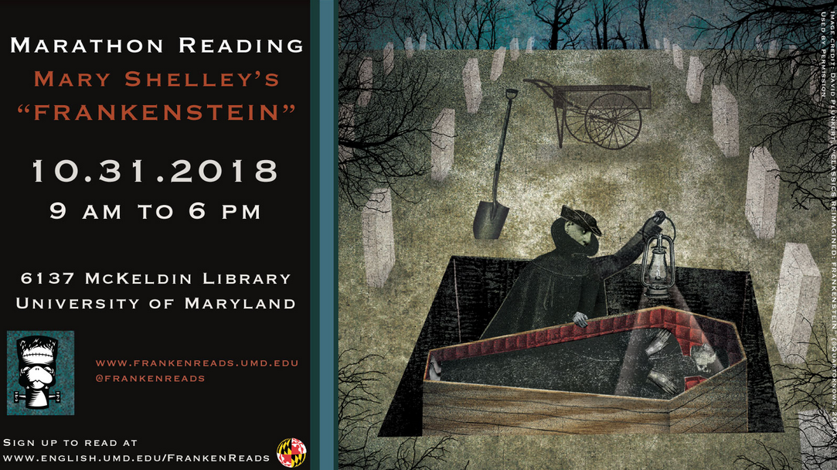

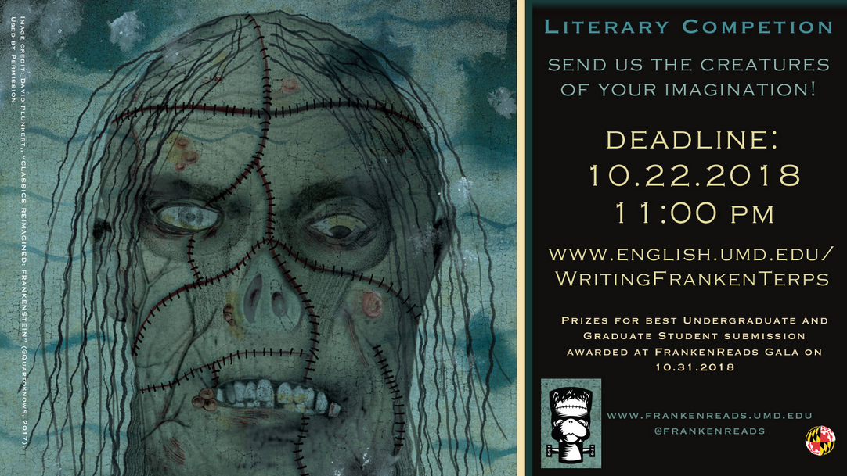
Marathon Reading of Frankenstein
Reading 9 am to 6 pm
Book Talk: Classics Reaimagined: Frankenstein
FrankenTerp Ice Cream
Prizes for Best Costume and Literary Competition
Notes:
We took a lunch break and served a pizza lunch and FrankenTerp ice cream created by the UMD Dairy
During the lunch, David Plunkert the illustrator of the bicentennial edition of Mary Shelley’s novel, Frankenstein: Classics Reimangined, gave an entertaining talk about his fascinating illustrations..
Plunkert also gave Karen Nelson, from the English department, permission to incorporate some of his images into their marketing materials, several of which are shown in this slide.
At the end of the marathon reading we had a party and prizes were awarded to the best costumes and for winners of the literary contest

Slide 25
The Marketing Campaign
Libraries’ Communications Office
Eric Bartheld, Director of Communications, Libraries
Aaron Ginoza, Social Media Coordinator, Libraries
Rebecca Wilson, Graphic Designer, Libraries
Juan Carlo Mandapat and Mallory O’Conor, Student Assistants, “Speare campaign
Simran Gill, Student Assistant, Franketerp Campaign
Notes:
Our Libraries’ Communications Office was responsible for creating the ultra successful marketing campaigns and promotional materials for both the Shakespeare and the Frankenstein celebrations.
These campaigns have since been recognized by winning a number of national design awards. Their latest, just a few weeks ago, was for best social media and best in show from the Academic Library Advancement and Development Network.

Slide 26
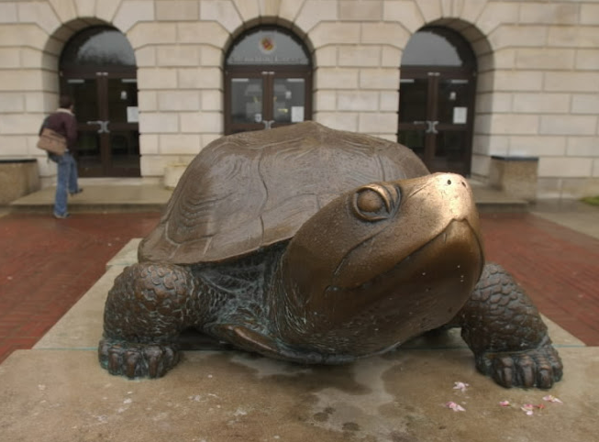
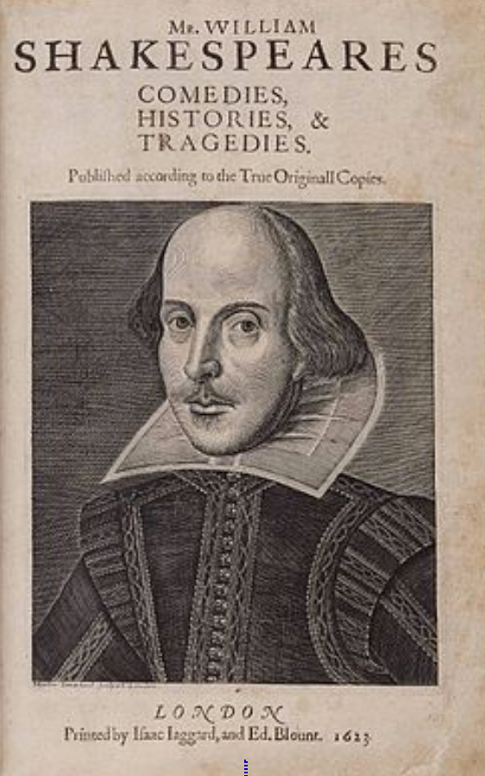
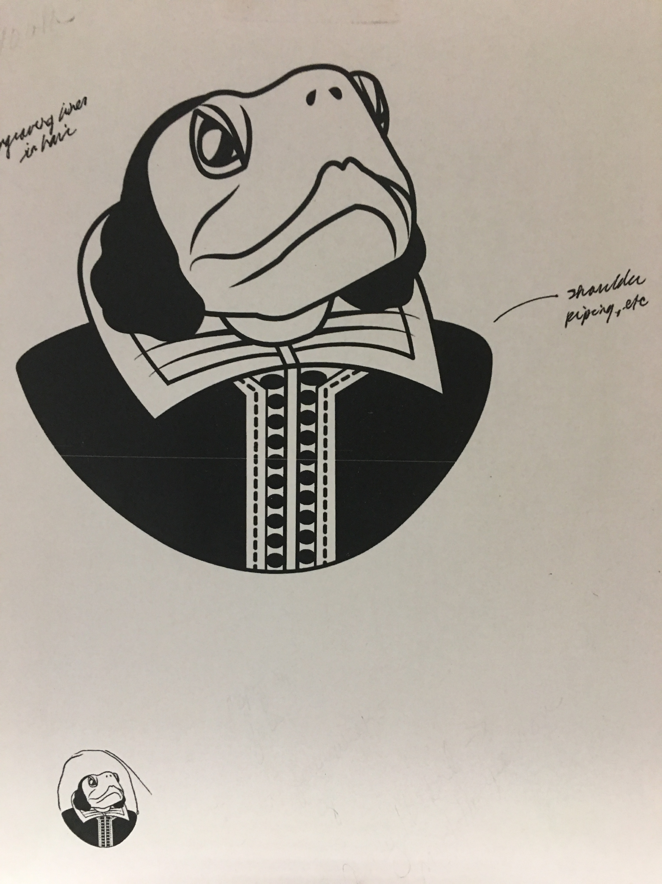
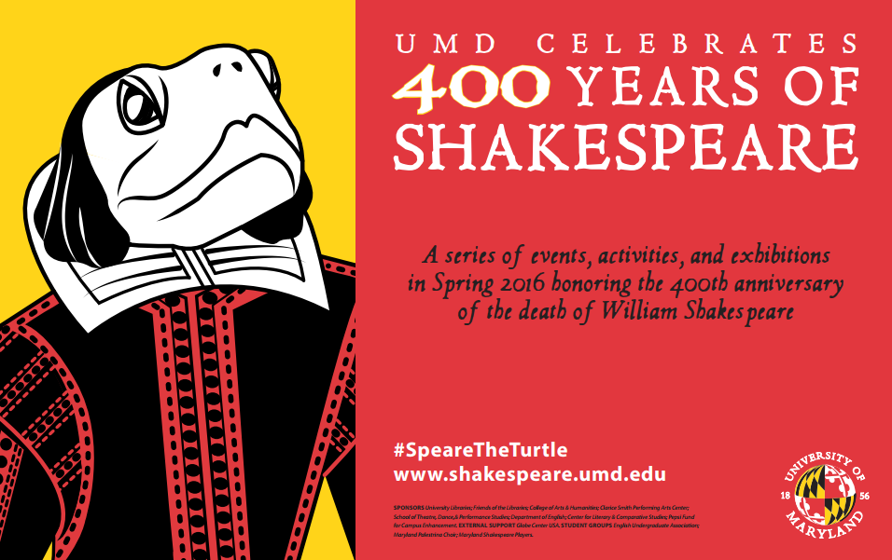
UMD Mascot “Testudo” as Centerpiece
Shakespeare becomes ‘Speare
Notes:
Our UMD Mascot, Testudo was the inspiration for our Shakespearean turtle, whom we named ‘Speare. ‘Speare was created by two of our graphics students under the expert supervision of our Graphics Coordinator Rebecca Wilson
They first photographed the statue of Testudo, which sits in front of McKeldin Library.
They then worked from the image of Shakespeare that appears in the First Folio edition of his plays and merged the two into a sketch that formed the final image of ‘Speare that then appeared in all of our promotional material.

Slide 27



From FrankenReads to FrankenTerp
Notes:
Our UMD Mascot, Testudo was also the inspiration for our Frankenstein turtle, whom we named FrankenTerp.
Our student assistant Simran Gill adapted the official Frankenreads logo, which was a green book with the “Frankenstein” neck bolts, into our FrankenTerp logo, in green and also in white with red background

Slide 28
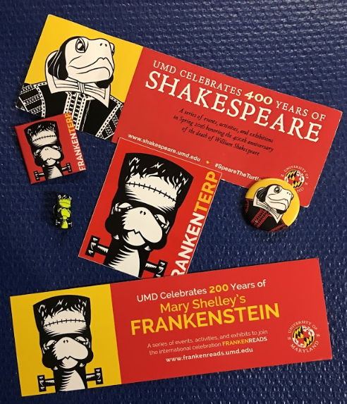
Bookmarks and Pins
Popular Giveaways
Notes:
The ‘Speare and FrankenTerp images appeared on our promotional materials which included poster exhibits, bookmarks, and pins. Here are a few examples.
These were very popular and were given away at all of our events.
The English Department also have hundreds made and gave them away to students in classes and other departmental activities throughout the semester.

Slide 29
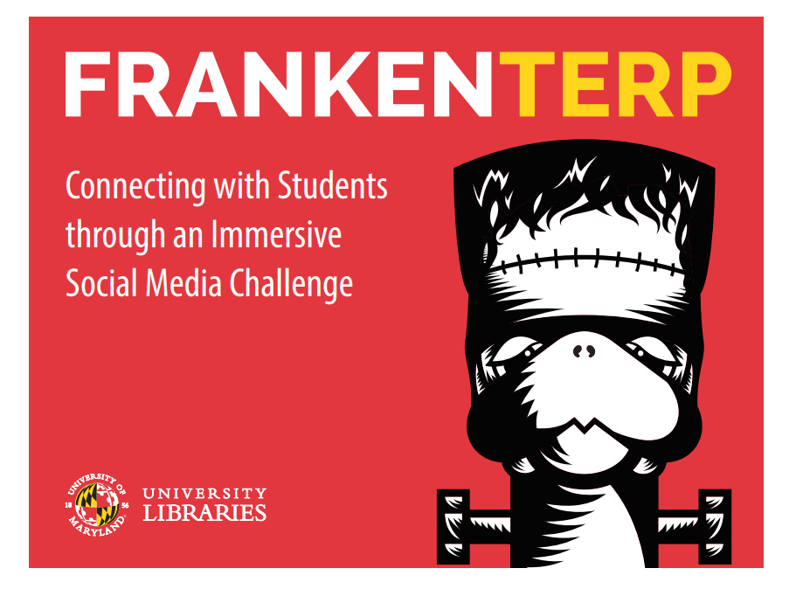
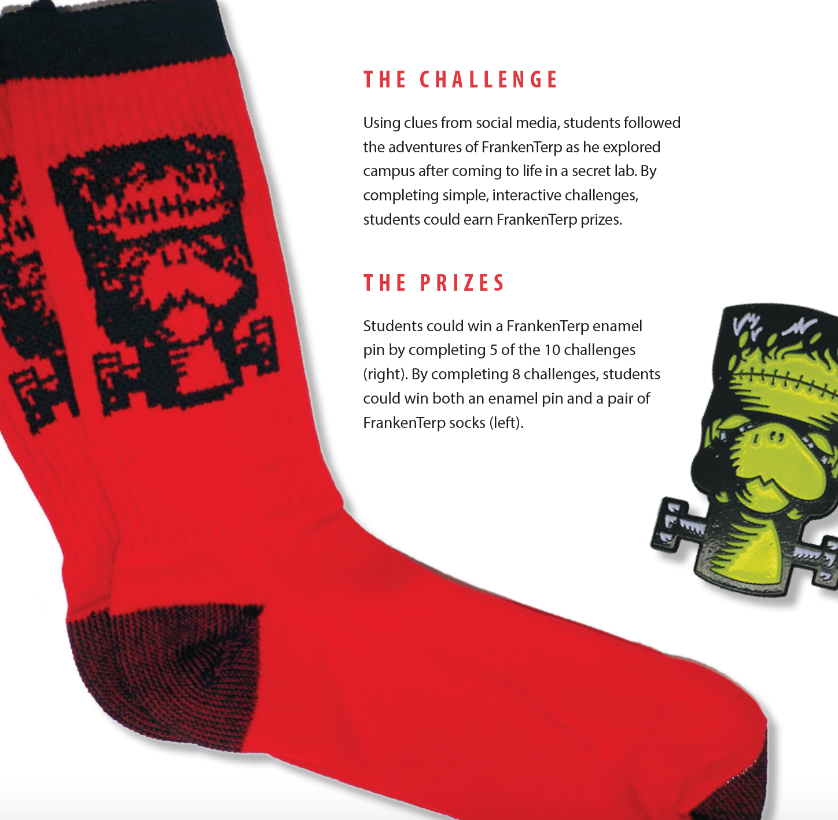
Social Media Challenge
Notes:
In 2018, to coincide with the Frankenstein celebration, FrankenTerp became the star of the Social Media Challenge, an immersive social media event which introduces incoming Freshmen to the services and resources the Libraries provide to support their educational and recreational needs.
Using clues from social media, students followed FrankenTerp as he explored campus and library services, after coming to life in a secret lab. By completing simple interactive challenges could earn FrankenTerp Prizes which included FrankenTerp socks and enamel pins.

Slide 30
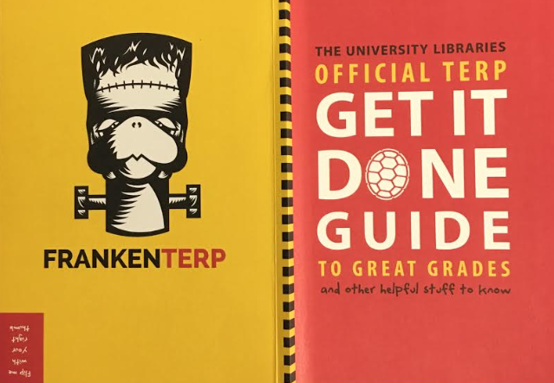
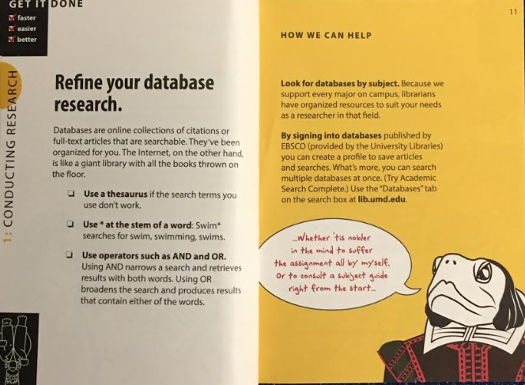
Libraries’ Get it Done Guide
Notes:
“Speare and FrankenTerp were also profiled in the Libraries’ Get It Done Guide which is published at the beginning of each academic year and is filled with valuable information to assist students in their research.

Slide 31
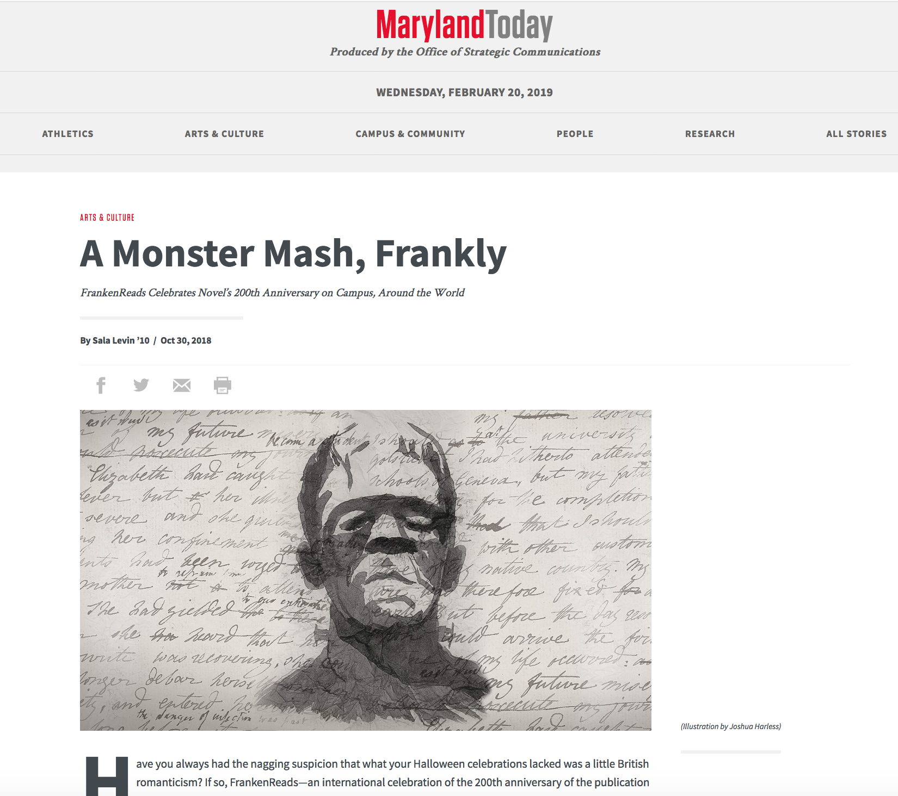
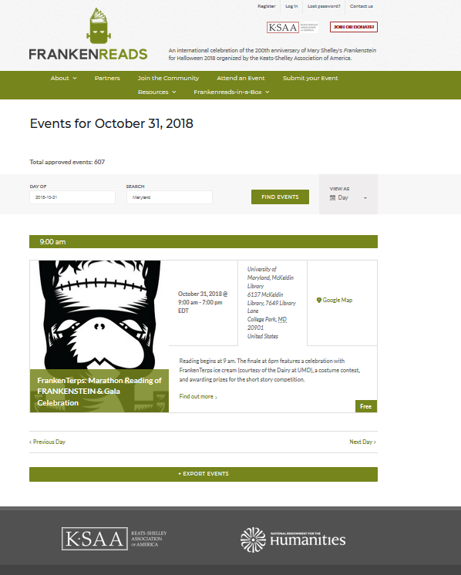
UMD Libraries in the News
Notes:
Marketing efforts for our Frankenstein celebration were very successful both on and off campus. the University’s Office of Communications, which publishes Maryland Today, profiled the FrankenReads Celebration and the Frankenstein marathon reading in the Libraries.
Our Marathon Reading event on Halloween was profiled in the events calendar of the International FrankenReads web site.

Slide 32
Accomplishments
Libraries = Excitement
Collections & Services
Teaching & Learning
Partnerships
Goodwill
Notes:
By positioning the Libraries as a key organizer of these celebrations we were able to accomplish our goals.
We built campus excitement around the Libraries
Through the coordinated exhibits
The ‘Speare and FrankenTerp button and bookmark giveaways
The Social media challenge
The Celebration parties, the Frankenstein Marathon Reading, The Film viewing, and the all important Dairy ice cream
Showcase the Libraries’ collections and services
through coordinated exhibits and tours
Through the Social Media Challenge
Become integrated with campus coursework through
Exhibits & tours
Partnering with the English Department in the Writing Contests
Creating the libguides and GIS storymap to help facilitate undergraduates’ research
We developed important partnerships within the Libraries and with Campus departments
All of the libraries on campus as well as our Special Collections were involved, as were all levels of staff – librarians, archivists, staff, and students
We worked closely with our Communications Office in developing the marketing campaign and promotional materials
Our collaborations with campus departments and centers served to strengthen our partnership within the College of Arts and Humanities.
We generated immense Goodwill towards the Libraries

