Slide 1

Ready, Set, Primo!: Re-envisioning Existing Library Instruction Lesson Plans
Amber Pierdinock-Weed (she/her)
Teaching and Learning Librarian
Benjamin Shaw (he/him)
Teaching and Learning Librarian
University of Maryland, College Park

Slide 2






Major themes
Relinquishing control in the classroom can lead to better student experiences
Disruption can be an opportunity to make needed changes
Just because longstanding programs “work” doesn’t mean they can’t be improved
Notes:
Throughout the presentation, we will be returning to some themes that emerged for us while we were completing this project and preparing for this presentation. While these themes were useful for us while we embarked on this project, these themes might also be helpful for you should you decide to redesign your own existing lesson plans at your home institution.

Slide 3
Today’s Agenda
Introduction to UMD Libraries and ENGL101 instruction
Issues with database demonstrations & Primo migration
Proposing a new lesson plan & getting buy-in
Re-envisioning our library instruction
Key Takeaways

Slide 4
Reflection Moment:
Think about a piece of your library instruction that you would like to change.
What is motivating that change?
Notes:
Before we start talking about our specifics at the University of Maryland, I want to introduce the first of a few reflection moments that we’re going to take throughout the session. Hopefully by having something in your head and mentally following along with our process, it’ll be easy for you decide if you’d like to directly apply our approach to your context. If you have a notebook, you can write this down, or you can just think about it in your head - you can close your eyes if you want - but the goal is to just reflect.
The question is: think about a piece of your library instruction that you would like to change. Why would you want to change this piece of your instruction? What is motivating that change?

Slide 5
Background
University of Maryland, College Park
  Public university, R1, Maryland’s largest university
  30,000 undergraduates, 9,800 graduate students
Teaching & Learning Services is an instruction-focused unit with 3 faculty librarians and 2 GAs.
  Partnership with ENGL101 Program (teach ~180-190 ENGL101 instruction sessions per year)
  Oversee three-semester teacher-training program and mentorship program for MLIS students. (Research & Teaching Fellowship)
  Support other librarians with teaching duties – lesson planning, materials development, assessment, internal workshops, instruction tools, etc.

Slide 6
ENGL101 and TLS Relationship
TLS
Teach a large number of one-shot sessions for ENGL101
Research and Teaching Fellows teach the majority of the one-shot sessions (which enables us to teach the volume that we do).
ENGL101
Embedded Library into syllabus
Gives TLS access to course materials (course assignments, syllabus, textbook)
Notes:
So just to give you some context for our lesson plan that we ended up updating. TLS has a long-standing partnership with the ENGL101 program, our First-Year writing course, which has lasted over a decade. As part of this partnership, each ENGL101 class visits the library for at least one library instruction session, and we make
As Amber mentioned, we are a large university, and so we have a large number of first-years taking ENGL101, and therefore a large number of one-shot sessions (over 180 per year, representing 34% of UMD’s total library instruction). That high volume of instruction is possible because of the Research and Teaching Fellowship. One unique thing about our program is that the majority of the sessions are taught by the Research and Teaching Fellows, who are MLIS students going through our teacher training program.
Biggest collaborator, super embedded, long-standing relationship - lesson plans longstanding - instructors have an expectation of how a one-shot will go

Slide 7
Context about the Research and Teaching Fellowship
PEER
MENTORSHIP
2023
spring fall spring
HIRING
PEER
MENTORSHIP
HIRING
spring fall spring
2024
HIRING
2025
spring fall spring
HIRING
OPTIONAL
REQUIRED
Notes:
The Research and Teaching Fellowship is a three-semester teacher-training program for MLIS students, where students receive mentorship and support in teaching, reference, and job applications. The Fellowship is a heavily structured program. In the spring, new Fellows receive mentorship from the graduating cohort and observe and co-teach ENGL101 sessions with our senior fellows. In the fall semester, Fellows focus on teaching ENGL101 sessions. In the spring, as the new cohort comes in, Fellows continue to teach, and they also provide mentorship to the junior fellows, who are emerging teachers.
Because of the cyclical nature of the program, it is difficult to implement curricular changes to ENGL101, since we must also consider impacts on the Fellows in all decision-making. These two programs are so deeply tied together that changes to one program always impact the other. Curricular decisions usually start by asking how we will then prepare the Fellows for the change and prepare them to deliver the lesson. TLS has provided a heavy amount of structure into RTF to help the Fellows succeed in the classroom.
Because of the Fellows, we have a menu of set activities that we teach for ENGL101, each designed for a specific research concept, that the Fellows can select from…

Slide 8
ENGL101 Assignments
Assignment | Summary | Library Support
Research Mini Project A | Students find 10 sources and conduct a source analysis; complete topic proposal | Choosing a topic; developing keywords
Research Mini Project B | Students find additional sources and create a research matrix to identify gaps in the research and show connections between sources. | Developing keywords; evaluating sources
Inquiry Essay | Essay focused on the importance of their topic and to consider how stakeholders view your topic | Evaluating sources; 1:1 research time
Position Paper | Students argue for a position about their topic | 1:1 research time
Notes:
And here are some of those activities in context with their corresponding ENGL101 assignments. ENGL101 takes an inquiry-based approach to research. Students choose their own research topic early in the semester, and they’re then charged with investigating that topic across multiple assignments, each designed to introduce a different aspect of the research process. for instance, the Research Mini Project A is intended to introduce finding sources and . Research Mini Project B is intended to introduce the idea of scholarship as conversation
While there are more assignments in ENGL101 than what is listed here, these are the assignments we typically see students for support.

Slide 9
Typical ENGL101 One-Shot as of Spring 2024
One-Shot Structure (2024)
Welcome and intro to Libraries
Introduction to information literacy concept
Choice of active learning activity
Database demonstration
Free search, 1:1 check-ins
How to get help in the Library.
(brainstorming topics, how keywords work, differences between types of sources)
(keyword generation, concept mapping, evaluating authority)
Academic Search Ultimate
Notes:
ENGL101 instructors come into the classroom expecting us to follow this format, since this has been how ENGL101 library instruction sessions have worked for so long.

Slide 10
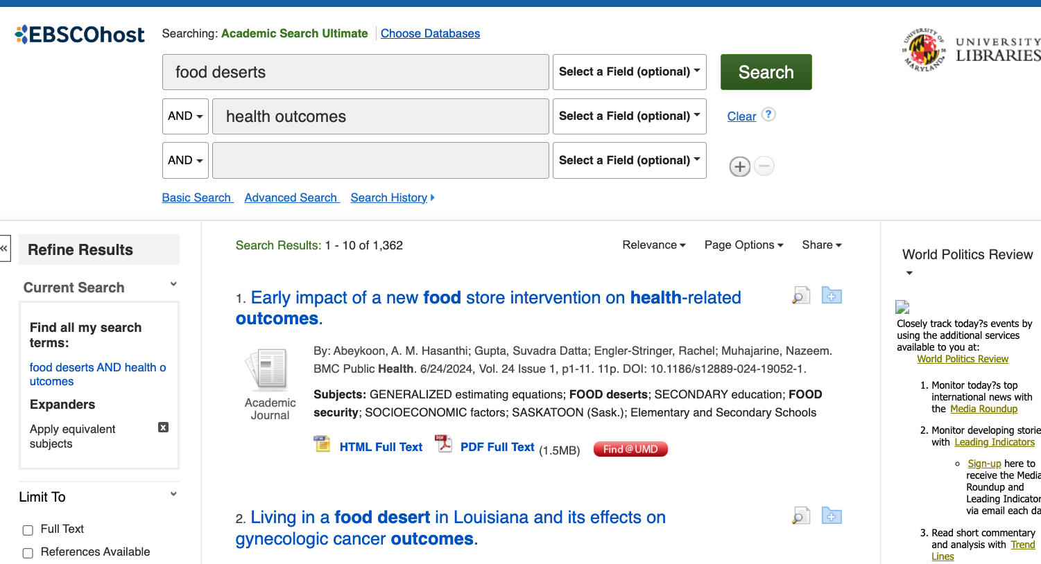
Searching in Academic Search Ultimate
Notes:
We were demonstrating ASU in our lessons, and ASU was a tool we liked. We chose ASU for the database demonstration because it’s a cross-disciplinary database with a little bit of everything in it, scholarly and popular sources, articles across different disciplines. It was a general-enough database that would cover most student topics. In addition,
EBSCO database allowed for an interface that was the same for many of our other databases, so it was easy for students to use.
Ability to choose additional databases and add them to their search.
Clear interface for using Boolean operators and autofill searching.
So we liked ASU for a lot of reasons, but we were teaching ASU as a point-and-click database demonstration, and we had been teaching it this way for a long time, even as other parts of our curriculum became more focused around active learning and student agency in the classroom.
There was also a lot of structural resistance
We were doing a point-and-click database demonstration because we
ALSO: the Fellows were comfortable with this platform and all of our teaching support documentation was focused on ASU.

Slide 11
Problems with Existing Database Demonstration
Database demonstration held at the end of the class session.
  Librarians often don’t make it to this part of the lesson plan or rush through it.
Point-and-click method of database demonstration was unengaging and students were having difficulty following along.
Students having difficulty accessing the databases after their library session.
  This leads to students using Google to find sources that don’t align with instructor requirements.
Notes:
We had been discussing some problems with the existing database demonstration to try and solve.
Librarians often rush through it - especially difficult for new librarian-instructors working on timing.
The database demonstration was already an outlier in our lesson plan, since the rest of our lesson plan is very active and discussion-based.
Info for Undergrads page exists but hard to find, students encouraged to bookmark but not intuitive
So we were thinking about ways to fix this, and we started thinking about what a student-driven rather than lecture-driven database demonstration would look like. We thought this was going to be our next project. But as Amber is going to discuss, something threw a wrench in those plans.

Slide 12
We were already thinking about how to improve database demonstrations when…

Slide 13


Summer 2024: Primo Migration
Notes:
Thought was there but had to table because UMD Discover appeared!
UMD implemented Primo (replacing WorldCat) as our discovery system in May 2024, branded as UMD Discover.
Over the summer, Teaching & Learning Services developed learning objects to teach the campus how to use UMD Discover, while we were also learning how to use the new catalog.
Had to table database demonstration update

Slide 14
How was TLS Responding to Primo?
01
Amber served on Primo Discovery Implementation Working Group
Service
02
Developed instructional videos for UMD Library website.
Updated LibGuides
Updated ENGL101 course module in Canvas.
Instructional Materials
03
Hosted workshops and training session about using Primo for reference and instruction.
Considered impacts of Primo on student learning and other instructional materials in the Libraries.
Preparing Others
Notes:
While in our learning process, we discovered new possibilities that the new system afforded.
Amber served on the Primo Discovery Implementation Working Group as the TLS representative.
Developed instructional videos about searching in Primo.
Assisted in updating LibGuides and the UMD Libraries’ Primo LibGuide with information about Primo
Updated ENGL101 course module in Canvas with Primo information.
Hosted workshops and training sessions about using Primo for reference and instruction.
Considering impacts of Primo on student learning and other instructional materials in the Libraries.

Slide 15
As we were developing instruction materials for the campus about Primo, we started to notice how many of its features were helpful for ENGL101 students.

Slide 16
Helpful features for ENGL101 in Primo
Citation Chaining | Saved Searches
What it is Users are able to see who is cited in an article and sources that are citing an article. Users have the ability to create their own citation chains. | What it is Users have the ability in Primo to pin/save sources and search strings to a personal collection.
Why we love it This tool gives a clear visual representation of the ACRL Frame “Scholarship as Conversation.” | Why we love it This is an easy way for students to save the sources they find while doing research and organizing their sources into collections. While students can do this in a citation manager like Zotero, this might be an easier tool for a First-Year or undergraduate student to use.
Notes:
While there are many features in Primo that we found helpful for students, the citation chaining tool and the pinned searches options were the most relevant for ENGL101 students.

Slide 17
Strengths and weaknesses of Academic Search Ultimate and Primo
Academic Search Ultimate | Primo
Strengths Resources from a variety of disciplines. Easy-to-access Boolean operators Academic articles and popular sources | Strengths Resources from every discipline All resource types - books, academic articles, popular sources, archival material, reviews Materials from all databases searchable Save searches, access all library functions within one account
Weaknesses Multiple steps to save sources Interface less intuitive | Weaknesses Harder to see Boolean operator features. Less extensive subject terms
Notes:
Seeing these new features that Primo had to offer made us think back to our ideas of updating our database demonstration. We realized that some of the features closely aligned with ENGL101. Started thinking this was equivalent to ASU but under even further investigation we realized that the resources offered in Primo were better than ASU and could help students with some of the issues with database demonstrations and also anecdotal issues we had been hearing from ENGL101 about the quality of sources that students were using in assignments.

Slide 18
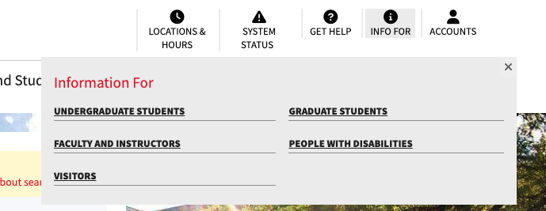
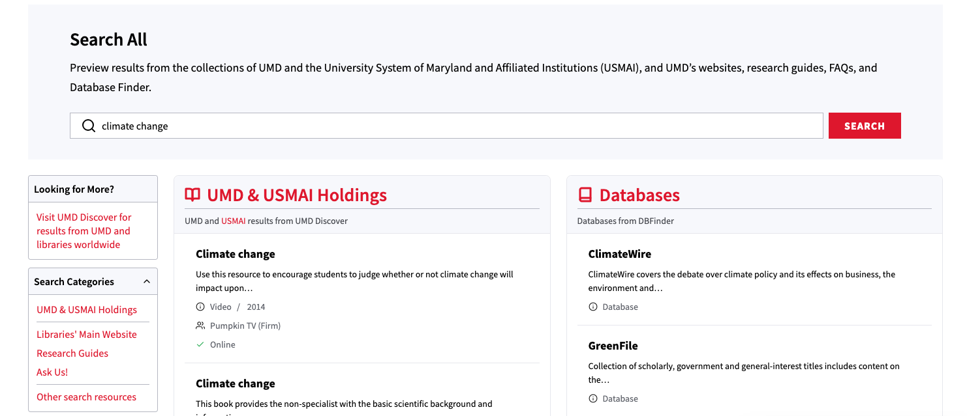
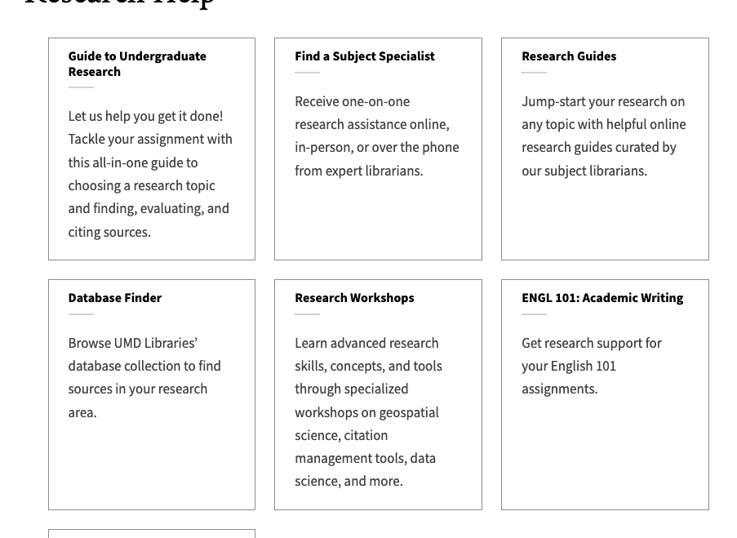
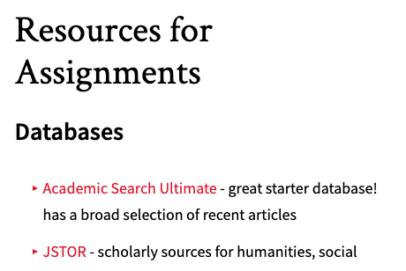
Students’ previous methods of accessing Academic Search Ultimate
Notes:
We were in the strange position of telling people to avoid the main search bar - Bento search was confusing

Slide 19
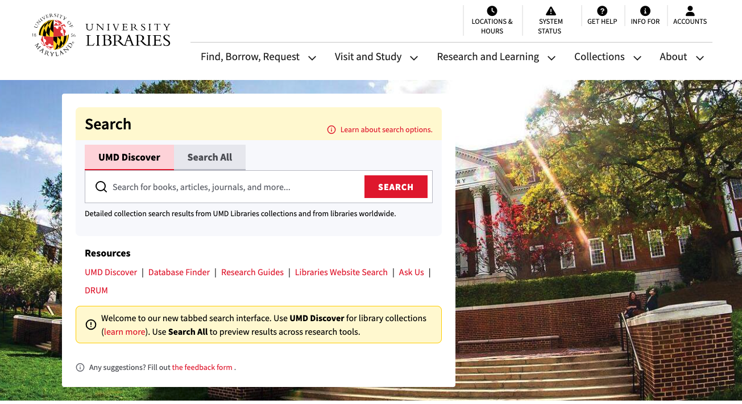
Students’ current method of searching for sources

Slide 20
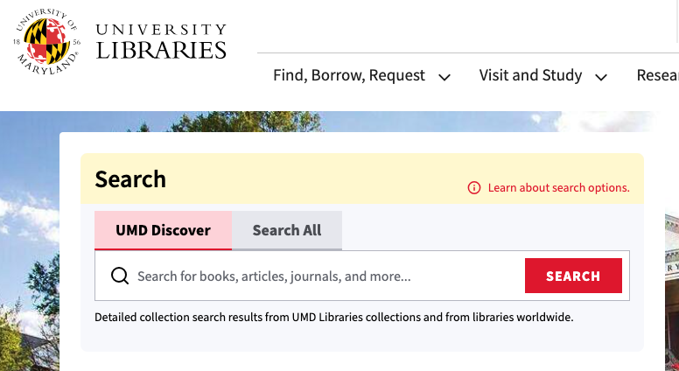
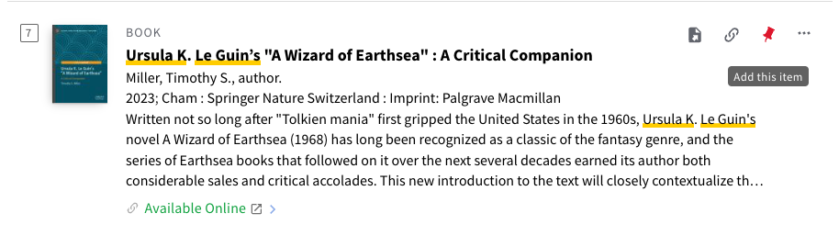
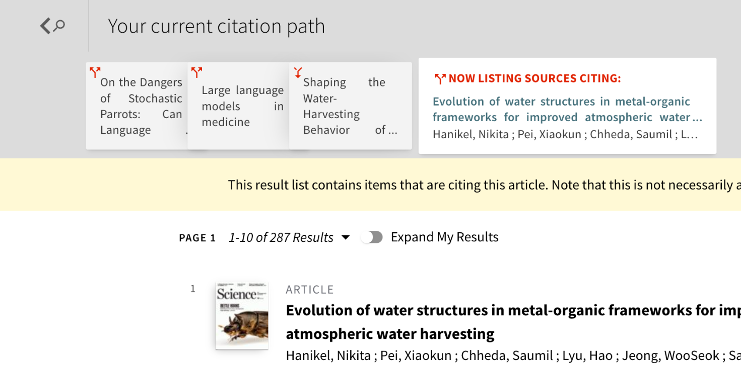
Could Primo Solve Our Problems?
Accessible
Intuitive
Illustrates IL concepts
Notes:
Accessible, intuitive, illustrated IL concepts
Pinning, citation chaining, one tool as opposed to multiple tools (less hidden curriculum of searching)

Slide 21
What if we replaced database demonstrations with teaching students how to use Primo?
Notes:
What if we entirely replaced our database demonstration with teaching students how to use Primo?

Slide 22

Separate goals aligning
Make database demonstrations for first-years more engaging and effective
Teach undergraduate students effective research strategies using Primo.
Replace database demonstration with student-driven catalog exploration
Notes:
We had our existing goals to introduce info lit to the campus around WorldCat
Solved two problems at once!
We were thinking that Primo’s search was capacious enough to fit the needs of our first-year writing students entirely.

Slide 23
Keep in mind, we were not teaching First-Year students how to use WorldCat (our previous discovery system).
Notes:
This idea was a big deal for a couple reasons. First, we had already moved away from doing catalog demonstrations in the past. We had stopped teaching WorldCat in ENGL101. At the time, ASU was a better search experience for FYS.. ASU worked better than WorldCat for ENGL101 students.
Students were originally taught WC and ASU. WC was meant to teach students about physical books and ILL, but we moved away from this because students at this level didn’t need this information. At the time, WorldCat was not serving the needs of our student population. They were not required to use book sources in their research and teaching students how to directly access databases was the better option at the time.

Slide 24
Would it be possible to not teach databases in ENGL101 one-shots?
Notes:
So in the past we had already chosen to not teach the catalog. But would it be possible to not teach databases?
We had to pump the brakes for a moment and think.

Slide 25
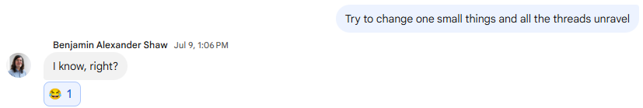
We had a LOT of conversations
Notes:
And so we had a LOT of conversations. This program is a huge ship to turn around, and making a change would have an impact on so many people around the Libraries and around campus - the Fellows, our subject specialists, ENGL101 faculty and students.
We heavily debated whether or not we should do this all.
We knew this would necessitate a pretty extensive redesign of our instruction. During the summer of 2024, we were extremely busy responding to the Primo migration on our campus and worried we would not be able to effectively and thoughtfully consider this project.
Our lesson plans and one-shot structure had been in place for so long. We were worried if we stopped teaching databases, would our entire one-shot fall apart? How integral to the one-shot was the database demonstration?
We’ve been doing it for so long, that making a larger change felt like a huge deal
We assumed that we would receive pushback from the ENGL101 program, because we had been doing instruction this way for so long. We anticipated heavy pushback from ENGL101 for not teaching how to use specific library databases (which is how we justified how deeply embedded we are into the program). If we stopped teaching library databases, would we lose our leverage with the program?
We were realizing how structured our program truly is, and how everything in the one-shot led into one another. (As this screenshot from one of our many gchats can testify.) Every time we returned to this idea, it felt like if we pulled on this thread, we would unravel our entire instruction program.
As this avalanche of questions emerged, we were thinking about some specific obstacles.

Slide 26
Expectations vs. reality
The ENGL101 materials will have too many direct references to ASU.
Vague references to databases, but nothing mentioned by name.
We’ll get too much pushback from ENGL101 faculty.
Once they saw Primo’s salient features, the faculty were on board.
We’ll ruin the scaffolding for higher-level courses by not introducing databases in ENGL101.
Database searching is introduced in subject-specific instruction, and not every student takes ENGL101 before subject instruction.
This will be too short notice for our teaching Fellows to adjust to a new lesson plan.
Grad students adapted well; creating extensive curriculum map and lesson plans helped support our students
Notes:
So here are some of the obstacles we expected on the way to making this big curricular change.
We also believed that the ENGL101 course materials would end up contradicting our idea and we would not be able to proceed in with the project. This led us to do a very deep diver into our ENGL101 curriculum, something we had not done in years.
The ENGL101 textbook is published at UMD by our Academic Writing Program, so some of the references are hyper-local to our campus. Because of this, we anticipated specific references to the databases. We knew we could not contradict what is in the ENGL101 materials. Needed to figure out if ASU or other databases were listed by name. We didn’t need to have the textbook updated or get ENGL101 instructors to change all their materials / what is being talked about in class.
We were also unsure if our ENGL101 faculty would resist this change, since we had been teaching ASU for so long. Ben is the ENGL101 liaison and reached out to ENGL101 leadership and they were open to a year-long pilot program to try out Primo. However, once we pitched them the features in Primo that excited us, they were willing to do a pilot.
We were also concerned that our subject librarians needed us to provide the introduction to ASU and other databases in ENGL101 for scaffolding purposes. Would not teaching this at However, upon closer examination, we realized that subject librarians focused more on teaching their students about their specific databases and knowing ASU at this level wasn’t necessary - this was being reinforced in other areas.
We needed to prepare the Fellows for this change. Another factor to consider was that the Fellows do not typically work over the summer, so the bulk of this teaching would be done by instructors who had comparatively little time to prepare. Although we scheduled additional practice sessions over the summer, Primo’s interface and capabilities were consistently changing over the summer as updates were pushed. This meant that instructors would inevitably not be fully up to speed on Primo searching by the time the semester started.
In fact, our grad students adapted very well to the change! We provided extensive materials to help structure the lesson, and We brought our students into the brainstorming and testing process for this lesson plan, which helped them learn about Primo and how to teach the catalog before the semester started. The fact that we and our students were still learning about Primo, and that it would not enter its “final form” before fall, actually played into our decision to create a student-driven demonstration. We could engage in inquiry together with students, and librarians could use their prior expertise to guide students to salient features.
Even though there was some logistical difficulty in making the change, the obstacles turned out to be not nearly as insurmountable as we first thought.

Slide 27
Reflection Moment:
Think about that piece of library instruction you want to change.
What would be your obstacles to making this change?

Slide 28
Process of Lesson Plan Design
Audit
Brainstorm
Conversations
Draft
Beta Test
What is the purpose of each activity?
How does this support the current ENGL101 student learning outcomes?
How would this activity need to be updated to reflect the change to Primo?
How do we teach this lesson plan to Research and Teaching Fellows?
Brainstormed learning outcomes and key concepts for students to learn.
Held conversations with Research and Teaching Fellows and subject librarians.
Created initial draft of the lesson plan.
Beta tested draft of lesson plan with Research & Teaching Fellows
Notes:
Once we had successfully assuaged our fears and ascertained that it was possible to make the change, the first thing we needed to do was a curriculum audit.
We knew that by reimagining the structure of our one-shot sessions that this would necessarily change the tone of our other activities. We realized we could take this one step further by doing an audit of our IL curriculum to see which structures needed to be tweaked to include Primo, but also which concepts could be communicated more effectively.
The ENGL101 program had updated their standard syllabus the year prior, and our instructional materials did not yet fully reflect that change. This audit helped us think more about the purpose of of each activity, how it was serving a curricular need, and if that curricular need was current.
We ended up building a curriculum map to help us with the audit. The curriculum map served multiple functions: a way for us to see everything we were teaching and creating clear justifications as to why we were teaching these skills. The curriculum map also helped the Fellows, as it acts as a decision-making tool for Fellows to decide how to structure a one-shot session, based on the assignment that students are working on in ENGL101.
Our next step was to go through important features of Primo search, and use those to brainstorm our learning outcomes and key concepts we wanted students to come away with. We next invited our Fellows into this process, and brought them in to share their insight into first-year students’ searching practices from the classroom. We also reached out to our subject specialists to engage them in conversation about this change, anticipate any pushback, and ensure that the program was scaffolded appropriately.
Amber then took the lead on drafting the lesson plan itself, providing a structure for our instructors to use. Finally, we did some beta testing over the summer with our teaching Fellows, giving them practice with the lesson plan while also providing us with insight into what was working and what needed to change. I’ll turn it over to Amber to talk about the lesson plan itself.

Slide 29
How do we teach our library catalog in a student-driven way?

Slide 30
Old vs. new lesson plans
Lesson Plan Structure (Previous)
Welcome and intro to Libraries
Introduction to information literacy concept (keyword generation, concept mapping, evaluating authority)
Choice of active learning activity (keyword generation, concept mapping, evaluating authority)
Database demonstration
Free search, 1:1 check-ins
Lesson Plan Structure (Current)
Welcome and intro to Libraries
Catalog exploration & discussion
Introduction to information literacy concept
Choice of active learning activity
Return to catalog to implement concept
Free search, 1:1 check-ins
Notes:
Better integrated throughout the lesson rather than out of context at the end
Navigate to Primo and give students the same keywords to search.
Student exploration with guided worksheet before any librarian-led demonstration.
Students share with partners what they found and questions they have.
Full Class Discussion on what students found and have questions about
Librarian adds any further necessary context & clear up any misconceptions
Librarian demonstrates any remaining key features
Students independent search for their topic with one-on-one research help with librarian.

Slide 31
Started with Backwards Design
Formative Assessment
Research Ecosystem
Exploratory Mindset
Notes:
Research ecosystem: further integrated into library systems, moving primo demonstration to the beginning of the lesson rather than the end
Formative assessment: Finding out what students were clicking with, rebuilding our knowledge base, collaborating with UX folks
How do we contextualize Primo in the research process more? The database demonstrations always felt out of place and disconnected from the information literacy skills that we were teaching earlier in class. Additionally, ENGL101 had requested more focus on database demonstration and a demphasis on information literacy skills. This was a solution to give ENGL101 more search time and also not demphasize IL skills. We wanted to better contextualize search as part of the research process to help it feel less linear and more iterative. We also wanted a lesson plan that taught an exploratory mindset that students can apply to databases in their future research.
There were also some pragmatic decisions we made: this was a new search tool that most librarians had little-to-no experience using and because the discovery system was implemented over the summer when few undergraduates are on campus, we did not have a sense of how undergraduate students would use the tool or how they would intuitively search. So we decided to incorporate intuitive search as a key component of the lesson plan.

Slide 32
Early goals and how they manifested in the lesson plan
Early Goal | Final Version
Introduce Primo early in session | First few minutes of open exploration, discussion and clarification, deeper exploration
Active learning, discussion-based | Students explore based on interest, think-pair-share
Seamlessly align with existing materials | Activity as “wrapper” for other concepts and activities; return to Primo searching throughout lesson to apply concepts
Introduce independent learning approach, evergreen, not specific to ENGL101 | Focused on exploration and resource understanding
Notes:
Giving students a topic to search that is broad enough to show the breadth of resources available.
Identifying and introducing filters that are important for ENGL101
No demo before students begin the activity
Get to see student thought process.
Students as peer teachers
Students get to pose authentic questions
Think-Pair-Share

Slide 33
Student Learning Outcomes
By the end of the session, students will be able to:
Navigate catalog and successfully find sources
Use citation chaining to find sources and map the scholarly conversation

Slide 34
Summary of Primo Lesson Plan
Librarian Navigates Students to Primo
Think (3 mins)
Pair (3 mins)
Share (5+ mins)
Librarian ensures students are inside Primo.
Librarian chooses keywords for students to use for their search.
Using a guided worksheet, students identify resource types and filters in Primo.
With a partner, students share what they have found and continue to explore Primo.
As a class, students share what they like about Primo and what they still have questions about.
Notes:
Navigate to Primo and give students the same keywords to search.
Student exploration with guided worksheet before any librarian-led demonstration.
Students share with partners what they found and questions they have.
Full Class Discussion on what students found and have questions about
Librarian adds any further necessary context & clear up any misconceptions
Librarian demonstrates any remaining key features
Students independent search for their topic with one-on-one research help with librarian.

Slide 35
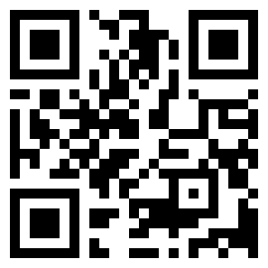
Primo Worksheet and Lesson Plan
Notes:
Needed extensive instructions because introducing this to the Fellows
Worksheet: this is the initial framing and primer. We intentionally made it this way to direct people towards a couple specific things and then allow for maximum student exploration. What skills do they need in this immediate moment, we are not forcing them there, they are getting there on their own.

Slide 36
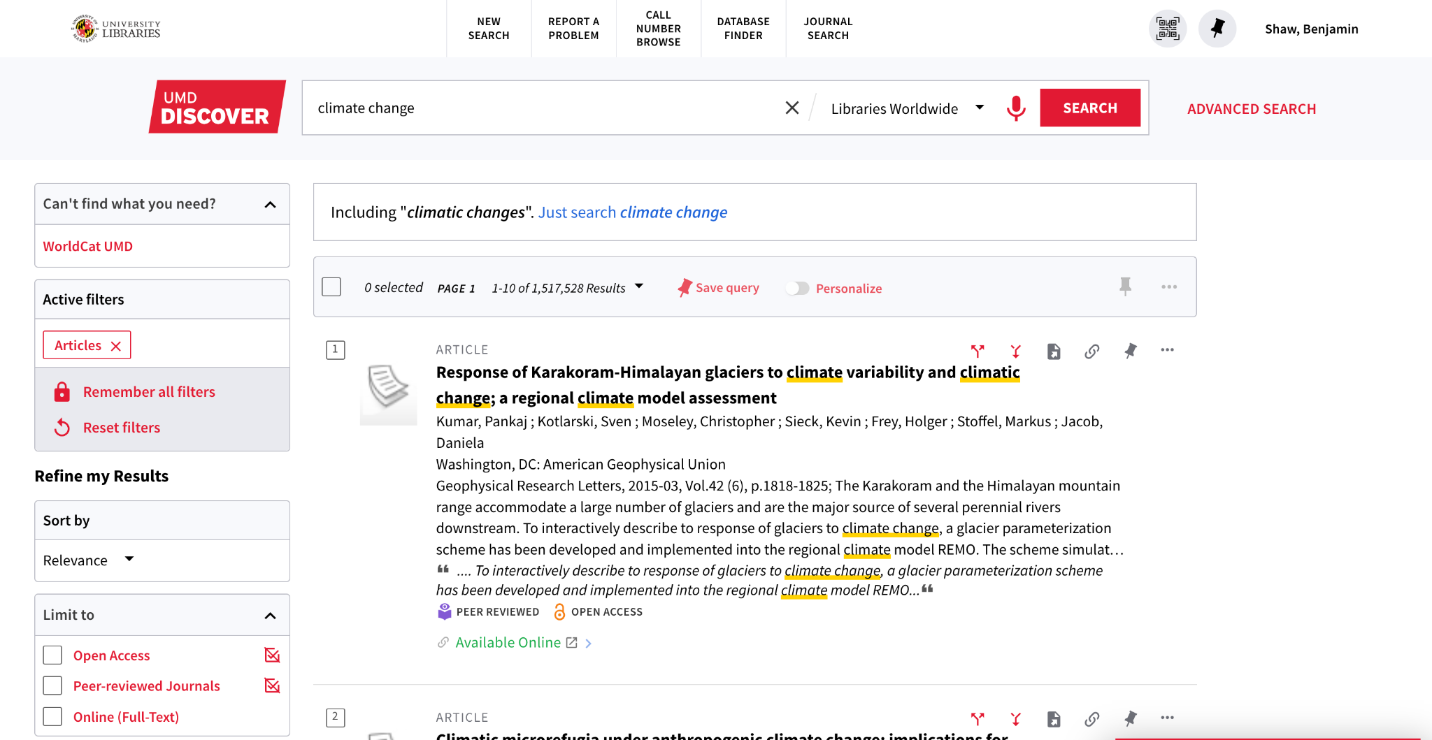
Filters students mentioned during class discussion (part 1)
Notes:
Students often had questions about the top level header, particularly the journal search and call number browse. At this stage in their research experience, students are usually not able to understand why they would need to use these features in their research. This eases into a conversation about why you would need these search skills and gives students a glimpse of the different skills they will need in the future.

Slide 37
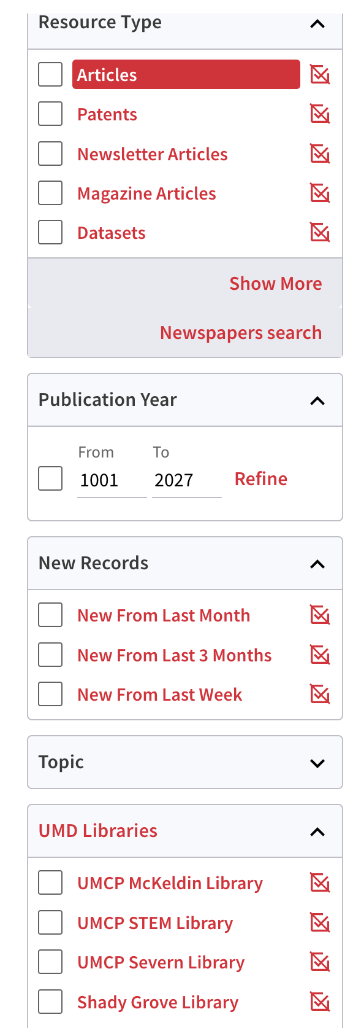
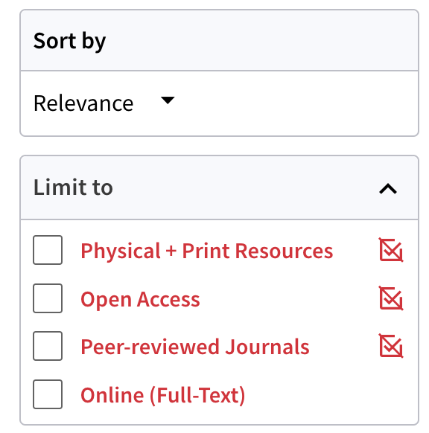
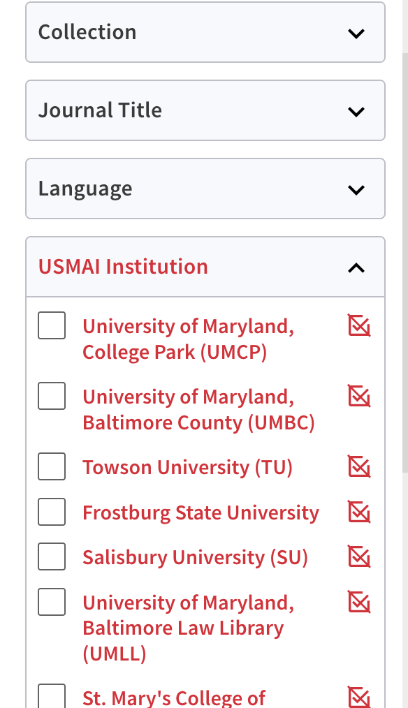
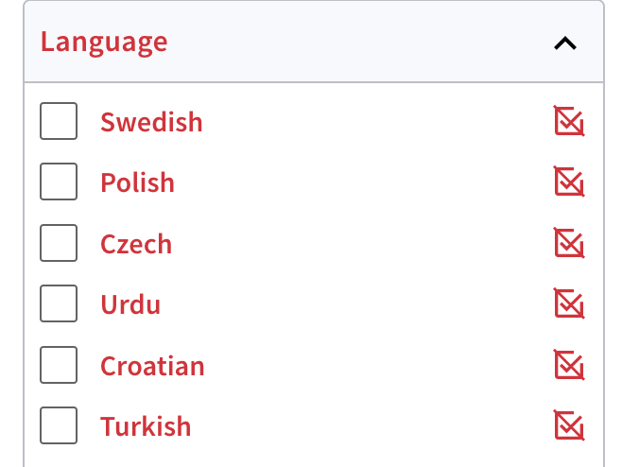
Filters students mentioned during class discussions (Part 2)
Notes:
Students were interested in the date filter, especially with the date from 1001 (this is a placeholder in Primo), but students regularly point this out and they are excited by the thought of older materials in the library. This does lead to a great discussion about the date of a source and when a student would need to filter by date. It’s also an introduction to conversations
Students also regularly point out the different campus libraries. This is something that we used to cover in our initial welcome to the library speech, but we ended up cutting that down because students were not engaged. Now, students are learning the same content, but we are teaching it in a way that allows them to explore. By understanding that our different campus libraries have different materials in them, we can have a holistic conversation about the libraries. It also creates interesting conversation to think about the different collections and why someone would need that filter.
By engaging in these discussions with students we are providing a more holistic understanding of how library catalogs work, beyond the immediate skills they need to complete their assignment. We also believe by introducing advanced level skills early in their college careers, and giving students a quick look to their academic future, that we can be contributing to students overall sense of belonging on campus.
What is USMAI? - gives opportunity to understand libraries as a system, more holistic view of the library than they would previously
Open Access filter - things were intentionally emphasized in the catalog
Students still want print books
Students are showing more curiosity and interest about the library in a way that they wouldn’t with a database
Library feels less theoretical because they can see the results - student-led discussion is focusing on things that are immediately more interesting as opposed to being lectured at
Building knowledge of the library
Why is there stuff about the performing arts library about climate change? Interdisciplinary act of research more holistically; furthers sense of belonging on campus bc they know more about the library

Slide 38
Current lesson plan structure
Lesson Plan Structure (Current)
Welcome and intro to Libraries
Catalog exploration & discussion
Introduction to information literacy concept
Choice of active learning activity
Return to catalog to implement concept
Free search, 1:1 check-ins

Slide 39
How It’s Been Going
Notes:
We think it’s been going very well! The pilot has expired, but based on the feedback we’ve gotten from students, faculty, and graduate Fellows, we’ve made it a permanent part of our standard lesson plan.

Slide 40
Future Work
Continue to monitor changes to UMD’s Primo interface.
  Features conducive to explaining key research concepts, include in future iterations of lesson plan
Currently doing an instructor survey on ENGL101 students’ source quality and research behavior post-Primo.
Students mention Primo more often than they mentioned Academic Search Ultimate in their assessment.

Slide 41
Our Takeaways
Relinquishing control
  Letting go of control and allowing students to control demonstrations allow more organic conversation.
Disruption as opportunity
  Existing, disparate problems can align and create solutions for each other.
Making changes to long-standing programs
  Letting go of things that don’t serve our program anymore
  Periodically review your instruction materials in conversation with your curricular needs.
  Try out a change - roadblocks may not be as firm as you think
Notes:
Bringing it back to our three themes from the beginning, here are some of the takeaways we have from this project, which we’ll use as guiding points for work we do in the future.

Slide 42
Reflection Moment:
Think about one of the obstacles to making your instructional change.
What is one way you could navigate around that obstacle or turn it into an opportunity?

Slide 43
Thank You and Acknowledgements
Thank you to the following people who also worked on this project:
Yasmin Bromir
Benjamin Henry
Emily Irvine
Lexi Kadis
Maddy Mikovits

Slide 44

Questions?
Amber Pierdinock-Weed (she/her),
Teaching and Learning Librarian, apierdin@umd.edu
Benjamin Shaw (he/him),
Teaching and Learning Librarian, bshaw1@umd.edu

