Slide 1


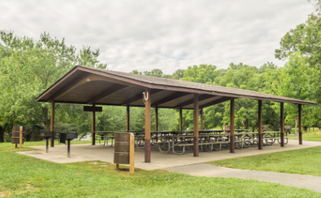
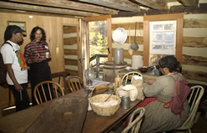
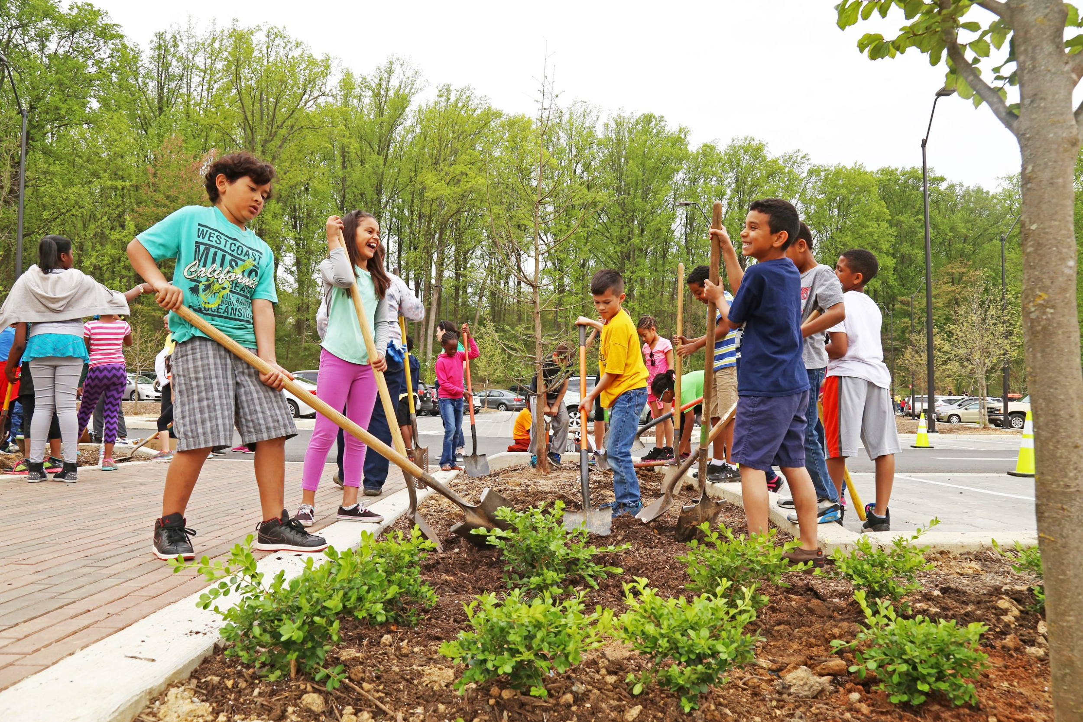
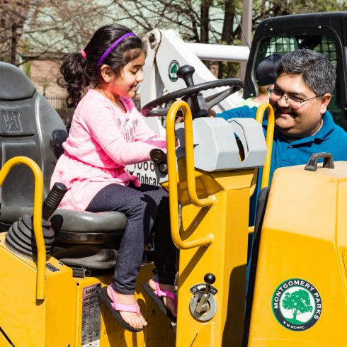
Montgomery Parks Outreach Strategy & Implementation Plan
CJRT Consulting Team

Slide 2
Agenda
Introductions | 3
Project Overview | 4
Analysis | 9
Recommendations & Implementation Plan | 17
Feedback/Questions | 27
Appendix | 28
Notes:
We will start today by giving you a general project overview, for those of you who are just joining us, and then go into our analysis of the issue and the research we have found. We will conclude with our recommendations, the implementation plan, and the financial cost associated with it.

Slide 3
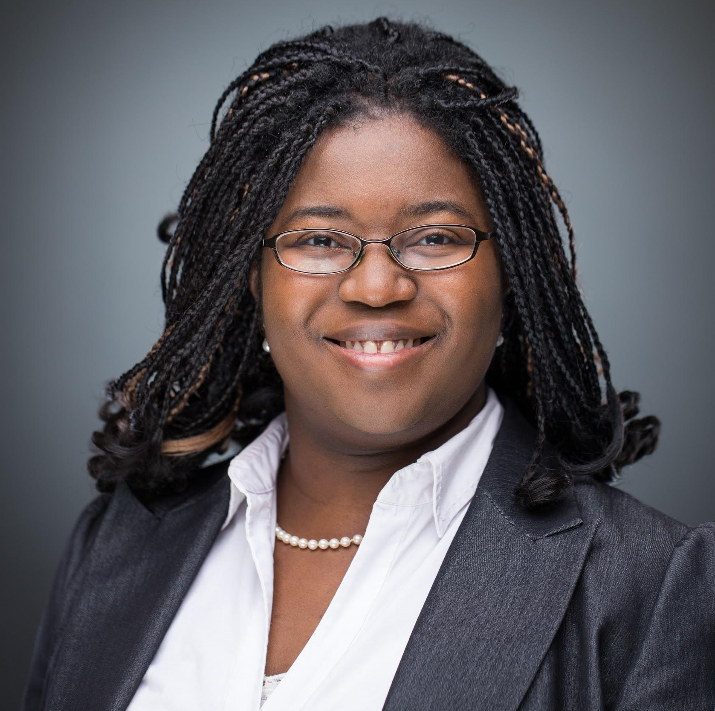
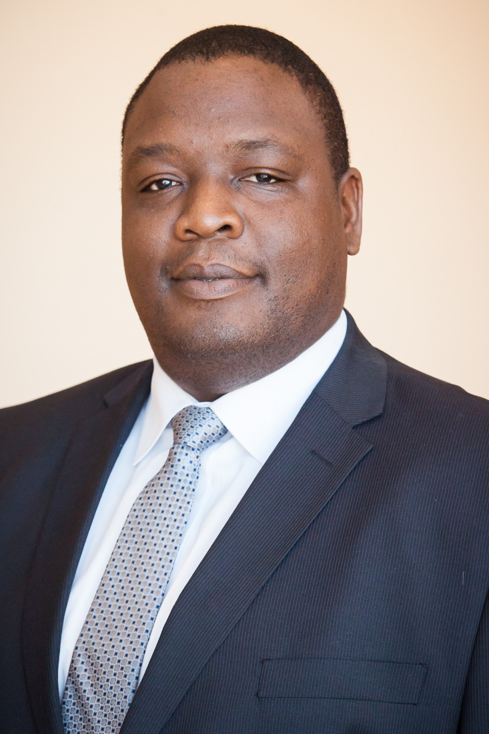
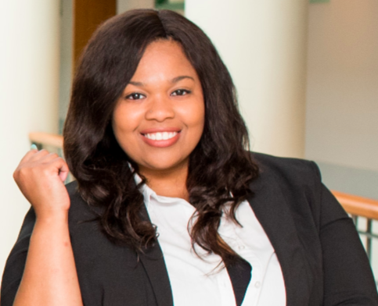
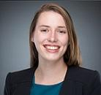
Introductions
Catherine Yourougou, JD, MBA Candidate
Excel Lover
Expertise: Volunteer & Nonprofit Management, Legal Consulting
Joseph Davies, MS, MBA Candidate
Strategy & Financial Impact
Expertise: Strategy, Operations, Human Capital
I am learning Korean by watching K-pop tv shows.
I may have forgotten what fun is the past 2 years.
Tatiana Torruella, MBA/MSW
Enthusiasm Specialist
Expertise: Human Capital Strategy &
Change Management
Rachel Carstens, MFA, MBA Candidate
Creative Guru
Expertise: Strategic Planning, Governmental Organizations, & Program Evaluation
I enjoy karaoke on long road trips.
I lived and went to school in Panama City, Panama during the summer of 2009. A mi, me encanta español!
Notes:
Introduce each person, mention that we are all MBA students

Slide 4
Project Overview
Montgomery Parks Mission:
Manage physical growth and plan communities
Protect and steward natural, cultural and historic resources
Provide leisure and recreational experiences
The Challenge
Over 1/3 of Montgomery County’s residents are non-English speaking; this population is growing
Low minority representation/attendance at planning meetings
Limited evidence that minority groups are utilizing the parks

Slide 5
Overall Project Goals:
To provide our client with a cost-efficient, effective, and sustainable communication strategy.
To provide an implementation strategy to achieve improved outreach, engaging non-typical park users.

Slide 6
Our Recommendations Will Provide
Evidence of community engagement and park utilization
Increased Funding/MP budget (Montgomery County)
Opportunity for Prestige/Recognition of Excellence

Slide 7
Where You Need A Boost
Majority is not reflected at planning meetings and is not reflected among current outreach engagement (e.g. social media)
Funding/Resources (particularly human capital)
Strategy for data

Slide 8
Preview of Our Plan:
Targeted Outreach
Black American
Latinx
Chinese
Analysis & Recommendations for 3 Target Populations
Cost Analysis of Recommendations
(cost effective & sustainable)
Implementation Plan & Power Point deliverable
Notes:
The goal of the project is to implement efficient, cost effective, and sustainable strategies for impactful outreach, into underrepresented communities, in order to maximize community involvement.
Catherine
In Scope:
Analysis and Recommendations on 3 target populations best way to communicate and engage them in Parks department
Includes possible partnerships, reaching out to ethnic media,
Financial analysis of recommendations
Cost of recommendations
Execution & potential next stops
How they should start setting up
Out of Scope:
More than 3 target populations
Actual hiring/distribution of resources
How to maintain the relationship

Slide 9
Analysis

Slide 10
Project Methodology: Primary Research
Interviewed key stakeholders:
  Montgomery Parks staff
  Natali Fani-Gonzalez, Commissioner
  1 current and 1 former Montgomery County Council staff
Interviewed experts:
  4 community organizers
  4 K-16 student-career pipeline professionals
  2 Social Work faculty
  2 graduate students
Notes:
Rachel

Slide 11
Project Methodology: Secondary Research
Included...
previous consultants work for key insights
local, state, and national parks usage data
existing research on ‘hard to reach’ and ‘expensive to reach’ best practices
existing research on best practices for improving institutional cultural competency

Slide 12
Minority Urban Park Use Trends & Desires
61.3% use
Avg 3+ hrs/visit
Fear for safety may impact use
Black American
Top Preferences for All Groups:
Social (family & organized groups)
Food-related & Exercise
Educational and experiential events were the least popular reasons for utilizing urban parks and forests.
71% use
Use parks for ‘social relaxation’
Less likely to exercise at parks
*groups ≳3
*group sports
Latinx
social, food,
weekends
Chinese
79.6% use
Most likely to exercise at parks
Desire water-based &
consumptive activities
Avg 1-2 hrs/visit
*10% come in groups of <10
Sources: Sasidharan, Willits & Godbey. (2005). Cultural differences in urban recreation patterns: An examination of park usage and activity participation across six population subgroups. Managing Leisure, 10(1), 19-38.
Gobster (2002) Managing urban parks for a racially and ethnically diverse clientele. Leisure Sciences, 24(2), 143-159, DOI: 10.1080/01490400252900121
Notes:
Gobster used on-site interviewing at one park across with 911 responses: 71% White, 12% Black, 11 % Latino, 4% Asian, 2% other, and 1% missing data. Beyond this, however, the sample of 49 Blacks, 45 Latinos, and 16 Asians was too small to answer questions about minority groups.

Slide 13
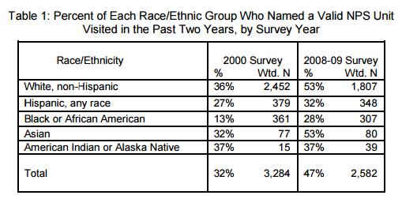
Park Usage: Key Statistics
National Parks
Montgomery Parks
A 2011 study of the National Parks System usage found:
Key Insights:
91% of MC residents reported visiting a Montgomery Park at least once in 2009
All county residents are no more than 2 miles from a park
U.S. Department of Interior. (2011). National Park Service Comprehensive Survey of the American Public 2008–2009 Racial and Ethnic Diversity of National Park System Visitors and Non-Visitors. Natural Resource Report NPS/NRSS/SSD/NRR. Retrieved from
https://www.nature.nps.gov/socialscience/docs/CompSurvey2008_2009RaceEthnicity.pdf
National Research Center, Inc. 2009
Notes:
Largest Non-English Speaking Groups:
% of total population | % of non-English groups
14.5% | 40.1% Hispanic
3.53% | 9.8% Chinese
2.9% | 8% African Languages

Slide 14
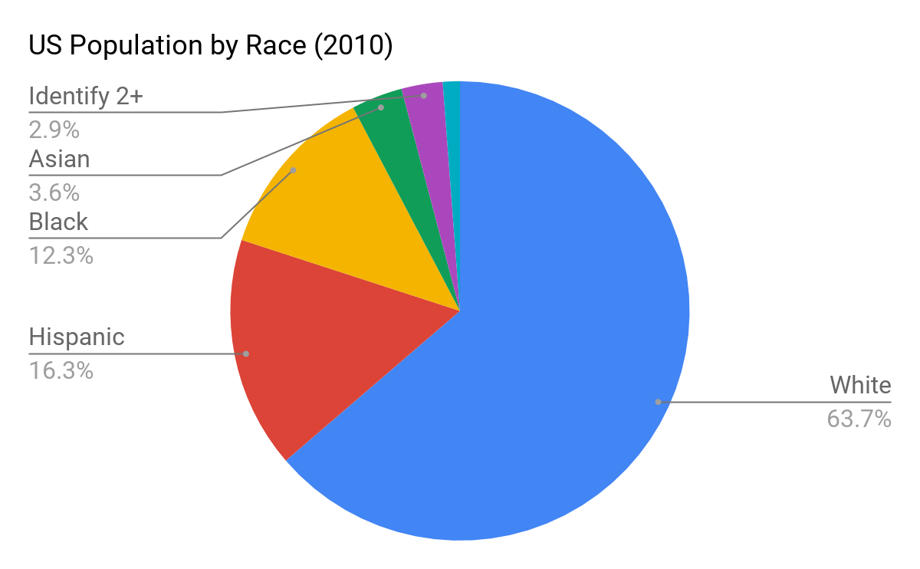
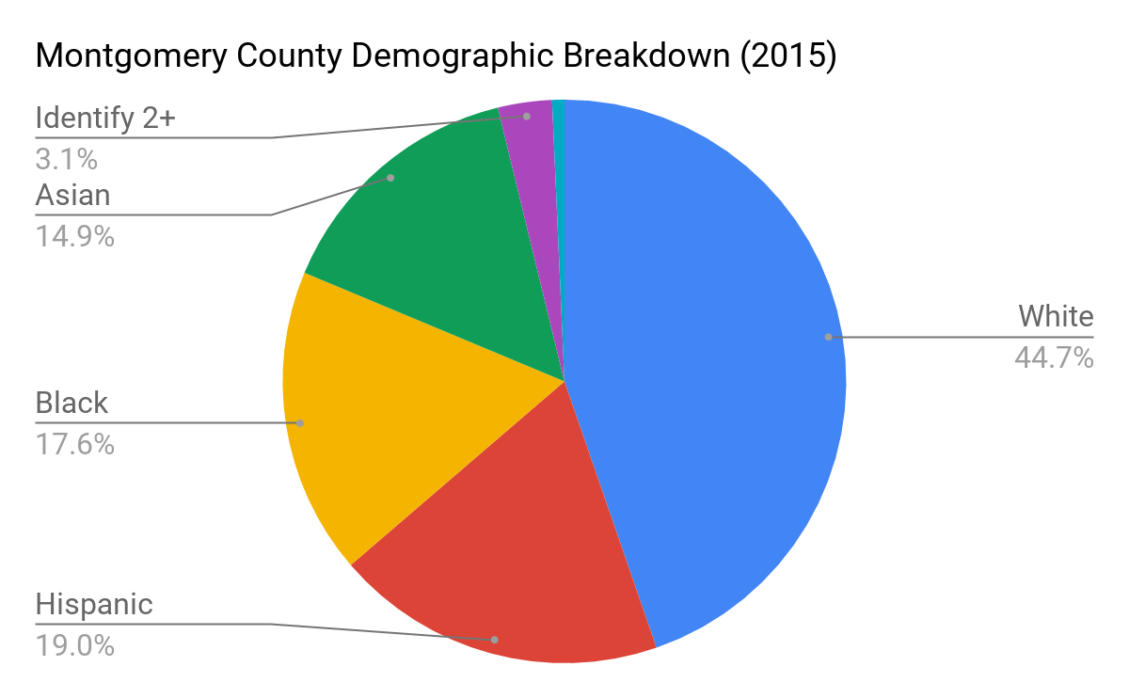
Demographic Breakdown
Montgomery County
National Average
Based on US Census (2010):
Based on US Census American Community Survey data:

Slide 15
Benchmarks: What Others Are Doing
Montgomery County: White 44.7% Latinx 19% Black 17.6% Asian: 14.9% FBP: 32.6%
County | Demographics | Targeted Implementation
Loudoun | White: 70.7% Latinx: 13.4%* Black: 7.8% Asian: 17.3% (Foreign Born Population: 23.3%) | Title VI Plan: Limited English Proficiency
Fairfax | White: 61.4% Latinx: 16.4%* Black: 9.6% Asian: 19.0% (Foreign Born Population: 30%) | “Venture into Volunteering”
Howard | White: 63.2% Latinx: 6%* Black: 18.2% Asian: 14.9% (Foreign Born Population: 17.3%) | Free Wifi Network/Open Access Portal Community Workshops
State: Maryland Department of Natural Resources | White: 59.3% Latinx: 9.8%* Black: 30.7% Asian: 6.6% (Foreign Born Population: 14.5%) | “Es Mi Parque”
Notes:
https://www.loudoun.gov/DocumentCenter/View/122720
https://sustainable.dc.gov/sites/default/files/dc/sites/sustainable/page_content/attachments/DCS-008%20Report%20508.3j.pdf
http://www.fairfaxcounty.gov/demogrph/demrpts/report/fullrpt.pdf
https://datausa.io/profile/geo/montgomery-county-md/#demographics

Slide 16
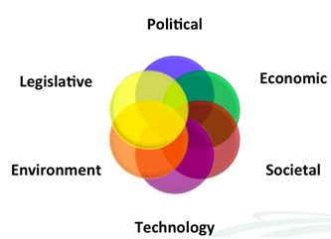
External Influencers to Minority Outreach
Immigration and Public Trust
Budget Constraints
Cultural Preferences
Barriers to Data Collection/Analytics
Notes:
https://siteresources.worldbank.org/EXTGOVACC/Resources/BehaviorChangeweb.pdf
Political Factors → political climate may discourage immigrant and minority groups from participating/engaging with Montgomery Parks
Current Immigration politics
Public trust in governmental agencies/police
Economic Factors → mainly budget constraints
Socio-Cultural Factors
Certain immigrant groups are less likely to participate/engage with Montgomery Parks because of culture; Come from cultures where input on public works is not solicited
It is not a priority for many groups
Technological factors → Barriers to data and analytics,
may not be able to get the information needed, even when solicited
May not have the technology and skills to analyze data gathered

Slide 17
Recommendations

Slide 18
Recommendations:
External-facing solutions:
Increase/expand translation focusing on ‘high touch’ resources
Increase targeted advertising
Hire “hubs” from the community to act as ambassadors
Target elderly populations and schools
Internal-facing solutions:
Hire full-time staff with expertise in minority outreach
Require cultural competency training for Montgomery Parks staff
Notes:
Joseph
Speak on assumptions we have:
assume these target populations want to be engaged, but do not know how
“meet them where they are”
Chinese:
Provide translation of key documentation
Targeted advertising to schools (including language schools), grocery stores, and rec centers
Latinx:
Increase/expand translation of key documentation
Targeted advertising: spanish language radio, tv, and news
Targeted advertising: churches, schools, grocery stores
African Americans:
Targeted advertising: churches, schools, rec centers
Learn from and listen to population’s concerns; address past wrongs

Slide 19
Phased Implementation
Phase I
(Year 1)
New Personnel
Cultural Competency Training
Translation
Targeted Advertising
Data Collection Strategy
Phase II
(Year 2)
Hire Hubs
Translation Continues
Pilot Outreach Programs
Phase III
(Year 3+)
Expand Outreach Programs
Expand Data Collection Strategy
Community Engagement Office

Slide 20
Solutions By Population
Primary Recommendations | Black American | Chinese | Latinx
Increase translation of key resources | N/A | Phase 1 Priority | Phase 1 Priority
Target advertising at established community spaces | All phases - Churches - National Pan-Hellenic Council - Public Schools | All phases - Ethnic specific grocery stores/markets - Community Centers - Language & Public Schools | All phases - Churches - Public Schools
Improve cultural competency to better meet this group’s needs | Phase 1 Priority | Phase 1 Priority | Phase 1 Priority

Slide 21
Implementation Plan: Phase 1
Hire a full-time Community Outreach Coordinator
Implement cultural competency training
Develop & implement a data collection strategy
Translation Services Strategy: Prioritize high touch resources
  Mission, Vision, Park Services
  How to make a reservation
  How to get involved: Volunteering & Partnerships

Slide 22
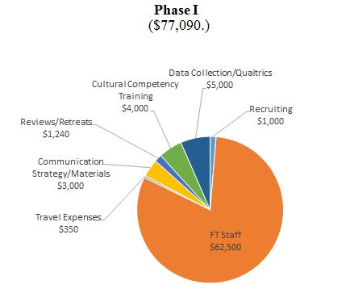
Cost Analysis: Phase I

Slide 23
Implementation Plan: Phase II
Targeted outreach pilot programs
Minority Outreach Coordinator will recruit and oversee 3 community “hubs,” representative of the 3 targeted communities
Continue translating key documents, expanding to additional languages

Slide 24
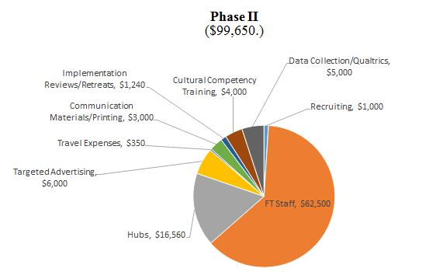
Cost Analysis: Phase II

Slide 25
Implementation Plan: Phase 3
Scaling Up
Creating a Community Engagement Office
Hiring a Community Engagement Director
Expand data collection and analysis to improve data driven decision-making

Slide 26
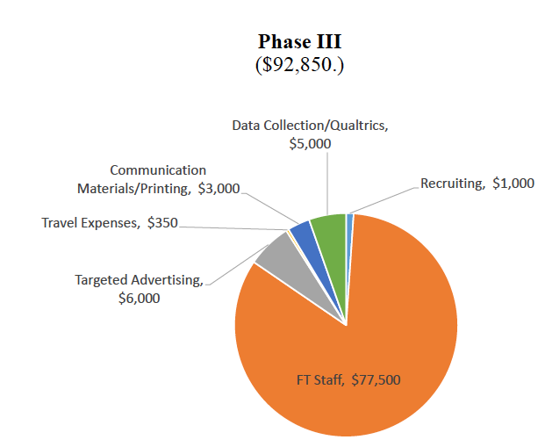
Cost Analysis: Phase III

Slide 27
Feedback/Questions?

Slide 28
Appendix

Slide 29
Opportunity Statement
Current State | Seeking efficient, cost effective, and sustainable strategies for impactful outreach into underrepresented communities.
Disruption/Influencing Event/Precursor (“The Gap”) | Past initiatives, follow-up research, and community engagement events (town halls, planning meetings, etc.) shows Montgomery Parks is not receiving enough input on initiatives and plans from underrepresented communities.
Desired result | More diverse and inclusive communication, input, and long-term engagement from target underrepresented communities.
Key Question(s) | What does MP stand to gain out of the initiative?; How does the target population benefit?; What are the measures of success for MP (qualitative and quantitative)?; How does MP define quality interactions?; Is there a measurable reward for success?; What is the optimal outcome?
Stakeholders | Montgomery County and DMV residents, Montgomery Parks Department & Associates (Community Recreation Specialists, Planning Board, naturalists, Montgomery County Police, among others), public and private schools and universities.
Constraints | Financial resources, human capital, staff buy-in and motivation to engage, geography, politics, language and cultural barriers, targeted communication.
Decision Criteria | Financial implications, quantifying impact, strategy for implementation

Slide 30
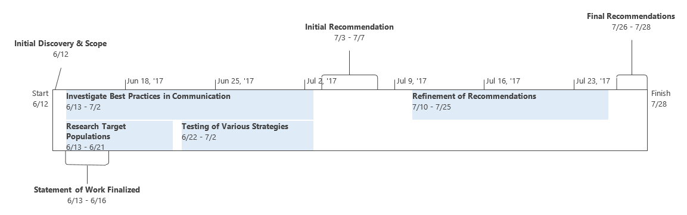
Overall Project Timeline
This timeline is based on the current understanding of the engagement

Slide 31
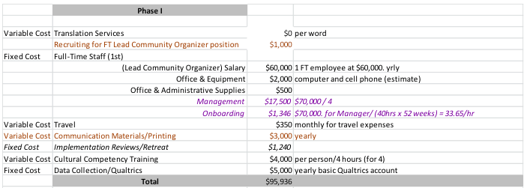
Cost Analysis: Phase 1

Slide 32
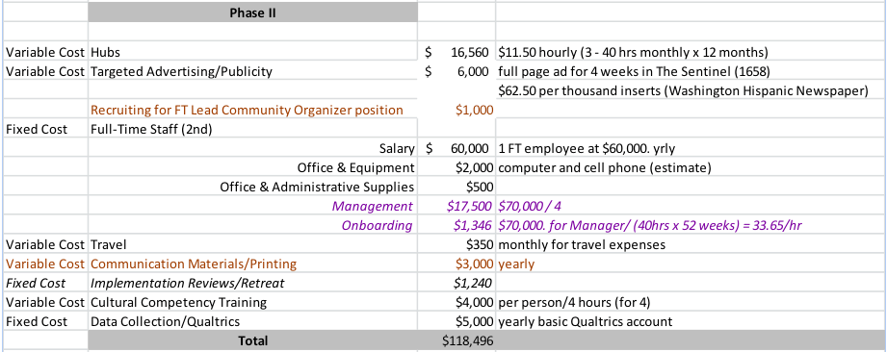
Cost Analysis: Phase II

Slide 33
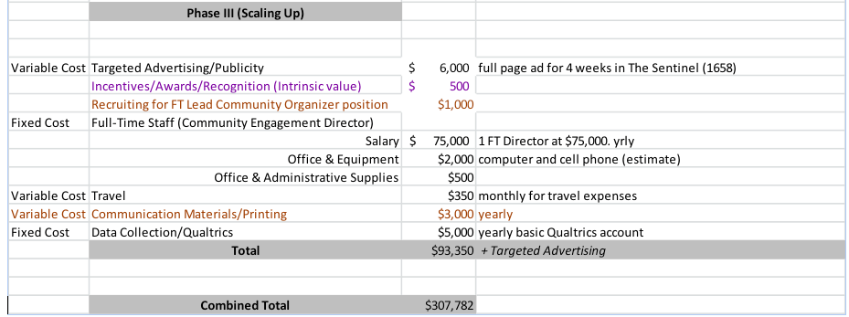
Cost Analysis: Phase 3

