Slide 1



Using Canvas and PechaKucha to Facilitate Undergraduate Peer Teaching of Evidence Based Practice
Alexander J. Carroll
Nedelina Tchangalova
Eileen G. Harrington
October 19, 2015
Mid-Atlantic Chapter of the Medical Library Association (MAC/MLA) Annual Meeting, Asheville, NC
Notes:
Image: http://7-themes.com/7015045-book-leaf-yellow-autumn.html
File Name: Book Leaf Yellow Autumn
Uploaded by: KalimJAJA
Date: 14.08.2015
Category: Nature
Image Size: 1680x1050 px
__________________________________________________________________________
Alexander J. Carroll is an Agriculture and Natural Resources Librarian -- Engineering & Physical Sciences Library (EPSL), University of Maryland, College Park.
Professional Profile: alexanderjcarroll.wordpress.com
Email: ajcarrol@umd.edu
Nedelina Tchangalova is a Physical Sciences and Public Health Librarian -- Engineering & Physical Sciences Library (EPSL), University of Maryland, College Park.
Professional profile: http://www.lib.umd.edu/epsl/contact-epsl/profile_Tchangalova
Email: nedelina@umd.edu
Eileen G. Harrington is a Health & Life Science Librarian, Priddy Library, The Universities at Shady Grove.
Professional profile: http://libguides.shadygrove.umd.edu/profile.php?uid=71206
Email: eharring@umd.edu
__________________________________________________________________________
REFERENCES
Association of American Colleges & Universities. (2010). Information literacy VALUE rubric. Retrieved July 10, 2015, from https://www.aacu.org/value/rubrics/information-literacy
Association of College & Research Libraries. (2000, January 18). Information literacy competency standards for higher education. Retrieved July 10, 2015, from http://www.ala.org/acrl/standards/informationliteracycompetency
Beatty, S. J., Kelley, K. A., Metzger, A. H., Bellebaum, K. L., & McAuley, J. W. (2009). Team-based learning in therapeutics workshop sessions. American Journal of Pharmaceutical Education, 73(6). Retrieved from http://www.ncbi.nlm.nih.gov/pmc/articles/PMC2769522/
Beyer, A. M. (2011). Improving student presentations Pecha Kucha and just plain PowerPoint. Teaching of Psychology, 38(2), 122–126. http://doi.org/10.1177/0098628311401588
Black, E. L. (2008). Toolkit approach to integrating library resources into the learning management system. The Journal of Academic Librarianship, 34(6), 496–501. http://doi.org/10.1016/j.acalib.2008.09.018
Blanco, M. A., Capello, C. F., Dorsch, J. L., Perry, G., & Zanetti, M. L. (2014). A survey study of evidence-based medicine training in US and Canadian medical schools. Journal of the Medical Library Association : JMLA, 102(3), 160–168. http://doi.org/10.3163/1536-5050.102.3.005
Bogoch, I., Cavalcanti, R., Weinberg, A., & Davis, B. (2012). Web-based blog supplement to evidence-based physical examination teaching. Medical Education, 46(5), 508–508. http://doi.org/10.1111/j.1365-2923.2012.04236.x
Brecher, D., & Klipfel, K. M. (2014). Education training for instruction librarians: a shared perspective. Communications in Information Literacy, 8(1), 43–49. http://doi.org/10.7548/cil.v8i1.280
Byrne, M. M. (2015, April). Active instructional strategy: Pecha Kucha. Presented at the National Nurse Educator Summit, Nashville, TN. Retrieved from http://www.nursingsummit.com/wp-content/uploads/2015/03/Active-Instructional-Strategy-Pecha-Kucha.pptx
Carroll, A. J. (2014, May). Preparing medical students for residency: efficacy of evidence based medicine instruction. Presented at the Medical Library Association Annual Meeting and Exhibition, Chicago, IL. Retrieved from http://drum.lib.umd.edu//handle/1903/15077
Conte, M. L., MacEachern, M. P., Mani, N. S., Townsend, W. A., Smith, J. E., Masters, C., & Kelley, C. (2015). Flipping the classroom to teach systematic reviews: the development of a continuing education course for librarians. Journal of the Medical Library Association : JMLA, 103(2), 69–73. http://doi.org/10.3163/1536-5050.103.2.002
Cullen, R., Clark, M., & Esson, R. (2011). Evidence-based information-seeking skills of junior doctors entering the workforce: an evaluation of the impact of information literacy training during pre-clinical years. Health Information & Libraries Journal, 28(2), 119–129. http://doi.org/10.1111/j.1471-1842.2011.00933.x
Datig, I., & Ruswick, C. (2013). Four quick flips: activities for the information literacy classroom. College & Research Libraries News, 74(5), 249–257.
Dorsch, J. L., Aiyer, M. K., Gumidyala, K., & Meyer, L. E. (2006). Retention of EBM competencies. Medical Reference Services Quarterly, 25(3), 45–57. http://doi.org/10.1300/J115v25n03_04
Dunning, D., Meyerowitz, J. A., & Holzberg, A. D. (1989). Ambiguity and self-evaluation: the role of idiosyncratic trait definitions in self-serving assessments of ability. Journal of Personality and Social Psychology, 57(6), 1082–1090. http://doi.org/10.1037/0022-3514.57.6.1082
Eldredge, J. D., Bear, D. G., Wayne, S. J., & Perea, P. P. (2013). Student peer assessment in evidence-based medicine (EBM) searching skills training: an experiment. Journal of the Medical Library Association, 101(4), 244–251. http://doi.org/10.3163/1536
Farkas, M. (2012). Participatory technologies, pedagogy 2.0 and information literacy. Library Hi Tech, 30(1), 82–94. http://doi.org/10.1108/07378831211213229
Foster, M. J., Shurtz, S., & Pepper, C. (2014). Evaluation of best practices in the design of online evidence-based practice instructional modules. Journal of the Medical Library Association : JMLA, 102(1), 31–40. http://doi.org/10.3163/1536-5050.102.1.007
Freeman, S., Eddy, S. L., McDonough, M., Smith, M. K., Okoroafor, N., Jordt, H., & Wenderoth, M. P. (2014). Active learning increases student performance in science, engineering, and mathematics. Proceedings of the National Academy of Sciences, 111(23), 8410–8415. http://doi.org/10.1073/pnas.1319030111
Fuchs, D., Fuchs, L. S., Mathes, P. G., & Simmons, D. C. (1997). Peer-assisted learning strategies: making classrooms more responsive to diversity. American Educational Research Journal, 34(1), 174–206. http://doi.org/10.3102/00028312034001174
Galvan, A. (2015, June 3). Soliciting performance, hiding bias: whiteness and librarianship. Retrieved from http://www.inthelibrarywiththeleadpipe.org/2015/soliciting-performance-hiding-bias-whiteness-and-librarianship/
Haak, D. C., HilleRisLambers, J., Pitre, E., & Freeman, S. (2011). Increased structure and active learning reduce the achievement gap in introductory biology. Science, 332(6034), 1213–1216. http://doi.org/10.1126/science.1204820
Jackson, P. A. (2007). Integrating information literacy into Blackboard: building campus partnerships for successful student learning. The Journal of Academic Librarianship, 33(4), 454–461. http://doi.org/10.1016/j.acalib.2007.03.010
Jonassen, D. (1999). Designing constructivist learning environments. In C. M. Reigeluth (Ed.), Instructional-design theories and models: a new paradigm of instructional theory (Vol. 2, pp. 213–239). Hillsdale, NJ: Lawrence Erlbaum Associates.
Kennedy, E. J., Lawton, L., & Plumlee, E. L. (2002). Blissful ignorance: the problem of unrecognized incompetence and academic performance. Journal of Marketing Education, 24(3), 243–252. http://doi.org/10.1177/0273475302238047
Klentzin, J. C., Paladino, E. B., Johnston, B., & Devine, C. (2010). Pecha Kucha: using “lightning talk” in university instruction. Reference Services Review, 38(1), 158–167. http://doi.org/10.1108/00907321011020798
Lynn, V. A. (2010). Foundations of database searching: integrating evidence-based medicine into the medical curriculum. Medical Reference Services Quarterly, 29(2), 121–131. http://doi.org/10.1080/02763861003723176
MacDonald, A. B. (2014). Information literacy instruction: to flip or not to flip the classroom (master’s thesis). University of North Carolina, Chapel Hill, NC. Retrieved from https://cdr.lib.unc.edu/record/uuid:43f73d7e-e9a2-45b9-83db-8d0f3b97b255
MacEachern, M., Townsend, W., Young, K., & Rana, G. (2012). Librarian Integration in a Four-Year Medical School Curriculum: A Timeline. Medical Reference Services Quarterly, 31(1), 105–114. http://doi.org/10.1080/02763869.2012.641856
Maggio, L. A., & Kung, J. Y. (2014). How are medical students trained to locate biomedical information to practice evidence-based medicine? A review of the 2007–2012 literature. Journal of the Medical Library Association : JMLA, 102(3), 184–191. http://doi.org/10.3163/1536-5050.102.3.008
Mayer, J., Schardt, C., & Ladd, R. (2001). Collaborating to create an online evidence-based medicine tutorial. Medical Reference Services Quarterly, 20(2), 79–82. http://doi.org/10.1300/J115v20n02_08
McEwen, H. A., Johnson, R., Stockton, L. M., Spalding, J. M., Sperling, D. M., & Weiss, L. N. (2014). Librarians’ role in evidence-based medicine integration into the medical curriculum. In A. Blevins & M. Inman (Eds.), Curriculum-based library instruction: from cultivating faculty relationships to assessment (pp. 158–164). Lanham, MD: Rowman & Littlefield.
Oakleaf, M. (2009). Using rubrics to assess information literacy: an examination of methodology and interrater reliability. Journal of the American Society for Information Science and Technology, 60(5), 969–983. http://doi.org/10.1002/asi.21030
Otter, M. E., Whittaker, S., & Spriggs, S. (2009). Using wikis and peer evaluation to teach medical students how to find and assess evidence based resources: a pilot study. New Review of Academic Librarianship, 15(2), 187–205. http://doi.org/10.1080/13614530903240502
Pickens-French, K., & McDonald, K. (2013). Changing trenches, changing tactics: a library’s frontline redesign in a new CMS. Journal of Library & Information Services in Distance Learning, 7(1-2), 53–72. http://doi.org/10.1080/1533290X.2012.705613
Rafferty, R. S. (2013). The impact of library instruction: do first-year medical students use library resources specifically highlighted during instructional sessions? Journal of the Medical Library Association : JMLA, 101(3), 213–217. http://doi.org/10.3163/1536-5050.101.3.011
University of Maryland Institutional Research, Planning & Assessment. (n.d.). Campus Counts. Retrieved from https://www.irpa.umd.edu/CampusCounts/index.html
Willingham, D. T. (2009). Why don’t students like school? A cognitive scientist answers questions about how the mind works and what it means for the classroom. San Francisco, CA: Jossey-Bass.
Xiao, J. (2010). Integrating information literacy into Blackboard: librarian-faculty collaboration for successful student learning. Library Management, 31(8/9), 654–668. http://doi.org/10.1108/01435121011093423

Slide 2
Why Flipping the Classroom?
Using Canvas and
PechaKucha to
Facilitate
Undergraduate
Peer Teaching of
Evidence Based
Practice
Alexander J. Carroll
Nedelina Tchangalova
Eileen G. Harrington
Notes:
Image: http://7-themes.com/7015045-book-leaf-yellow-autumn.html
File Name: Book Leaf Yellow Autumn
Uploaded by: KalimJAJA
Date: 14.08.2015
Category: Nature
Image Size: 1680x1050 px

Slide 3
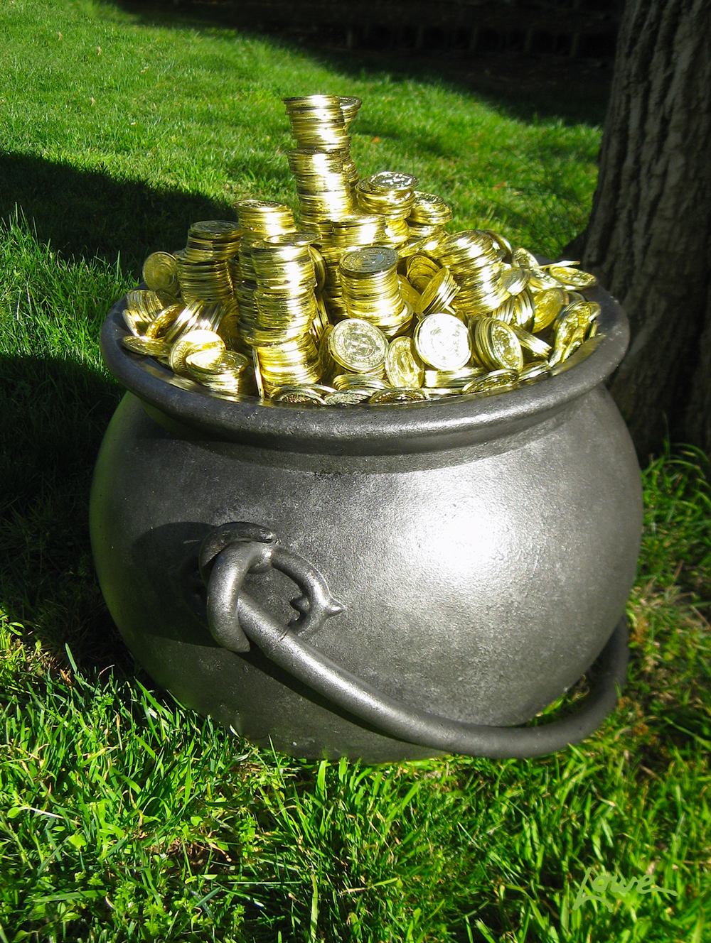
We Found a Pot of Gold!
Thanks to the
MAC/MLA Research & Assessment Grant
we embarked on this research journey.
Find your inspiration and
apply yourself at
http://macmla.org/committees/rac/grant.html
Notes:
Image by David C. Lowe
http://davelowe.blogspot.com/2012/03/pot-of-gold-prop.html
This pilot program was also sponsored with a grant from University of Maryland (UMD) Libraries Research Fund awarded in 2014.

Slide 4

Program Planning
Course Development
Participant Selection and Recruitment
Flipped Classroom Implementation
Program Evaluation and Assessment
Notes:
Image: http://7-themes.com/6965930-autumn-leaves.html
File Name: Autumn Leaves
Uploaded by: SumbO
Date: 18.04.2015
Category: Other
Image Size: 2560x2048 px
_____________________________________________________________________________________
PROGRAM PLANNING
Course development
Participant selection and recruitment
Flipped classroom implementation
Program evaluation and Assessment

Slide 5
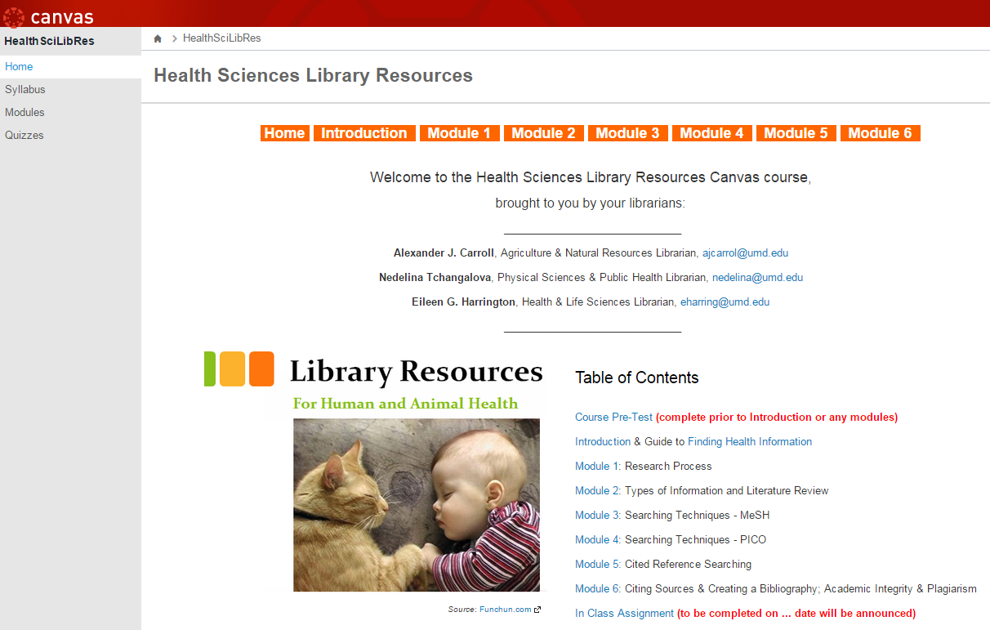
Course Development
Course is now publicly available at https://umd.instructure.com/courses/1166815

Slide 6
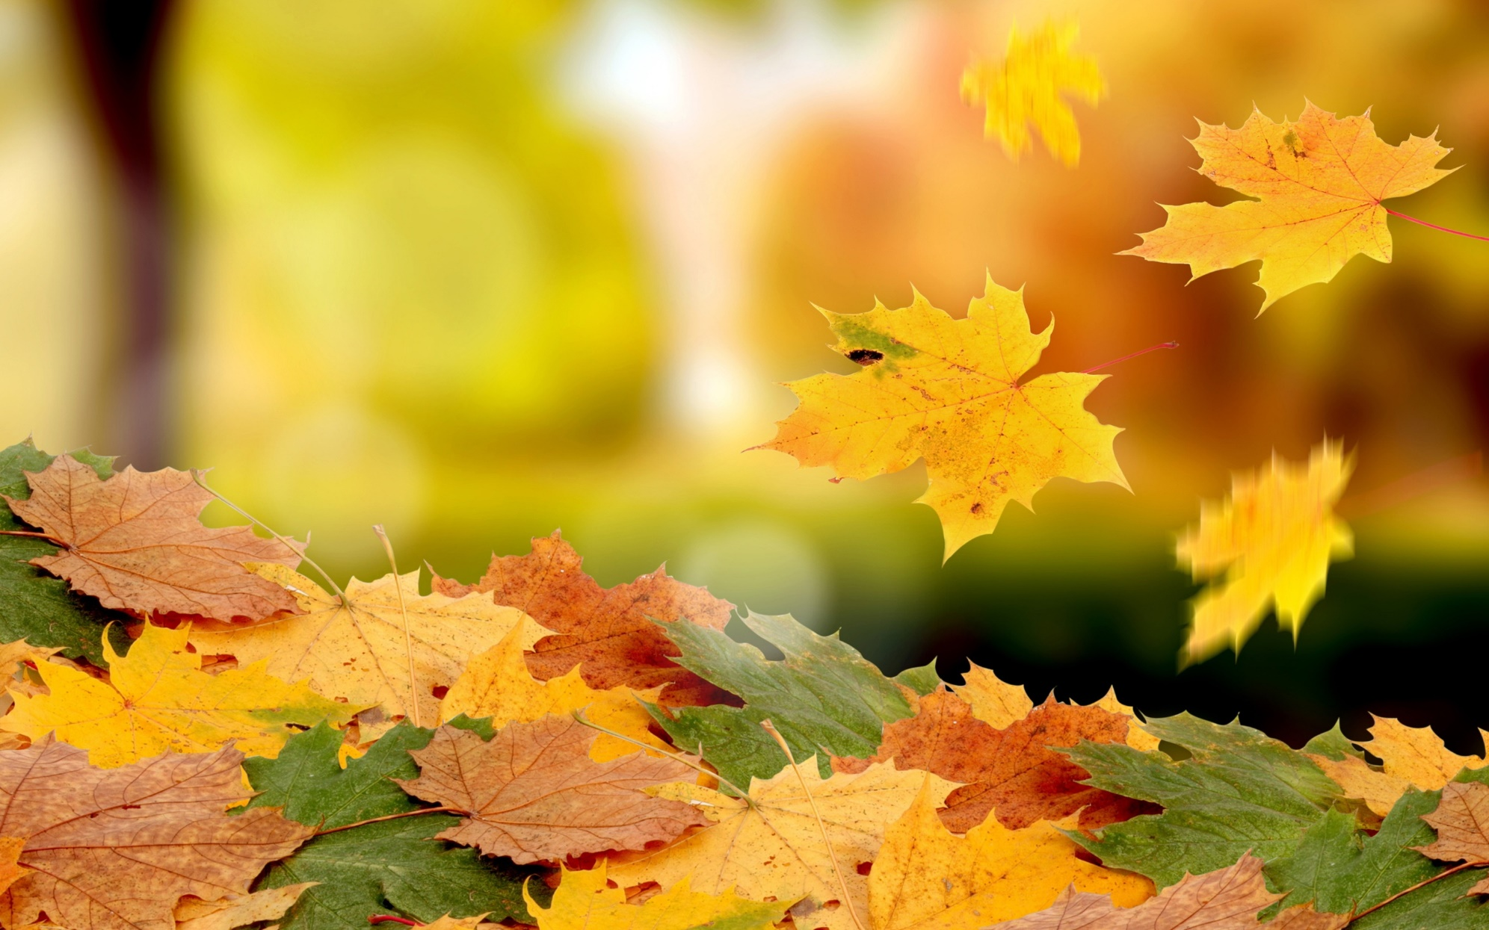
Assessment Tools
Research Assignments
Homework
Notecards
Pecha Kucha Presentations
Quizzes
Notes:
Image: http://7-themes.com/6885110-beautiful-autumn-leaves-wallpaper.html
File Name: Beautiful Autumn Leaves Wallpaper
Uploaded by: mika
Date: 31.08.2014
Category: Nature
Image Size: 2880x1800 px
File Size: 1162.22 Kb
_____________________________________________________________________________________
ASSESSMENT TOOLS
Quizzes (Rubric: http://drum.lib.umd.edu/bitstream/1903/16346/6/Quizzes_Rubric.pdf )
Notecards
Students Presentations (http://drum.lib.umd.edu/bitstream/1903/16346/5/Student%20Peer%20Assessment%20Rubric.pdf )
Student Homework
Student Research Assignments (http://drum.lib.umd.edu/bitstream/1903/16346/11/Student%20Research%20Assignment%20Rubric.pdf)

Slide 7

What Did We Learn Along the Run?
Notes:
Image: http://7-themes.com/6953395-sneakers-leaves-autumn.html
File Name: Sneakers Leaves Autumn
Uploaded by: picchecker
Date: 20.03.2015
Category: Other
Image Size: 1680x1050 px
File Size: 354.71 Kb
_______________________________________________________________________________________________________________
Move to the next slide to discuss:
Benefits to students
Importance of faculty-librarian collaboration as a key factor for program’s success.

Slide 8

Students Had Fun!
Notes:
Image: http://7-themes.com/6981865-girl-leaves-autumn-mood.html
File Name: Girl Leaves Autumn Mood
Uploaded by: JekaLem
Date: 26.05.2015
Category: Celebrities
Image Size: 1680x1050 px
File Size: 233.59 Kb

Slide 9

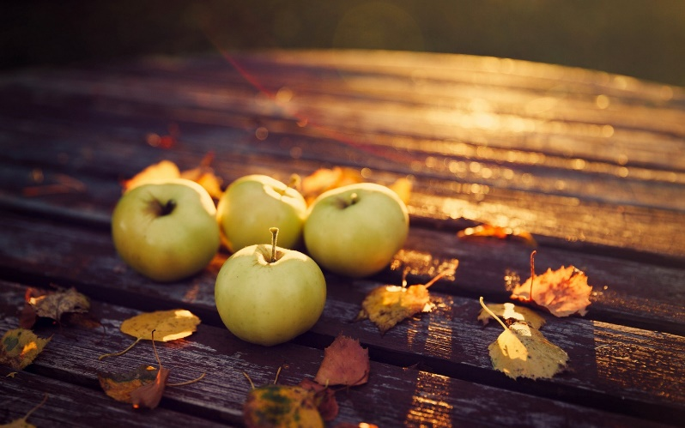

Faculty and Librarians Enjoyed Working Together!
Notes:
Image with apples: http://7-themes.com/6968501-apples-leaves-autumn-evening.html
File Name: Apples Leaves Autumn Evening
Uploaded by: Lambada
Date: 24.04.2015
Category: Nature
Image Size: 1680x1050 px
Image with a yellow cup: http://7-themes.com/7014008-mood-mug-cup-yellow-hot-tea-leaves-yellow-autumn.html
File Name: Mood Mug Cup Yellow Hot Tea Leaves Yellow Autumn
Uploaded by: Sn۞Wflake™
Date: 12.08.2015
Category: Food and Drink
Image Size: 1680x1050 px
File Size: 208.64 Kb
Image with hands: http://leadershipwatch-aadboot.com/2014/05/11/developing-team-and-accountability/

Slide 10

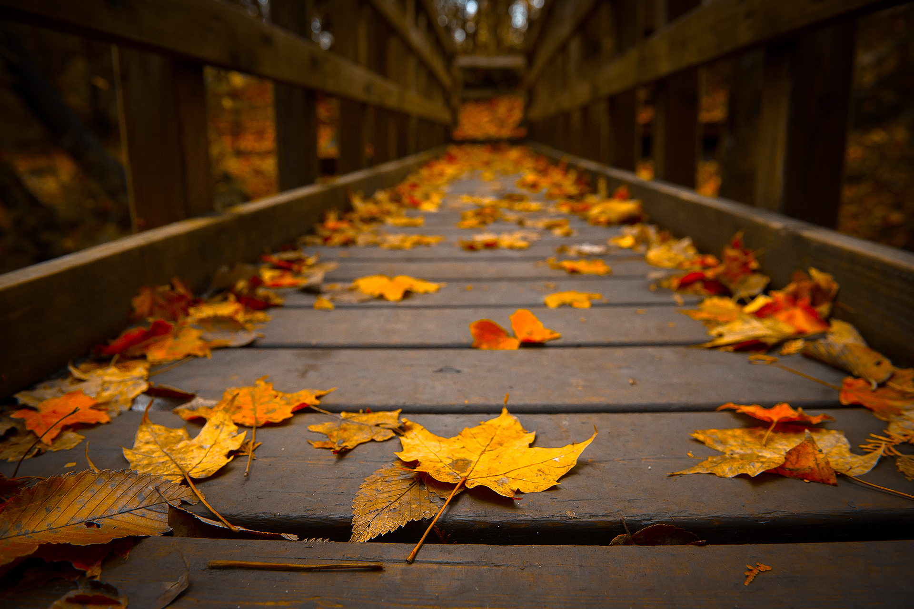
Challenges & Future Directions
Notes:
Image: http://7-themes.com/6982350-autumn-bridge.html
File Name: Autumn Bridge
Uploaded by: YandeG
Date: 28.05.2015
Category: Nature
Image Size: 1920x1280 px

Slide 11
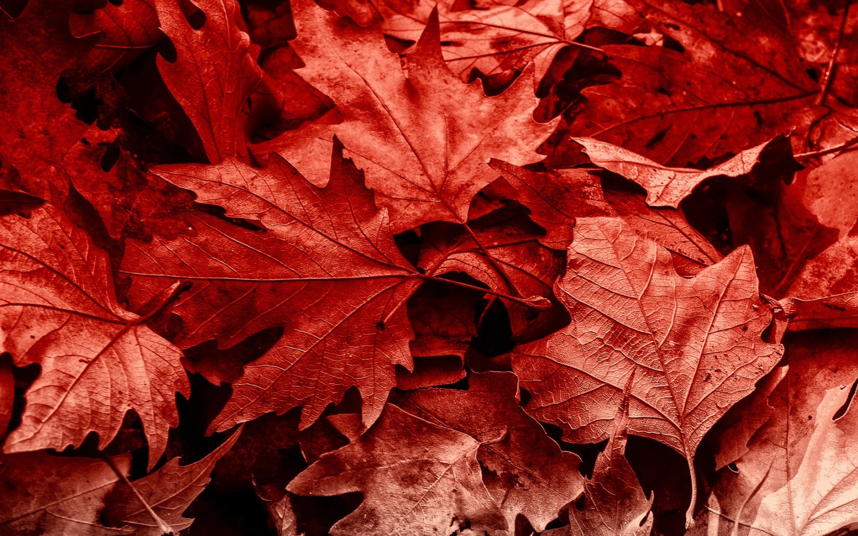
Thank you
Questions?
We take them seriously. Just email us!
Alexander J. Carroll ajcarrol@umd.edu
Nedelina Tchangalova nedelina@umd.edu
Eileen G. Harrington eharring@umd.edu
Notes:
Image: http://7-themes.com/6914188-many-leaves-autumn.html
File Name: Many Leaves Autumn
Uploaded by: voynoff
Date: 17.12.2014
Category: Nature
Image Size: 1680x1050 px

