Slide 1
Interlibrary Loan and Reserves Required Reading Initiative
Melissa Eighmy Brown
University of Minnesota Interlibrary Loan Borrowing
___________________________________________________
CIC ILL Face to Face Meeting, University of Maryland
October 22nd 2015

Slide 2
ILL Textbook Pilot project initiated in February of 2014
The Pilot Process
  While processing ILL requests, staff identified required readings for classes by searching the bookstore textbook website.
  If the libraries didn’t already hold a copy of the item, Interlibrary Loan purchased either a multiple use e-book or the print, using Gobi Addon within ILLiad.
  ILL contacted the subject librarian and Reserves staff to have the items placed on Reserve (both purchased and discovered titles), making them freely accessible to students and instructors.
  ILL also attempted to borrow a copy from a CIC Big Ten library partner whenever possible.
  Instructors and students are thrilled with the service!

Slide 3
WHY DO ALL THIS EXTRA WORK?
University of Minnesota President Eric Kaler’s testimony to the US Senate Committee on Health, Education, Labor and Pensions July 24th, 2014:
“I come before you today to share how the University of Minnesota is addressing the most critical issues in higher education today:
First, ensuring access and affordability;
Second, forging strong partnerships to achieve student success;
And third, establishing programmatic innovations to ensure students— particularly low-income students—get their degrees in a timely fashion. ”
http://president.umn.edu/content/president-kalers-testimony-united-states-senate-committee-health-education-labor-and

Slide 4
Student Savings
The University’s Strategic Plan
eLearning Initiative
The Libraries’ Strategic Plan
Unit and Division Goals

Slide 5
Pilot Data and Usage
Mediated Required Reading Requests
  Fall 2014: 235
  Spring 2015: 321
Most accessed ebook (purchased): | Reframing organizations : artistry, choice, and leadership (2635 times) OLPD5385; PA5011 (100 students enrolled in courses)
Most accessed ebook (discovered): | Introductory statistics with R Statistics and computing (2144 times) BIOL3272; BIOL5272 (42 students enrolled in courses)
Most circulated print book (purchased): | Analysis of transport phenomena: (25 times between 3 students) CHEN4704; CHEN 8301 (26 students enrolled in courses)
Most circulated print book (discovered): | Direct social work practice: (29 times between 7 students) ADDS5021 (44 students enrolled in course)
Circulated | 0-10 times | 11-25 times | 26-100 times | 101+ times
Purchased Print | 38 | 4 | 0 | 0
Purchased Electronic | 9 | 0 | 4 | 15
Discovered Print | 41 | 1 | 0 | 0
Discovered Electronic | 6 | 0 | 4 | 7

Slide 7
Outcome: Bookstore Student Savings Partnership
Student Savings Website
Partnership between the bookstore and the Libraries
They provide the library with a textbook list
We purchase multiple use ebooks (200 purchased for the Fall 2015 semester)
We link our holdings in Library course pages, eReserves and create a list for the website.
Next semester: links to library ebooks on the bookstore website.

Slide 8
ILL Operationalizing for Fall 2015
Streamlined Procedures for Required Readings
  Only purchasing multiple use ebooks (No Print)
  ILL adds Purchased and Discovered titles to Student Savings Fall 2015 Workbook (No emails with Reserves and Liasions) Reserves makes sure that all titles are linked in the Libraries’ course pages and Reserves Direct and instructors are contacted.
  If unable to purchase, we try to borrow, but we don’t do both for a patron unless they specifically ask for the print. We expanded borrowing to all library partners, not just CIC.
  Our ILS, Alma, has an “Interested Patron” feature for orders, so patrons will receive an email when an ebook title is activated in Primo. ILL adds the patron’s email to the Gobi order and Resource Management adds the interested patron in Alma.

Slide 9
Fall 2015 Results So Far…
Total Mediated as of 10/15/15 | 404
Multiple use ebook requests available in Libraries’ collection | 51
Multiple use ebooks purchased by ILL ($2,499.52) | 23
Print copies from libraries’ collection placed on hold for patron | 22
Print copies borrowed from other libraries (mediated) | 248
Print copies borrowed from other libraries (unmediated/UBorrow) | 259+
Requests sent to library partners (awaiting response/shipping) | 26
Cancelled by patron | 20
No library is able to lend this item/No purchase available | 6

Slide 10
ILL Cost and Savings Estimates
Total cost of purchases: $17,427
  ILL was allocated an additional $15,000 for the pilot and $10,000 for FY16
The average savings per student:
  $53.66 for purchased e-books
  $54.54 for borrowed print
Actual ebook estimated savings (Reserves Direct/ILL users x bookstore price) for Fall 2014: $4,478
Actual ebook estimated savings (Reserves Direct/ILL users x bookstore price) for Spring 2015: $3,369
Potential savings (bookstore price x enrolled students) in ebook purchases for Fall 2015: $101,617
Approximately 984 required reading texts borrowed from other libraries from the duration of the pilot to present (estimate is probably low!)

Slide 11
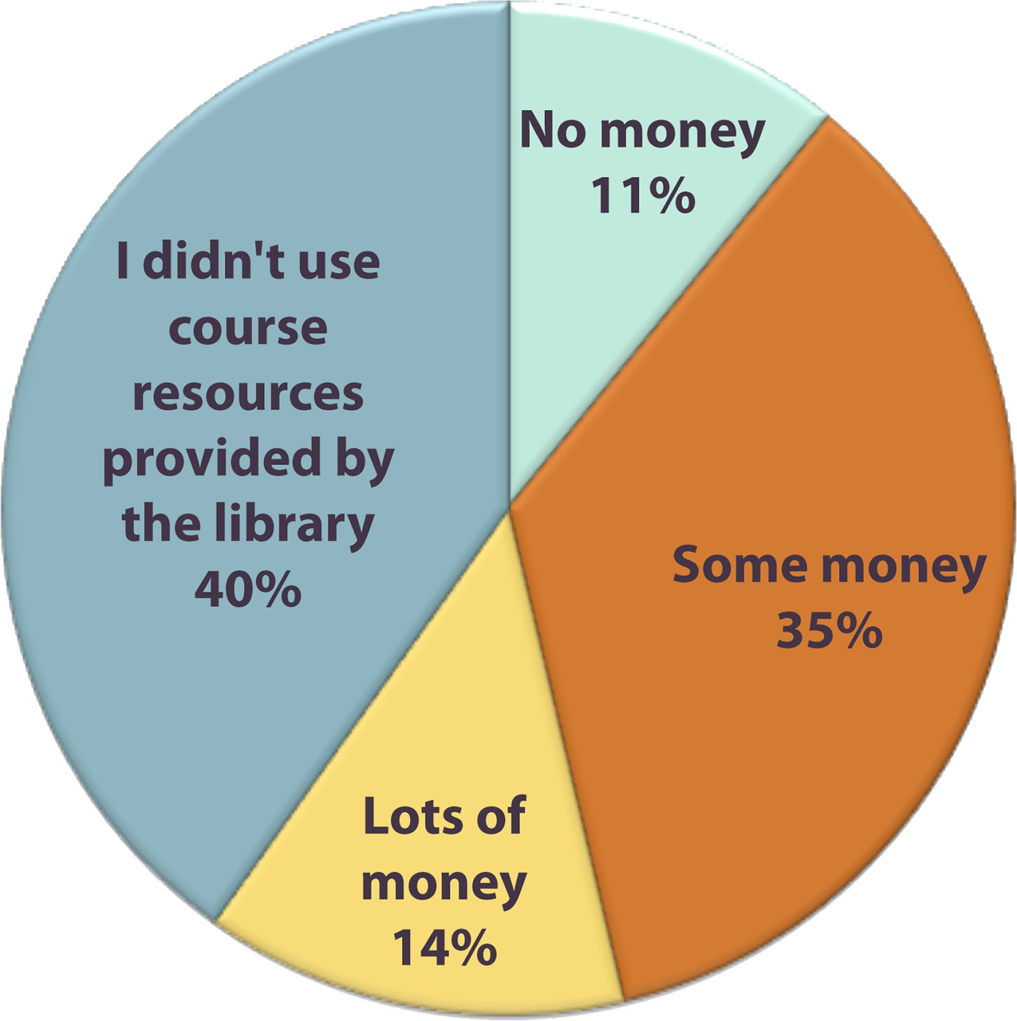
Emily Riha (ILL) and Danika Stegeman (Reserves) conducted surveys in December 2014 and May 2015 to assess format preference (e-book vs. print), potential cost savings for students, and awareness and use of ILL and Reserves.
8,310 students surveyed
827 responses

Slide 12
            Questions?

