Slide 1
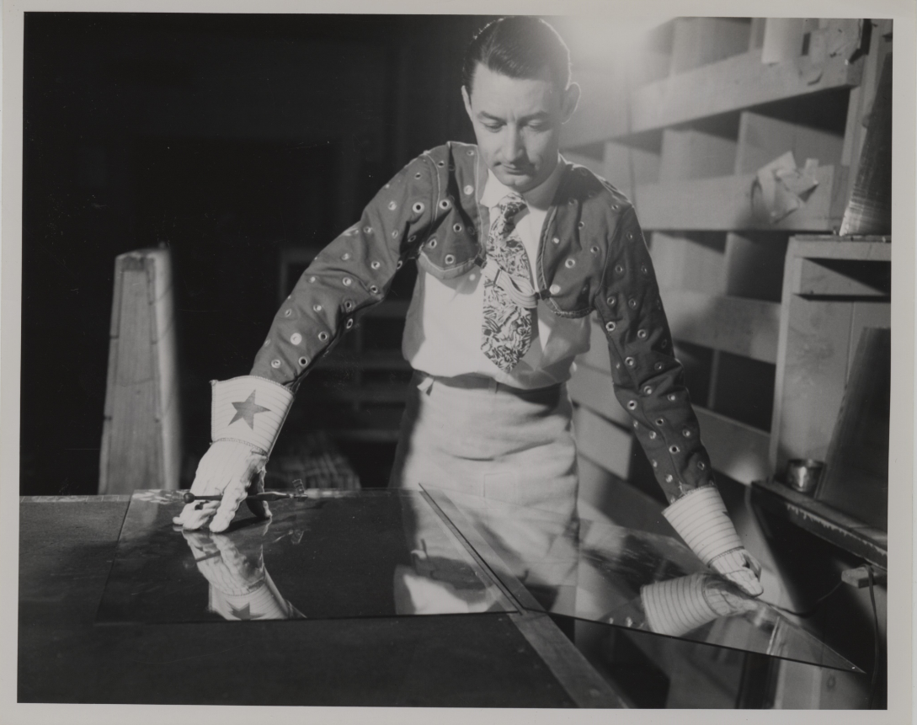
From PPG Works #8 to the Work of Processing: Harnessing Personal Experience and Lifelong Glassworkers to Enhance Description of
PPG Industries Photographs

Slide 2
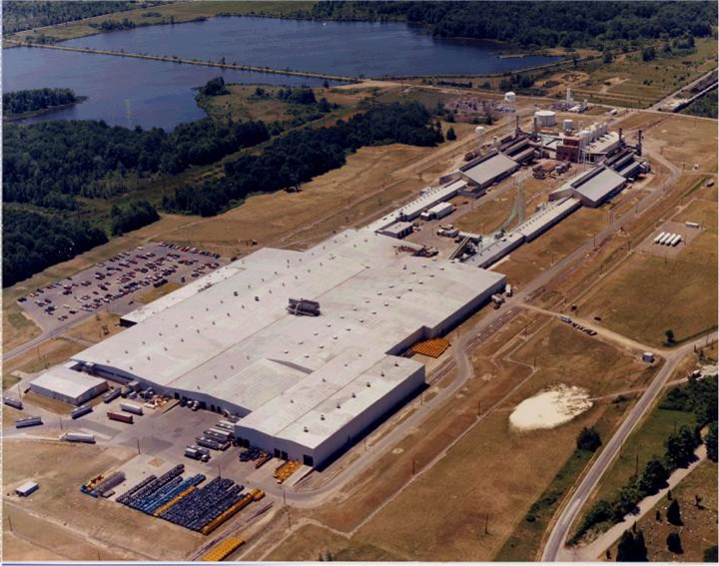
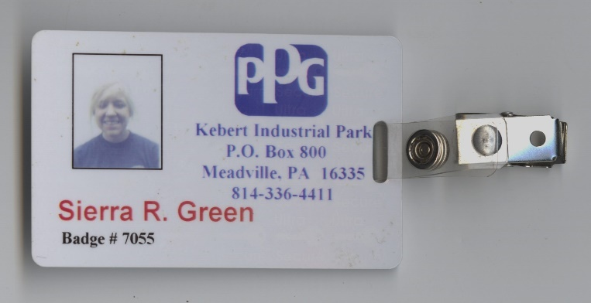
PPG Works #8
Aerial View of Pittsburgh Glass Works Plant.
Google Earth Imagery

Slide 3
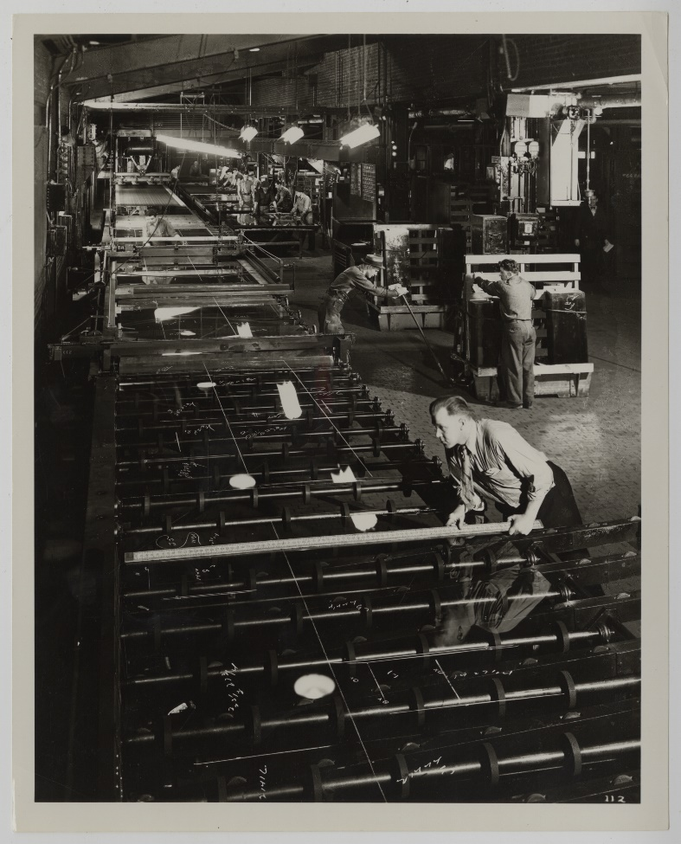
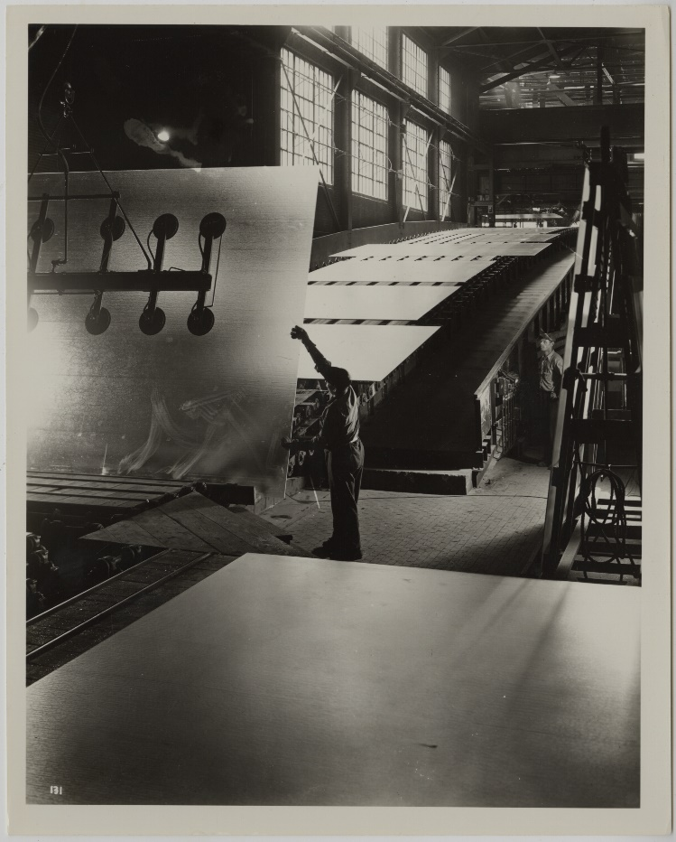
PPG: The Company & The Collection
The Company
Founded in 1883
Glass, Paints, Chemicals, Fiberglass,
Paintbrushes, etc.
Glass manufacturing over time
Glass: Shattering Notions exhibit
The [Photo] Collection
Prints, Negatives, Color Slides
Public Relations Department
Glass, Paints, Chemicals, Paintbrushes, etc.

Slide 4

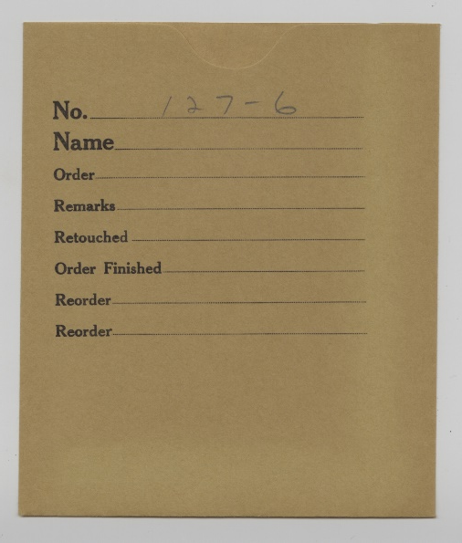
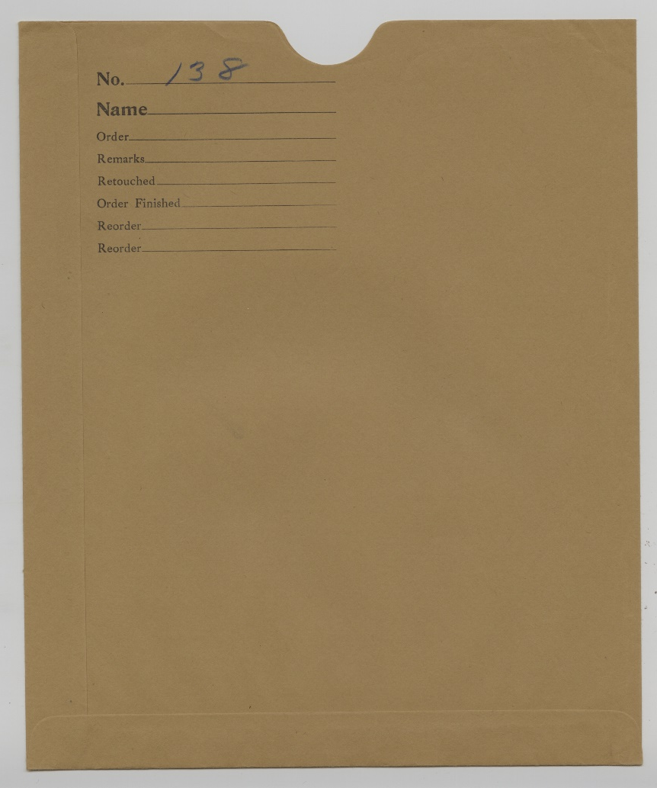

Slide 5


The Photograph Collection:
By the Numbers
169
328
159

Slide 6
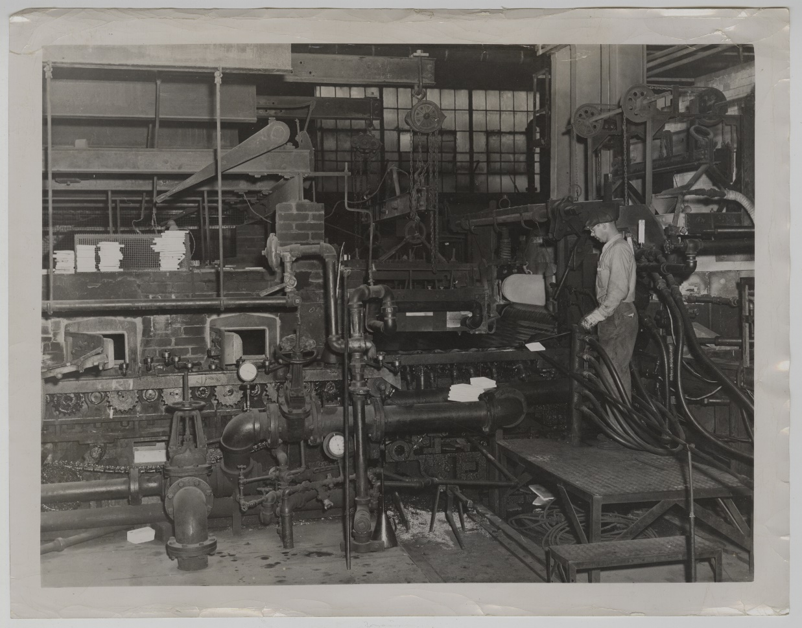
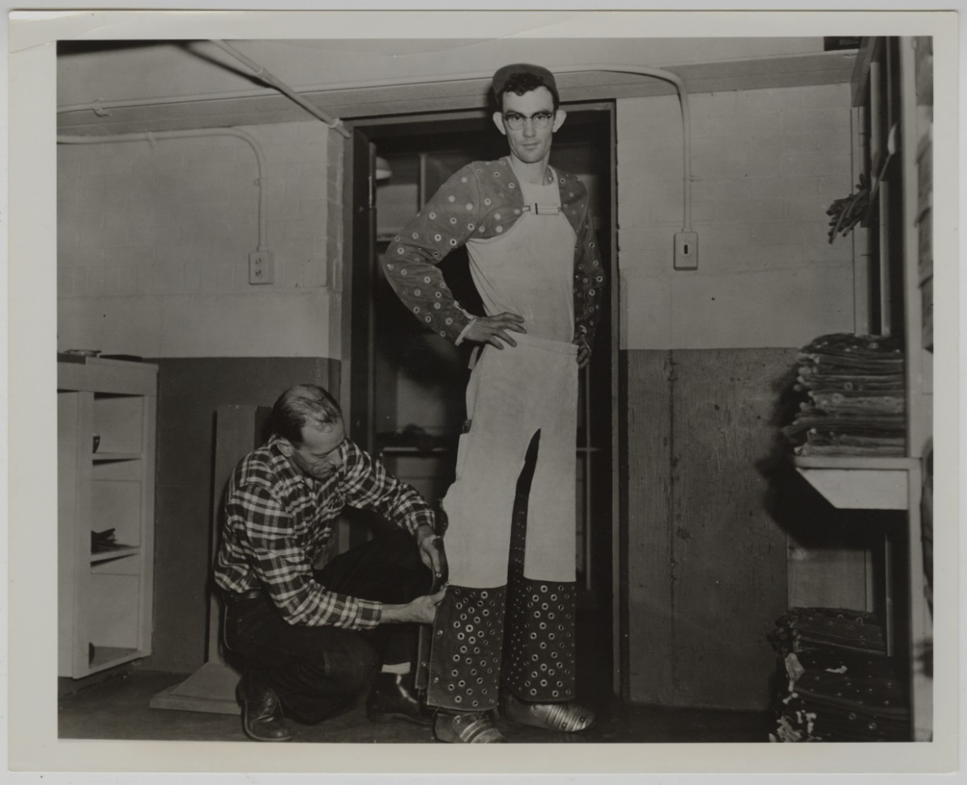
Enhancing Description: Layer 1

Slide 7
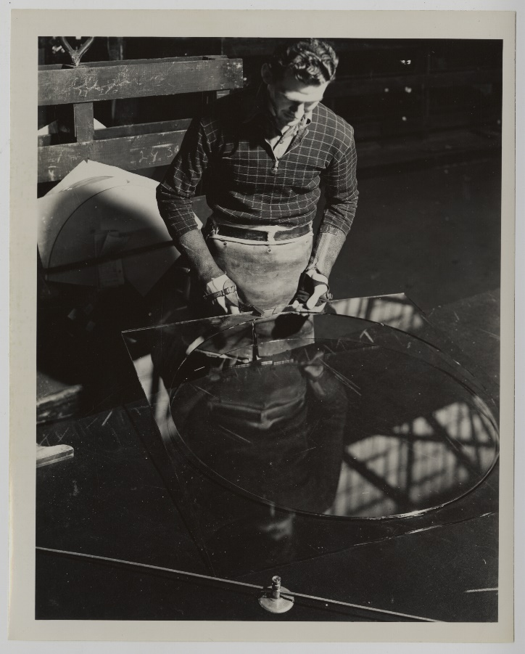
Enhancing Description: Layer 2

Slide 8
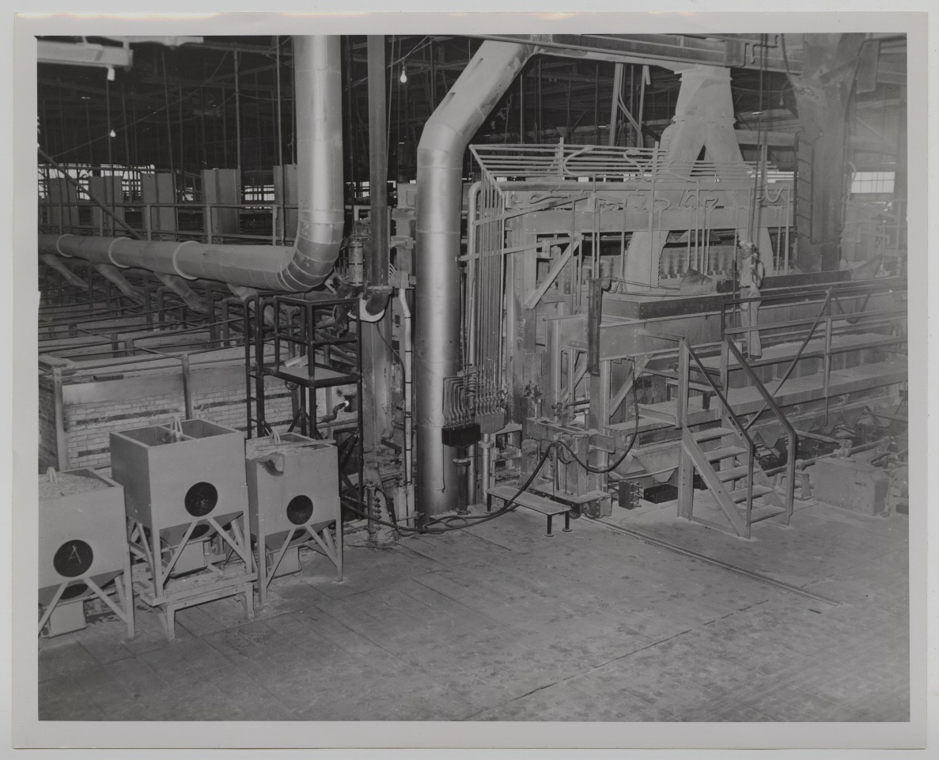
Enhancing Description: Layer 3

Slide 9
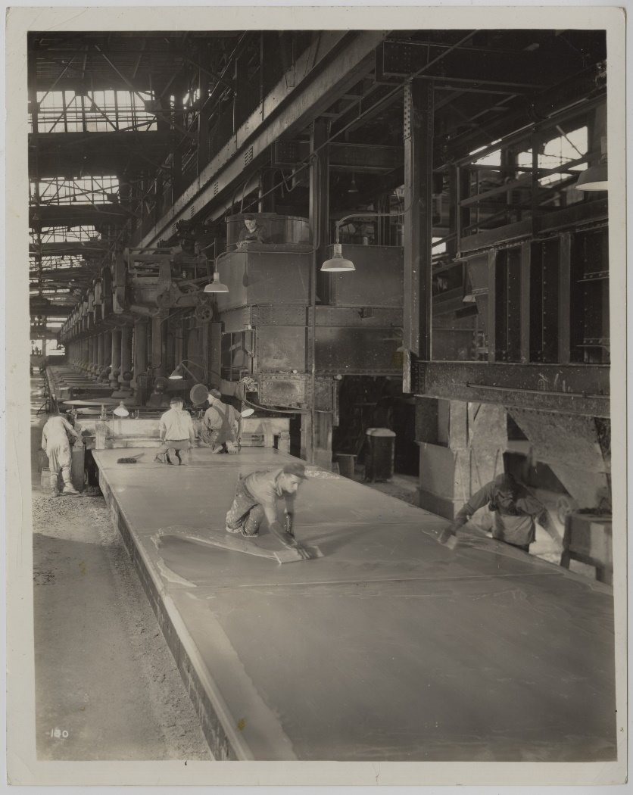
Adapting Serendipity into
Actionable Strategies
Identify Broad Area(s) of Need
    Survey Gaps in light of Provenance
Identify Emblematic Images
Find Industry Insiders to Help
    Retiree groups
    Unions
    Social media
    Plant managers
    Plant workers
    Mechanical engineers
    Tenure and interest=key
Create Tools for Knowledge Exchange
    Google Drive
    Email
    Text messages
    Google Forms
    Simple taxonomy: “MSS_667_B01_F04_I01” vs. “Image 1”

Slide 10
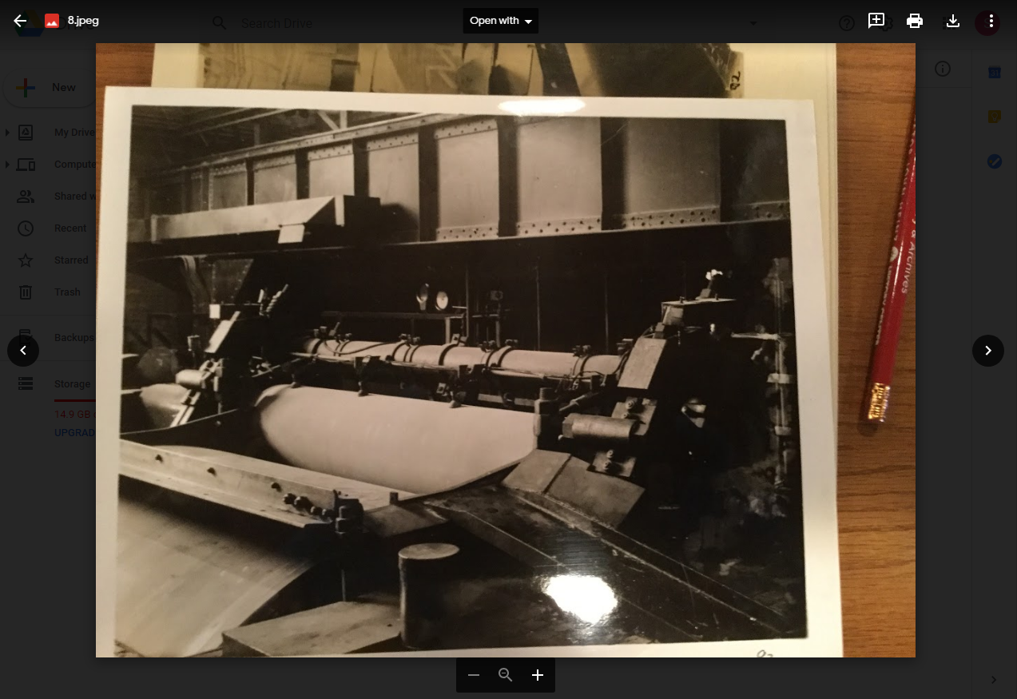

Slide 11
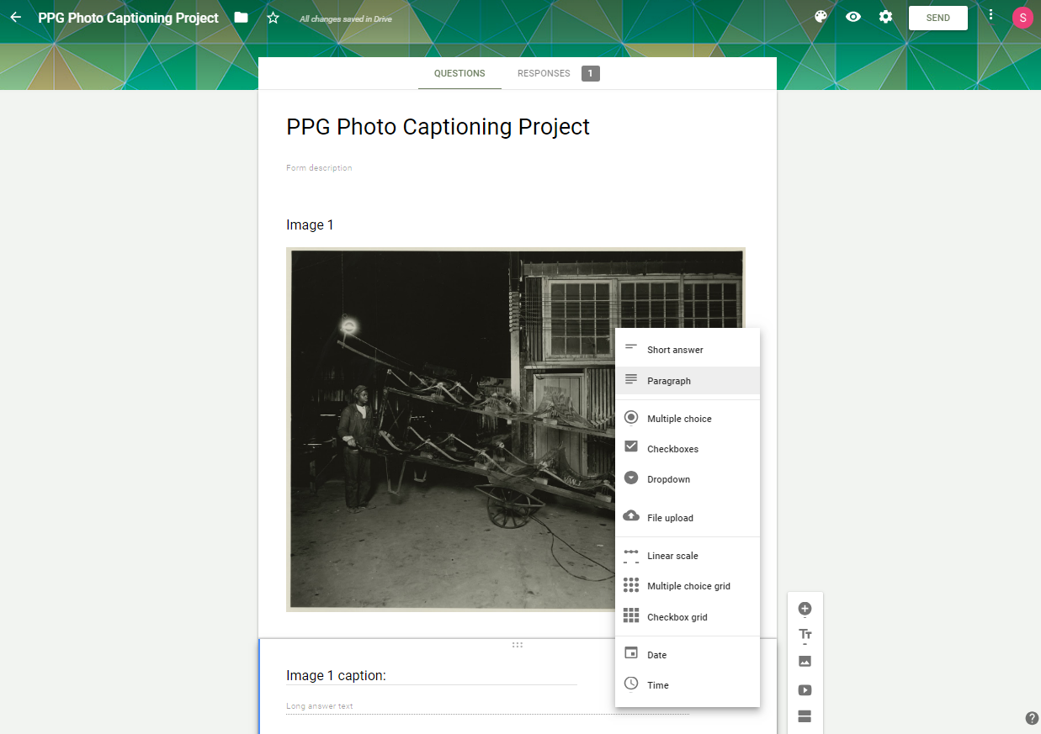

Slide 12
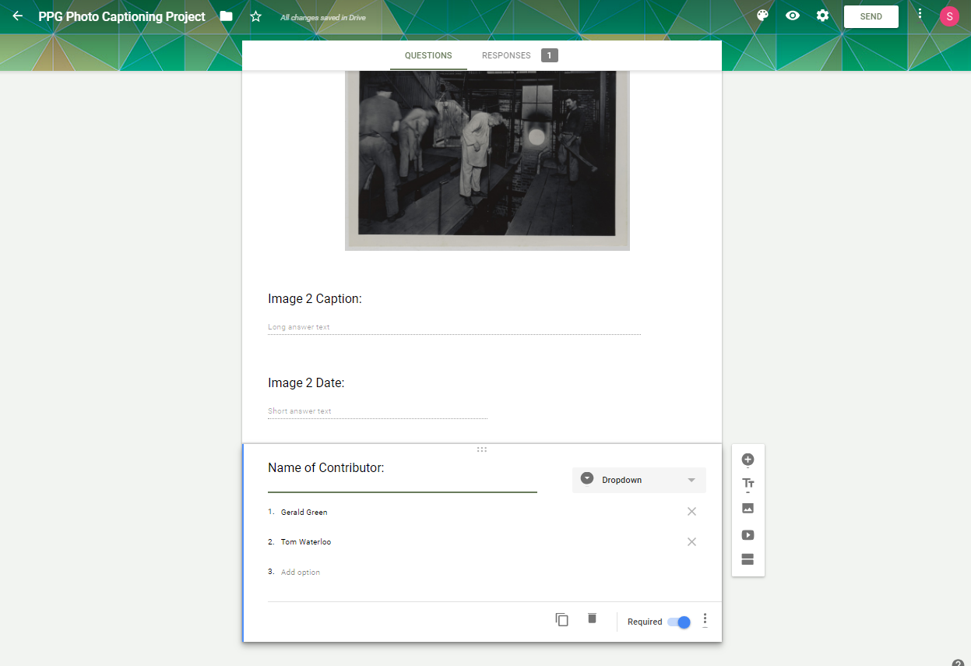

Slide 13
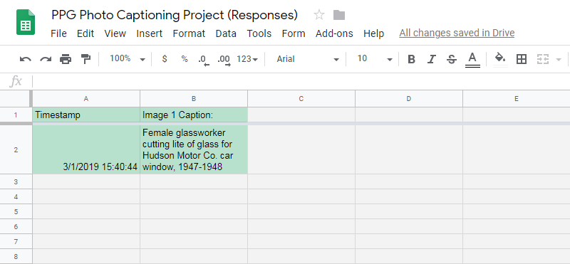

Slide 14
Adapting Serendipity into
Actionable Strategies
Identify Area of Need
  Survey Gaps in light of Provenance
Find Industry Insiders to Help
  Retiree groups
  Unions
  Social media
  Plant managers
  Plant workers
  Mechanical engineers
  Tenure and interest=key
Create Tools for Knowledge Exchange
  Google Drive
  Email
  Text messages
  Google Forms
  Simple taxonomy: “MSS_667_B01_F04_I01” vs. “Image 1”

Slide 15
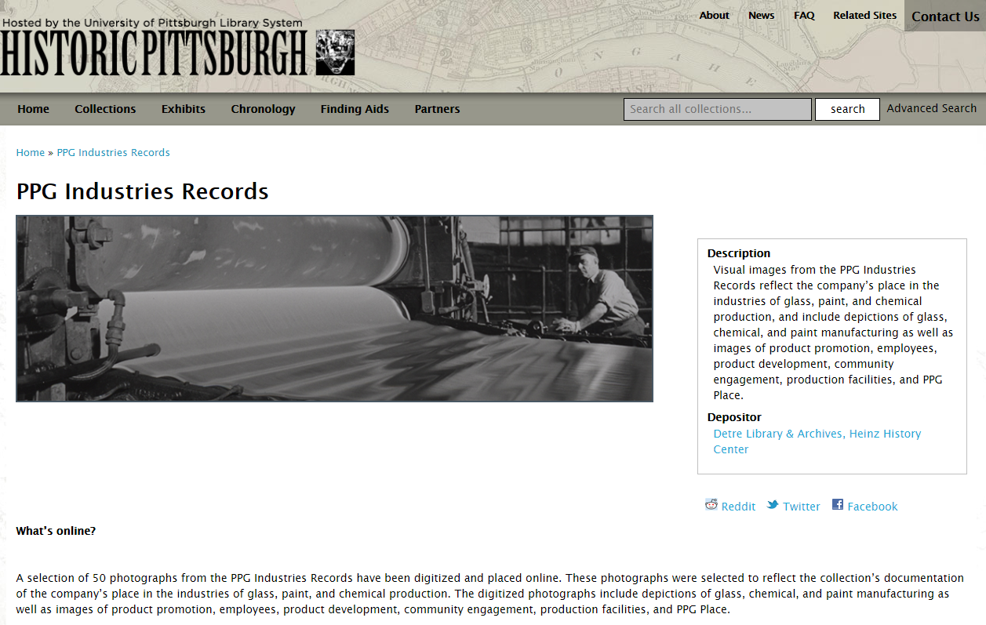
https://historicpittsburgh.org/collection/ppg-industries-records

Slide 16
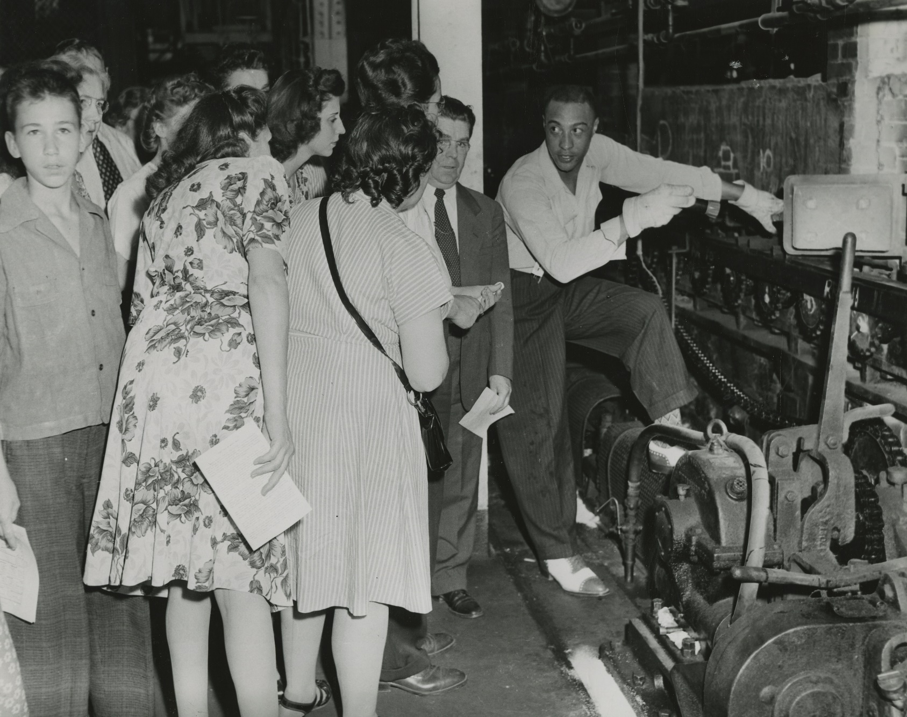
Conclusion

Slide 17
Select
Bibliography
Hughes-Watkins, Lae’l. “Filling in the Gaps: Using Outreach to Acquired Documentation on the Black Campus Movement, 1965-1972.” Archival Issues Vol. 36, No. 1, 2014. 27-42.
Theimer, Kate. “Participatory Archives: Something Old, Something New.” Address given at Midwest Archives Conference. April 19, 2012. https://www.slideshare.net/ktheimer/theimer-participatory-archives-mac-keynote

