Slide 1
Seeking out initiatives & partnerships for digital instruction & engagement as a systems librarian
Joseph Koivisto, University of Maryland
@Joseph_Koivisto | jkoivist@umd.edu
Notes:
Hello everyone, in the short time allotted me today, I’m going to discuss… this.

Slide 2
Alternate title
Notes:
Or, as I had initially wanted to call it...

Slide 3
Climbing out of the basement:
A systems librarian’s journey
Notes:
Climbing out of the basement: a systems librarian’s journey

Slide 4
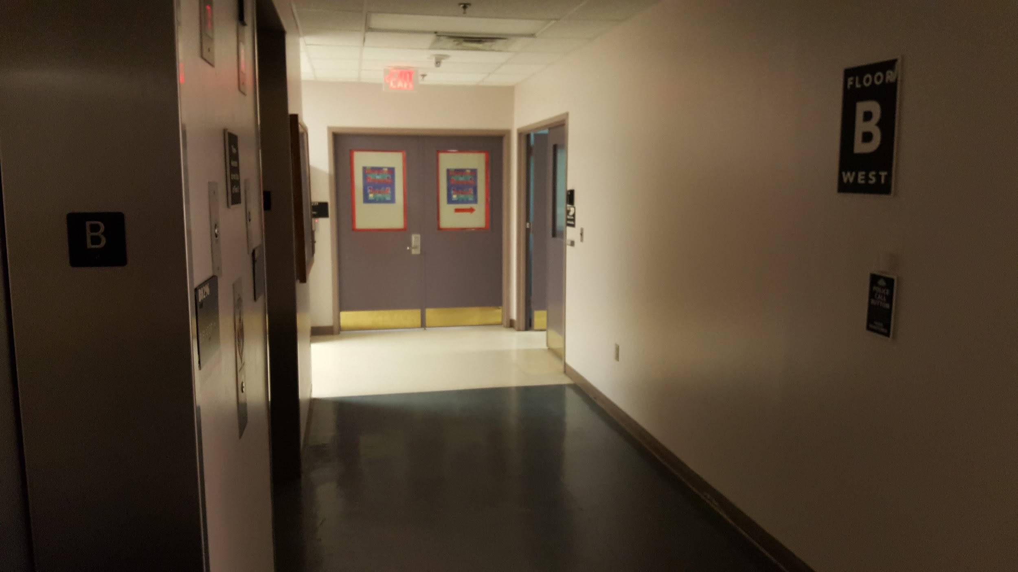
Notes:
As a systems librarian, we sometimes find ourselves in positions where our interactions with other library staff and faculty occur through services tickets, emails, and other formal avenues for technical service. While this is an effective manner of governing “systems” work, it can leave very little room for the collegial interaction and engagement that we hope to find at university libraries.

Slide 5
Challenges for Systems Librarians
Notes:
Why does this happen?

Slide 6
Challenges
Job description / nature of work
Position within institutional hierarchy
Physical separation
Consortial obligations (for me)
Notes:
The very nature of systems work can be isolating. Our job descriptions frequently stipulate that our primary role is as a liaison between the system users and the system.
Others may find that they exist within an institutional hierarchy in which others in the library & commonly others within their very own department are tasked with engaging and collaborating with other departments/teams.
Sometimes our physical department location (as for me, in the basement, near the servers, where it is literally always dark, and cold, and humid) can be a barrier to the spur-of-the-moment “hey let’s go see what the systems librarians might have to say about this” behavior
And sometimes, the very real obligations of working in a subject- or campus-agnostic department can be a hindrance to engagement and outreach. I myself help to serve 17 campuses and, technically, belong to none of them but to all of them (despite being housed at UMD College Park)

Slide 7
Systems Librarian Strengths
Notes:
But despite these challenges and limitations, systems librarians have quite a bit to offer to the general library community.

Slide 8
Strengths
In-depth knowledge of library system infrastructure
Data & coding skills
System Support
Development
Data Archiving & Preservation
Familiarity with wide range of resource & system interactions
Unique perspectives on relevant contemporary topics
Notes:
For example, we have an in-depth knowledge of the system and application infrastructure that make up the library environment and can help to paint a more holistic image of what the library and it’s tools
Systems librarians also have in-depth knowledge, or at the very least passing familiarity with a number of skills important to modern librarianship such as data & coding, application support and development, and digital preservation.
We also have in-depth knowledge of a wide variety of resource and system interactions including automated acquisitions and catalog activities, e-resource subscription & authentication, indexing, usage statistics retrieval and more.
And systems librarians have unique perspectives on a number of contemporary issues related to librarianship such as: the advent of SaaS library systems, algorithmic bias in library systems and the impact on resource discovery and use,

Slide 9
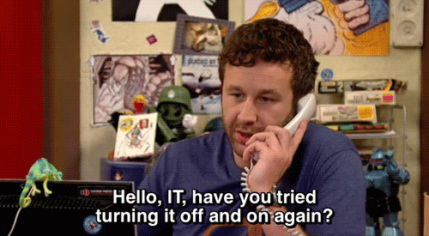
https://giphy.com/gifs/the-it-crowd-chris-odowd-F7yLXA5fJ5sLC
Notes:
WE know that we are more than just help-desk-esque IT workers. But it doesn’t always seem that we are perceived that way especially w/r/t outreach and engagement activities.

Slide 10
Initiatives & Partnerships
Notes:
But that doesn’t mean we have to maintain that perception. So what are some ways we can capitalize on our skills to make the best of initiatives and partnerships within our institutions?

Slide 11
Initiatives & Partnerships
(The Sprinting Tour)
Notes:
Let me give you a sprinting tour of some of the approaches I tried during the first year and a half of my time at College Park.

Slide 12
Coding Workshop
Opportunity to collaborate with other tech-oriented librarians
Instructional & outreach opportunity
Solve librarians’ coding problems
Increase awareness of systematic approaches to problems
Chance to improve own skills
Notes:
At the University of Maryland ,we hold a weekly coding workshop that allows for tech oriented librarians to hone their coding skills, also giving new-to-coding librarians and opportunity to try their hand at new languages, new skills, and other more system-oriented work.
This is a great opportunity for me as a systems librarian to engage either one-on-one or in a group with other librarians while also capitalizing on my skills. And of course, was a good chance for me to brush up on some rusty coding skills.

Slide 13
Coding Workshop
Professional Development Offering: BASH tutorials
Introduction to coding, many first time coders
Large interest, large turnout
Technical failures
Notes:
We even tried to expand this workshop model into a set of first-time coder tutorials for an introduction to BASH. There was a large amount of interest and other librarians outside of our digital systems team were excited by the opportunity to 1) learn more about what we do on a daily basis and 2) gain new skills.
DEMYSTIFY

Slide 14
Emerging Technologies Discussion Group
Monthly discussions on new & developing tech trends
Gives systems librarians a chance to both participate in and lead discussions
Gives systems librarians an opportunity to present themselves as subject specialists
Present new & emerging tech in context of library systems, services
Notes:
The emerging technologies discussion group is a monthly session in which we have conversations of emerging trends in tech-driven library services, demos of new applications, programs, and tools.
As a system librarian, this gives me an opportunity to present myself as a subject specialist, presenting new technologies not only as a facet of the work I do, but also within the context of library services writ large. I can also use this as a chance to help frame other topics from a perspective of library systems.
This also gives me a chance to be a visible participant in campus conversations, allows me to meet librarians that have limited interaction with our department, and also gives me a chance to lead discussions by suggesting topics and tools that are 1) interesting to my role within the library and 2) important to everyone within our campus community but may need a specialist perspective to be understandable.

Slide 15
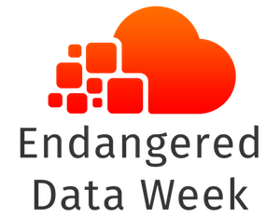
Endangered Data Week
Partnership with MITH
Event planning to encompass skills-based learning, consciousness-raising, and interdisciplinary perspectives on tech & social problem
https://wiki.diglib.org/images/d/dc/Edw-logo.png
Notes:
The highlight of my years was participating in the planning and execution of UMD’s Endangered Data Week events. This brought me in contact with several folks internal and external to the libraries. Also allowed me to pair up presentations from humanist scholars and researchers with hands-on skills based sessions on data preservation. This also increased the visibility of others within our digital systems division and even inspired us to plan future collaboration with the iSchool on code-based data preservation tutorials.
Highlights the value that external initiatives can bring as an opportunity to 1) begin new initiatives and partnerships and 2) bring in fresh project/event topics to your campus community that reflect positively on you.
Granted, Purdom was one of the coordinating partners for the event, so that lowered the bar for participation; but it again provided a chance for systems librarians to participate in a large, visible campus initiative.

Slide 16
What to do
Notes:
What are some proactive things that you can do to help increase the likelihood of finding initiatives and partnerships within your own institution?

Slide 17
What to do
Clearly communicate with supervisor re: expectations
Initiate conversations with potential collaborators
Get out of your space
“Stretch your legs”
Notes:
First and foremost, clearly communicate with your supervisor about your job, your day-to-day tasks, and your supervisor’s expectations about your performance and participation in outreach and engagement activities. This can sometimes prove difficult if you are expected to be monitoring servers and support tickets for 8 hours a day. However, being upfront with your supervisor will allow both of you to clearly articulate what it is you are expected to do and what you want to get out of the work you do and the work you want to do with others.
Be the one to initiate conversations with potential collaborators. Start small: speak with folks from other departments about what it is that you do and try to find ways that you might be able to enhance existing plans and initiatives. Then, once you have integrated into what has been built before, find ways to add your critical lense, specialization, background to the mix.
Get out of your space. It’s sometimes hard for systems librarians to get up away from their offices but...

Slide 18
Notes:
Come on: who wants to come meet down here?

Slide 19
What to do
Clearly communicate with supervisor re: expectations
Initiate conversations with potential collaborators
Get out of your space
“Stretch your legs”
Notes:
If your office environment is unwelcoming, hard-to-find, or just plain creepy, perhaps meeting collaborators outside of your office setting will help you to be more visible within the campus community.
Lastly, stretch your legs in the conceptual sense. While it is important to bring your special flavor of librarianship to conversations, do not be shied away from conversations that are outside of your immediate wheelhouse. By serving as the systems specialist in the room, you can help others to gain new perspectives they had previously been unaware of. Look at national and international initiatives (such as EWD) as an opportunity to stretch your own conceptual framework and find ways to apply your domain specialization to these events tasks

Slide 20
“I FORGET THAT YOU ARE PART OF THE [SYSTEMS TEAM] BECAUSE I ALWAYS SEE YOU OUT DOING STUFF”
-Paraphrase of a generous coworker
Notes:
Have my efforts been a success?
Based on this quote from a generous coworker at UMD, I’d wager: yes.

