Slide 1
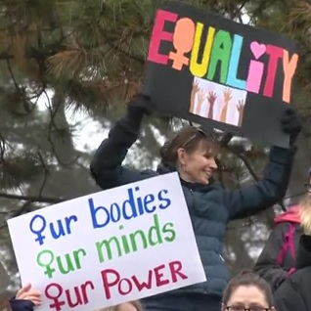
Supporting Solidarity:
Appraising and Collecting Online Content Surrounding the Women’s Marches in Maryland
Caitlin Rizzo and Jen Wachtel, University of Maryland

Slide 2
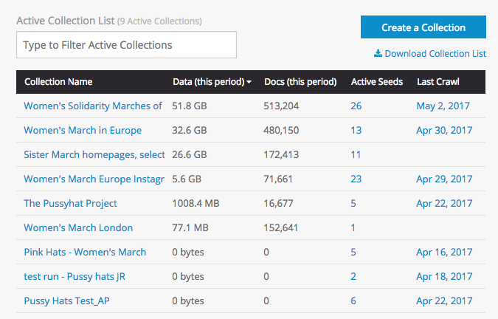
The Task & the Tools
The Assignment: Appraisal as Activism
Archive-It
Informational Session
Help Center
Test Crawls
Captures
Snapshot of the University of Maryland iSchool’s Instance of ArchiveIt.
Notes:
Introducing the Assignment: This project took place in the context of an entire course on appraisal and had powerful pedagogical implications for teaching students not only the intellectual work of appraisal, but also the tools needed to carry out collection development and appraisal for born digital materials, especially at a point when so many activist communities are online.
We used the Internet Archive’s ArchiveIt tool to collaborate on the project, and as part of our class attended an information session guided by one of ArchiveIt’s employees. In the session, we learned how to form collections, compile/format seed lists (or lists of URLs we wished to crawl), create test and production crawls, and navigate the interface. We were also introduced to the ArchiveIt help center, a wonderful resource!
The help center helped the group format crawls for more complicated formats, and also helped with general questions as we prepared our test crawls.

Slide 3
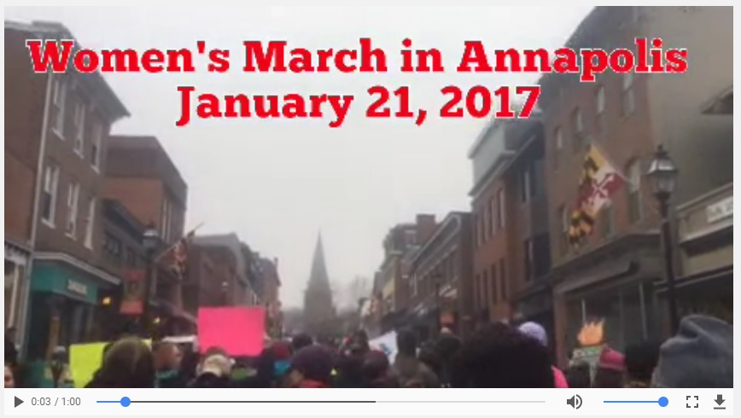
Appraisal
National Women’s March already well-documented
Narrow focus on local groups in Maryland
Evidence of (not about) the functions of solidarity marches
Created, organized, and generated by solidarity marches
Archived YouTube video
on Wayback
Notes:
-documenting all national and global solidarity marches would be too broad
-Kate Shilton and Ramesh Srinavasan in Archivaria (2007) - of not about the community

Slide 4
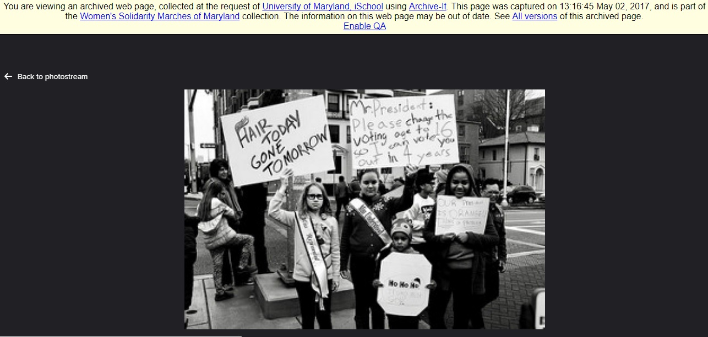
Availability: Wayback Machine

Slide 5
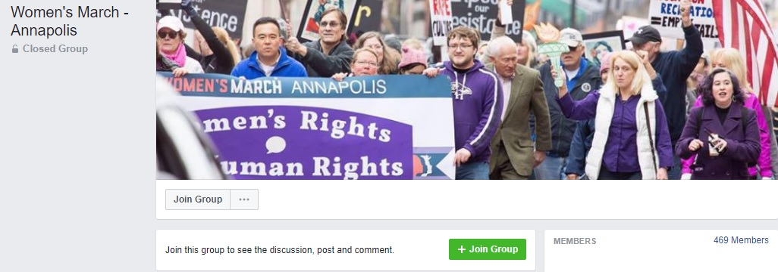
Formats and Challenges to Availability
Transferring crawls
Google Maps on official pages
Facebook page and group access
YouTube and local newspapers: robots.txt
Flickr heavily encoded
Notes:
-transferring crawls: UMD Electronic Records Archivist has many pending transfers and we also had a moratorium on collections for the past year
-Facebook required us to join closed groups, risking our own privacy. Facebook pages and groups: only captured once but they are still continuously updating. Should we run continuous crawls?
-YouTube: changed seed rules to “ignore robots.txt” per Archive-It guidelines for YouTube crawls
-local newspapers: did not receive a response in time to submit assignment (Caitlin speaking more on ethics)
-Flickr: required use of proxy mode to handle java encoding
-official pages: those that registered with the Women’s March website as solidarity marches usually had Google Maps to pinpoint their location

Slide 6
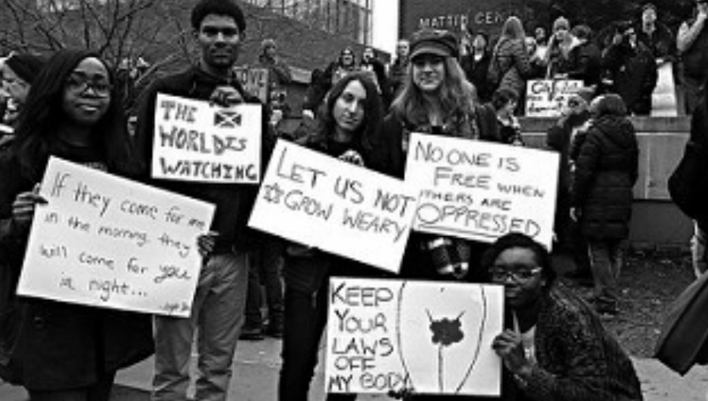
Archival Activism, Outreach, & Pedagogy
“The archivist’s appraisal practice should attempt to move the profession and his or her own institution toward the goal of a broadly based societal archives--the ideal animating Samuels’ documentation strategy--by intervening in the broader appraisal process to protect what contributes best to that goal.”
--Tom Nesmith (2011), “Documenting Appraisal as a Societal Archival Process”
Notes:
Though we certainly experienced a fair share of technical challenges, overall the lessons of the assignment far outweighed the difficulties. I want to focus particularly on the pedagogical implications of teaching archival activism. On the surface, the assignment can seem a little controversial in that it asks students to engage in an activist project that they may or may not support. However, I’ve chosen Tom Nesmith’s quote to point out that what the assignment demands is nothing less than what the profession demands: a broad engagement in society, not only representing a society but also acknowledging the role professionals play as individuals that are ruled by and have no option but to act within societal bounds. The most pedagogical implication of the assignment was not lost on us: that archival activism is not a side interest or something we do own our time as students, but it’s inescapable in our field to engage with social movements. Instead of hiding from activism or saving that work for community archives, we need to understand that activism, outreach, and pedagogy is integral to our job. In this assignment we had to engage in all three. Activism as documentation, outreach to communities, and pedagogy to teach communities about our own goals and objectives.

Slide 7
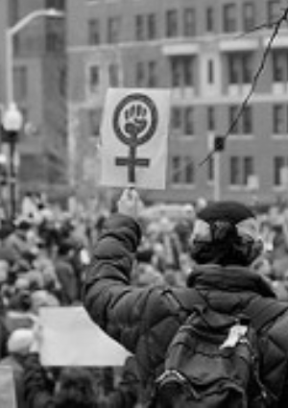
Take Aways
Gatekeepers & Webmasters
Outreach as Activism
Community Voice
Notes:
Now that we’ve spoken broadly about what was accomplished, we want to acknowledge some of the core “take aways” from this project.
I think an extremely important lesson learned was that communities are extremely broad. I have this bullet point on Gatekeepers and Webmasters. Beginning the assignment, I imagined the community itself might the only gatekeepers we would face. Sometimes individual members are protective of their images, their websites, and their representation and they have every right to be. However, that was not what we experienced at all. Instead, we found a completely different issues. Not the women themselves, but webmasters (the individuals in charge of content located on websites) often ended up gatekeepers. They just didn’t understand what we were doing. [Delmarva webmaster in charge content]
This leads to my second point here, about outreach as activism. The easiest part of this assignment in a way was deciding what to document; the hardest often was explaining why we would want to do that and how we would do that. Outreach to this community in the broadest sense was essential.
Community voice - ethically, we must work with records creators in community archives projects. Archive carries voice of participants far beyond the marches. “Supporting solidarity”

Slide 8
Special Thank Yous:
Erin Berry, Ricky Punzalan,
Ed Summers, Amy Wickner, and Liz Novara!

