Slide 1
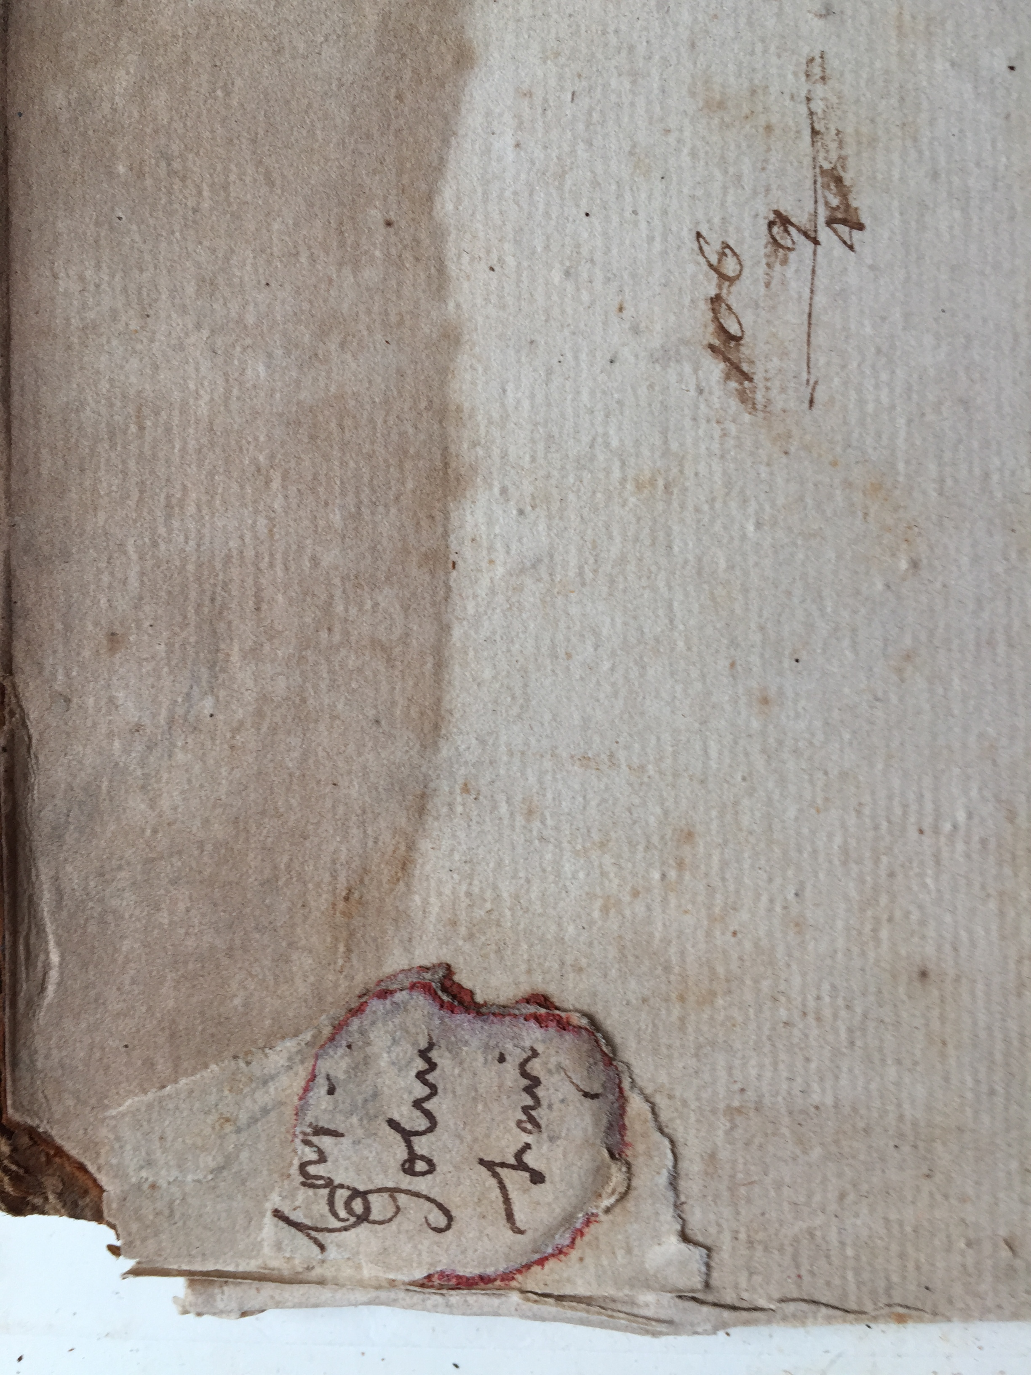
Paper Will Kill the Court System
Geof Huth
Chief Records Officer
Chief Law Librarian
NYS Unified Court System
MARAC, Morgantown, WV
13 April 2019
Notes:
I began my tenure at the New York State Unified Court System
In my position as Chief Records Officer
(now four years ago) with these words:
“Paper will kill the court system”
That sentence went out in an internal newsletter
I said “kill”
That phrase was the title of the article
It was a shot across the bow
An indication we needed to change to survive
When I added the role of Chief Law Librarian a year later
I made a similar statement about paper books
The simple process of managing books in paper
Storing, finding, moving, replacing, discarding them
Burdened the court system

Slide 2
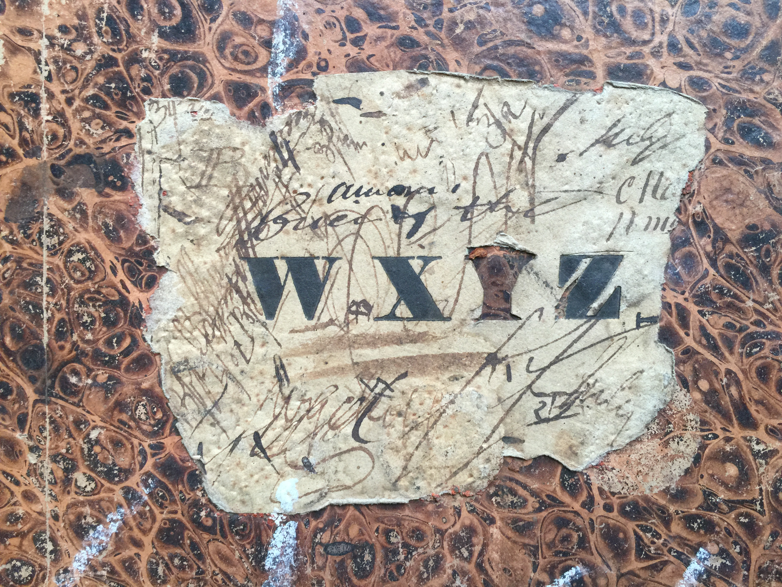
The Way Forward is Change
Notes:
Our only hope was to change our ways
To abandon manual processes
To require the submission of electronic case papers
To increase digitization so we could eventually end digitization
To eliminate the paper we had
Paper that we often could not find
Paper we didn’t need
Paper that slowed us down
Paper that even threatened to bring down one of our buildings with its weight
But our work is more that eliminating paper
It’s about process changes
It’s about demonstrating the value of our work to others

Slide 3
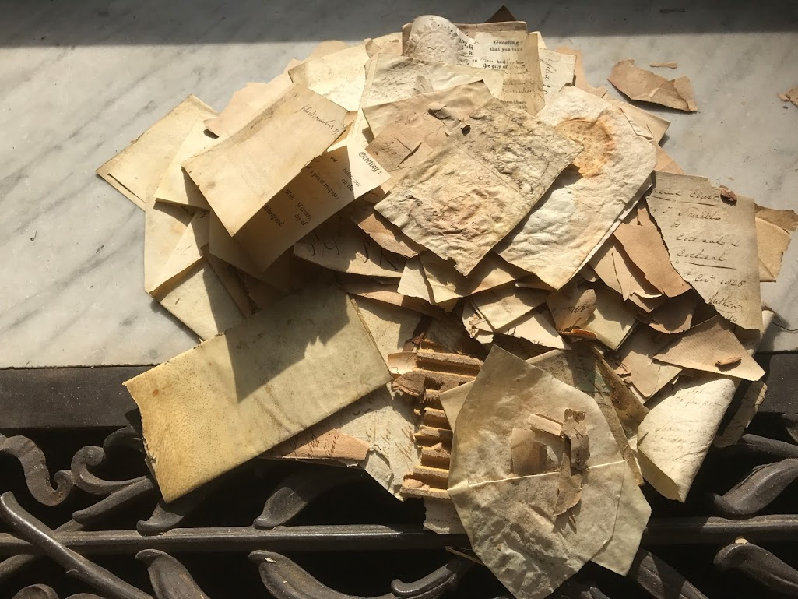
People Made This
Notes:
My first order of business was to meet people
Because records management and archives are about both
People make the records
Manage the records
Use the records
And decide how to do all of these
People are the ones who create the messes
And the ones who must fix them
I began by meeting with my staff
To evaluate the extant work processes
To understand their understanding of our work
And to design a new way forward
Almost immediately, we began to change our processes and focus
Afterwards, I visited people in the court system
Though not in all 1400 or so courts and offices
To learn how they managed records and what problems they faced

Slide 4
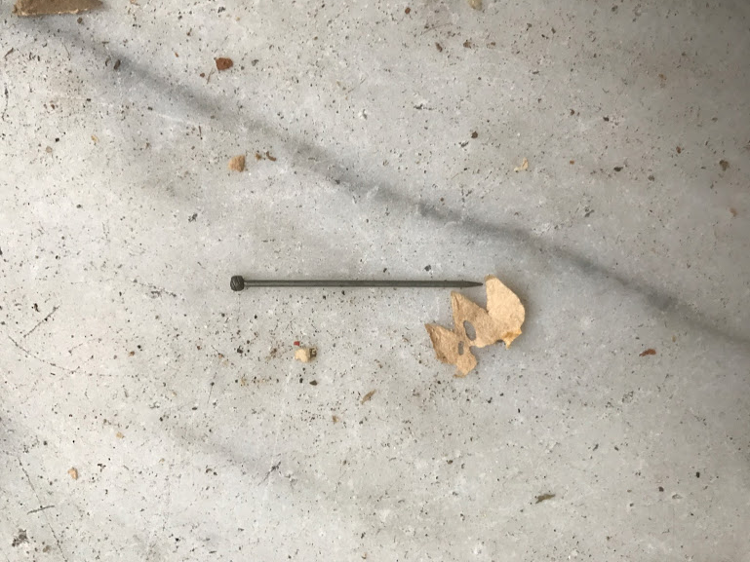
A Point
Notes:
The work of a records manager is to solve other people’s problems
Whether they want them solved or not
Yet always with their input
And never alone
Remember this:
We don’t know everything
Our record-creating colleagues know more than we do
But we also know more than they do
And our joint sets of knowledge overlap
So we cannot help anyone
Until they help us
We must embrace this need to collaborate
To learn from others
But also to teach them
Not an edict, but a conversation

Slide 5
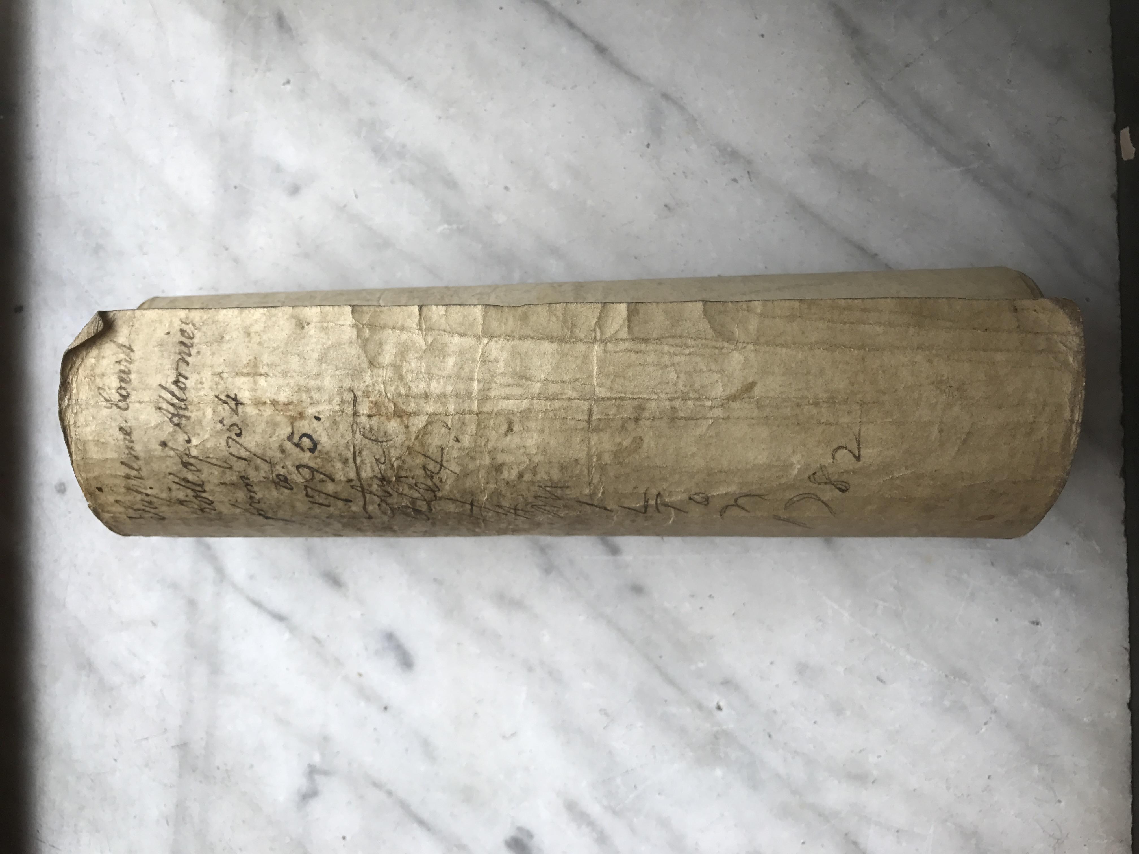
Old Processes, New Ideas
Notes:
Processes change either naturally or unnaturally
Natural processes are generally slow and small
Unnatural ones are fast and dramatic
To make a difference, we have to go with the unnatural
But we can’t do that alone
We need at least some buy-in from others
Support from higher-ups
Support from the creators of records
And the means to convince others
To make a change, we must believe in ourselves
And we must make changes to benefit others
The focus of our work cannot be ourselves
We must be sure of ourselves but focused on others
As you can see from this photo
In the courts, we’re still dealing with parchment
So it might take us a while to address all the paper we have made

Slide 6
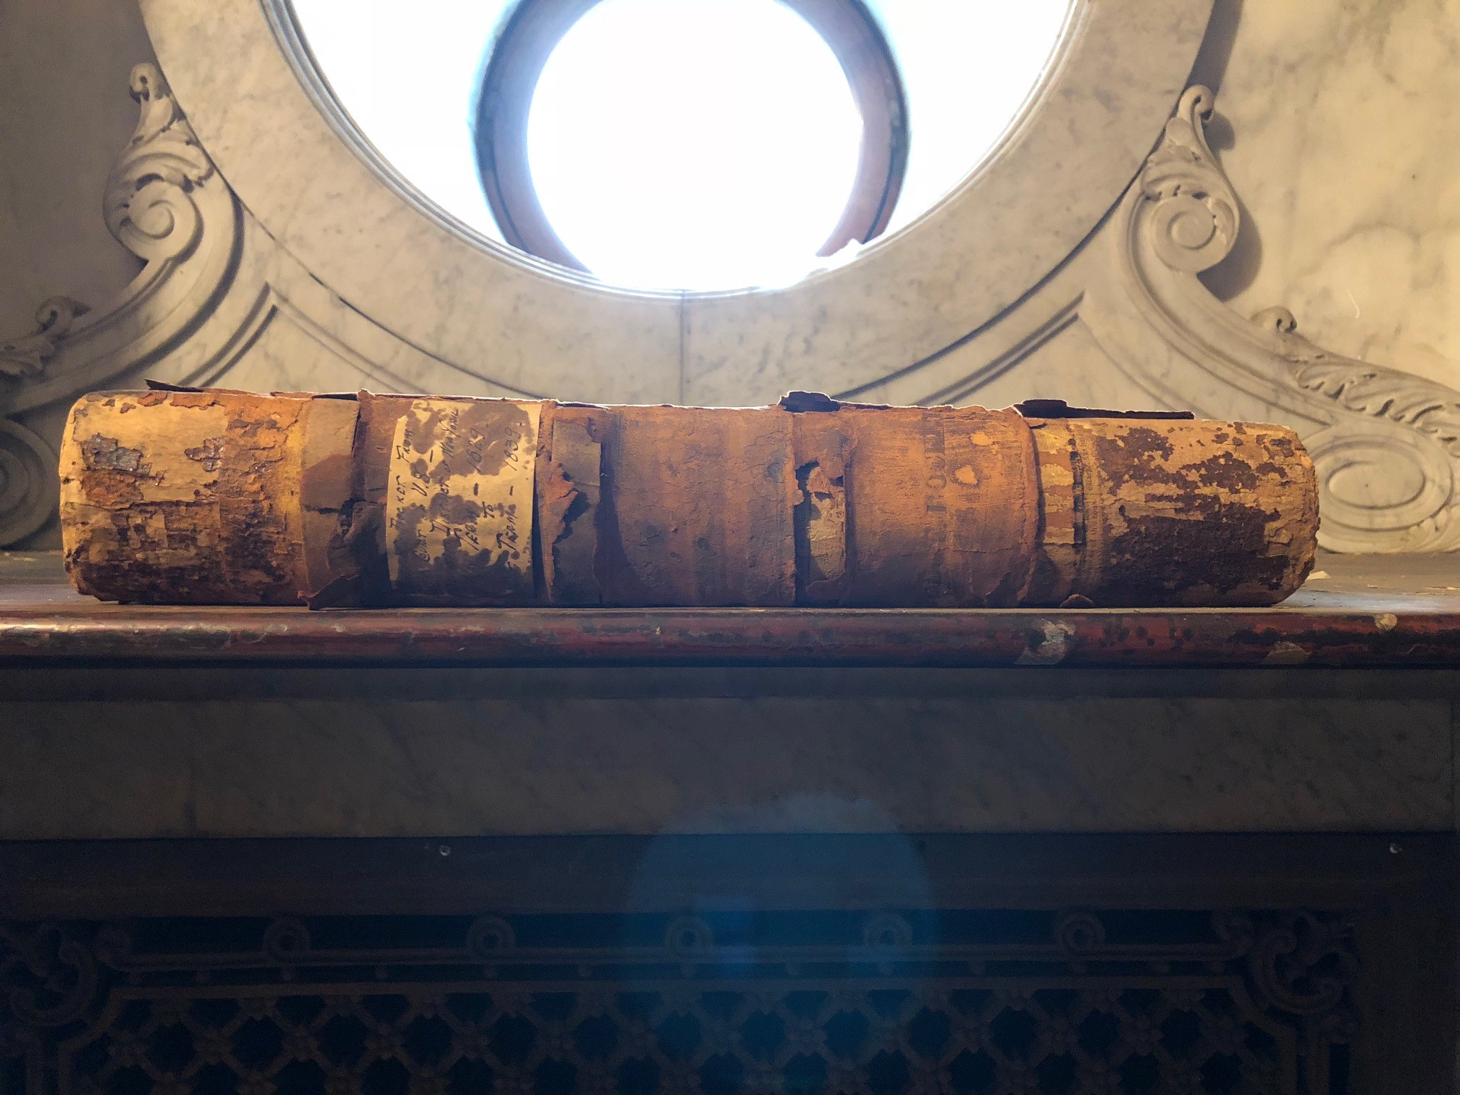
A Few Ideas
Notes:
Here are the ideas I developed in the first few months of my tenure:
Reduce Risk (the overarching goal)
Improve Retention Scheduling and Disposition
Expand Our Service Orientation
Implement Full Digital Records Creation and Management
Transfer Archival Records to Archival Repositories
Update Records Management Directives
Improve Funding for Records Activities

Slide 7
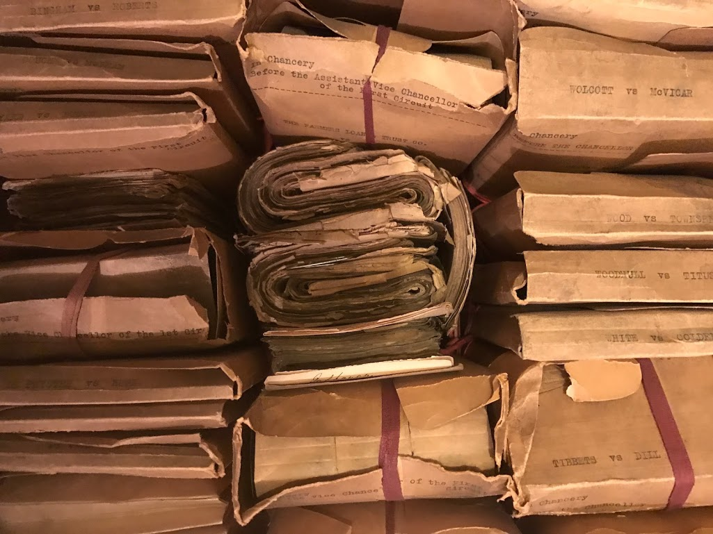
Accomplishments
Notes:
Reduced Risk
Improved control over records, greater knowledge of records issues
Improved Retention Scheduling and Disposition
This has been slowed down by the review process
Expanded Our Service Orientation
We have added two field officers to our team
Implement Full Digital Records Creation and Management
Discouraged microfilming, funded digitization, increased digital storage
Transferred Archival Records to Archival Repositories
We’ve transferred 1.5K cf, with 12K more coming (or going)
Updated Records Management Directives
All revised, but awaiting review process
Improved Funding for Records Activities
Received $2M last year, another $2M this year

Slide 8
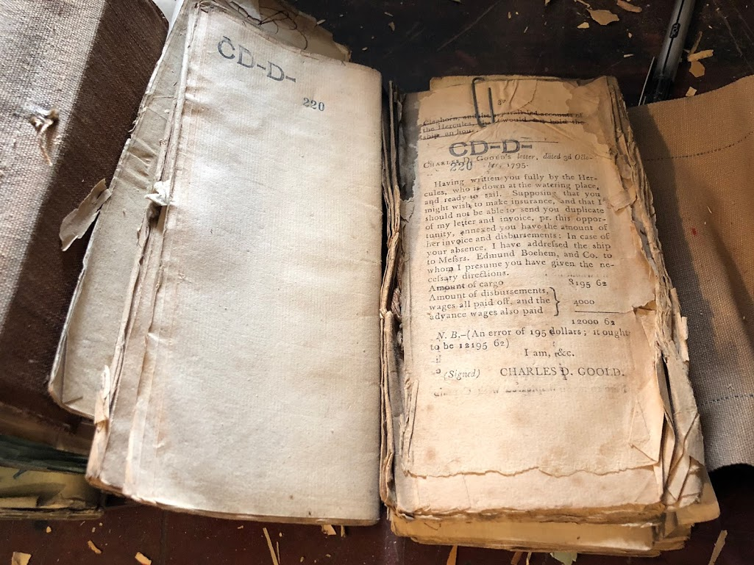
Notice the Patternlessness
Notes:
Notice the patternlessness in all of this work
Or maybe there was a pattern
It was that we were all over the place
My goal was to revive and reinforce RM from all perspectives
My unit
Archives
Outreach
Organization as a whole
The general public
Rather than merely improve records management
The goal was to make the unit known
I was the new person
And I had credibility from my job interviews
But also from how quickly we made changes
And how I quickly found solutions to problems people posed
Because it is our job to solve problems

Slide 9
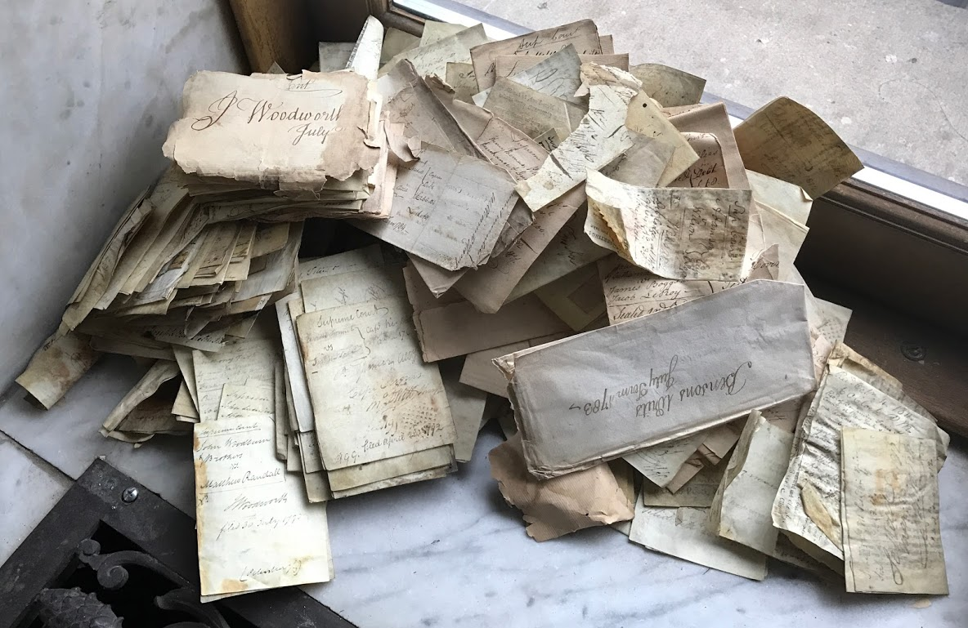
Ancient Records
Notes:
Early in my tenure, I was taken to a dusty archives
Where few records were in pristine order
While others were in a strangely pristine (but dusty) reorder
This collection was once the purview of the Division of Ancient Records
Literally. Now it’s the Division of Old Records
This archives had these features:
About 14,000 cubic feet of records from 1674 to the 1940s
Many security problems
No environmental controls
Dirt, dust, and trash all around
Many series in total disarray
Many records damaged
Incomplete intellectual control
Limited physical control
At the end of the tour, I was asked for a solution
I gave two:
Either build a giant archives for many millions of dollars
And staff it with at least 10 archivists and conservators
Or depatriate the records to NYSA and the NYC municipal archives
Within a little over a year, we had transferred 1,500 cf to NYSA
And were rewarded with a prominent photo-heavy story in the NY Times
The story demonstrated we and our archival records mattered
This gave us credibility

Slide 10
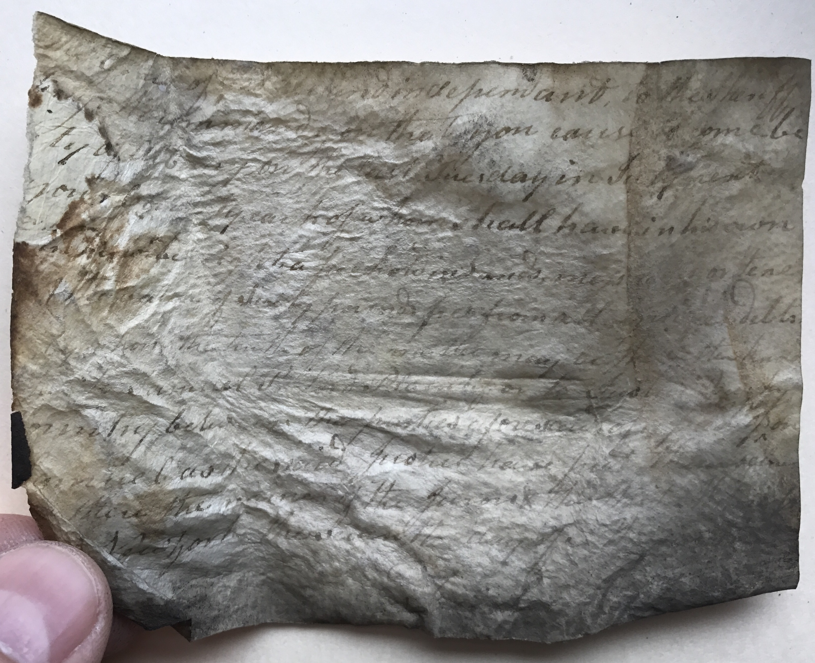
To Do is to Learn
Notes:
All of this work provided advantages to us
We learned much about the courts while doing all of this
When dealing with the oldest records
We determined what records we actually had
We learned how the courts operated in the past and now
We unified fractured and disorganized series
We began the process of preserving these records
So that we could save these records for use
We described the records for ourselves
We learned how to be better records managers and archivists
Since we were giving these records away
We needed good descriptions
So we could document what we transferred
And so we could maintain intellectual control
Even over records we no longer had
Our goal was to maintain professional standards
To define ourselves as competent, believable professionals

Slide 11
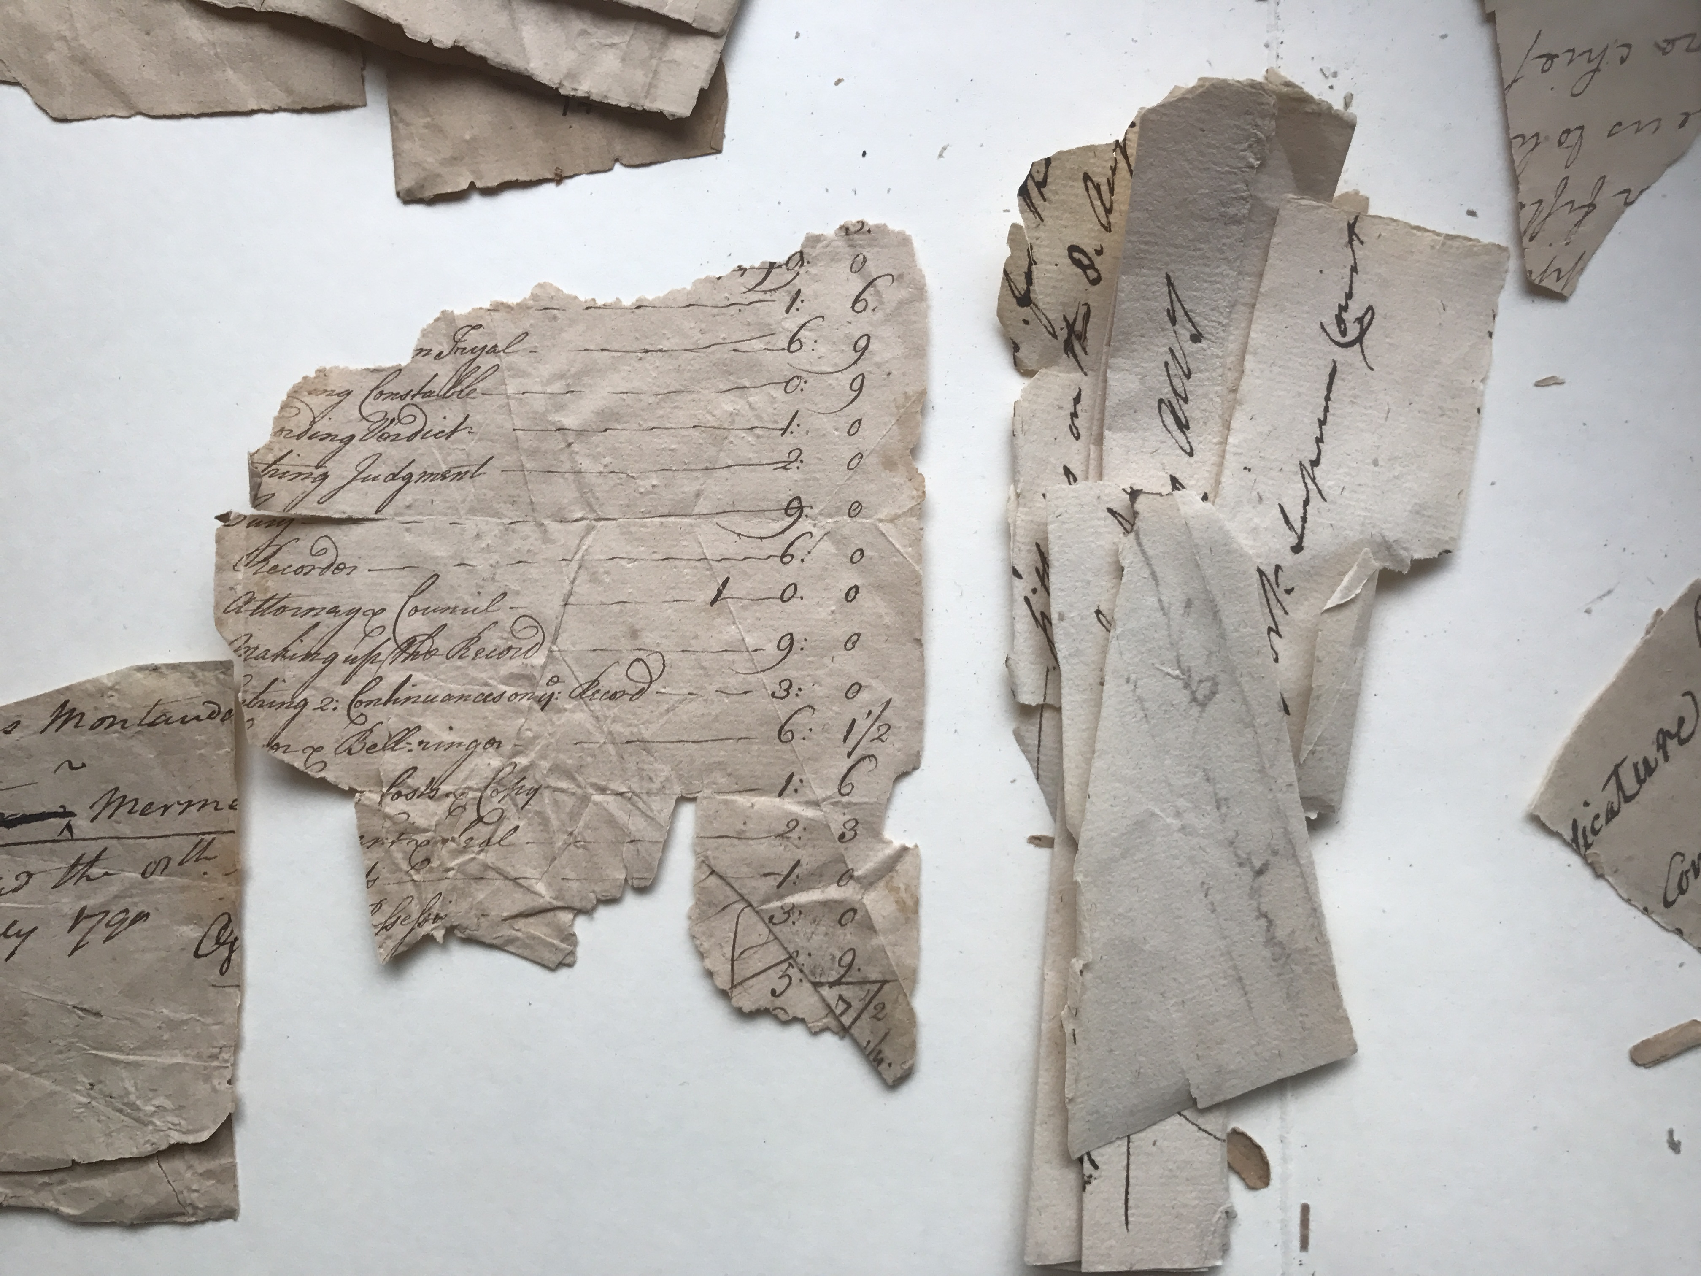
Becoming Digital
Notes:
But I still had to solve our paper problem
Almost immediately upon taking my job, I worked with our IT department
To set up the means for them to store more of our courts’ digital records
Because we can protect digital records better than paper records
Because we have strict e-records storage standards developed by ORM
Because we can save money and avoid increasing space needs
By digitizing records and protecting the resulting digital surrogates
We help make the organization faster and more efficient
To do this, we discourage microfilming
Why do we do this?
Because much microfilm will end up being digitized in the future
Because we can protect digital records better than microfilm
And because microfilm is slower

Slide 12
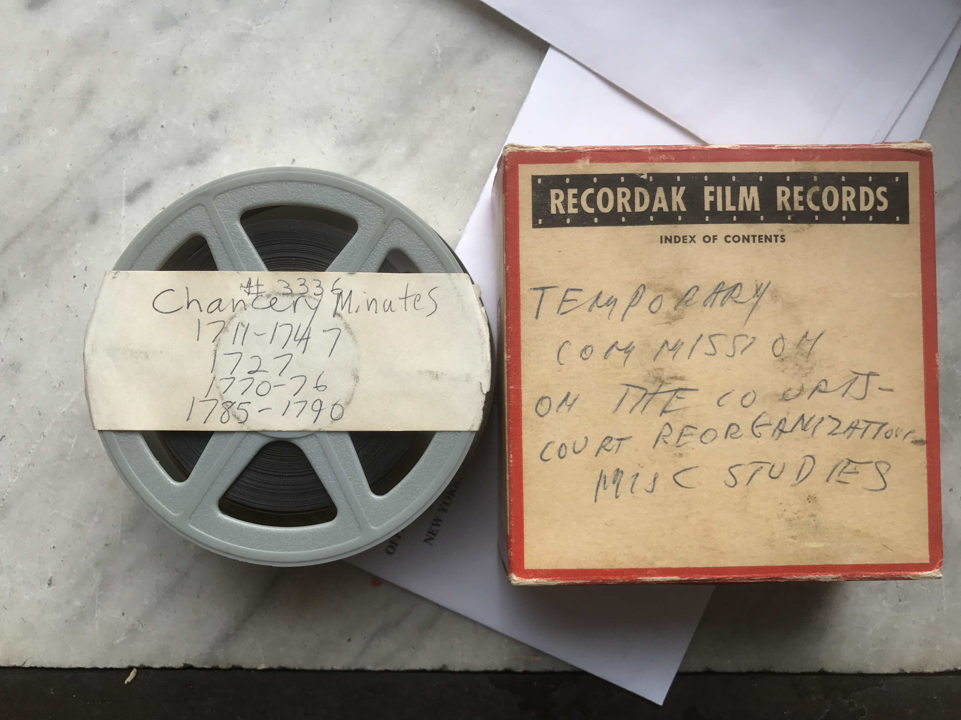
Digitize Everything
Notes:
Many court records are heavily used
Famous cases are requested over and over again
Even when the case papers no longer exist
So our digitization initiative transforms micrographics as well
Using automated machines in court houses
We are scanning many thousand images a day
Which barely scratches the surface of the billion or so images we have
These changes clean up court houses
And help staff finally gain control of their records
And records storage areas
And they make people uncomfortable
Nobody likes microfilm
But most people know it’s a reliable storage medium
And the loss of tactile records is a sea change some cannot easily navigate

Slide 13
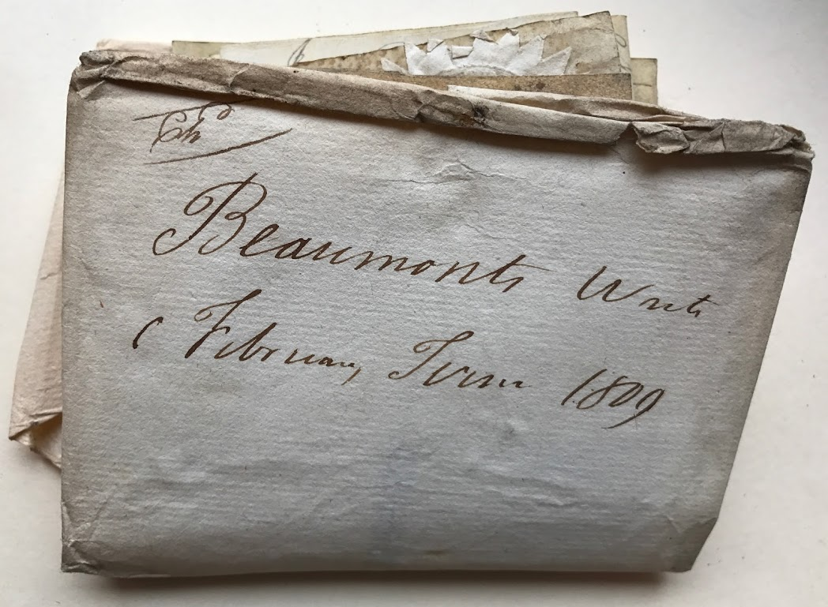
Access is Beautiful
Notes:
Part of what we have done is return value to the records
We dispose of the unnecessary
We protect the important
We provide access to everyone
When you are managing only the records you need
Your life is a little sweeter
When you can find the information you need
You can better do what you need to do
We have enhanced access in many ways
Digitized and OCR’d records to make them more usable
Put records of our second highest courts online
Accessible for free
Increased access to archival records by donating them away
[See Next Page]
And we have one other project
One not yet begun
One to identify all civil cases involving Donald Trump
And preserving them all as archival
Not for any political reasons
But because his life has revolved around such cases
Those court papers tell part of his story
That of a president
So the country will need the details

Slide 14
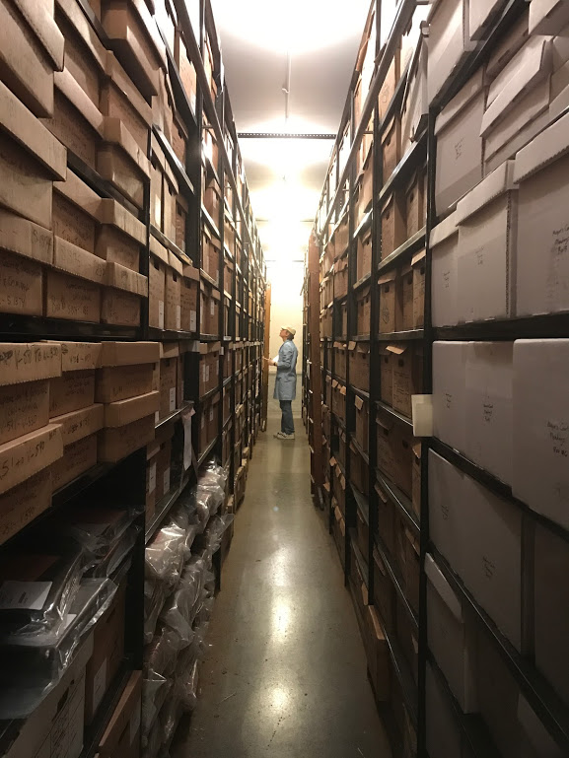
Change is Coming
Notes:
With precarious paper records storage
With storage aisles less than three-feet wide in some cases
With tons of microfilm taking up valuable space
With records awaiting but never attaining disposition
With costs rising as stores of records grow
We had to make a change
Changes
We needed to become a more proactive unit
We needed to have a large and positive effect on our organization
We needed to try to determine our own destiny
Even though that is hard to do
We had to do what was hard to do

Slide 15
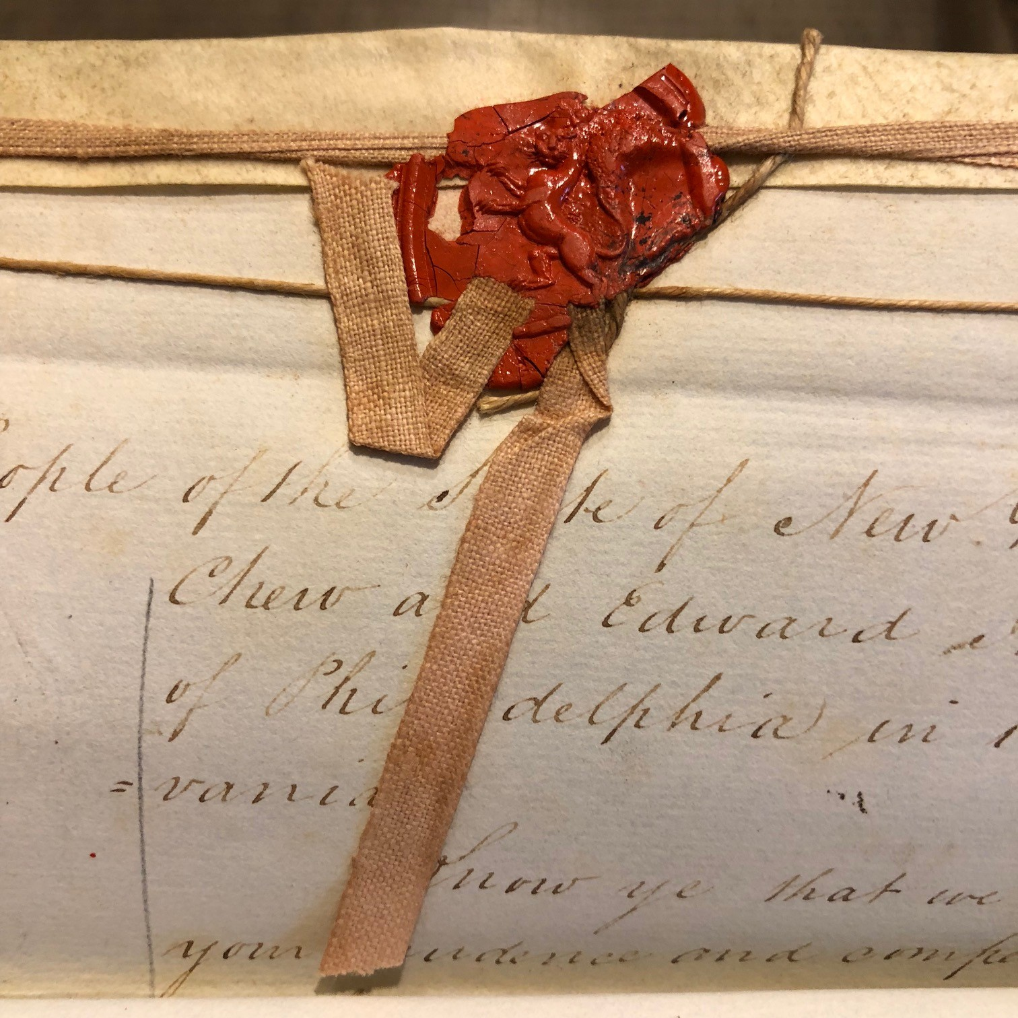
In the End
Notes:
In the end
(Though we are not yet to the end)
People responded
Sure, some resisted change
But most appreciated the help of problem solvers
People wanted the service
We had always served them
But now we were helping them transform their work
We were making a difference

Slide 16
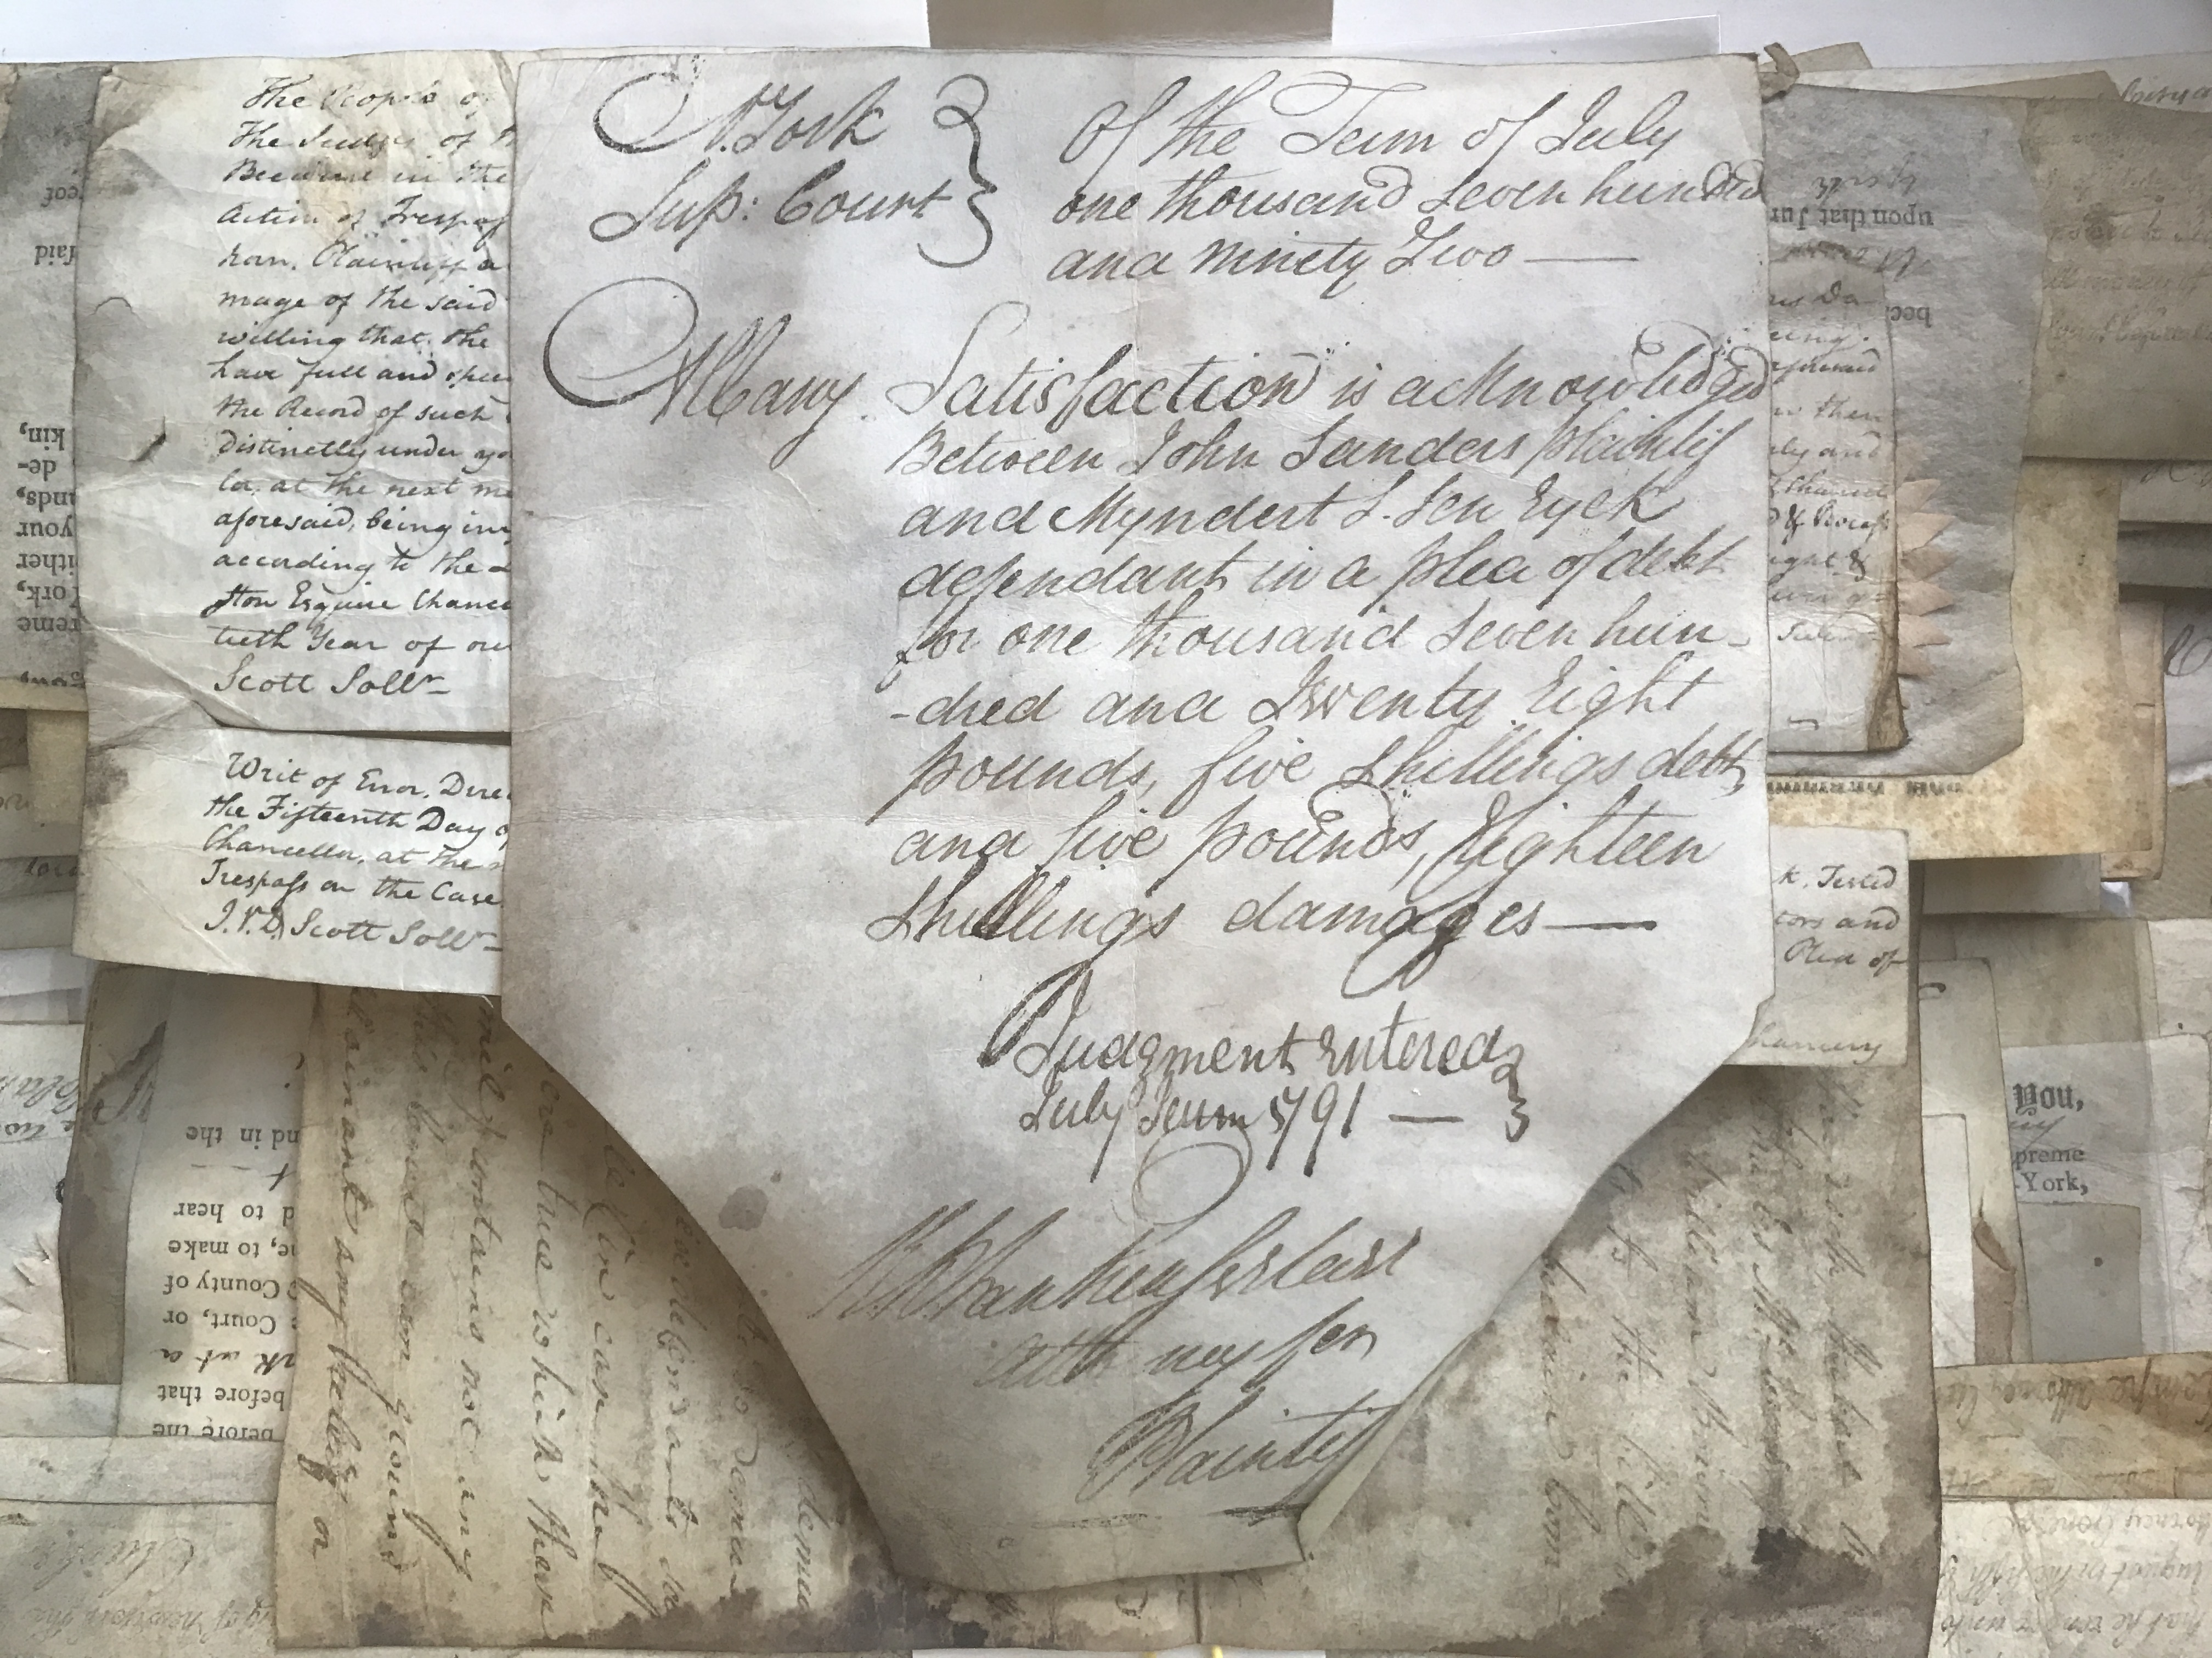
Be Valuable
Notes:
I have only one message for us:
Be valuable
Being right is good
Doing right is good
But to make real change
People have to see us as valuable
They must need us
And we need them
Because we are servants to everyone
Office workers, administration, researchers, the public
For office workers, we ease their work
We get them to their records faster
For administration, we reduce costs
We increase productivity
For researchers and the public, we save the records they need
We make them more easily available
If we are going to be anything in our organizations
We need to be as much as we can be

