Slide 1
The Pandemic, the President, and the Press: Access to the White House Correspondents’ Association Emails
Jen Wachtel
(formerly) Processing Archivist, University of Maryland Libraries
Joshua Westgard
Systems Librarian, University of Maryland Libraries
MARAC Fall 2021 Conference Session 17
Notes:
Former Mass Media and Culture Processing Archivist at UMD Special Collections and University Archives at the University of Maryland. As of late September, at History Associates and nothing I say here represents History Associates.
If you came here looking for a case study in email archives, you came to the right place!
I will introduce the WHCA Project, its content, and an overview of creating an email archive. My colleague Josh Westgard will speak to the technical side of the project and has a longer view of the project as a whole.

Slide 2
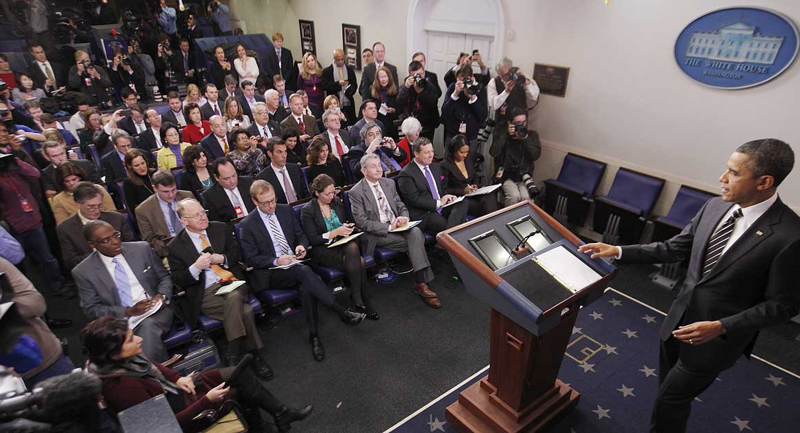
Access to Email Archives: Timeline
WHCA: free press and robust coverage of the presidency and administration (founded 1914)
Issued a request for proposals in 2016 to preserve and provide access to pool reports
UMD and partners selected as repository of record
WHCA began transferring born-digital records to UMD via Box
I joined in 2020 as processing archivist: quality assurance of email redactions
Source: Politico, 2015
Notes:
What is the White House Correspondents Association?
Mission of WHCA: ensure a strong free press and robust coverage of the presidency by advocating for access by the media to the President, White House events, and administration officials
WHCA Members: reporters and photographers who cover the White House as their regular beat
UMD and its partners responded to the WHCA’s Request for Proposals in 2016, and were selected as the repository of record.
WHCA began digitally transferring its pool reports in email format to UMD, delivered via Box.
I joined the project in 2020 in my capacity as Mass Media and Culture Processing Archivist, responsible for running quality assurance on email redactions: email, physical address, phone numbers.
What is a pool report? report from the press pool covering the actions of the president and the administration

Slide 3
WHCA Project Scope
Build and preserve comprehensive archive of WHCA pool reports and related content
Physical and digital pool reports
Develop and use digital tools to automatically reformat pool reports
Redact targeted pool reports
Notes:
UMD Libraries and its partners agreed on a Project Scope with the WHCA in 2016
Build and preserve a comprehensive, searchable archive of the White House Correspondents Association (WHCA) pool reports and related content for research, teaching, learning, and journalism
Gather physical and digital pool reports held by WHCA members, presidential libraries, and other to add them to the archive
Develop and use digital tools that will automatically reformat the pool reports as necessary
Create metadata to make the pool reports searchable and filterable,
Redact targeted personal information about pool reporters as needed (that’s where I come in)
Josh will speak more to the digital tools mentioned above

Slide 4
Labor/Staffing
Project Manager: Mary Galvin
Journalism and Communications Studies Librarian (Subject Expert): Chuck Howell
Software Development Manager: Ben Wallberg
  + 1 occasional Senior Software Developer: Peter Eichman
Systems Librarian (Programmer): Josh Westgard
Processing Archivist: Jen Wachtel
Electronic Records Archivist: Amy Wickner
Graduate Student Assistant: Selena St. Andre
Notes:
I am one of 8 people including Josh

Slide 5
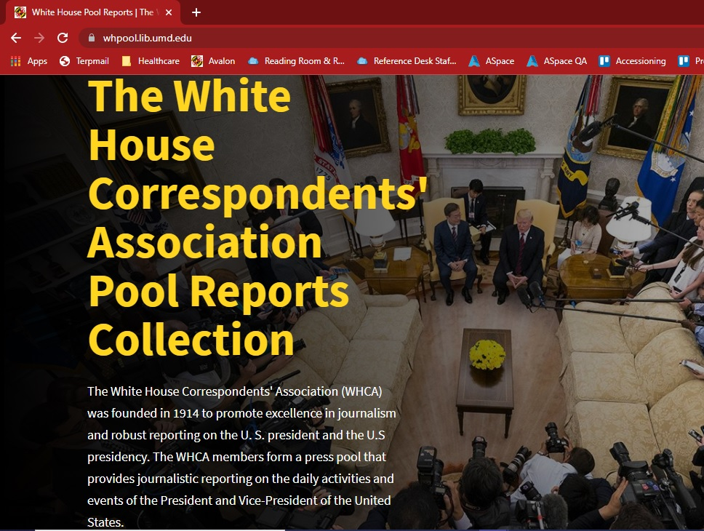
White House Correspondents Association (WHCA) Collection
WHPOOL.LIB.UMD.EDU
Notes:
As of 2020, we have a live database.
WHCA Project is a comprehensive collection of White House pool reports for journalists, researchers, students, and the general public created by the University of Maryland Libraries and its partners in collaboration with the White House Correspondents Association
Philip Merrill College of Journalism (UMD)
College of Information Studies
Freedom Forum Institute
Extensive collection of pool reports that provides a searchable, freely accessible database
Collection complements materials at the University of Maryland Libraries that document the history of radio and television broadcasting in the Mass Media and Culture Collections, including the Library of American Broadcasting and the National Public Broadcasting Archives

Slide 6
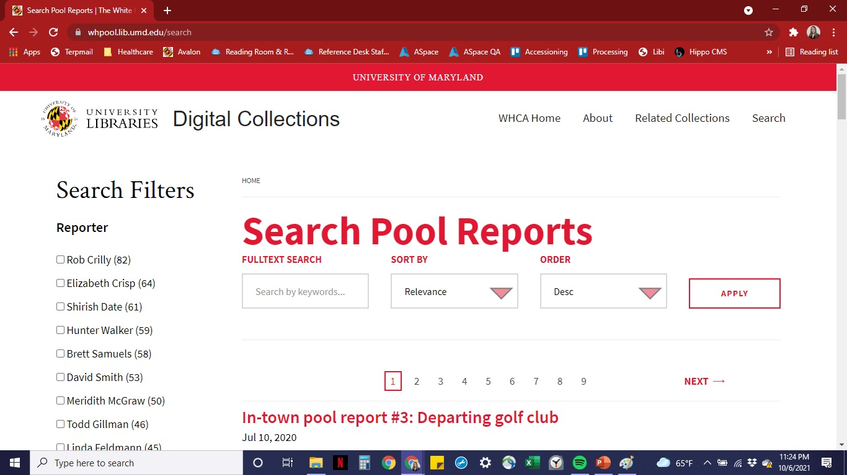
Project Status
Notes:
1,800 pool reports dated June 25 – September 2020 are posted live online and redacted
Project staff still collecting and preserving pool reports from Oct 1, 2020 through present
Recently obtained and preserved email pool reports from George W. Bush and Barack Obama administrations

Slide 7
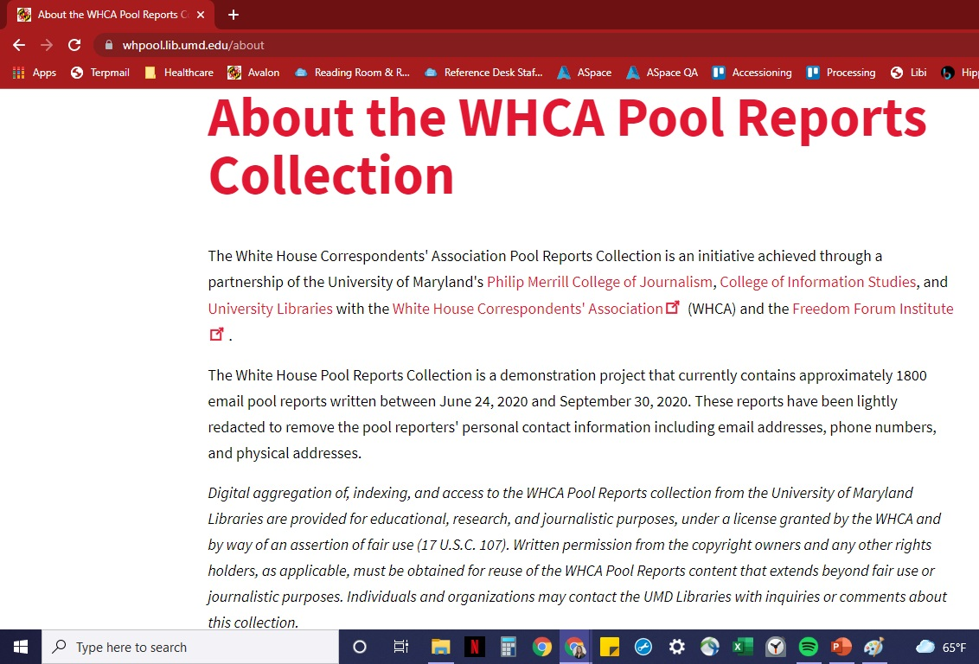
Archival intervention: Why redact?
Notes:
Pool reports come in the form of email and contain current, active PII (personally identifiable information) for journalists.
WHCA stipulated that we must redact PII to protect their journalists.
Ethical question: To what degree should archivists intervene in the record?
Acknowledgement: In line with the fact that archives are not neutral, we recognize up-front that the arrangement and presentation of the record reflects both human and algorithmic interpretation
Decided to include a “Processing Note” with the records – this highlighted note clearly stipulates exactly which interventions we made: “These pool reports have been lightly redacted to remove the pool reporters’ personal contact information including email addresses, phone numbers, and physical addresses.”
Now becoming common archival practice to note archival interventions, such as harmful language notes (cite Kirsten Wright, 2019 “Archival interventions and the language we use.”)

Slide 8
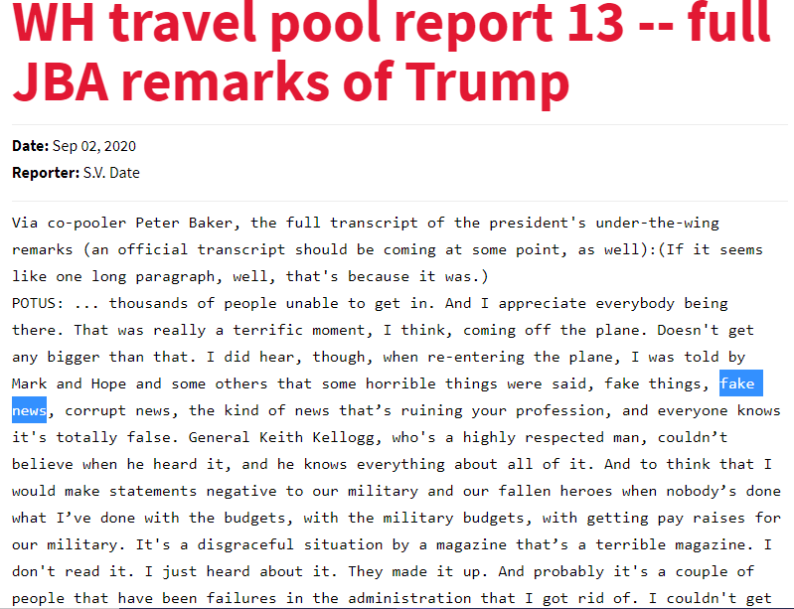
Political Climate: “Fake News”
September 2, 2020
Notes:
Another reason to redact is to protect journalists from retaliation in a climate where the president was publicly disparaging their profession and where journalists were coming under attack
Emails also reflect the tension between the tension between the press and the president
“If it seems like one long paragraph, well, that’s because it was. POTUS: “…some horrible things were said, fake things, fake news, corrupt news, the kind of news that’s ruining your profession, and everyone knows it’s totally false.””

Slide 9
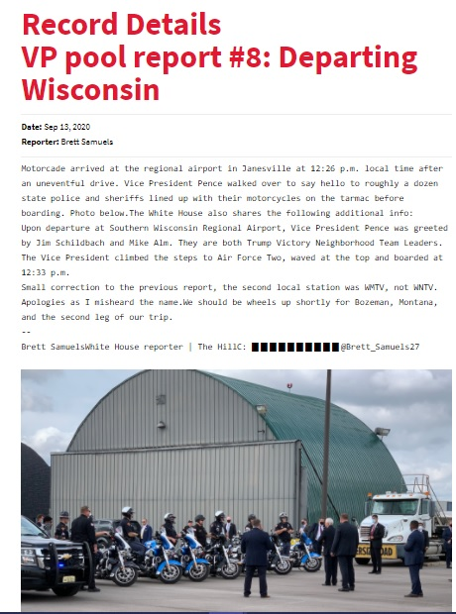
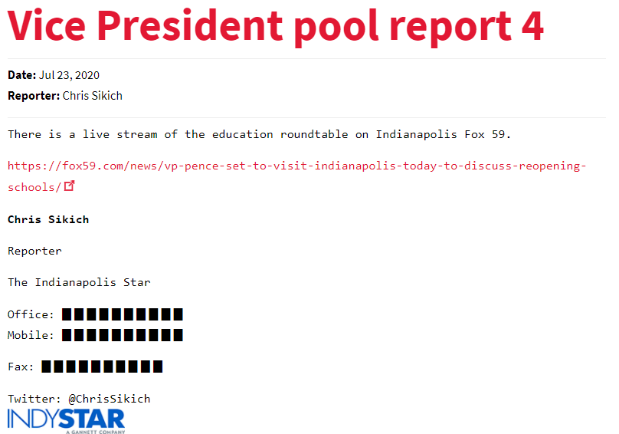
Redaction Examples
Notes:
As you can see here, we decided to protect journalist’s identities
Archival intervention consisted of rendering the raw html and redacting physical addresses, email addresses, and phone numbers

Slide 10
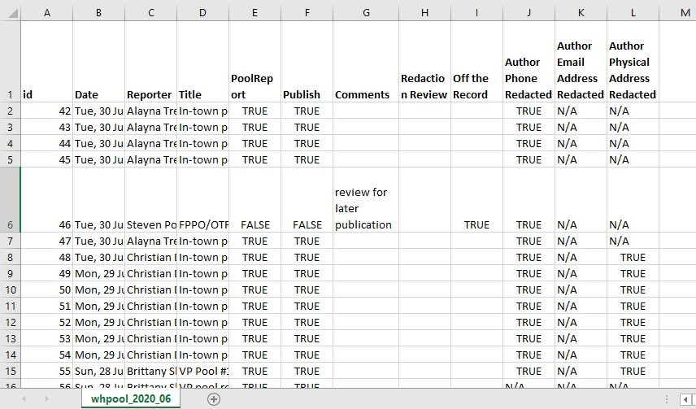
Redaction and QA Process: approximately 5,225 emails reviewed
Notes:
Quality Assurance: I reported on whether email author’s phone numbers, email addresses, and physical addresses were redacted
Delivered CSV reports like these to the software developers and programmers prior to final upload into the public database
Individual review of 5,225 emails between myself and graduate student assistant Selena St. Andre as of September 3, 2020, documenting June 2020 – April 2021
Next, I’ll dive into the content of these emails

Slide 11
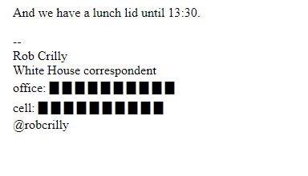
Content: Day-to-Day Activities
Thursday, December 3, 2020: Lunch Lid
Notes:
“And we have a lunch lid until 13:30.”

Slide 12
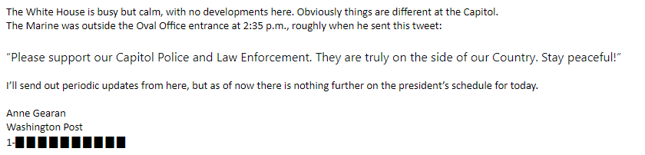
Content: Historical Events
January 6, 2021: insurrection at the Capitol
Notes:
“The White House is busy but calm, with no developments here. Obviously things are different at the Capitol.”

Slide 13
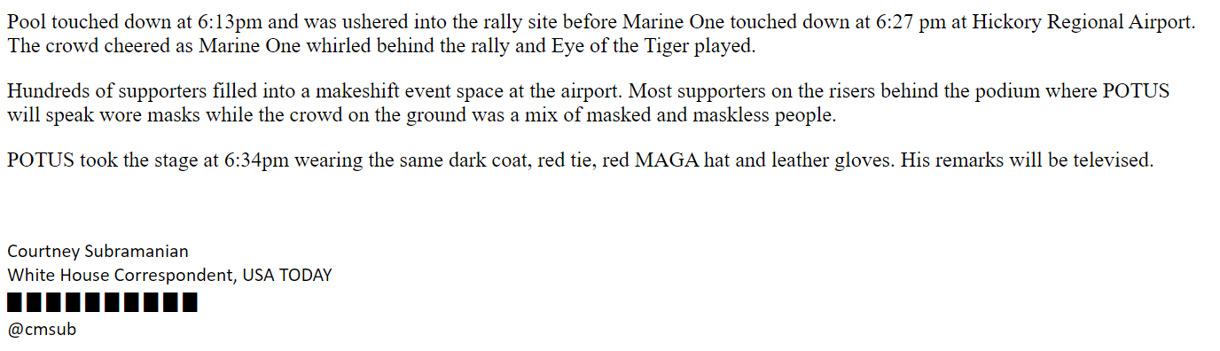
Content: 2020 Presidential Campaign
Sunday, November 1, 2020 Out-of-Town Pool Report: Arrival at Campaign Rally in Charlotte, NC
Notes:
“Hundreds of supporters filled into a makeshift event space at the airport. Most supporters on the risers behind the podium where POTUS will speak wore masks while on the ground was a mix of masked and maskless people.”

Slide 14
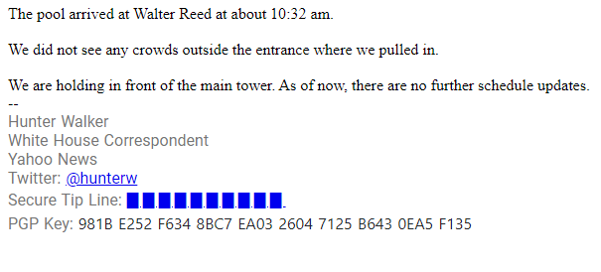
COVID, masking, and social distancing: Pool Report vs. Pool Note
Pool Report: Monday, October 5, 2020: President Trump at Walter Reed for COVID treatment
Notes:
UMD’s algorithm captured pool reports and pool notes
pool reports specifically document the activities of the president, vice president, First Lady, and the administration.
“We did not see any crowds outside the entrance where we pulled in. We are holding in front of the main tower. As of now, there are no further schedule updates.”

Slide 15
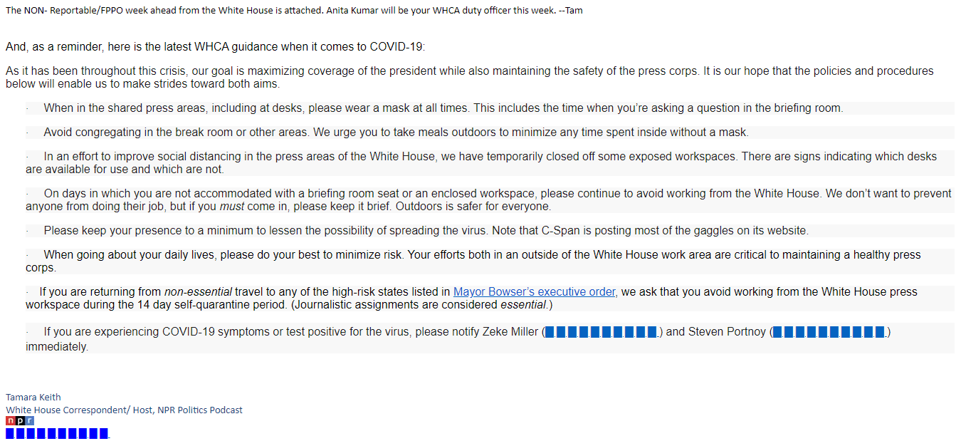
COVID, masking, and social distancing: Pool Report vs. Pool Note
Pool Note: Sunday, October 18, 2020: Non-Reportable/ For Press Pool Only
Notes:
Pool Notes are also of possible historical interest as they document the workings of the WHCA, like masking and social distancing policies.
Selected text: “On days in which you are not accommodated with a briefing room seat or an enclosed workspace, please continue to avoid working from the White House. We don’t want to prevent anyone from doing their job, but if you must come in, please keep it brief. Outdoors is safer for everyone.
Collection is both a valuable historical resource documenting the presidency and the press, but also a useful case study in stewarding an email archive.
Josh Westgard will dive into the technical aspects of that stewardship and long-term goals.

Slide 16
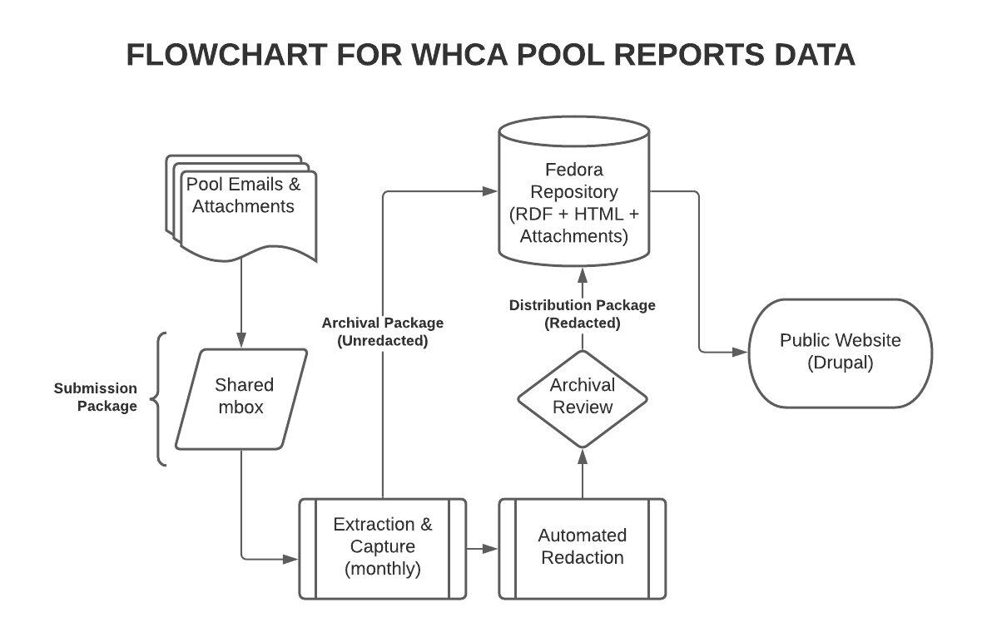

Slide 17
Future Directions
Improved accessioning tools
  Fix extraction bugs
  Better automated redaction
Expanded collecting (legacy email and print)
Improved harvesting
  Capture related files
  Better metadata capture (named entity recognition)
Notes:
Produce digital tools that will harvest external content and media linked from within the pool reports
Create complementary content for the project website, such as lesson plans, stories, timelines, etc to promote the collection and enhance its value
Goal: obtain more content from WHCA members and other entities which hold paper-based pool reports; with enough capacity, support the complete run of pool reports
Goal: Add more content as staffing capacity allows, assure quality of data and records

Slide 18
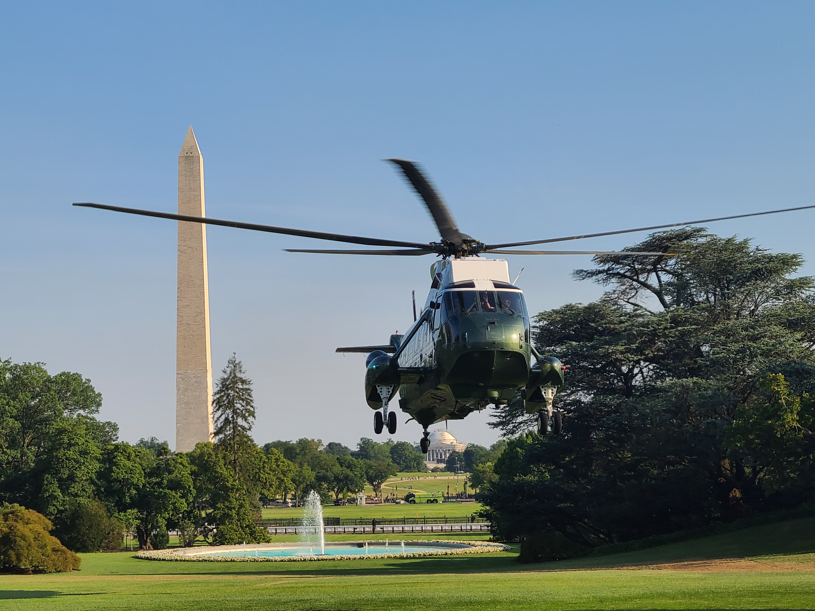
Thank you! Any questions?
Jen Wachtel
jw23@terpmail.umd.edu
Joshua Westgard
westgard@umd.edu
President Trump arrives on South Lawn via Marine One, July 14, 2020 (Reporter: Francesca Chambers)

