Slide 1
Remote Control: Managing ILL during the COVID-19 Pandemic
Brynne Norton
Head, Resource Sharing and Reserves
University of Maryland College Park
Lorrie Woods
Resource Sharing Coordinator
University of Maryland College Park

Slide 2

About University of Maryland College Park
40,700+ students in
  102 undergrad majors, 115 master's programs and 84 doctoral programs
8 Library branches, with centralized interlibrary loan services

Slide 3
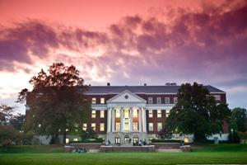
About Resource Sharing
Resource Sharing is part of the Resource Sharing and Reserves Unit.
The Unit consists of 9 employees.
Four employees have resource sharing as a core duty.
There is cross-training in all unit duties for back up, support and customer service.
We typically supply over 14,000 loans and borrow over 25,000 items/articles

Slide 4

What happened during the pandemic
Communication
Workflows &
Load Balancing
Student Employees
Morale
(Re)Defining Success

Slide 5

Communication: Managing Expectations

Slide 6


Changes to ILLiad
Disabled loan form
Created an ebook work form*
  From article request form, deleted unneeded fields, renamed others to mirror a loan form for better patron experience
New delivery location for Curbside Pick Up
New clarification notifications
Changes to OCLC
  New holdings groups and paths
  Deflected returnables
  Edited borrowing notes and delivery method in constant data

Slide 7
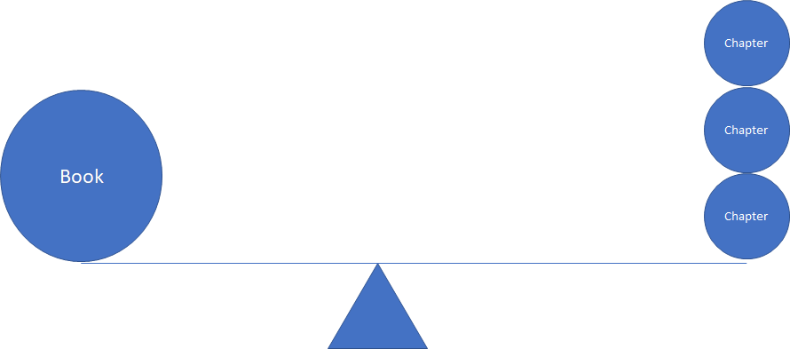
Ebook Workflow &
Best Practices
Request type is article, doc type is ebook
Ebook Processing Queue
  Requests can be routed from any queue
  Form routes directly to this queue
Choose the ebook record from OCLC, if it came in on a print record, switch it!
  If no ebook was available, send clarification request offering chapters
Find lenders by prioritizing proven lenders and free lenders
  Most public libraries can not ILL ebooks
Use the new constant data for ebooks & add "requesting ebook" to title
Unfilled: send note to patron suggesting chapters (or hard copy when possible)
  Patron responds with chapters
  Change doc type to book chapter, then clone request for each chapter, update information, delete OCLC information

Slide 8
Printing
Flags for each scanning student, print for each separately
  Move anything you do not want to print into a queue with no automations
  View requests, add flag
  Print requests
  Move others back to Awaiting Stacks Searching to wait for the next scanner
Check progress
  Each request shows in the queue for the status and under the flag
  Check the flag to see their progress
  Check the queue to see lagging requests
  NOS? Add notes and reprint for the next student employee
  Clear flags at the end of the week
Maintain quarantine distance
  Chat with students in the stacks to answer on the fly questions before scanning
  Label each cart with each student’s name
  Active requests up top, upright
  Completed on bottom shelf, flat

Slide 9
Hiring and Training Student workers at a distance
Zoom calls for interviews
Training
  Email overview and procedures
  Video demonstration
  One in person demonstration
  Zoom for coaching
VIsual Feedback is more useful than verbal or written
  Send pictures or screen shots for clarification when possible
  They will model the behavior they see

Slide 10
Student workers workflow and distance
ALI
CIC
DANA
ALI CIC
THIS
became
THIS
JAIME
DANA
CILL
CILL
JAIME SCAN
SCAN

Slide 11
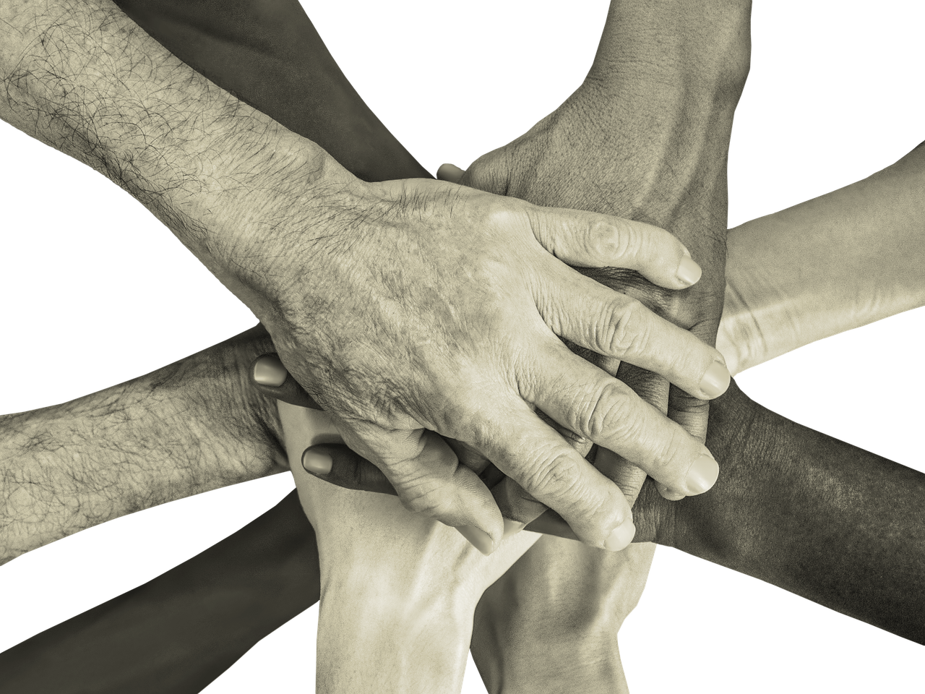
Morale

Slide 12
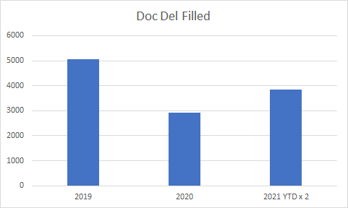
(Re)defining Success - Document Delivery
*Note: Document Delivery during the pandemic was most likely lower due to the use of the HathiTrust Emergency Access items which made approximately 40% of our collection available electronically

Slide 13
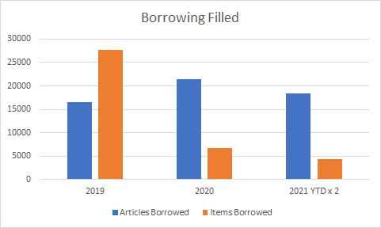
(Re)defining Success - Borrowing

Slide 14
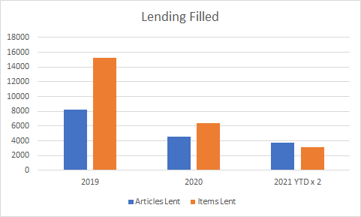
(Re)defining Success - Lending
*Note: Lending during the pandemic was most likely lower due to the use of the HathiTrust Emergency Access items which made approximately 40% of our collection unavailable for lending.

Slide 15
Thank you!
Many thanks to the entire Resource Sharing & Reserves Unit and in particular to Ashley Chen, Borrowing Specialist, for her work on the eBook workflow and processing.

Slide 16
For further questions or information,
please feel free to contact us!
Lorrie Woods
lwoods11@umd.edu
Resource Sharing Coordinator
University of Maryland College Park
Brynne Norton
bnorton1@umd.edu
Head, Resource Sharing & Reserves
University of Maryland College Park

