Slide 1

The Changing Terrain of Academic Libraries
Responding to Evolving Needs of Students and Faculty
Yelena Luckert Judy Markowitz Nevenka Zdravkovska
MLA- DLA, Cambridge MD, May 3, 2018

Slide 2
Goals for the Day
We will cover Public Services initiatives:
Reference services - Judy Markowitz
Merge of branches - Nevenka Zdravkovska
Liaison Workforce - Yelena Luckert
Results - Yelena Luckert
Notes:
YL:
== Like many other academic libraries, Univ of Maryland underwent through many changes.
== We do it for our patrons, i.e. students and faculty
== We practice data driven decision making -- Evidence of assessment is throughout the presentation.
== We will leave enough time for questions at the end, but if you have questions during the presentation, please ask.

Slide 3
Reference Changes
Responded to the needs of patrons in different library locations
McKeldin / Art / Architecture / Performing Arts / STEM
All Subject Librarians participate In-depth appointments with individual patrons Email questions asked directly Email questions assigned from LibAnswers
Additional distinct models of reference services are provided within different locations Single service desk “On call”
Notes:
JM. We are always striving to meet the academic, research, and information needs of the campus community in both traditional and innovative ways. I am focusing on how we provide reference services to meet the needs of our patrons. Since we have several branches on campus our response to reference needs vary from location to location. All locations have a single service desk, but staffed differently. McK Library Services Desk desk is covered by staff and students and is the only location where librarians are scheduled to be on call away from the desk. Students are at the desk for Art Library and Architecture Library and the librarian in those two libraries are in their offices but if not available, patrons are advised to email /Performing arts has staff and students with librarians in their offices and similar to Art/Architecture, if not available, patrons are advised to email/ STEM schedules students, staff and librarians at the desk. Regardless of location, all subject librarians participate in in-depth appts ...

Slide 4
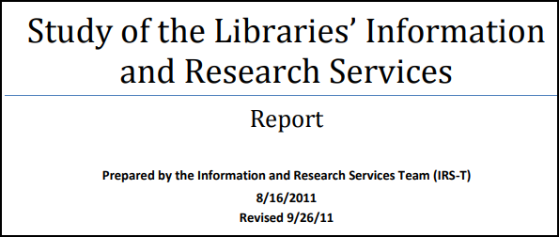


Background
Special Task forces charged with assessing, researching current situation and providing recommendations
Study of the Information and Research Services https://drum.lib.umd.edu/handle/1903/17460 McKeldin Merged Desk http://hdl.handle.net/1903/20582 Virtual Information Services http://hdl.handle.net/1903/20583
Librarians reporting on their reference activities via their annual reports, workplans and annual reviews
Notes:
JM Before making major changes, we conducted several studies starting in 2011. The first, the Study of the Libraries Information and research services focused on the challenges facing the existing reference services due to: physical / virtual reference points, staffing, and changes in the types of questions being asked at the desks versus questions being asked directly to the subject librarians. The McKeldin Merged Desk committee was charged with planning for a single service point for the first floor of Mckeldin Library. Data and findings and recommendations and implementations from the 2011 report were considered in the final recommendations focusing on many issues including the particular service model, training needs and the role of subject librarians. We had not examined our virtual reference offerings since 2003 when UMD became a member of the Maryland AskUSNow/QuestionPoint cooperative. So, we developed a Virtual Information Services Task Force and after deliberations on the recommendations, we moved away from the cooperative and began to use Springshare for Chat and libanswers (email questions)

Slide 5
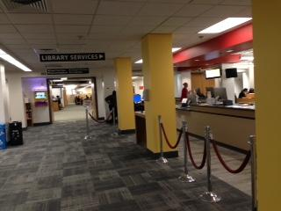
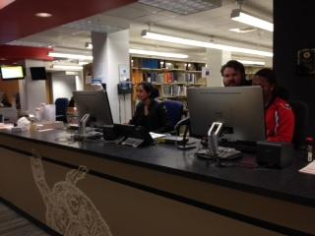
Focus on McKeldin - Our Main and Largest Library
Fall 2014 - Combined the separate circulation and information desks into a Single Service Desk - Libraries Services Desk (LSD)
Librarians no longer required to physically serve at the new desk
Reference provided using an “on-call” model
Reference questions asked at the desk are referred to the on call librarian
On Call staffed by Subject Librarians from Humanities and Social Sciences and Librarians from Teaching and Learning
Notes:
JM This has been one of our most successful undertakings. We have of course, made changes along the way since the initial implementation. The on-call model means the Librarians are at their own desks getting work done while waiting to be called downstairs. This model is working extremely well and we are currently providing excellent reference service.

Slide 6
Extensive on-going training sessions provided by the Reference Coordinator Librarian
For new librarians and graduate assistants
For staff and students at the Library Services Desk (LSD) How and when to refer Basic reference assistance Known items (catalog, holdings and location information) Access databases Access subject and course libguides
For Virtual Reference Chat LibAnswers RefAnalytics
Training for Reference Services
Notes:
JM The training for students and staff on how and when to refer is essential and is working well. There is always training for staff and students at the start of the fall semester and depending on staffing changes, training might be at other times. We incorporate skits for student and staff training. Training for new librarians and GA’s is ongoing, again depending on when we have new hires. For virtual reference, we offer training for new librarian and staff hires and we provide ongoing email reminders throughout the semester. We have an internal libguide for virtual reference.

Slide 7
Virtual Reference
Moved from QuestionPoint to Springshare CHAT and LibAnswers
Triage Group monitors the services Coordinator for Reference Services (Librarian) Coordinator for Library Services Desk (Staff)
Fall/Spring Coverage Monday - Thursday 8am - 9pm Friday 8am - 6pm
Fall 2015 - McKeldin On Call Librarians add signing into CHAT to answer the reference/research questions Monday - Thursday 10am - 6pm Friday 10am - 3pm
Notes:
JM We are happy with springshare chat and libanswers. As co-manager of the triage group, I spot check chat and libanswers questions, assign libanswers questions to appropriate librarians, make sure shifts are covered, send reminder emails with directions and screenshots related to procedures, policies and tips.
We are constantly evaluating our service. We might change our hours for example. And currently, we have someone from a designated location or service (ILL) on chat - because before we had one person from every location and we found that no one would answer because everyone assumed someone else would!

Slide 8
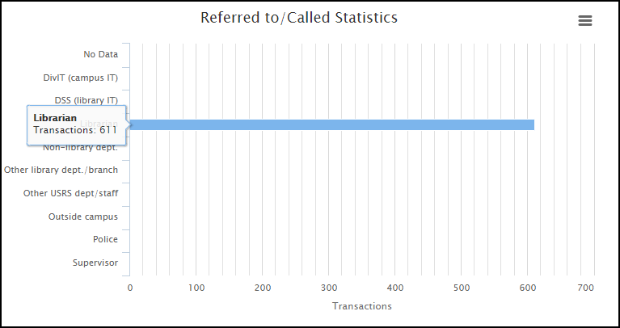
Reference - Some Statistics
Questions referred from the Library Service Desk (LSD) to On Call Librarians September 1, 2015 - March 31, 2018
Notes:
JM Many of you probably already use Springshare’s RefAnalytics and, of course the stats are only as good as the people recording them! We have tried really hard to make sure everyone at the LSD record all transactions, but we know there are always more questions than actually recorded. At any rate, we know for sure that we have 611 instances of the librarians on call being called down to the desk or answering questions via the phone). The total number of questions recorded from the LSD is 23,374 in the categories of: directions, facilities/disturbances, known item search, policies, services, supplies, technology and topical/subject specific. The 611 number is 2.61%. Of the other categories known item is 3086 (13.2%) and topical/subject area is 757 (3.24%)

Slide 9
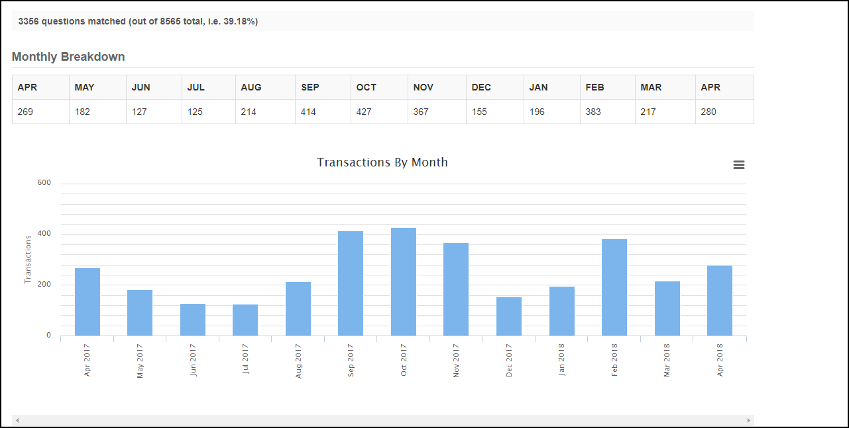
Consultations = all questions answered by subject specialists. Includes: email, in-person, chat, libanswers, phone. Snapshot = April 1, 2017 - April 30, 2018
Notes:
JM:
One year statistics for consultations (April 1, 2017 through April 30, 2018)
Over 3000 consultations.
Popular months - semester months:

Slide 10
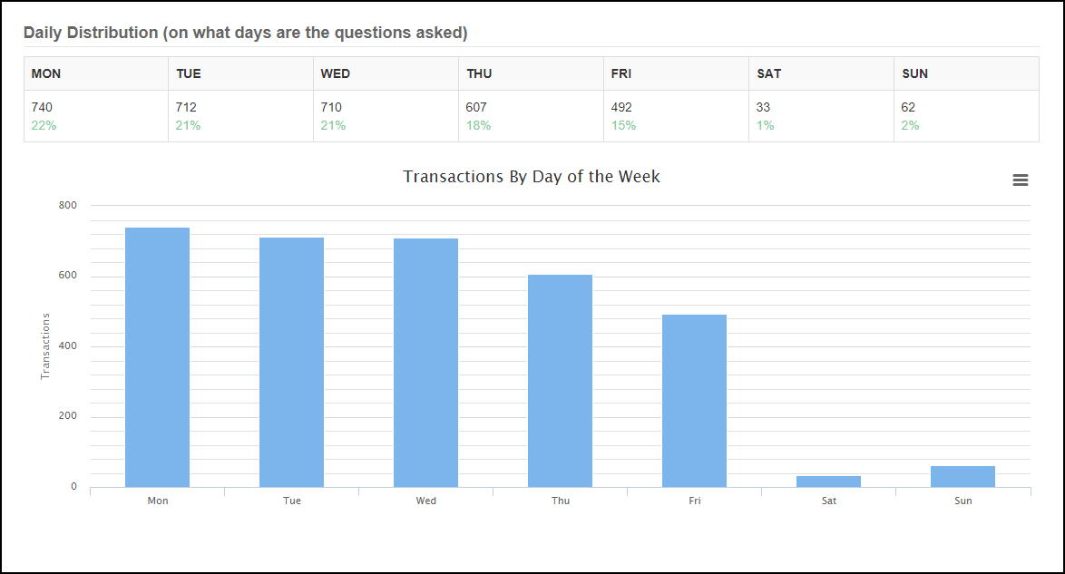
Notes:
JM: Most popular days of the week as you can see are mon - wed. After all, the weekend starts on Thursday!

Slide 11
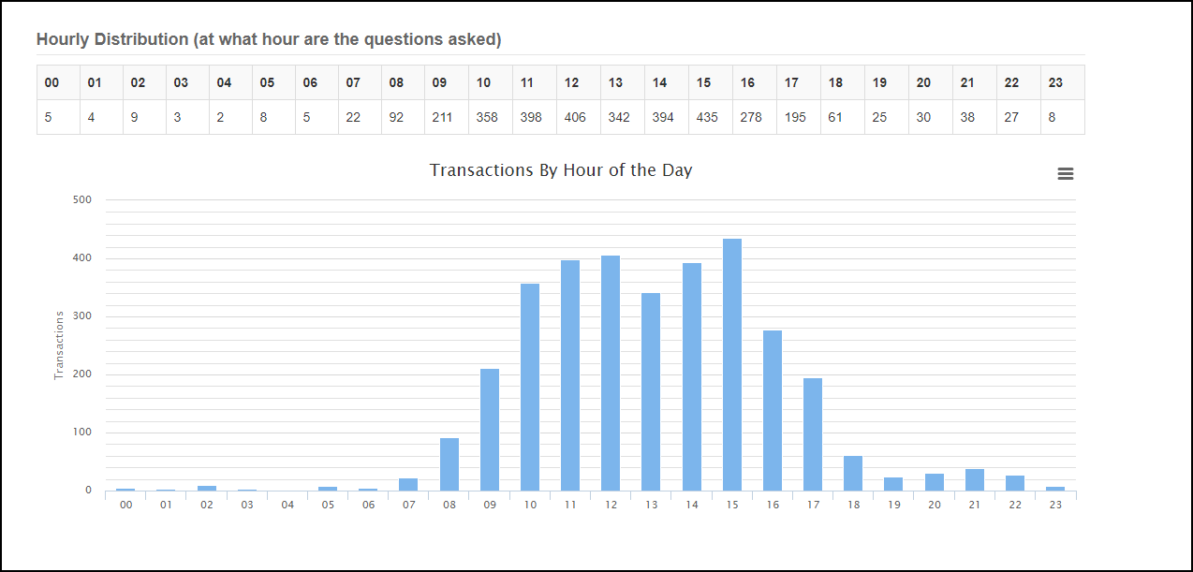
Notes:
JM: and students seem to be working most 10 - 12 and then 2-4

Slide 12
Planning for merge
Received mandate in Fall 2016 to vacate the Chemistry Library
Timeframe
Communications
Campus
FAQ page posted to EPSL and Chemistry Library 9/25/2017 webpages (developed in April 2017)
Opportunity to evaluate collections & services
Regular meetings and updates:
STEM staff
Public Services staff
Collections group
Chemistry Department
Notes:
NZ.
A little bit of background. There were two science branches: Chemistry and EPSL. Chemistry being the smaller of the two. In the Fall of 2016, the master campus plan indicated that the space occupied by the Chemistry Library will be reclaimed by the Chemistry Department. There was no time-frame. However, at the end of 2016, we were told that we need to vacate the space occupied by the Chemistry Library by the end of 2017 calendar year. That gave us just one year to vacate the space. In January 2017 we started working a plan how to proceed. Unfortunately, an official announcement from the provost office was never issued.
To help public services staff answer questions from the public, because it was obvious that something was happening, we created an FAQ page in April 2017, and decided to make the page public at the end of September 2017. We decided that this was a good opportunity for the Libraries to evaluate collections & services in the two branches, and to turn this as a positive thing for the users.
Throughout the year we had regular meetings with STEM staff - who did all the intellectual work evaluating the collection and more, public services staff especially staff in McK stacks maintenance and Severn Library, collections group, and of course the Chemistry department.

Slide 13
Collections evaluation
Space constraint
Process
STEM Library staff engagement/dedication
Support from administration
Collaboration with other units
Both branches remained open during the entire Fall semester
Assessments
Notes:
NZ
Why did we decide to evaluate the collection? As we all know, space is at premium. As students work more collaboratively, especially in the sciences, there’s always a need for more study area. Before the online world, there was a need for multiple copies of journals and books for each of our branches. We knew there was a lot of duplication in our collection.
Process:
I was really impressed by the dedication of STEM librarians, who worked tirelessly to make the best for our users. I should also point out that the Libraries administration was extremely supportive, so did every unit that we asked for assistance.
Both branches remained open during the entire year.
But, let me elaborate on the assessments - our services, our space and especially collection.

Slide 14
Collections assessment
Collections available at EPSL and Chemistry before the merge
Engineering
Life Sciences
Math
Physical Sciences
Many duplicates, outdated editions, but also available at McKeldin and in Severn (off-site storage)
Reviewed all items by call number regardless of location
Used GreenGlass, usage statistics, etc.
Notes:
NZ:
Let me start with the collections.
To set the stage a little bit, before the merge, the vast majority of the collection in the two science branches were Engineering, Life Sciences, Math and Physical Sciences. However, there were materials in other call numbers as well. Also, the collection of life sciences was predominantly housed at Mckeldin. There were many duplicates in the science branches, but also in the main library, and in our storage facility. We decided early on, that we need to evaluate every single item in the science branches, but that also required evaluating to a certain degree the collections at McKeldin and Severn. To evaluate the book collection, we used greenGlass from OCLC (Sustainable Collection Services): “Analyze your library or consortial collection to manage and share print monographs” https://www.oclc.org/en/sustainable-collections.html
The spreadsheet were massive, but it was an educated way of making decisions. We looked at usage stats, number of copies in our locations, but also how many copies a certain book is available worldwide or through our partners - USMAI and BTAA,
For the periodicals, it was much easier. We withdraw every titles that we had purchased the electronic archive, for example ACS, RSC, Springer, etc.

Slide 15
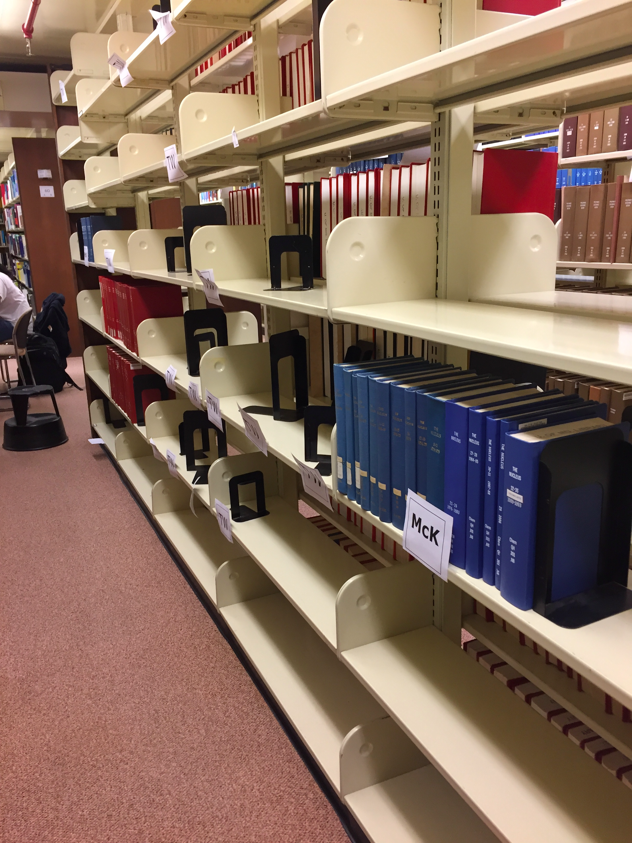
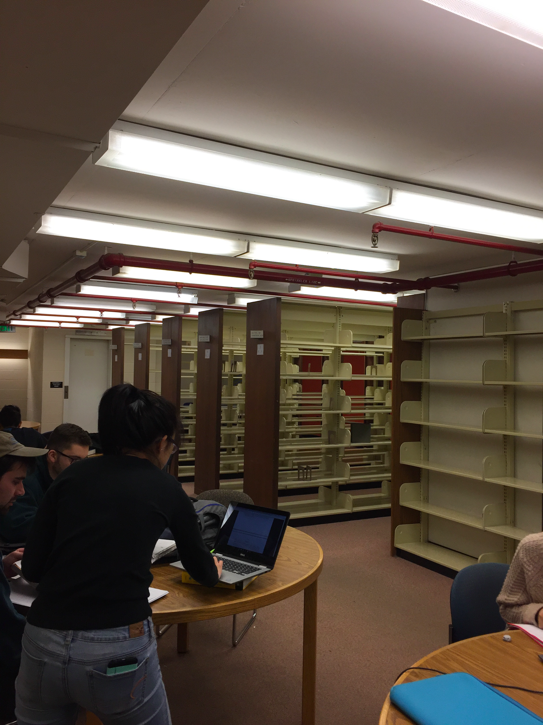
Collections results
Collections remaining at STEM Library after merge
Engineering
Physical Sciences
Mathematics
Collections permanently moved to McKeldin
Life Sciences
Call numbers A-P
Numbers of items/branch:
Chemistry - 67,936 items (March 2017)
EPSL - 254,223 (March 2017)
STEM Library current holdings - 225,533 (February 2018)
Notes:
NZ.
Due to space constraints, we decided to integrate into one location certain collections. For example, at EPSL and Chemistry, we had very few books in call numbers A-P. The vast majority were in the Qs and Ts. Also, since the vast majority of the life sciences, medicine, and agriculture collections were at Mckeldin, we decided to move all books in call numbers QH-S to McKeldin. So, after the merge, the collections that are housed at STEM are engineering, physical sciences and math.
The change in collection required substantial shifting in STEM and McKeldin, and processing materials at Severn.
Here are some numbers. Total combined before the merge: 322, 159
I don’t have the exact numbers of how many of these roughly 100,000 items went where.
These couple of pictures show how we labeled the bound periodicals for their final destination, and also how the space was used while we were doing the work.

Slide 16
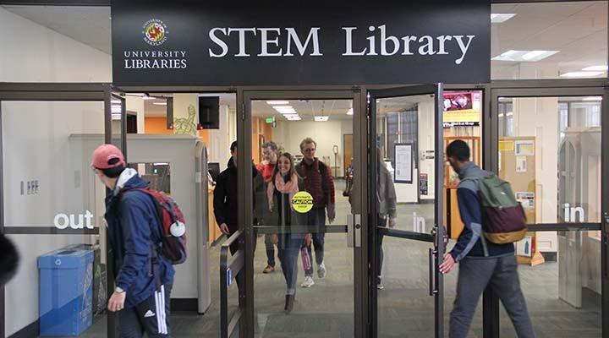
STEM Library
Officially started under new name January 1, 2018
New website unveiled
Catalog reflects new name
Notes:
NZ.
The space was vacated by the deadline, and the STEM Library officially started in January 1, 2018.
We used movers to move the collection in two increments - before Thanksgiving, and end of December (to avoid disturbing students during exams).
For political reasons, Libraries management decided that the merged entity should get a new name. Also, the old name of the Engineering and Physical Sciences Library, especially its abbreviation - EPSL - was not a known acronym like STEM.
In addition to assessing the collection, we worked on a new web site, that combined the information from both branches. However, we also decided that we need to assess the web presence, using google analytics stats to “retire” certain content. Everything was ready for January 1, 2018 when the new website had its debut.
Soon after we returned to work in January, we also updated the name of the location in the catalog.

Slide 17
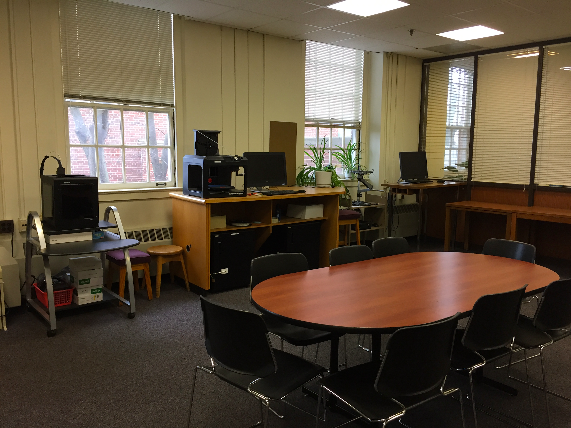
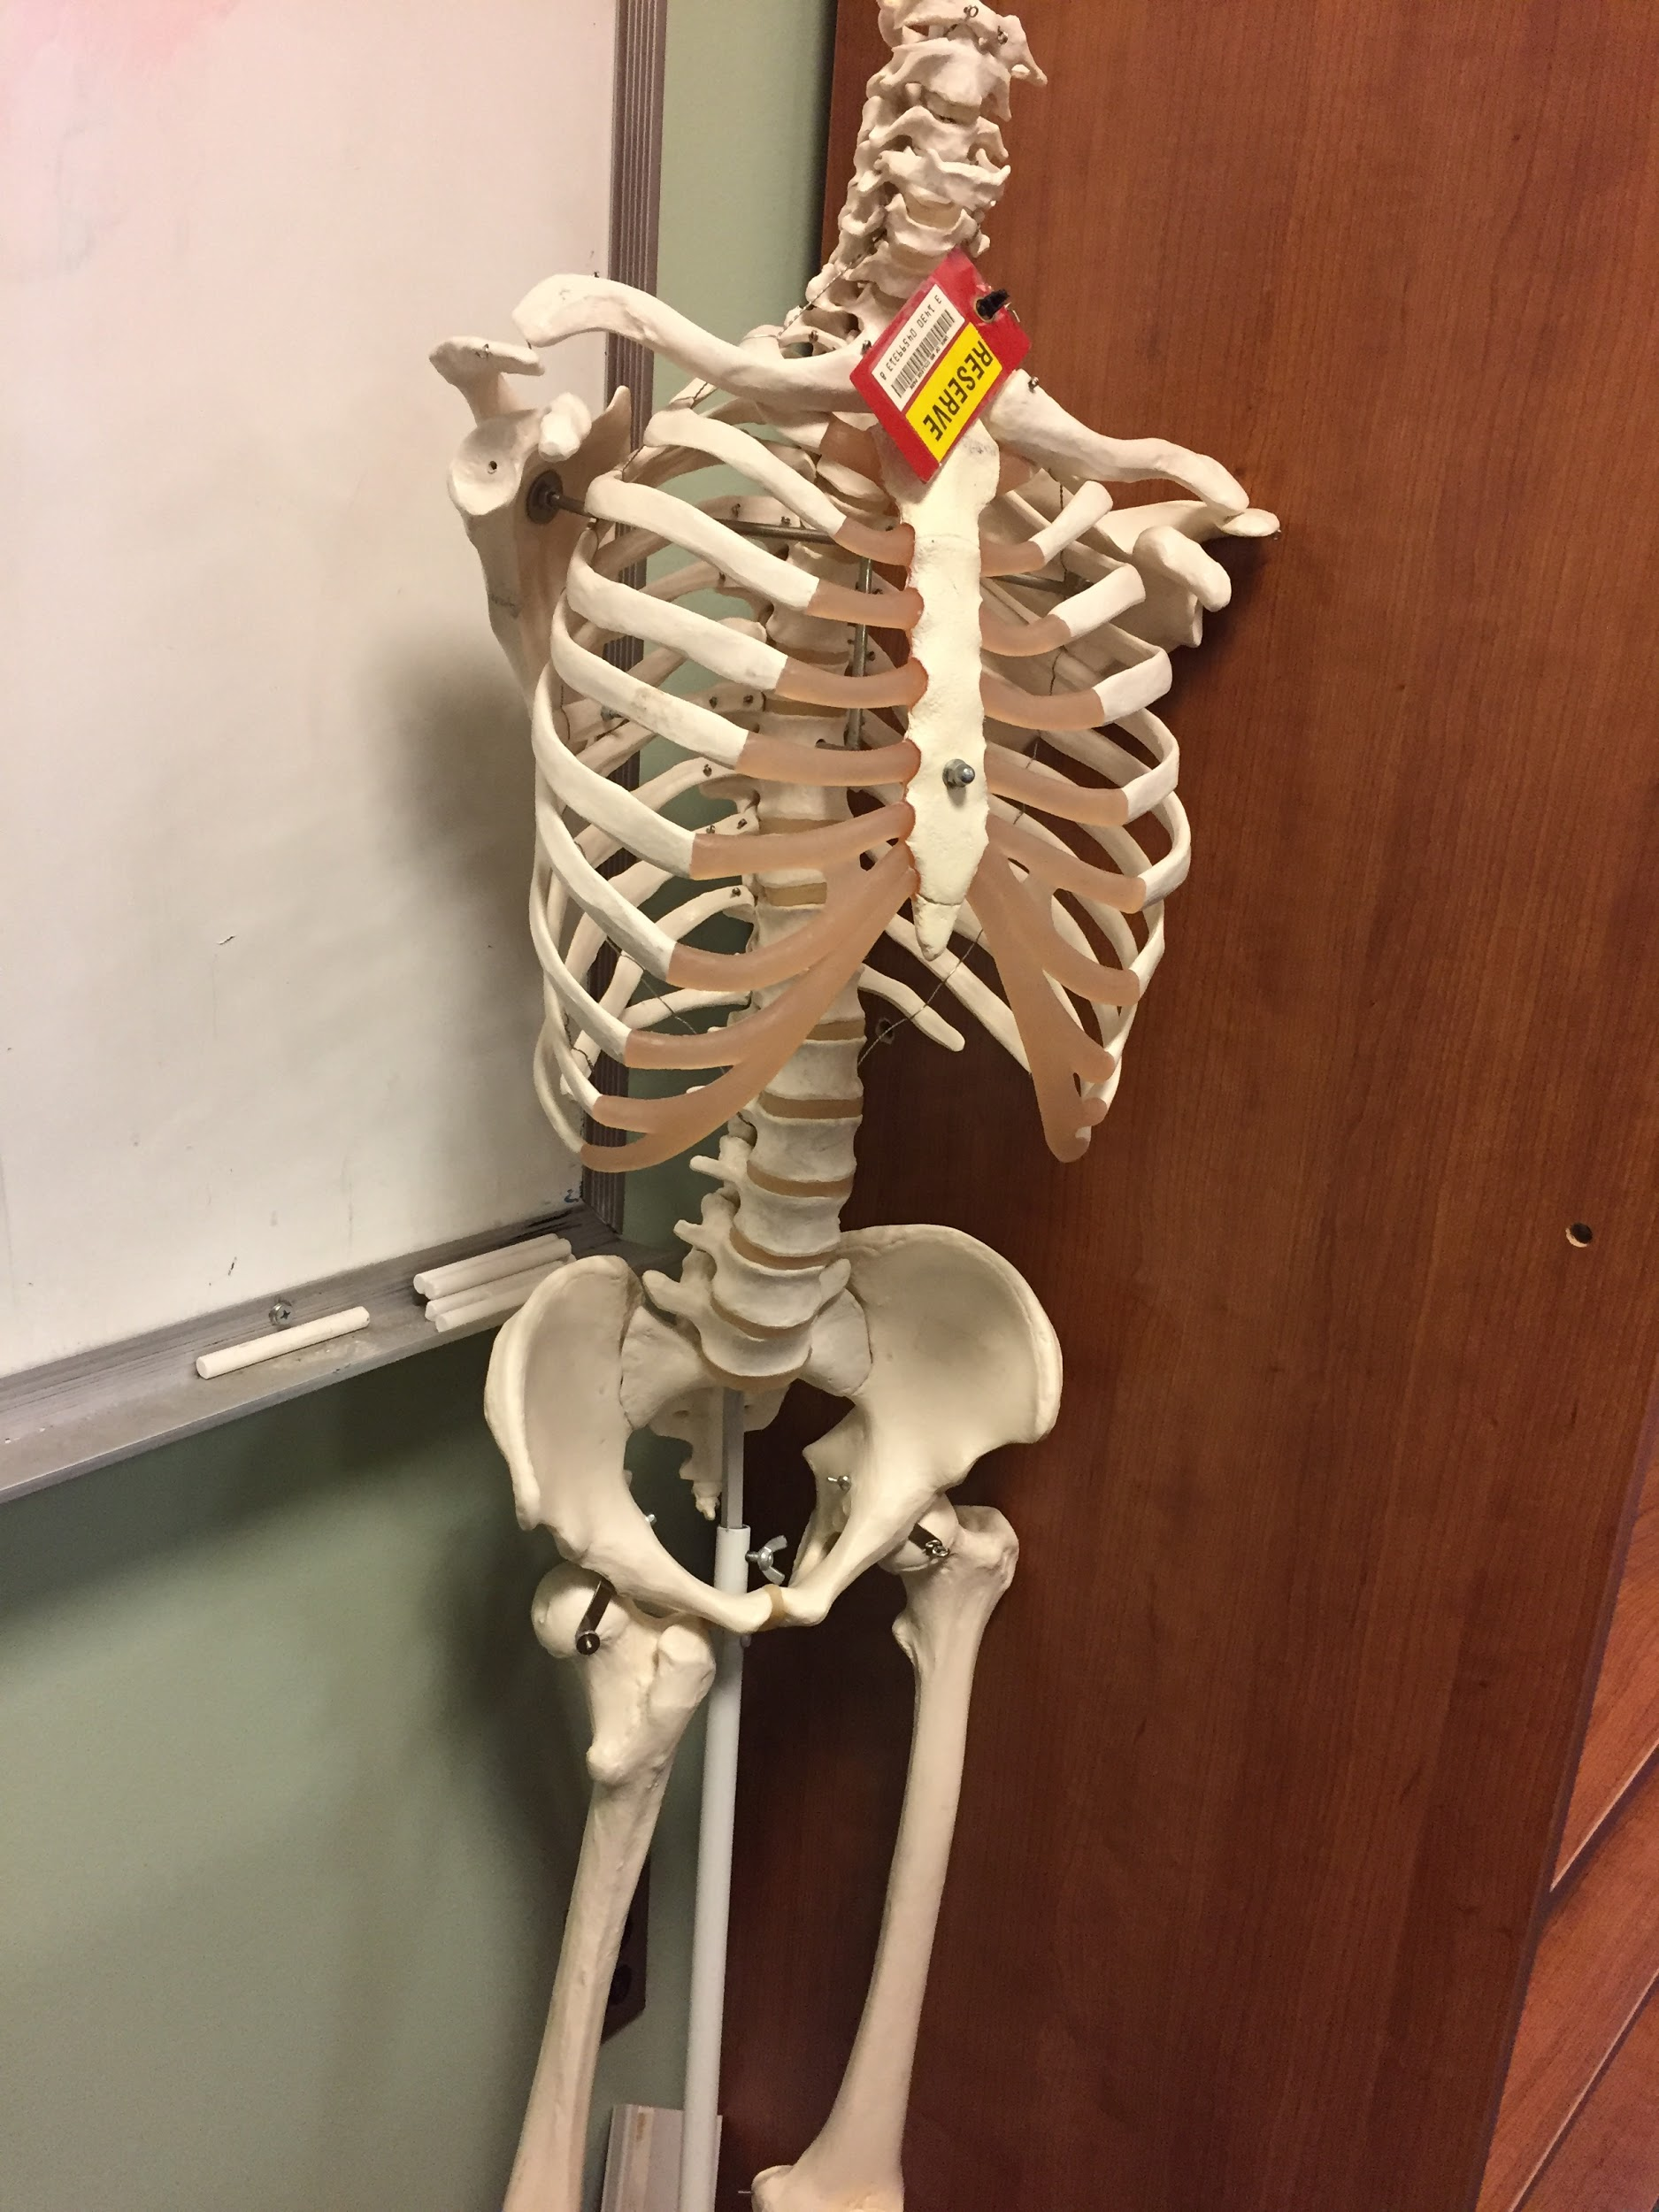
New/Improved Services
All STEM librarians under one roof
Synergy
New space for Makerspace
3D printing
Showcase 3D prints according to season
Expended equipment for loan
Theta Ricoh 360° camera
Circuit (Analog Parts) Kits
Expanded course reserves
Skeleton, muscle models
Notes:
NZ
As mentioned before, this mandate was a great opportunity to evaluate/assess the services we provided and adjust/make improvements.
All STEM librarians got individual offices, including the Chemistry Librarian who was previously located in the Chemistry Library. The picture at the top depicts the space that was the place where EPSL librarians had desks before they got their individual offices. We are in the process of remodeling it to be a Makerspace, but you can imagine that it was pretty crowded when we had the full-time and part-time librarians, the graduate assistant’s desks - it was the home of 7 people at one time. We have moved our 3D printing there and we’re in the process of adding more technology like laser cutters and such. We also display our 3D prints in a showcase in the public area, and changing the display according to season - Halloween, Valentine’s Day, Easter, Christmas, Passover, etc.
Our equipment for loan is extremely popular. We have been lending laptops (MacBook Airs and Dells), chargers, headphones, etc for many years. Recently we have added a 360 degree camera that was recently used in two courses. Also, by students’ request, we have added circuit kits.
In our course reserves, we have added a skeleton and muscle models for some of the biology course. These materials are not traditional course reserves items, so our staff had to be innovative to process them.

Slide 18
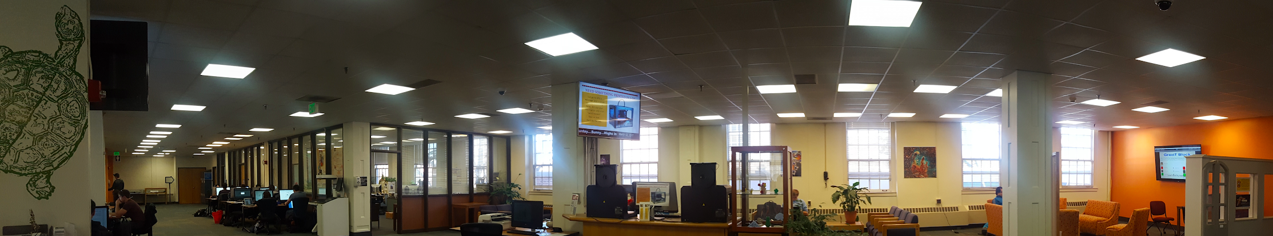
Space Improvements
Librarians individual offices
Long overdue improvements
New carpet
New furniture
Notes:
NZ
Some of the improvements made:
All science librarians have individual offices, and all are under one roof. Before the chemistry librarian was in Chemistry. The problem with the old space, since they shared one large room was that they had to do consultations with patrons in another room.
Also, the STEM library finally got some long overdue improvements - new carpet and new furniture.
Expended study area for students on the 2nd floor - and much more. If you have visited the old library before, I urge you to come visit us now.
And now, I’ll pass it to Yelena.

Slide 19
Workloads and Workflow of Public Services Librarians
Re-define ourselves, work priorities and core responsibilities
Define our mission, vision, goals and strategic priorities
Develop CORE competencies, http://hdl.handle.net/1903/17457
Changed annual review processes to reflect new job requirements, https://drum.lib.umd.edu/handle/1903/18056
Notes:
YL:
Of course these changes in services and spaces are intimately intertwined with workloads and workflows and flexibility of the workplace.
So another one of our profound changes is redefining the roles of librarians:
Re-define ourselves, work priorities and core responsibilities: no reference desk for most librarians
Re-organization: Research and Learning Department was established to consolidate all liaisons
Define our mission, vision, goals and strategic priorities: We are already on the second re-etiration since 2013
!!!! These are collective exercises. We have developed ways to make sure that everyone is involved in discussions over these issues, particularly those that effect people’s day-to-day responsibilities and assessments.

Slide 20
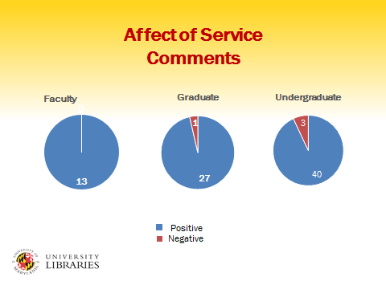
Types of Assessment - Some examples
Library wide
Ethnographic Study, 2012
LibQual, Spring 2017
Attached to specific functions
SpringShare for CHAT and Reference
Learning Outcomes Assessments Program
Instructional statistics
Data in collections decisions
Task Forces (Liaison Task Force,
https://drum.lib.umd.edu/handle/1903/17456)
Informal questionnaires (at the door, twitter, email, etc.)
Notes:
YL:
Many decisions are data driven
== LibQual: 5005 participants, our mean 7.08 - high score, all campus populations participated
== LOA: new 4-year program with rotation
== Collections: circ stats, ILL, data usage for e-resources, consultations with faculty and each other
== Task Forces (complex issues) and Hot Teams (short term, single issue) -- Liaison Task Force Report
== Informal questionnaires: wary about overwhelming users - so use sparingly

Slide 21
Assessment of Services through Annual Reviews of Liaison Librarians
They are a DEVELOPMENTAL tools designed to:
Guide our work
Be self-motivating
Inform outcomes
Show impact and individual growth
Provide training framework for existing liaisons and new hires
Notes:
YL:
Annual review process is one of our most important assessment tools. It provides us with information how well we are doing in all areas of librarianship: reference, instruction, collections, outreach, scholarly communication/big data
Can’t have annual assessment without understanding what is required of everyone: hence the development of CORE competences
Annual reviews are not meant to be PUNITIVE, but developmental. It is a conversation between supervisors and supervisee.
It is also benchmarking to support institutional goals.
Impact can be shown in a variety of different ways, both quantitative and qualitative. We give librarians a lot of freedom on how they want to demonstrate it.
Perpetual work in progress

Slide 22
Focus on Training
In-house training
On Boarding Checklist, https://drum.lib.umd.edu/handle/1903/17458
Research and Learning Forums
Peer Observation Teaching Program
Specialized forums: Multigenerational workforce, “Kick Ass” Communication Workshop
Outside training
Conferences
Webinars
Sending people for workshops that we can’t provide, like on visualization
Notes:
YL:
== With so many changes we have to help people adjust and thus training is an important element, and is included in annual reporting
== explain:
On Board Checklist: updated regularly
Research and Learning Forums: conversations about day-to-day work and how to make it better, for example innovation in teaching, what everyone should know about new reference procedures, developing teaching learning outcome assessment program, things about collections and collection management, discovery issues, etc.
Peer Teaching Observation
Multigenerational workforce
Kick Ass - to help librarians and curators in how to deliver their messages: elevator speech on what we do, think on your feet. Run by office of communication and DC Improv Comedy group
Outside training - prof development funds and admin funds

Slide 23
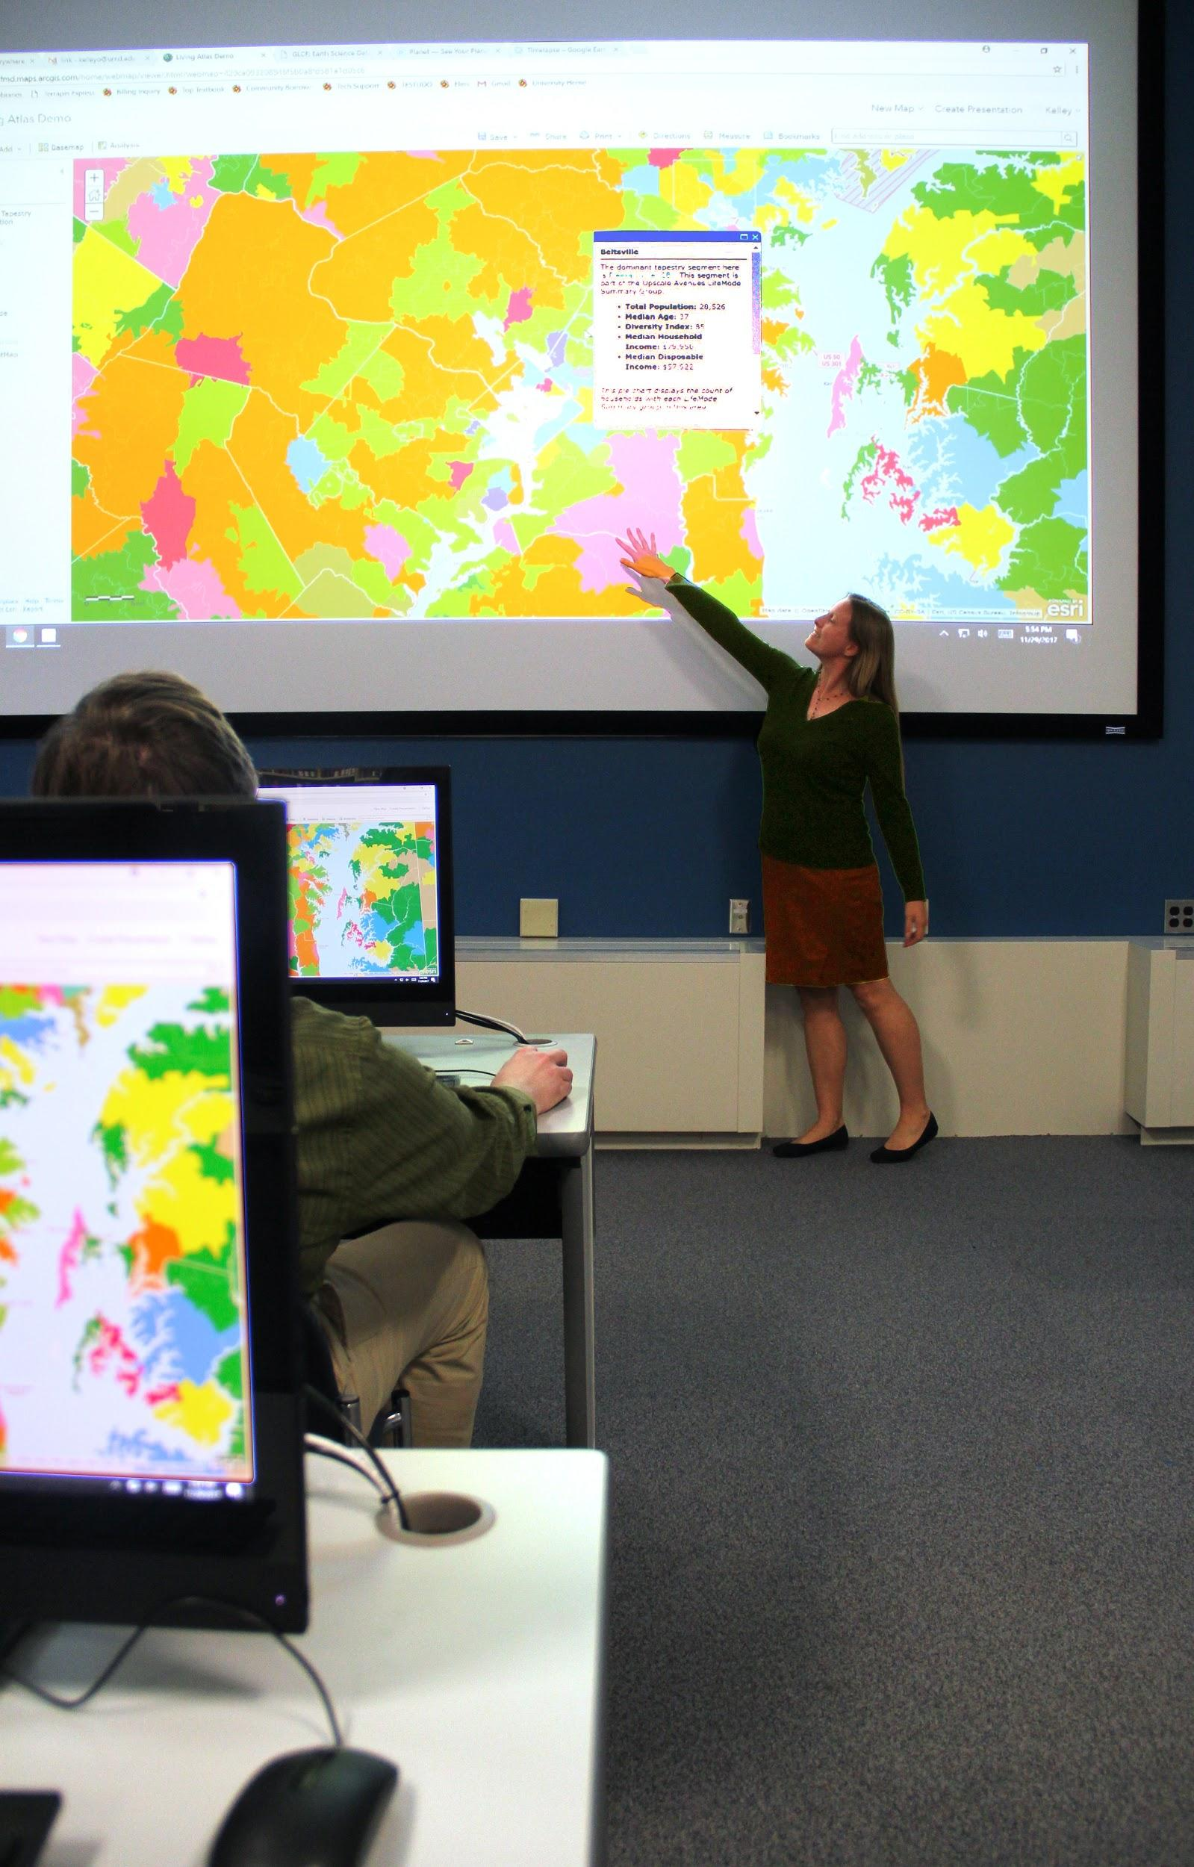
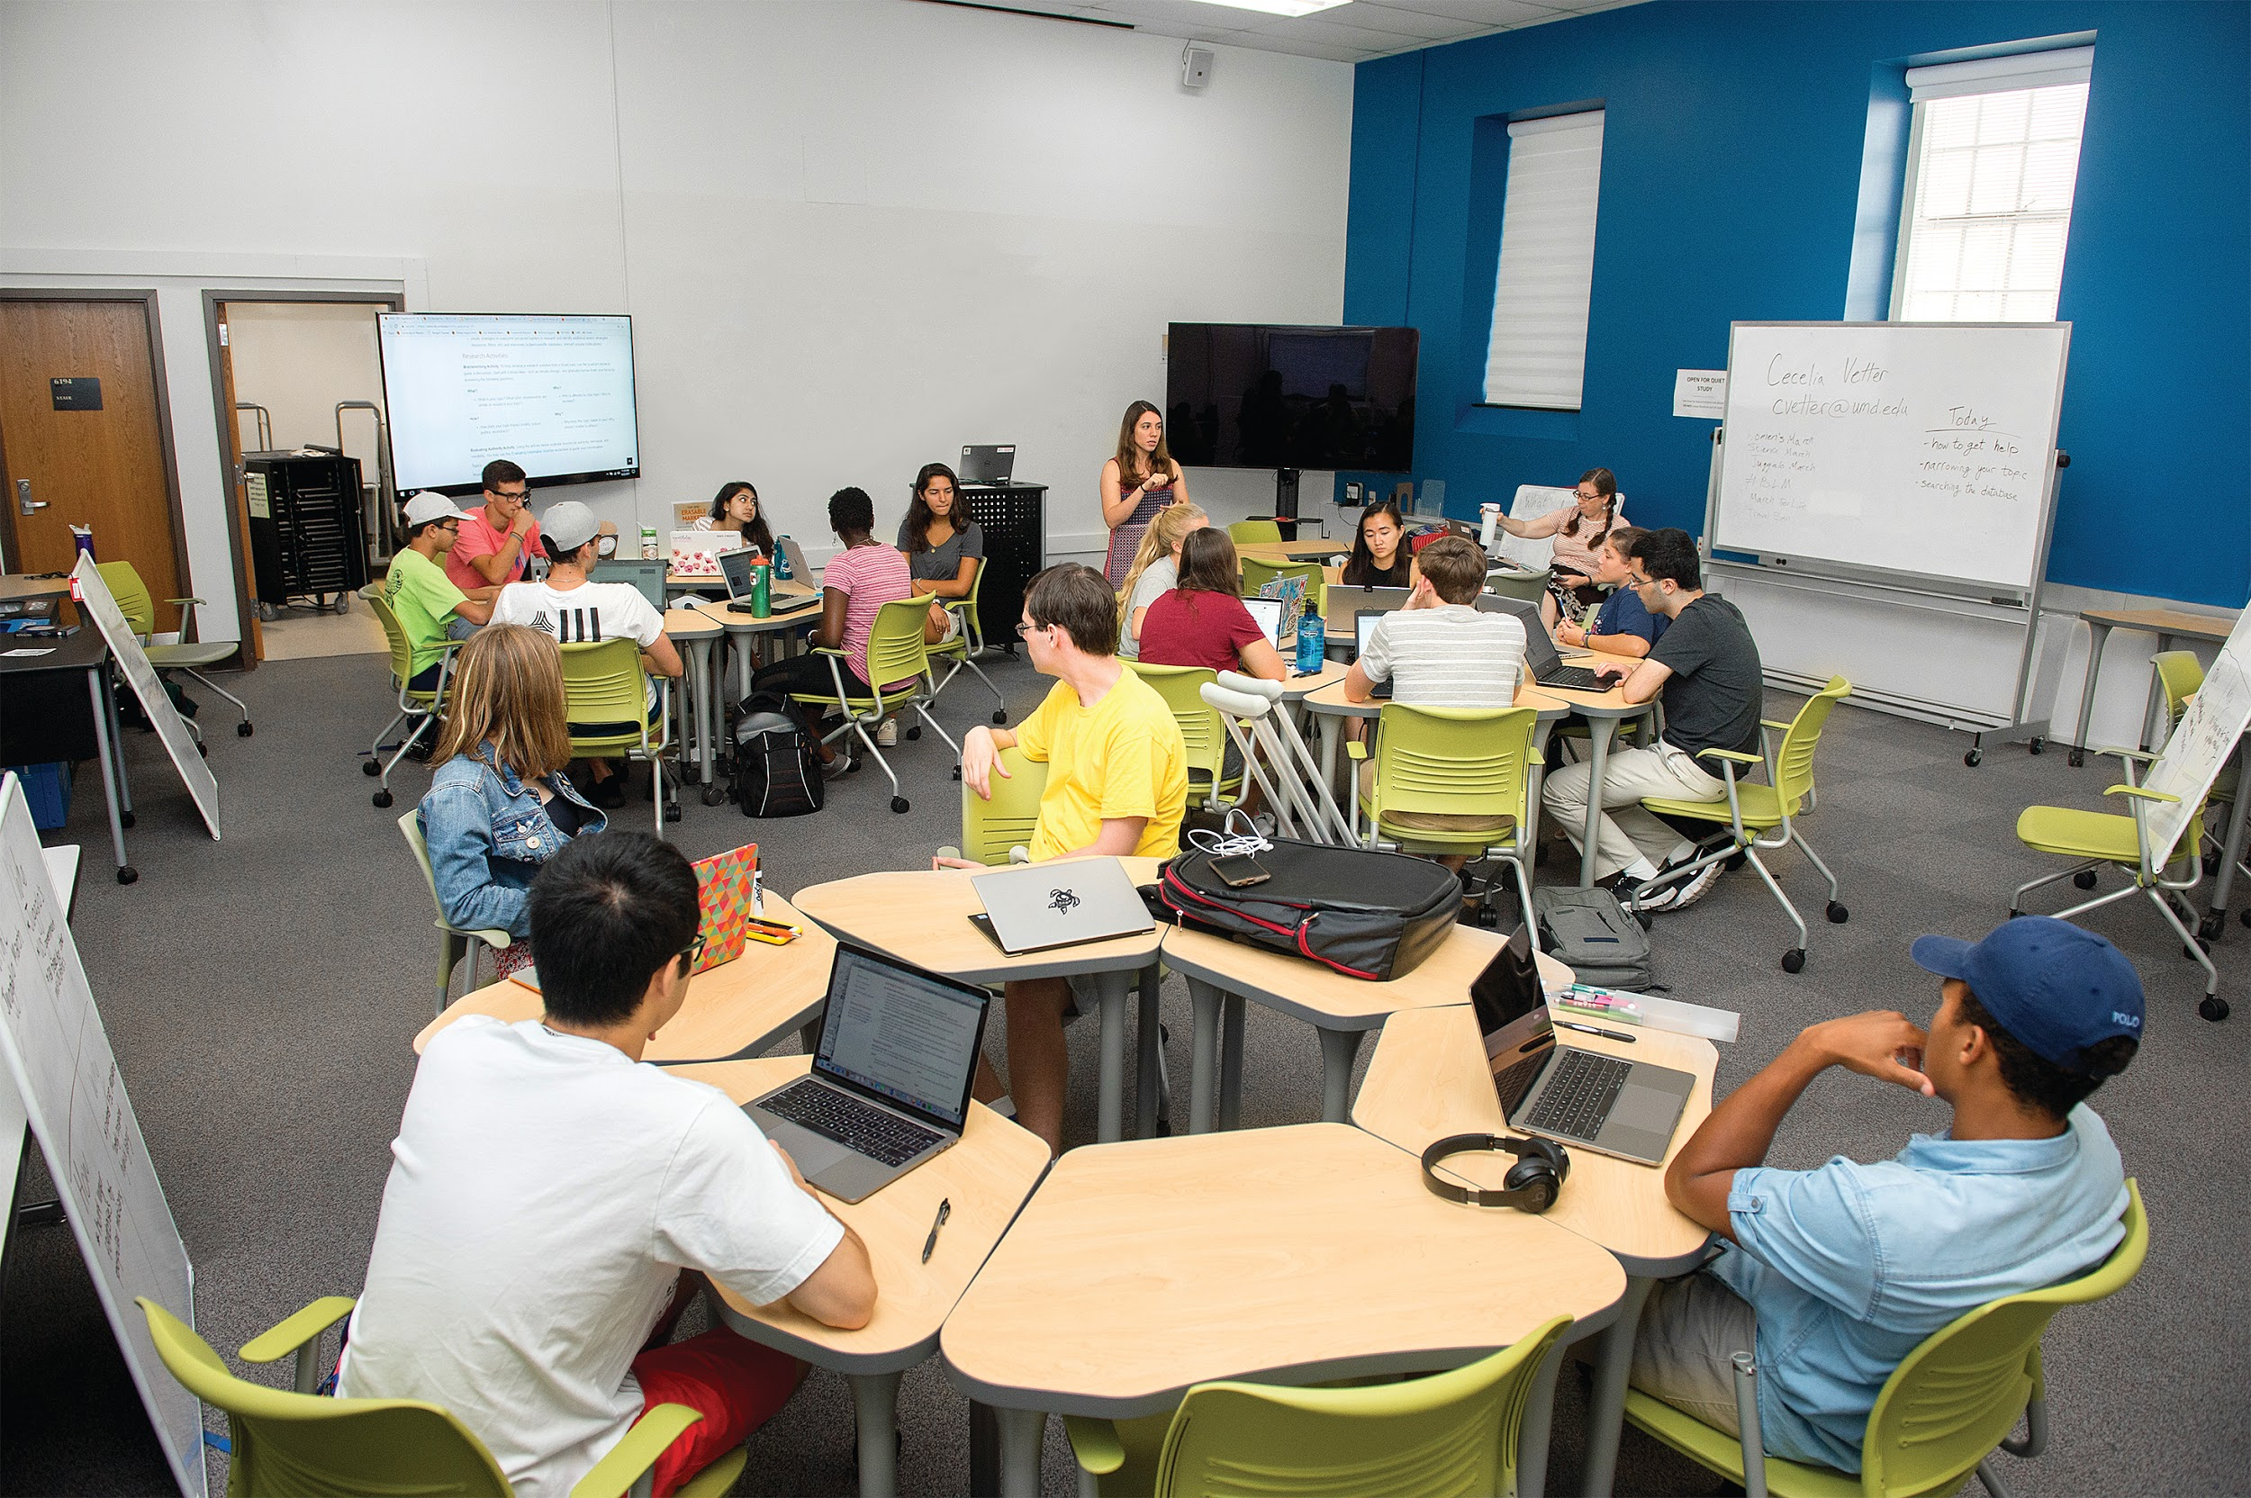
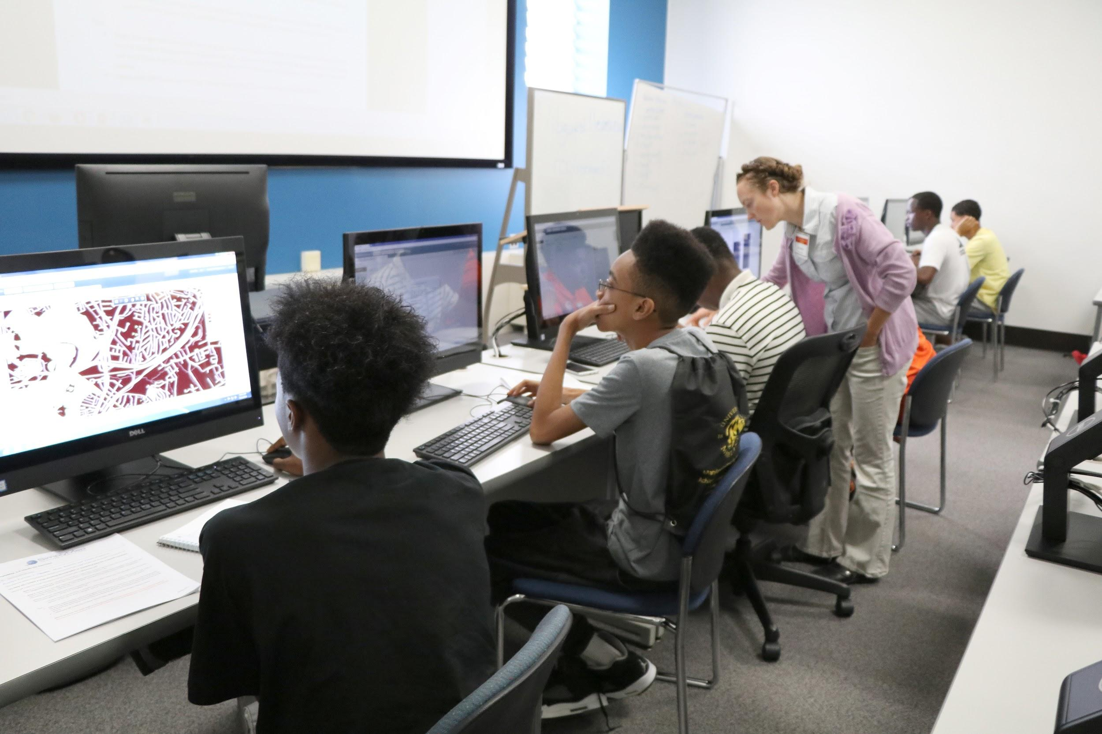
What we do differently: Teaching
More emphasis on Teaching, including LOAs and Peer Observation Program
Working with Research Commons creating workshops for grad students
Providing programs for college bound
Developing innovative teaching spaces
Notes:
YL
Since we redefined our roles and have changed our services, and based on user input and data that we collect, we are doing many things differently than before.

Slide 24
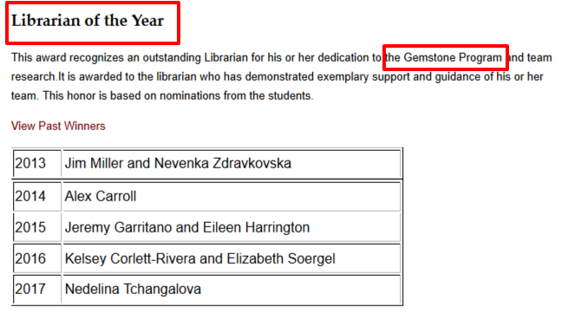
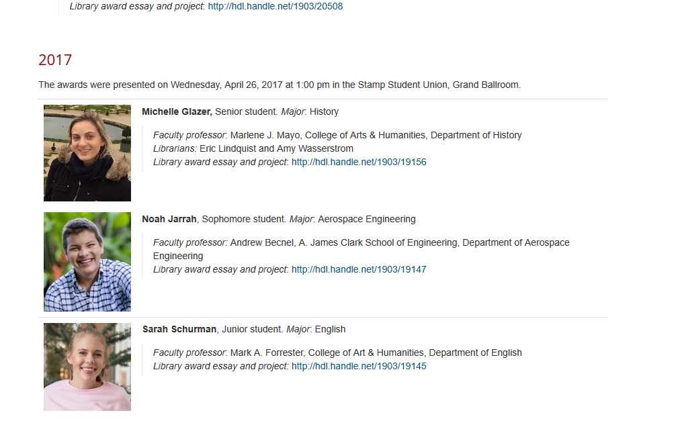
More Emphasis on Student Research
Gemstone Program
Library Award for Undergraduate Research
Notes:
YL
== Gemstone
== Lib Award for Undergrad research - librarians judge

Slide 25


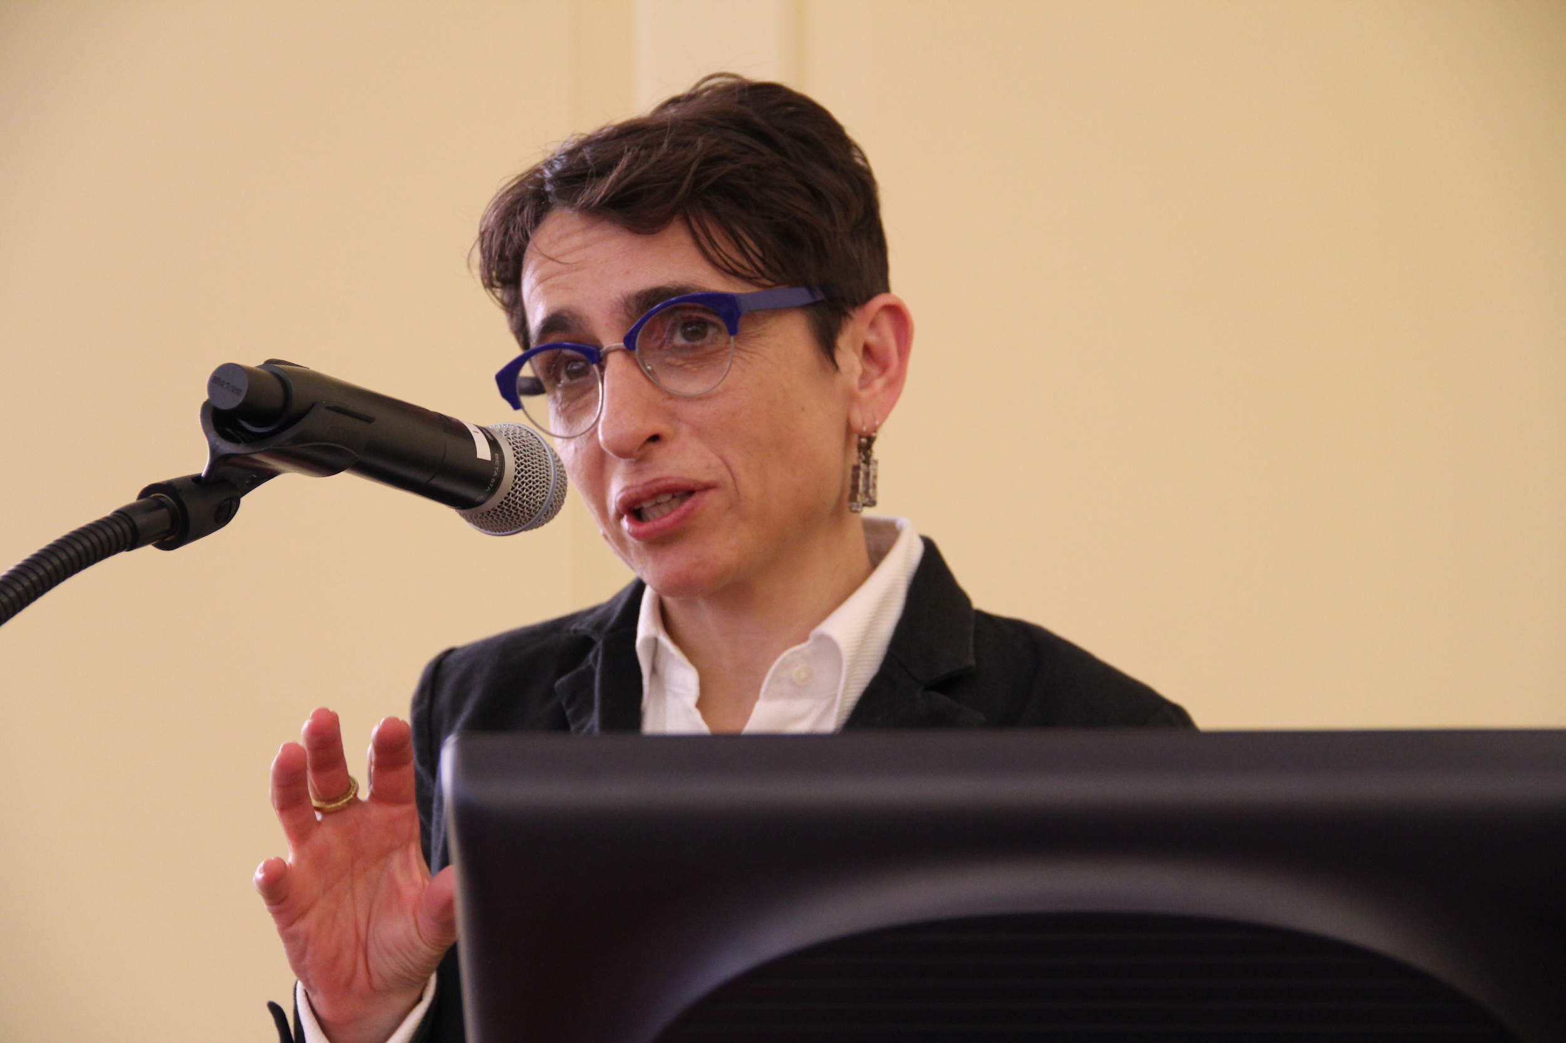
More Emphasis to Partner with Departments
Shakespeare at the Libraries
Invited artists in residence
Developing conferences
Mounting events
Notes:
YL

Slide 26


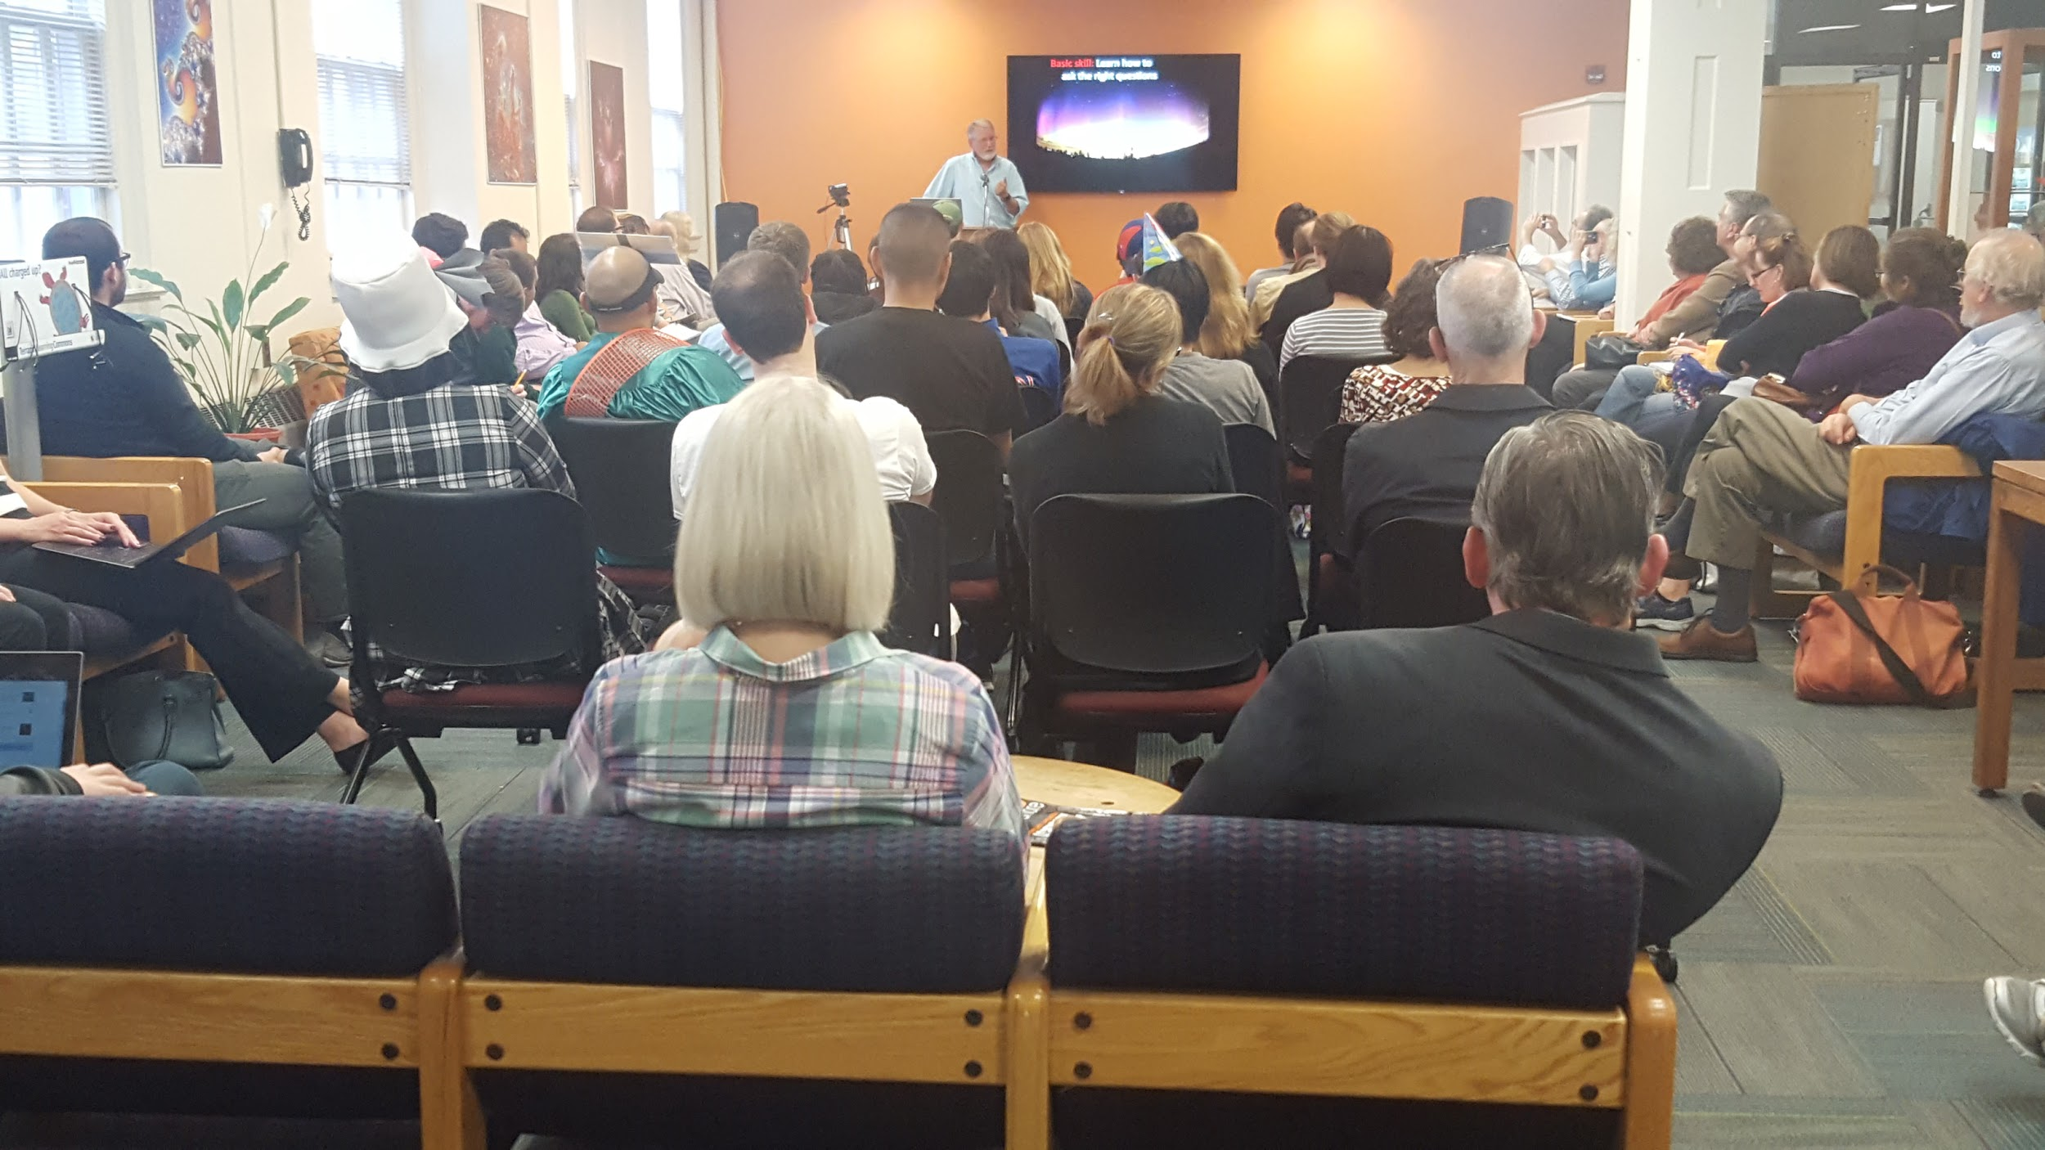
More Emphasis on Becoming the Center of Campus Intellectual Life
Speaking of Books
STEAM Salons
Interdisciplinary Dialogues
Notes:
YL

Slide 27
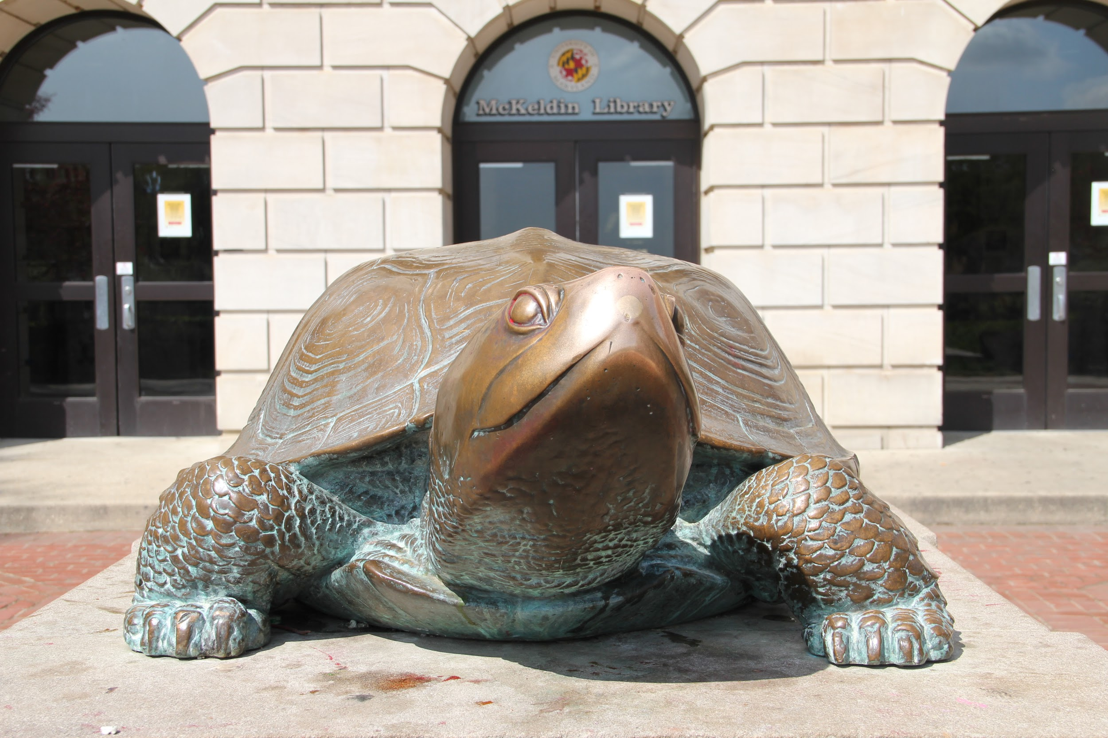
THANK YOU. QUESTIONS?
Yelena Luckert
yluckert@umd.edu
Judy Markowitz
judym@umd.edu
Nevenka Zdravkovska
nevenka@umd.edu

