Slide 1
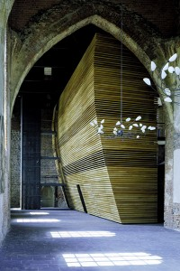
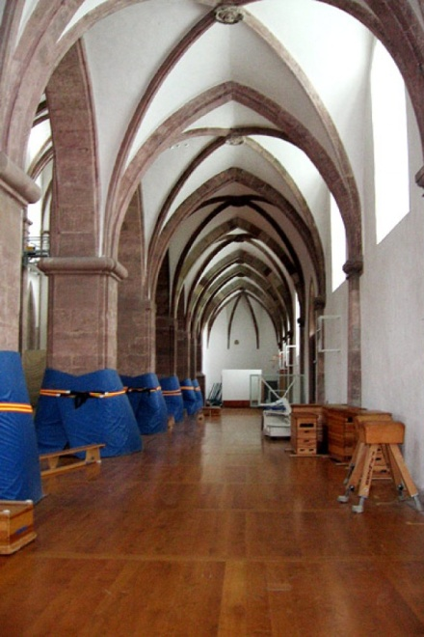
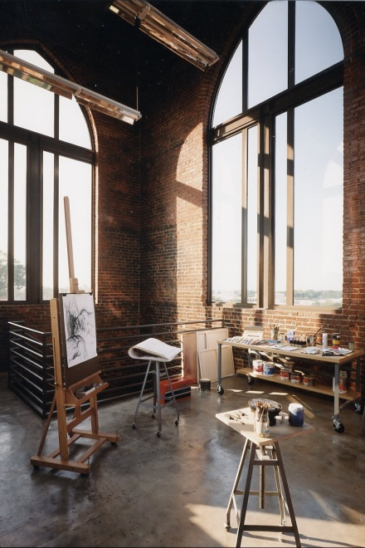
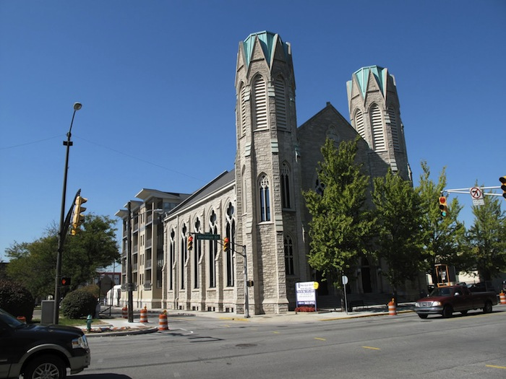
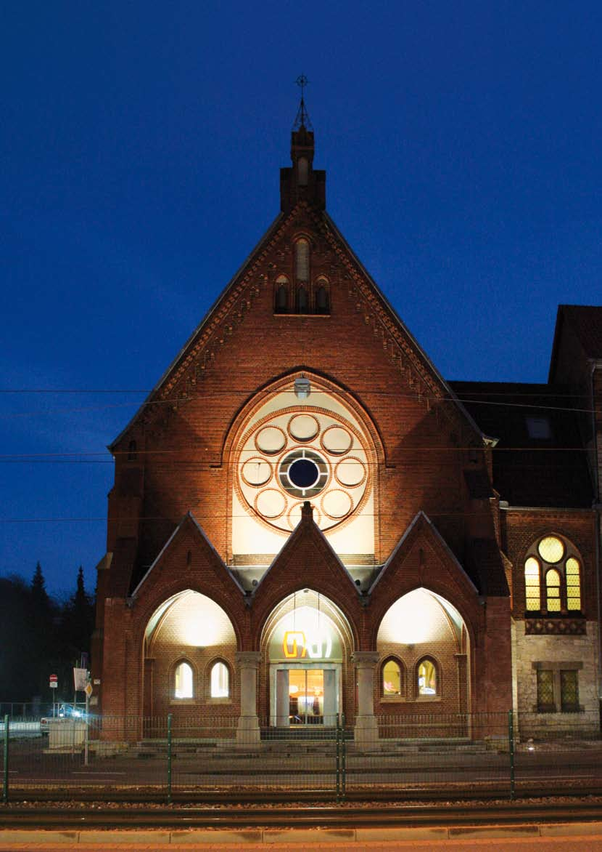
Houses of God… or not?!
Approaches to the Adaptive Reuse of Churches
in Germany and the United States
Houses of God… or not?!
Approaches to the Adaptive Reuse of Churches in Germany and the United States
Notes:
Before I start my presentation I would like to thank my project advisor Don Linebaugh and my second reader Michele Lamprakos for their advice and guidance. I would also like to thank my family that supported me throughout my studies
As Prof. Linebaugh mentioned, I looked at the adaptive reuse of churches in Germany and the US for my final project.
Combining my architecture background and my current historic preservation studies I wanted to analyze how adaptive reuse affects historic buildings. I decided to look at churches, because they are such a specific building type and their adaptive reuse often causes controversy. Also, more and more churches have become redundant in the past few decades due to demographic changes and shrinking congregation.

Slide 2
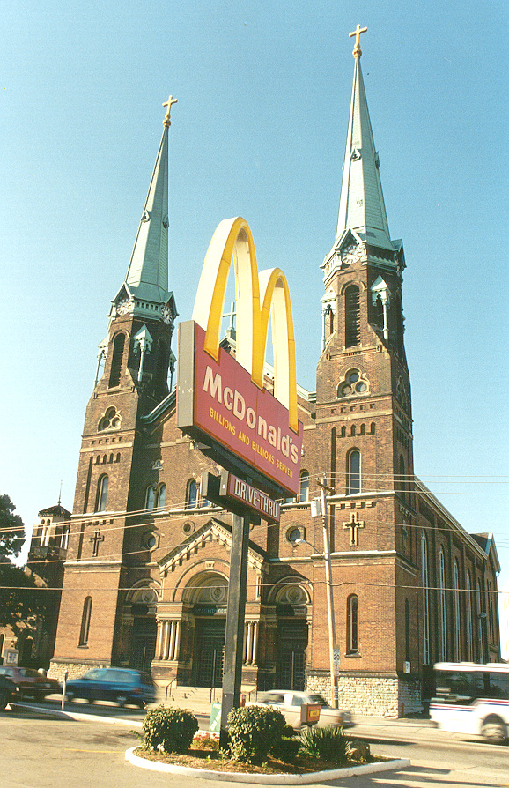
METHODOLOGY
Religion
Preservation
The church’s view
Case studies: values assessment
Research questions
  Effect on churches?
  Integration of new use?
  Public Perception?
Houses of God… or not?!
Approaches to the Adaptive Reuse of Churches in Germany and the United States
Notes:
NEW SLIDE: During my research I looked at a variety of sources, including books, journal and newspaper articles and online sources and websites. I explored religion in Germany and the US as well as preservation laws and the protection of churches in both countries. I also looked at what the church has to say about the reuse of its redundant buildings. During this research, I found that many values are involved in the adaptive reuse of churches. I therefore looked at some case studies in greater detail and assessed them according to the values involved. The main research question of my final project included: in which ways does adaptive reuse affect churches? How can new uses best be integrated in church buildings? Are people ever able to see churches as anything other than what they were?

Slide 3
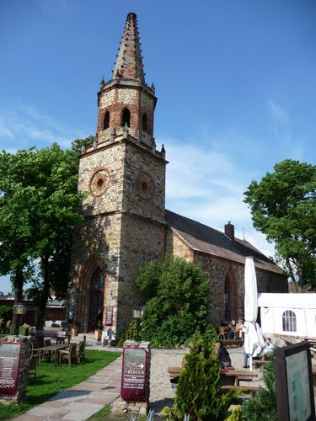
OVERVIEW
Churches and Values
New Uses for Churches
Case Studies
  Sankt Marien in Muencheberg
  Sankt Maximin in Trier
  McColl Center in Charlotte, NC
  Meridian Arch in Indianapolis, IL
  Martinikirche in Bielefeld
Conclusion
Houses of God… or not?!
Approaches to the Adaptive Reuse of Churches in Germany and the United States
Notes:
NEW SLIDE: in my presentation, I will first discuss the different values of churches; I will then outline 5 types of reuse that have been applied to churches and present one case study for each reuse type

Slide 4
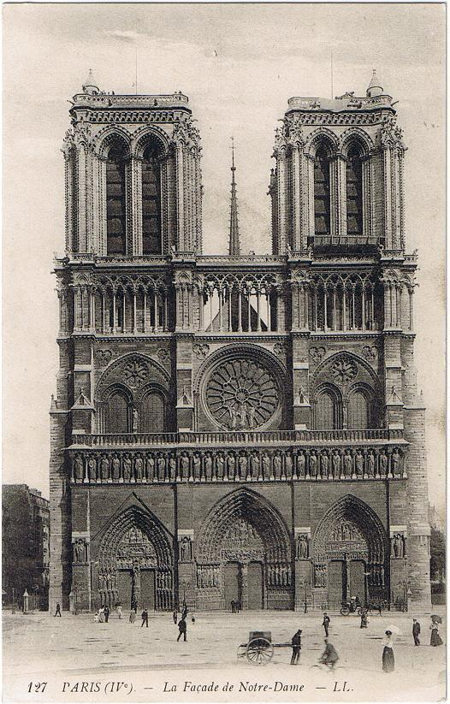
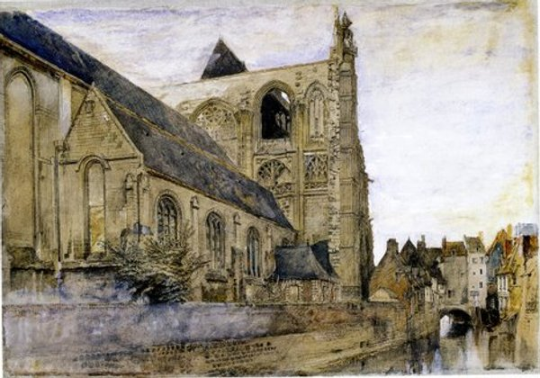
CHURCHES AND VALUES
Houses of God… or not?!
Approaches to the Adaptive Reuse of Churches in Germany and the United States
Notes:
NEW SLIDE: as opposed to warehouses or apartment buildings that are regularly reused, churches are traditional monuments. One can even argue that they are monuments from the beginning as they are constructed with the intent to represent god and the church in our society. Churches are also a building type with a long history of preservation and were among the first buildings to be preserved. Viollet-le-Duc, for example, restored many churches like Notre-Dame on the right, while Ruskin argued for letting them acquire a patina of age. While most of these early preservation efforts focused on historic and aesthetic values, the adaptive reuse of churches deals with a much more complex set of values

Slide 5
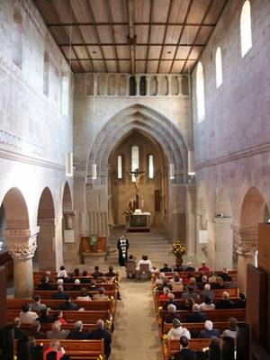
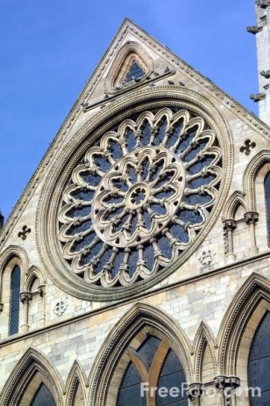
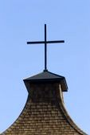
CHURCHES AND VALUES
Use Value
- use for religious purposes
Architectural Value
church as a building
exterior and interior character
Representational/Symbolic Value
representation of church through use
representation of church through architecture
Houses of God… or not?!
Approaches to the Adaptive Reuse of Churches in Germany and the United States
Notes:
NEW SLIDE: While there are numerous values inherent in churches, I focused on the three most prevalent values for the purpose of assessing my case studies. These values can be attributed to the use as a church, the architecture of the building and its representational or symbolic character, which relates to both use and architecture.
CLICK- Churches are places of worship and of memory as people remember certain events in their lives that took place in a church. This notion of a place of worship and memory includes a strong emotional value that people associate with the use of church buildings.
CLICK- The architectural value of churches includes their historic and aesthetic values. Furthermore, historic church structures have scientific value as they can serve for the study of architecture and building techniques.
CLICK- Churches represent faith and the church and its values in cities and in society. This representational or symbolic value relates to the use as a church, but mostly to the church building and its exterior appearance. It is the value that is most easily perceived by the public.

Slide 6
CHURCHES AND VALUES
Adaptive Reuse
Use Value
- use for religious purposes
Church use versus new use
Architectural Value
- church as a building
- exterior and interior character
Changes, additions, demolition?
Representational/Symbolic Value
- representation of church through use
- representation of church through architecture
Loss of representational character?
Houses of God… or not?!
Approaches to the Adaptive Reuse of Churches in Germany and the United States
Notes:
NEW SLIDE: Adaptive reuse affects these values in churches.
CLICK- The use value is changed by a new use depending on how it relates to the original religious use. It focuses on the relationship between new and old use and how well they harmonize or how much they conflict.
CLICK- Architectural Value relates to the architectural appearance of the church and how and to what extent it is altered when a church is reused for new purposes. It relates to the historical fabric of the structure as well as the exterior and interior character of the building
CLICK- Representational or symbolic value changes at least to some extent depending on different new uses and the extent of change to the exterior appearance of the church building. Even with a new use, a church building can still represent the church if the exterior appearance of the building is retained.

Slide 7
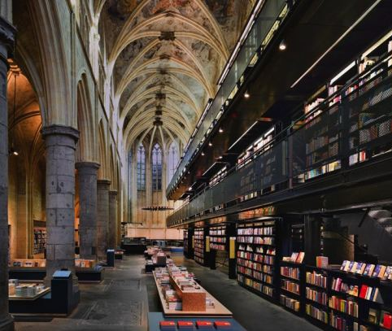
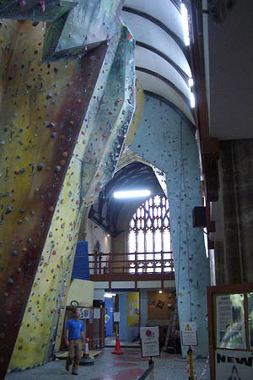
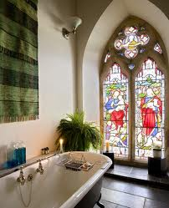
NEW USES FOR CHURCHES
Extended Use
Use for events, performances and recreation
Public Cultural and Social Use
Residential and Office Use
Commercial Use
Houses of God… or not?!
Approaches to the Adaptive Reuse of Churches in Germany and the United States
Notes:
NEW SLIDE: New uses for churches can be defined by how different they are from the original religious use and to what extent the new use requires changes to the church structure. During my research I have identified (these) five types of reuse that range from being very similar to the religious use to being completely unrelated and perhaps even conflicting. They were the most prevalent in all case studies and also reflect the graduated approach taken by German churches to reusing their buildings. These reuse types are extended use; use for events, performances and recreation; public cultural and social use; residential and office use; and commercial use.

Slide 8
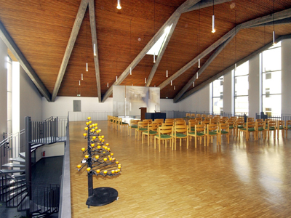
NEW USES FOR CHURCHES
Extended Use
Houses of God… or not?!
Approaches to the Adaptive Reuse of Churches in Germany and the United States
Notes:
NEW SLIDE: An extended use of churches means that, in addition to religious use, the building is opened for other purposes that relate more or less directly to the church’s work and activities. For example, all Church functions can be accommodated in the church building. (PHOTO) This church in Germany, for example, has offices on the ground floor and space for worship on the second level. The church could also be used for church related events and concerts or for art exhibitions. Another option is to share the building with other Christian congregations or the city or town government.

Slide 9
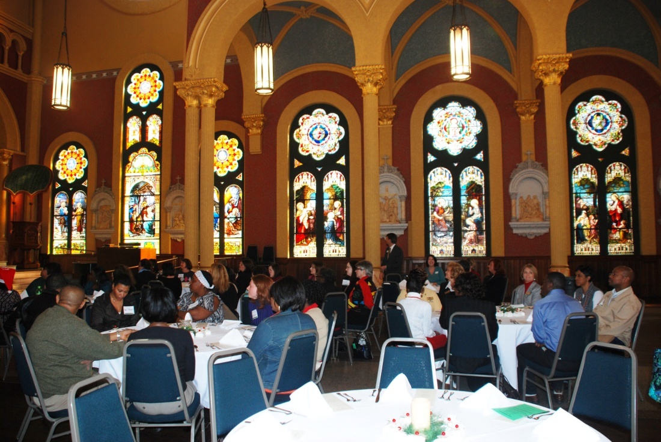
NEW USES FOR CHURCHES
Use for events, performances and recreation
Houses of God… or not?!
Approaches to the Adaptive Reuse of Churches in Germany and the United States
Notes:
NEW SLIDE: The use for events, performances and recreation is similar to extended use, but here the church is not used for religious purposes anymore. These new uses need an open, flexible space and usually only require minor changes to the church building such as the removal of pews and other furnishings. The exterior and interior structures mostly remain the same and the building retains its character. The example you see here is the Sacred Heart Cultural Center in Augusta, GA, which is used for all kinds of cultural events.

Slide 10
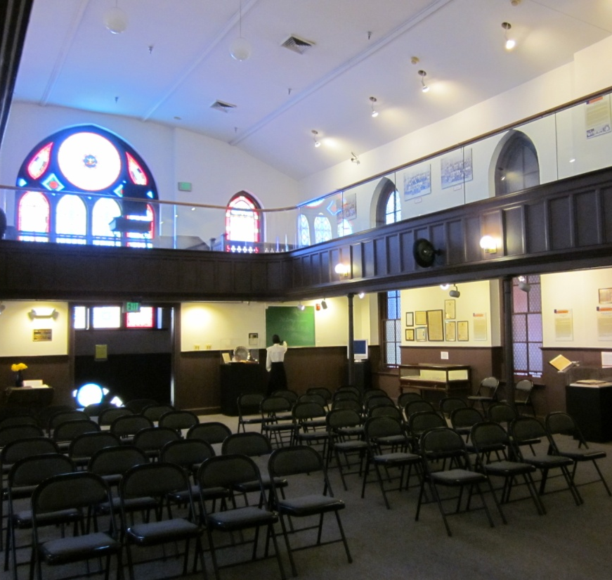
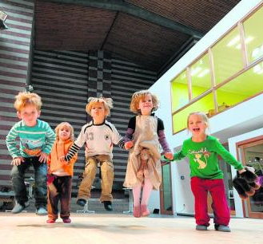
NEW USES FOR CHURCHES
Public Cultural and Social Use
Houses of God… or not?!
Approaches to the Adaptive Reuse of Churches in Germany and the United States
Notes:
NEW SLIDE: Public cultural and social use is another new use that concurs with the public image of the Church. A popular cultural use for church buildings is use as a cultural center or museum use, for example the Banneker-Douglass Museum on the left(PHOTO). Social uses include schools, advisory centers and kindergartens (PHOTO) like this example in Hamburg where a new structure has been inserted into the church.

Slide 11
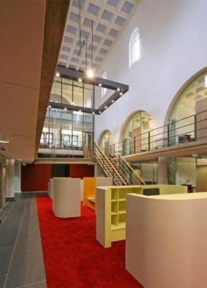
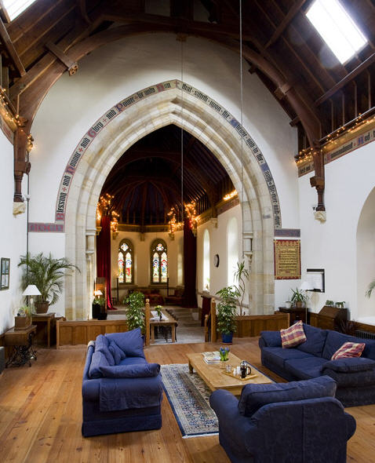
NEW USES FOR CHURCHES
Residential and Office Use
Houses of God… or not?!
Approaches to the Adaptive Reuse of Churches in Germany and the United States
Notes:
NEW SLIDE: Residential and office use is not preferred, but accepted by the Church, especially if the new use is related to the Church and its work. These uses often require alterations to the interior or even the exterior. Additional floors will have to be inserted into larger structures in order to create apartments or offices, which can make it difficult to retain the church’s interior character. (PHOTOS) The examples show a German church used for office space and the conversion of a smaller church into a home.

Slide 12
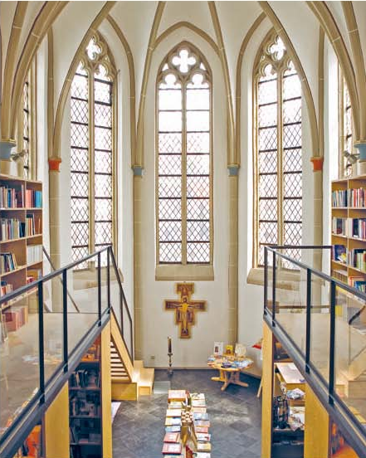
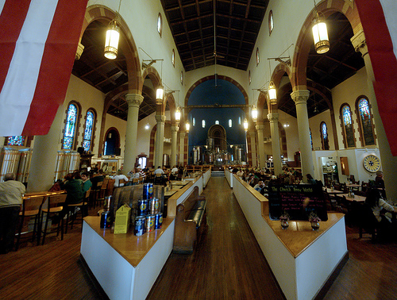
NEW USES FOR CHURCHES
Commercial Use
Houses of God… or not?!
Approaches to the Adaptive Reuse of Churches in Germany and the United States
Notes:
NEW SLIDE: The central location of churches, their recognition value and their special character make them desirable buildings for commercial use. This reuse type is often opposed by Churches as it contradicts their self-image as public, charitable institutions. Exceptions are new uses that have a religious or church-related aspect, for example the religious book store you see on the left (PHOTOS). Restaurants, like the Church Brew Works in Pittsburgh seen here (PHOTO), are also a popular reuse for churches and usually retain the large open space.

Slide 13
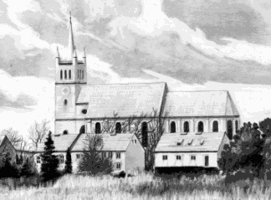
CASE STUDIES
Extended Use: Sankt Marien in Müncheberg
Houses of God… or not?!
Approaches to the Adaptive Reuse of Churches in Germany and the United States
Notes:
NEW SLIDE: my case studies represent the five different reuse types and also reflect different ways of dealing with the existing structure. The first example is Sankt Marien in Muencheberg in Germany. It represents the extended use of churches. The church was first established in the 13th century and altered around 1820 after plans by Karl Friedrich Schinkel. It was mostly destroyed during World War II and reconstructed after German reunification in 1992. During the reconstruction, the existing ruin was added on to and a new roof was constructed.

Slide 14
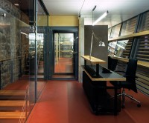
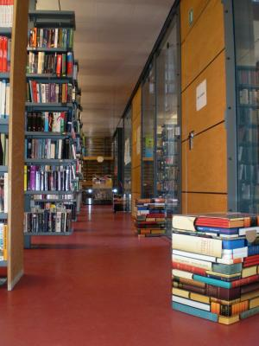
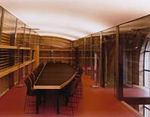
CASE STUDIES
Extended Use: Sankt Marien in Müncheberg
Houses of God… or not?!
Approaches to the Adaptive Reuse of Churches in Germany and the United States
Notes:
NEW SLIDE: Because the local congregation was too small for the church and appropriate funding could not be secured, it was decided in 1997 that the church would not only be used for worship, but also for the city library and as a community and cultural center. The new use of Sankt Marien is closely related to and even includes the original church use. It therefore harmonizes very well with the original use of the church.

Slide 15
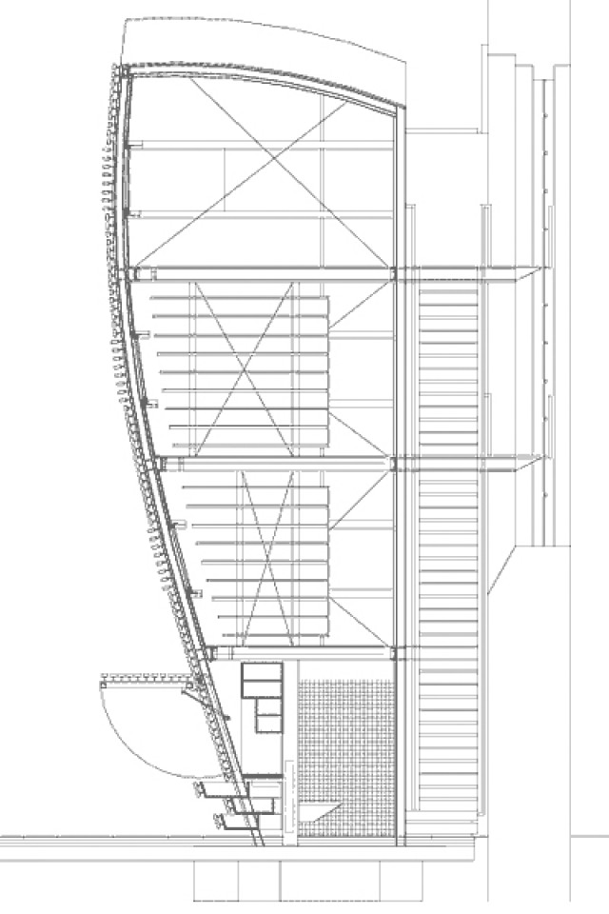
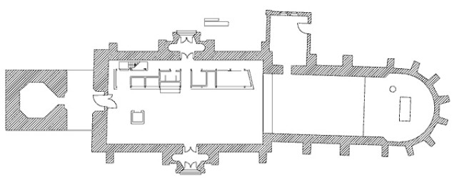
CASE STUDIES
Extended Use: Sankt Marien in Müncheberg
A
A - A
A
Houses of God… or not?!
Approaches to the Adaptive Reuse of Churches in Germany and the United States
Notes:
NEW SLIDE: As part of the reuse project, (PHOTO) a 4-story free-standing structure (CLICK) was inserted into the nave in order to accommodate the city library and rooms such as a small kitchen, bathrooms and a conference room.

Slide 16
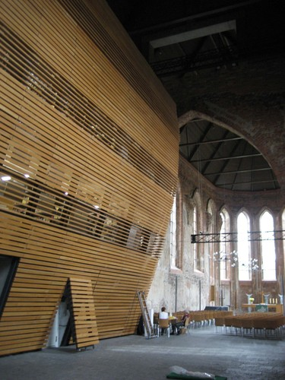
CASE STUDIES
Extended Use: Sankt Marien in Müncheberg
Houses of God… or not?!
Approaches to the Adaptive Reuse of Churches in Germany and the United States
Notes:
NEW SLIDE: (PHOTO) This steel structure is glazed on all sides and additionally clad in wood lamellas on the sides facing the church interior. A steel elevator tower provides access to all floors. The church’s nave remains an open space with flexible seating.

Slide 17
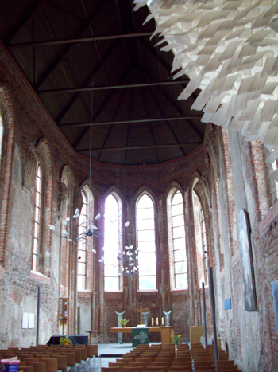
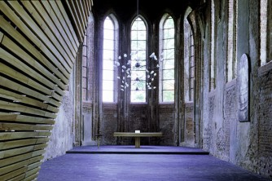
CASE STUDIES
Extended Use: Sankt Marien in Müncheberg
Houses of God… or not?!
Approaches to the Adaptive Reuse of Churches in Germany and the United States
Notes:
NEW SLIDE: The reuse project has only slightly altered the appearance of the building. The main character of the church interior has been retained and can be experienced as a whole.

Slide 18
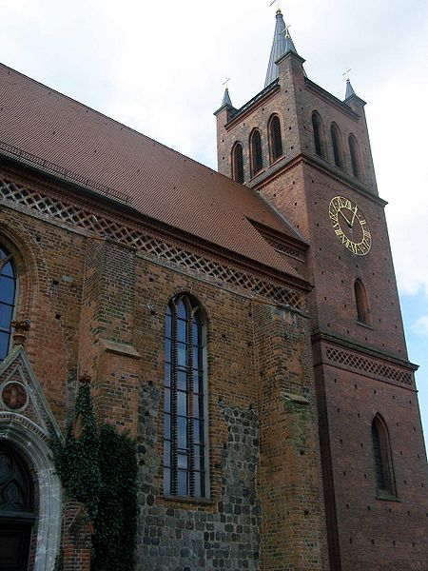
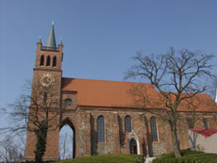
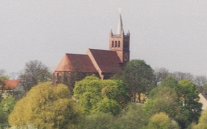
CASE STUDIES
Extended Use: Sankt Marien in Müncheberg
Houses of God… or not?!
Approaches to the Adaptive Reuse of Churches in Germany and the United States
Notes:
NEW SLIDE: The reconstruction has restored the architectural unity and exterior appearance of the church. The reuse project also reinstated the building’s purpose and its representational value as a church. Sankt Marien’s symbolic value within the city has therefore been enhanced by the new use and the new architectural unity

Slide 19
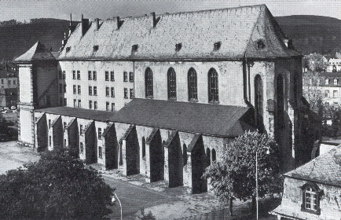
CASE STUDIES
Use for Events and Recreation: Sankt Maximin in Trier
Houses of God… or not?!
Approaches to the Adaptive Reuse of Churches in Germany and the United States
Notes:
NEW SLIDE: Sankt Maximin in Trier is an example for use for events and recreation. The current church was built as part of a convent in 1698. The abbey closed in 1801 and the church was first reused for craftsmen and was eventually converted into barracks in 1815. At that time 4 additional floors were constructed and new windows were inserted, (CLICK) which you can see in this historic photograph; after WWII the church was used by several schools and abandoned in 1976;

Slide 20
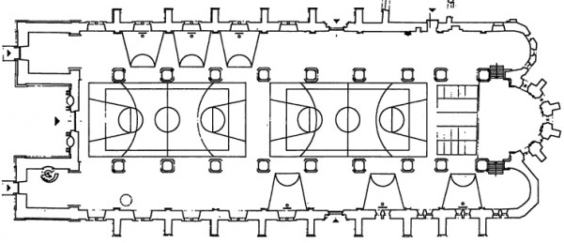
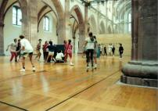
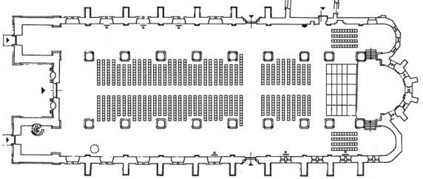
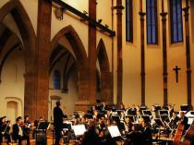
CASE STUDIES
Use for Events and Recreation: Sankt Maximin in Trier
Houses of God… or not?!
Approaches to the Adaptive Reuse of Churches in Germany and the United States
Notes:
NEW SLIDE: Today the church is used by surrounding schools as a gym and also for events and concerts. The additional floors were demolished; the windows were reconstructed and restored.

Slide 21
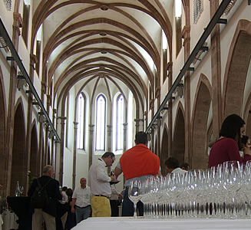
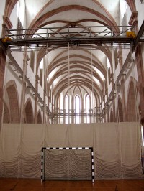
CASE STUDIES
Use for Events and Recreation: Sankt Maximin in Trier
…
Houses of God… or not?!
Approaches to the Adaptive Reuse of Churches in Germany and the United States
Notes:
NEW SLIDE: In order to retain the large open space but still be able to use it for different purposes, curtains that can be moved along a rail made of steel (PHOTO) were inserted into the building; A new floor was also constructed and a removable plaster was applied to the walls for acoustic reasons

Slide 22

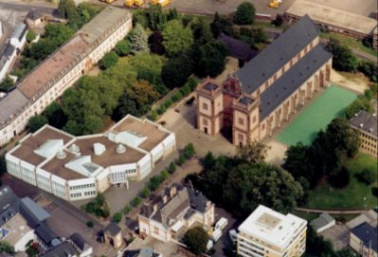
CASE STUDIES
Use for Events and Recreation: Sankt Maximin in Trier
Houses of God… or not?!
Approaches to the Adaptive Reuse of Churches in Germany and the United States
Notes:
NEW SLIDE: The new use of Sankt Maximin is neutral to its original use as a church and does not cause any conflicts. The adaptive reuse project has reinstated both the exterior and interior unity of the church as windows have been restored and additions to the interior were removed. The building can therefore serve as a symbol for the church again.

Slide 23
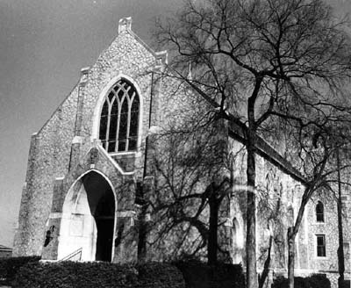
CASE STUDIES
Cultural Use: McColl Center for Visual Art in Charlotte, NC
Houses of God… or not?!
Approaches to the Adaptive Reuse of Churches in Germany and the United States
Notes:
NEW SLIDE: McColl Center for Visual Art in Charlotte, NC is an example for cultural use of a church. The building was constructed in 1926. It had three floors and housed a double-height worship hall and also a meeting room, classrooms, clergy rooms, dressing rooms and storage rooms. The congregation abandoned the church in the 1970s when it could no longer afford to maintain the building

Slide 24
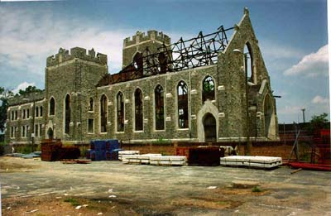
CASE STUDIES
Cultural Use: McColl Center for Visual Art in Charlotte, NC
Houses of God… or not?!
Approaches to the Adaptive Reuse of Churches in Germany and the United States
Notes:
NEW SLIDE: The church then stood vacant and burnt in 1985 with only the exterior walls remaining. In 1995, Bank of America purchased the property and plans emerged to turn the church into a center for artists.

Slide 25
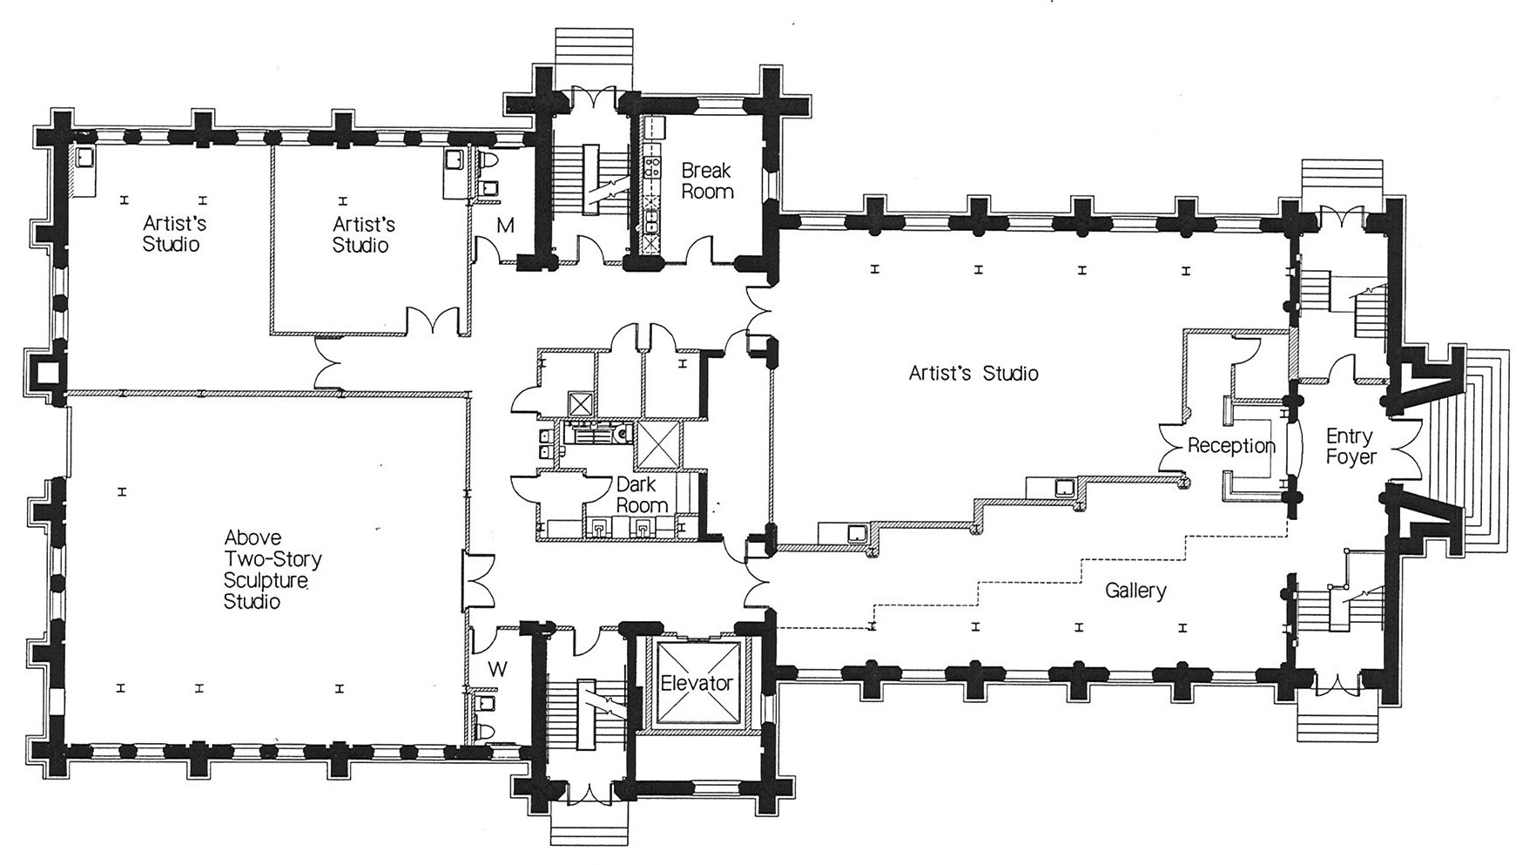
CASE STUDIES
Cultural Use: McColl Center for Visual Art in Charlotte, NC
Houses of God… or not?!
Approaches to the Adaptive Reuse of Churches in Germany and the United States
Notes:
NEW SLIDE: (FLOOR PLANS ) Today the church houses the McColl Visual Center for Arts, which offers scholarships and 9 studio spaces for young artists and also includes exhibition space.

Slide 26
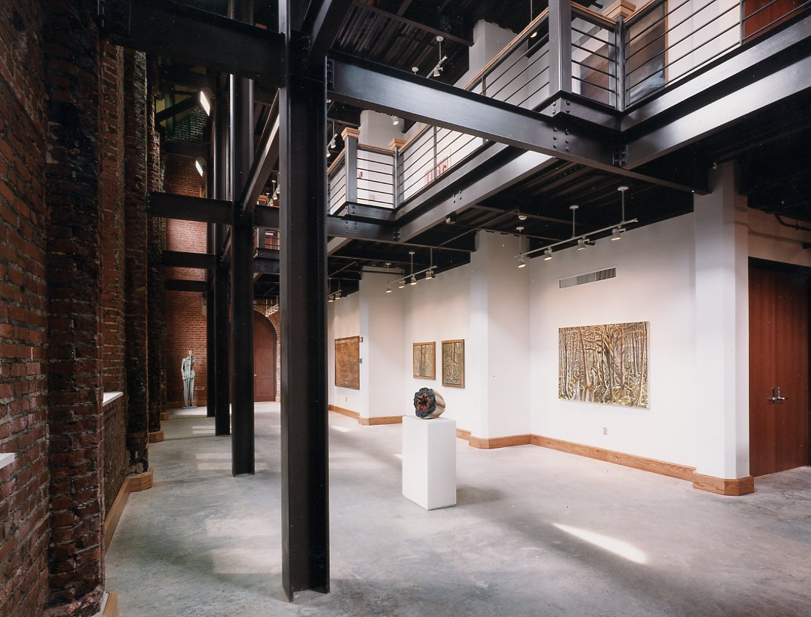
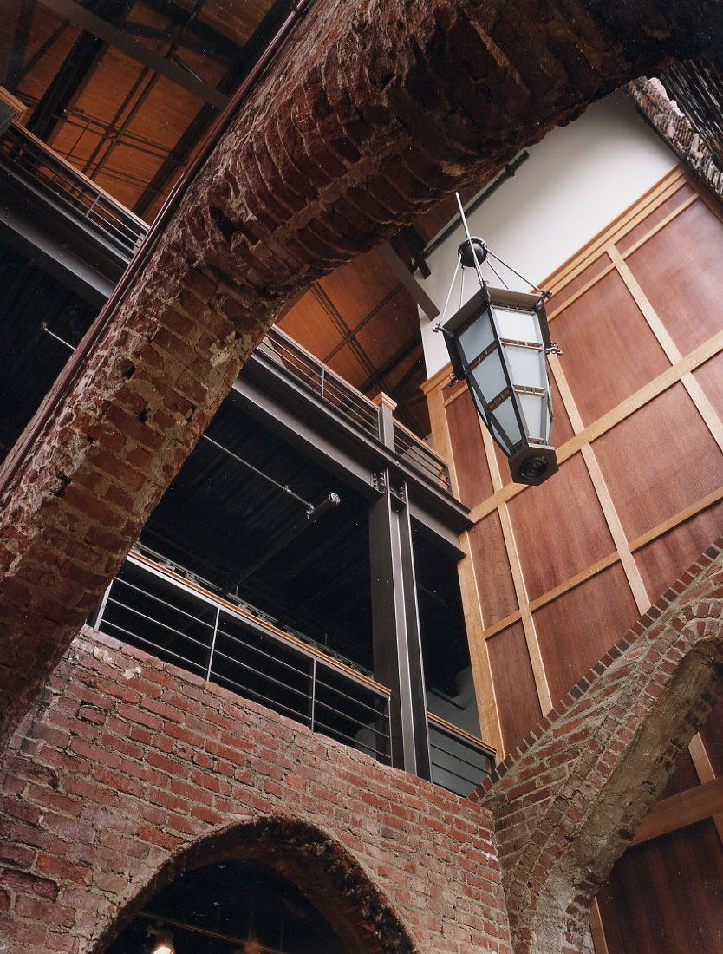
CASE STUDIES
Cultural Use: McColl Center for Visual Art in Charlotte, NC
Houses of God… or not?!
Approaches to the Adaptive Reuse of Churches in Germany and the United States
Notes:
NEW SLIDE: The architects retained the existing walls and constructed a new, free-standing steel structure within the old church walls. They also reconstructed the roof and inserted new windows. A gallery that spans 3 floors lets people experience some of the former large open space. Overall, they followed the concept of separating old and new (materials etc.); Remaining bits of plaster were removed from exterior walls and left the brick exposed (unlike original)

Slide 27

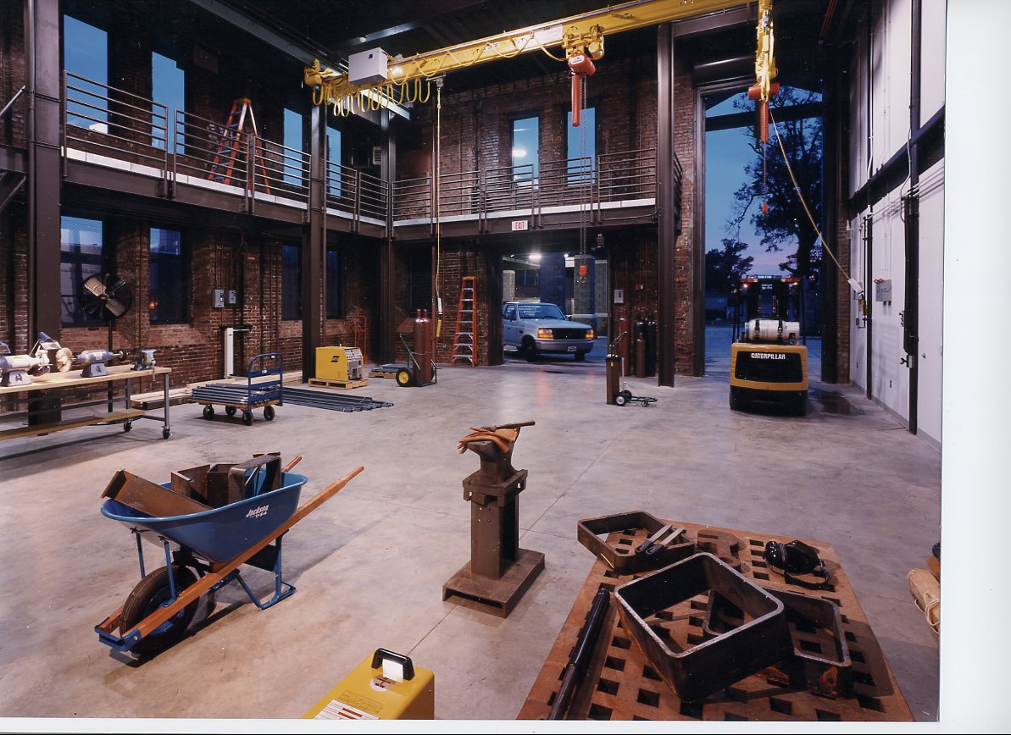
CASE STUDIES
Cultural Use: McColl Center for Visual Art in Charlotte, NC
Houses of God… or not?!
Approaches to the Adaptive Reuse of Churches in Germany and the United States
Notes:
NEW SLIDE: The new use of the building harmonizes well with the use as a church, especially since the center reaches out to the community and is open to the public. The interior of the church has been remodeled and the former open sanctuary can only partially be experienced.

Slide 28
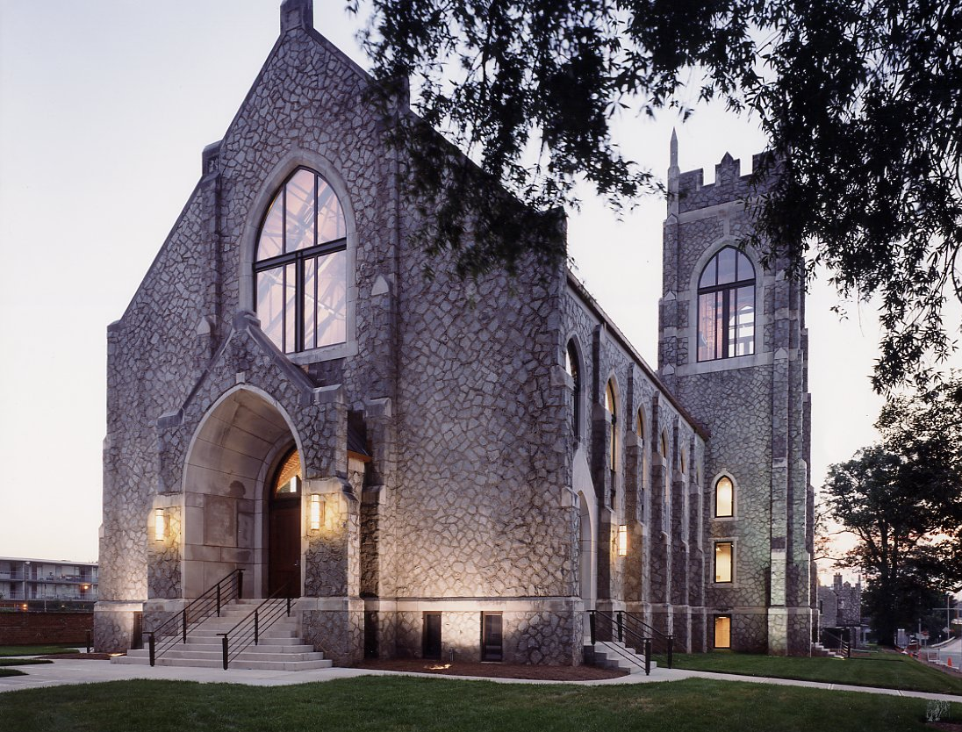
CASE STUDIES
Cultural Use: McColl Center for Visual Art in Charlotte, NC
Houses of God… or not?!
Approaches to the Adaptive Reuse of Churches in Germany and the United States
Notes:
NEW SLIDE: The exterior appearance of the church has been reconstructed and the building can once again serve as a symbol for the church within the city. In addition, the adaptive reuse of the church has spurred other redevelopment projects in the area.

Slide 29


CASE STUDIES
Residential Use: Meridian Arch in Indianapolis, IL
Houses of God… or not?!
Approaches to the Adaptive Reuse of Churches in Germany and the United States
Notes:
NEW SLIDE: The next example, Meridian Arch in Indianapolis, shows how an economically driven residential use can affect a church building. The Church was completed in 1906. The congregation left the building in the 1940s, because it needed a larger facility. The Indiana Business College took over the church in 1947, added offices and classrooms and moved out in 2003. ; As you can see in the right picture, the steeples and many original windows had been removed. The church was adapted by Hearthview Residential, a commercial real estate and construction firm that originally wanted to demolish the building. Community activists and the Indianapolis Historic Preservation Commission placed the church on the local register and saved it from demolition. The commission only made provisions for three facades of the church exterior, though, and not for the interior.

Slide 30


CASE STUDIES
Residential Use: Meridian Arch in Indianapolis, IL
NEW
OLD
Houses of God… or not?!
Approaches to the Adaptive Reuse of Churches in Germany and the United States
Notes:
NEW SLIDE: As a result, a majority of the church was demolished and only the exterior walls and parts of the former sanctuary remained. Demolition started in 2007 and a new addition was constructed on the west façade of the church. Today, the complex houses a total of 22 condos, 8 of which are located in the church.

Slide 31



CASE STUDIES
Residential Use: Meridian Arch in Indianapolis, IL
Houses of God… or not?!
Approaches to the Adaptive Reuse of Churches in Germany and the United States
Notes:
NEW SLIDE: The adaptive reuse project has significantly impacted the church. While the new use is neutral to the original church use, the architectural value has been diminished. The interior has completely changed and cannot be perceived as a whole. The windows within the condos convey some of the church’s character, but have been cut into sections by additional floors and walls (PHOTO).

Slide 32

CASE STUDIES
Residential Use: Meridian Arch in Indianapolis, IL
Houses of God… or not?!
Approaches to the Adaptive Reuse of Churches in Germany and the United States
Notes:
NEW SLIDE: The new addition is distinguishable from the old structure, but is not subordinate. It appears as a foreign subject that alters the exterior appearance of the church and affects its symbolic value.

Slide 33

CASE STUDIES
Commercial Use: Martinikirche in Bielefeld
Houses of God… or not?!
Approaches to the Adaptive Reuse of Churches in Germany and the United States
Notes:
NEW SLIDE: The last example, the Martinikirche in Bielefeld, is an example for commercial use as a restaurant. The church was built around 1896 and a bell tower and a side aisle were added in 1909. An apartment for the sexton was added to the church in the 1950s. It was abandoned by the congregation in 1975 and served as a meeting space for the city’s Greek-orthodox congregation until 2001

Slide 34


CASE STUDIES
Commercial Use: Martinikirche in Bielefeld
Houses of God… or not?!
Approaches to the Adaptive Reuse of Churches in Germany and the United States
Notes:
NEW SLIDE: In order to achieve a satisfactory solution for both the church and the new user, the architect studied the church’s history and the protestant church congregation organized meetings that provided church members with the opportunity to learn about the proposed new use and to voice their opinion about the reuse project.

Slide 35


CASE STUDIES
Commercial Use: Martinikirche in Bielefeld
Houses of God… or not?!
Approaches to the Adaptive Reuse of Churches in Germany and the United States
Notes:
NEW SLIDE: The Greek-Orthodox congregation had constructed a new structure within the church that had to be removed. The side aisle had also been walled up and had to be re-opened. The organ loft had to be removed due to fire protection requirements and was replaced by a new gallery

Slide 36

CASE STUDIES
Commercial Use: Martinikirche in Bielefeld
Restrooms
Kitchen
Houses of God… or not?!
Approaches to the Adaptive Reuse of Churches in Germany and the United States
Notes:
NEW SLIDE: (FLOOR PLANS) The sexton’s apartment was also demolished and replaced by a 2-story structure (CLICK) that houses the kitchen and storage rooms. Bathrooms (CLICK) were accommodated in a small addition south of the tower.

Slide 37


CASE STUDIES
Commercial Use: Martinikirche in Bielefeld
Houses of God… or not?!
Approaches to the Adaptive Reuse of Churches in Germany and the United States
Notes:
NEW SLIDE: The new use as a restaurant is rather far from the old use as a church, but the congregation was able to actively participate in the adaptive reuse process. Thanks to meetings with church members, the project has been accepted by the community. Furthermore, church officials have approved of the reuse, referring to the biblical meaning of food as God’s gift.

Slide 38

CASE STUDIES
Commercial Use: Martinikirche in Bielefeld
Houses of God… or not?!
Approaches to the Adaptive Reuse of Churches in Germany and the United States
Notes:
NEW SLIDE: Even though the building is not protected under German preservation laws, the architect decided to take into consideration the architectural value of the church and to retain its structure. Since the interior of the church has been restored, its original character has mostly been reinstated.

Slide 39

CASE STUDIES
Commercial Use: Martinikirche in Bielefeld
Houses of God… or not?!
Approaches to the Adaptive Reuse of Churches in Germany and the United States
Notes:
NEW SLIDE: The representational value as a church has been slightly reduced by the adaptive reuse project since the new use is so different from the original church use. The exterior appearance of the church has been retained, though, and it can still serve as a symbol for the church.

Slide 40

CONCLUSION
- new uses should relate to and not contradict the values of the church
- the success of adaptive reuse of churches depends on several factors
  the new use
  the treatment of the fabric
  considering all values involved
  informing and involving stakeholders in the planning process
  Values-centered approach is good option for the reuse of churches
Houses of God… or not?!
Approaches to the Adaptive Reuse of Churches in Germany and the United States
Notes:
NEW SLIDE: I took away several lessons from studying the adaptive reuse of churches in Germany and the US.
First, new uses that relate to the original religious use, or at least don’t contradict it, are usually the better choice and often help with retaining the character of church buildings.
CLICK: Also, the success of an adaptive reuse project really depends on several factors: on the one hand are the new use and the treatment of the existing fabric. But even more important is the consideration of all values associated with churches and involving stakeholders in the planning process.
The adaptive reuse project at the Martinikirche is a good example. It shows that even uses that apparently conflict with the original church use can be accommodated in church buildings if all stakeholders are involved in the planning process. It shows that a successful adaptive reuse project does not only depend on a compatible use, but also on how the building and the values connected to it are approached and respected
CLICK: A values-centered approach, which includes a preliminary study and the inclusion of all stakeholders, therefore stands out as a recommended approach for the adaptive reuse of churches

Slide 41
THANK YOU!
Houses of God… or not?!
Approaches to the Adaptive Reuse of Churches in Germany and the United States
Notes:
NEW SLIDE: Thank you for attention. I’d be happy to answer any questions.

