Slide 1
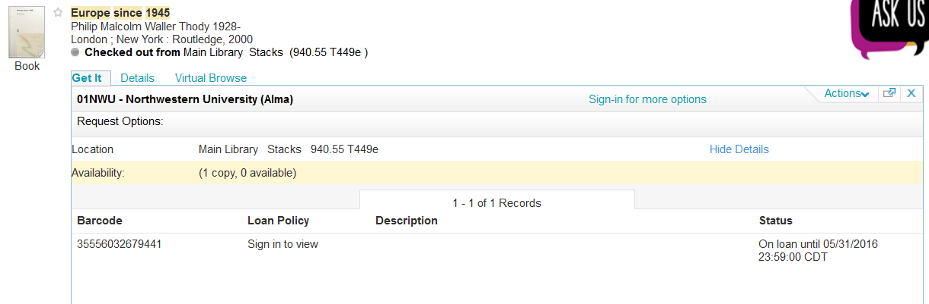
I need a copy of this book but NUL’s is out.

Slide 2
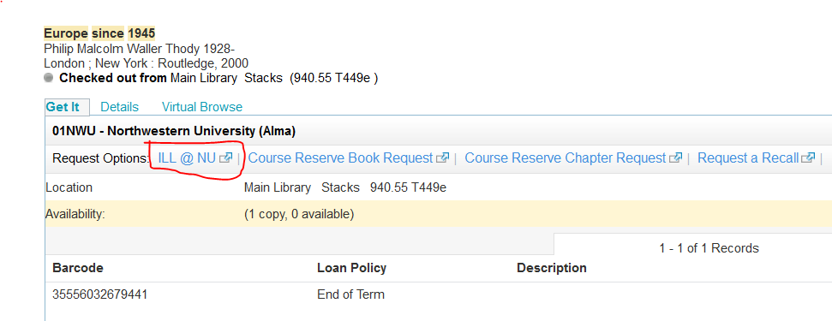
I can sign-in and request it via ILL, but I want to UBorrow it…

Slide 3
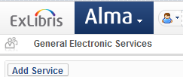
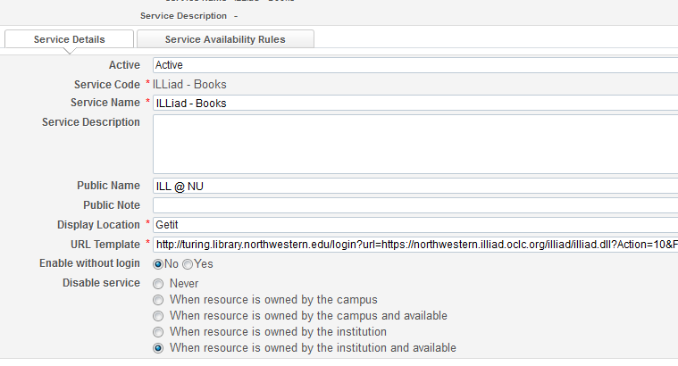
The display of a General Electronic Services option is controlled by ownership and shelf availability only.

Slide 4
Can an instance of Primo populated with Alma-based availability and Alma-based display logic for external systems intelligently display a preferred request option?

Slide 5
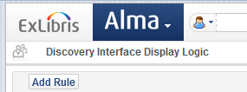
For user groups United Adjunct Faculty,United Alumni,United Dept.,United Doctoral Stdnt,United Faculty,United Family Card,United Guest,United Ill, Mail Loan,United Locb, Acts,United Seabury Doc Stud,United Seabury Faculty,United Seabury Staff,United Seabury Student,United Staff,United Student,United Summer: Hide service General Electronic Service with Service = ILLiad – Books
Discovery Display Interface Logic only allows us to hide an option from a patron group. It does not allow for ranking of services.

Slide 6
And then we need to program and reprogram when things change… Oh, and add an additional server…
Support CORS (Cross-Origin Resource Sharing) in their RequestItem API so that it can be called from the browser instead of from the server. The reason for this is that is it far easier to insert a bit of JavaScript into the result template to add the ILL link on the fly than it is to code, compile, and deploy the same functionality on the server. Especially since Primo is written in Java, which would involve a lot of extra overhead and maintenance on our part for what should be a very simple call-and-response operation.

Slide 7
Is displaying a UBorrow link in the discovery tool the best route or is a background search of UBorrow better?
How can we make most effective use of the web services?
Where is the most effective place to do that? Do I put it and maintain it in multiple places or can I have in just one place?
Ultimately, the question is what does this web service do for us? What does it automate? Does a patron need to see it? Where can we best use it?

