Slide 1
Managing Audiovisual Digitization
Robin C. Pike
UMD Libraries Library Research and Innovative Practice Forum
June 4, 2015

Slide 2
Overview
Co-creating a pre-conference workshop for the Society of American Archivists August 2015 Annual Meeting, with digitization vendor George Blood (George Blood Audio, Video, Film) and consultation vendor Josh Ranger (AV Preserve).
Workshop objectives:
  Audiovisual obsolescence and degradation
  Collection survey tools
  Processes for planning and managing projects
  Technical standards
  Working with vendors
Brief synopsis, focus on my contributions

Slide 3
Features of Workshop
Information for librarians/archivists doing the work
Gap in current national curriculum
Hands-on exercises
  Project plan template
  Item-level survey tool
  RFP template
Take-home templates
  Survey tools, templates
  Shipping manifest
  Packing checklist

Slide 4
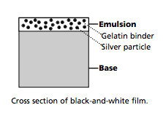
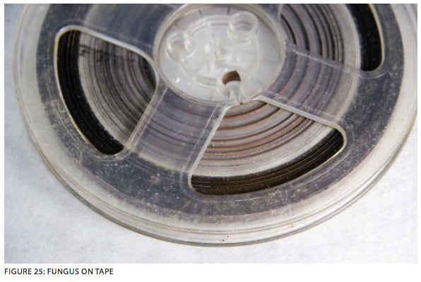
Introduction to Media and Preservation Initiatives
Physical format structure
Equipment obsolescence
Media preservation initiatives
Trend toward digitization as preservation
NFPF Film Preservation Guide, p10
IUB, FACET Format Characteristics and Preservation Problems, p31

Slide 5
Defining Project Specifications
Setting project specifications, deliverables
Defining how you measure project specifications
Defining pass/fail
Why?

Slide 6
Collection Survey Tools
Survey for planning digitization
  What you need
  How you’ll capture it
Informs SOW, deliverables
  Format
  Duration
  Condition sampling
  Prioritization
  Selection

Slide 7
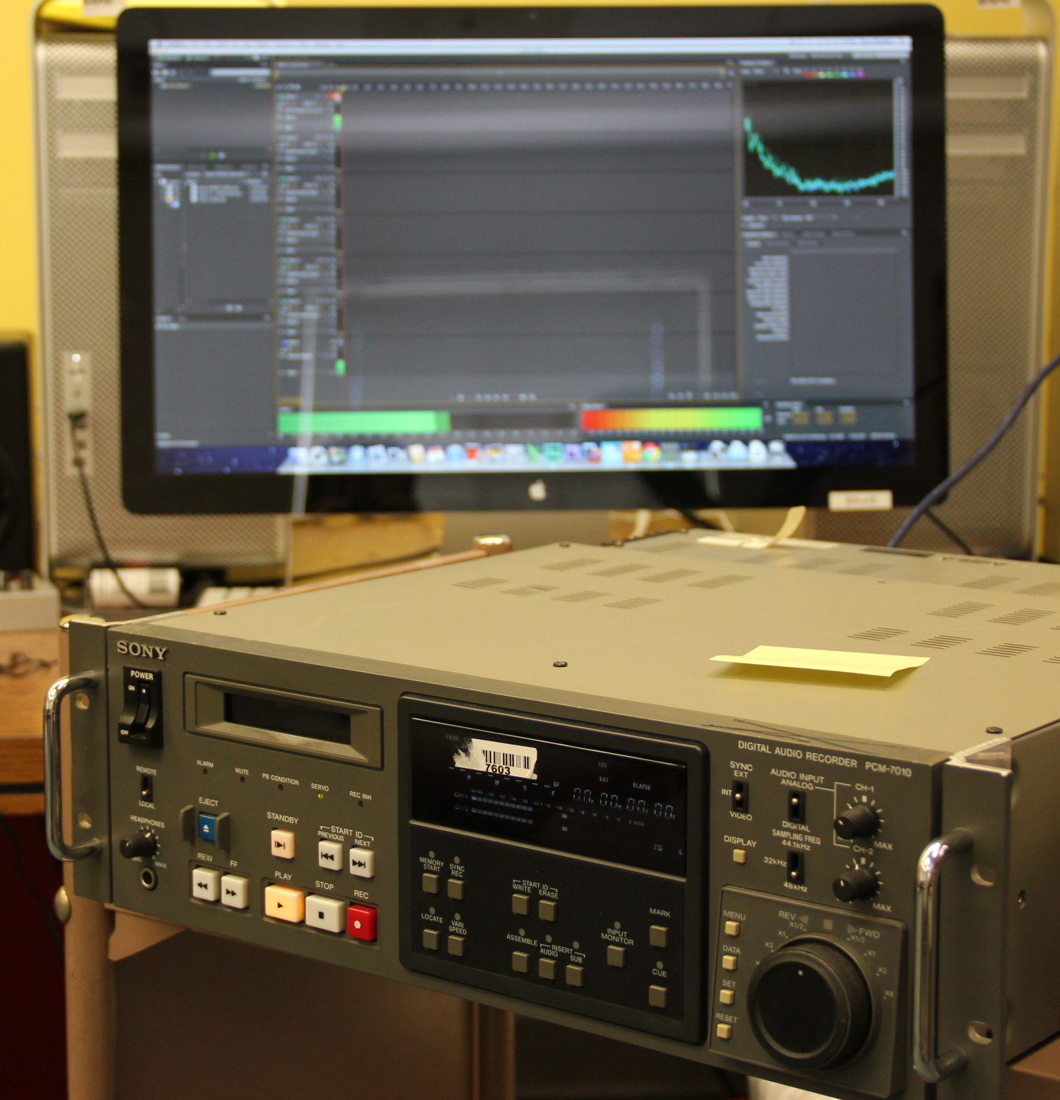
Digitization Location
In-house v. Vendor
  General considerations:
    Technical expertise
    Equipment availability
    Standards
    Project timeline
  In-house considerations:
    Maintain equipment
    Maintaining workstations and personnel over 10-15 years
  Vendor considerations:
    Prepping, packing
    Additional shipping costs
    Rare formats

Slide 8
Funding Sources
Internal
  Operations
  Gifts/endowments
  Discretionary
External (sources list)
  Fundraising
  Grants
  Foundations

Slide 9
Project Planning
Standards
  File deliverables
  Metadata
  Why select specific standards
Storage requirements
Project roles, responsibilities
Project timeline
Project plan template

Slide 10
Working with a Vendor
Project scope and timeline
Competitive bid process
Developing a SOW
Developing a relationship
Preparing materials
  Packing materials
  Shipment manifest/metadata

Slide 11
Concluding a Project
Quality checks, tools
Plan to ingest, archive, make accessible
Project post-mortem
  Document!

