Slide 1
Watershed Restoration Prioritization Project
Sheryl Mathias, Binguan Zhang and Xinyun Zhang
Under the supervision of Dr. Kathy Weaver
Course INFM 737: Information Management Capstone Experience
The University of Maryland– College Park
Spring 2018
PALS - Partnership for Action Learning in Sustainability
An initiative of the National Center for Smart Growth
Gerrit Knaap, NCSG Executive Director
Uri Avin, PALS Director

Slide 2
Project Overview
Collaborative effort between PALS, the National Center for Smart Growth and UMD iSchool
Partner with Stormwater Management Division of the Department of the Environment (DOE), Prince George’s County, on an environmental challenge: to restore clean water to the Chesapeake Bay area
Problem: County needs an automated tool to prioritize watershed restoration projects by Total Maximum Daily Load (TMDL) of pollutants
Solution: Use current land use and TMDL datasets to calculate, aggregate and visualize three main TMDLs to standardize project prioritization decisions

Slide 3
Project Evolution
Planned
Fall: Planning Phase
Project documents preparation
Research and learning
Spring: Implementation Phase
Task completion
Handover deliverables
Actual
Scope change: narrowed datasets to pollutant load and land use categories only
Name change: from “Restoration Project Prioritization” to “Watershed Restoration Prioritization”
Schedule change: new tasks to reflect shortened implementation time (8 weeks) and narrowed scope
Documentation change: Rewritten to reflect scope and schedule changes

Slide 4
Deliverable: Automated Tool
Two parts
Calculation Tool
Utilizes land use and TMDL data to calculate total TMDLs
Visualization
Displays TMDL loads by type and by rank
Benefits
More effective and efficient decision-making
No existing tool of its kind
Can be used immediately
Scalable

Slide 5
Project Management
Implementation Team
Calculation Tool:
Binguan Zhang
Xinyun Zhang
Visualization:
Sheryl Mathias
Work Flow Process
Reported weekly to Derek Winogradoff via email
Worked closely with Charles Walsh, GIS Specialist
Met weekly with UMD project management team

Slide 6
Project Background
The goal is to serve DoE’s mission to improve water quality and satisfy the Federal Mandate to meet the National Pollutant Discharge Elimination System (NPDES) Municipal Separate Storm Sewer System (MS4) requirement of reducing nitrogen, phosphorus, and sediment in Prince George’s watersheds by 2025. The requirement is set by the EPA.
Currently design teams select projects on a site by site basis, based on information sources such as SharePoint, MS Project, PGAtlas and field study. There is no existing visualization or scoring tool that prioritizes projects based on how much nitrogen, phosphorus, and sediment is produced in an area.
This project’s objective is to prioritize areas for restoration based on the amount of pollutants a site is producing, thus saving energy, effort, time, and making the process more cost effective.

Slide 7
Calculation Tool
Overview
The tool calculated nitrogen, phosphorus, and sediment in a certain area based on the Chesapeake Bay Program land use classifications and the Maryland Department of Natural Resources 12-digit watershed as the analysis area.
The calculation process can be implemented in any area to calculate pollutants generated by the amount of land use.
It ranks pollutants produced in each watershed based on Chesapeake Bay Program land use.
Users can change data input fordifferent analyses and configure data analysis mechanism to produce different results.

Slide 8
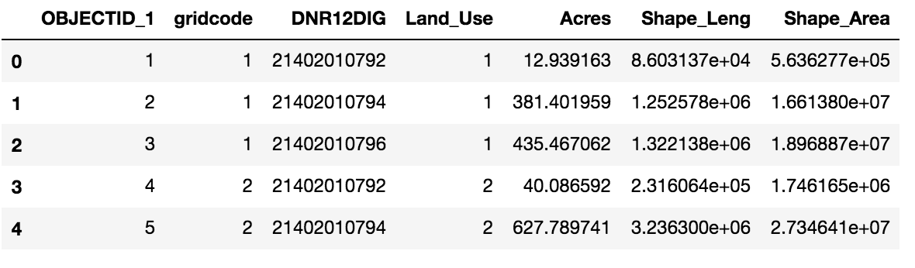
Calculation Tool
Input
Datasets with the same format
Given the amount of each land use classification within each watershed

Slide 9
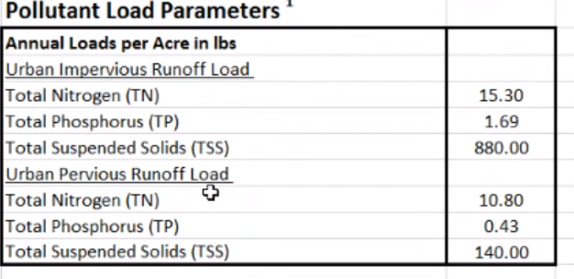
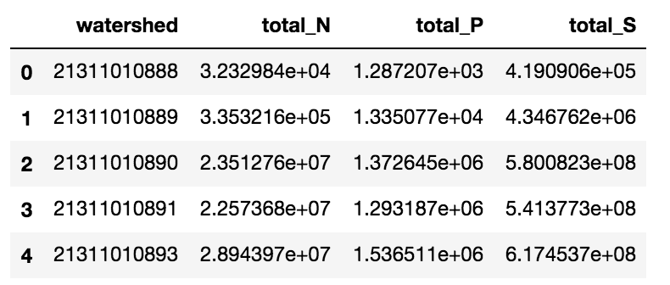
Calculation Tool
Output
TN, TP, TS for each watershed
Using pollutant load as multiplier

Slide 10
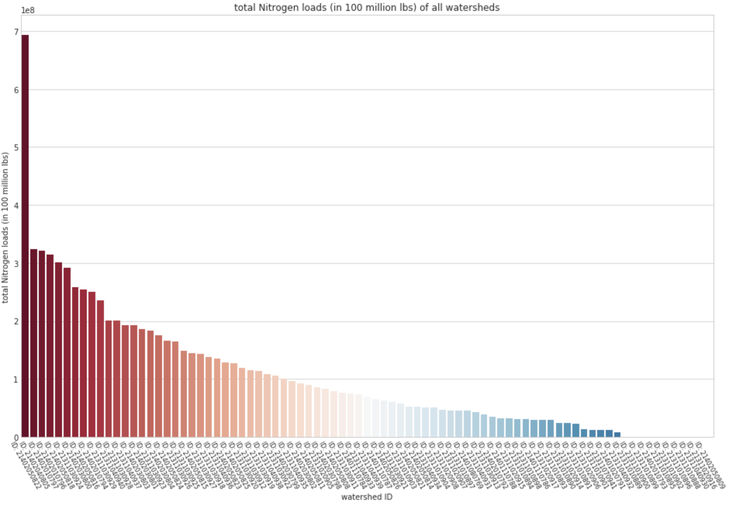
Calculation Tool
High
Medium
Low
Determines low, medium, high by percentiles
Configurable
Low: 0-50%
Medium: 50-80%
High: 80-100%

Slide 11
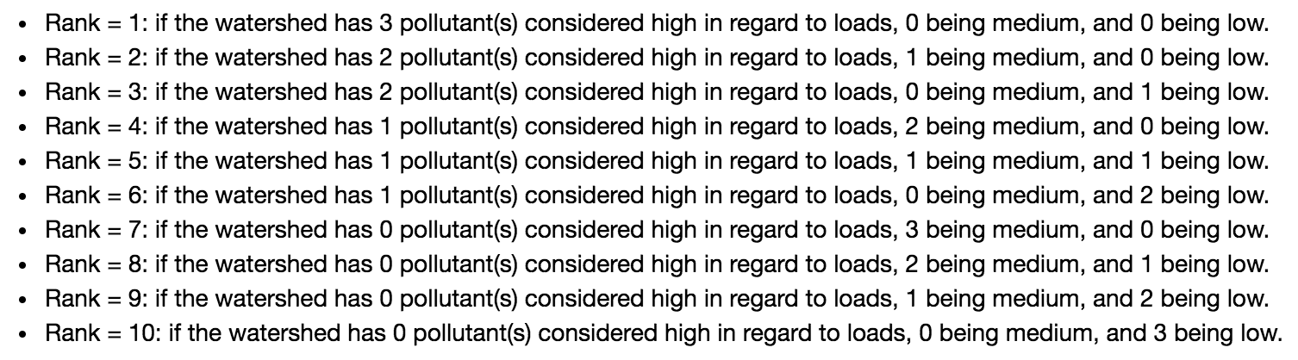
Calculation Tool
Output: once each watershed is assigned an HML for each pollutant, the watershed could be ranked by pollutant produced

Slide 12
Visualization Dashboard
Overview
The data visualization dashboard is a web mapping application using ESRI ArcGIS. It enables the user to view watersheds in two displays: Simple Display and Ranking Display.
Simple Display: shows nitrogen, phosphorus and sediment for each watershed as a separate item on the map.
Ranking Display: is a map with layers for each watershed ranked based on the TMDL of pollutants in each watershed.

Slide 13
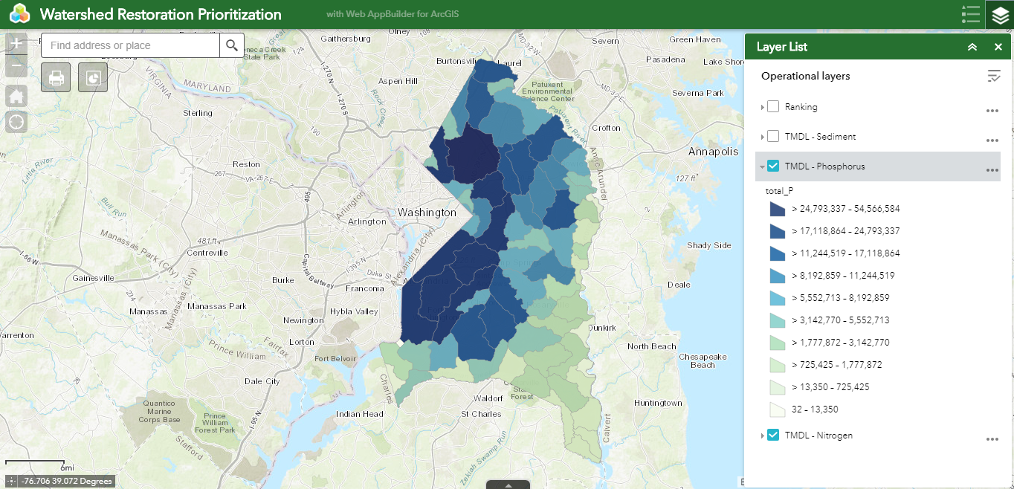
Simple Display - Phosphorus Layer
The map represents all watersheds classified by the amount of phosphorus produced.
The darker shades of blue represent watersheds that generate the highest amount of phosphorus analyzed by the tool.
Color coding scheme for the three pollutants was provided by Derek Winogradoff and Charles Walsh.
Notes:
Format the image

Slide 14
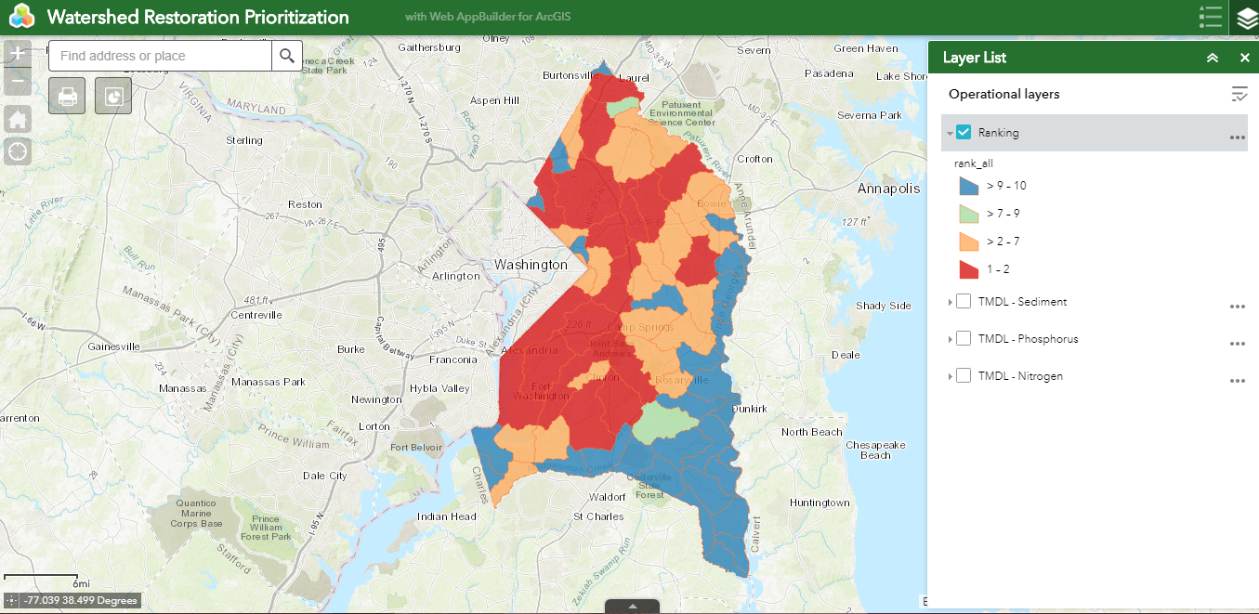
Ranking Display
The map represents all watersheds color- coded and categorized by rank.
Red: High (Ranks 1-2)
Light Orange: Medium? (Ranks >2-7)
Light Blue: Medium? (Ranks >7-9)
Blue: Low (Ranks > 9-10)
When a user hovers over the pie chart, relevant watersheds are highlighted on the map.

Slide 15
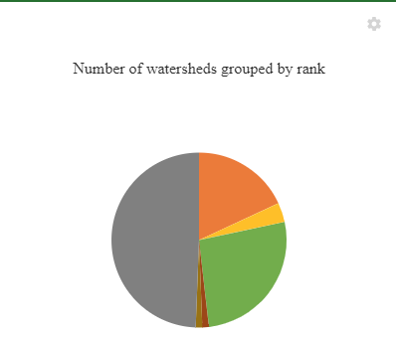
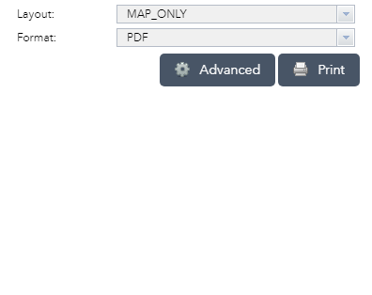
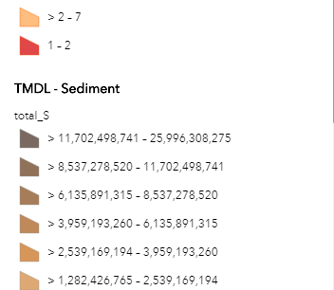
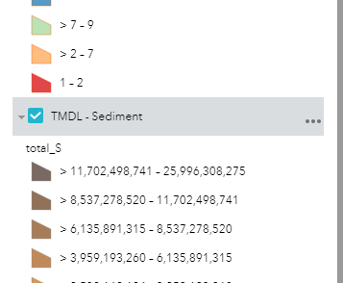
Use of Widgets
This infographic widget displays a pie chart that categorizes watersheds by rank.
Each pie slice is a subset of watersheds for a specific rank.
Used Print widget, which allows the user to print the map in any format: PDF, JPG, GIF and PNG.
Used the legend and layer widget to represent the three pollutants and ranks as four map layers.

Slide 16
Findings
The Anacostia watershed near College Park has a land use composition that generated the most pollutants
The watershed near the Washington Metropolitan area generates the most pollutants
The watersheds that produced high values for all three pollutants have similar land use compositions

Slide 17
Wrap-Up
Handover of code for tool
Thank you to DoE for consulting experience
Thank you to Technical Staff for support
Thank you to PALS and the National Center for Smart Growth for the opportunity to undertake real world solutions

