Slide 1
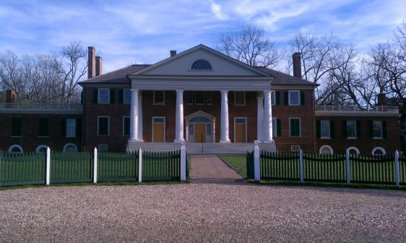
History and Heritage at
James Madison’s Montpelier
Tom Hardej May 15, 2012 HISP 711

Slide 2
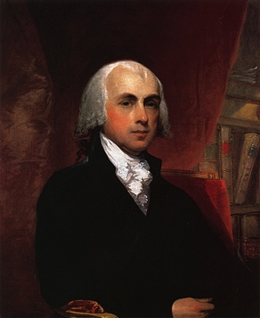
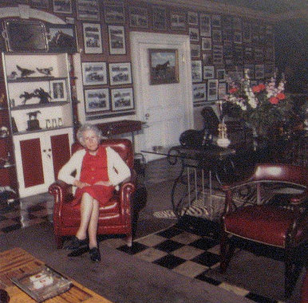
Introduction
James Madison
Marion duPont Scott

Slide 3
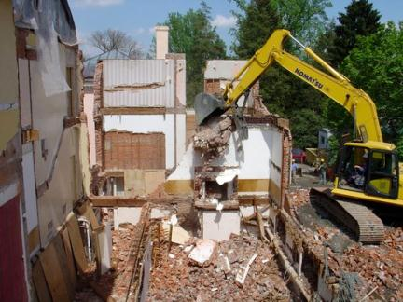
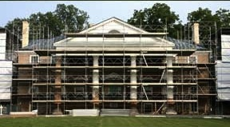
Introduction

Slide 4
Research Questions
What were the consequences of this restoration?
What are the visible and invisible narratives at James Madison’s Montpelier?
Why is the duPont narrative at Montpelier significant and how can it be preserved on the landscape?

Slide 5
Overview
Methodology
Background Information
The Madisons and the duPonts
The Restoration
Effects on the Landscape Today
Current Interpretation of Montpelier
Montpelier Walking Tour
Conclusion

Slide 6
Methodology
Numerous Montpelier Site Visits
  House Tours
  “Self-Guided” Landscape Tours
  Conversations with Staff and Volunteers
Interviews with Key Players
  Restoration Architect
  Advisory Committee
  Montpelier Foundation & National Trust Staff
  Preservation Scholars
Historical Research
  Archives

Slide 7
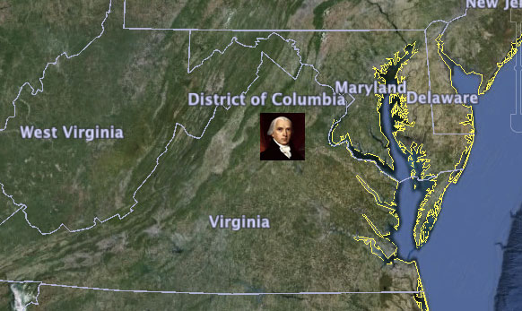
Orange County, VA

Slide 8
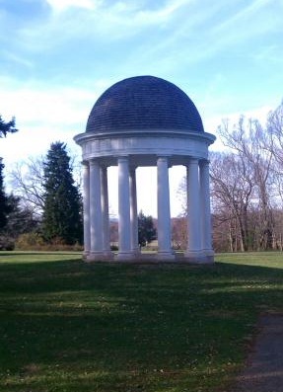
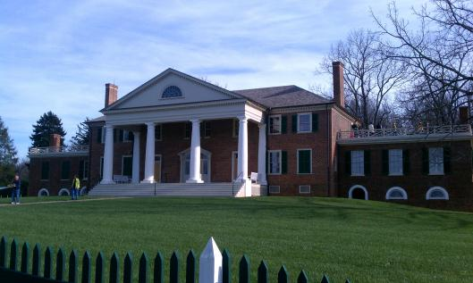
Madison Montpelier

Slide 9
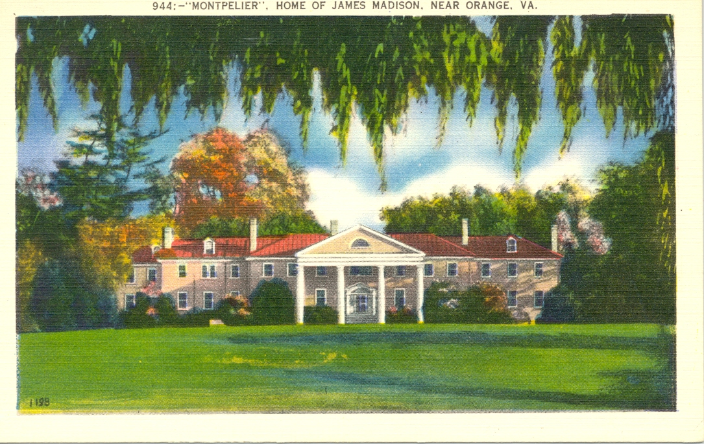
duPont Montpelier

Slide 10
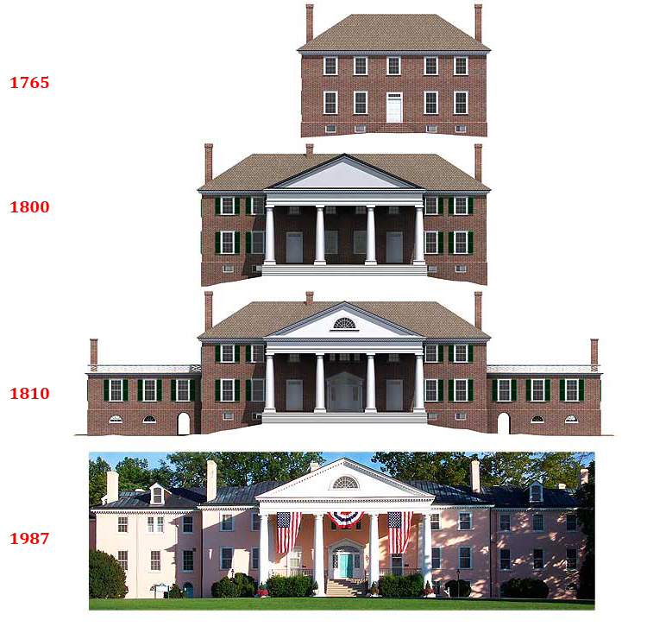
Montpelier Over Time

Slide 11
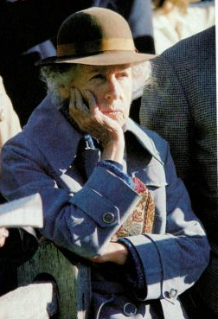
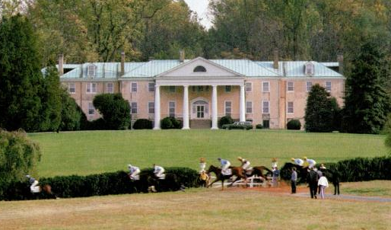
duPont Montpelier

Slide 12
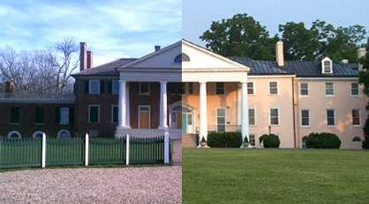
Pre-Restoration Montpelier
(2011)
(ca. 2000)

Slide 13
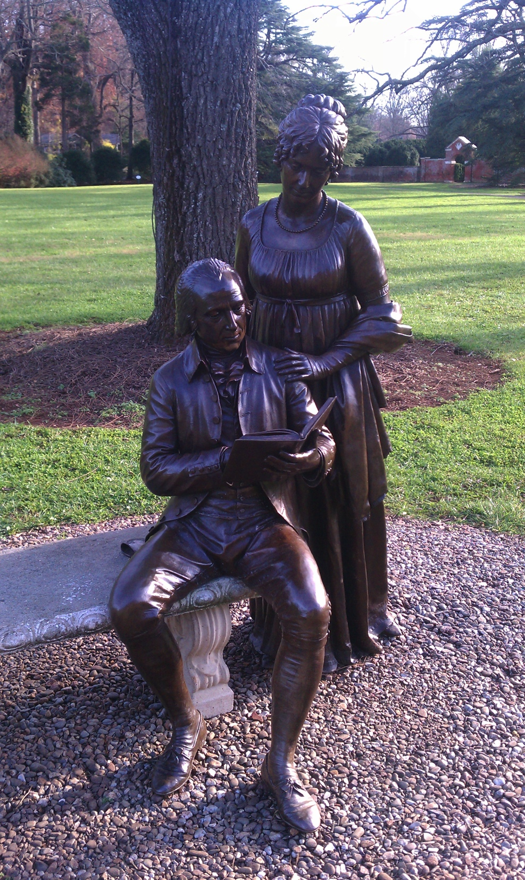
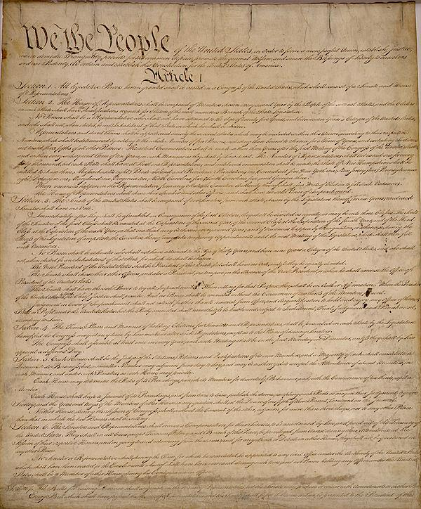
Montpelier Foundation

Slide 14
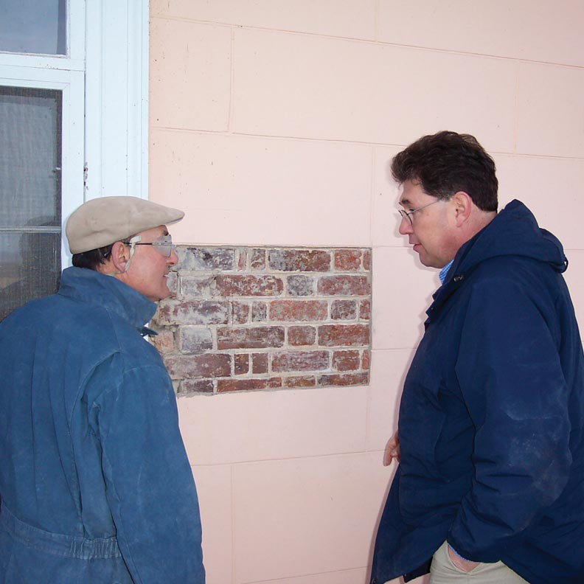
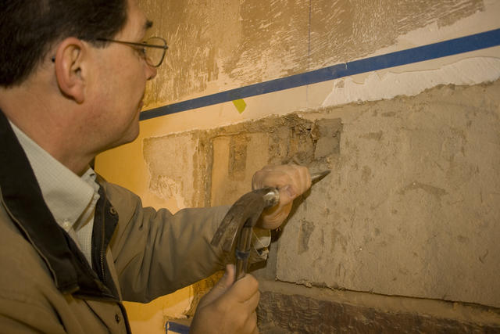
Restoration Advisory Committee

Slide 15
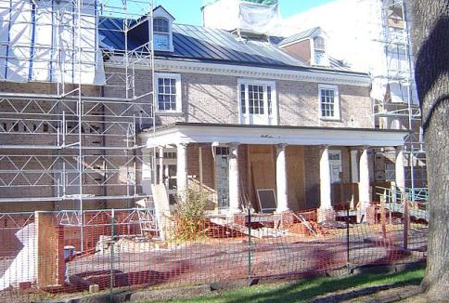
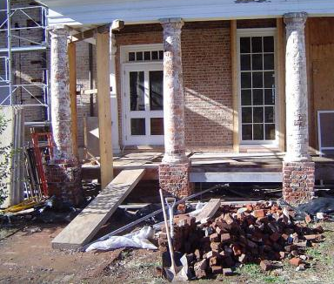
Restoration

Slide 16
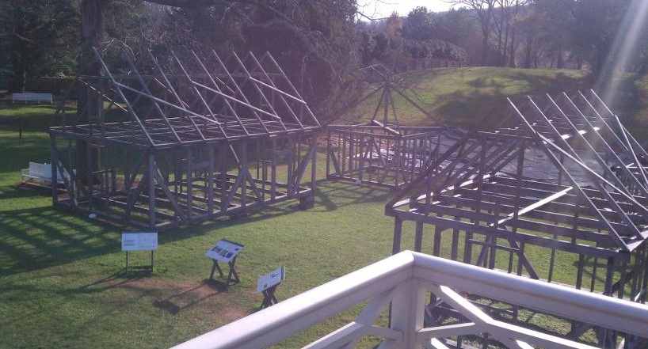
Reconstructed Slave Quarters

Slide 17
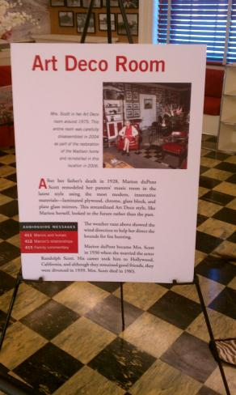
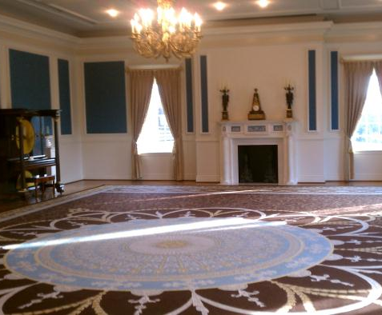
The William duPont Gallery

Slide 18
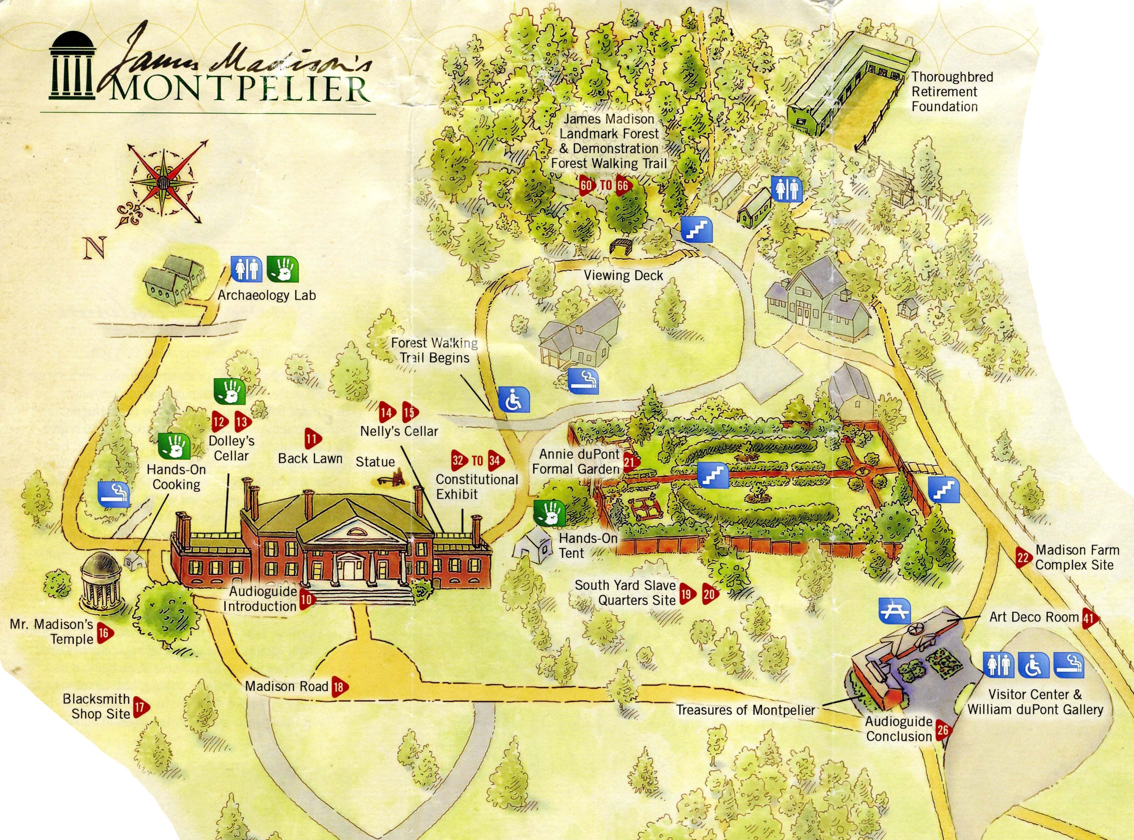
James Madison’s Montpelier

Slide 19
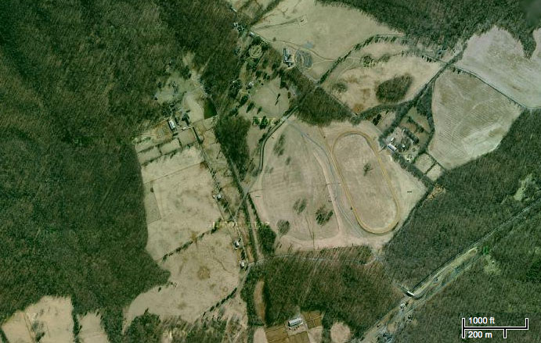
Mapping Montpelier

Slide 20
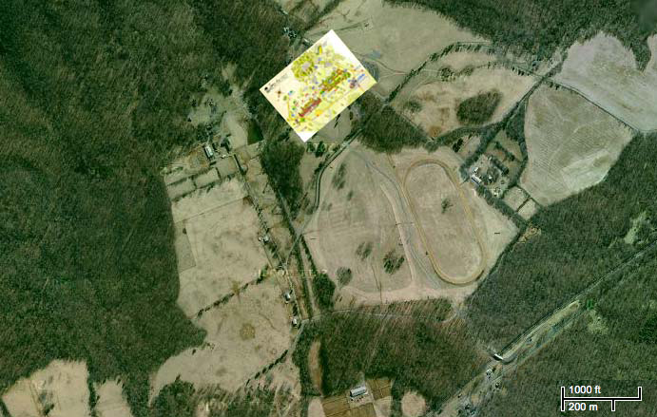
Mapping Montpelier

Slide 21
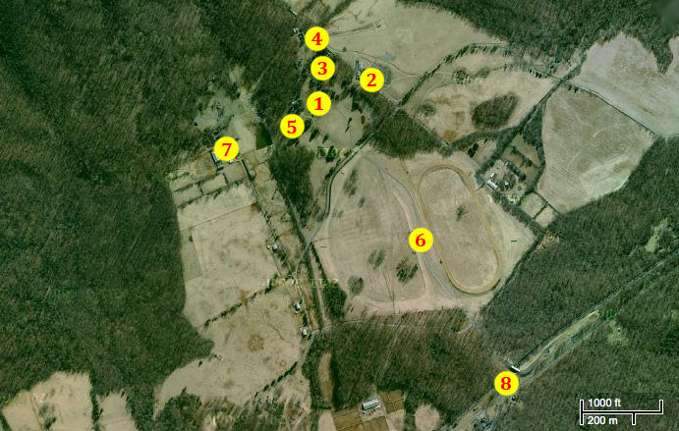
Mapping Montpelier

Slide 22
Walking Tour
1) The Main House
2) The Visitor Center (Art Deco & Drawing Room)
3) Annie duPont Formal Garden
4) Barns & Stables
5) Horse Graveyard
6) Montpelier Hunt Races
7) Bassett Cottage
8) Montpelier Depot Train Station

Slide 23
Walking Tour
1) The Main House
2) The Visitor Center (Art Deco & Drawing Room)
3) Annie duPont Formal Garden
4) Barns & Stables
5) Horse Graveyard
6) Montpelier Hunt Races
7) Bassett Cottage
8) Montpelier Depot Train Station

Slide 24
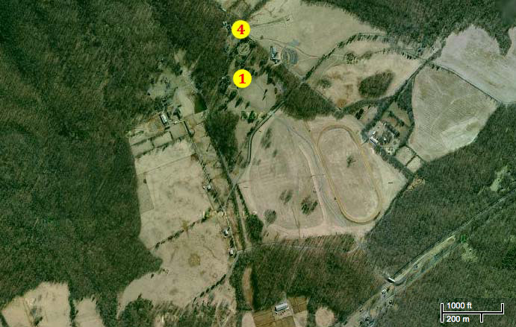
Barns & Stables

Slide 25
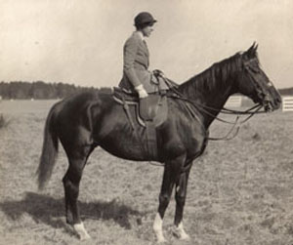
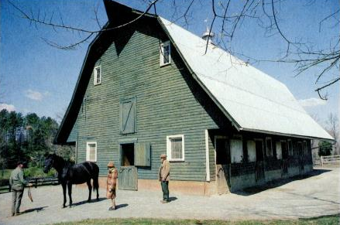
Barns & Stables

Slide 26
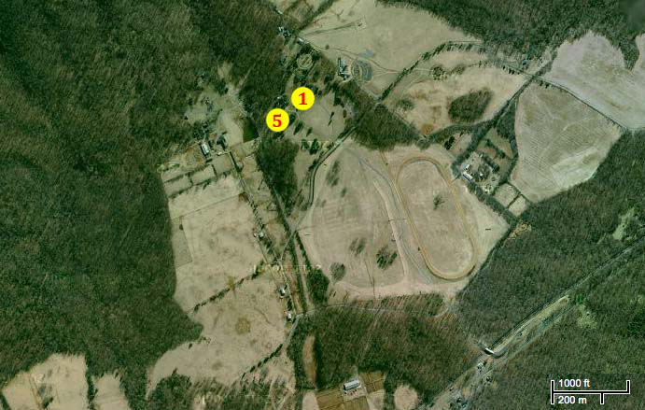
Horse Graveyard

Slide 27
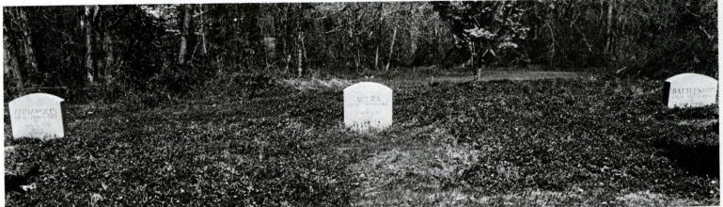
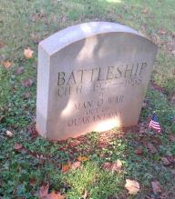
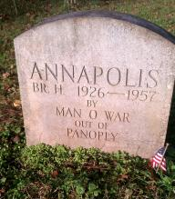
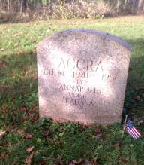
Horse Graveyard

Slide 28
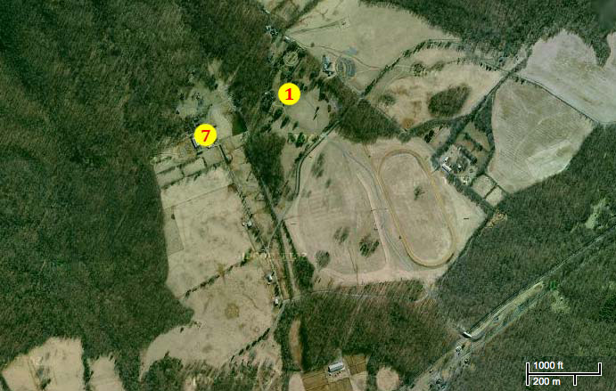
Bassett Cottage

Slide 29
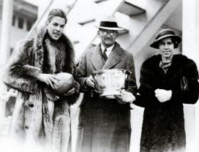
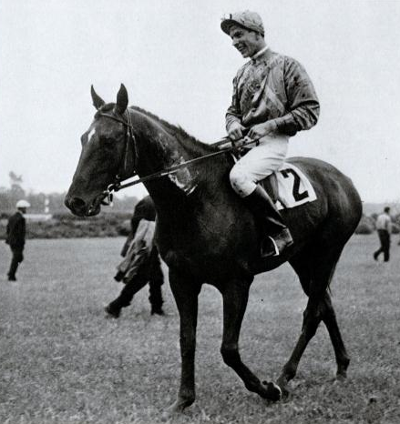
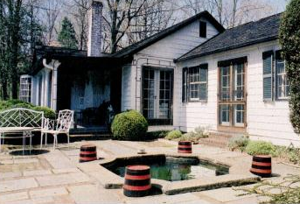
Bassett Cottage

Slide 30
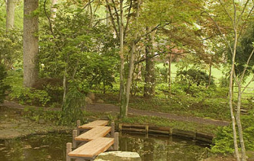
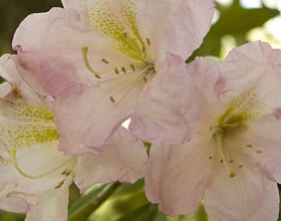
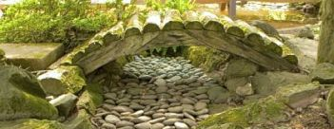
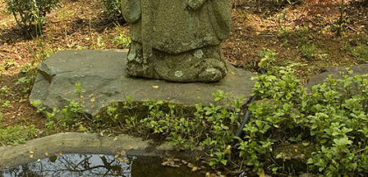
Oriental Garden

Slide 31
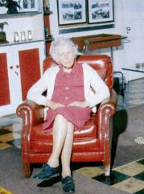

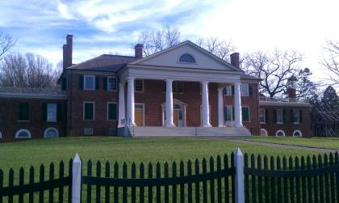
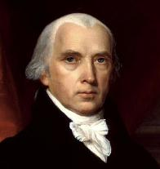
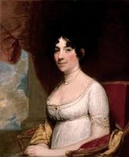
Conclusion

Slide 32
Questions?
Thanks to my committee
Dr. Donald Linebaugh
Dr. Mary Corbin Sies

