Slide 1
HMNP Advisory
Board Meeting
University of Maryland Libraries
Thursday, April 18, 2019
Notes:
Logistics
Tell people where the restroom is and about compost/trash/recycling
Introduce Dan
Dan’s welcome

Slide 2
Agenda
Welcome/Lunch/Introductions
HMNP Project Updates
Overview
Phase 1-3
NDNP Awardees Conference
Phase 4
Future Plans
UMD Newspaper Repository/MD Newspaper Repository
Case Studies
Brainstorming: Outreach and Programming
Conclusion/Next Steps

Slide 3
Project Overview

Slide 4
US Newspaper Program (USNP), 1982-2001
Enhance access to historic American newspapers
Locate, catalog, and preserve on microfilm newspapers published in the United States
150,000 titles cataloged, 600,000 holdings, more than 75 million pages filmed
Established the USNP Preservation Microfilming Standards
All 50 states participated
Notes:
The US Newspaper Program (USNP), a National Endowment for the Humanities grant-funded initiative that occurred between 1982-2001, facilitated newspaper preservation and access across all 50 states through the location of newspapers, catalog record creation, and the creation and circulation of microfilm copies of newspapers. Each state in the program designated a repository for the microfilm, with additional use copies sent to many state public libraries and historical societies. In total, this program enabled the cataloging of 150,000 titles, 600,000 holdings, and more than 75 million pages filmed. This project established preservation microfilming standards for newspapers that are still employed today. This project greatly facilitated patrons’ free access to newspapers, although it still presented accessibility issues. Despite the increase in access across more organizations, many patrons still faced technical and physical limitations posed by the media and preferred published newspaper abstracts. Indexes to births, marriages, and death announcements were essential, particularly when identifying ancestors before 1850 when the census and vital records are incomplete, however, most indexing projects focused on large dailies and county newspapers of record and neglected many titles from smaller towns. Indexers also did not create indexes containing more than names and places, making research into news events and daily life featured in the news articles and advertisements just as inaccessible.

Slide 5
National Digital Newspaper Program (NDNP), 2005-present
Project publication date range: 1690-1963
One award per state/territory
Multiple content partners
~100,000 pages per award
Multiple award opportunities
Title selection criteria
Microfilm selection criteria
Other deliverables: title essays, survey data
Notes:
Modeled after the access provided by licensed newspaper databases but with an intent for preservation and access, free newspaper access in the 21st century has evolved from microfilm to a freely accessible database of digitized newspapers. Established in 2005 and growing out of the USNP, “The National Digital Newspaper Program (also known as NDNP), a partnership between the National Endowment for the Humanities and the Library of Congress, is a long-term effort to develop an Internet-based, searchable database of U.S. newspapers with descriptive information and select digitization of historic pages.” “In order to plan for phased development, the annual award program began with targeting digitized material for the decade 1900-1910. In subsequent award years, the time period was gradually extended decade by decade, to cover the historic period 1836-1922.” The project now focuses on newspapers from 1690-1963, and requires the title be in the public domain. NEH makes one award to each state partner, who in turn collaborates with relevant state partners to include additional content. The awardee digitizes approximately 100,000 pages in each two-year award. State partners are encouraged to seek second and third awards to produce a total of approximately 300,000 digitized pages, though some states have now been granted fourth and fifth awards. We have been fortunate to receive a fourth award.
The NDNP award program funds digitization with the goal of funding the content contribution from all US states and territories. Partners are asked to select titles based on high research value, geographic and temporal coverage, and reflecting a variety of ethnic, racial, political, economic, religious, or other special audiences and interest groups. The titles should also not be available on another database. Partners are also encouraged to select higher quality microfilm and with the newspapers on the film being of sufficient completeness to enable the most accurate Optical Character Recognition (or OCR). When microfim isn’t available, we can digitize from print, as we have had to in Phase 3 and 4. In addition to digitized newspapers, awardees are expected to provide 500-word essays about the history of a title, or a family of titles, created through title changes or mergers. Awardees also need to perform a survey of digitized newspapers, and provide this data including links for the titles that are freely available elsewhere, such as via the Google mass digitization project.

Slide 6
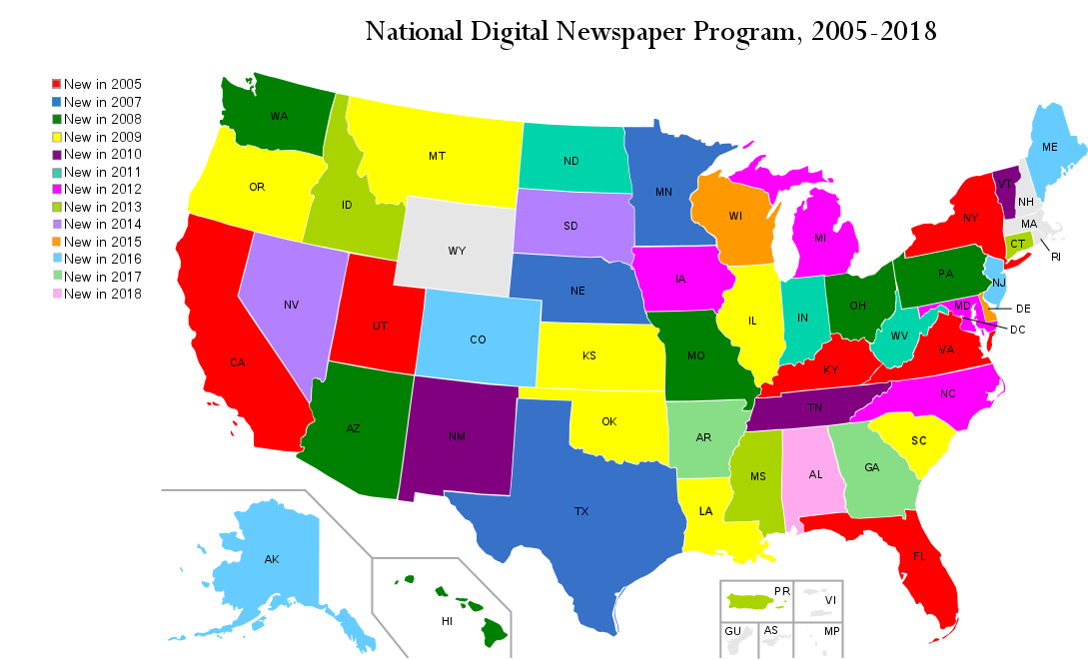
NDNP Partners
46 states, D.C., PR
Notes:
NDNP now contains content from 46 states, DC, and one territory--Puerto Rico.
As Dan mentioned earlier, the broad history of Maryland is represented in this large, nationwide repository, ensuring our State’s story is included in the larger narrative of our country. This allows researchers to browse, perform keyword searches, or do data mining through this large collection of OCR and newspaper pages.

Slide 7
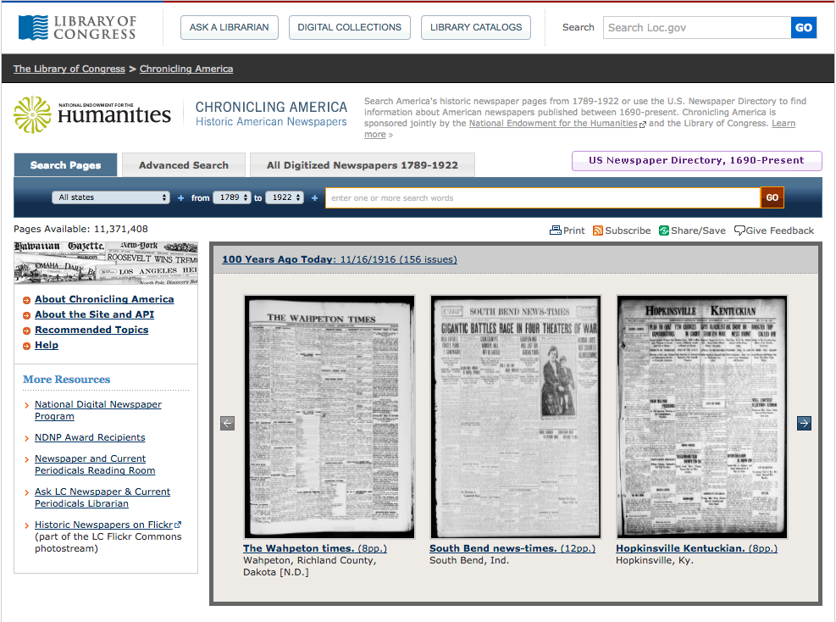
Chronicling America
http://chroniclingamerica.loc.gov/
Notes:
After we submit digitized batches of images and metadata to the Library of Congress, their staff review and ingest the digitized newspapers to Chronicling America, the newspaper repository.

Slide 8
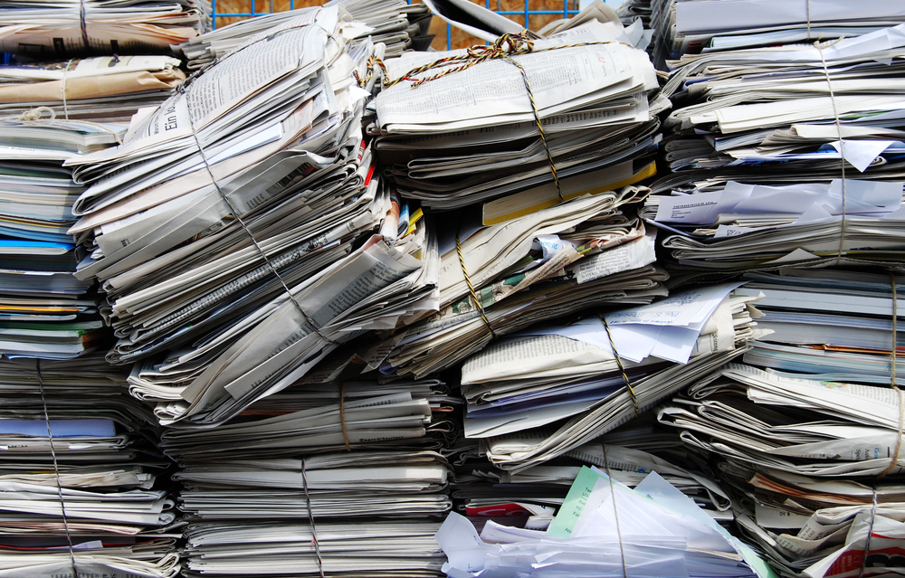
ChronAm Usability
Search for:
News articles
Life events
Obituaries
Marriage
Birth
Advertisements
Cartoons
Poetry
Literature
Sheet music
And much, much more!
Notes:
Robin:
These historic newspapers include news articles, announcement of life events, advertisements, Cartoons, poetry, literature, sheet music, and much more.

Slide 9
Chronicling America Features
Advanced search: https://chroniclingamerica.loc.gov/#tab=tab_advanced_search
Narrow search by state, title, date range, language, phrases, words within a number of words from each other
List of all titles: https://chroniclingamerica.loc.gov/newspapers/
List of MD titles: https://chroniclingamerica.loc.gov/newspapers/maryland/
US Newspaper Directory (non-digitized titles and digitized titles on ChronAm and elsewhere): https://chroniclingamerica.loc.gov/search/titles/
Notes:
Chronicling America currently features a simple and an advanced search, which is what I use more frequently to search Maryland newspapers. The advanced search allows for limiting a search by state, newspaper titles (and you can select more than one), a date range, language (or it will search OCR for all languages as default), phrases, or non-exact phrases where words should appear within a specified number of words from each other. This is particularly useful when you are searching for events or names in a family.

Slide 10
ChronAm Searching Options
Simple Search
Most inclusive search
Advanced Search
Narrow down many results
US Newspaper Directory 1690-present
Part of the original US Newspaper Project
Search all newspapers (digitized or not)
All Digitized Newspapers 1789-1924
Search within a specific newspaper title
Notes:
Robin:
The search interface offers multiple options for simple and advanced searches, and links to the directory of all cataloged newspaper titles. Within the simple search, you can limit by state, a handy feature if you want to search in Maryland only, and the date range.

Slide 11
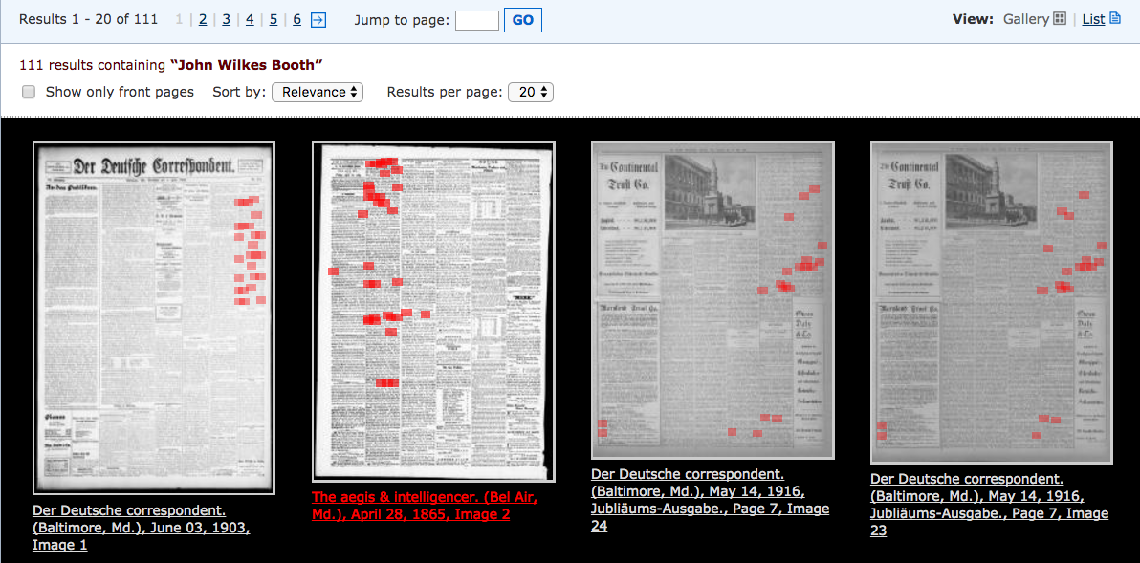
Simple Search in ChronAm
Search terms: “John Wilkes Booth”
Highlighted in search results
Notes:
Robin:
After you perform a search, the keywords will highlight, leading you to successful results. This simple search shows the results of a Maryland search for “John Wilkes Booth,” with no other limits. As you see, the these results contains many red highlights, showing that this article might be highly useful in your research, whereas if the page doesn’t show many red highlights, it might not provide as many details.

Slide 12
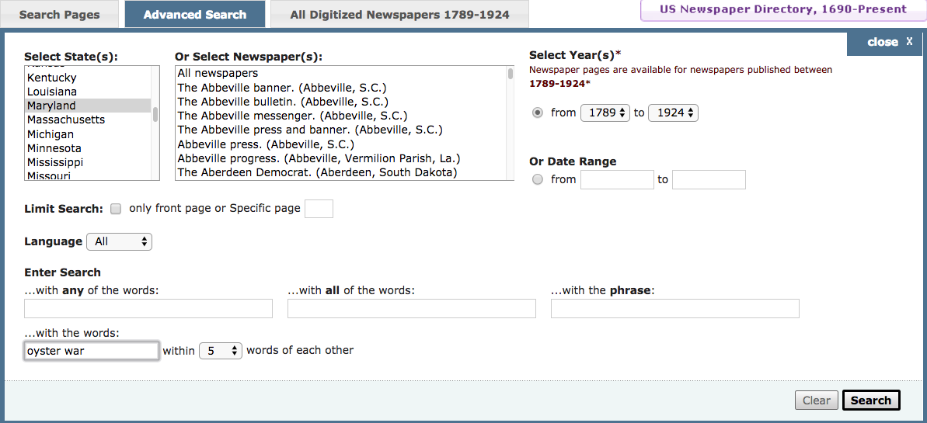
ChronAm Advanced Searching Options
Notes:
Robin:
The Advanced search offers many more limitations. In addition to limiting by state and date, you can limit by newspaper title, front page only, language, and have more options for searching words. You can narrow/expand using Chronicling America Advanced Search: “with any of the words,” “all of the words,” “with the phrase,” and “with the words within x number of spaces.” In this example, I chose to search through Maryland and Virginia papers for the words “oyster” and “war” within five words of each other.

Slide 13
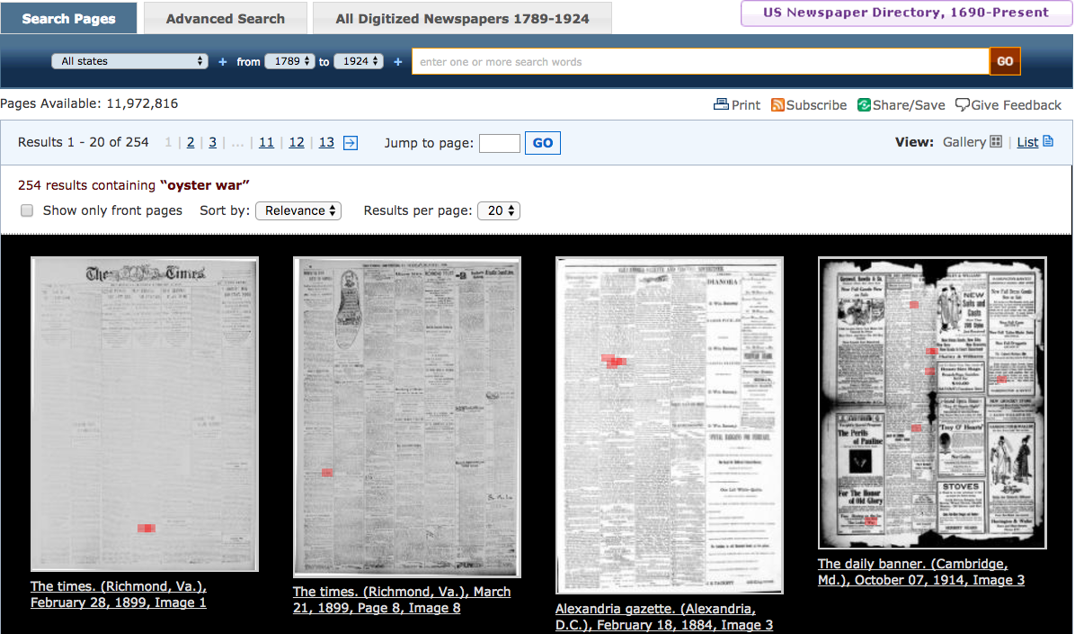
Advanced Search in ChronAm
Notes:
Robin:
The results provide over 5,000 pages of articles documenting oyster wars from Maryland and Virginia.

Slide 14
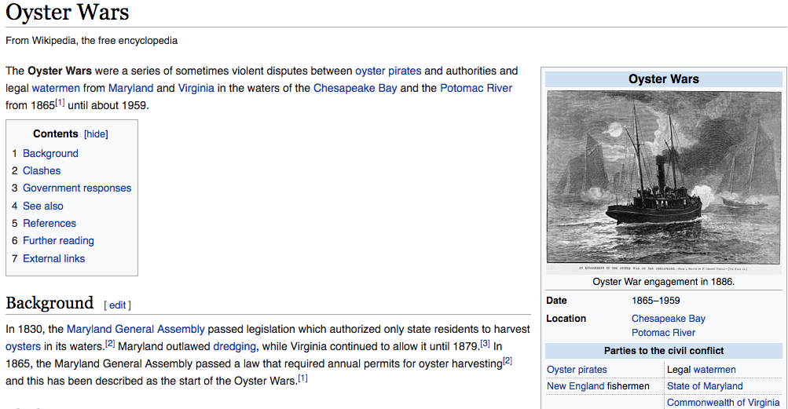
Using Primary Sources in Research
Notes:
Robin:
For those of you who don’t know, the oyster wars occurred between Maryland and Virginia in the Chesapeake Bay and Potomac River, from about 1865-1959, due to unequal harvesting laws between the two states, resulting in illegal activities and clashes on the water. This Wikipedia page relies on secondary sources and modern sources for citations, and is an example of resources that could be elaborated on by using historical newspapers as primary source material. Because this search would require looking at two states’ newspapers from a discrete era, it is an ideal example of when to use Advanced Search.

Slide 15
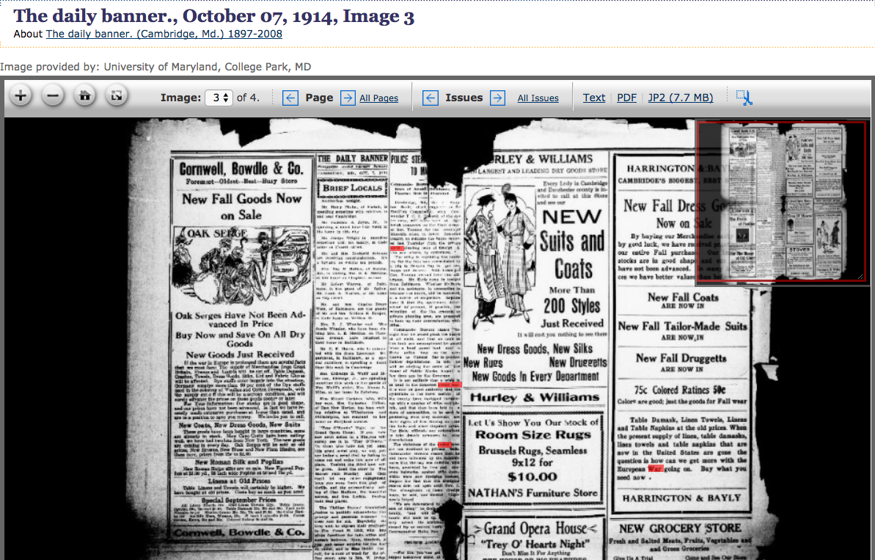
Using the ChronAm Interface
Download individual pages
Text (OCR)
PDF
JP2 image
Notes:
Robin:
After you click on a results page, you can zoom in closer to read the text. The top inset shows what area of the page you are viewing. If you are interested in downloading your results, you have multiple file options, as OCR text, PDF, and JPEG 2000.

Slide 16
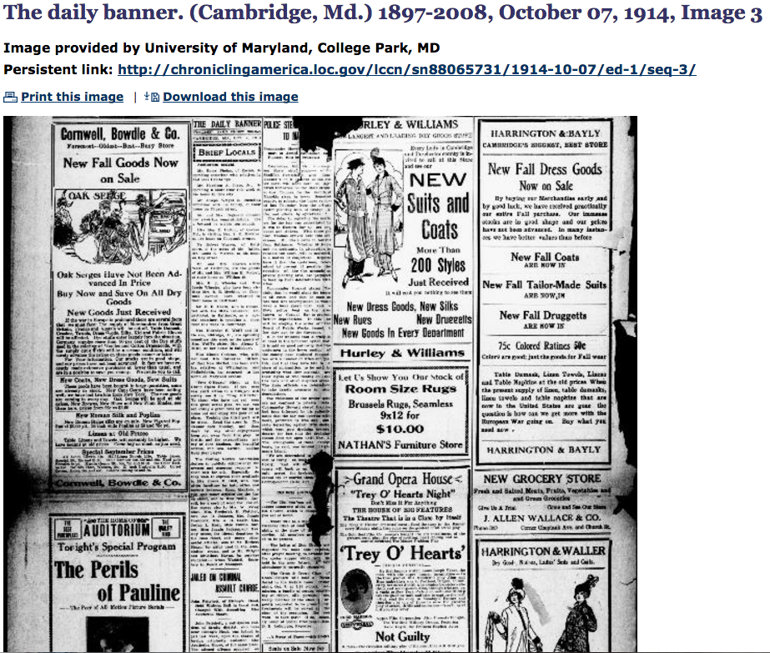
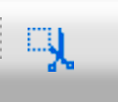
Downloading Options
Use clipping tool to grab a single article or image from a full page:
Notes:
Robin:
The viewing box can be used in conjunction with the clipping tool, the tool on the far right of the toolbar. Creating a clipping creates an image file with metadata so you know where the clipping came from, which is helpful to continue your research.

Slide 17
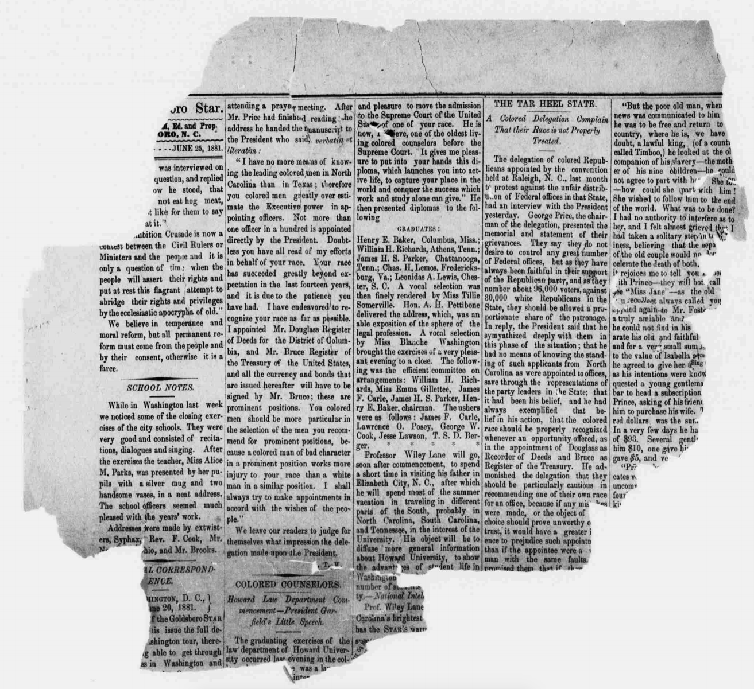
ChronAm Database/OCR Limitations
Poor-quality originals
Inconsistent/mixed fonts
Faded text
Missing characters
Page bleed-through
Tight gutters/missing text
Column confusion
The Goldsboro star. volume (Goldsboro, N.C.), 25 June 1881. Chronicling America: Historic American Newspapers. Lib. of Congress. <http://chroniclingamerica.loc.gov/lccn/sn91068338/1881-06-25/ed-1/seq-2/>
Notes:
Robin:
Chron Am has some limitations, caused by newspaper incompleteness or less than ideal quality issues, such as inconsistent or mixed fonts, faded text, missing characters, bleed through from the reverse side of the page, or tight gutters if the newspaper is bound, or column confusion caused by an error in the OCR script reading the newspaper.

Slide 18
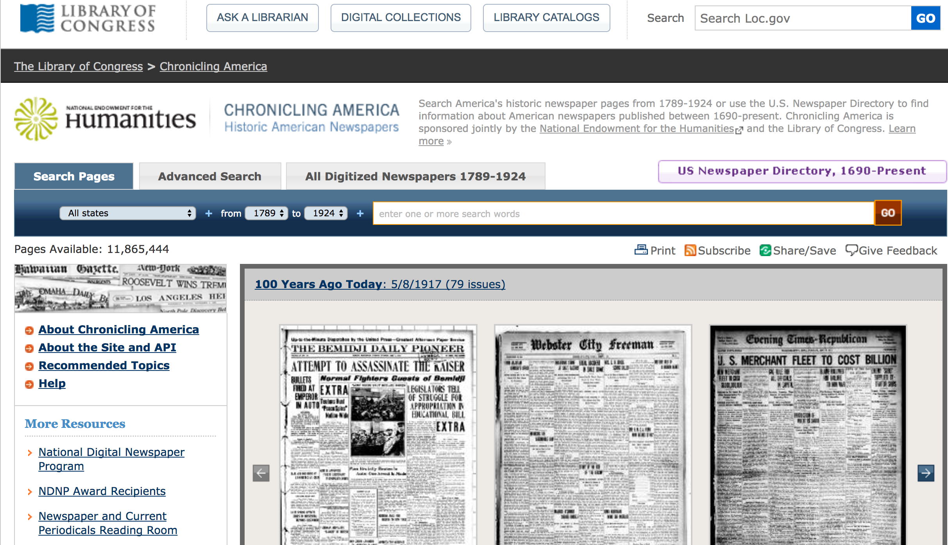
ChronAm v. Other Newspaper Databases
Only undigitized titles
Public domain restriction
More data capabilities
Notes:
Robin:
Though Chronicling America has nearly 12 million pages of newsprint from across the country and a substantial subset from Maryland, the collection is not exhaustive. It excludes specific papers because the NDNP will not digitize newspapers available elsewhere, including commercial database products like Proquest, Readex, or Newspapers.com. For example, the archives of the Afro-American, the premiere African American title in Maryland, and is available via Proquest. Readex holds limited runs of four additional African American newspaper titles. These titles form the known, extant copies of African American newspapers in Maryland, and are not included in the Maryland corpus on Chronicling America, creating a knowledge gap for those who lack access to these databases.
ChronAm does provide much greater capabilities for repurposing the newspapers and OCR, expanding the usage of the data beyond that of straight research.

Slide 19
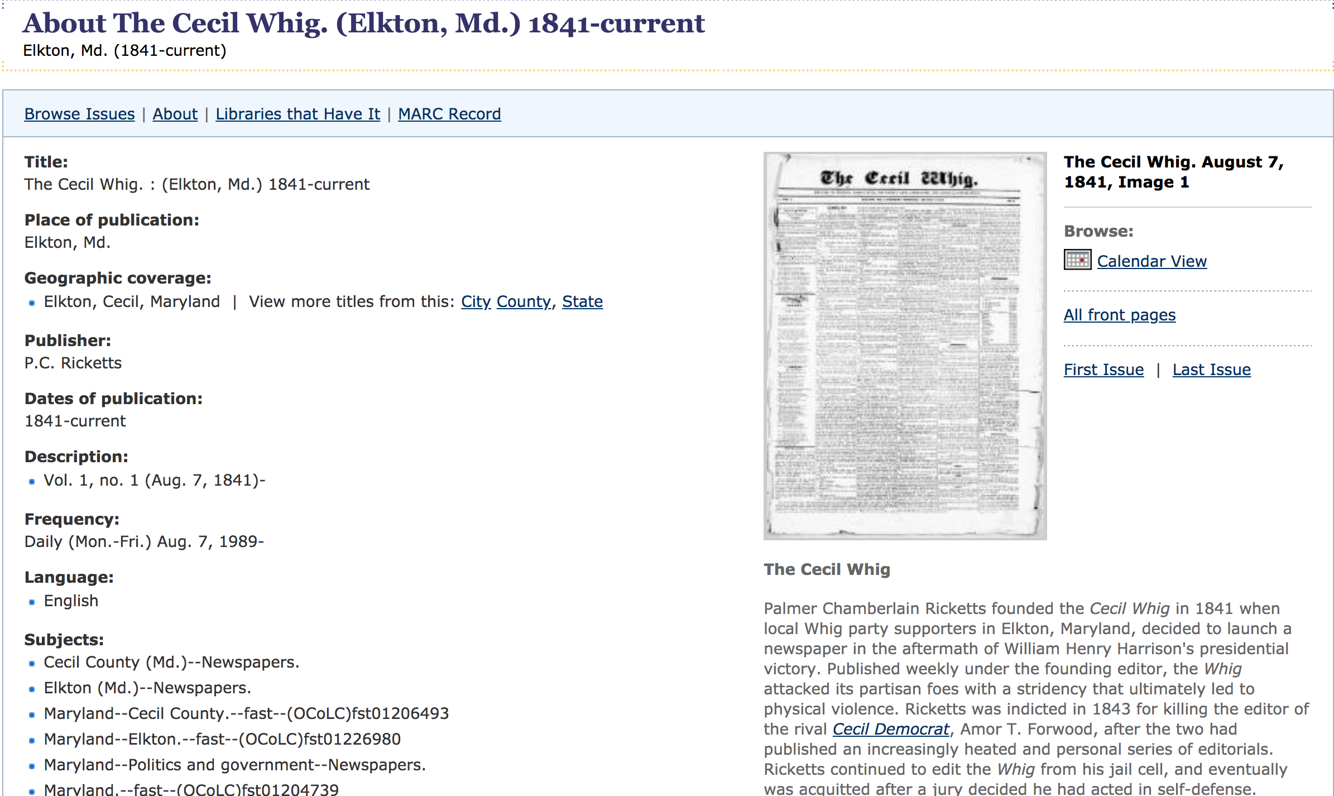
Title Views
Sample: Cecil Whig
https://chroniclingamerica.loc.gov/lccn/sn83016348/issues/
Notes:
Title views offer metadata from the catalog record, the essay, and different ways to quickly access or browse issues in the title.

Slide 20
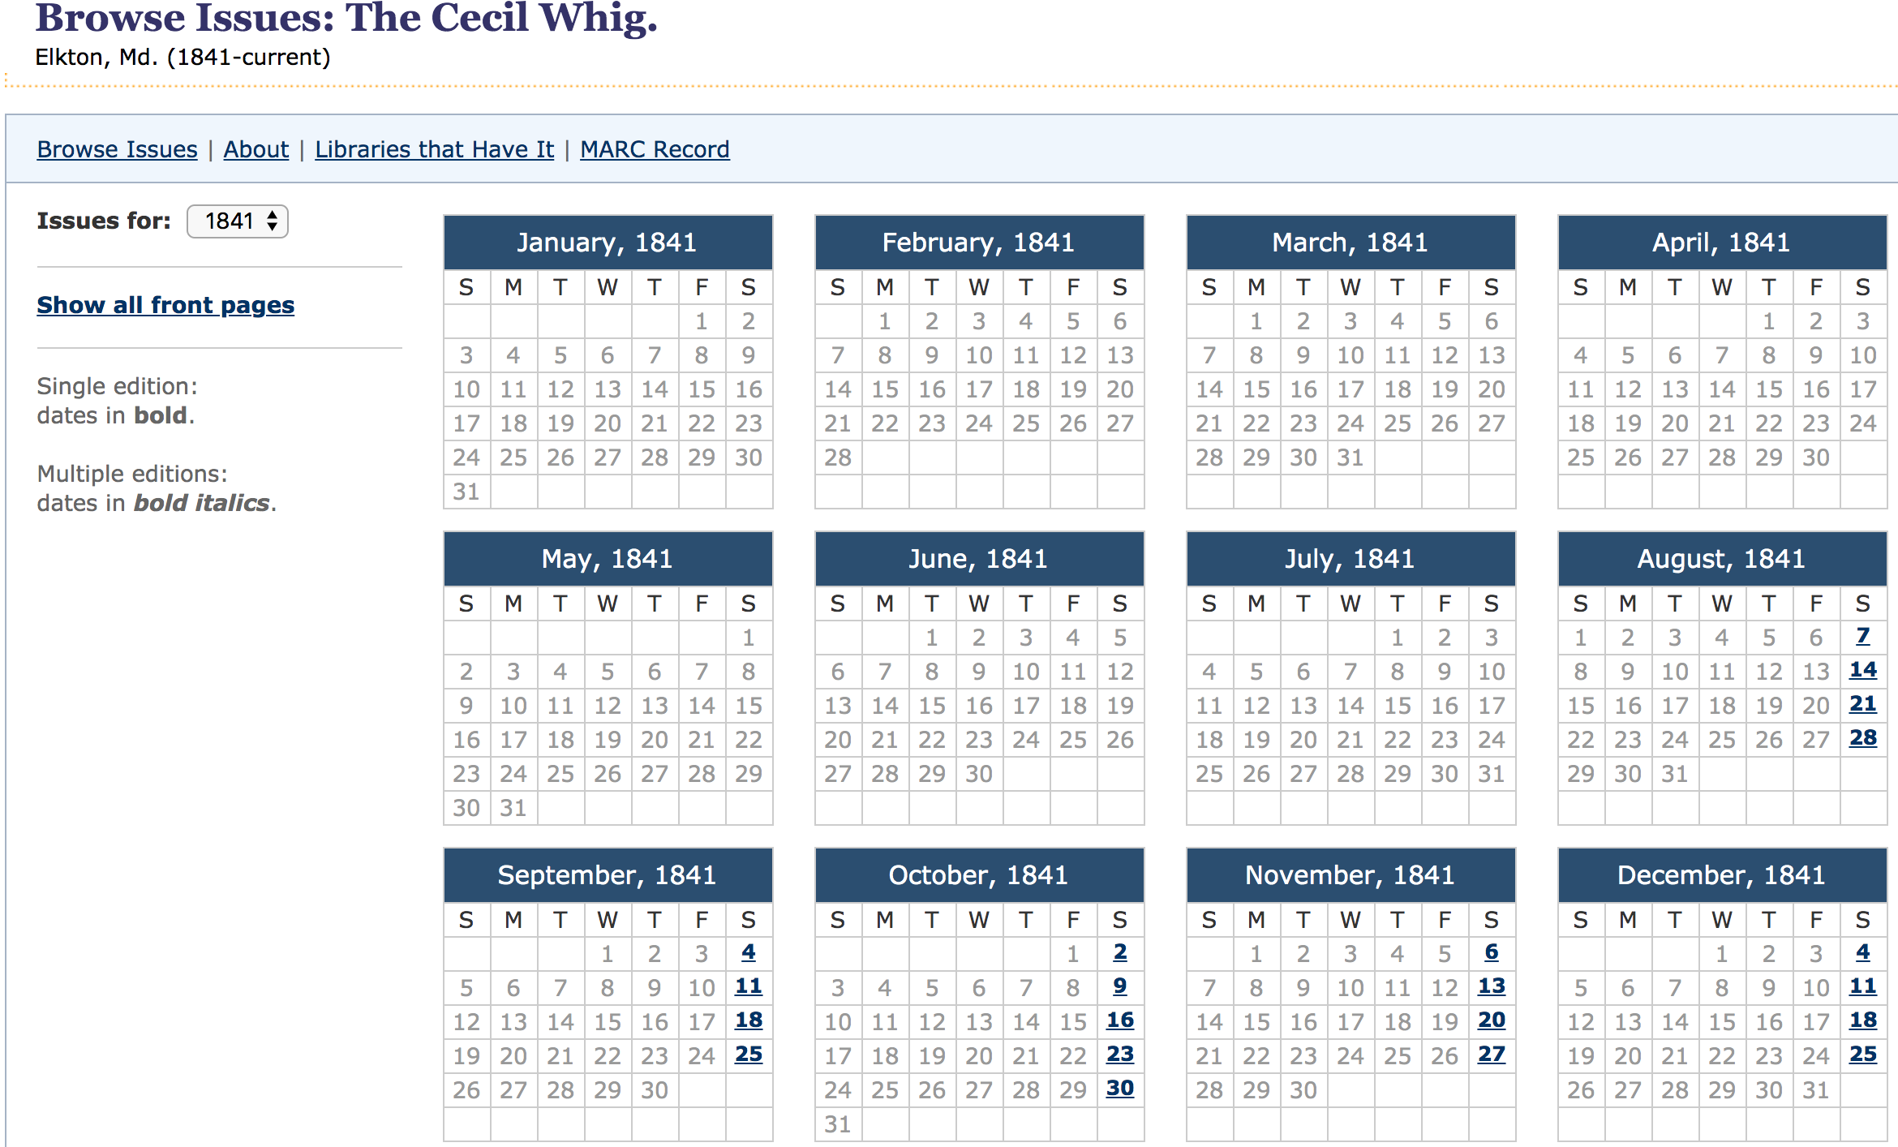
Calendar Browse View
Sample: Cecil Whig
https://chroniclingamerica.loc.gov/lccn/sn83016348/issues/
Notes:
We suggest the Calendar Browse view when patrons would like to quickly browse all issues of a title, see the publication schedule, or see what issues are available when only sporadic issues are available. In this example, you can see the first available issues of the Cecil Whig start midway through the year but all issues are on ChronAm.

Slide 21
ChronAm Search Tips
Family Names:
Search full name, first and middle initial and last name (e.g., W.D. Barrows), maiden name, or last name
Spelling variants
Quotation marks around exact names
First name abbreviations (e.g., Chas. for Charles, Wm. for William)
Women may be identified by husband’s name (e.g., Mrs. John Smith)
Vocabulary and Spelling:
Vocabulary and spellings have changed. Browse newspapers for potential search terms contemporary to the period.
Synonyms: “wedding,” “marriage,” “nuptial,” etc.
Typos occur often in historic newspapers and text recognition is imperfect (e.g., “e” for “o”)
Notes:
Robin:
Beyond searching for famous people and popular topics, for genealogical research or other name-based research, it’s important to consider that names may be worded in several ways, such as first and last, or just initials and a last name. Spelling variants are also common with many names, including people, but also the names of places as towns and cities went through incorporation process. Using quotation marks around names can be helpful, particularly if the last name is common or the name for something else (such as “Pike”), but it can also rule out too many results. Finally, married women were often referred to by their husband’s name, so family history may require more research.
The vocabulary or spellings for words have changed through time, so if search results are not yielding results, browse the newspapers around the period in which you want to find information, and then use synonyms for words.
Finally, typos in the newspaper or unclear text can result in imperfect OCR. If your search results are still not yielding results, try substituting letters--to OCR, ”e” and “o” are often interchangeable.

Slide 22
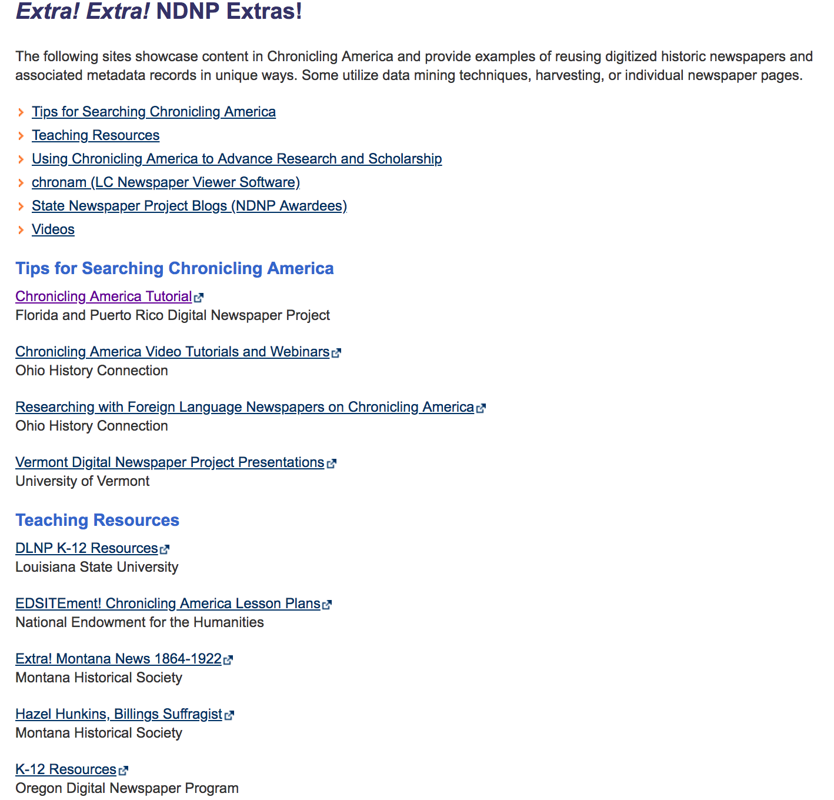
NDNP Extras
https://www.loc.gov/ndnp/extras/
Searching tutorials
Teaching resources
Data projects
http://americaspublicbible.org/
http://www.americanlynchingdata.com/index.html
Notes:
LC has posted NDNP Extras on their website, linked from ChronAm, to provide search tutorials and teaching resources. Also on this site are links to data mining projects. Some projects are examples of humanities research, such as the America’s Public Bible, that traces specific quotes and frequency of quotes through the entire ChronAm. Other projects are more serious, such as the American Lynching project, that traces the rise and decline of lynching documented in newspapers across the US through time, and by state, documenting the history and cultural implications of this crime.

Slide 23
Phase 1-3 Updates
2012-2018

Slide 24
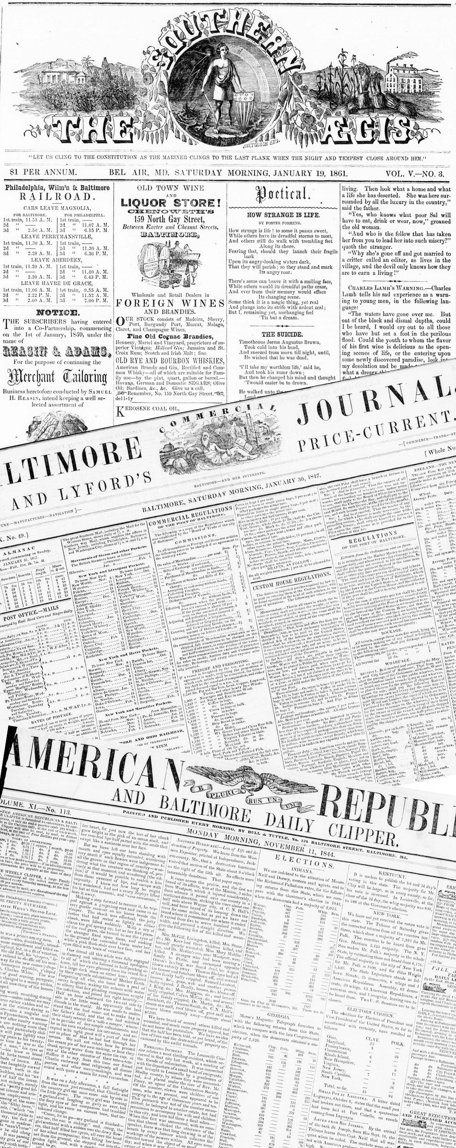
Selection
Quality, completeness, long run
Families of titles
Geographic representation
Community representation
Focus: 20th century
Notes:
The Historic Maryland Newspapers Project (HMNP) began in 2012 as the Maryland State newspaper digitization project. The first three phases focused on selecting titles that were not digitized elsewhere; that were of good print quality and good microfilm quality, and had long runs or were important enough papers to group in an area for shorter runs. The Advisory Board has made sure that Maryland has wide geographic representation and wide community representation--for example, in the labor papers from western Maryland digitized in the third phase, and in the immigrant community papers digitized so far. A new focus of the third phase was digitizing more papers into the 20th-century, to take advantage of the Library of Congress expanding the date range. As an aside, in January of 2019, 1923 is now out of copyright and in the public domain! We now gain one year each year!

Slide 25
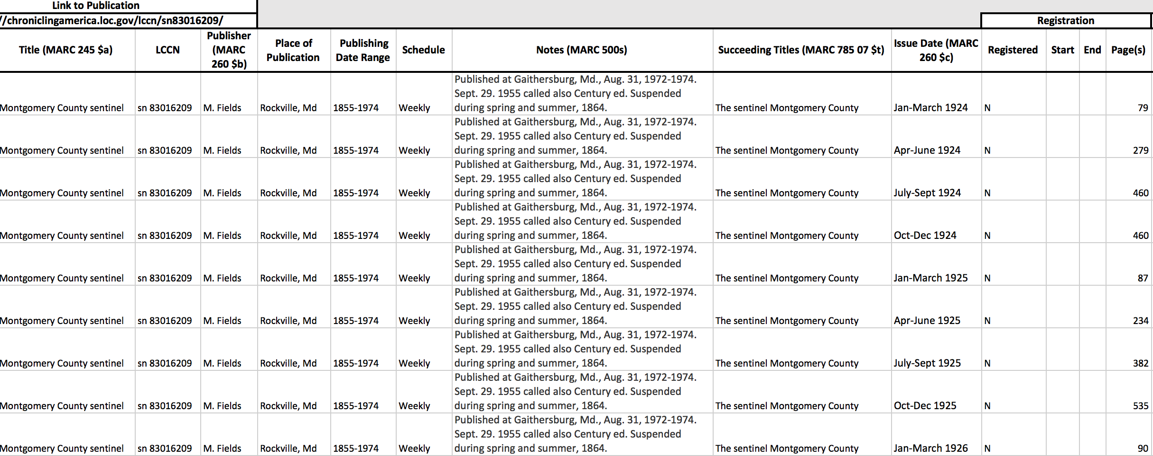
Copyright Research
Notes:
Since 2016, when the Library of Congress expanded the criteria for digitization into post-1922 content, we have digitized additional 20th century content because we’re finding that many modern genealogists and other researchers, such as those researching WWI and WWII and the origin of civil rights, are most interested in this content. Based on the topics judged at many History Day competitions, school-age students are also most interested in topics presented in the latter part. We’ve developed a quick and effective method for researching the copyright registration and renewal status of newspaper titles from 1924-1963 allowing us to expand into these decades. The procedures Doug and I wrote for the third phase are easy enough for both graduate and undergraduate students to follow, and they are the ones who do the legwork for this part of the project. Also statuses are documented in spreadsheets, as pictured here, and this documentation is used as proof to the Library of Congress that the titles are in the public domain. So far, all the titles we have researched have not been registered. And while some titles have syndicated or minimal copyrighted content within the papers, it is not a large enough percentage that we feel is a risk to prevent us from digitizing the papers. We also can’t find record that some of the syndicated content copyright was renewed, again, suggesting the content is in the public domain.

Slide 26
Progress
316,168 pages (3 phases)
32 families of titles
1840-1946
8 Titles 1923-1963
Notes:
From 2012-2018 during the first three two-year phases, the project digitized 316,168 pages across 32 families of newspaper titles from 18 cities dating between 1840-1946. Pam has prepared a handout of information about the titles we have digitized and plan to digitize. There are extra copies in the back of the room if you want to take some to your institutions or stakeholders to assist with research.

Slide 27
Partnerships
State Partners
Library of Congress, Maryland State Archives, Maryland State Historical Society, Frostburg State University Library
Advisory Board
Notes:
For the first three phases, we had four content partners, which is in sharp contrast to the number of partners Pam will mention for phase 4. Without these partners, we could not have achieved our goals for wide geographic, community, or temporal representation.
I also want to acknowledge the expertise of the Advisory Board in proposing and tracking down titles, based on patron interest, ability to meet the goals of the grant theme, and knowledge of the importance of the title. Through this, we have collectively built a body of newspapers representing the people, businesses, and culture of Maryland.

Slide 28
Beyond NDNP Deliverables
Website: https://www.lib.umd.edu/digital/newspapers/home
Newspaper Gateway
https://www.lib.umd.edu/newspapergateway
Social Media
Pinterest: https://www.pinterest.com/MDnewspapers
Twitter: @historicmdnews
Facebook: https://www.facebook.com/HistoricMDNews/
Instagram: https://www.instagram.com/historicmdnews/
Wikipedia
Title essays
Notes:
In addition to meeting the deliverables of the grant, over the past three phases, we’ve experimented with different elements of web-based projects and outreach. The project website links to resources and project staff and advisory board members, as well as giving background for the project. In addition to capturing the newspapers digitized and available at freely accessible sites, as we do for the LC survey, we also document what newspapers are available via paid sources. There is a little bit of problematic linking for these, as we’re trying to link to persistent URLs for repositories that may not have them, and updating them as they’re available, we’re making available as much as possible.
While Liz Caringola, first Project Manager, began our social media project with a Pinterest account, Rebecca Wack, second project manager, started Twitter, Facebook, and Instagram accounts to maintain virtual outreach. She also initiated a thematic monthly ChronAm Party with monthly and party hashtags that now other state partners and the Library of Congress participate on Twitter. This was the first national outreach initiative undertaken by the partners. LC provided Rebecca statistics on these parties and she tracked engagement with the accounts for MD’s individual efforts. Twitter and Facebook proved the majority of engagement, though with different audiences, and Pam plans to maintain these accounts.
After Doug writes the essays for each title or title family, our student assistants edit the essays for Wikipedia and post them online, linking to resources Doug provides, as well as other Wikipedia pages, and external resources.

Slide 29
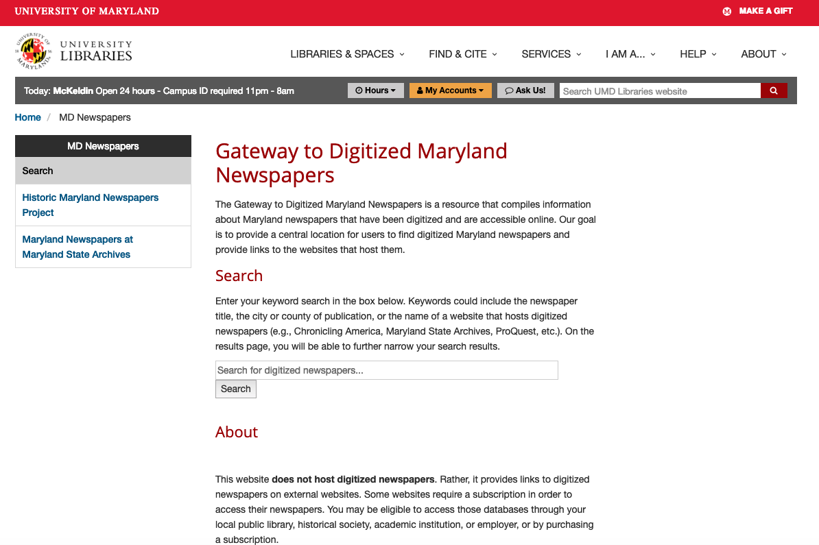
Notes:
Talk about gateway, and search

Slide 30
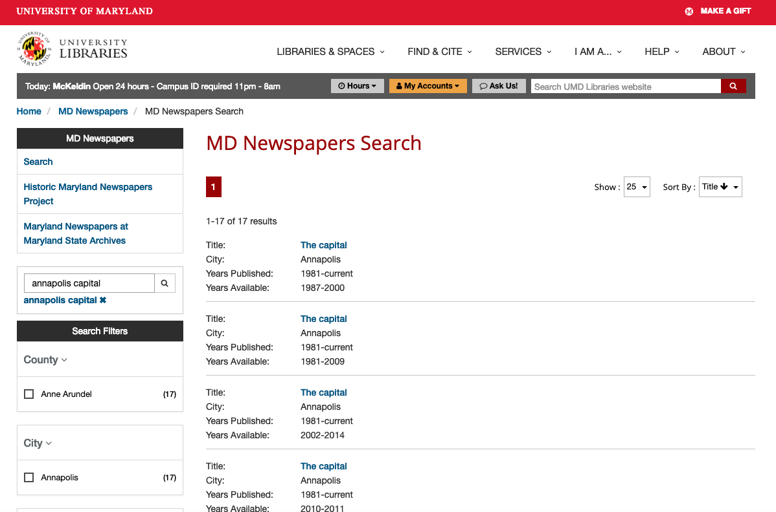
Notes:
Talk about results page

Slide 31
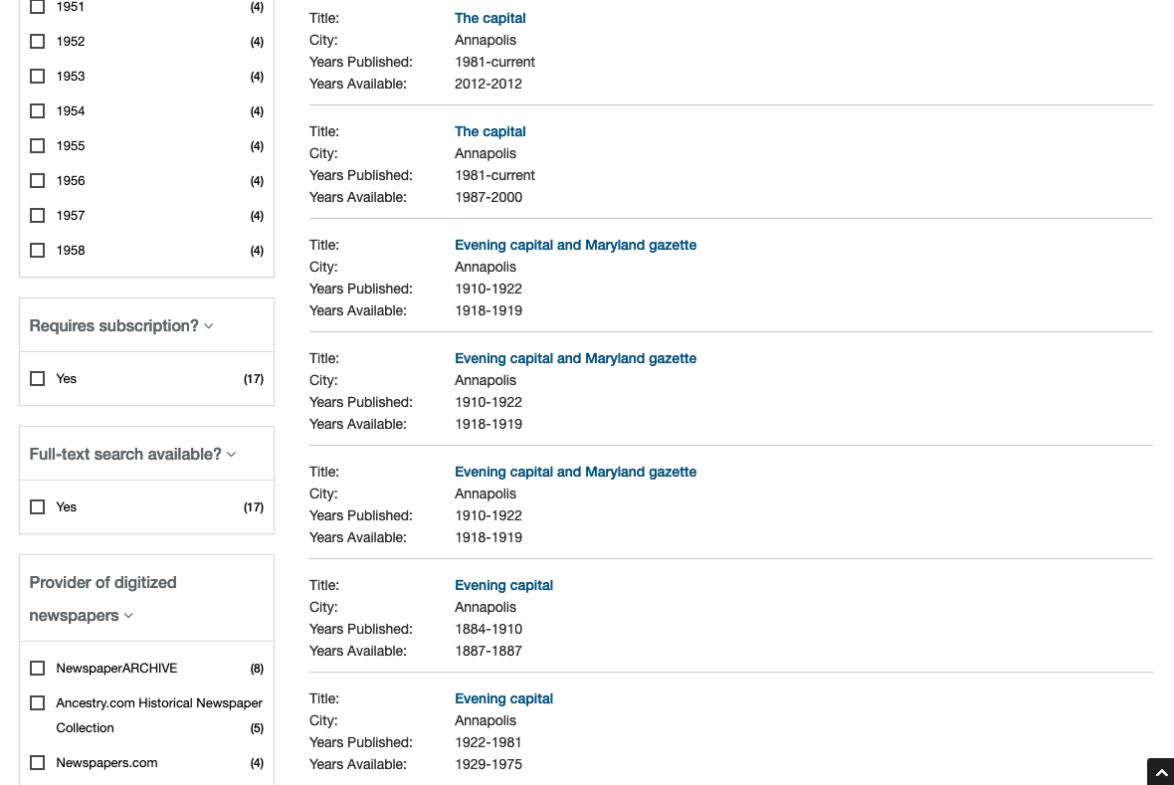
Notes:
Talk about filters continuing on the results page

Slide 32
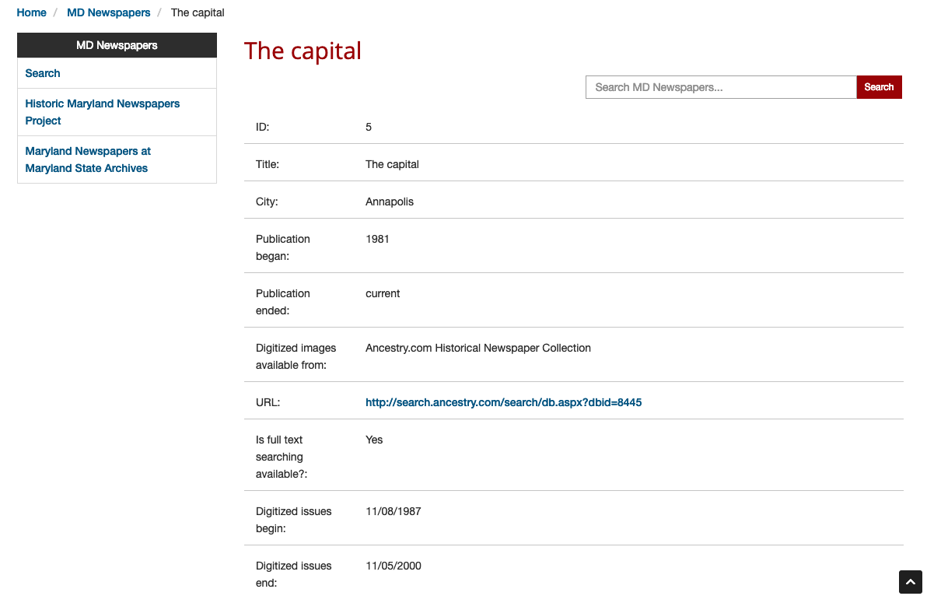
Notes:
Talk about record view

Slide 33



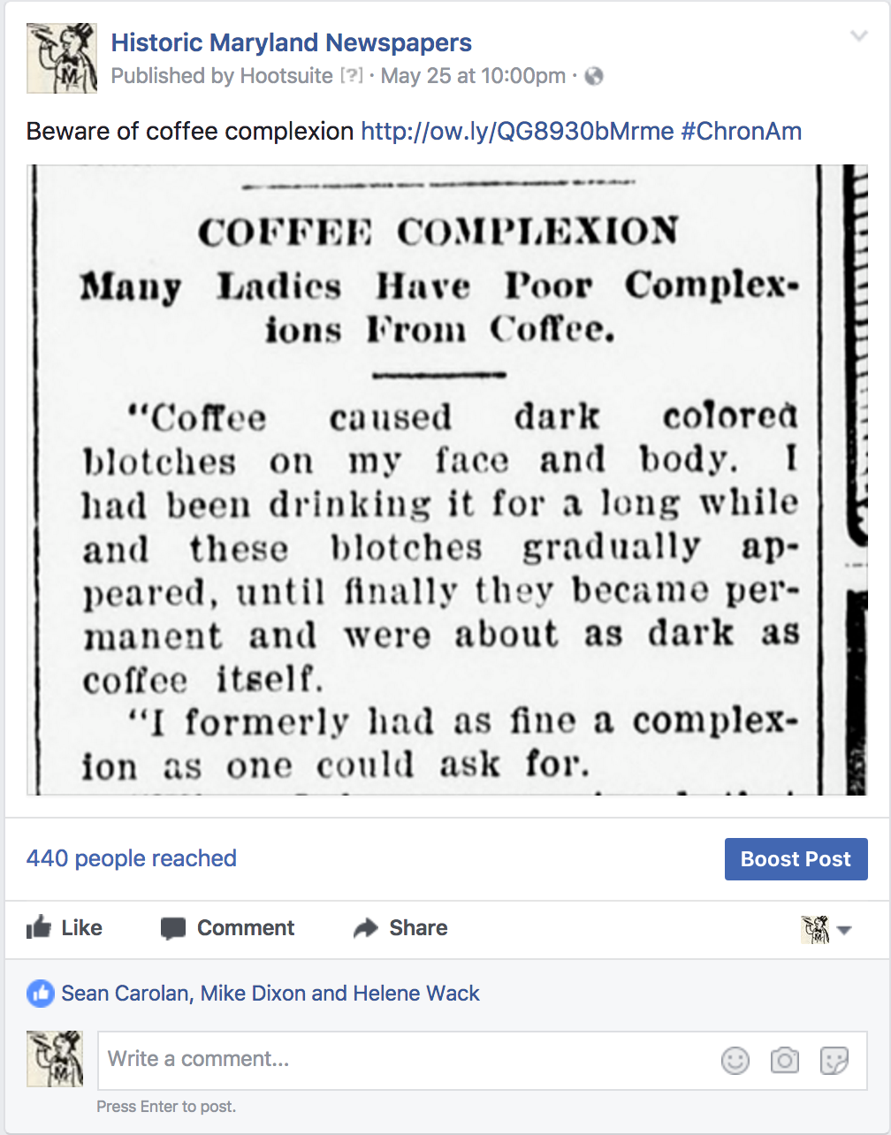
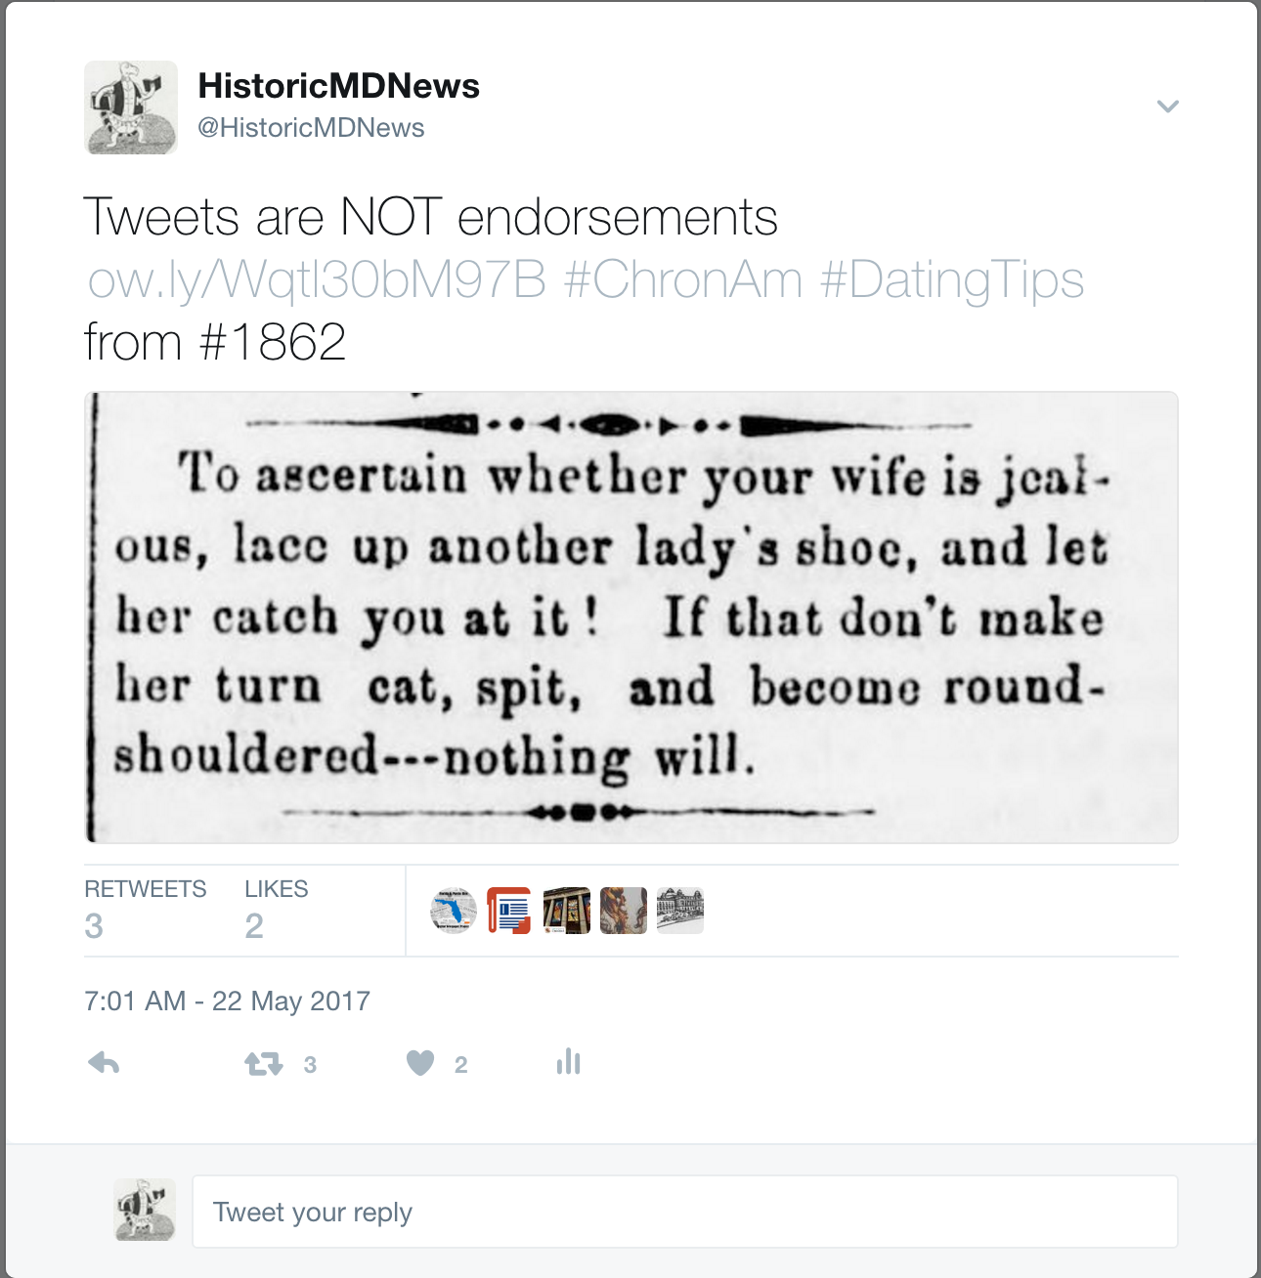
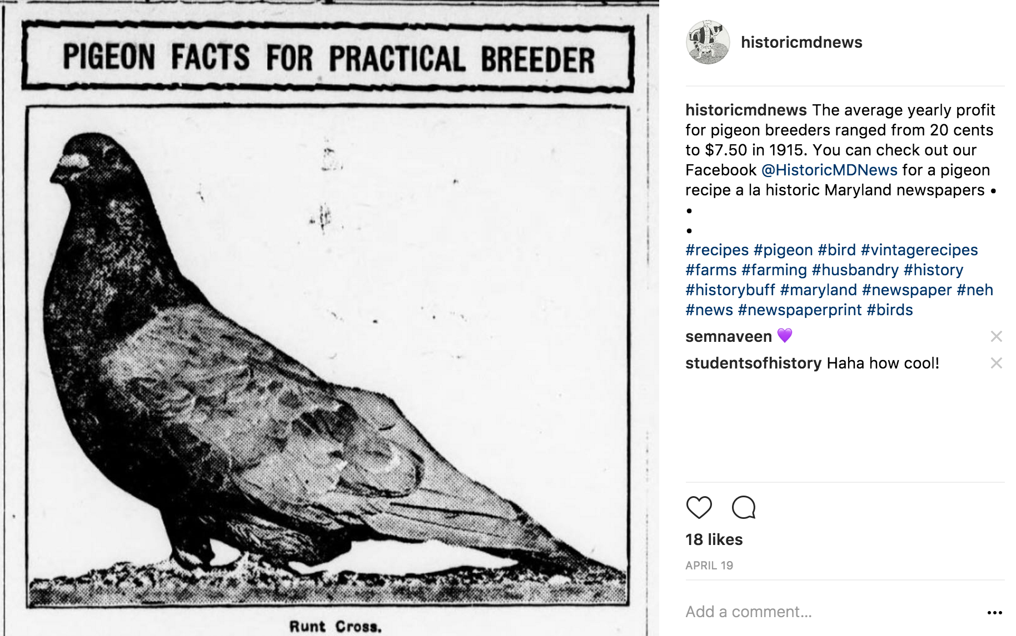
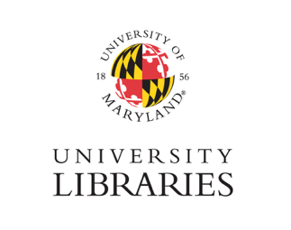
HMNP Outreach - Social Media
Notes:
Facebook allows us to go more in-depth on particular subjects and generally yields more click-throughs to Chronicling America.
Twitter allows us to stay topical and reach younger users with greater volume. We tend to interact with other state newspaper projects on Twitter as well.
Instagram allows us to have fun. We post absurd ads and articles and have seen respectable engagement as far as “likes” and “comments” are concerned.

Slide 34
Outreach
Phase 2:
Digital Maryland presentations at public libraries
Phase 3
Genealogical research brochure
Maryland Newspaper Conference, partnering with Digital Maryland
UMD Social Justice Day poster
Public library presentation
Notes:
After we completed more English content in phase 2 and 3, we began traveling for outreach programs. In phase 2 we partnered with Linda Tompkins-Baldwin to present at 5 public library programs across central Maryland. At the beginning of phase 3, Doug and I developed a genealogical research brochure, which now needs some updates, and again partnered with Digital Maryland and Linda to create a Maryland Newspaper Conference. Rebecca gave one additional presentation at Harford County Public Library regarding how to use Chronicling America for their community audience, which happened to be primarily genealogists.

Slide 35
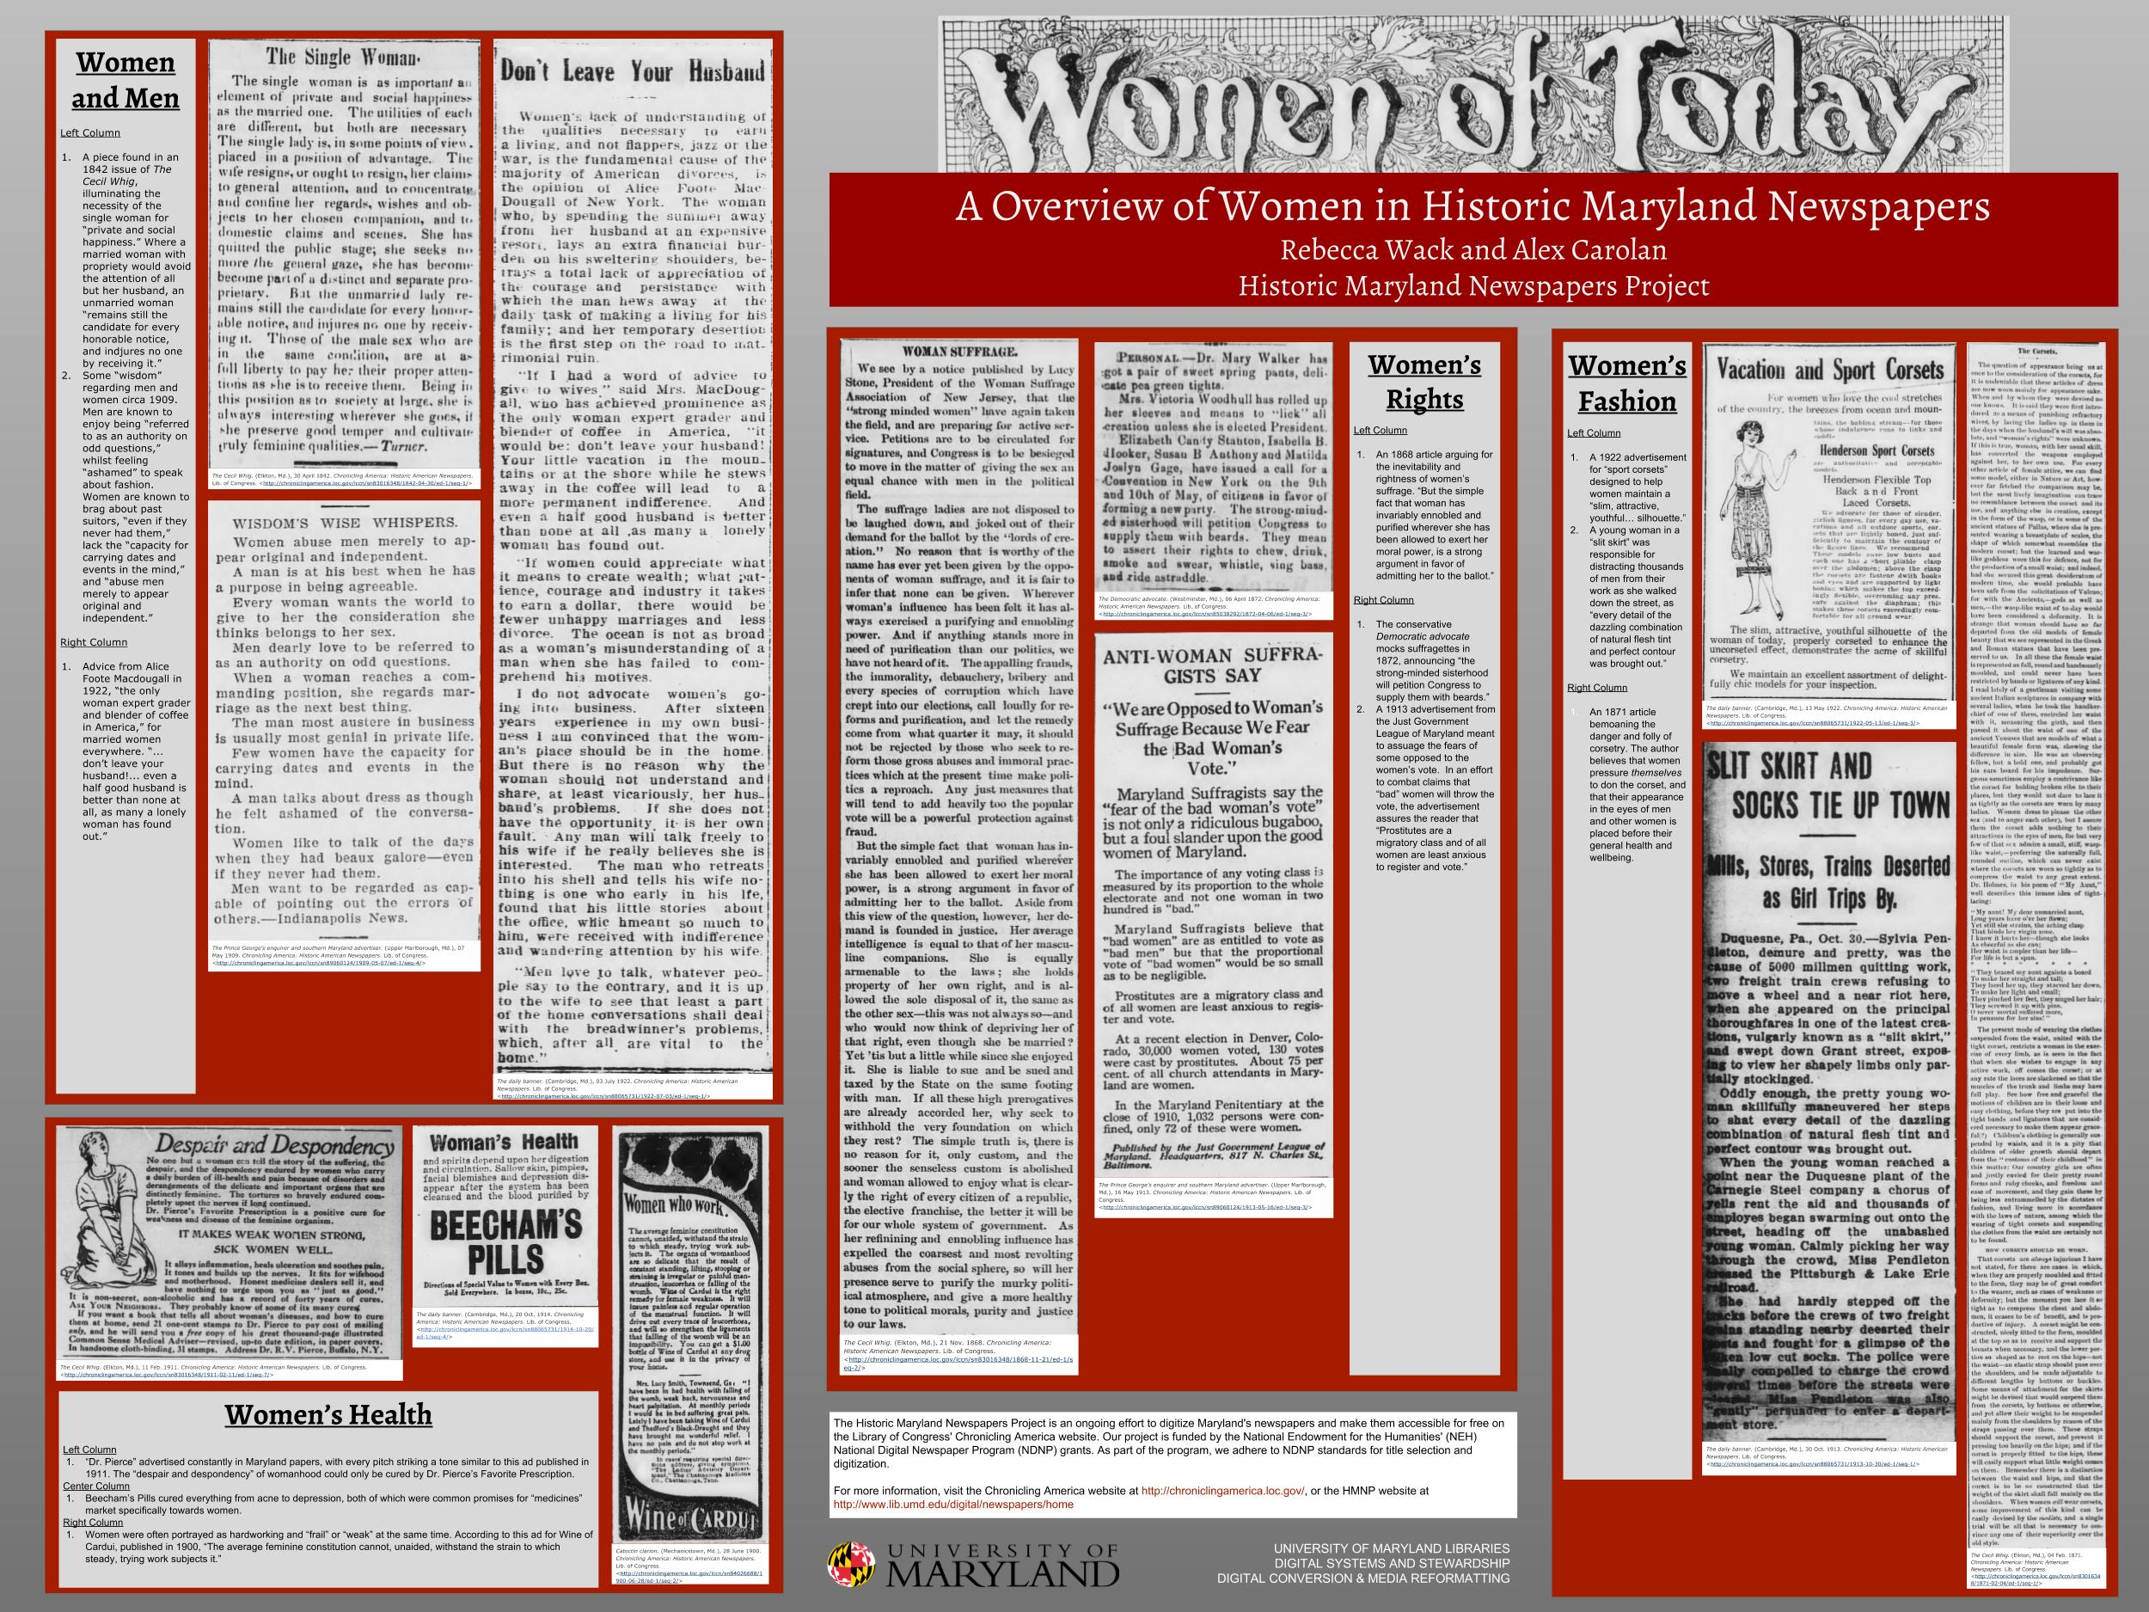
HMNP Outreach - UMD Social Justice Day
Notes:
In April 2017, Rebecca and a student presented at UMD’s Social Justice Day, a poster entitled “Women of Today - An Overview of Women in Historic Maryland Newspapers”. It covered issues of women and men, women’s health, women’s rights, and women’s fashion. They selected a variety of articles from Maryland papers on ChronAm and discussed them with students and conference attendees. The female students in particular seemed rather shocked that marriage and health issues do not seem to have changed much, at least as far as media handling is concerned.

Slide 36
NDNP Awardees Conference Updates
Notes:
While the big topic in 2017 remained whether and how to include post-1922 content, the 2018 NDNP Awardees Conference brought big changes.

Slide 37
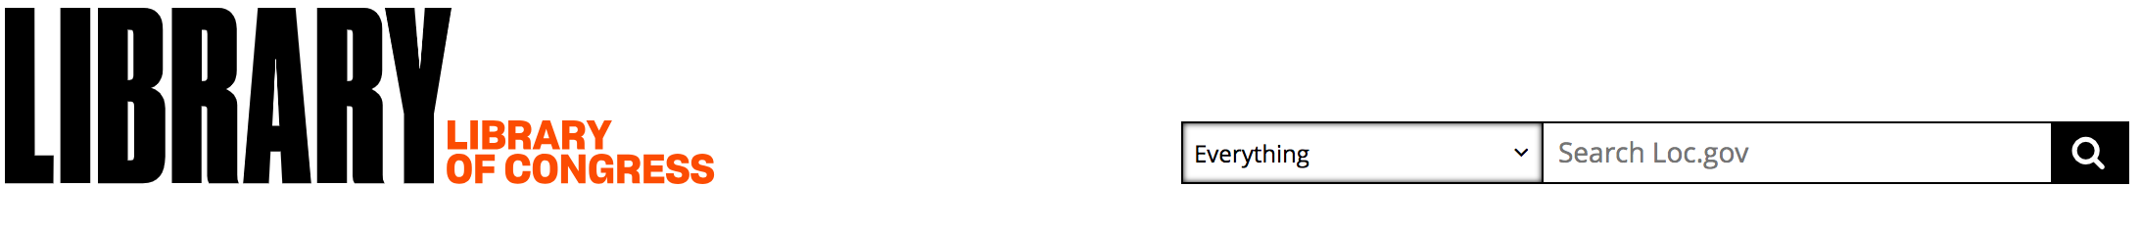
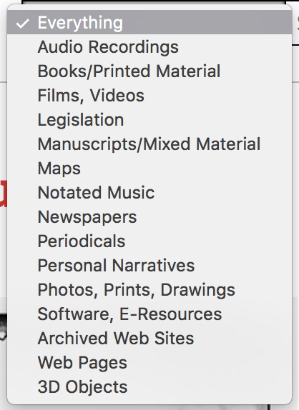
New LC Digital Collections Interface
https://www.loc.gov
Notes:
The biggest change for 2018 was the introduction of the LC logo and LC digital collections interface. Using the drop-down menu, you can now search all collections and formats for keywords, or you can filter by newspapers. With the newspaper filter, the results provide hits on ChronAm newspapers as well as other Library of Congress collections outside of the project, including collections of Japanese Internment Camp papers, clippings collections, and related collections. You can further filter by state and project, leading you to the same results as on Chronicling America. LC will eventually be sunsetting Chronicling America as an interface as they will incorporate the searchability and display capabilities into their main digital collections interface. The date for this has not yet been announced. We will provide plenty of notification and new search tutorials in the coming months to prepare stakeholders and patrons to use the new interface.
(demo?)

Slide 38
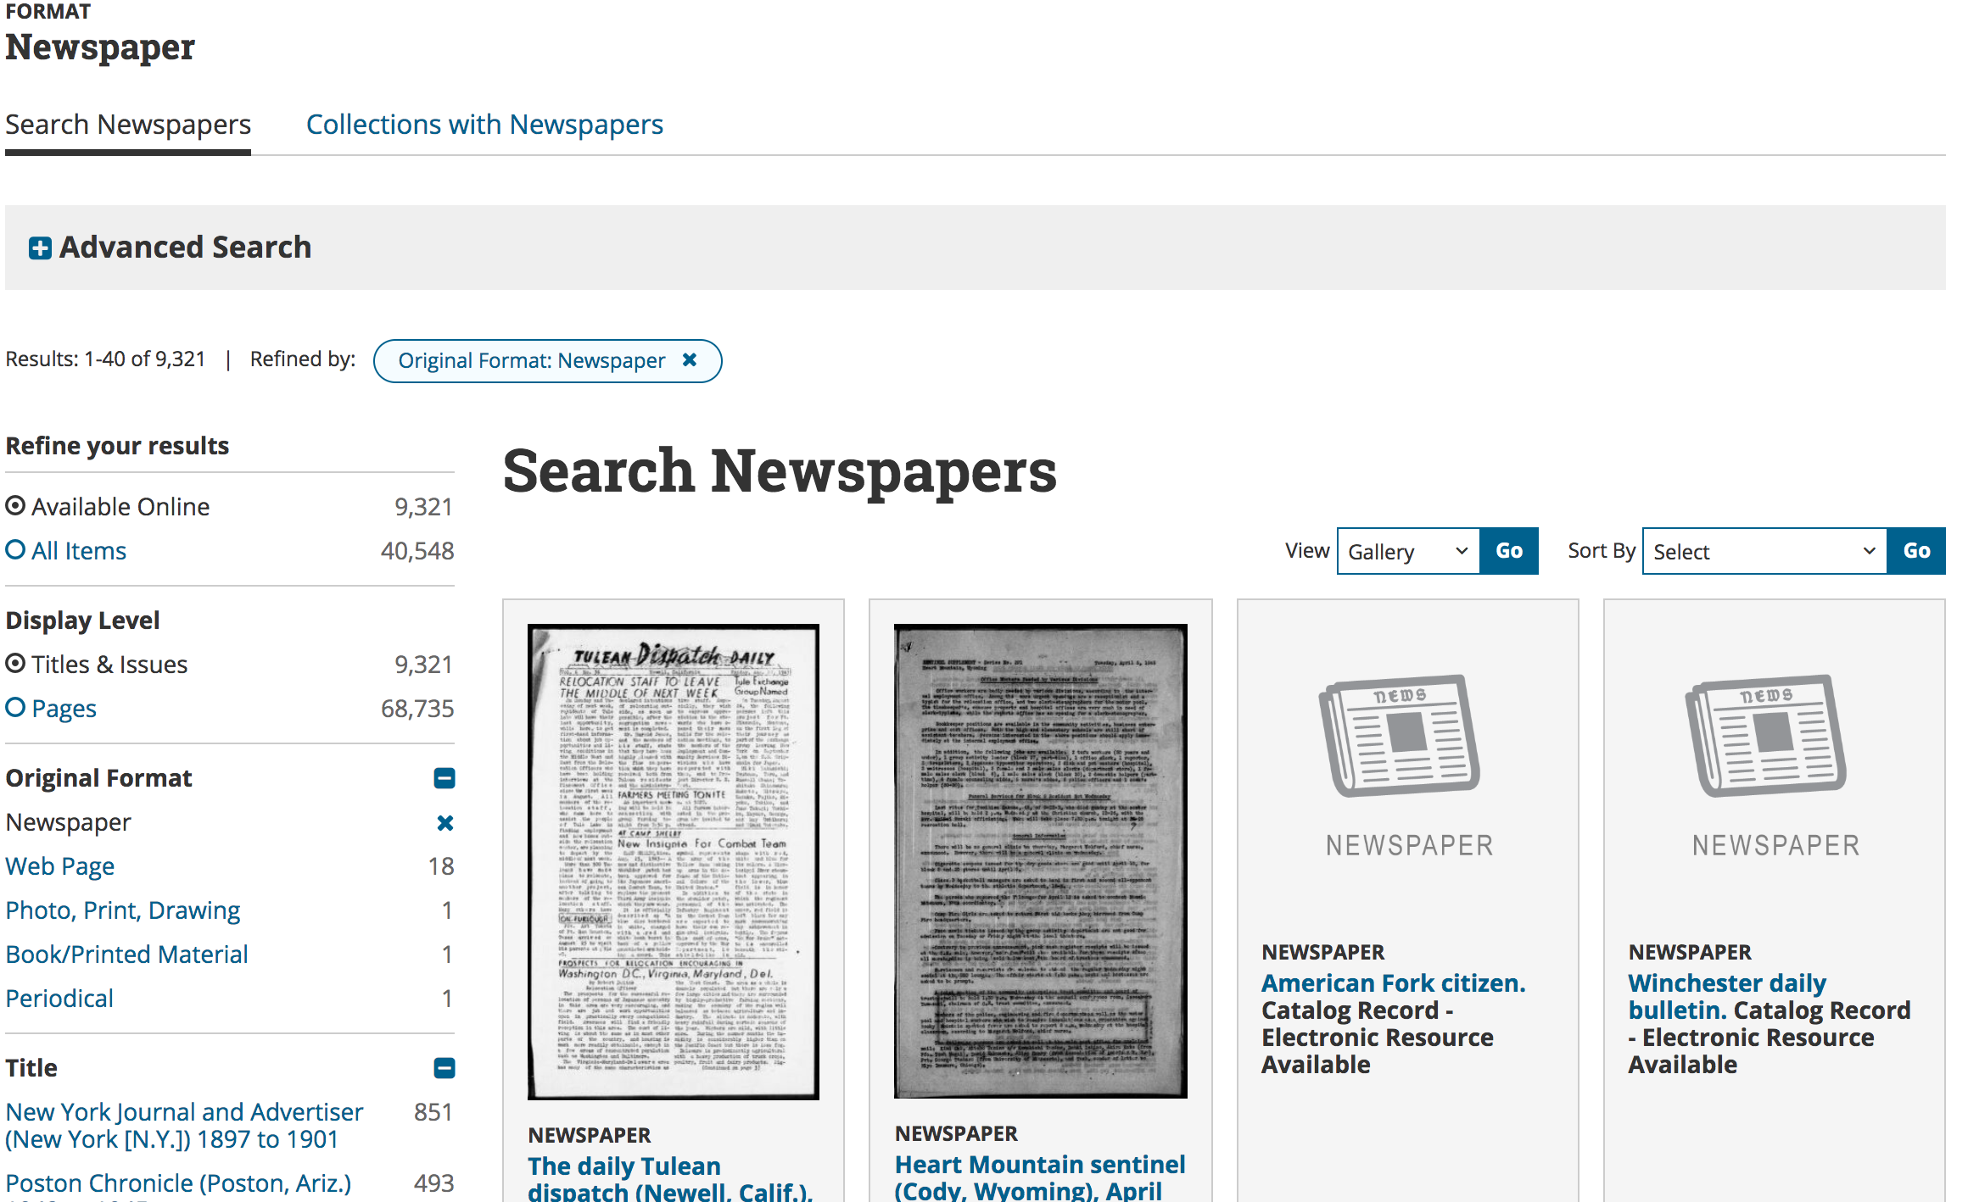

Slide 39
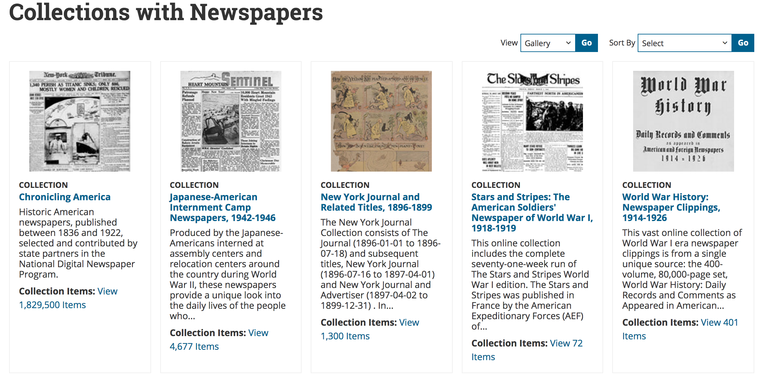

Slide 40
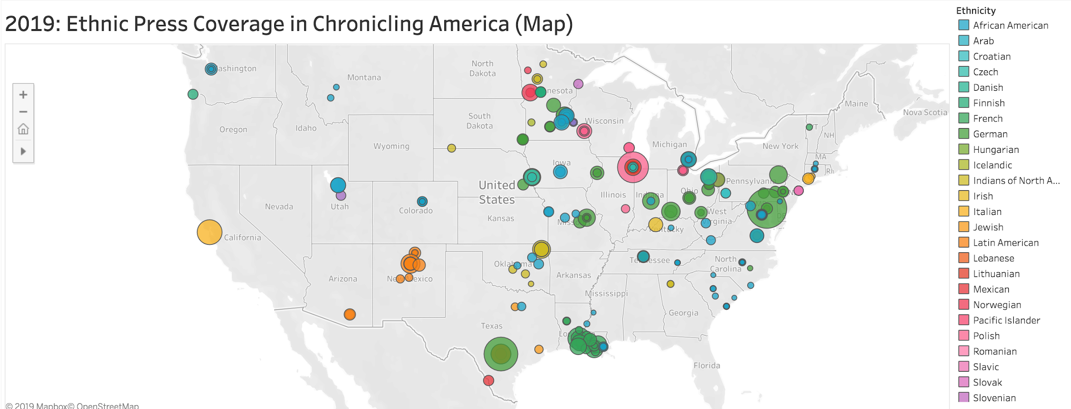
Tableau Public
https://public.tableau.com/profile/chronicling.america#!/
Notes:
Another interesting project LC introduced at the 2018 Awardees Conference was experimentation with visualizing the metadata in Tableau Public, a data viz web-based application. LC has provided several standard views of the national data in language, ethnicity, or temporal representation by state. In this image, the big green circle over our region is primarily Der Deutsche Correspondant, but as we add more non-English language titles this round, we will bring more documentation of immigrant groups to the Mid-Atlantic.
(demo)

Slide 41
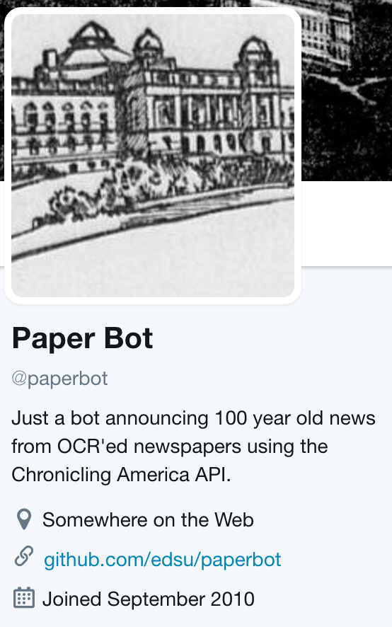
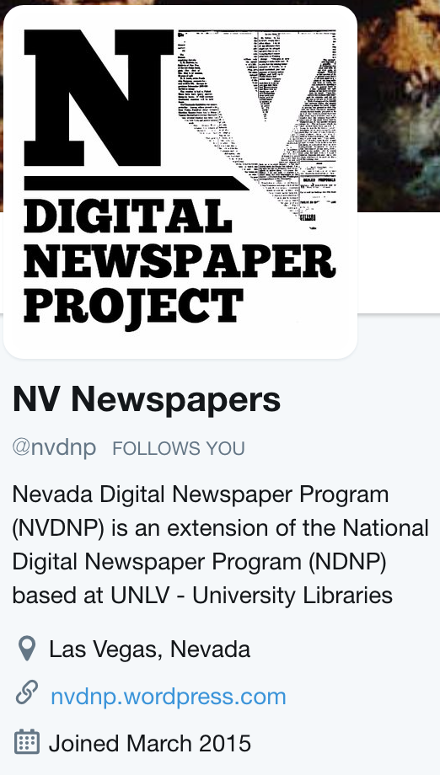
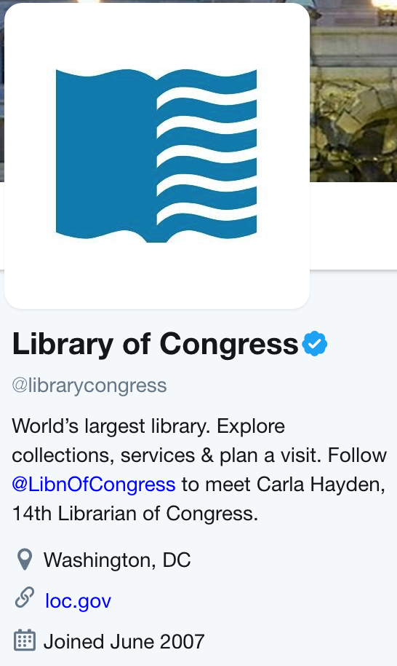
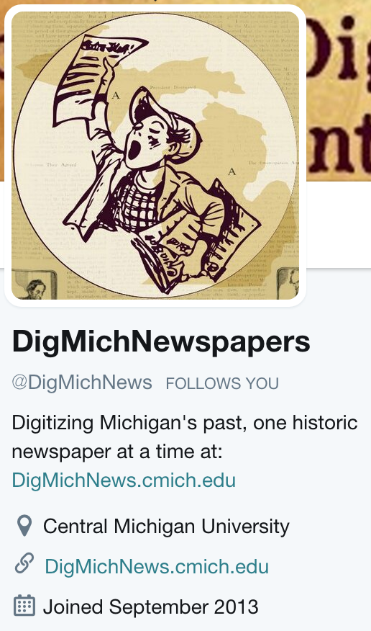
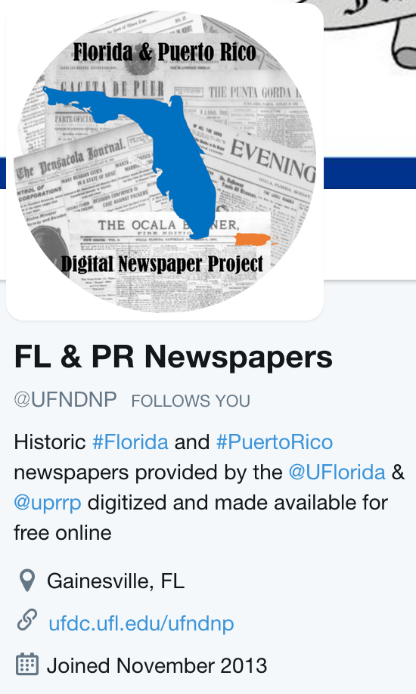
#ChronAm - Other NDNP Social Media Accounts
Notes:
NDNP has continued to expand their social media presence with LC and other state projects expanding their reach. Again, the #ChronAmParty monthly event brings together interaction between our accounts and theirs, and generates more interest and engagement with the digitized newspapers.
@PaperBot retweets #ChronAm posts on Twitter
@LoC is a general account which occasionally posts ChronAm content
@DigMich and @UFNDNP are as active as we are

Slide 42
Phase 4 Updates
Notes:
Pam

Slide 43
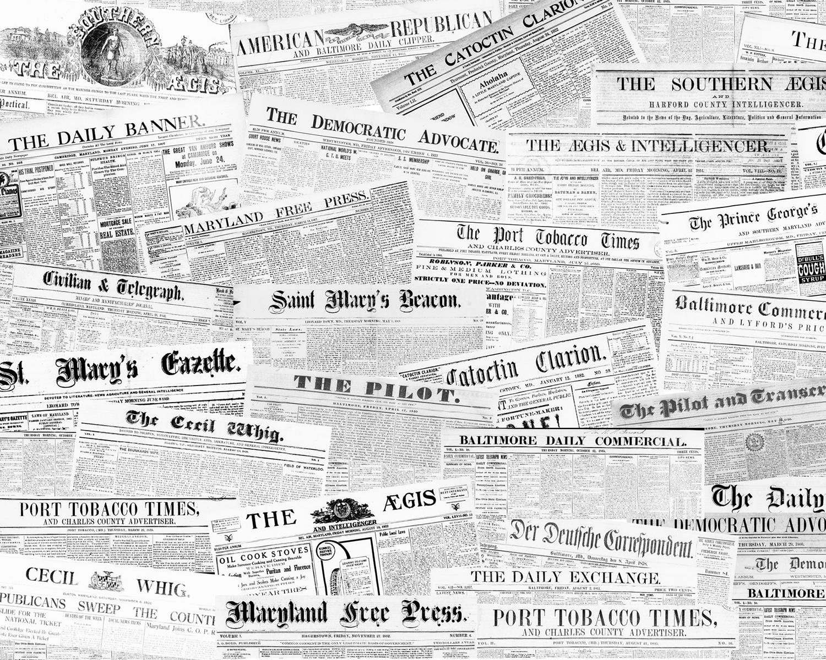
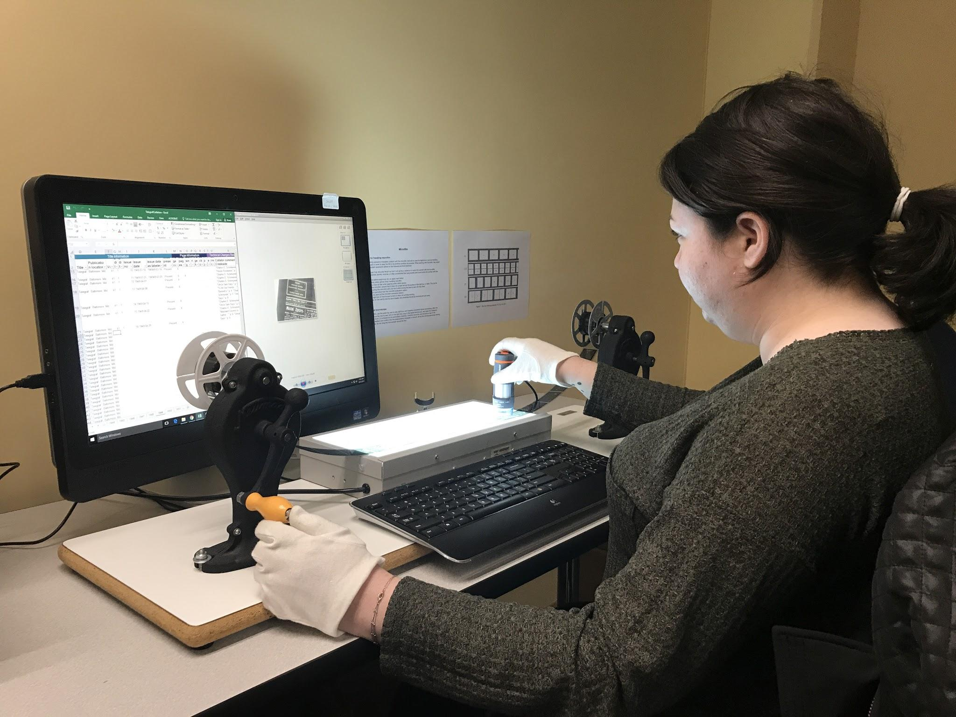
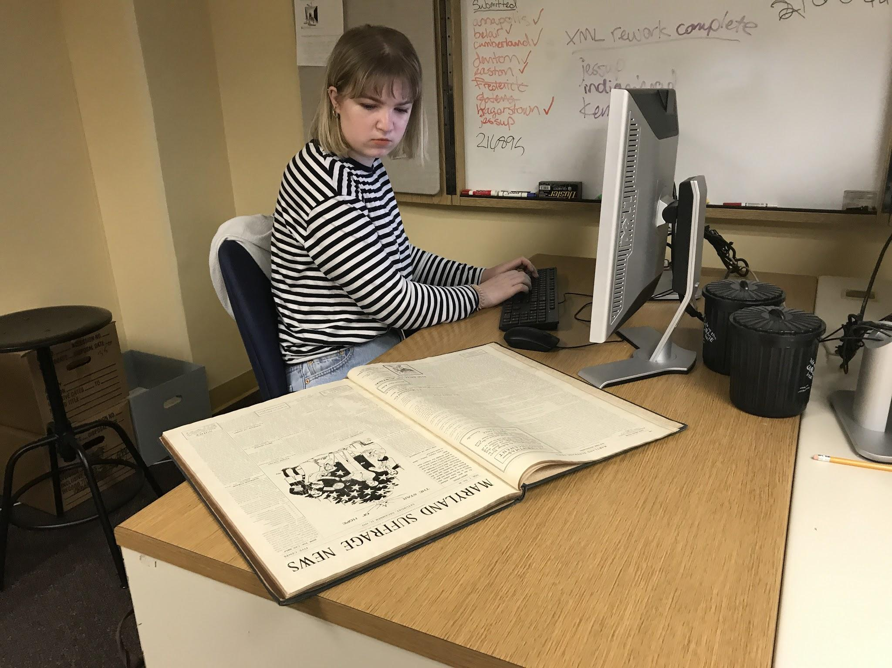
Phase 4 Staff
Co-Principal Investigators:
Douglas McElrath
Robin C. Pike
Project Manager:
Pamela A. McClanahan
Student Assistants:
Sydney Schneider
Jane Sonneman
Notes:
Our Co-Principal Investigators on our National Digital Newspaper Program (NDNP) grant are Doug McElrath and Robin Pike, and I’m the Project Manager. Our current student assistants are Sydney Schneider and Jane Sonneman.
I have photos here of our student assistants. Sydney is doing metadata collation on the duplicated microfilm reel on the Telegraf working on a lightbox with a digital microscope; and Jane is also completing metadata collation, but she is working with a bound volume of newsprint for the Maryland Suffrage News.
Additionally, our Catalog Department and Digital System Stewardship Division will provide support to the project as needed.
Also, special thanks to Rebecca Wack for her assistance in training me as I’ve started on this project, as well as Liz Caringola for her advice, both former HMNP Project Managers still on staff here at UMD Libraries.

Slide 44
Phase 4 Advisory Board Members
Jill Craig, Western Maryland Regional Library
Maria Day, Maryland State Archives
Caprice Di Liello, Enoch Pratt State Library
Michael Dixon, Historical Society of Cecil County
Lisa Eaker, University of Maryland College of Education
Anna Kephart, Southern Maryland Studies Center, College of Southern Maryland
Grace Leatherman, Maryland Humanities Council
Mary Mannix, C. Burr Artz Public Library, Frederick County Public Libraries
Doug McElrath, University of Maryland Libraries
Kent Randell, St. Mary’s College of Maryland
Leslie Van Veen McRoberts, Nabb Research Center for Delmarva History and Culture, Salisbury University
Notes:
A full list of our Phase 4 advisory board members.
Thanks so much for joining us today and all of your work already in selecting titles for this phase.
We are missing Caprice, Michael, Anna, Mary, and Leslie today.

Slide 45

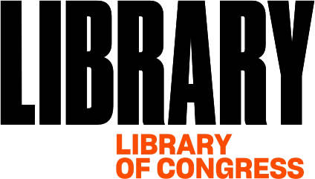
Phase 4 Partners
Maryland State Archives
Enoch Pratt State Library
Center for Research Libraries
National Woman’s Party
Montgomery County
Historical Society
Prince George’s County Memorial Library System
St. Mary’s College of Maryland
Greenbelt News Review
Greenbelt Museum
Notes:
Here are our partners for Phase 4. The National Digital Newspaper Program (NDNP) is a joint partnership of National Endowment for the Humanities and Library of Congress, which makes the Historic Maryland Newspaper Project (HMNP) possible.
This is a list of our content partners for this phase, and we’re able to have several of our content partners here with us today.
Phase 4 is the first time we’re working with this many partners, and we’re so thankful to have this content included in Chronicling America and to build these relationships.

Slide 46
Phase 4 Focus
Documenting underrepresented communities
Post-1922 content (1923-1963)
Completing titles previously selected for digitization
Total of 110,000 pages
Notes:
This is where the focus for phase 4 has been in title selection.
About 50% has been documenting underrepresented communities. We have demographically diverse titles in Italian, German, and Czech. We also have the Maryland Suffrage News, a paper written by and for women advocating for suffrage, and its subsequent title the Maryland Women’s News after women got the vote.
The other half of the content is focused on post-1922 now that the copyright year has moved forward. With some copyright research, we also can include content up until 1963 as set by the grant.
Within that, we have been able to include a couple of titles that had been selected for digitization in previous phases, but did not work out to get digitized, such as the Montgomery County Sentinel and The Republican from Garrett County. Now, we will be able to include a wider date range for those titles than we would have been able to in a previous phase.
We anticipate submitting approximately 110,000 pages this phase.

Slide 47
Phase 4 Timeline
NDNP Phase 4 Grant
Sept. 1, 2018 to Aug. 31, 2020
Fall 2018 - Winter 2019: Title Selection, Obtaining Originals, Beginning of Metadata Collation
Spring 2019 - Spring 2020: Metadata Collation, Digitization, and Batch Submissions to LC
Annually: Survey of digitized Maryland newspapers
Ongoing: Outreach, Submission of title essays
Notes:
The National Digital Newspaper Program (NDNP) Phase 4 Grant for the Historic Maryland Newspapers Project runs from September 1, 2018 to August 31, 2020.
Here is a brief overview of the timeline. In the beginning stages of the grant from last Fall through the beginning of this year, project staff and the advisory board were finalizing title selection and obtaining the original content, and student assistants were beginning metadata collation.
Metadata collation will continue over the next several months, while we are also in the process of transferring materials to the digitization vendor. As we receive those digital files back from the vendor, we will complete quality control on the images and metadata. We anticipate sending batches to Library of Congress (LC) starting this summer through Spring of next year. As they are approved by LC, the titles will go online in Chronicling America.
In addition to the digitization of the titles, each year as a part of the grant, we complete a survey of all digitized Maryland newspapers and track that information. It is submitted to LC as a part of the grant, but we also make that information available through the Gateway to Digitized Maryland Newspapers on our site (https://www.lib.umd.edu/newspapergateway).
Ongoing throughout the project, we will be doing outreach at public libraries, schools, and other programs and events.
Also, throughout the project Doug will be working on the Title essays that are included on the Chronicling America site and the student assistants also update and create wikipedia entries using the title essays.

Slide 48
Phase 4 Titles
Title | Publication Location | Years to Digitize
Baltimore wecker / Taglicher Baltimore wecker | Baltimore | 1856-1872
Katholische volkszeitung | Baltimore | 1874-1888
Il risorgimento italiano nel Maryland | Baltimore | 1922-1930
Telegraf | Baltimore | 1917-1951
Trench and camp | Admiral | 1917-1919
Hammond gazette | Point Lookout | 1862-1864
Maryland suffrage news / Maryland women’s news | Baltimore | 1913-1922
The Republican | Oakland | 1877-1963
Montgomery County sentinel | Rockville | 1855-1963
Greenbelt cooperator / Greenbelt / Greenbelt news review | Greenbelt | 1947-1963
Notes:
This is our finalized title list for Phase 4. Not counting title changes, we are digitizing 10 titles this round.
The first four titles here are our foreign language titles. These are all based out of Baltimore ranging in dates from the mid 19th to the mid 20th centuries. We have our two German titles - the Baltimore Wecker and the Katholische Volkszeitung, our Italian title - the Il Risorgimento Italian nel Maryland, and our Czech title - the Telegraf. This meets with our theme of documenting underrepresented groups especially the immigrant community, which is not always otherwise well-documented in the historical record. Newspapers are often one of the only primary sources for these communities’ activities. All of the foreign language titles except the Telegraf were provided on microfilm by the Maryland State Archives from the work they had done as the Maryland state awardee of the US Newspaper Program, the predecessor to the National Digital Newspaper Program. The Telegraf was supplied by the Center for Research Libraries.
Next we have the two base papers, the Trench and Camp and Hammond Gazette, which is the first time we’re including this kind of content. The Trench and Camp is a WWI era paper published at Fort Meade supplied by Enoch Pratt Library. The Hammond Gazette is a civil war era weekly created for those at the union hospital in Point Lookout, MD provided by St. Mary’s College.
Then we have The Maryland Suffrage News loaned to us by the National Woman’s Party out of the Belmont-Paul Women’s Equality National Monument in DC. This was a high priority title, especially with the centennial of the 19th amendment coming up. Also, this is the first title that we will digitize exclusively from print for this project.
Then we have The Republican of Garrett County, which adds geographic representation for western Maryland to our content, and this also is supplied by Enoch Pratt Library.
The Montgomery County Sentinel had been a title of interest for digitization in earlier phases, and once we learned The Montgomery County Historical Society had this on microfilm, we were able to include it for digitization in this phase.
Our last title is the Greenbelt News Review. The Greenbelt Cooperator had been digitized in an earlier phase on microfilm from the Maryland State Archives. We were later contacted by the Greenbelt News Review, which is still publishing today, and they were able to loan us their paper copies to extend our coverage to 1963.
Thank you to our advisory board for guiding the selection process, and to Rebecca, Robin, and Doug on their work researching and finalizing our titles.

Slide 49
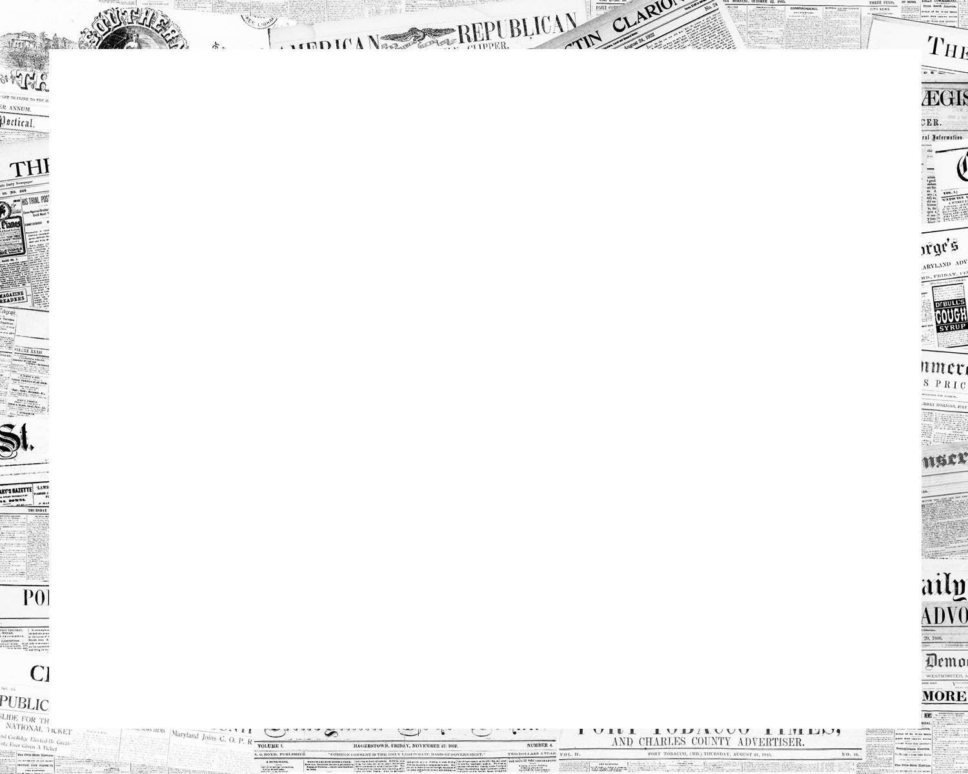
Phase 4 Status
Sample batch with digitization vendor
Metadata collation in progress
Originals in process of being transferred to UMD
Notes:
Currently, our sample batch is with our digitization vendor, Creekside Digital, for rework. We’re using a reel of the Telegraf, our Czech title, as our sample batch. As we had expected may happen, we needed to go back to the vendor for rework to get the language configuration correct in the OCR. The Telegraf is almost entirely in Czech except for a couple of sections in the masthead and an occasional advertisement. The OCR algorithm was picking up English throughout though, for example in some text blocks that started with English words such as proper nouns it was coding the text block English instead of Czech. We will be providing very specific instructions to the vendor with the Telegraf to default to Czech and only use English when we have noted it in our metadata collation spreadsheet.
If we don’t have anymore rework and the batch is accepted by LC, we anticipate being able to start submitting full batches by the end of May or beginning of June. We’ll be submitting the print first because that will take longer for digitization. We’ll submit the Telegraf and the other foreign language titles early on as well to make sure there is plenty of time to handle any problems that arise from the OCR language encoding.
The metadata collation is in progress and has just this week been completed for everything we have on site now. For the titles that were done by the Maryland State Archives, the students could collate from PDF images provided by the Archives. Then for the Greenbelt and the Suffrage News, collation could be done from the print. For our other titles, we’ll be collating from the microfilm using a lightbox and digital microscope as you saw in the picture of Sydney earlier.
We have four more titles to collate and those are titles that are either with the microfilm duplication vendor or still in the process of being transferred to UMD. We had two content partners bring two titles today, and we should have the other two very soon. We should be receiving a batch back from the microfilm duplication vendor any day, and then we’ll be sending one more batch.

Slide 50
Phase 4
Plans
Outreach
Public libraries and others
On campus
Data Analysis
Understanding data set
Visually representing newspaper data and gateway data
Chronicling America Milestone
Notes:
We’ll be talking about this more later this afternoon, but we have plans to do more outreach during this phase. We’ll continue to do presentations at public libraries and with other groups. I have a genealogy presentation planned with Harford County Public Library. They asked us to come back after Rebecca did a presentation there last year.
I’ve also been looking into on campus outreach. I’ll be working with our outreach and instruction librarians in Special Collections to include Chronicling America in more lib guides and in more classroom instruction. We think this will be a good digital primary resource for student projects. I’ve also met with a couple of our subject librarians about ideas on reaching out to faculty and incorporating Chronicling America. Doug and Robin will continue to highlight Chronicling America in their content when they teach or are guest speakers in the classroom as well. We’d like to brainstorm with all of you later about additional outreach as well.
With this newspaper project and the OCR text and metadata creating a large data set, I think it would be interesting to explore this data a little more to see if we can learn more about our content. This may be something other states would be interested in applying to their data as well. I’m going to research this area and see what projects we could do in this area. Additionally, we’d like to take the data from the survey of digitized newspapers that powers the gateway and visually represent this data in some different ways to help users better understand the content and access the newspapers, such as looking at the titles regionally in some different ways. Hopefully there will be more to share on this later in the year.

Slide 51
Future Plans
Notes:
Doug
Be prepared to talk about seeking more non-English language content and ethnic press content, pursuing more content from post-1925 (in 2020), papers of record, including Evening Capital or News American, which would require pursuing this paper with Proquest.

Slide 52
BREAK

Slide 53
UMD Newspaper Project/
MD Newspaper Repository
Notes:
Doug and Robin

Slide 54
UMD Student Newspapers Digitization Timeline
2013: The Diamondback project conception
2015: UMD Launch fundraising campaign #1
2016: The Diamondback Digitization Project, Phase 1
2017: The Diamondback Digitization Project, Phase 2
2017: UMD Launch fundraising campaign #2
2017: UMD student newspapers, Phase 1
2018: The Diamondback Digitization Project, Phase 3
2019: UMD student newspapers, Phase 2
2019: The Diamondback Digitization Project, Phase 4
2020: The Diamondback Digitization Project, Phase 5
2020: UMD student newspapers, Phase 3
Notes:
Robin:
With the growing expertise in newspaper digitization and the METS-ALTO metadata standard promoted by NDNP, in 2013, the Manager, DCMR was approached by the University Archivist, Anne Turkos, to digitize The Diamondback, the student newspaper of record, and its earlier preceding titles, from 1910-present. Because there was no likely funding for this project, the University Archivist created a crowd-funded campaign in 2015 to raise money for an initial project phase, which resulted in raising $30,550 from the crowd-funding campaign, an additional $1,000 from the Student Government Association, and an additional $2,000 from an Anacostia Trails Heritage Area Inc. grant. The DIC approved the project to begin for the fiscal year 2016 project cycle. The first phase of the project was limited to approximately 28,500 pages, from 1910-1971 due to funding and also because publication and copyright was transferred from the university to Maryland Media, Inc., a private company, beginning in October 1971, and the University Archivist was still in discussions to allow permission to digitize content after 1971.
The second digitization phase of approximately 48,500 pages, from 1971-1998, began in January 2017 using the remaining fundraised money and additional Libraries gift money. A second fundraising campaign and continuing donations funded the third through fifth phases, taking us to 2016 for the Diamondback, approximately 92,000 pages total across all pages, which will be ingested this summer.
University Archives gift funds have digitized Black Explosion, Eclipse, another African American student newspaper, and Mitpeh, the Jewish student paper this year. We will conclude other student papers in 2020. These will total between 15,000-20,000 pages altogether.

Slide 55
UMD Student Newspapers Technical Process
NDNP Technical Guidelines
Image files
METS-ALTO
Article-level segmentation
Digitization from microfilm and print/TIFF images
Metadata collation (inventory)
Vendor digitization
Quality control
Ingest/archive
Notes:
Robin:
Project stakeholders, including the myself, Liz Caringola (former HMNP project manager), and University Archivist Anne Turkos, agreed that the project would primarily follow the NDNP standards including the image files and METS-ALTO metadata. METS-ALTO is a combination of two XML metadata schemas. METS provides descriptive information about the page, issue, microfilm reel, etc. ALTO encodes OCR and the page style and layout, essentially creating coordinates for each word. Together, METS-ALTO creates a complete metadata picture of the newspaper page. It’s what also enables the word-searching and the word-highlighting of the words you searched for. This is why creating simple PDF or TIFF files won’t work. Anne determined that in addition to the NDNP deliverables and UMD-unique metadata fields, she wanted patrons to have access to article-level segmentation, which would provide additional METS-ALTO files of text-corrected OCRed titles to assist patrons with searching and content indexing.
While the project primarily relies on microfilm for digitization because it is more cost effective, early issues would also be digitized from print after a conservation vendor repaired the aged and damaged issues; these issues were included in the second project phase. UMD students created an issue-level inventory, with added metadata for the reel and batch, through a process called metadata collation. A student also performed automated checks on the batch using the Digital Viewer and Validator tool developed by the Library of Congress for NDNP batches, and proceeded to manually inspect 20% of the issues digitized.
We have ingested all content digitized to date.

Slide 56
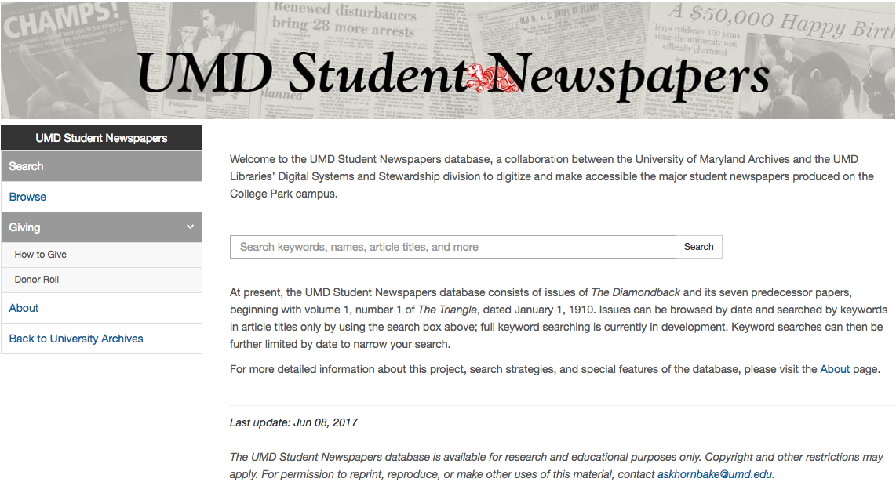
UMD Student Newspapers Timeline
2016-2017: Development of image server, image viewer, repository backend
2017: Content ingest
2017: Development of administrative interface, public interface
2018-2019: Development of additional features
https://www.lib.umd.edu/univarchives/student-newspapers
Notes:
Robin:
At the same time as project digitization, development in 2016 was progressing on the UMD Student Newspapers Repository.
The Software Systems Development and Research department was provided technical requirements for the administrative and public interfaces as guidelines to build the user interfaces of the repository. They first began work on the backend of the repository, including the image server and the image viewer. A Systems Librarian ingesting digitized content into repo beginning in February 2017 and completed in early March.
The interface was officially rolled out in the fall 2017 semester.
Through the rest of 2017, into 2018 and 2019, developers will continue to work on adding additional features and allowing editing in the administrative interface.

Slide 57
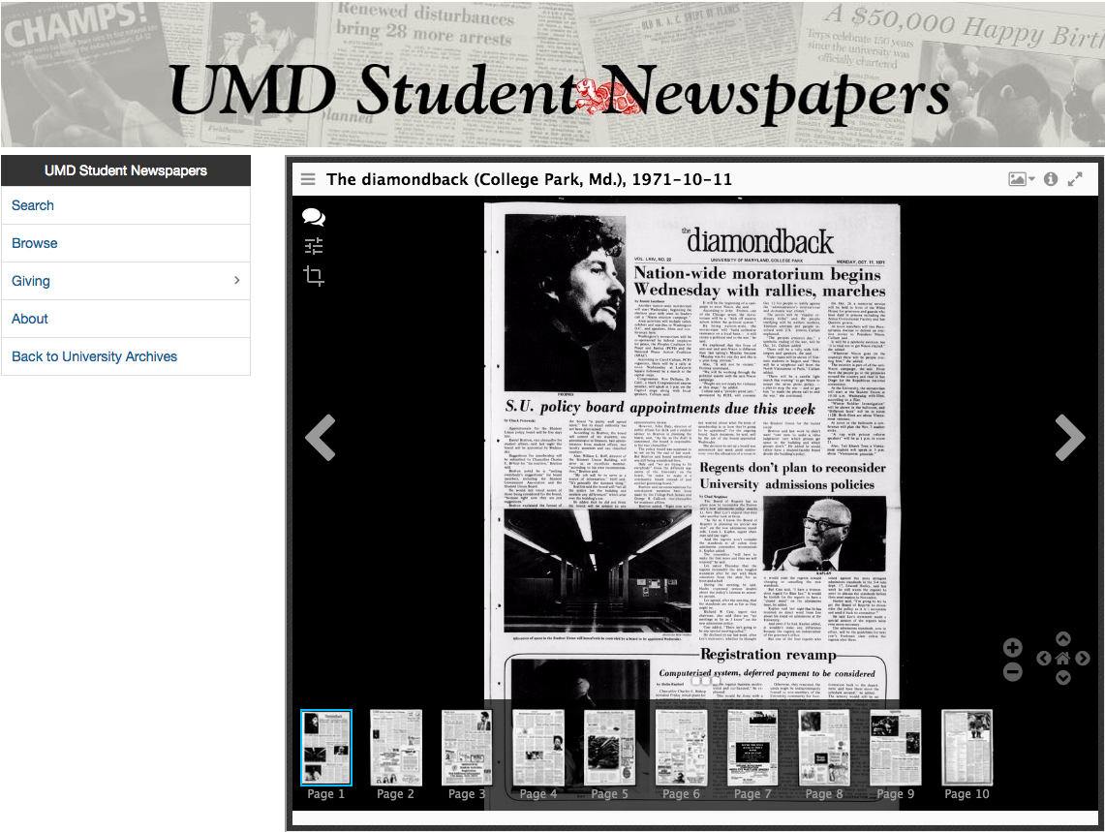
UMD Student Newspapers Viewer
Notes:
Robin:
This is the default viewer for each issue, which shows a main page viewer, options for scrolling through each page, and tools to manipulate the image in the viewer.

Slide 58
Maryland Digital Newspaper Repository
Challenges
Development and ingest
Funding and staff resources
Limited time, need to prioritize UMD’s own collection development and ingest
Notes:
Robin:
We still want to pursue creating a Maryland Newspaper Repository, but challenges in the implementation of the Student Newspapers repository data, even though we didn’t think had variations in the data, we experienced difficulties with ingest. Greater variation of data produced if UMD doesn’t have complete control over data production, with create too much overhead and development for staff, beyond our current resources. We’re still interested in pursuing funding as a collective or independently, and Pam and I have begun to discuss possible fundraising models or sources.
With limited staffing and time for development and to dedicate to ingest, and without external funding needed to push the initiative, we need to allocate that to work centered around UMD’s collections--getting newly digitized materials into the new repository and also migrating our previously-digitized content from the past 15 years.

Slide 59
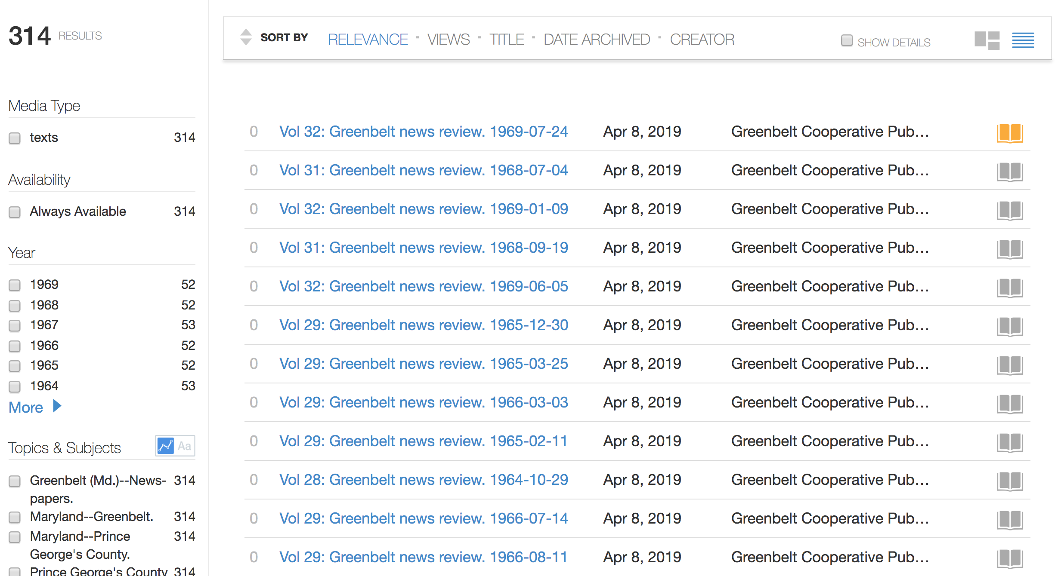
Future Partners
Pilot with Greenbelt Archive Project, uploading to the Internet Archive, maintaining files for later processing
Greenbelt News Review/Cooperator
Notes:
We are laying the groundwork, however. We are currently performing a small digitization project for a non-profit that formed around digitizing the 1964-present Greenbelt News Review. We are creating TIFFs that can be post-processed and ingested at a later date into a more interactive repository, but for now, we are refining metadata created by volunteers and ingesting issues into the Internet Archive for them, for a fee. We have ingested the 1960s so far, and will be working to ingest new content monthly. Once we digitize all the content, we will ingest the materials also digitized for Chronicling America so that all their digital content is located in one place for their community to search the archives of this unique paper.

Slide 60
Case Studies:
How are people using
Chronicling America?

Slide 61
Featured Case Studies
Doug McElrath, University of Maryland Libraries
Historical research
Mary Mannix, Frederick County Public Libraries
Genealogy reference
Kent Randell, St. Mary’s College of Maryland
Classroom instruction
Grace Leatherman, Maryland Humanities Council
History Day
Maria Day, Maryland State Archives
Suffrage research

Slide 62
BREAK

Slide 63
Brainstorming:
Outreach and Programming

Slide 64
Brainstorming: Outreach and Programming
Outreach
Genealogy brochure update, brochures on other topics?
Presentations to public libraries, genealogy groups, other
Programming with advisory board members
Instruction for students, teachers
Maryland History Day, National History Day
Publish HMNP updates / Chronicling America how-to with MARAC, MLA, genealogical bulletins
MARAC Newspaper / NDNP interest groups
Roundtable with other awardees / other advisory boards
Staying in touch after this meeting
Listserv, conference calls?

Slide 65
Conclusion/Next Steps

Slide 66
Questions

Slide 67
Contact Us!
Pamela A. McClanahan
Doug McElrath
Robin C. Pike
Historic Maryland Newspapers Project
University of Maryland, College Park
Email: lib-newspapers@umd.edu
Website: http://www.lib.umd.edu/digital/newspapers/home

