Slide 1


Access to Primary Health Care for Asylum Seekers and Refugees
An Umbrella Review of Key Factors
Presented by:
Maryam A. Hashmi (mhashmi1@umd.edu)
Authors:
Dr. Negin Fouladi, Professor Kate Frazer, Elizabeth Millwee, Damilola E. Ajayi,
Nedelina Tchangalova, Roubina Karhily
18th European Public Health Conference, Helsinki, Finland
12-14 November 2025
Notes:
Good [morning ]. Thank you for giving me the opportunity to present today. My name is Maryam Hashmi, and I’ll be speaking to you about an umbrella review that examines asylum seekers and refugees’ access to primary health care.

Slide 2




Background
Statistics
Health Care Access
Methodology
79.5 million individuals were forcibly displaced,
33.8 million seeking refuge beyond their home countries.
Source: UNHCR Global Trends 2021
Access to healthcare is a fundamental human right
Umbrella review to identify evidence reporting barriers and facilitators to Primary Health Care (PHC)
Notes:
In 2019, more than 79 million people globally were forcibly displaced, with over 33 million seeking refuge outside of their home countries. As outlined in the 1951 Refugee Convention, access to healthcare is a fundamental human right and a priority for the United Nations High Commissioner for Refugees (UNHCR).
This umbrella review set out to identify barriers and facilitators to primary healthcare access, compare findings across different health systems, and highlight implications for policy and practice. In the next few minutes, I’ll walk you through the background, our methods, key findings, and recommendations for future research and action.

Slide 3


Our Aims
Methods and Eligibility Criteria
Asylum seekers and refugees’ access to primary health care
Inclusion
Studies of refugees and asylum seekers
Focus on primary health care access
Reviews with a systematic component
Reporting of barriers or facilitators
01
Identify barriers to primary health care access
Highlight facilitators that improve access
02
03
Review models, frameworks, and methods
Compare findings across countries and systems
04
Exclusion
Non-refugee or mixed populations
Secondary or specialized care focus
Reviews published before 2012
No relevant outcomes
05
Outline policy and practice implications
Databases searched on February 27, 2025: Academic Search Ultimate, CINAHL, Cochrane Library, LILACS, PsycINFO, PubMed, Scopus, SocINDEX, and Web of Science
Notes:
We aimed to identify the barriers and facilitators influencing asylum seekers and refugees’ access to Primary Care (PC), Primary Health Care (PHC) or Community Health Care (CHC) in high-income countries (HIC) and low-and middle-income countries (LMIC). Specifically, we sought to:
Identify the key challenges that limit asylum seekers and refugees’ access to primary health care.
Examine the factors that facilitate or improve access to primary health care for these populations.
Analyze existing models, frameworks, and methods used to document the factors influencing access.
Synthesize findings across different healthcare systems and country contexts to provide a comprehensive understanding of access barriers and facilitators.
Highlight implications for policy and practice to enhance primary health care accessibility for asylum seekers and refugees.
We sought to identify studies of refugees and asylum seekers with a focus on primary health care access. We looked at only reviews that have a systematic component and report on barriers or facilitators to access of primary health care. A comprehensive search was conducted on February 27, 2025. Databases searched included Academic Search Ultimate, CINAHL, Cochrane Library, LILACS, PsycINFO, PubMed, Scopus, SocINDEX, and Web of Science. Primary studies, non-systematic reviews, hospital or tertiary care settings, and gray literature were excluded.

Slide 4
Results
Identification of studies
Studies identified through database searching
February 27, 2025
Academic Search Ultimate (EBSCO): n=109
CINAHL (EBSCO): n=127
Cochrane Library: n=14
LILACS: n=5
PsycINFO (EBSCO): n=26
Public Health (ProQuest): n=106
83% (15/18) from high-income countries
Origins: South/Southeast Asia, Africa, Middle East, South America
28% (5/18) focused on women
72% (13/18) on access to physical healthcare (i.e., preventive, maternal, dental, cancer, pharmacy services)
28% (5/18) on access to mental healthcare
❌ No reviews focused solely on children
❌ No reviews on vaccination barriers/facilitators
PubMed (National Library of Medicine): n=165
Scopus (Elsevier): n=211
SocINDEX (EBSCO): n=16
Systematic Review Journal: n=4
Web of Science (Clarivate): n=87
Identification
N=870
Duplicates removed and records excluded
Duplicate studies: n=453
Protocols: n=13
N=466
Records screened with
title and abstract
N=404
Records excluded
N=309
Screening
Full-text records assessed for eligibility
N=95
Full-text records excluded with reasons
Wrong intervention/focus: n=5
Wrong outcome: n=7
Wrong population: n=46
Wrong publication type: n=14
Wrong setting: n=5
N=77
Records included in the review
N=18
Included
Notes:
Out of 404 records screened by title and abstract, 95 full-text articles were assessed, and 18 systematic reviews met the inclusion criteria. Of these, 83.3% (15/18) were conducted in high-income countries. Reported regions of origin included South and Southeast Asia, Africa, the Middle East, and South America. 27.8% (5/18) of reviews focused exclusively on women, 72.2% (13/18) assessed access to physical healthcare, including preventive, maternal, dental, cancer, medication, and pharmacy services, and 27.8% (5/18) assessed access to mental healthcare. No reviews focused exclusively on children, nor did they report barriers and facilitators to vaccinations.
Articles were excluded if they focused on outcomes outside our scope, were of an ineligible publication type, included broader populations beyond asylum seekers and refugees, or examined provider perspectives, were set in non-relevant contexts, or evaluated interventions outside our area of focus. (Can be a speaking point: Early observations suggest limited research specific to asylum seekers and refugees, indicating a potential gap in the literature)

Slide 5
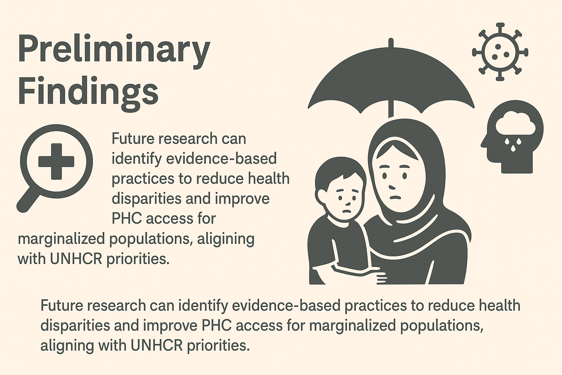
Preliminary Findings
Gaps in Literature
Barriers: i.e., Language, financial constraints, stigma, mistrust, and transportation.
Enablers: i.e., family/community support, bilingual staff, and culturally sensitive care.
Population Focus: Strong emphasis on primary healthcare
Sociocultural/Political Factors: Stigma, discrimination, and policy restrictions significantly influence health access and outcomes.
Underrepresented Populations: Limited research on children and women.
Domains Missing: Gaps in communicable disease prevention and mental health uptake.
Enablers Understudied: Barriers are well documented, but facilitators receive less attention.
Geographic Skew: Low-middle-income countries largely absent.
Policy & Intervention Evidence: Few studies rigorously evaluate policies, programs, or evidence-based practices that reduce disparities and improve PHC access.
Future research can address gaps by focusing on children and women populations, LMIC contexts, communicable disease prevention, mental health, and evidence-based interventions aligned with UNHCR priorities.
Notes:
Preliminary Findings
Our preliminary findings show that refugee and asylum seeker health research has largely concentrated on barriers to access, with recurring challenges such as language difficulties, financial constraints, stigma, mistrust of health systems, and transportation. Enablers like family and community support, bilingual staff, and culturally sensitive care were identified in limited studies. Much of the evidence focuses on primary health care such as preventive, maternal, dental, cancer, medication, and pharmacy services, with less attention to children’s health, communicable diseases and mental health. Finally, across all contexts, sociocultural and political factors such as stigma, discrimination, and restrictive policies emerge as key influences on health access and outcomes.
Gaps in the Literature
Our review highlights several gaps in the literature. Children and women refugees remain underrepresented, and crucial areas like communicable disease prevention and mental health are insufficiently studied. While barriers are well documented, enablers that support access are far less explored. The evidence is also geographically skewed toward high-income countries, leaving out most of the displaced populations living in low- and middle-income settings. Finally, few studies thoroughly evaluate policies or interventions, meaning we still lack clarity on which strategies truly reduce disparities and improve primary health care access.
Future Research
Future research can address overlooked groups like children and women, expand beyond high-income countries to low- and middle-income countries, and focus more on communicable disease prevention, mental health, and enablers. Most importantly, we need evidence on which interventions and policies work, so we can reduce disparities and improve Primary Health Care access in line with the United Nations High Commissioner for Refugees priorities.

