Slide 1
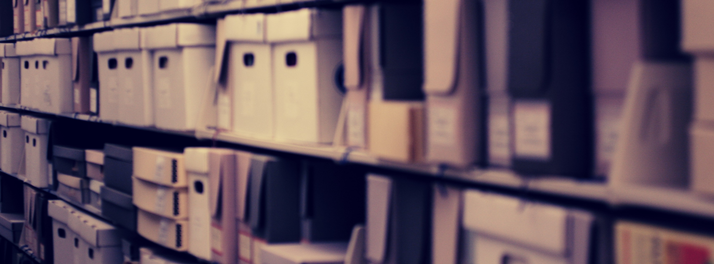
ARCHIVES SPACE
T E C H D E M O S : M A N A G E Y O U R C O N T E N T
Caitlin Rizzo, Head of Collection Management
Eberly Family Special Collections, Penn State University

Slide 2
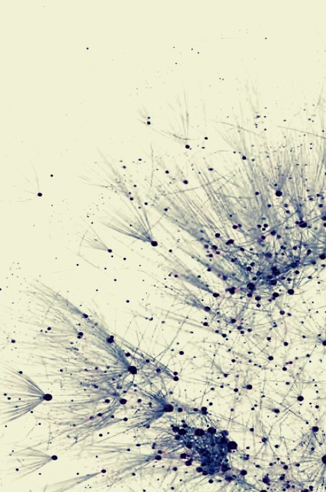
THE
BASICS
O P E N S O U R C E
ArchivesSpace is an open source software that is free and available for download, distribution, and modification. The source code is available to individual users as well as an active, development community l via GitHub: https://github.com/archivesspace.
W E B A P P L I C A T I O N
ArchivesSpace is a web application that allows staff and users to access information about collections online via a . web browser. The application gives archivists the power to publish information for public view or to isolate sensitive information in the staff interface.

Slide 3
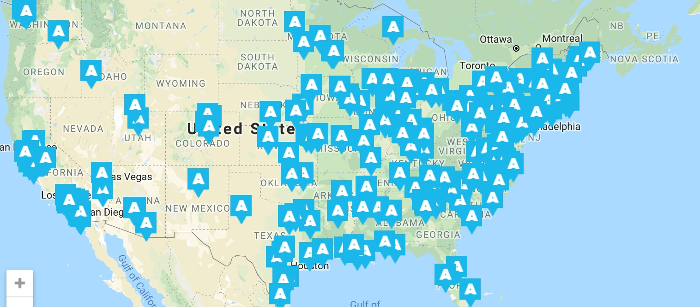
O P E N S O U R C E A R C H I T E C T U R E & C O M M U N I T Y D E V E L O P M E N T
A R C H I V E S S P A C E A S A T O O L D R I V E N
B Y C O M M U N I TY
C o m m u n i ty s u p p o r t a n d d e v e l o p m e n t a r e a n i m p o r ta n t p a r t o f A r c h i v e s S p a c e ' s s u s ta i n a b i l i ty a s a c o l l e c ti o n
m a n a g e m e n t to o l . A r c h i v e s S p a c e ' s m i s s i o n i n te g r a te s a c o m m u n i ty m e m b e r s h i p m o d e l th a t s u p p o r ts s h a r e d
g o v e r n a n c e , c o o p e r a ti v e d e v e l o p m e n t, a n d m u tu a l s u p p o r t.

Slide 4
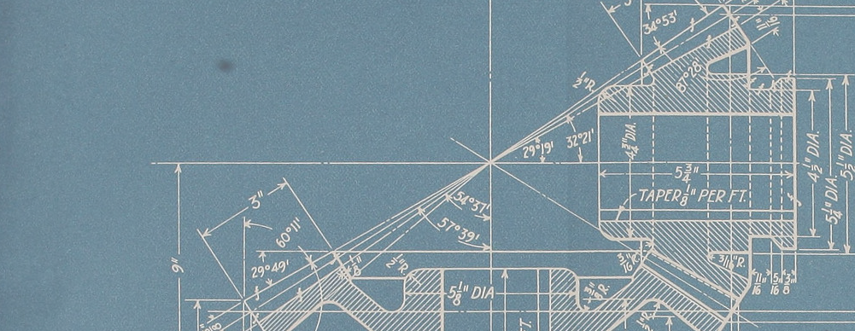

I N T R O D U C I N G T H E A P P L I C A T I O N ' S I N F R A S T R U C T U R E
A P P L I C A T I O N A R C H I T E C T U R E & T E C H N O L O G Y R E Q U I R E M E N T S
B A C K E N D & S O L R S E A R C H
STAFF
I N T E R F A C E
PUBLIC USER
I N T E R F A C E
Records creates in ArchivesSpace are stored in a relational database indexed by SOLR search technology. A REST API allows users to query and modify the database.
ArchivesSpace's staff interface is a web interface that allows staff to create, modify, publish, and delete local records from a web browser.
The PUI allows archivists to make finding aids, accession records, and subject/agent files accessible to users. The customizable interface also allows for branding.

Slide 5
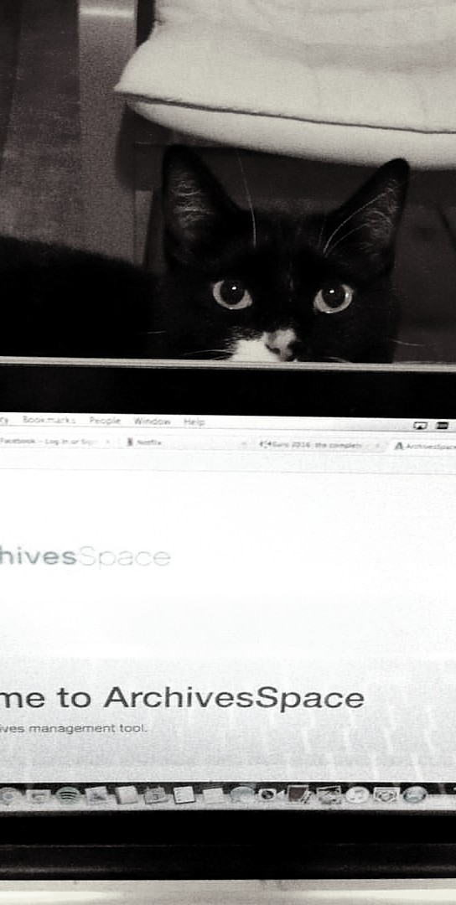
T A K I N G A T O U R O F T H E
T O U R I N G T H E A P P L I C A T I O N
S A N D B O X
Developers often joke that open source software is "free like a puppy" (strike that, kitten), "not like a beer." For archivists interested in learning what ArchivesSpace implementation might look like but not necessarily ready to leap into what are often messy implementation/migration phases, ArchivesSpace offers a sandbox demo available here: http://archivesspace.org/application/sandbox.
Touring the sandbox environment helps archivists understand how ArchivesSpace works to create consistent(-ish) structured data that can be integrated across other archival systems and software as well as used to create a variety of access points. Let's take a look!

Slide 6
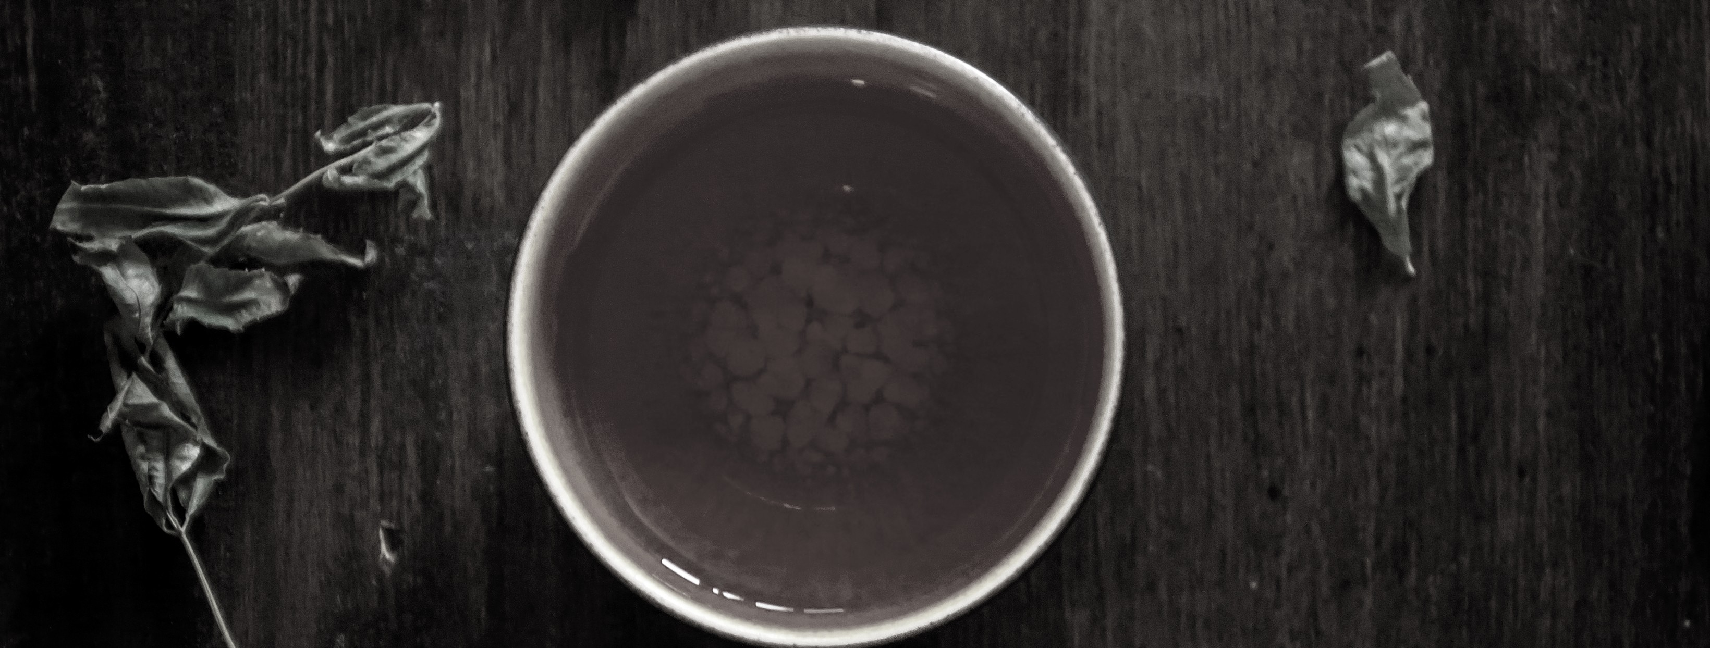
LET'S TALK TEA
ARCHIVESSPACE T I P S , T R I C K S , A N D W H A T I W I S H I H A D K N O W N

