Slide 1
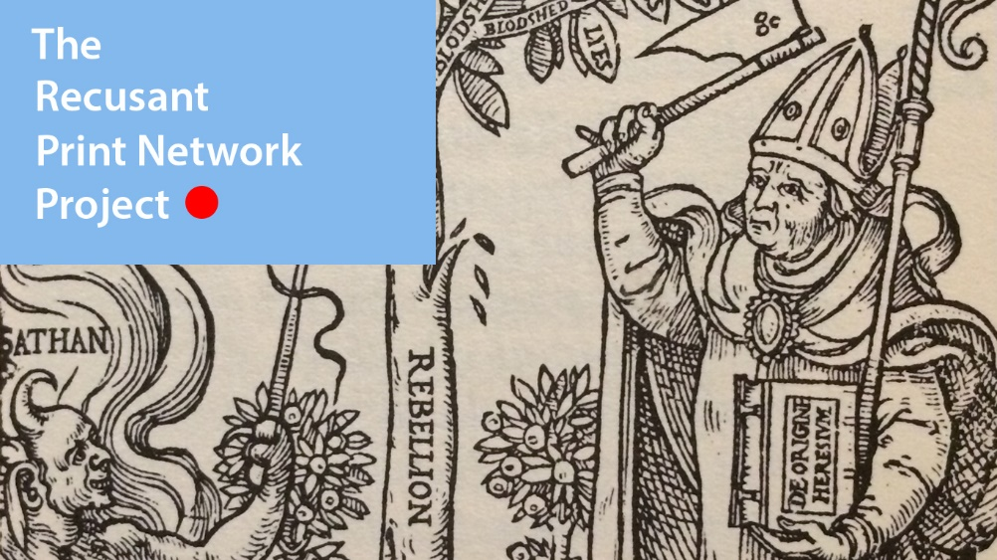
Phase 1:
Experimentation
in research
format
Jordan S. Sly, University of Maryland
Ways of Knowing, Cambridge, MA Oct 2017

Slide 2
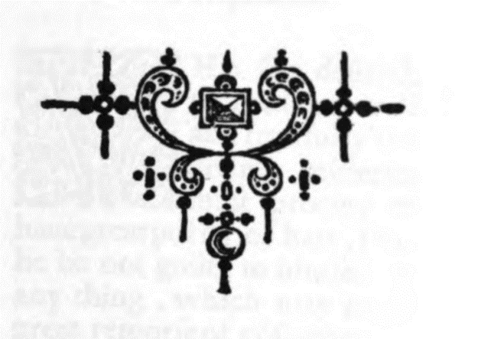
Goals & Thesis
By removing the obstacle of shelf bound and geographically separated volumes and by quantifying elements of their creation, the network and nature of recusant literature is made more immediate by illustrating known trends and potentially opening avenues of research.
Thesis

Slide 3
Goals & Thesis
Will network data analysis tools allow a new level of immediacy with the vast body of Recusant literature?
What can we learn about Early Modern Catholic printing missions by visualizing the hubs of recusant literature?
What future work can be made possible with a visual and workable database such as this?
Research
Questions

Slide 4
Goals & Thesis
To find new questions, trends, and supporting data by collating, analyzing, and graphically displaying like information —in this case Recusant literature— that is distinct from traditional forms of scholarship
To use this data and scholarship to work within and potentially expand the extant historiography of recusancy and lend evidence to a particular avenue of various scholarly debate (ex. the Haigh/Bossy debate)
Goals

Slide 5
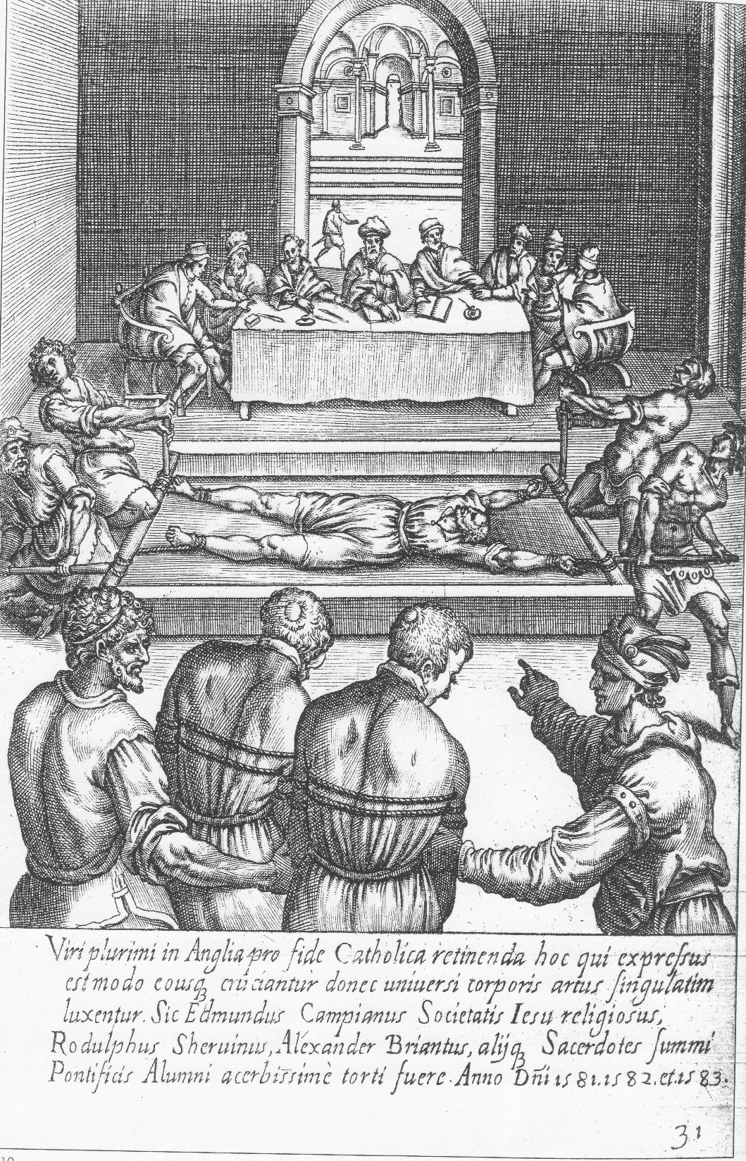
Key Terms
Recusant/recusancy: Illegal Catholic community in Early Modern England.
Recusancy Acts 1593
The persecution of Catholics, like the Marian persecution of Protestants created English martyrs
Campion on the Rack
Engraving by Giovanni Cavallieri after Niccolò Circignani from Ecclesiae Anglicanae Trophaea (Rome 1584)
Houghton Library, Harvard University
Image: http://jesuitinstitute.org/Pictures/Campion5.jpg

Slide 6
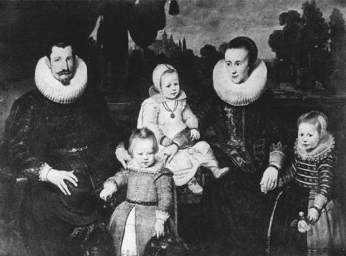
Key Terms
Who were recusants?
Priests: manorial, rungate, continental
Those who harbored priests (often women, widows, etc.)
Those who practiced personal devotion
Church Papists (those who attended Prot. Mass, but remained confessionally Catholic)
Copyists (often women copying by hand devotional literature)
Printers

Slide 7
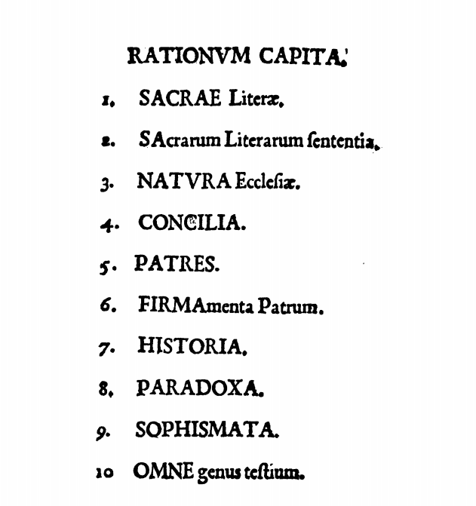
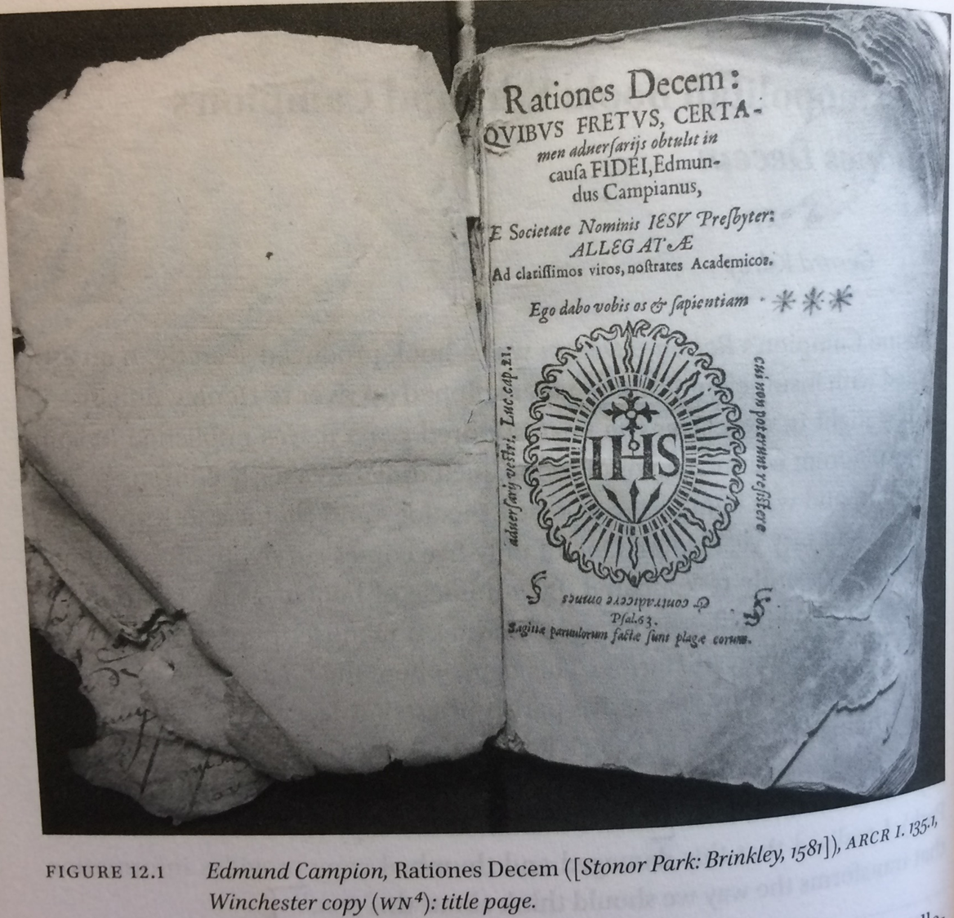
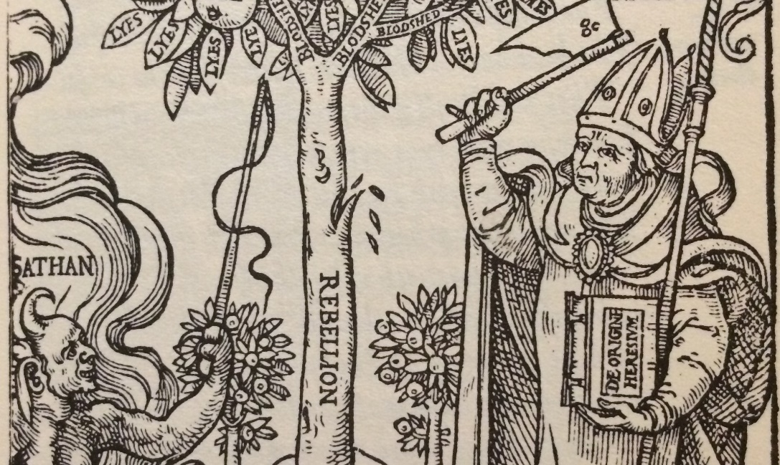
What is Recusant Literature?
Key Terms
English Catholic Martyrs
Teaching of the Church fathers
There is an instructive element
Arguments against Protestantism
Legitimacy of the Catholic Church
Talking points
Spiritual direction
Personal faith (ownership)
Mythography
Early Modern Catholic Samizdat
Post-Tridentine and “global”
From Edmund Campion Rationes Decem, 1581
Stanislaus Hosius, The Hatchet of Heresies, 1565

Slide 8
Data Sources and Methods
Stage 1, Phase 1
Data Source | Format | Method | Benefit | Access
English Recusant Literature, D.M. Rogers (ed.) | ~400 Vol. set of facsimile text reproduced in org. size | Physical copying and data entry | Defining ‘recusant’ literature in a useful way by setting parameters | -Print (UMD holds about 13 discontinuous Vols. -Hathi Trust full text (UMD Libraries)
A Catalogue of Catholic Books in English Printed Abroad or Secretly in England, A.F. Allison and D.M. Rogers | Catalogue representing known (as of ~1956) recusant literature | Reference | Defining scope and terminology | Print
Eng. Short Tile Catalogue ESTC | Database with linked EEBO full text | Cross-reference and use of STC/ESTC scholarship | Usable and scrapable metadata Authoritative scholarship (mostly) | UMD Libraries

Slide 9
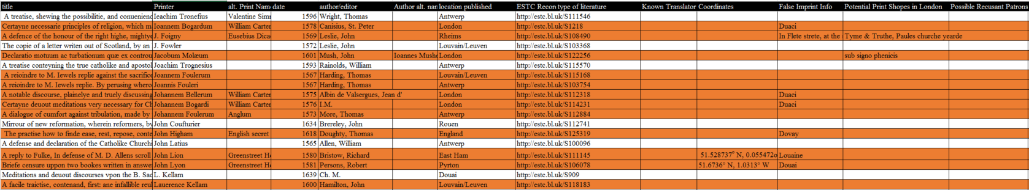
Data Sources and Methods
Able to do about 100 by hand and the OCR from Hathi Trust was poor making any scraping effort difficult
Constantly distracted by the interesting finds within the texts
Difficultly summing up each text in simple string data
Began seeing the potential for the project and future plans

Slide 10
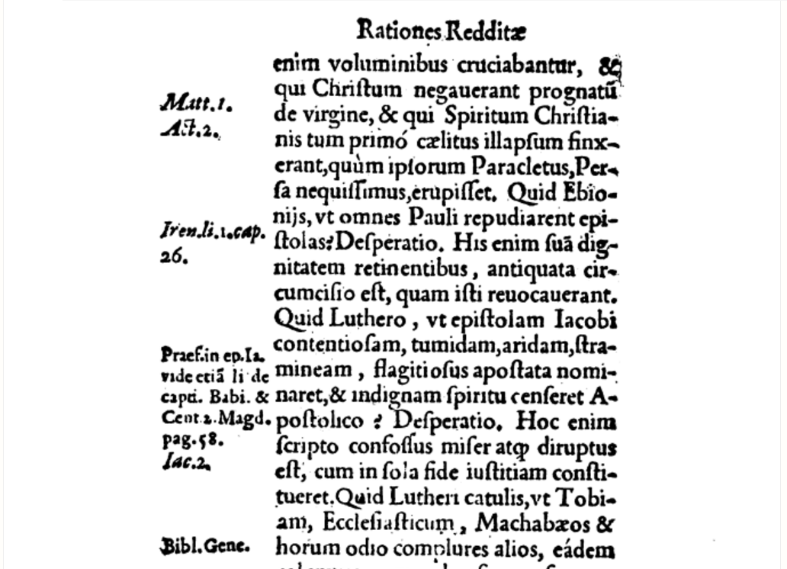
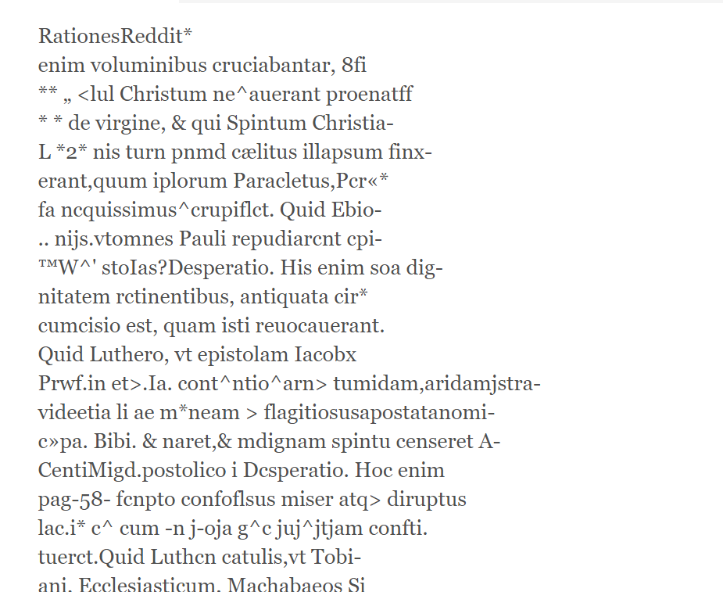
Hathi Trust OCR could be better
Footnote: There is no reason for Reddit

Slide 11
Data Sources and Methods
Stage 2, Phase 1
Data Source | Format | Method | Benefit | Access
EEBO-TCP | Scraped metadata from EEBO-TCP via Anupaum Basu | Cleaning and editing data to work with project goals More quantitative analysis than previous work | ~1000 records to work with that changed the shape of the project and preliminary conclusions | ESTC numbers and linked EEBO Full Text
Stage 1 Data |  | Rectifying datasets with each other and normalizing fields where possible/known Ex. W. Carter =William Carter, etc. | The EEBO-TCP data includes very specific records from phase 1 & 2 of that project, so having additional data helps the validity. Much more work to be done.
EEBO-TCP Data is limited and doesn’t include many of the ERL texts
Limited to defining the fields as “Catholic Literature,” and “Controversial Literature” which makes the data less accurate overall
Usable and manageable for this project (48, 000 in Basu’s spreadsheet, edited to about 1,000 through the controlled vocabulary filtering

Slide 12
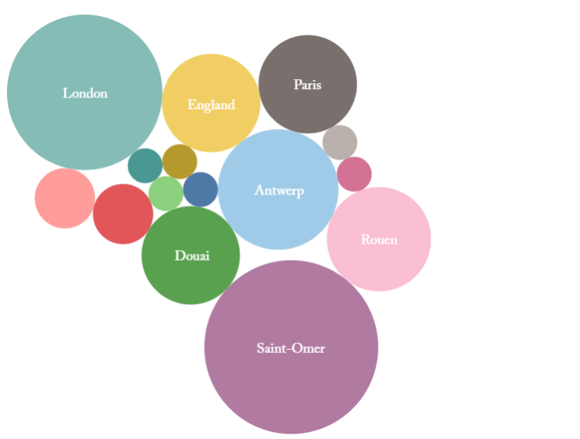
Rates of Printing by Location (Demo Data)
20
8
8
12
9
8
25

Slide 13
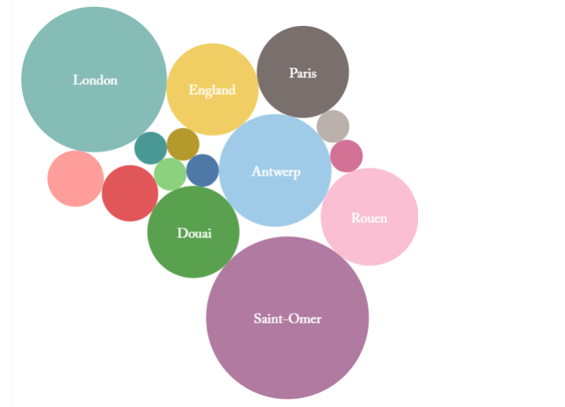
20
8
8
12
9
8
25

Slide 14
20
8
8
20
8
E. Ham
1
HoT
1
8
12
12
9
8
9
8
ENGLAND = 30
25
25

Slide 15
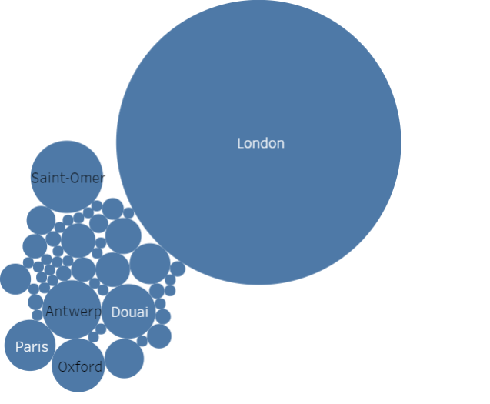
Rates of Printing by Location (EEBO-TCP Data)
Tot. =962 (Catholic—Controversial)
London=682
Saint-Omer= 44
Antwerp= 29
Douai= 25
Oxford= 24
Paris= 22

Slide 16
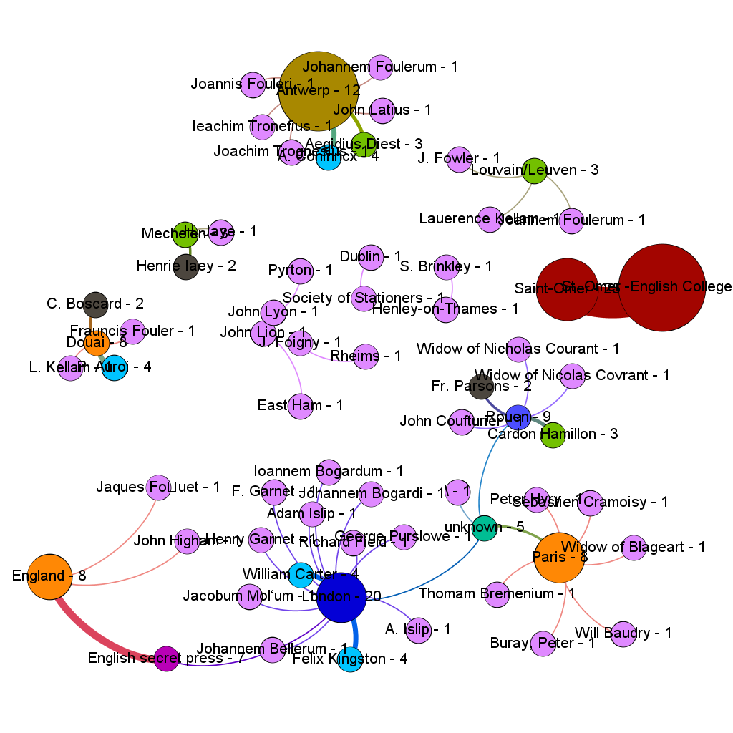
Location and Printer Frequency (Demo Data)

Slide 17
Location and Printer Frequency (Demo Data)

Slide 18
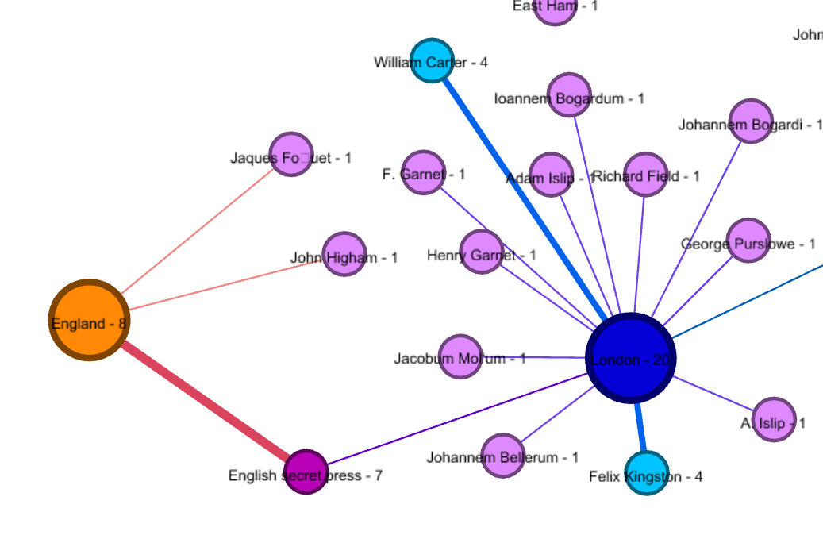
English Print Network (Demo Data)

Slide 19
English Print Network (Demo Data)

Slide 20
Location and Printer Frequency (Demo Data)

Slide 21
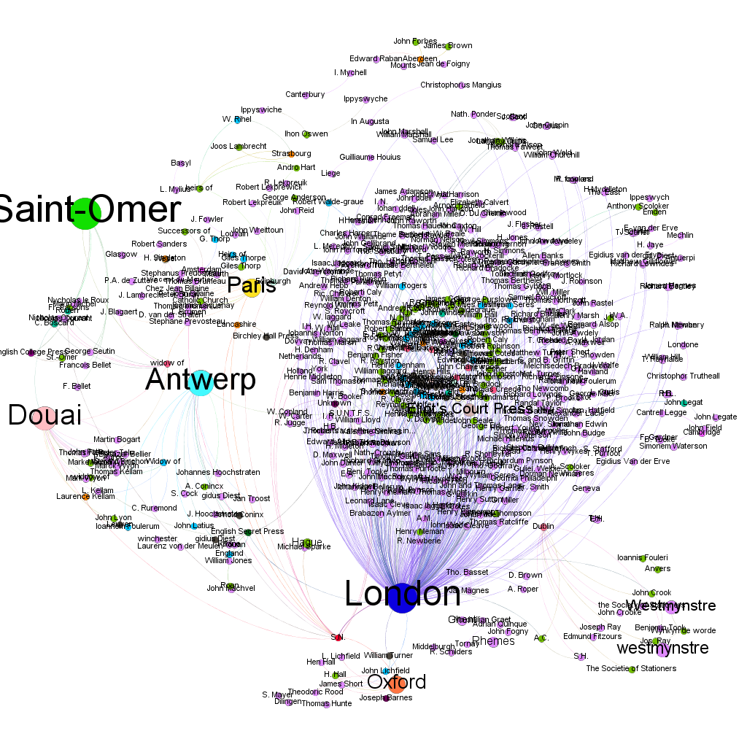
(EEBO-TCP Data) Location and Printer Frequency
European printing network of Catholic Literature
Jesuit Printing Mission
Seminary Colleges and “English” Colleges are hubs

Slide 22
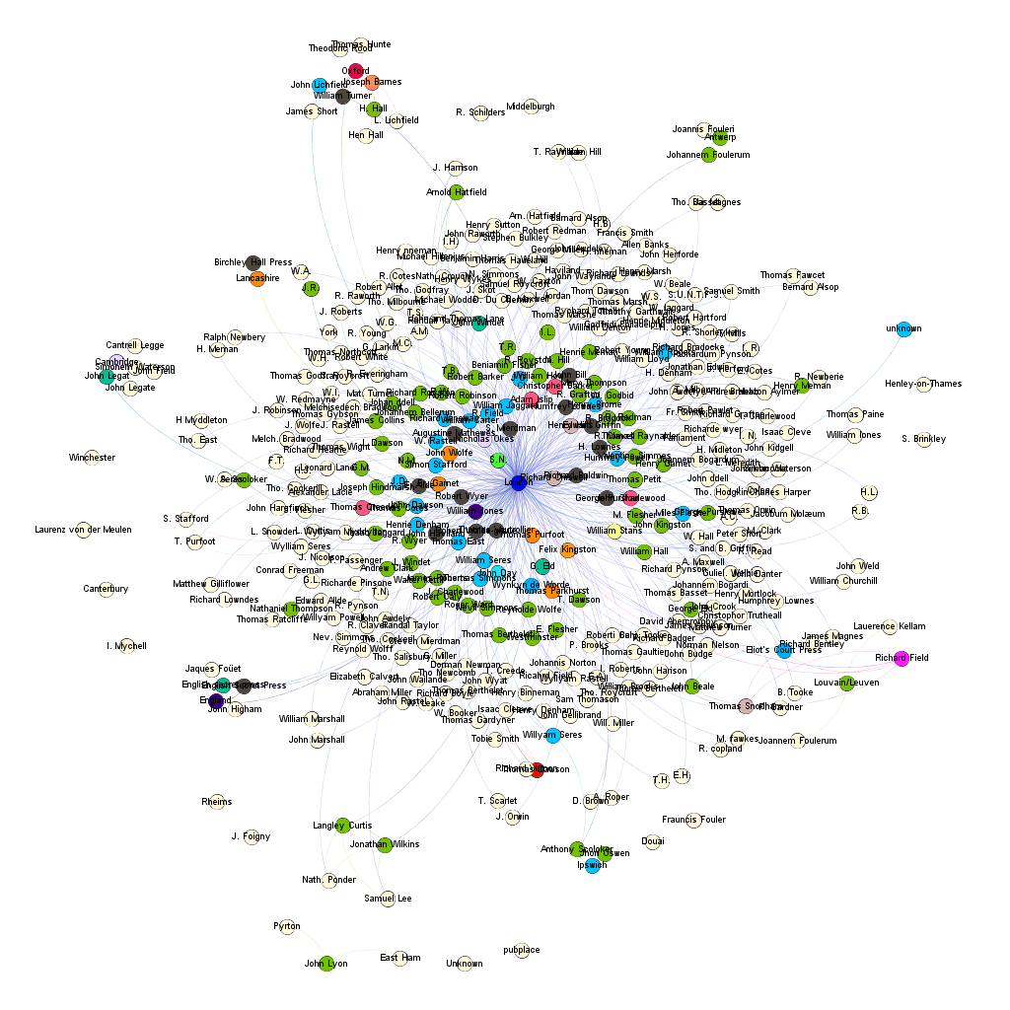
(Merged Data) English Recusant Literature Printing Network

Slide 23
trpnp.org

Slide 24
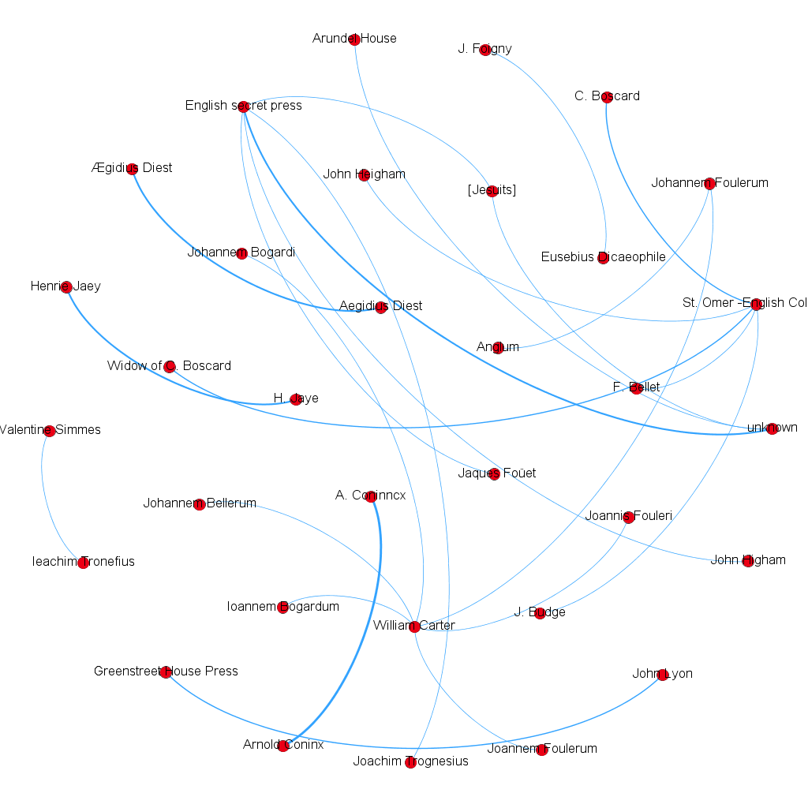
(Demo Data) English Recusant Literature Printing Network with Alt. Names

Slide 25
So What?
Higher than expected rate of “false imprints” – ESTC reliance on the phrase?
Data-driven evidence towards traditional debates
Potential shift in geographical locus of printing
(according to false imprints)
Suggested higher rate of English Clandestine printing
High rate of S.N. or sine nomine records
The ability to highlight particular printers and their associations
(ex. William Carter) with the potential for the discovery of new printers or secret associations
Tool or toy?
Exploration, abstraction, or distraction?

Slide 26
So What?
By displaying the information in a more immediate way, we can learn about anomalies and question assumptions
Franco Moretti and the idea that these quantitative and digital methods cannot replace traditional forms of analysis, but they can enhance through new avenues of inquiry
This project is on-going, but has found a lot of new questions
Some of the origins of this project came from bibliometrics research and is an area we need to be increasingly conversant in
Next step should involve more intensive focus on the statistical models and assessing with more seriousness the weighting of the connections

Slide 27
Visualization Software
Gelphi, gelphi.org
  Learning curve
  Weighting models change display
  Powerful if you know what you’re doing
  Open source
Tableau, public.tableau.com
  Dead-simple
  Best for graphs and straightforward models
  Cannot really handle complex and multi-dimensional datasets
  Both have pretty severe limitations
    Neither allow for dynamic processing
    Data analysis needs to be done elsewhere

Slide 28
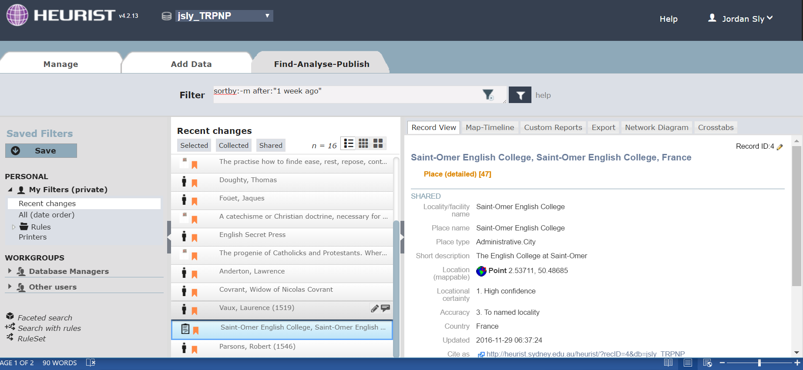
Future ideas and what’s possible with the data
Illustrating the printing location (Greenstreet House) and the selling location (“under the syne of Blacke Beare Pauls Church-yard”)
Matching the false imprint information with the ESTC scholarship-derived location
Database to more accurately and thoroughly capture location and biography information
Interactive Data visualizations (more like Six Degrees of Francis Bacon)
Continue to build the social network through traditional scholarship but informed by the data collection and display

Slide 29
