Slide 1
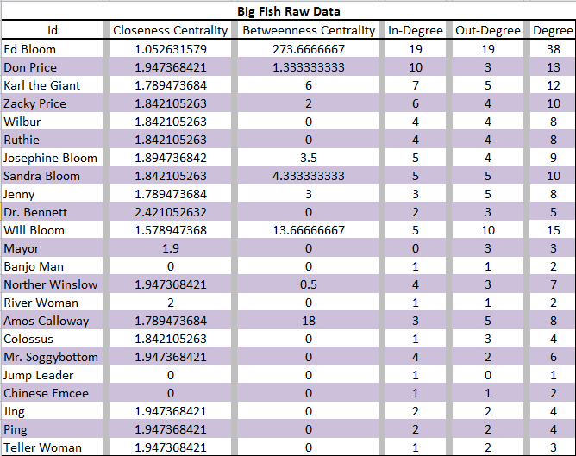
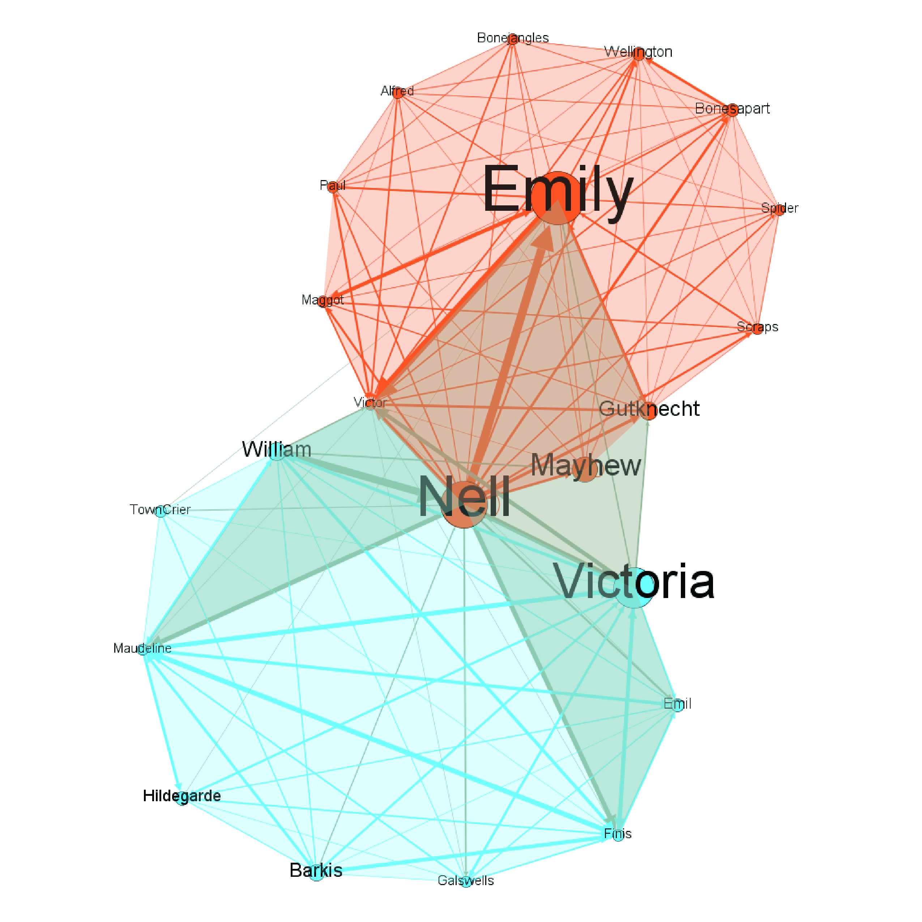
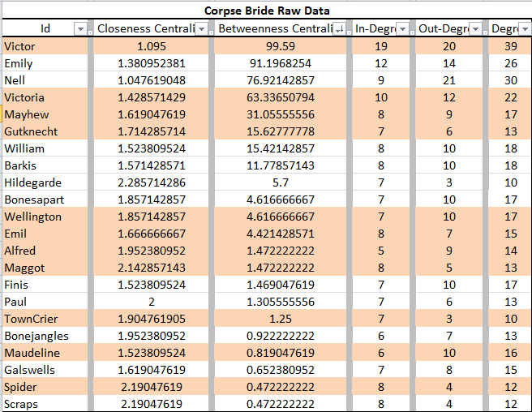
Tim Burton: Character Network Analysis
Nickolas Falk – Priddy Library, Universities at Shady Grove
Introduction
Based on each scene within the movie and number of times the character spoke to another character, I was able to gauge the tie strength between the characters and apply this to the character network visualization. Without the technological and programming capabilities, my study was set-up to be accomplished by manual data collection with synthesis and visualizations done by Gephi 9.1. I used auditory cues to build tie strength, adjacency matrices, data based on character appearances and data collected of who appears with whom (qualified by the criteria of a character speaking to character).
The CBO triad have high values for betweenness centrality (the number of shortest paths from all characters to all others that pass through their data point); Victor with 99.590, Emily with 91.196 and Nell with 76.921. Again, from the CBH triad, Victoria from CBH has a betweenness centrality of 63.336.
Social network theory can contribute to the understanding of the structural properties of a movie and the data contained within it. The meaning or importance of the individual characters and the community in a movie is conditional on their position in a complex scheme of social relationships reported by the data.
Based on the idea that we can extrapolate key properties of a movie by collecting, compiling and analyzing its associated data character network analysis and comparison of two Tim Burton movies: this project entailed Corpse Bride and Big Fish. Based on the criteria of who spoke with whom, who appears with whom and the overall number of appearances throughout the films, I collected and compiled the data with the hopes of discovering trends within the network relationships that generate enthusiasm among Tim Burton’s fan base.
Raw Data
Corpse Bride Network
Background
Researchers have explored movie analysis based on complex character network structures. By suggesting that “roles in a movie form a small society and their interrelationship provides clues for movie understanding,” Weng, Chu and Wu (2007) focused on the social structures, leading roles and hidden communities.
Similarly, Park, Oh and Jo (2011) argued that “movie analysis through social relationships among characters can support various types of information better than audio-visual feature analysis.” By combining dialog with character social networks, they created a character-net to identify major and minor role classifications, community clustering and sequence detection.
Ding and Yilmaz (2010) used character affinity to find communities of characters and identify leaders within them. They also showed that analyzing the contents of the movie can fairly accurately establish the relationships between characters.
Applying the same methods and principles of triads to the movie Big Fish, there are again two main triads; the first triad of main characters, the Big Fish Hollywood (BFH) and Big Fish Outsider (BFO). The character network visualization demonstrates the cliques in the BFO triad. The first clique with Amos Calloway as the hub includes Mr. Soggybottom, Colossus, Karl the Giant and Ed Bloom. The second clique, Will Bloom as the hub contains Dr. Bennett, Josephine Bloom, Sandra Bloom and Ed Bloom. The third clique, Ed Bloom as the hub connects Don Price, Zacky Price, Wilbur, Ruthie.
Big Fish Network
Conclusion
Case Study
Burton has continually worked inside the mainstream movie scheme, but has also experienced an exceptional freedom to follow his eccentric, abnormal stories of characters existing on the peripheral of society. Although this particular study is inconclusive as it is based on only two of the twenty-three films and human-based data collection, it still holds some merit. Based on the analysis, I conclude that a large portion of Burton’s fan base certainly see something of themselves in the guy who gives it his all but never quite makes it, a mother trying to hold two families together or any of the piece of the story in which they can insert themselves. Through these films, Burton fans identify not with the heroes or victims but, rather, the complex and underlying characters relationships whom society may regard as misunderstood.
These relational tendencies are facilitated with a use of overlapping triadic networks. The first is the ever popular Hollywood main characters while there is a subtle network just below that, which introduces an “outcast” type character. This in turn helps make it okay to be an outsider and fit into society. More studies would likely add further support to this theory.
Results
In my research I meshed various approaches by recording both the visual components of overall appearances throughout the movie and compared it to the character network data derived from who appears, qualified by the criteria of who talked to whom. This was along the lines with what was done with RoleNet, developed by Weng, Chu and Wu (2007), an automated program with facial recognition technology; although I set about using alternate criteria and collected the data myself.
Burton is using a triad of characters in two sets. One triad is comprised of the Hollywood set, what the audience see’s the most and tend to relate to; meanwhile there is a second triad that appeals to the fan base, which is formed between two of the first triad and a third “outsider” type character. There is also a third triad of story relationships combined with a clique in each of these relationships.
The first set of data was collected for Corpse Bride. Looking at the data for pure number of times a character appears, the first triad of main characters is Victor with 195, Emily with 167 and Victoria with 108 appearances. This provides the Corpse Bride Hollywood (CBH) movie scripting for main characters pretty well.
The second underlying triad, Corpse Bride Outsider (CBO) is found when looking at the data pulled using Gephi 9.1. Victor has a closeness centrality (the average distance to all other characters) of 1.095 showing that he is very centrally connected to all the characters. This holds true for Emily; closeness centrality of 1.380, but our “outsider” Nell is now introduced; closeness centrality of 1.047. To provide perspective, Victoria from CBH has a closeness centrality of 1.428.
References:
Ding, Lei, and Alper Yilmaz. "Learning Relations among Movie Characters: A Social Network Perspective." Computer Vision – ECCV, 2010: 410-423.
Park, Seung-Bo, Kyeong-Jin Oh, and Geun-Sik Jo. "Social network analysis in a movie using character-ne." Springer. January 18, 2011. http://download.springer.com/static/pdf/628/art%253A10.1007%252Fs11042-011-0725-1.pdf?originUrl=http%3A%2F%2Flink.springer.com%2Farticle%2F10.1007%2Fs11042-011-0725-1&token2=exp=1452961908~acl=%2Fstatic%2Fpdf%2F628%2Fart%25253A10.1007%25252Fs11042-011-072.
Weng, Chung-Yi, and Wei-Ta Chu. "RoleNet: Movie Analysis from the Perspective of Social Networks." IEEE Transactions on Multimedia, 2009: 256-271.
Weng, Chung-Yi, Wei-Ta Chu, and Ja-Ling Wu. "Movie Analysis Based on Roles' Social Network." IEEE International Conference on Multimedia and Expo, 2007: 1403-1406.

