Slide 1


Melting the Ice International Students and UMD
Nedelina Tchangalova
nedelina@umd.edu
Reference & Instruction Librarian
Engineering and Physical Sciences Library (EPSL)
Maryland Library Association (MLA) Annual Conference
May 4 - 6, 2011 - Clarion Resort, Ocean City, Maryland
Notes:
Hello! My name is Nedelina Tchangalova. I will walk you through my experience in welcoming international students at the University of Maryland. I will explain some strategies that I use to make them feel not as guests but feel as they are at home.

Slide 2
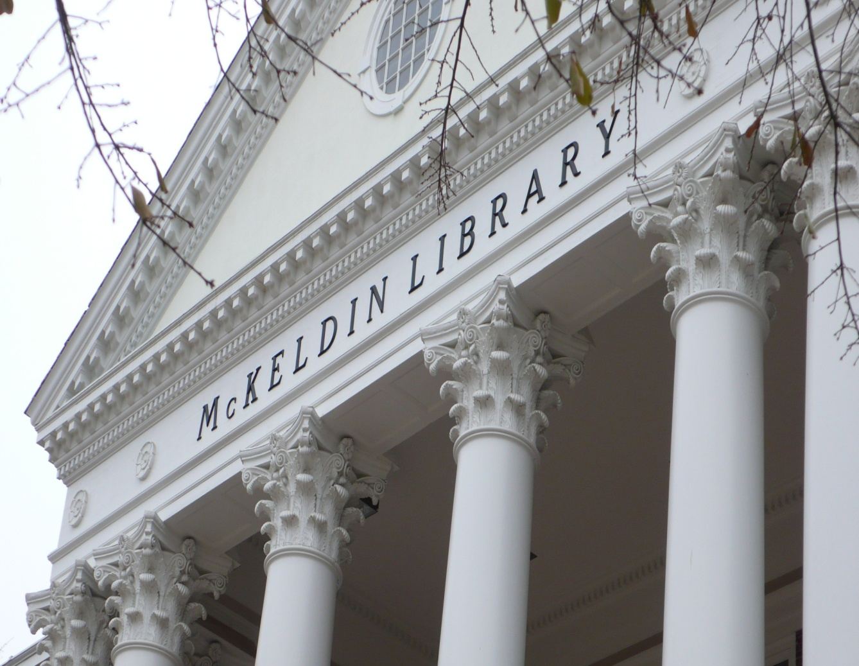
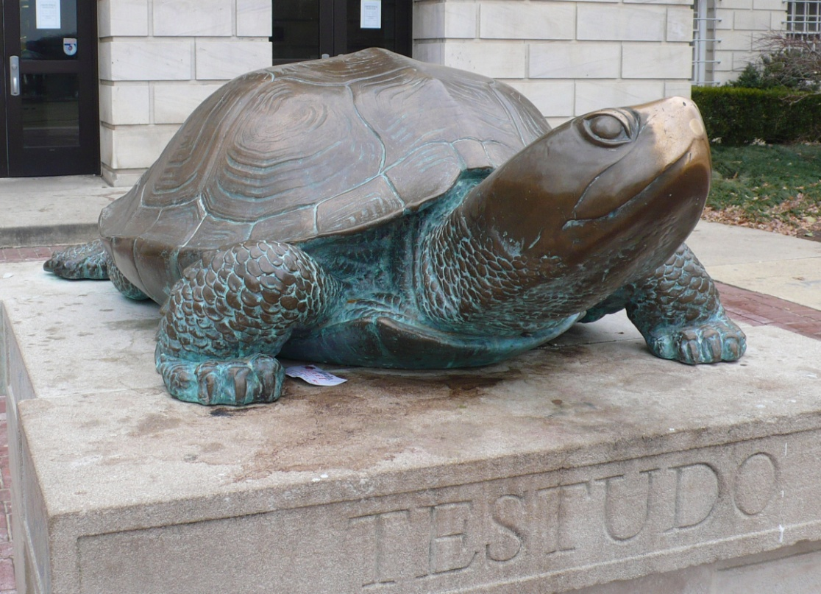
Welcome
to the University of Maryland in College Park!
Notes:
So, welcome to the University of Maryland! This is the 2nd Alma Matter after I received my first Master of Science (MS) degree in Chemical Engineering from Sofia, Bulgaria.
Living in the state of Maryland, I applied to the only library school in the state and graduated with a Master of Library Science (MLS) degree falling in love with this terrapin [CLICK]. As a consequence, I became an academic librarian at the Engineering & Physical Sciences Library (EPSL), combining both my degrees in engineering and library science. I was one of the students from the international pool … [NEXT SLIDE]

Slide 3
Fall 2010 Student Enrollment
10,719
Grads
26,922
Undergrads
TOTAL: 37,641 students
3, 600 international students
(10% of the student population)
Notes:
This fall semester, about 38,000 students enrolled in the University of Maryland programs. International students are a significant and growing population at the University of Maryland – College Park.
[CLICK] With more than 3,600 international students or 10 percent of the students who enrolled at the University of Maryland (UM) on campus in 2010, we have over 150 different countries represented in our university community, placing the university among the top 20 U.S. universities serving international students.

Slide 4
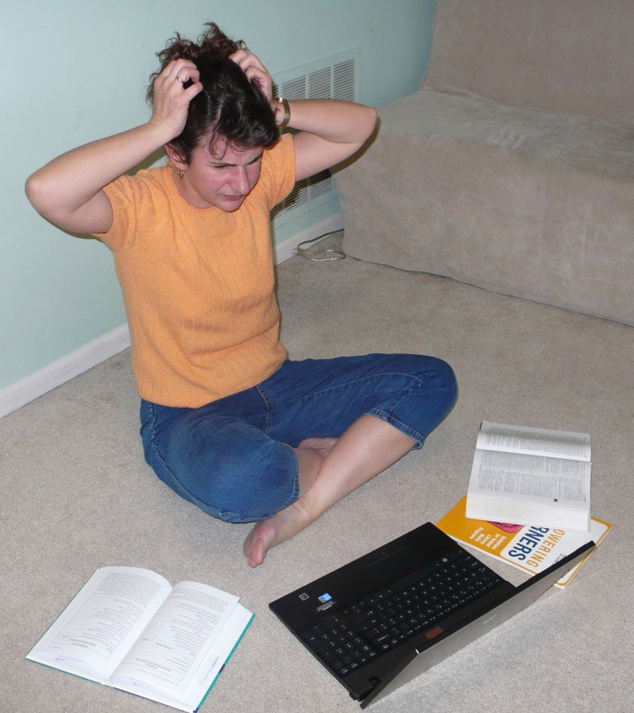
The First Days in the US
Language barriers
Cultural differences
Social isolation
Notes:
[CLICK] And I was myself one student from this pool.
[CLICK] I had to deal with the language barrier at that time, as well with the huge space on campus.
[CLICK] I experienced a cultural shock and was insure on of proper classroom behavior. I didn’t even know how to call the professor: should I use formal or informal greeting, should I address the professor by his/her first or last name, should I add a title such as “Professor” or “Dr.” before the last name. I was surprised to see my classmates bringing food and drinks in the classroom and making noise with the plastic bags from snacks while the professor presented his/her lecture.
I was even terrified, when I saw a student crossing his/her legs on the top of the table during lectures.
[CLICK] I was completely lost. I was isolated socially and didn’t know where I can find other international souls to make a better adjustment on campus life. And on the top of this…. [NEXT SLIDE]

Slide 5
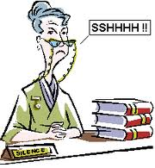

The Library Jargon
Notes:
I had to deal with the library jargon while pursuing my library degree. I was terrified when the professor asked us to visit the library and find the recommended readings in the databases. At the reference desk, I asked the librarian: “Where can I find these articles? The databases are not on the shelves.” At that time, I didn’t have any idea what does a database mean.
Back in Bulgaria, we didn’t even have an online catalog. I searched the library card catalog to find books --- How many of you have had this experience? --- and read print indexes and abstracts to find journal articles. In my engineering library in Bulgaria, the books were not available for check out. The librarian was a typical stereotype of a librarian [CLICK]: wearing glasses, sitting behind her desk without even trying to stand up and help you to find the book on the shelf. In some libraries in Bulgaria, the stacks are closed and you can not take the advantage of browsing the shelves.
So, when I came in the United States, I found a total different world.
Boolean searching, stacks, ILL, check-out are familiar terms for librarians and some American students. The terms are scary for the international students. I wasn't exposed to the various activities listed on the next slide. [NEXT SLIDE]
http://www.youtube.com/watch?v=TvX-8m7ClGo

Slide 6
Student s and the Libraries
Library Orientations
International Coffee Hour
Employment and Mentoring
Notes:
Foreign students have not only different academic need, they have also different social needs. There are many services on campus to assist students in coping and adjusting to life in the United States. One of the first steps in making these programs accessible and meaningful to foreign students is for library professionals to foster a closer collaboration with faculty. Foreign students have different academic needs. Collaborating with faculty will expose the student to the library services such as research assistance and this way might influence the student to use the library.
Nowadays, different departments on campus work together in helping students to adjust to the university life while they are facing cultural difficulties, language barriers and social isolation.
Before the beginning of every semester (in January and August), the international students attend a campus orientation provided by the Office of International Education Services. Here, they learn about various federal and University policies, programs, services and resources available for them on campus and students are being introduced to the vibrant educational life in College Park.
UM Libraries are partnering with the Office of International Education Services to offer library orientations and introduce the resources, services and collections to the newly coming students. Librarians attend International Coffee Hour and meet with students in an informal setting. Finally, UM Libraries provide employment opportunities for the students and thus expose them to the worklife in the United States.

Slide 7
Library Orientations
Sessions’ Length
30 min
60 min
Yearly Statistics
170 students
10 sessions
ACRL Standard 1
Learning Outcomes
ACRL Standard 2
ACRL Standard 5
Source: http://www.lib.umd.edu/UES/instruction-internationalstudents.html
Notes:
The libraries are very intimidating even for the American students, and this is why many professors require students to attend library orientations or bibliographic instructions. It depends on the librarian faculty to foster a positive library experience for the international student.
At the library orientations, the goal is to give a brief overview of the 8 libraries on campus and to encourage students to ask questions about how the libraries could assist them in their study and research.
The length of the orientations are 30 or 60 minutes.
The Libraries teach approximately 170 international students in 10 orientation sessions per year. These statistics may vary.
As an accredited institution, UM Libraries follow the ACRL standards for information literacy.

Slide 8
ACRL Standards and Student Learning Outcomes
Standard
Standard
Standard
Recognize that there are different types of research tools, such as the Libraries' catalog, periodical databases, and the Internet.
Identify the different ways to get help from library staff.
Develop an awareness for the importance of citing works to avoid plagiarizing.
1
2
5
Notes:
We want them to:
[CLICK] Recognize that there are different types of research tools, such as the Libraries' catalog, periodical databases, and the Internet.
[CLICK] Identify the different ways to get help from library staff.
[CLICK] Develop an awareness for the importance of citing works to avoid plagiarizing.

Slide 9
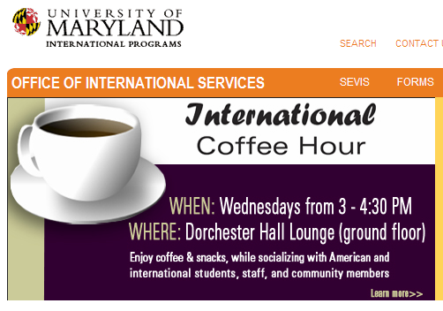
Notes:
International Coffee Hour is a weekly event (during the Fall and Spring semesters) where students, staff, and the Maryland community can get together and socialize. Each week a different campus organization sponsors the International Coffee Hour.

Slide 10
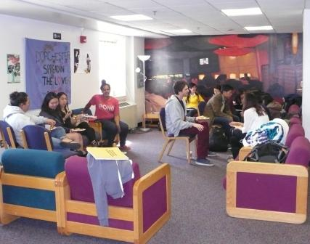
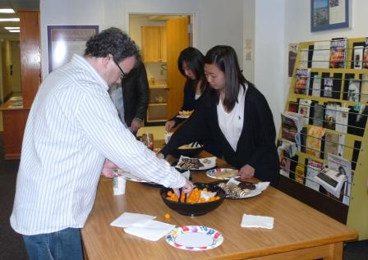
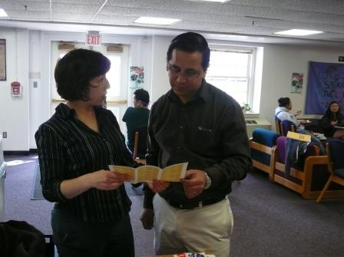
International Coffee Hour
Notes:
Here you see the event was sponsored by the UM Libraries .
[CLICK] Picture 1: It is an informal setting where students meet current and new friends, as well faculty members.
[CLICK] Picture 2: The libraries provide free drinks and snacks for students’ enjoyment.
[CLICK] Picture 3: A student talks to a librarian. The librarian brings a laptop to demonstrate a search in the library catalog or databases. Here, on this picture, she is showing a directory of librarian subject specialists.
My experience: talking to students in an informal setting makes the librarian more visible and approachable. International students are encouraged to ask any questions ranging from finding books in the stacks to where to eat on campus. I hand them out my business card and very often students contact me with questions they have regarding their assignments or even cultural life on campus.

Slide 11
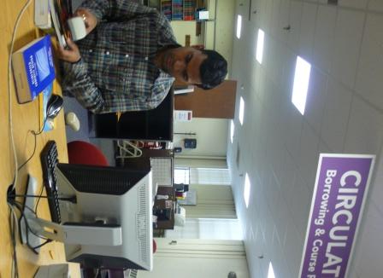
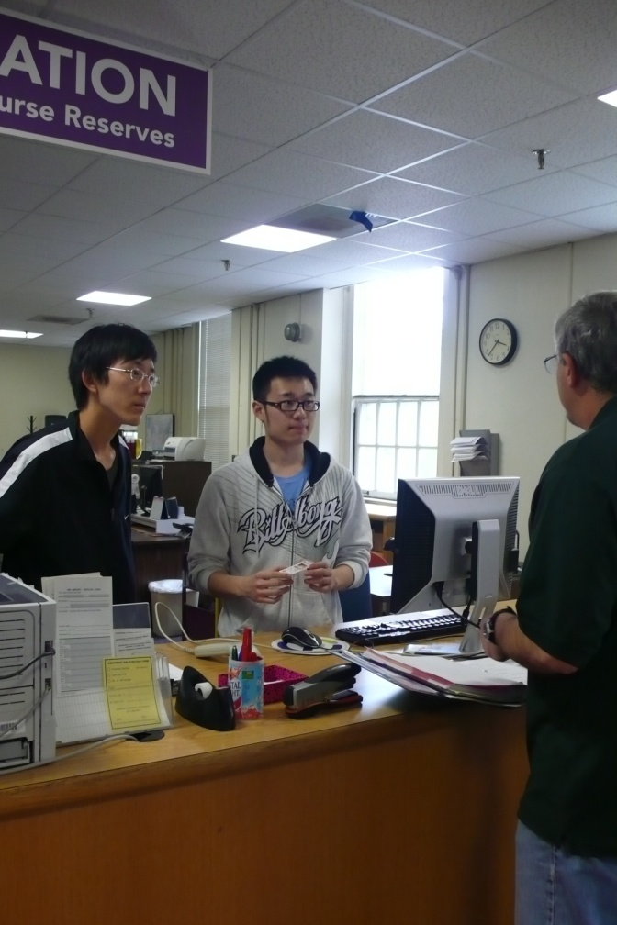
Employment and Mentoring
Notes:
[CLICK] Left picture: a student from India checking in books
[CLICK] Right picture: students from China, helping a customer
We hire students all year long and teach them how to navigate not only the library landscape but the campus environment. We transform the employment into mentoring.
It’s very important to be aware of cultural differences. Many times, international students wait for you to speak first. So greet them with a smile and chat with them whenever you have a chance to. I take an extra step to minimize the distance in the hierarchical structure and often mentor a student working at the reference desk. I work with the student and assist her/him in learning the library operations faster and be a confident searcher. I take an extra step to invite the student for a lunch or a walk in our break time, and provide mentoring opportunities as they arise. I am often asked for letters of recommendations as the students pursue their career development further.
Talk about the student with religious needs, the need to be organized and honest on the workplace, teach him/her professional attitude.

Slide 12
Conclusions and Recommendations
In the classroom
Outside the classroom
Gather background information from students
Avoid idioms
Limit the use of library jargon
Speak clearly and at a normal rate
Plan extra time for Q&A
Greet students with a smile
Speak first
Be patient
Learn about student’s country and culture

Slide 13
References
Amsberry, D. (2008). Talking the Talk: Library Classroom Communication and International Students. Journal of Academic Librarianship, 34(4), 354-357.
Baron, S. & Strout-Dapaz, A. (2001). Communicating with and empowering international students with a library skills set. Reference Services Review, 29(4), 314 - 326.
Evans, K. (2006). INTERLINK at Indiana State University: adventures in library instruction for international students. Indiana Libraries, 25(4), 8-10.
Leedock, J. & Roth, C. (Presenters). (2011, July 13). Revamping pre-arrival communications for international students. [Webcast]. Retrieved from http://www.academicimpressions.com/PDF/0711-intl-orientation.pdf
Sackers, N., Secomb, B. & Hulett, H. (2008). How well do you know your clients?: International students' preferences for learning about library services. Australian Academic & Research Libraries, 39(1), 38-55.
Shaffer, C., Vardaman, L. & Miller, D. (2010). Library usage trends and needs of international students. Behavioral & Social Sciences Librarian, 29 (2), 109-117. doi:10.1080/01639261003742231
University of Maryland Libraries. (2010). International Student Orientations. Retrieved from http://www.lib.umd.edu/UES/instruction-internationalstudents.html

