Slide 1
High-Performance DRAM System Design Constraints and Considerations
by: Joseph Gross
August 2, 2010

Slide 2
Table of Contents
Background
  Devices and organizations
DRAM Protocol
  Operations and timing constraints
Power Analysis
Experimental Setup
  Policies and Algorithms
Results
Conclusions
Appendix

Slide 3
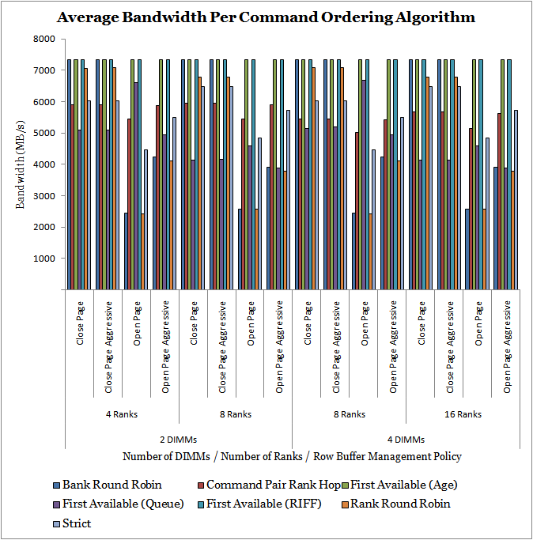
What is the Problem?
Controller performance is sensitive to policies and parameters
Real simulations show surprising behaviors
Policies interact in non-trivial and non-linear ways
Notes:
MC is much like a CPU
Out of order, multi-level scheduling
Connects the CPU(s) to the memory, cpu is fixed, drams are fixed, must work to connect the two
Applications have unique access patterns

Slide 4
DRAM Devices – 1T1C Cell
Row address is decoded and chooses the wordline
Values are sent across the bitline to the sense amps
Very space-efficient but must be refreshed
Notes:
Cells and bitlines

Slide 5
Organization – Rows and Columns
Can only read from/write to an active row
Can access row after it is sensed but before the data is restored
Read or write to any column within a row
Row reuse avoids having to sense and restore new rows

Slide 6
DRAM Operation

Slide 7
Organization
One memory controller per channel
1-4 ranks/DIMM in a JEDEC system
Registered DIMMs at slower speeds may have more DIMMs/channel

Slide 8
A Read Cycle
Activate the row and wait for it to be sensed before issuing the read
Data begins to be sent after t_{CAS}
Precharge once the row is restored
Notes:
Add parallel structure

Slide 9
Command Interactions
Commands must wait for resources to be available
Data, address and command buses must be available
Other banks and ranks can affect timing (t_{RTRS}, t_{FAW})

Slide 10
Power Modeling
Based on Micron guidelines (TN-41-01)
Calculates background and event power

Slide 11
Controller Design
Address Mapping Policy
Row Buffer Management Policy
Command Ordering Policy
Pipelined operation with reordering
Notes:
Looks like a cpu
pipelined

Slide 12
Controller Design
Notes:
Two levels of scheduling
Looks like a cpu

Slide 13
Transaction Queue
Not varied in this simulation
Policies
  Reads go before writes
  Fetches go before reads
  Variable number of transactions may be decoded
Optimized to avoid bottlenecks
Request reordering

Slide 14
Row Buffer Management Policy

Slide 15
Address Mapping Policy
Chosen to work with row buffer management policy
Can either improve row locality or bank distribution
Performance depends on workload
Notes:
Long line for express checkout vs short line for normal checkout

Slide 16
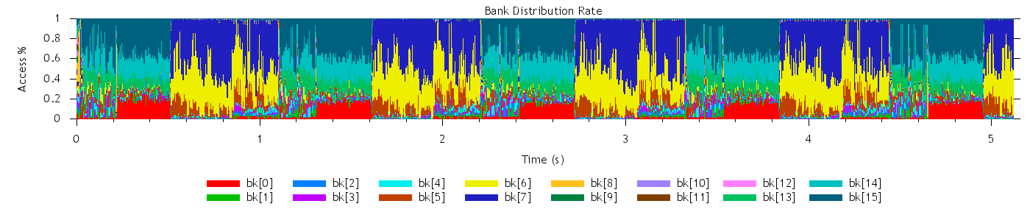
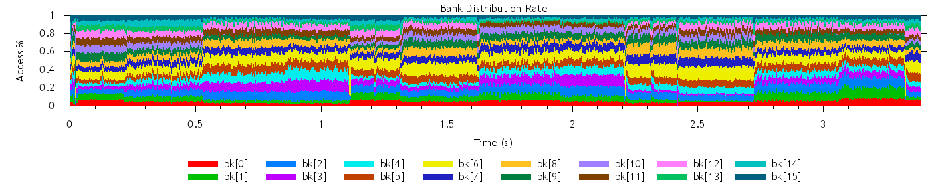
Address Mapping Policy – 433.calculix
Low Locality (~5s) – irregular distribution
SDRAM Baseline (~3.5s) – more regular distribution

Slide 17
Command Ordering Algorithm
Second Level of Command Scheduling
  FCFS (FIFO)
  Bank Round Robin
  Rank Round Robin
  Command Pair Rank Hop
  First Available (Age)
  First Available (Queue)
  First Available (RIFF)
Notes:
Command scheduler

Slide 18
Command Ordering Algorithm – First Available
Requires tracking of when rank/bank resources are available
Evaluates every potential command choice
  Age, Queue, RIFF – secondary criteria

Slide 19
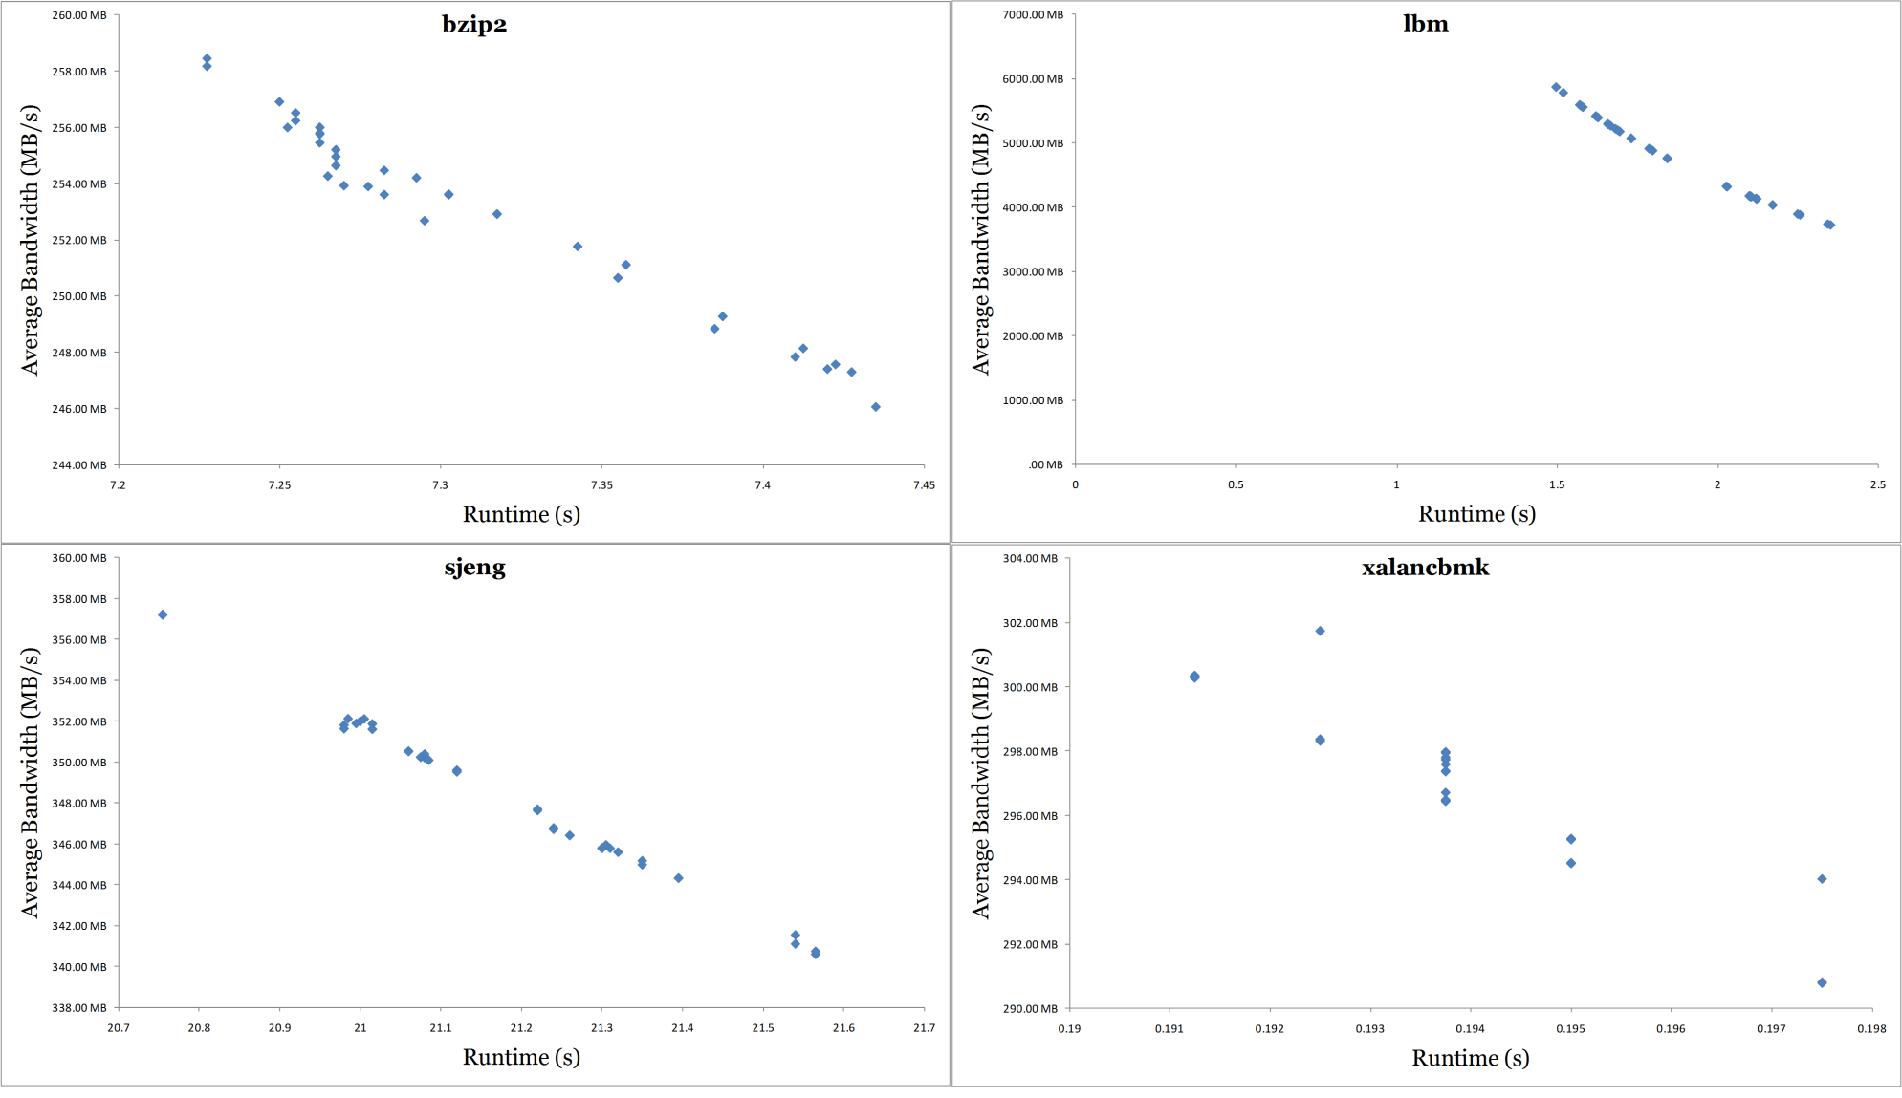
Results - Bandwidth

Slide 20
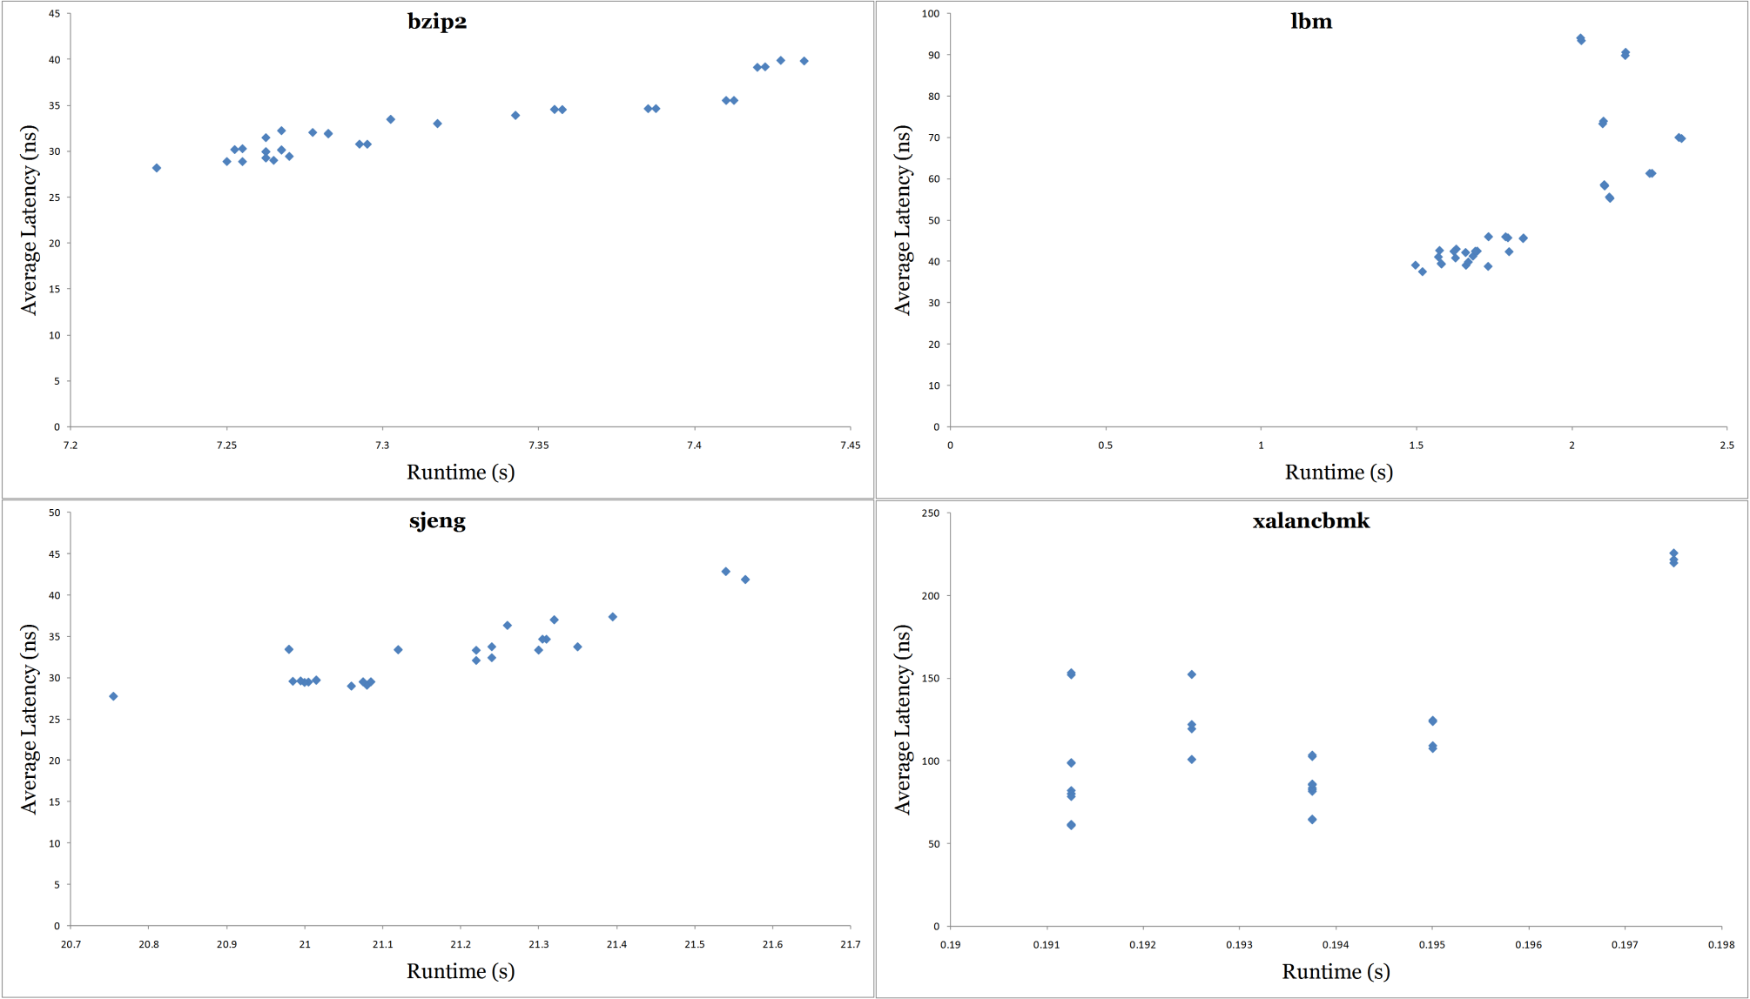
Results - Latency

Slide 21
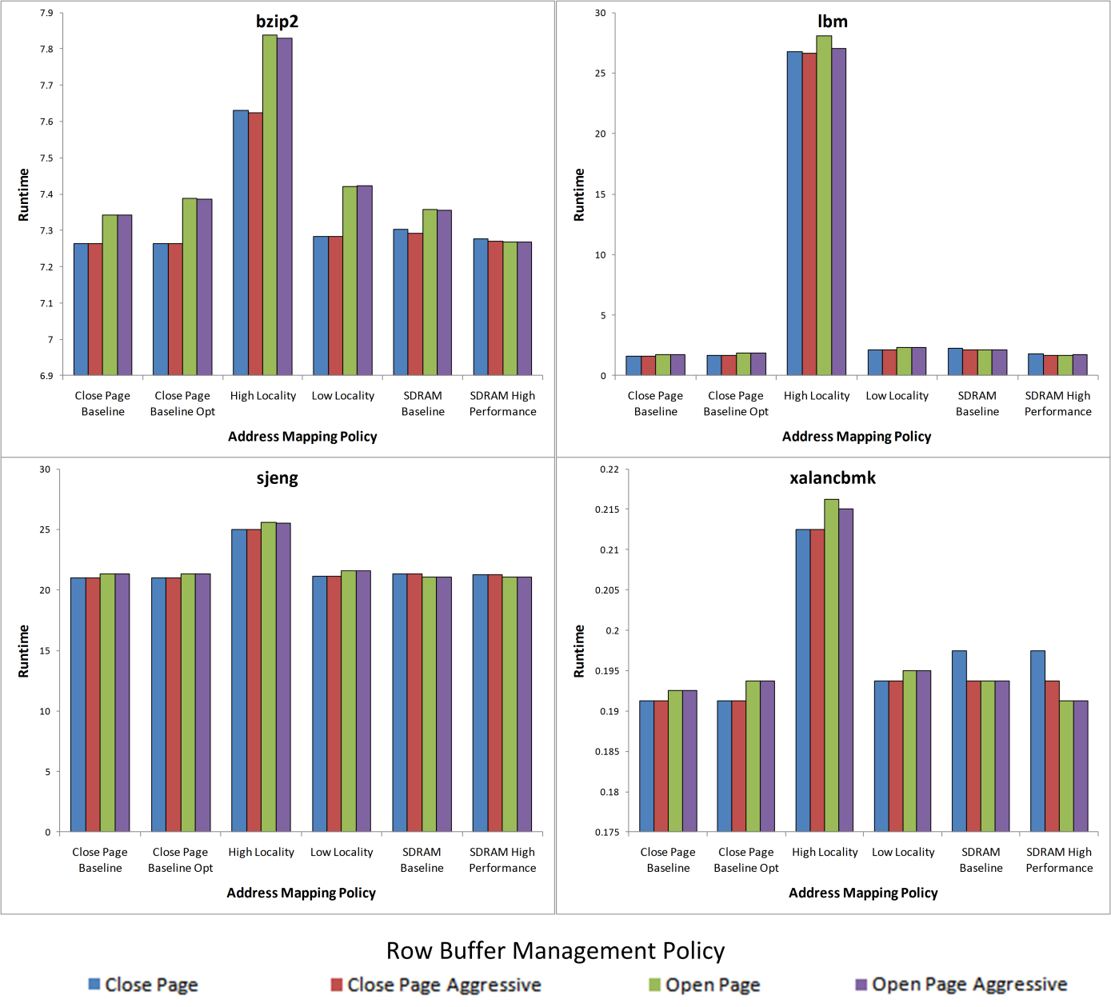
Results – Execution Time

Slide 22
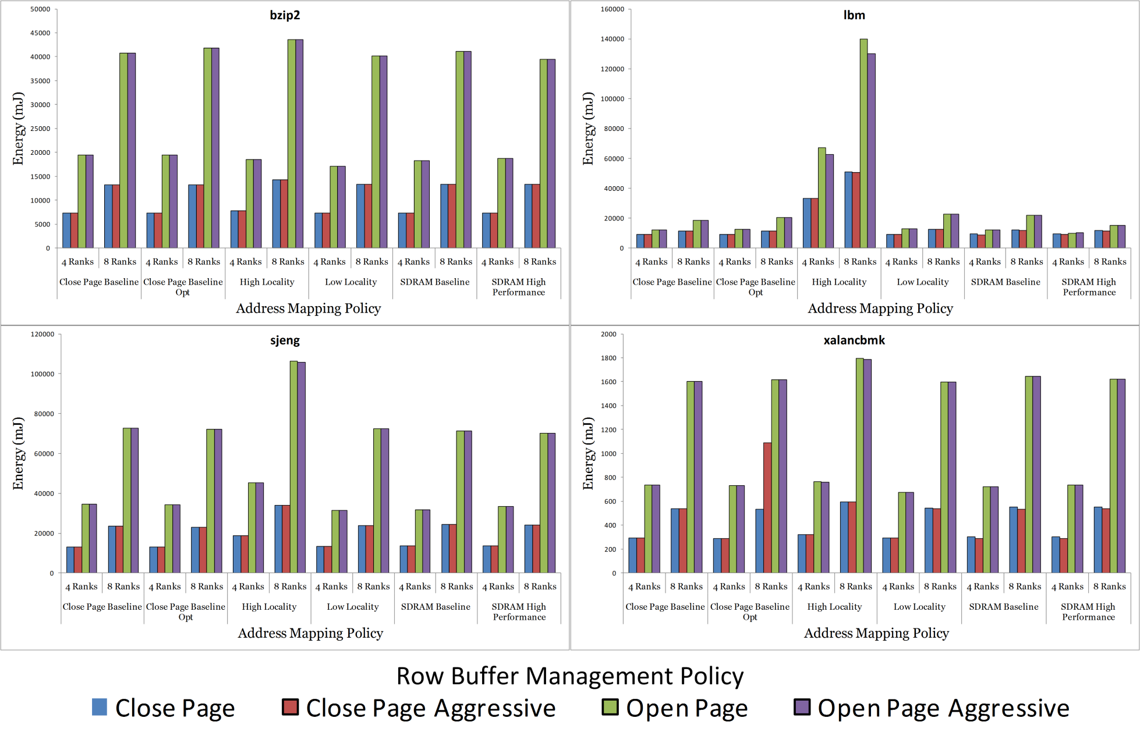
Results - Energy

Slide 23
Command Ordering Algorithms

Slide 24
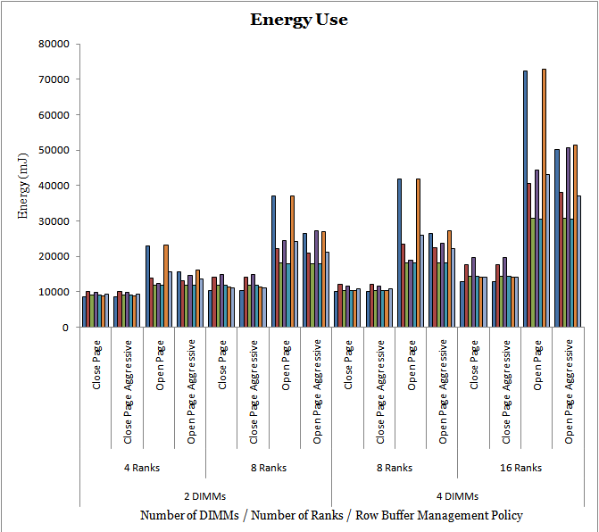
Command Ordering Algorithms

Slide 25
Conclusions
The right combination of policies can achieve good latency/bandwidth for a given benchmark
  Address mapping policies and row buffer management policies should be chosen together
  Command ordering algorithms become important as the memory system is heavily loaded
Open Page policies require more energy than Close Page policies in most conditions
The extra logic for more complex schemes helps improve bandwidth but may not be necessary
Address mapping policies should balance row reuse and bank distribution to reuse open rows and use available resources in parallel

Slide 26
Appendix

Slide 27
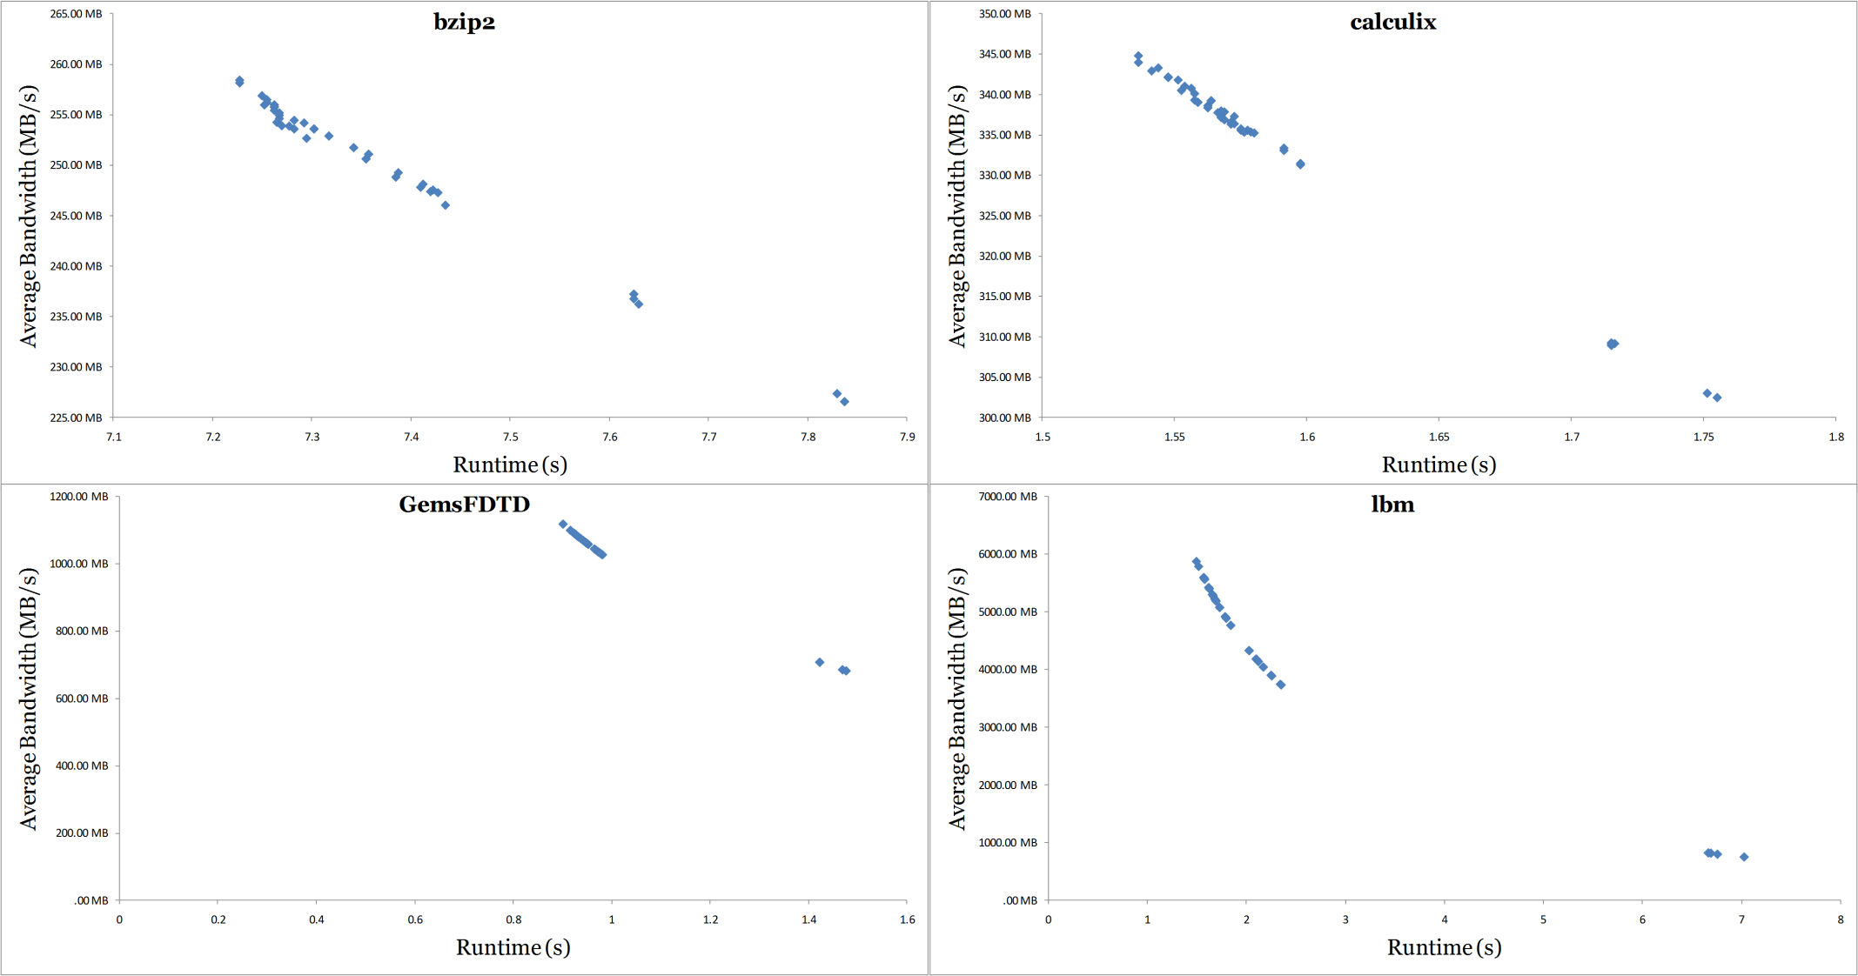
Bandwidth (cont.)

Slide 28
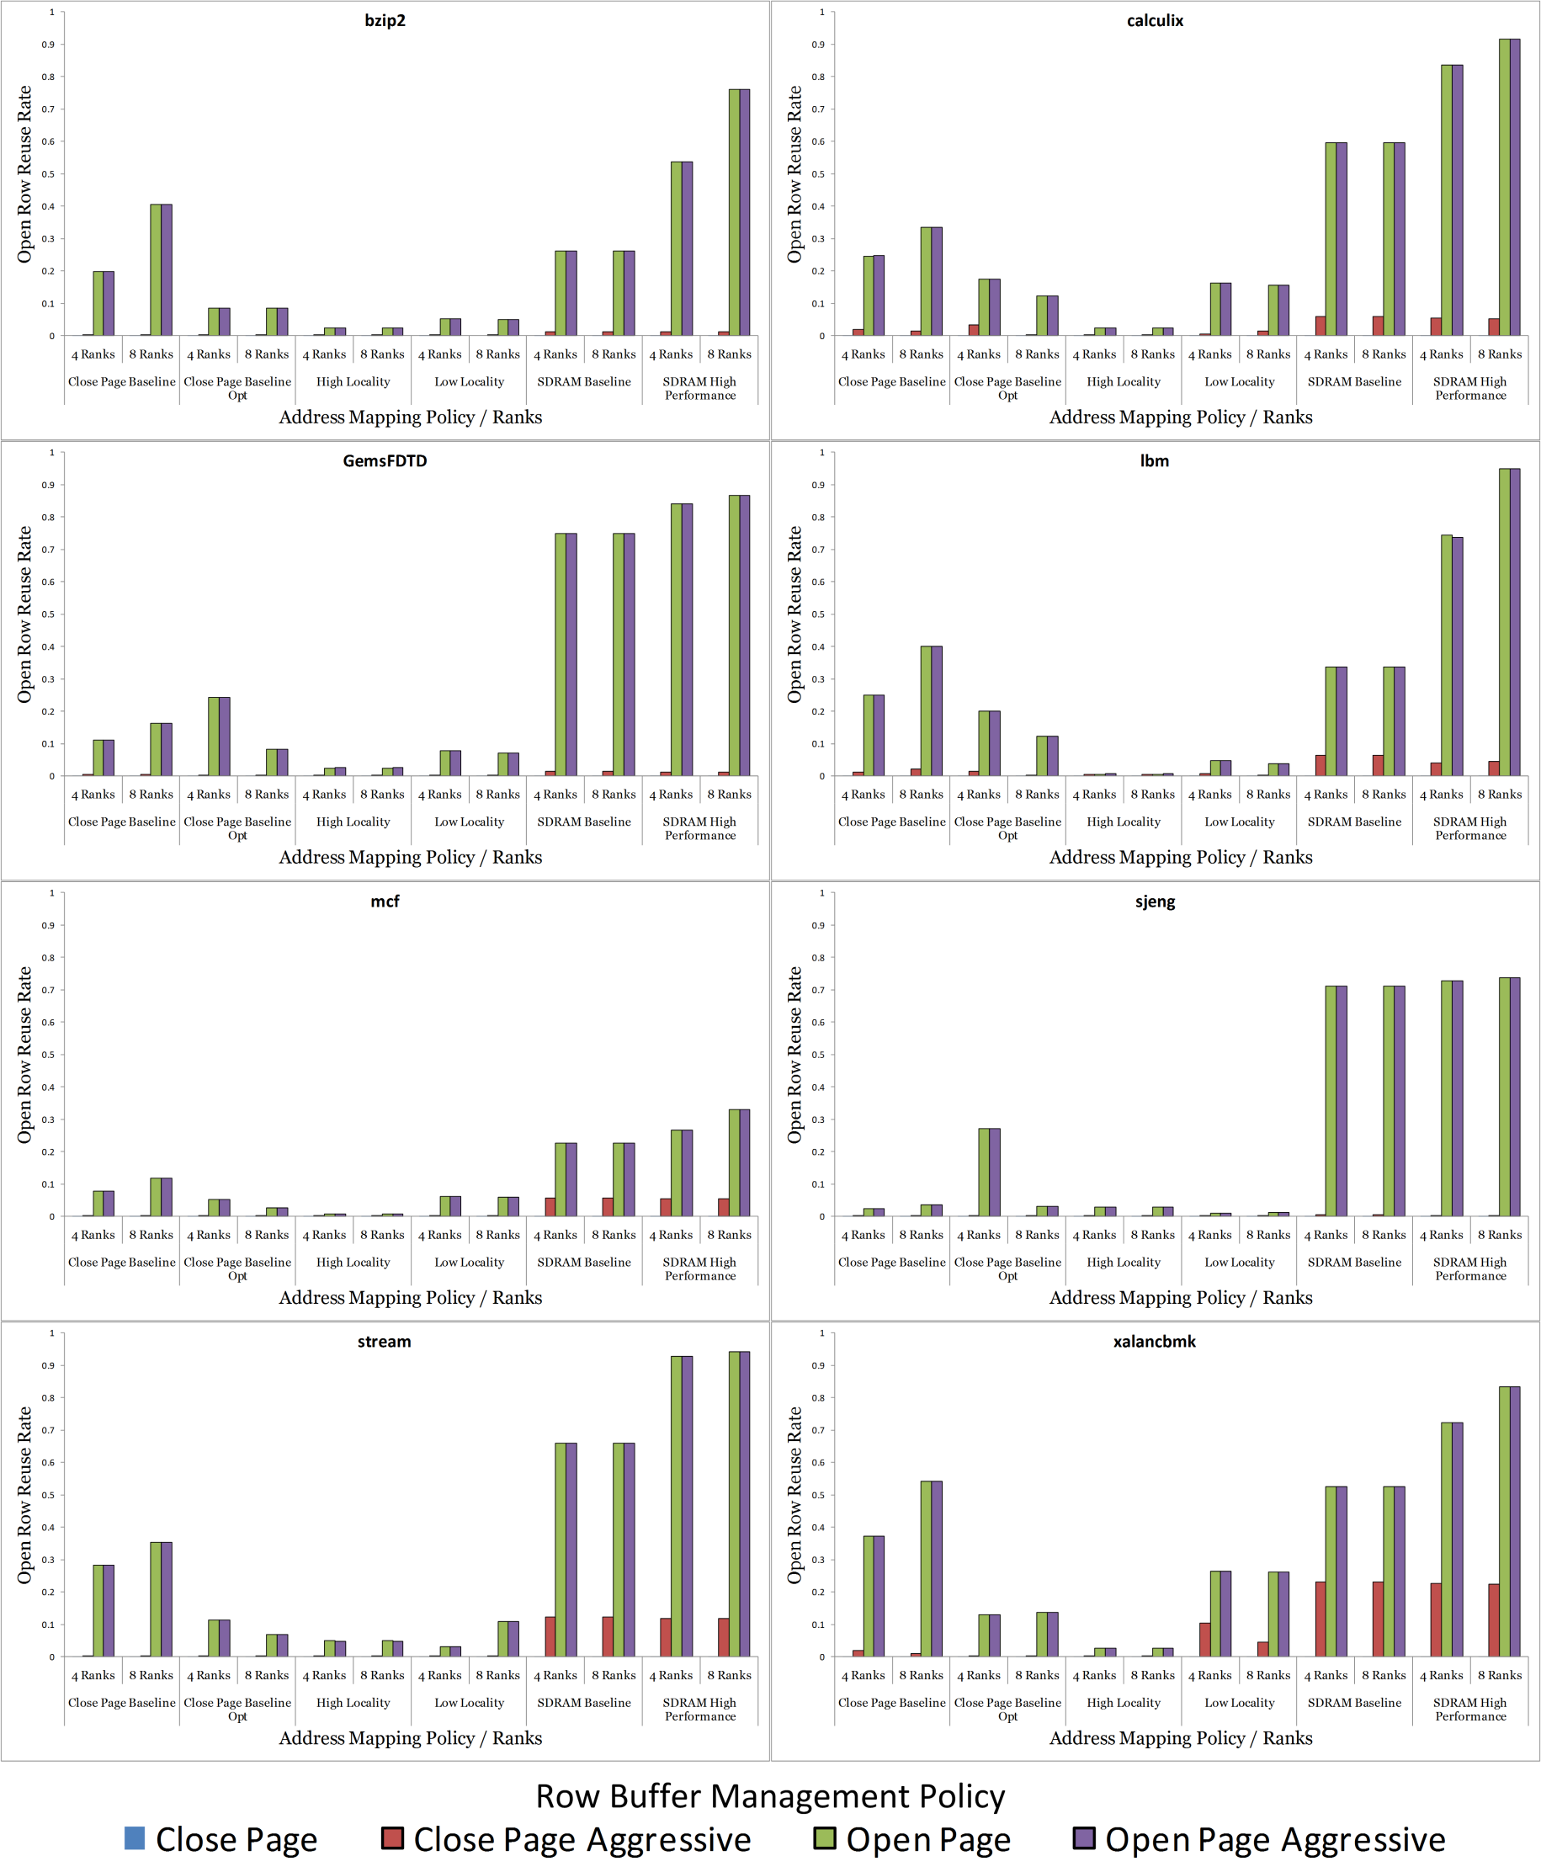
Row Reuse Rate (cont.)

Slide 29
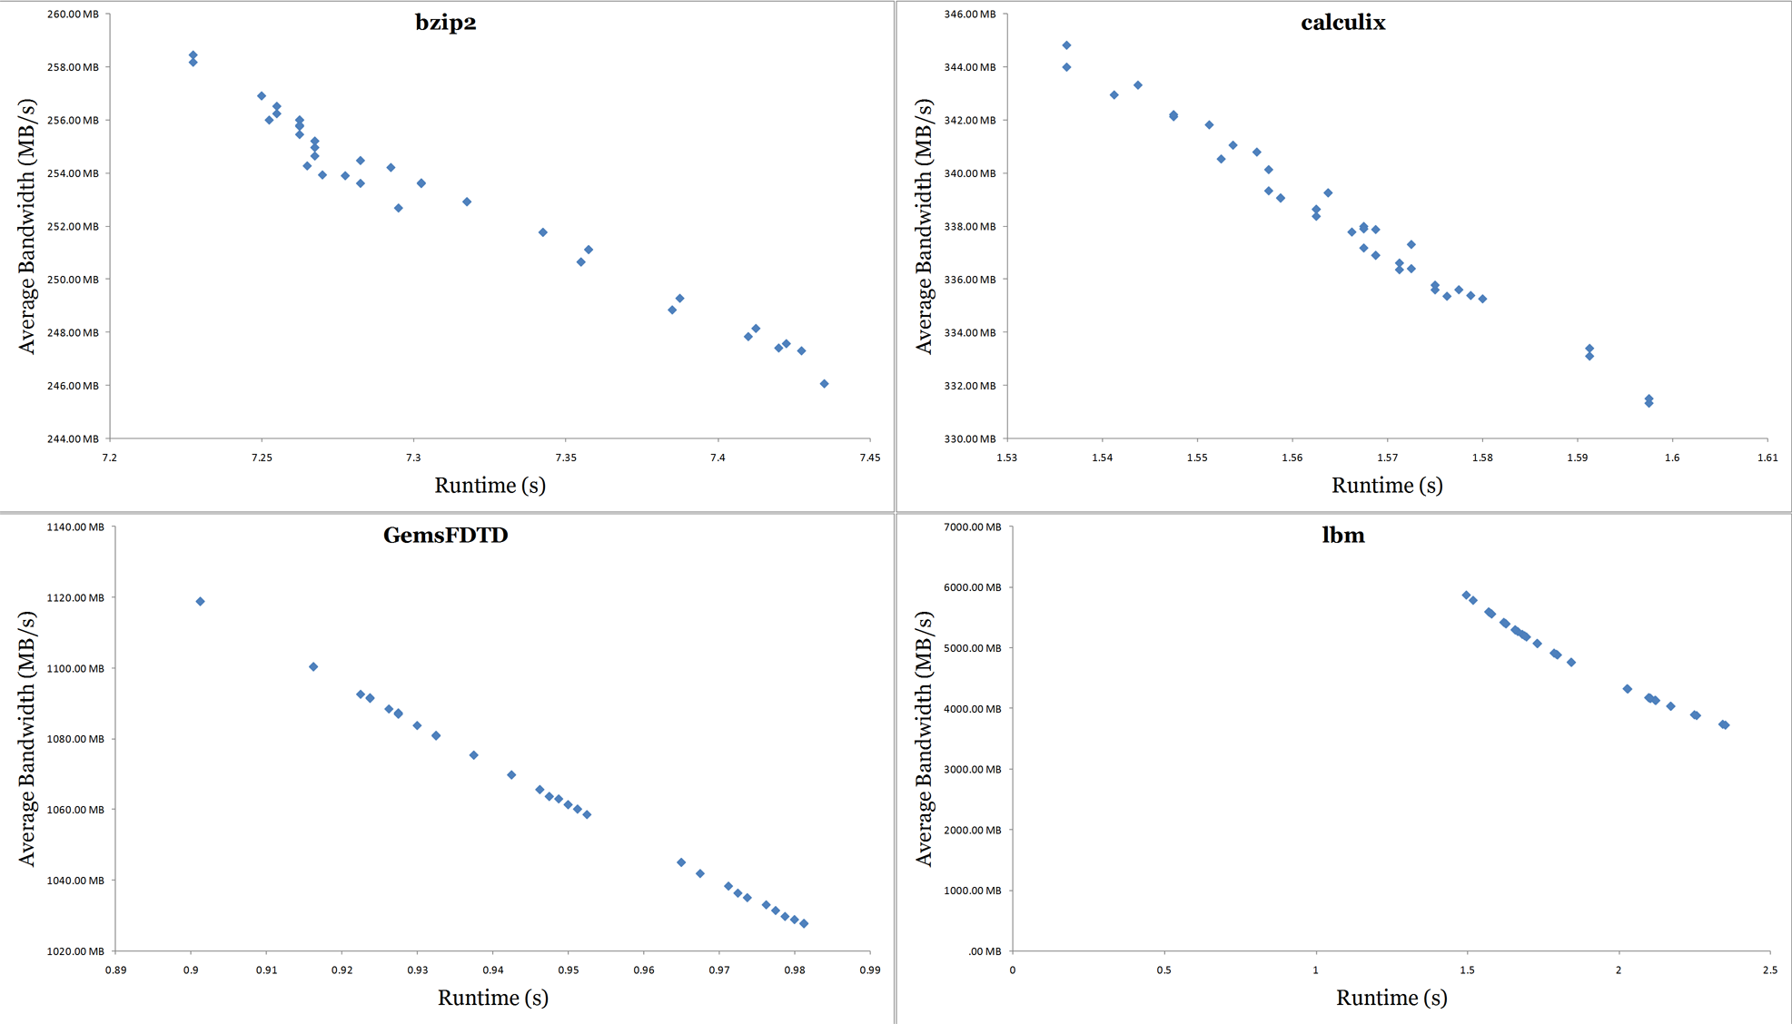
Bandwidth (cont.)

Slide 30
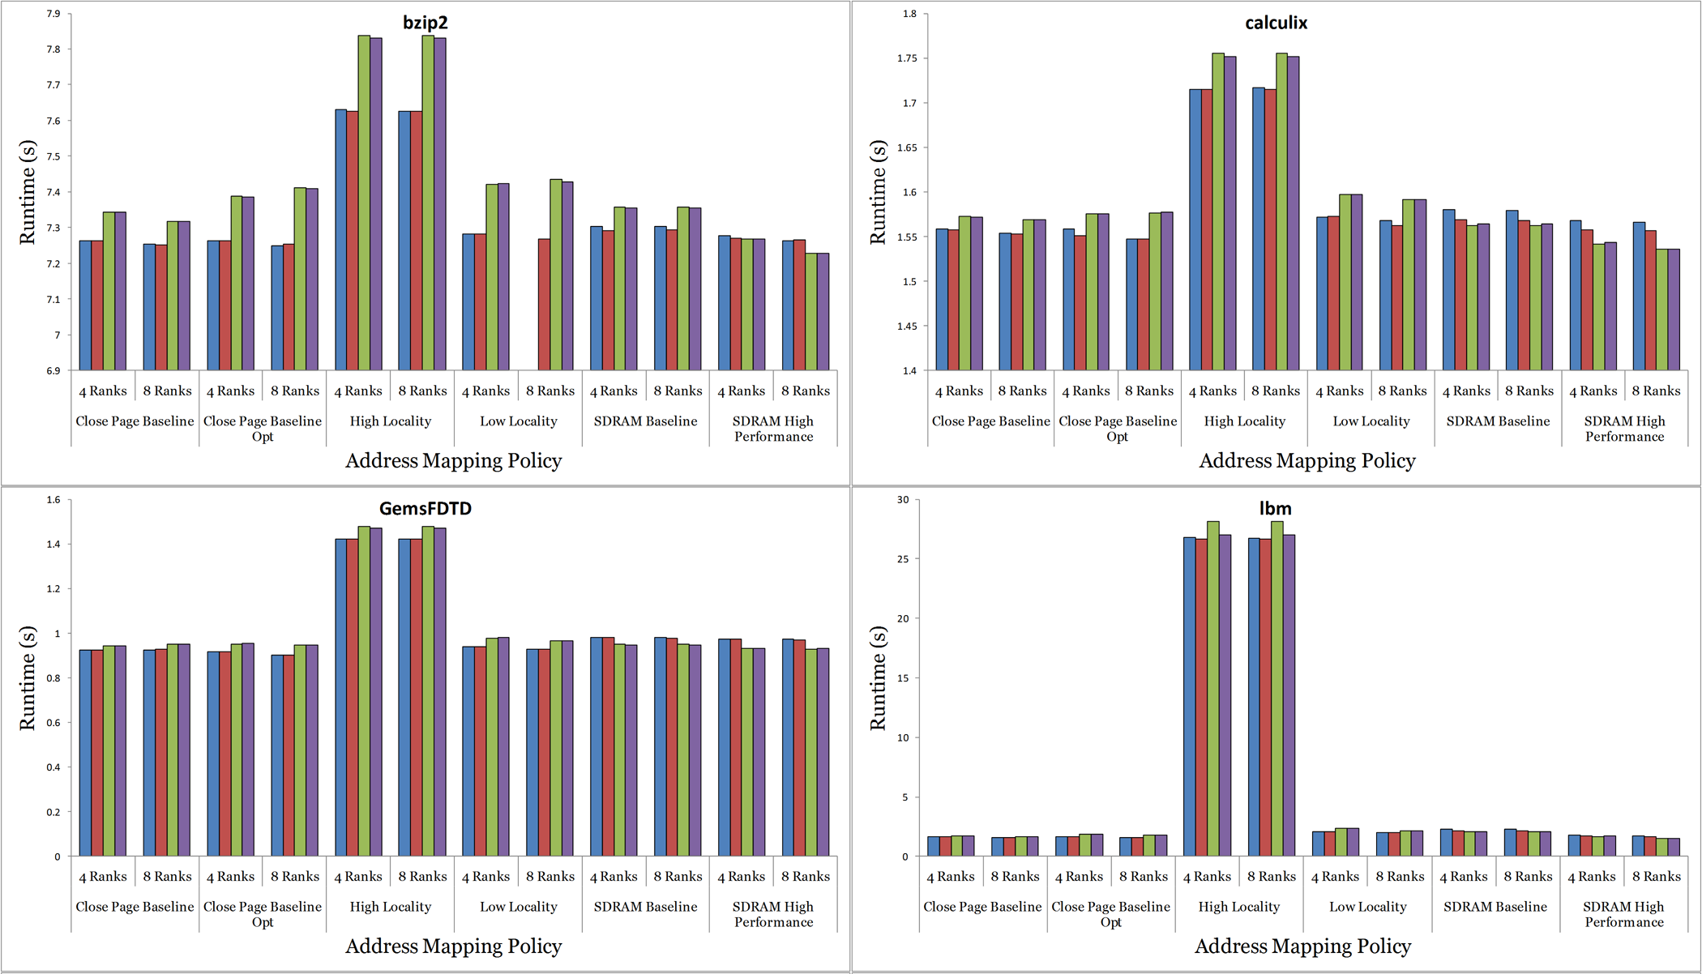
Results – Execution Time

Slide 31
Results – Row Reuse Rate
Open Page/Open Page Aggressive have the greatest reuse rate
Close page aggressive rarely exceeds 10% reuse
SDRAM Baseline and SDRAM High Performance work well with open page
429.mcf has very little ability to reuse rows, 35% at the most
458.sjeng can reuse 80% with SDRAM Baseline or SDRAM High Performance, else the rate is very low

Slide 32
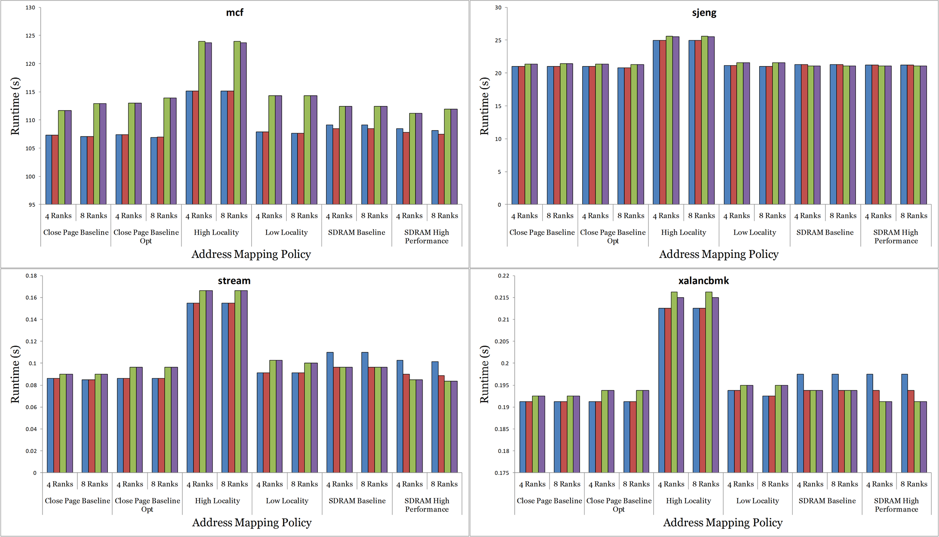
Execution Time (cont.)

Slide 33
Row Reuse Rate (cont.)

Slide 34
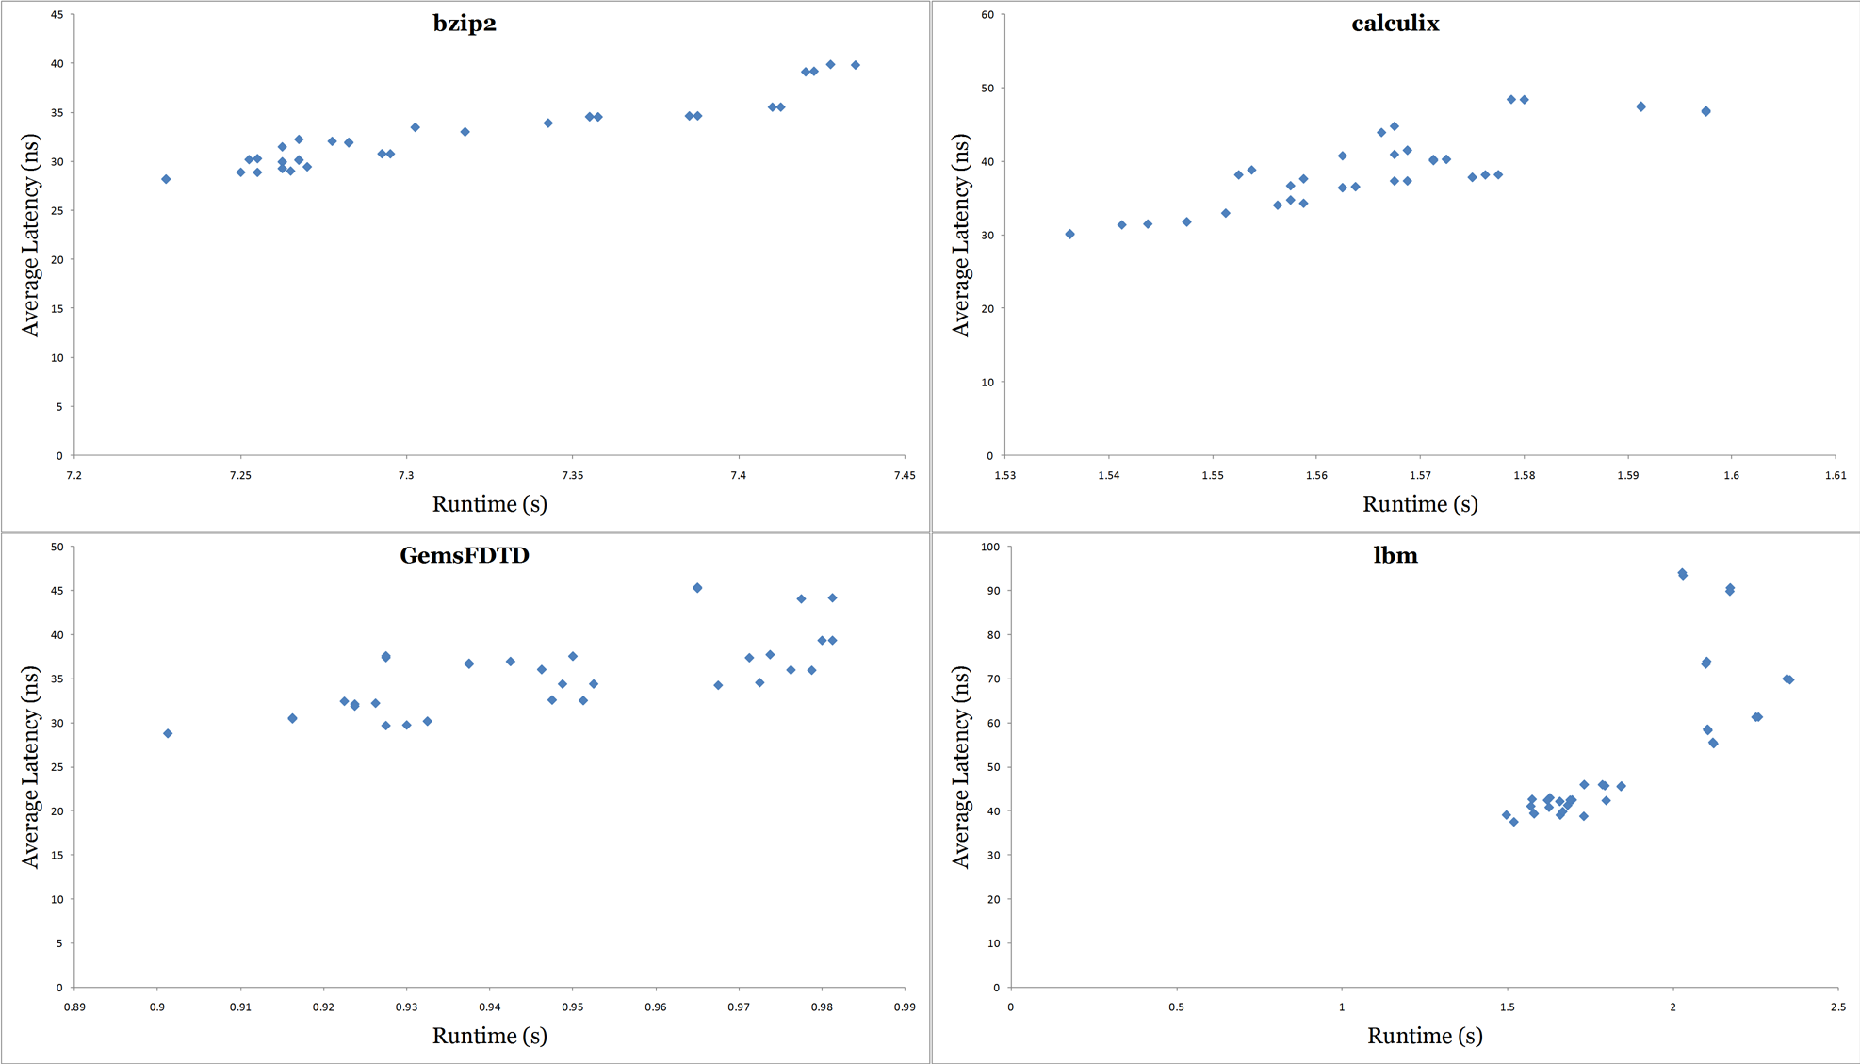
Average Latency (cont.)

Slide 35
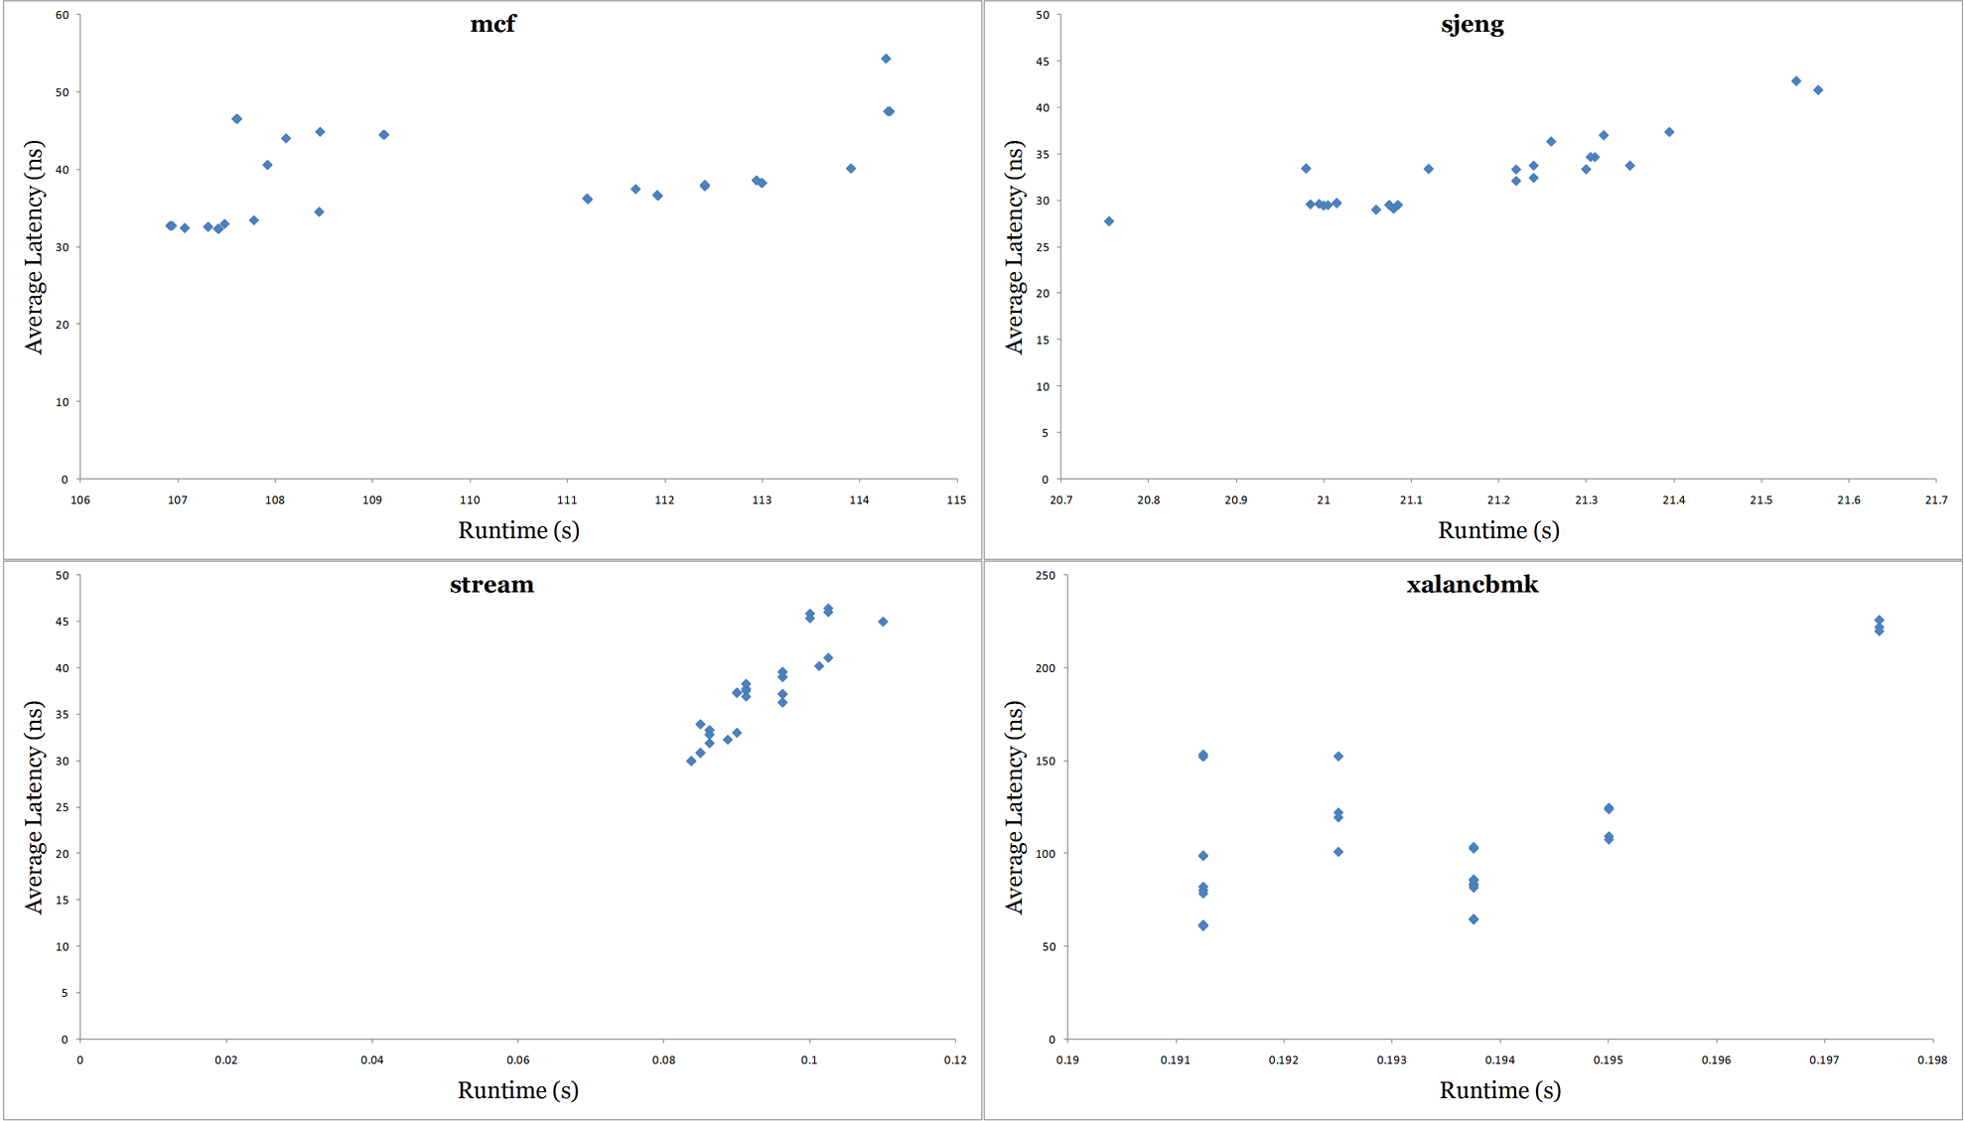
Average Latency (cont.)

Slide 36
Results - Bandwidth
High Locality is consistently worse than others
Close Page Baseline (Opt) work better with Close Page (Aggressive)
SDRAM Baseline/High Performance work better with Open Page (Aggressive)
Greater bandwidth correlates inversely with execution time – configurations that gave benchmarks more bandwidth finished sooner
470.lbm (1783%), (1.5s, 5.1GB/s) – (26.8s, 823MB/s)
458.sjeng (120%), (5.18s, 357MB/s) – (6.24s, 285MB/s)

Slide 37
Results - Energy
Close Page (Aggressive) generally takes less energy than Open Page (Aggressive)
The disparity is less for heavy-bandwidth applications like 470.lbm
  Banks are mostly in standby mode
Doubling the number of ranks
  Approximately doubles the energy for Open Page (Aggressive)
  Increases Close Page (Aggressive) energy by about 50%
Close Page Aggressive can use less energy when row reuse rates are significant
470.lbm (424%), (1.5s, 12350mJ) – (26.8s, 52410mJ)
458.sjeng (670%), (5.18s, 14013mJ) – (6.24s, 93924mJ)

Slide 38
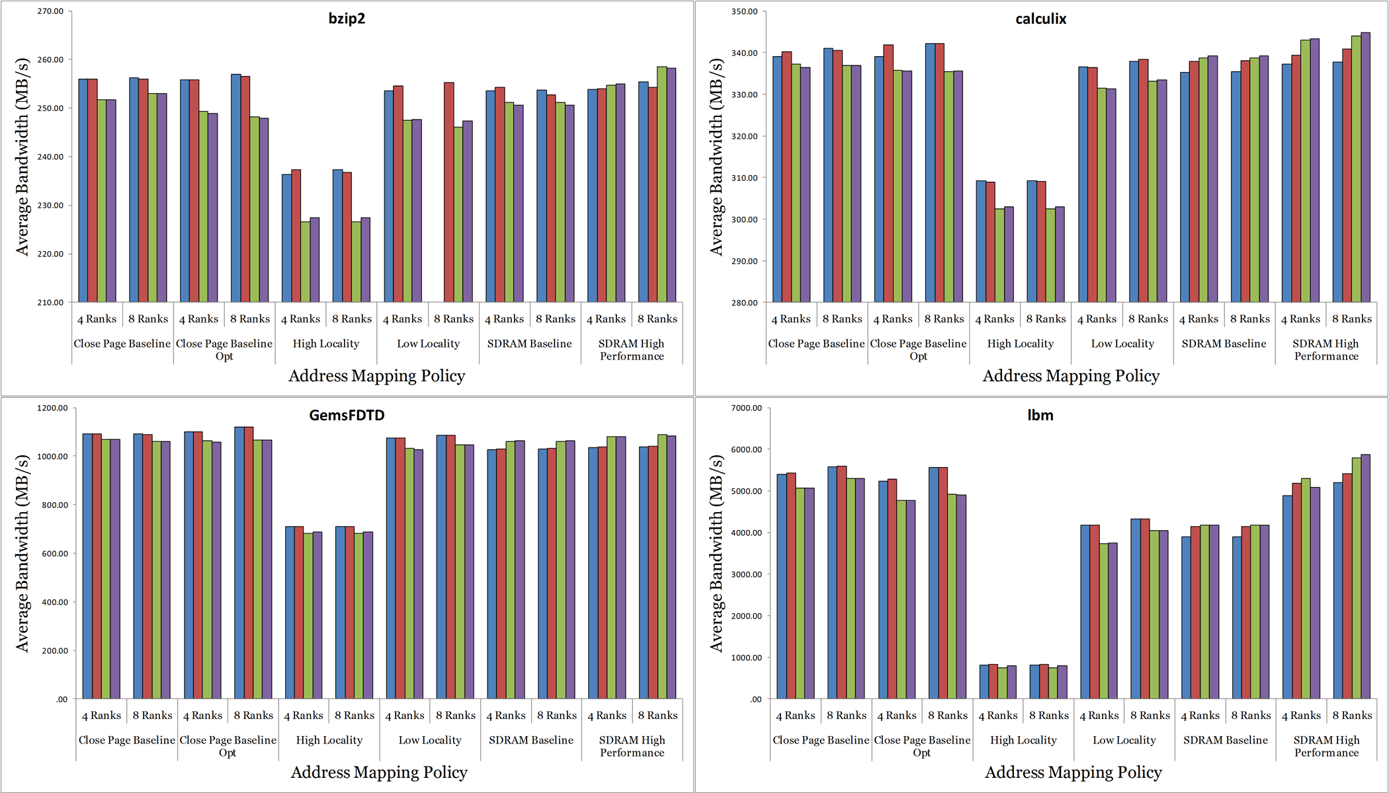
Bandwidth (cont.)

Slide 39
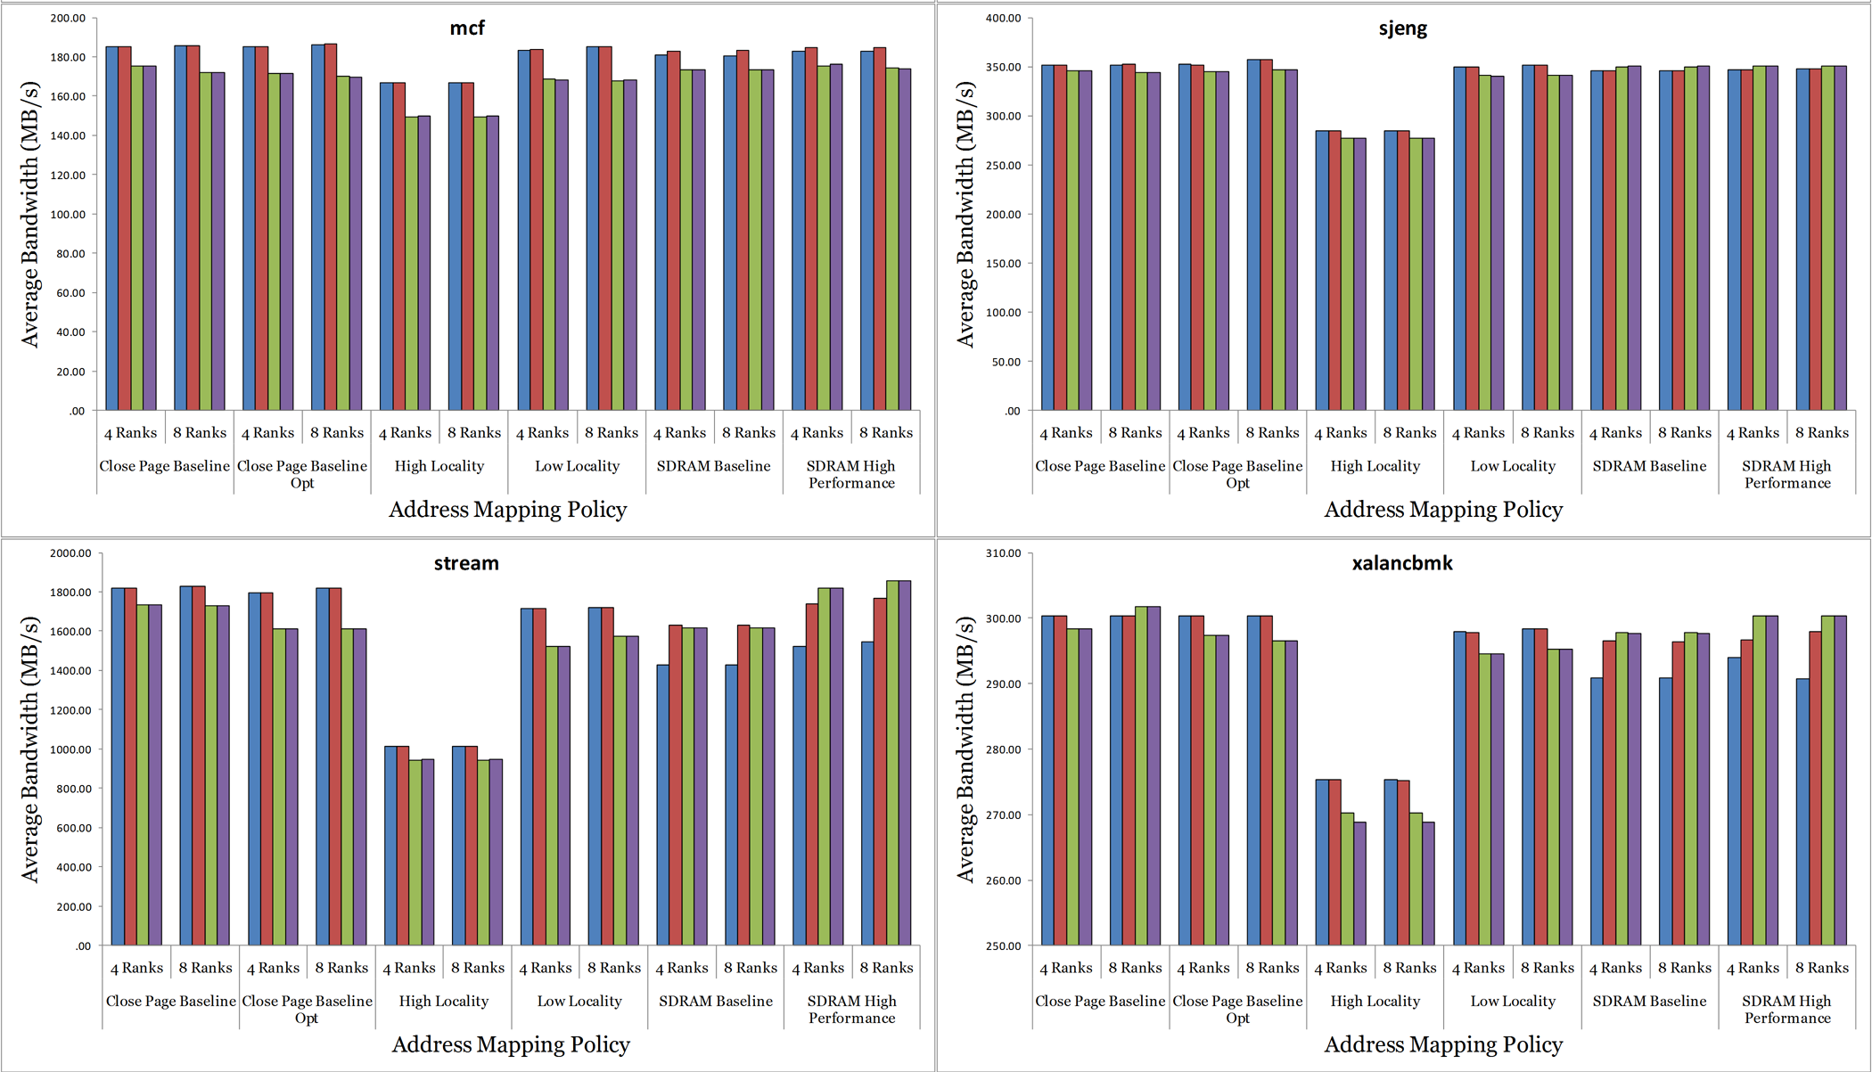
Bandwidth (cont.)

Slide 40
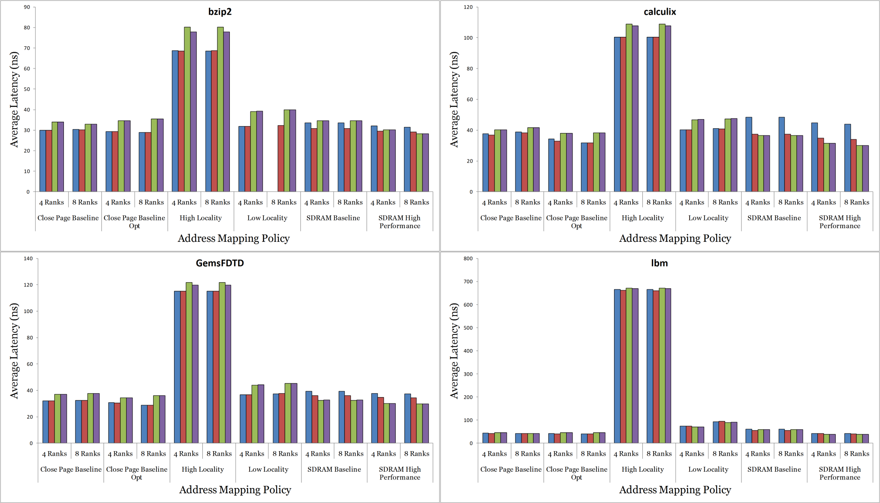
Results – Average Latency

Slide 41
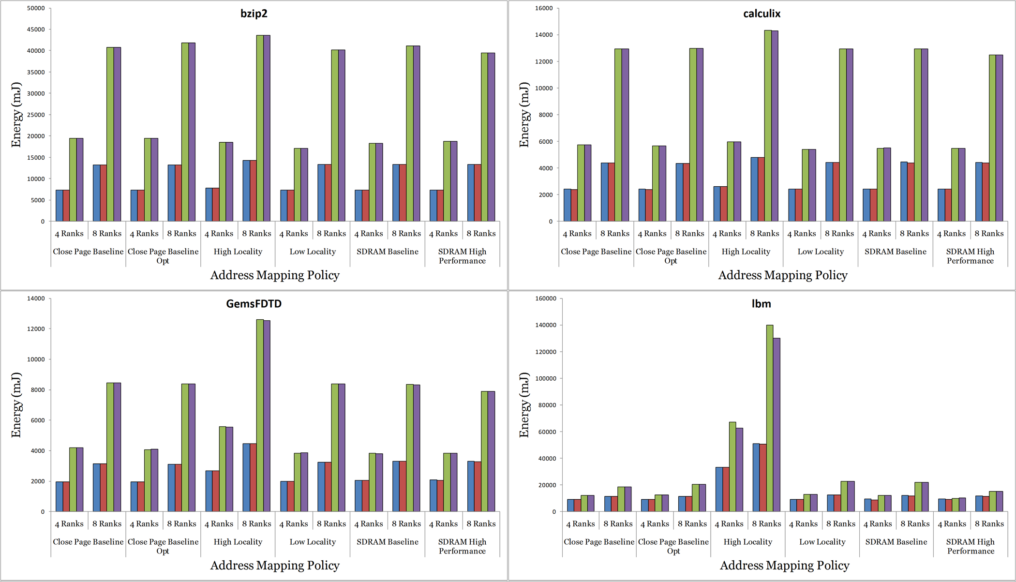
Energy (cont.)

Slide 42
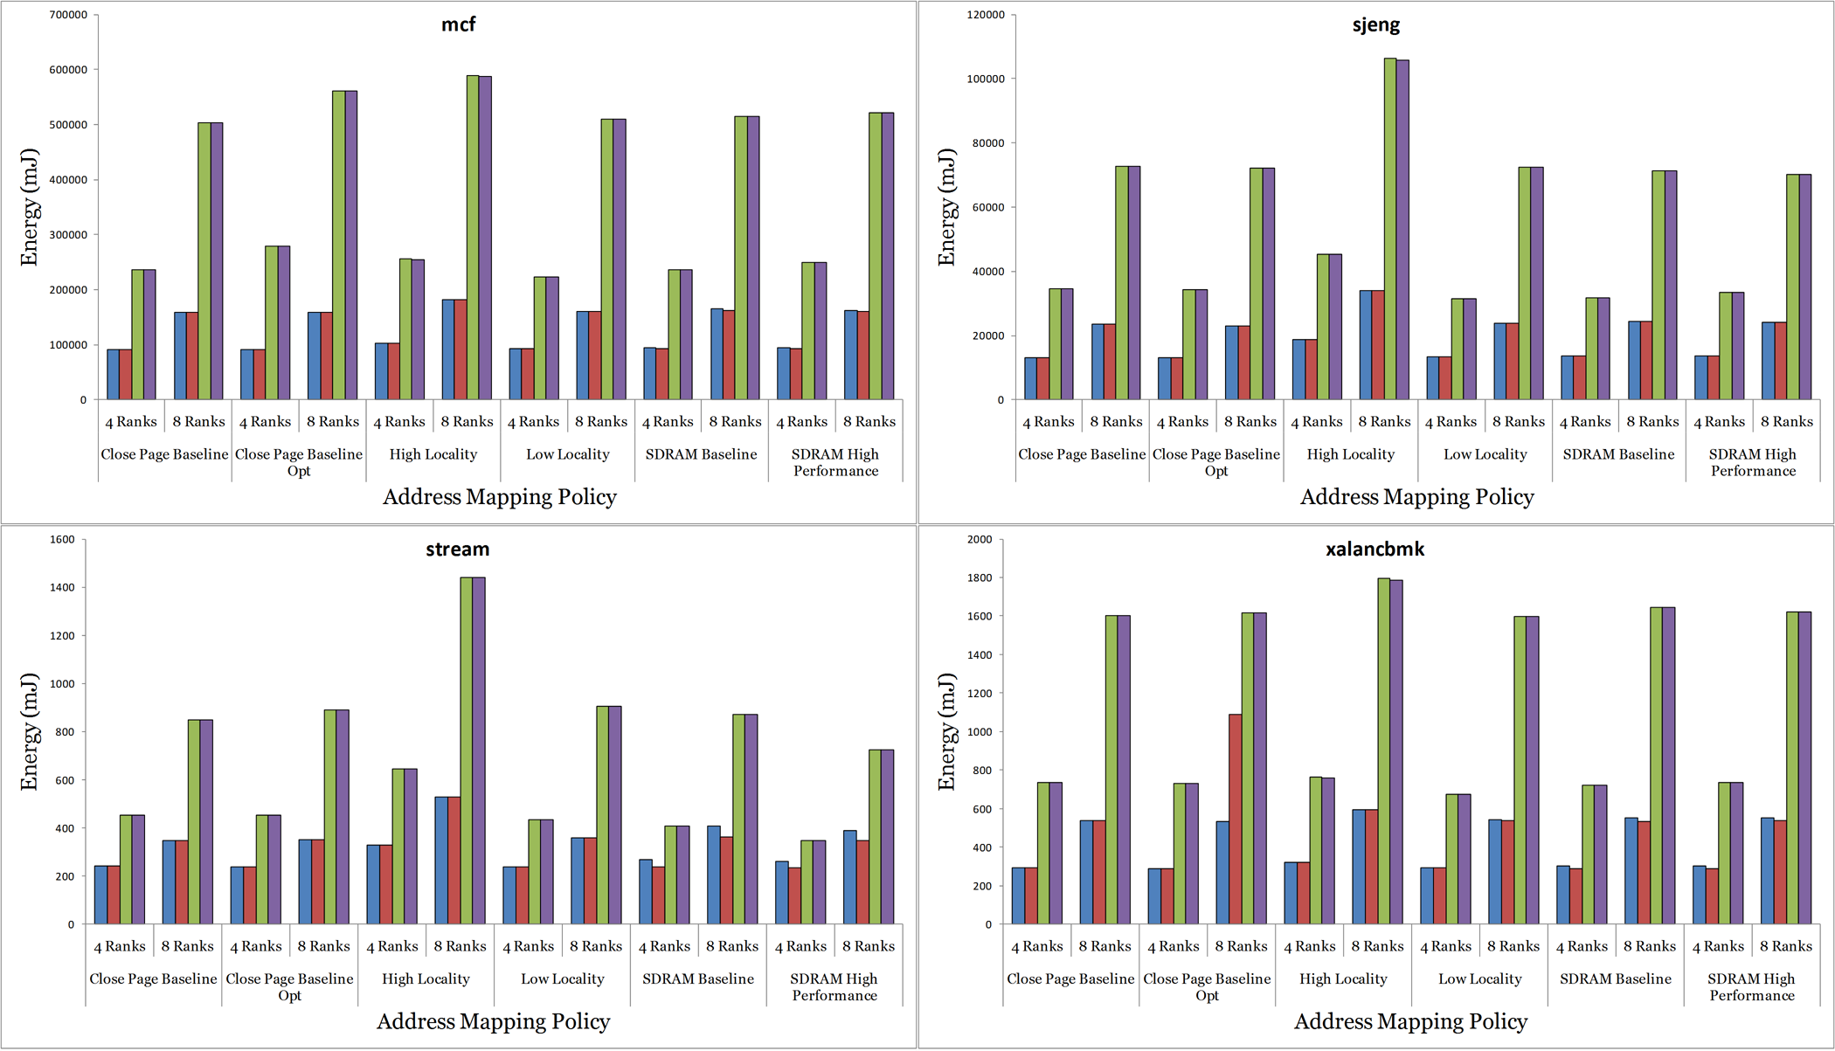
Energy (cont.)

Slide 43

Average Latency (cont.)
Notes:
finish

Slide 44
Memory System Organization

Slide 45
Transaction Queue
RIFF or FIFO
Prioritizes read or fetch
Allows reordering
Increases controller complexity
Avoids hazards

Slide 46
Transaction Queue – Decode Window
Out-of-order decoding
Avoids queuing delays
Helps to keep per-bank queues full
Increases controller complexity
Allows reordering

Slide 47
Row Buffer Management Policy
Close Page / Close Page Aggressive

Slide 48
Row Buffer Management Policy
Open Page / Open Page Aggressive

