Slide 1
Open Access
These slides offer an outline and language to engage a faculty or graduate student audience in a discussion about open access and to acquaint them with OA resources available through the university library. Please feel free to use these slides for your own teaching or to develop presentations tailored to your own community
© 2024 Michelle Wilson, University of Maryland Libraries
CC-BY-SA 4.0

Slide 2
What’s the goal of this workshop?
Provide clear information about different OA publishing models
Answer questions or concerns you may have about open access and how it may impact your work as researchers and authors
Equip you to make informed decisions about how to publish openly in the way that best aligns with your goals for your research

Slide 3
What is Open Access?
Open Access refers to the open availability of information online, free of any fees or other access barriers

Slide 4
By “open access” to this literature, we mean its free availability on the public internet, permitting any users to read, download, copy, distribute, print, search, or link to the full texts…
Budapest Open Access Initiative Declaration
February 14, 2002
https://www.budapestopenaccessinitiative.org/read/

Slide 5
What “Open Access” doesn’t mean
Open Access does not apply only to journals or journal articles, but can refer to monographs, textbooks, digital scholarship projects, datasets, code and virtually any other kind of digital publication
Open Access journals are not necessarily predatory or of poor quality
Not all open access models are fee-based
Open Access does not = a loss of copyright

Slide 6
Why do we keep pushing Open Access?
Knowledge Equity
Open Access benefits the global research ecosystem and all of its participants.
We need to consider the potential impact and utility of our research to people all over the world, regardless of whether they have the means to pay for access to commercial publications, and databases.
This is a moral imperative that has tangible benefits in the advancement of human knowledge

Slide 7
Why do we keep pushing Open Access?
Benefits to researchers
Open Access provides a theoretically unlimited audience for your work.
OA provides access to your research to professionals working outside of academic systems
OA has been shown to increase citation rates and raise the impact of your work (Piwowar et al., 2018)

Slide 8
What are the key concerns?
Open Access models and movements are not immune to inequality
OA models that rely on authors paying for publication costs push out less well-funded researchers. This often reinforces barriers to advancement that already exist for minority and non-western authors who are more vulnerable to economic disadvantage through the existence of systematic inequalities.

Slide 9
What are the key concerns?
Changes to scholarly communication landscape and ecosystem (change is always hard!)
Shifting OA models can be confusing to researchers.
There are valid concerns about the continuation of current publishing systems, such as society journals and other publications with subscriptions that financially support scholarly organizations

Slide 10
Common Types of Open Access

Slide 11
GREEN
GOLD
DIAMOND

Slide 12
Green Open Access
Your research is published in a paywalled publication, but you are allowed to make a version of the content available somewhere else online.

Slide 13
Paywall
A paywall is how we refer to restricting access to content by requiring a purchase or a paid subscription

Slide 14
Green Open Access
Green OA may be achieved by submitting a version of the article to a repository like arXiv, DRUM, or SSRN
The final, typeset version of the article does not need to be openly available. A preprint or Author Approved Manuscript (AAM) may be considered appropriate Green OA alternatives
Allows you to choose your publication venue without restriction as well as the mechanism for making your content open, considering audience, costs, etc.
Some negotiation and/or amendment to you agreement with the publisher may be necessary

Slide 15
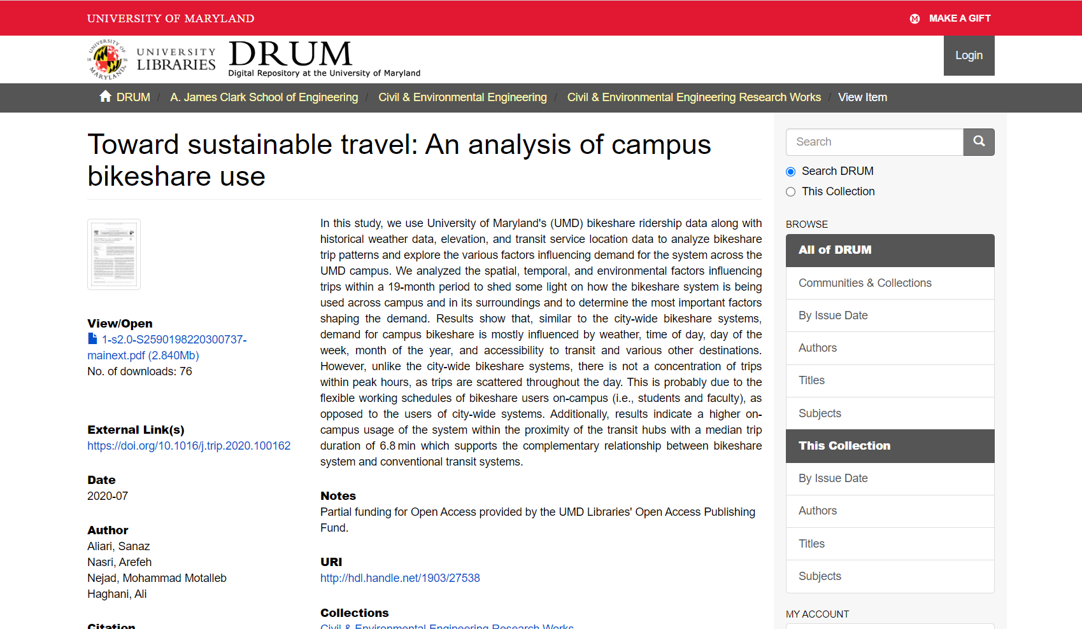
Notes:
Example of an article published by ENCE faculty deposited in DRUM and published in a journal (on next slide)
https://drum.lib.umd.edu/handle/1903/27538

Slide 16
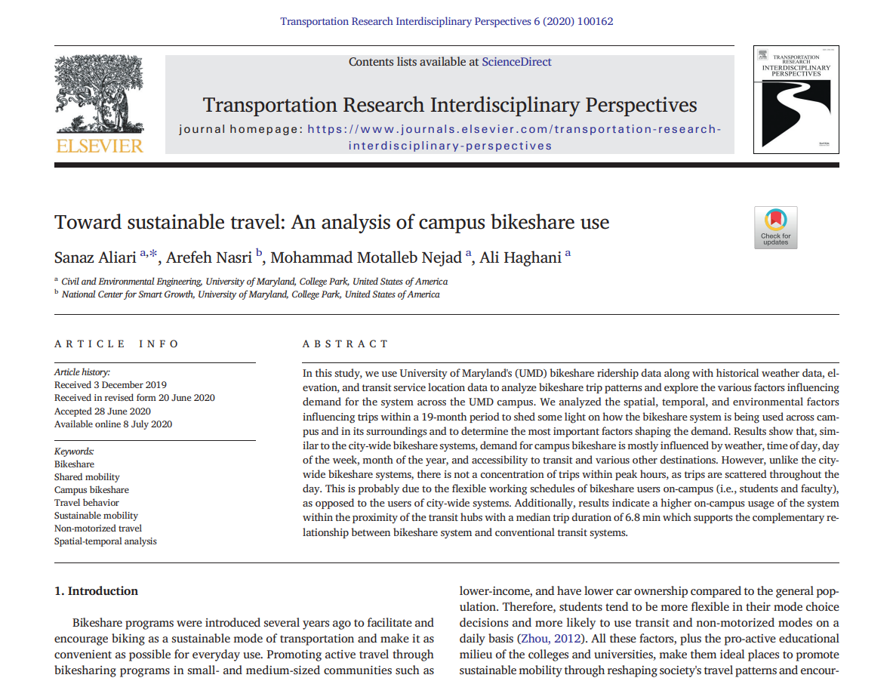

Slide 17
Gold Open Access
You pay money to the publisher, usually called an Article Processing Charge (APC), to have your article available open access.

Slide 18
Gold Open Access
An APC may be designed solely to cover the cost of production and labor associated with the publication of your research or may be assessed to “recoup lost revenue” the publisher might otherwise have received from subscriptions
APCs may be very expensive, which can preclude some authors from paying them, especially younger scholars and graduate students, individuals at community colleges and other institutions with fewer research funding opportunities, as well as individuals from the global south and less affluent economic regions around the world

Slide 19
Gold Open Access
Many Gold OA journals fall into the category of HYBRID journals, where some articles are OA, and others are only available to subscribers, depending on whether the author has chosen to pay the APC
Gold Open Access is one of the most prevalent journal publishing models, which means that authors have a lot of choice and can publish in many high impact and established titles

Slide 20
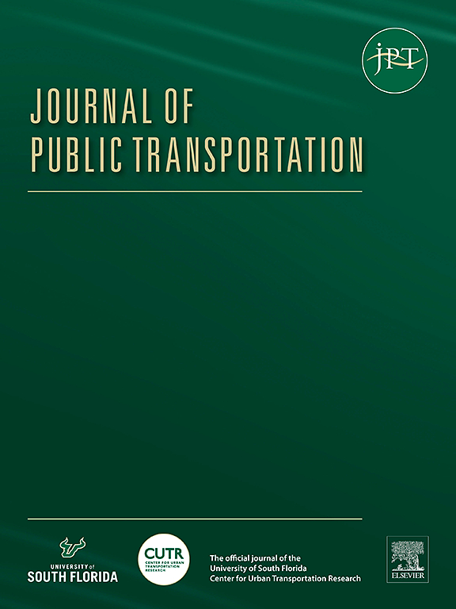
Gold OA
$1700 APC
Notes:
Journal of Public Transportation (GOLD OA, Elsevier)

Slide 21
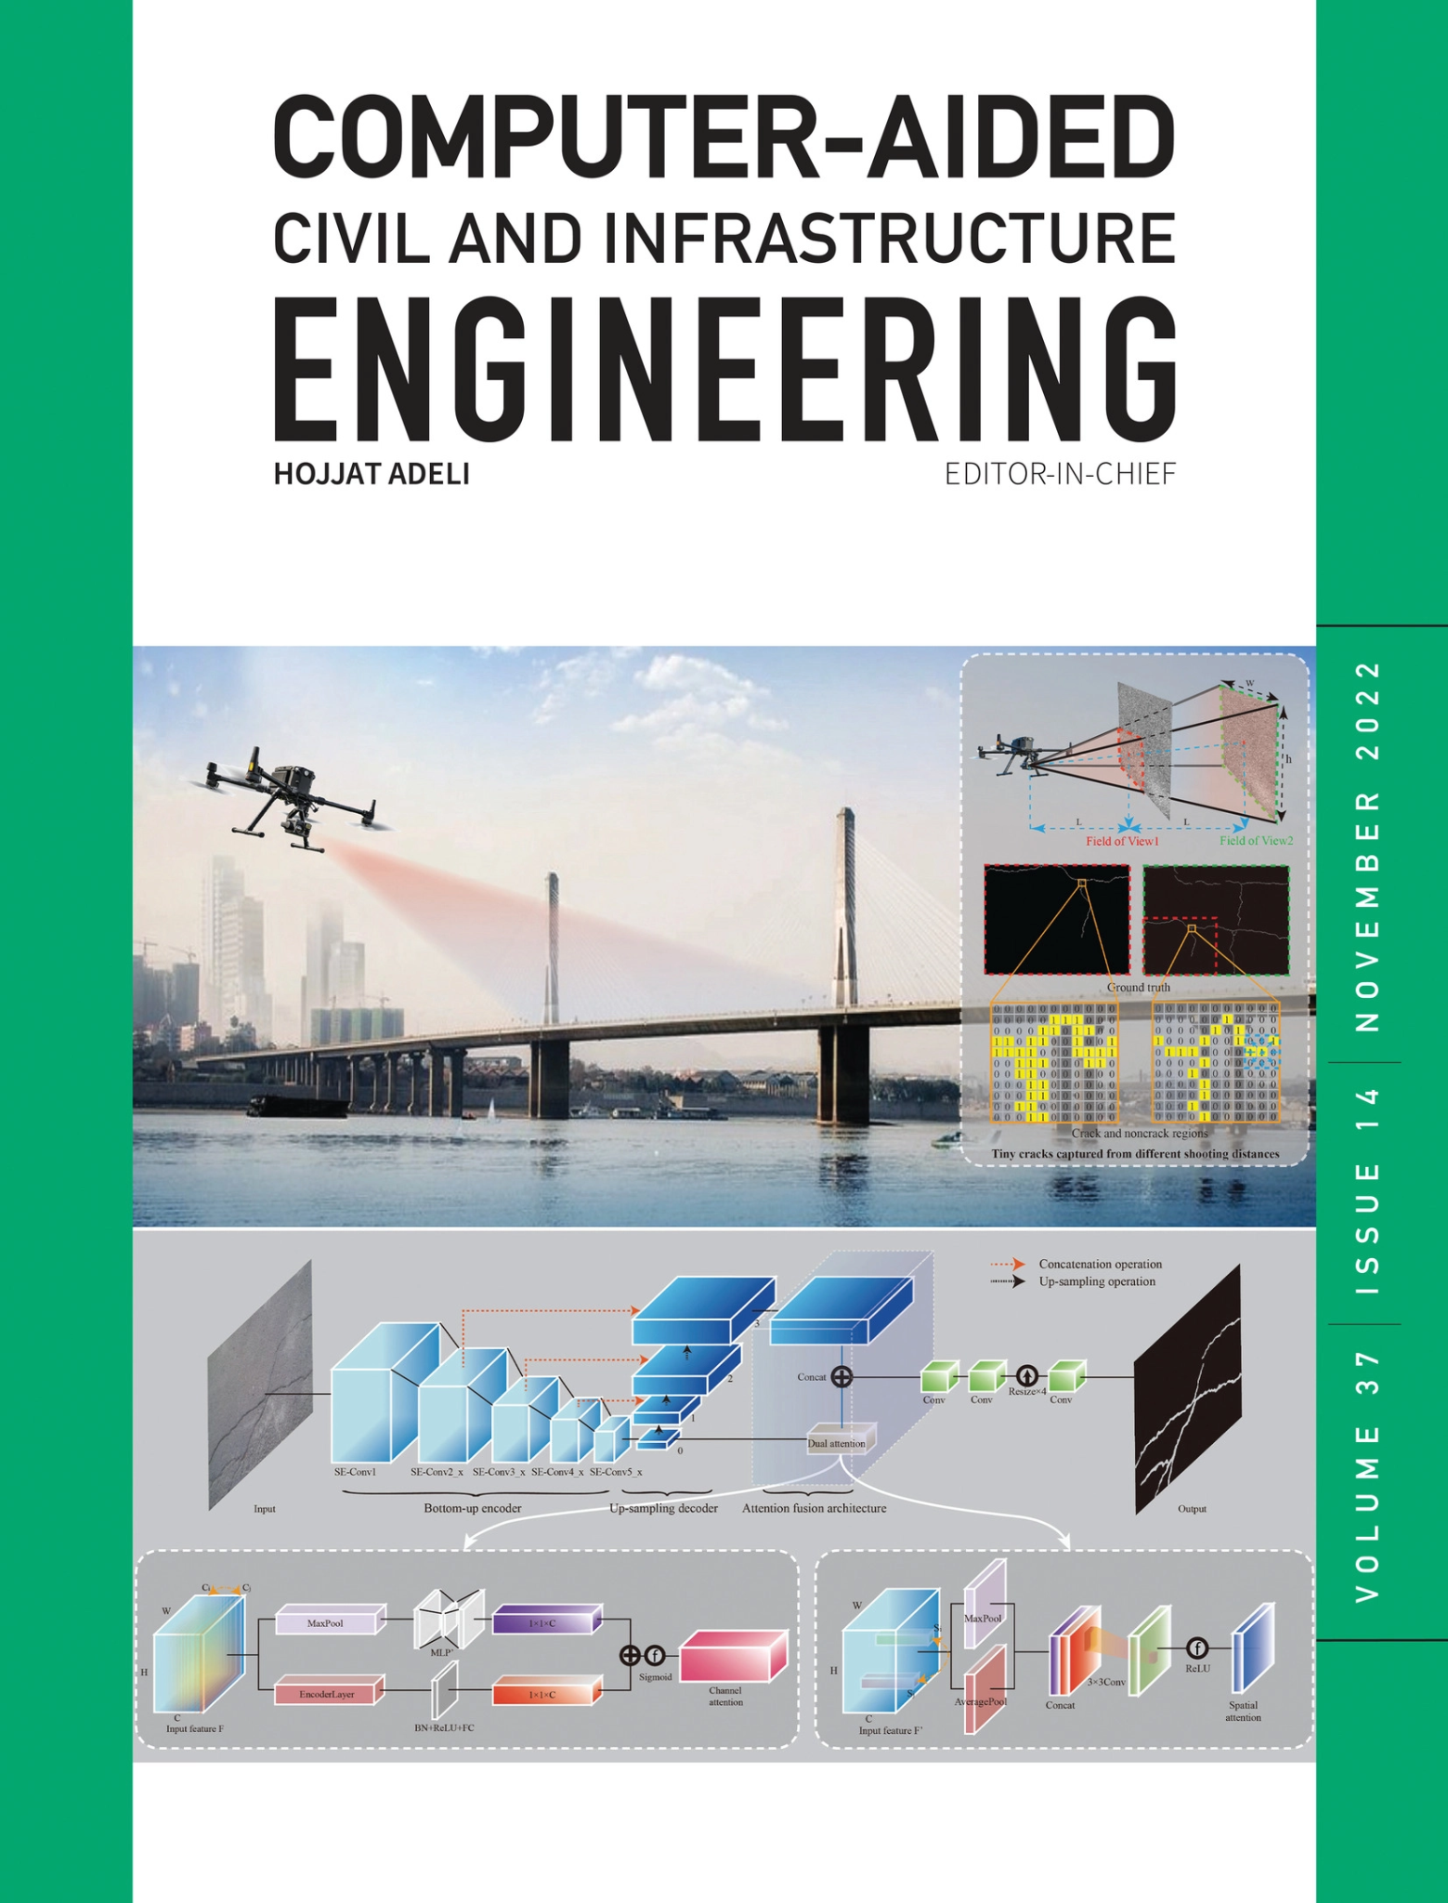
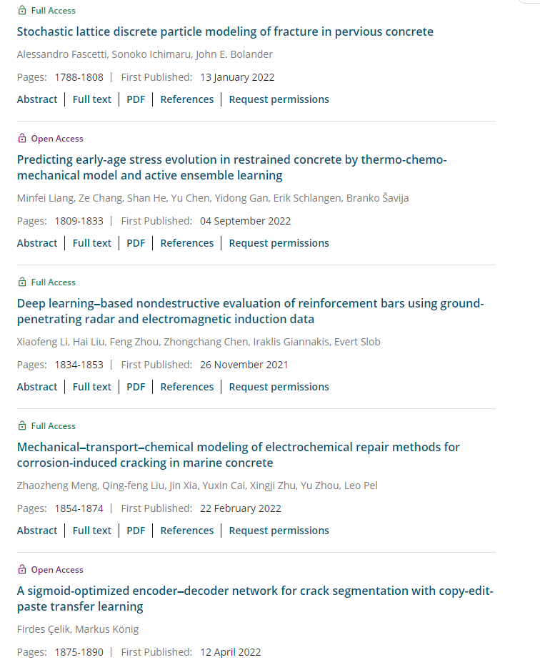
Gold OA on campus
Insert examples
Notes:
Computer-Aided Civil and Infrastructure Engineering (Wiley hybrid OA)

Slide 22
Gold Open Access
A recent shift to “Read and Publish Agreements” has shifted the burden of APC payments to institutional libraries as subscribers. The Library pays a higher subscription rate and the authors affiliated with that institution get discounts or waivers on open access fees

Slide 23
Read and Publish Agreements @UMD
Wiley Agreement
Under the Big Ten Academic Alliance agreement with Wiley, UMD corresponding authors may publish articles in Wiley hybrid journals (except for Gold OA titles) at no additional cost.
Cambridge University Press Agreement
Under a Read and Publish agreement with Cambridge University Press, UMD authors may publish articles as gold Open Access without paying an Article Processing Charge (APC).
Public Library of Science (PLOS)
Article processing fees for PLOS Biology and PLOS Medicine are waived for corresponding authors from BTAA institutions. 25% discount is applied to publication fees where one or more of the contributing authors are affiliated with a BTAA institutions, but the corresponding author is not.

Slide 24
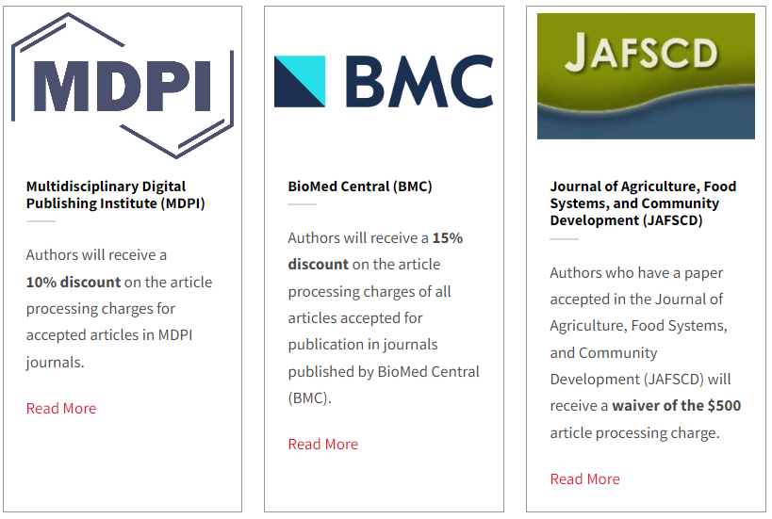
Journal Discounts
@UMD

Slide 25
UMD Libraries Open Access Publishing Fund
Open to UMD faculty members, post-doctoral researchers, or currently enrolled graduate or undergraduate students whose article has been accepted for publication in an open access journal
50% of article APC funded up to $3000
One funded article per fiscal year

Slide 26
Diamond Open Access
Your article is free to read and free for the author to publish.

Slide 27
Diamond Open Access
Diamond Open Access is considered to be one of the most ethical forms of open access
Often these are some of the newest journals, may be published by independent organizations or by libraries? Are they good journals?

Slide 28
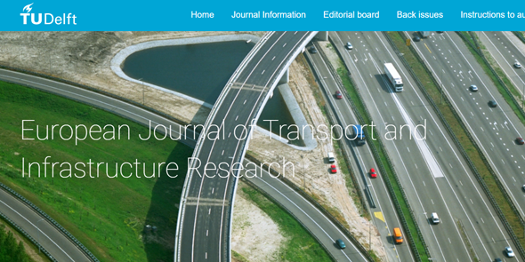
The European Journal of Transport and Infrastructure Research (EJTIR)
“The European Journal of Transport and Infrastructure Research (EJTIR) is a peer-reviewed open access journal with no article processing charges and no publishing fees. All papers are double blind peer-reviewed. EJTIR aims to publish high-quality papers on the behavioral, organizational, economic, and/or public policy dimensions of the planning and operations of transport systems.”
https://journals.open.tudelft.nl/ejtir
Notes:
Example of a Diamond Open Access journal (no APC, no subscription charge, online only)

Slide 29
Common Open Access Concerns

Slide 30
“Predatory” Journals
A publication that charges an author to publish an article in an open access venue without offering quality peer review or editing services.
Predatory journals mimic the Gold OA model
Open Access journals should not automatically be considered predatory unless they demonstrate other concerning signs

Slide 31
Signs of a Predatory Journal
Aggressive solicitation
You’ve never heard of it before. It isn’t listed in the Directory of Open Access Journals (DOAJ), or as a member of OA or publishing ethics organizations
You can’t find information about the editorial board, or they don’t seem qualified
The journal touts bogus impact factors, such as the GIF ( Global Impact Factor), Index Copernicus Value, Citefactor, or the UIF (Universal Impact Factor). Impact Factors can be verified via Web of Science, Dimensions or Google. [A librarian can help!]
The peer review period is very short or non-existent
You are asked to pay before your article is peer reviewed and/or revised

Slide 32
Reputation and quality
Is this journal any good?
There are many high impact journals that are published Open Access
There are also many reputable, ethically run journals that have not yet established impact factors but are well indexed and gaining in respect and reputation
The DOAJ stringently reviews publications for quality, although just because a journal is not in the DOAJ does not mean it is either predatory or poor quality
Assess the community around the journal

Slide 33
Assess an Open Access Journal
Check to see if the journal is listed in the Directory of Open Access Journals (DOAJ)
Check to see if the journal or its publisher is a member of the Committee on Publication Ethics (COPE), Open Access Scholarly Publishing Association (OASPA), or
Find the masthead of the journal and look up the members of the editorial board. If you are suspicious look up the editors faculty or researcher profiles on their home institution’s website.
Check where/whether the journal is indexed (Google Scholar, SCOPUS, Thomson Reuters, and disciplinary indexes). A librarian can help you to do this!
If applicable, check the journal’s impact factor. (A librarian can help you do this too!)
Read through past issues of the journal

Slide 34
OA Mandates

Slide 35
UMD Equitable Access Policy
Ratified by the University Senate in April 2022, the UMD Equitable Access Policy requires all faculty members to grant a nonexclusive license to all research articles they publish while they are employed by the University
This means that we are enforcing a Green OA model - you will need to deposit either the Author Approved Manuscript or final version of your article to the university repository
This means that having greater literacy around open access options and how to converse with publishers about them will be important

Slide 36
Funder Requirements
It is increasingly common for research funders to require public or open access to research outputs
It is your responsibility as the researcher to meet funder requirements, which means that you need to select a publishing option that complies with the terms under which you accepted the grant
The Office of Science and Technology Policy (OSTP)

Slide 37
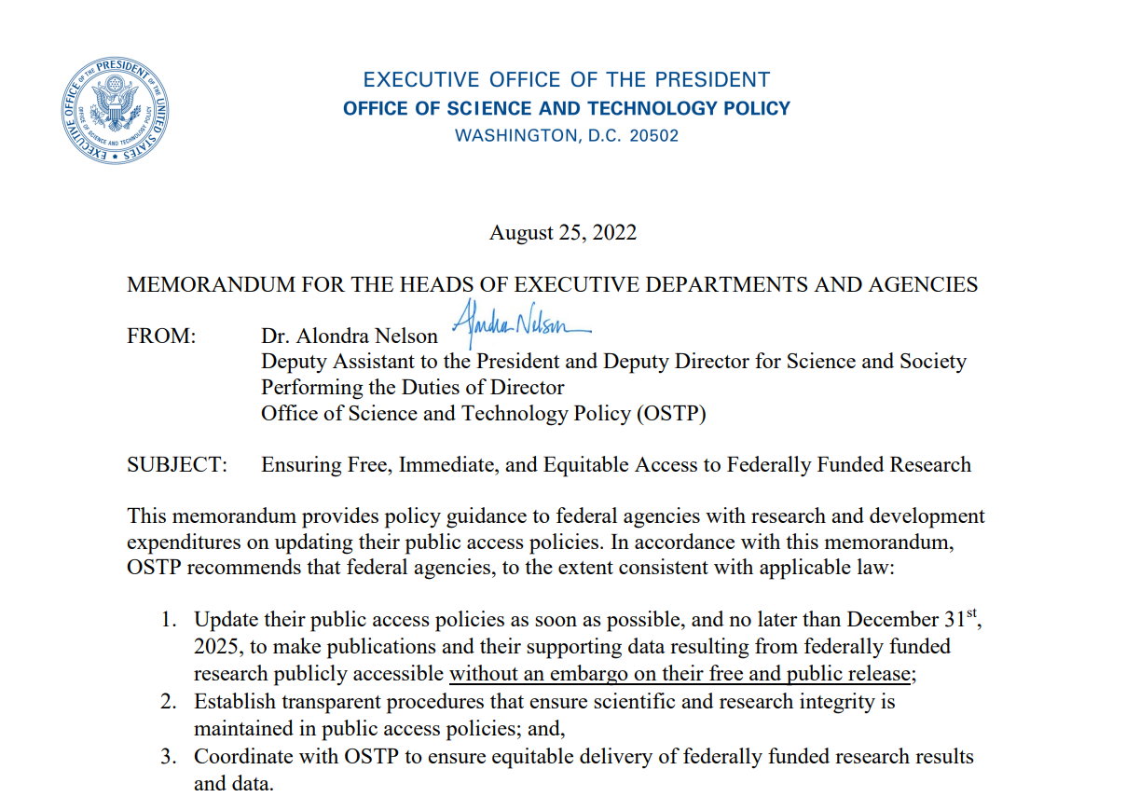

Slide 38
Support from the Libraries
Help to evaluate or select a journal
Discuss funder requirements, publisher agreements, and open publishing options beyond journals, such as repositories
Instruction and consultations for classes and teams

Slide 39
Contact Us
Liaison Librarians
Open Scholarship Services: lib-open-scholarship@umd.edu
Notes:
Reach out to your subject specialist to help you evaluate or select a journal
Reach out to lib-open-scholarship@umd.edu to discuss funder requirements, publisher agreements, and open publishing options beyond journals, such as repositories

Slide 40
Further Resources
Academic Journals - Evaluation, Selection, and Author Rights https://doi.org/10.7916/d8-rn52-xe88
Considerations - Selecting and Evaluating Academic Journals https://doi.org/10.7916/d8-gy2n-zv93

Slide 41
References
Piwowar, H., Priem, J., Larivière, V., Alperin, J. P., Matthias, L., Norlander, B., Farley, A., West, J., & Haustein, S. (2018). The state of OA: A large-scale analysis of the prevalence and impact of Open Access articles. PeerJ, 6, e4375. https://doi.org/10.7717/peerj.4375 “OA articles receive 18% more citations than average, an effect driven primarily by Green and Hybrid OA”

