Slide 1


BTAA Geoportal: an update on collections, metadata and interface design
Nathan Piekielek¹, Jaime Martindale², Kelley O’Neal³
¹The Pennsylvania State University
² University of Wisconsin-Madison
³ University of Maryland, College Park

Slide 2
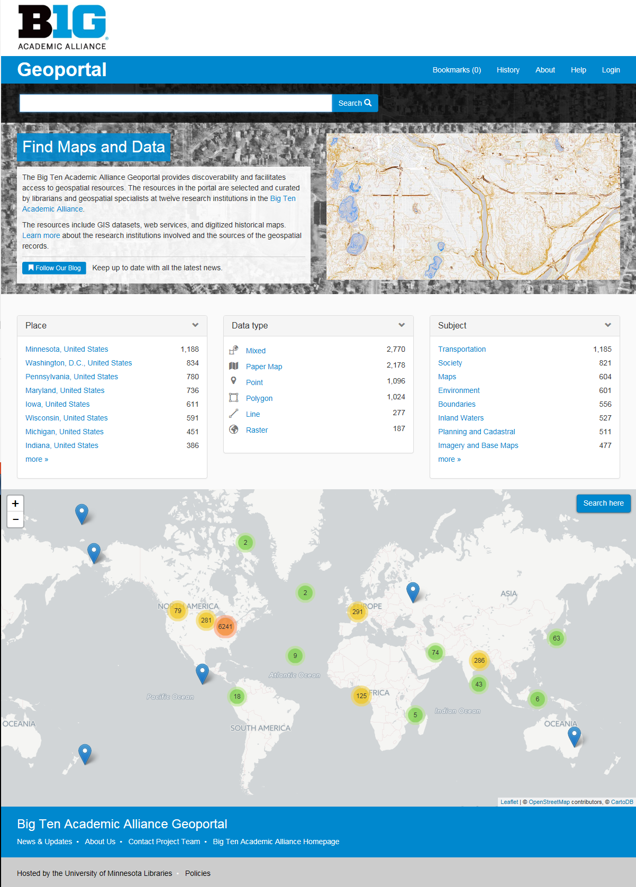
Outline
Background (Nathan)
Collection development (Nathan)
Metadata (Jaime)
Interface design (Jaime)
Future Work (Jaime)
Live Demo (Nathan)

Slide 3


The Data (geospatial?) Revolution (reintroduce history of the project and lose the “why we need it” parts on background)
“ 80 – 90% of gov’t produced data has a spatial component.”
National Geospatial Advisory Committee 2008
“ 70 – 80% of information managed by businesses is connected to a specific geographic location.”
Geographic Information and Technology Association 2006, from Byrd 2012
Petabytes
2005 2010
(Gantz et al. 2007)
Notes:
In the early days of GIS and digital cartography in the 1990s there was so little digital geospatial data available at the time that finding anything relevant to your topic was a major challenge to the point that you often had to collect/create it yourself
Fast-forward 20yrs and everyone (quite literally everyone with a smart-phone), is producing spatial data to the point that finding data relevant to your topic remains a challenge, but not b/c of a dearth of spatial data, but rather we’re drowning in data
[describe the graphics]

Slide 4
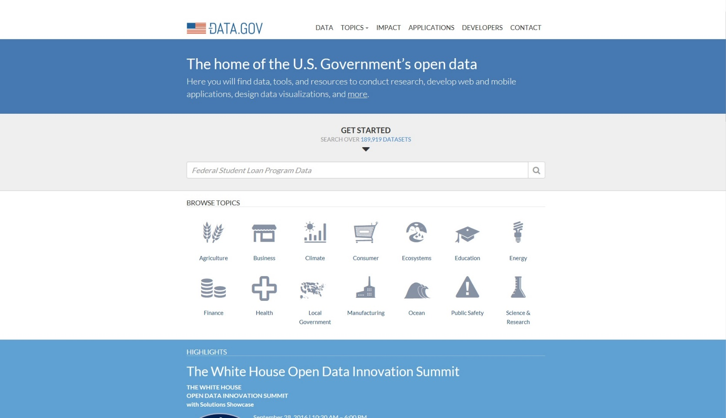
The Holy Grail –Consolidated Search
Notes:
In response to the drowning in data syndrome, we’ve seen gov’t, academia and most of the major players in the spatial data management game strive for consolidated discovery and access solutions –
In library terms the holy grail of a ‘union catalog’ – a single place that people can search and discover the holdings of every library out there.

Slide 5
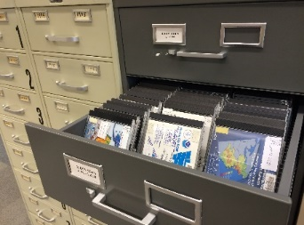
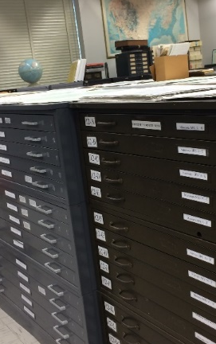
Geospatial data in libraries
Public Domain Data
Digital Maps
Proprietary Data
Geospatial Data
Research Data
Maps
Scanned Maps
(Adapted from N. Kong, CNI 2016)

Slide 6
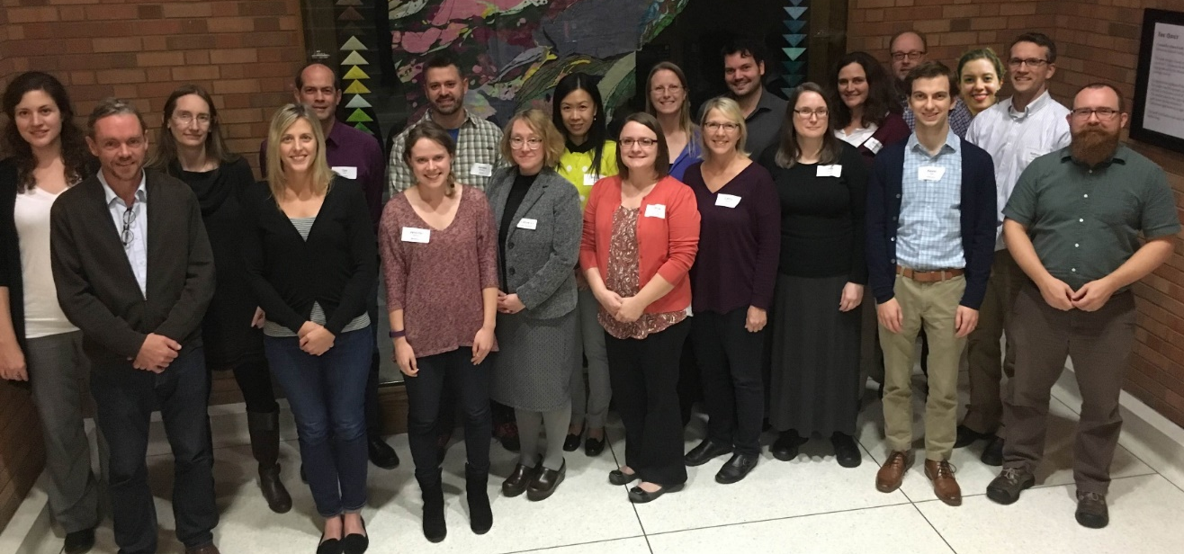
Task
Force
(2015)
James Whitacre, University of Illinois at Urbana ­­Champaign
Sam Brown and Taylor Hixson, University of Chicago
Jennifer Liss and Theresa Quill, University of Indiana
Cathy Hodge & Rob Shepard, University of Iowa Kelley O'Neal & Bria Parker, University of Maryland
Nicole Schlotz, University of Michigan
Kathleen Weessies & Amanda Tickner, Michigan State University Ryan Mattke, Karen Majewicz & Melinda Kernik, University of Minnesota
Danny Dotson and Josh Sadvari, Ohio State University
Linda Ballinger, Nathan Piekielek, & Paige Andrew, Pennsylvania State University Nicole Kong and Shirley Li, Purdue University Jaime Martindale & AJ Wortley, University of Wisconsin­­ Madison

Slide 7
Resources
Project Coordination/Administration, U. Minnesota
1.0 FTE Metadata Coordinator, U. Minnesota
0.25 FTE Spatial Data Analyst, U. Minnesota
Apache Solr Server and support, U. Minnesota

Slide 8
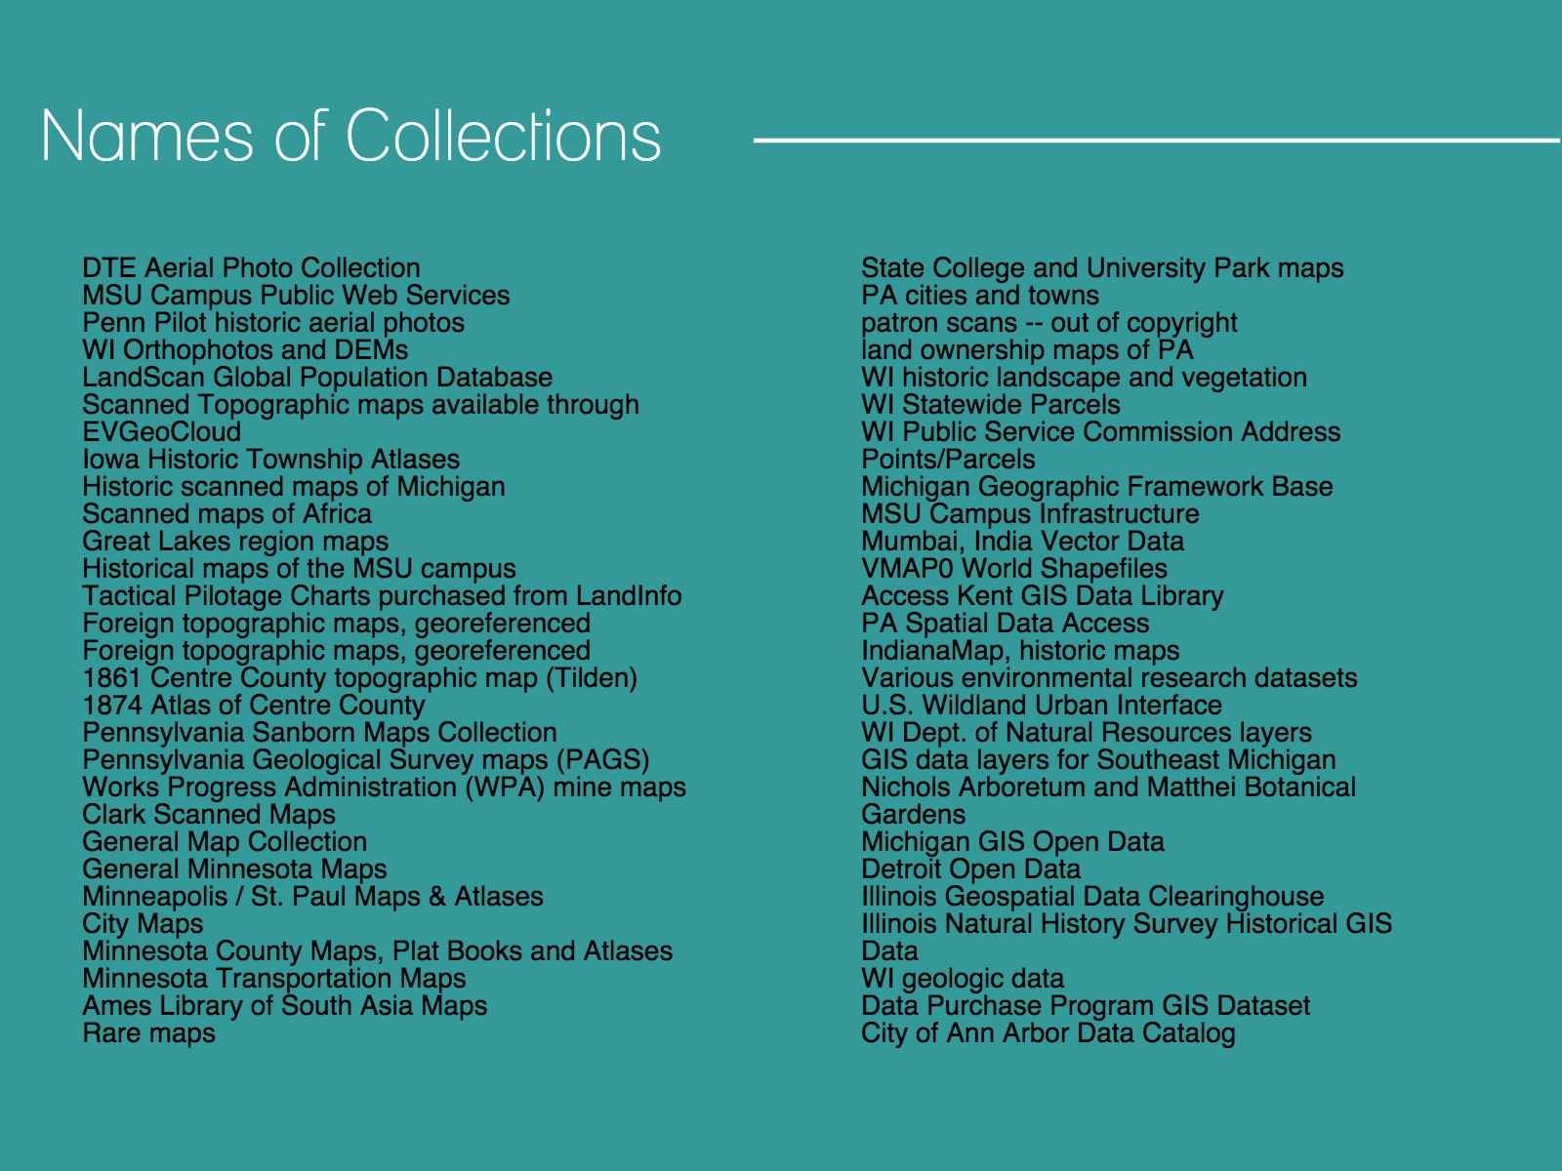
Collection Development
Notes:
First step was to identify some different collections of data and other content to include
Each institution was given freedom, but we first concentrated on existing, publically available data.

Slide 9
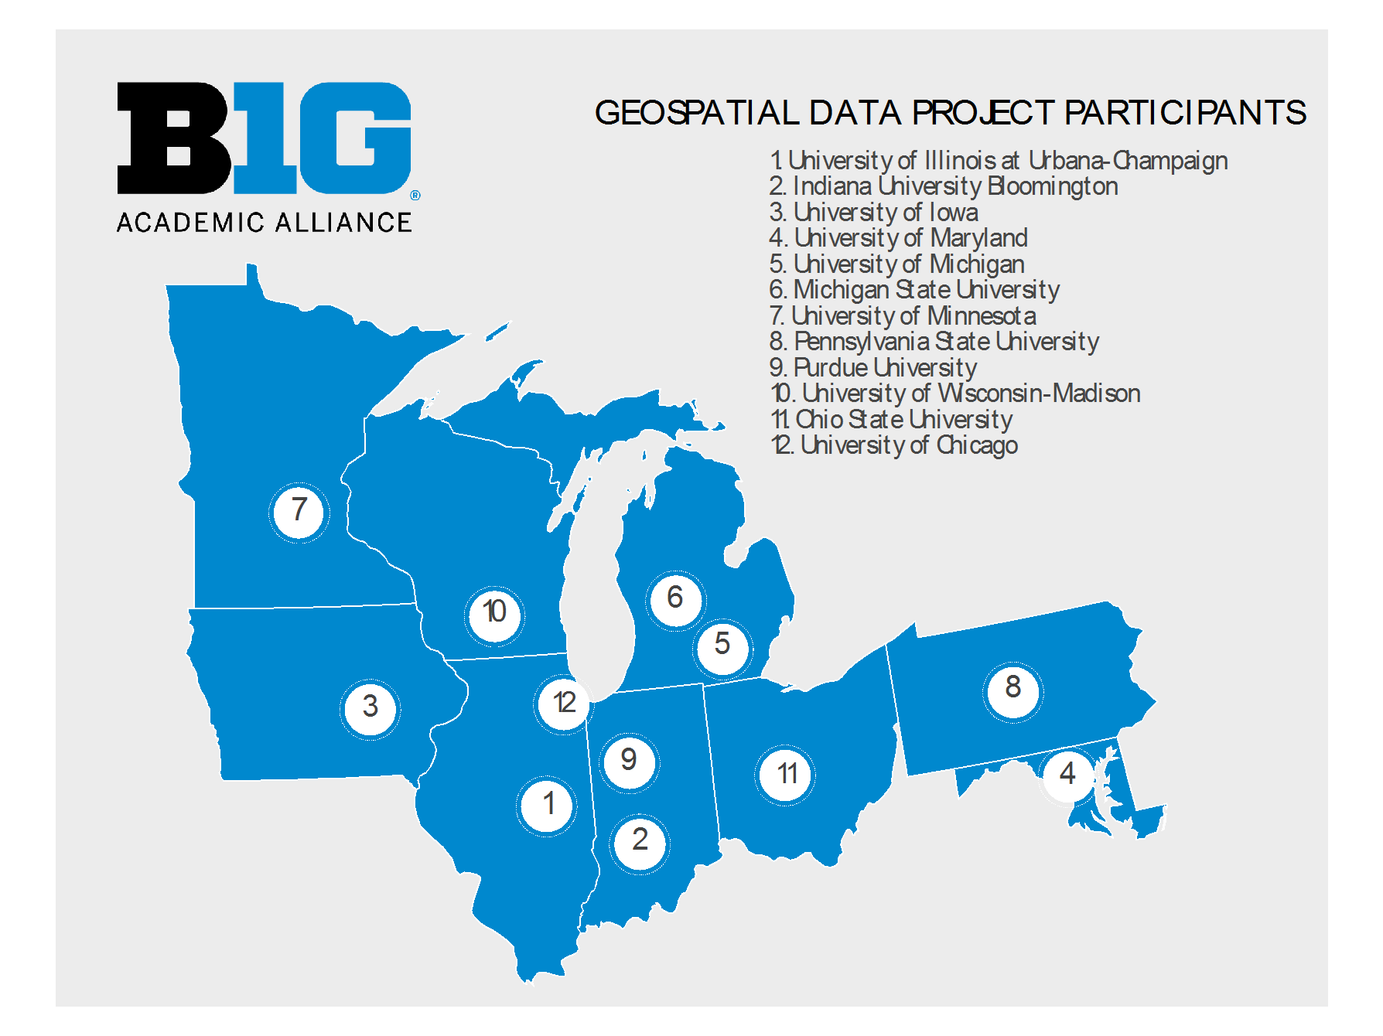
Geographic Concentration
Notes:
We also concentrated our scope on geospatial data most relevant to the geographies of participating institutions. However, through our digitized maps collections, we also managed to fill in more limited coverage around the world. We will highlight some of our collections later in a demo.

Slide 10
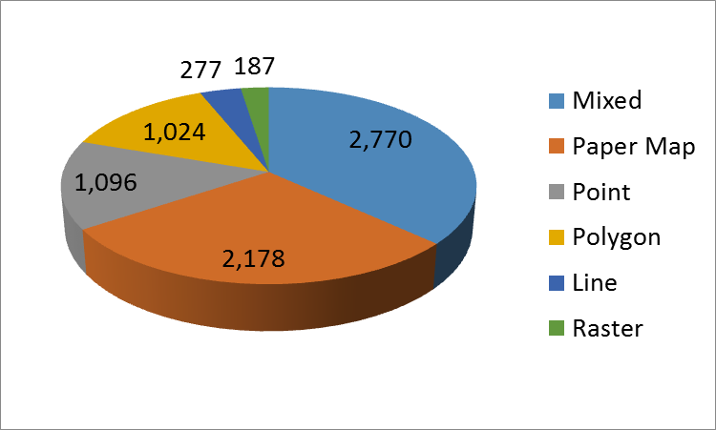
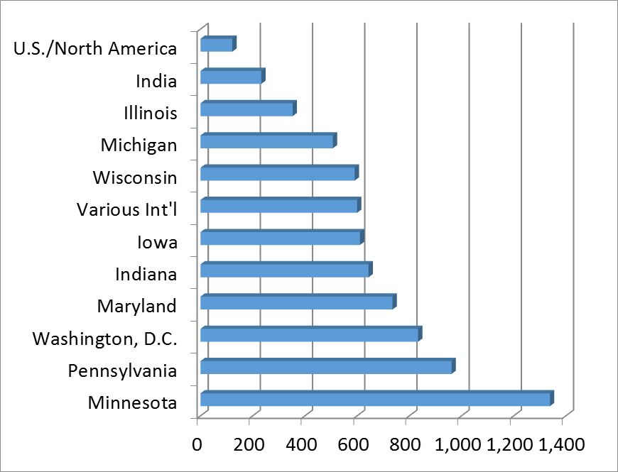
Collections at a Glance: 7,532 Records
Data Type
Geographic Region
All datasets are open to the public
Map/dataset creation dates range from 1630 - present
Notes:
Overview of stats highlighting our current collections.
Mixed is predominantly mixed vector. The collection consists of 29% digitized maps and 71% rasters/vectors. More than half the collection is in shapefile format.
The distribution of geographic regions illustrates the emphasis on the Big 10 geographic region. Most international datasets are digitized maps.

Slide 11
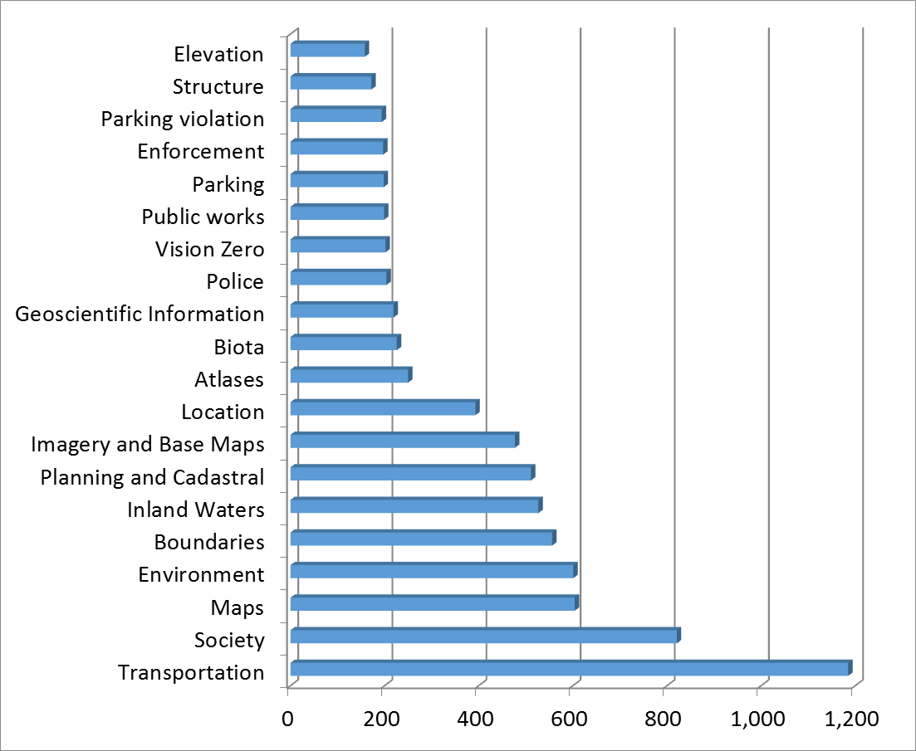
Collections at a Glance: Categories
Notes:
The categories are derived from the metadata standard with a few additions.
(Vision Zero is a multi-national road traffic safety project that aims to achieve a highway system with no fatalities or serious injuries involving road traffic.)

Slide 12
Collection Development Updates
Gap Analysis tool to evaluate collection omissions
Exploration of online Federal Depository Library Program map and geospatial data collections to augment accessibility
Collection Development Policy and Strategic Plan to guide collection growth
Notes:
The Gap Analysis tool was used for self-evaluation of current collections at the institutional level. The analysis was performed using the ISO metadata categories to determine thematic omissions. The results of this analysis will be used to drive future collection priorities and directions.
While the addition of FDLP holdings into the Geoportal will not replace physical access, they will increase accessibility and discoverability overall.
We are in the process of developing a collection development policy and strategic plan to guide and formalize our collection, process, and future plans.

Slide 13
Metadata overview
The BTAA geoportal indexes metadata that points users to the original source for download access
Existing geospatial records usually exist as ISO 19139, FGDC, or ArcGIS 1.0 schemas/formats
Existing scanned map records are usually exist as MARC or Dublin Core
Institutions: (1) harvest records from existing resources/collections (2) create/augment original records (3) work with Metadata Coordinator to acquire data then extract metadata

Slide 14
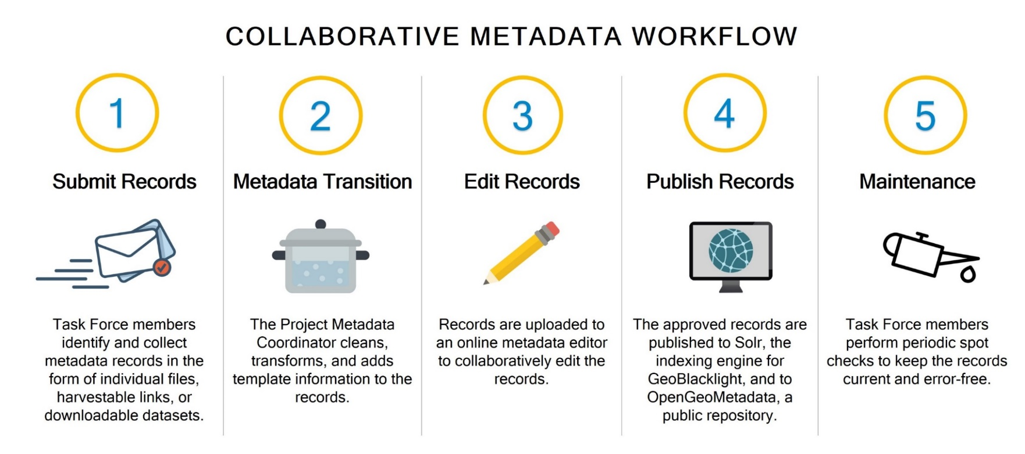
Current metadata workflow
(Adapted from K. Majewicz, BTAA GDP 2016)
Notes:
Now that we have our content, we need a workflow to deal with the metadata…
Step 1: Institutions
Step 2: Project Metadata Coord.
Step 3: Institutions
Step 4: Project Metadata Coord.
Step 5: Both

Slide 15
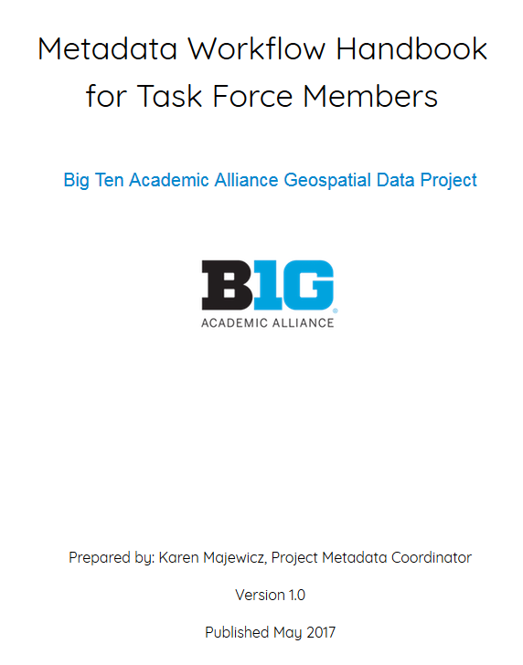
Metadata updates
New metadata workflow handbook
Streamlined process to enhance efficiency and accuracy
Notes:
Eliminating github for record sharing
Not using Asana

Slide 16
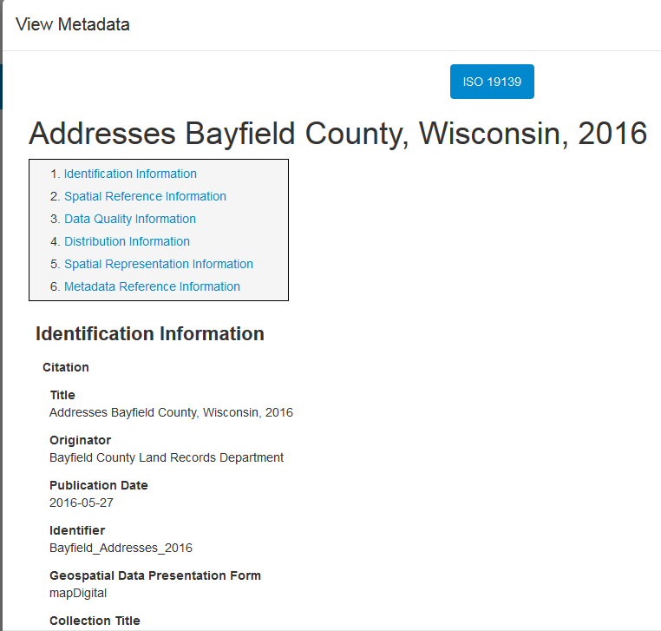
Metadata updates – notable changes
GeoNetwork & ISO: too bulky for all items
Used GeoNames as thesaurus to normalize place names
Normalized theme keywords – focus on ISO Topic Categories & LC subject headings
New HTML view of full metadata records
Notes:
Using Omeka and Dublin Core for scanned maps
(Some of this work stemmed from user testing results!)
GEONAMES: For all of the ISO records, we export the records from GeoNetwork into a spreadsheet and manually change the Place Name keywords to a standardized phrase, such as "Duluth, Minnesota, United States." We then re-import them to GeoNetwork. While we can record the thesaurus name in ISO, I haven't figured out a good method for recording the specific GeoNames URI for places. I am hoping GeoNetwork incorporates this function in an upcoming release.
For the Dublin Core records, we use the GeoBlacklight plugin. We can type a place name into the Spatial Coverage field within the interface, which uses an API to query GeoNames. This produces a drop down list in the field for us to select a value. This action pulls in both the string ("Duluth, Minnesota, United States") as well as the URI ("http://sws.geonames.org/5279468"). The GeoNames URI gets stored in the Dublin Core field Relation. If we look up the GeoNames URIs in advance, we can also use a spreadsheet update in Omeka and import the GeoNames URIs in a batch.
NORMALIZE KEYWORDS We make sure that every GIS record has at least one ISO topic category, which is not difficult to normalize since there are only 19. Beyond that, most of the incoming public GIS records have messy keywords that seem more like "tags." Acronyms, misspellings, agency names, and capitalization variants were some of the keyword types that were removed or cleaned up.
Like the Place Name keywords, we just exported everything to spreadsheets. We used OpenRefine to find similar keywords and normalize them. If the keywords were from ArcGIS portals and of very poor quality, I didn't even add them to our GeoBlacklight records.
The scanned map records all have Library of Congress keywords. These could really use some normalization work, but we haven't done it yet, mainly because they are "official" MARC records that we are hesitant to mess with.

Slide 17
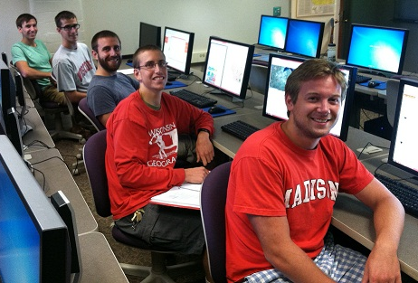
Interface (Re)Design
Fall of 2016 – Usability sub-group created
Working group: 6 members from 5 institutions plus one student assistant
Charge was to develop and implement usability testing measures and a heuristic evaluation to assess usability and perceived ease of use of the geoportal
Initial important question: Who is our target audience?
Notes:
Testing at Minnesota, Michigan, and Michigan State

Slide 18
Heuristic Evaluation
Allowed for assessment against established principles of usability
Group collaborated via a Google spreadsheet to create weighted scores
Overall evaluation resulted in a score of 82/100
Still noted room for improvement in several areas: Keyword searching; Facet organization

Slide 19
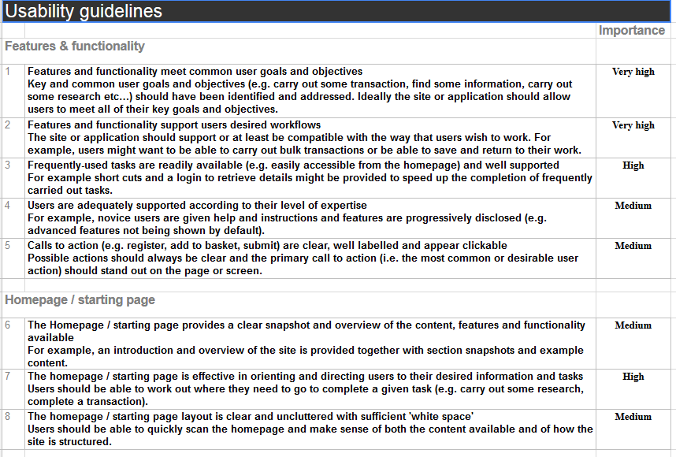
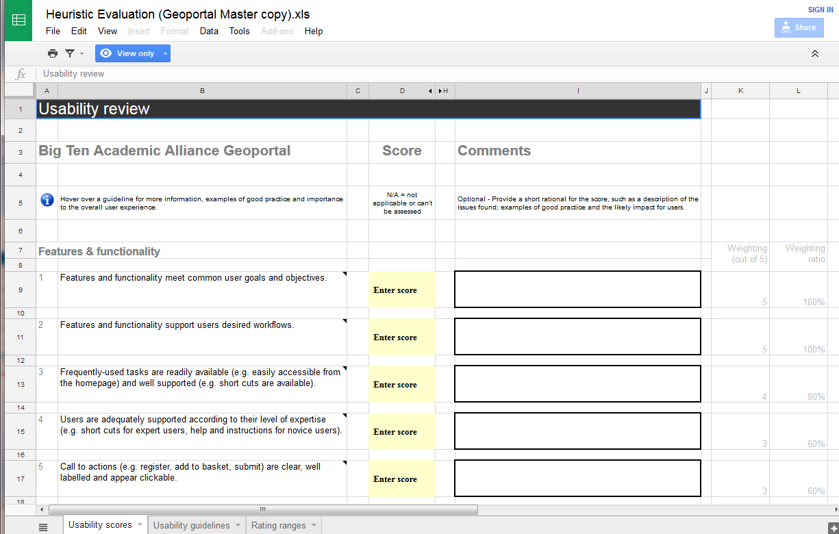
Heuristic Evaluation: tools and methods

Slide 20
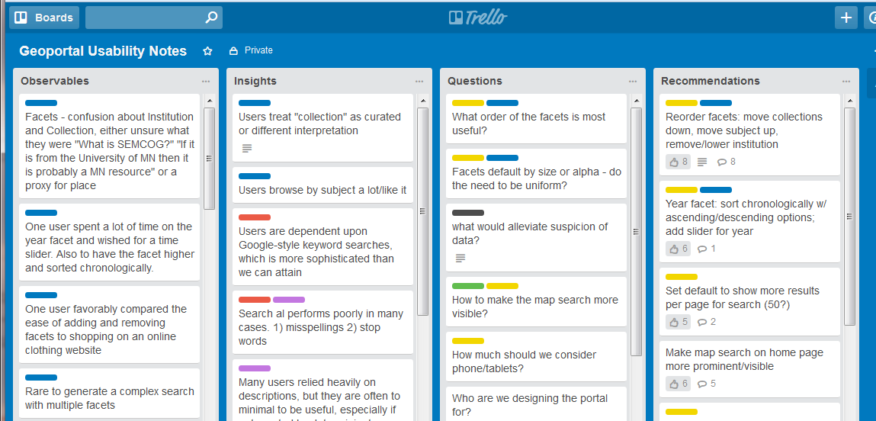
Usability Testing
Total of 16 (1-hour) user tests completed (various groups)
Observations were recorded and organized using Trello
Findings were grouped and prioritized, resulting in a series of recommendations
Notes:
User groups- those with and without GIS knowledge, undergraduate students to advanced researchers – three institutions completed this: Michigan, Minnesota and Michigan State
Trello- online project management tool

Slide 21
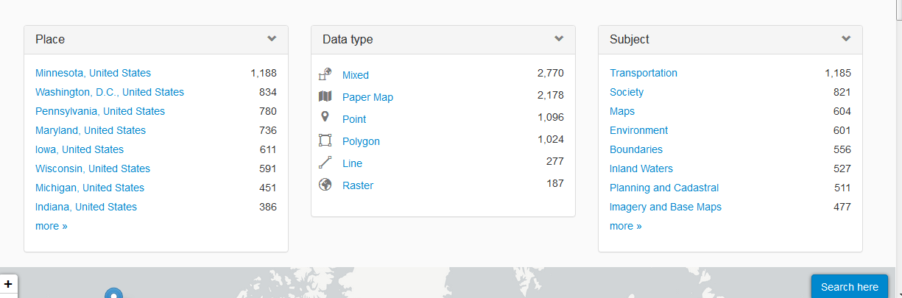
Evaluation & Usability Testing – primary recommendations
Normalize element values for keywords, place names, data authors/publishers
Add synonym file to Solr
Encourage robust “description” entries in metadata
Remove problematic facets & reorder existing ones
Make map search more prominent
Metadata Working Group
Priority Facets
Notes:
Much of this work had to overlap with the metadata working group. Problematic facets are due to incomplete or poorly populated metadata fields. Reordering and prioritizing facets meant
SYNONYMS in Solr This is an optional built in Solr function. We took the list created by the Task Force and made a text file where each line contains synonymous terms separated by a comma. This document was then added directly to Solr.

Slide 22

Future Work
Collection Development
- Fill thematic and geographic gaps in collection content
- Explore authenticated access for proprietary/licensed data
- Georeference scanned maps and historic aerial photography
Metadata
- Metadata outreach (workshops, guides, conference participation)
Overall Project - Strategic planning for a sustainable future - Data archiving - Enhancing analytics and usage statistics

Slide 23
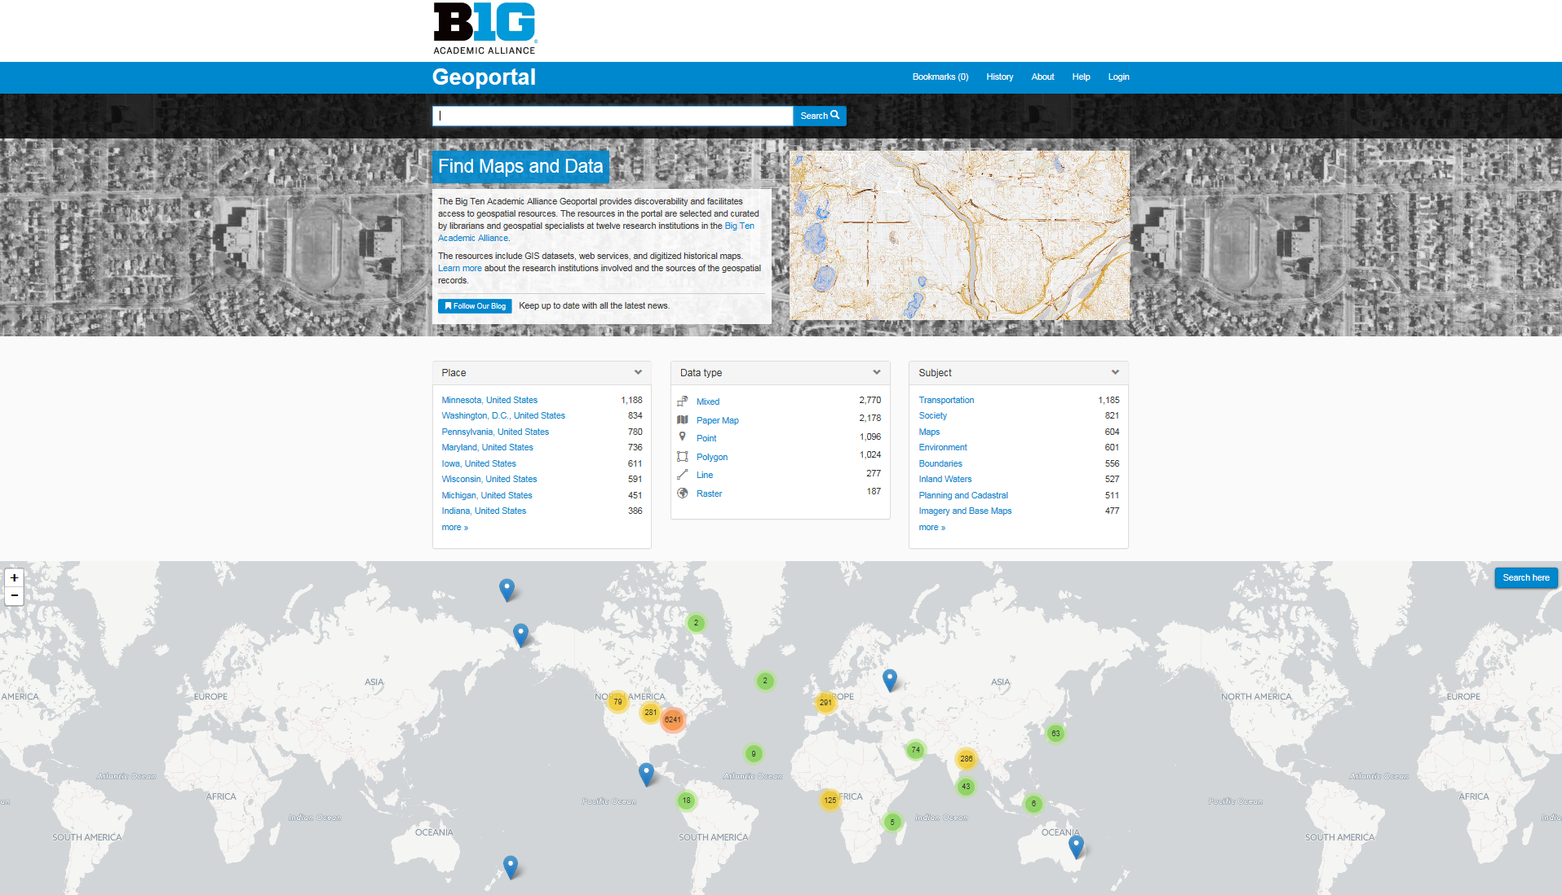
The Geoportal (live demo)

Slide 24
References cited
Gantz, J.F. et al. (2007). A forecast of worldwide information growth through 2010. IDC: analyze the future, Framingham, MA.
National Geospatial Advisory Committee. (2008). A national geospatial strategy.
Byrd, J.B. (2012). The political surveyor: the need for a geospatial market study. Professional Surveyor Magazine (http://archives.profsurv.com/).
Kong, N. (2016). A multi-institution project toward geospatial data discovery. Coalition for Networked Data, San Antonio, TX.
Holstein, A. (2015). Geographic Information and Technologies in Academic Libraries: An ARL survey of services and support. Information Technology and Libraries, March: 38-51.
Association of Research Libraries (ARL). (March 1999). The ARL geographic information systems literacy project: A SPEC kit. SPEC kit, 238. Washington, DC: Association of Research Libraries, Office of Leadership and Management Services.
Xia, J. and M. Wang. 2014. Competencies and responsibilities of social science data librarians: an analysis of job descriptions. College and Research Libraries, May 362-388.

Slide 25
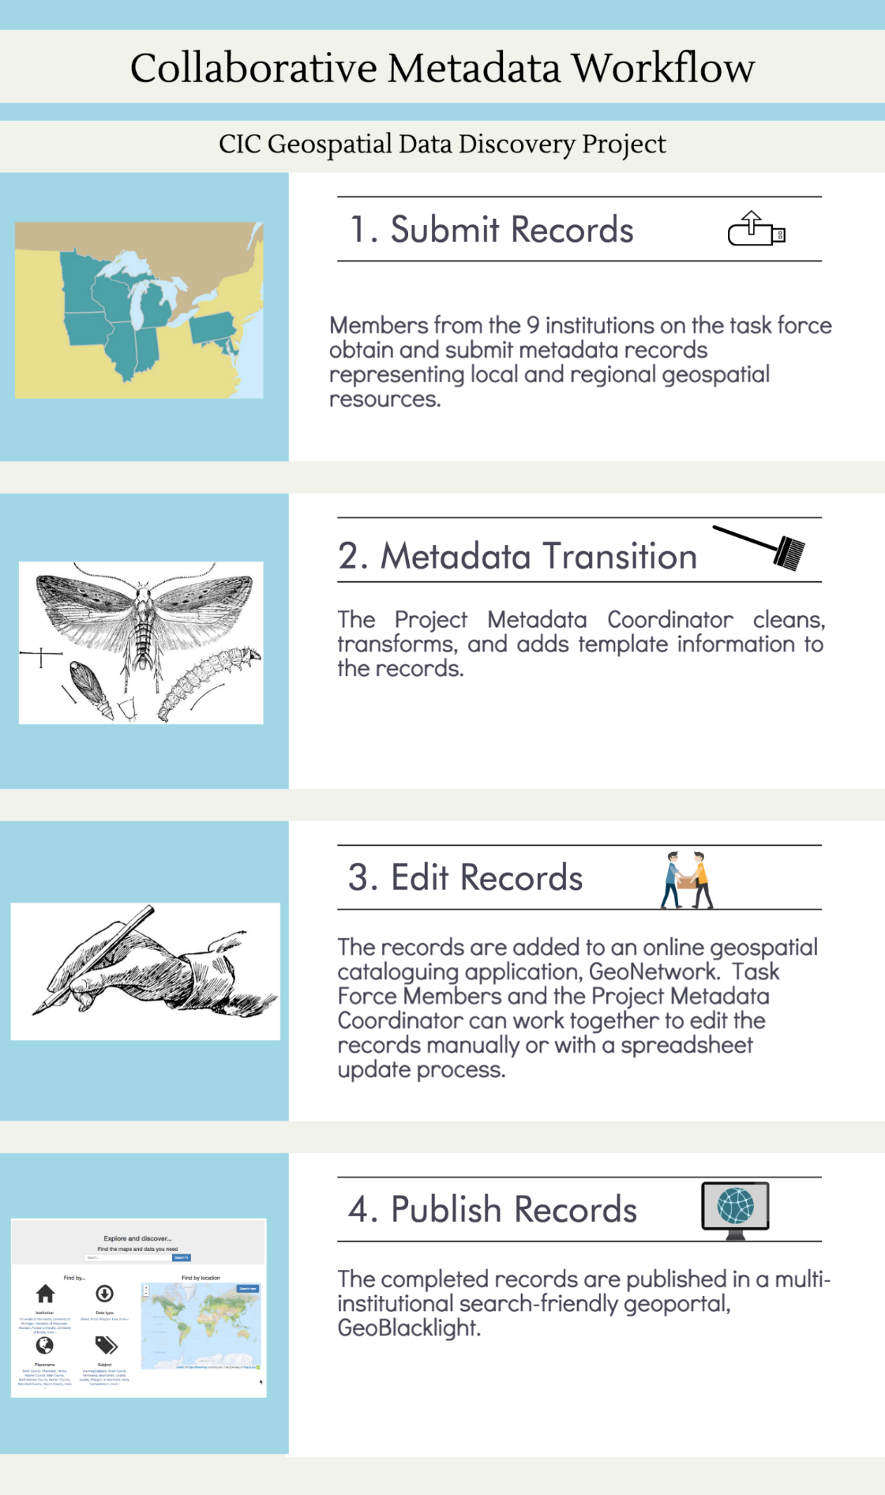


Collaborative metadata workflow

