Slide 1

Managing Digitization Priorities with Metrics
Robin C. Pike
MARAC, S1: Archival Impact, April 15, 2016

Slide 2
History of Digitization
Ad hoc
Office of Digital Collections and Research
Digital Collections Unit
Digital Conversion and Media Reformatting

Slide 3
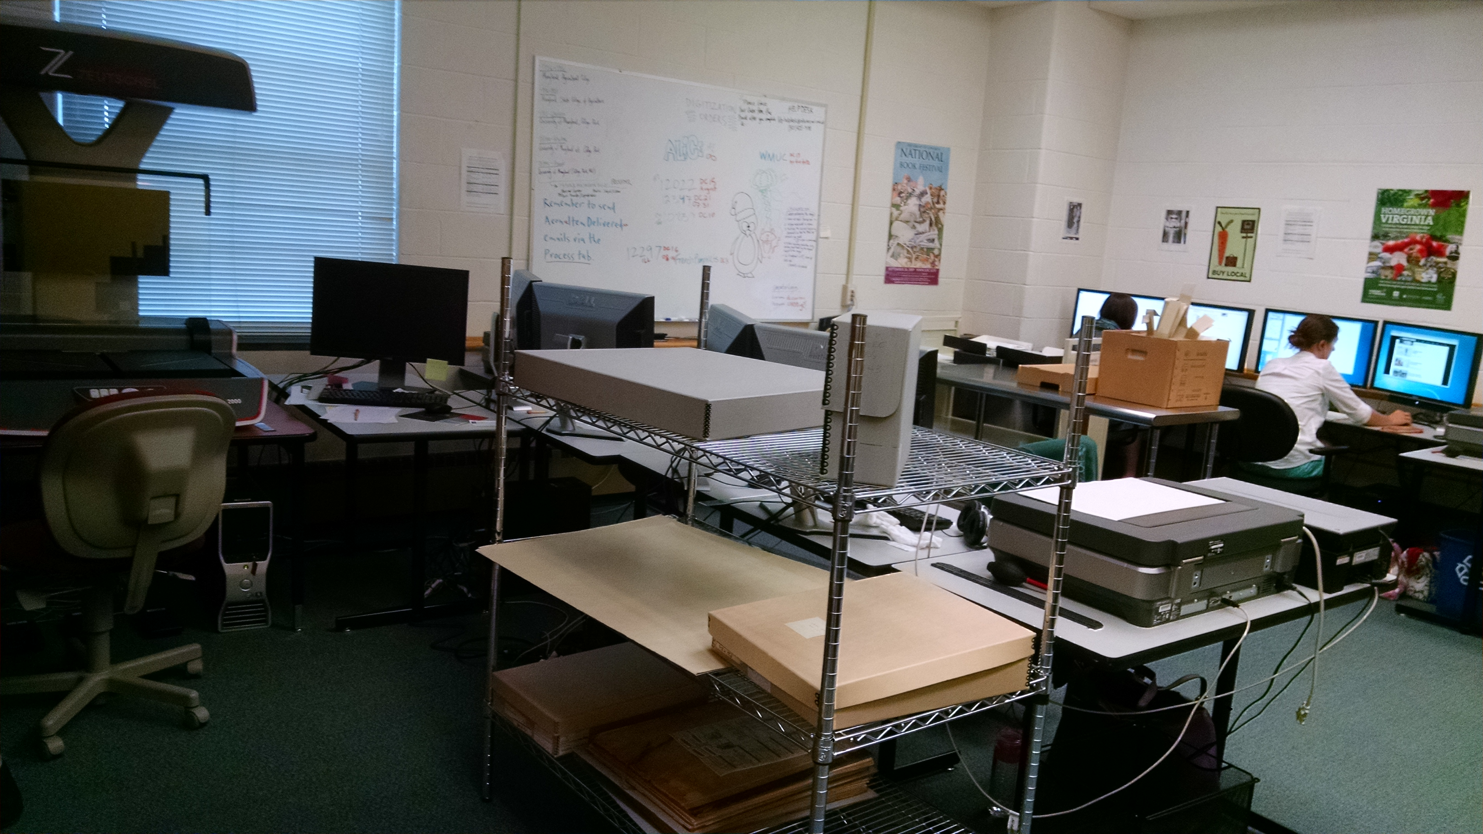
Development of Workflows
Four-year process
In-house
Vendor

Slide 4
Development of Digital Collections
Seven campus libraries
Broad collection interests

Slide 5
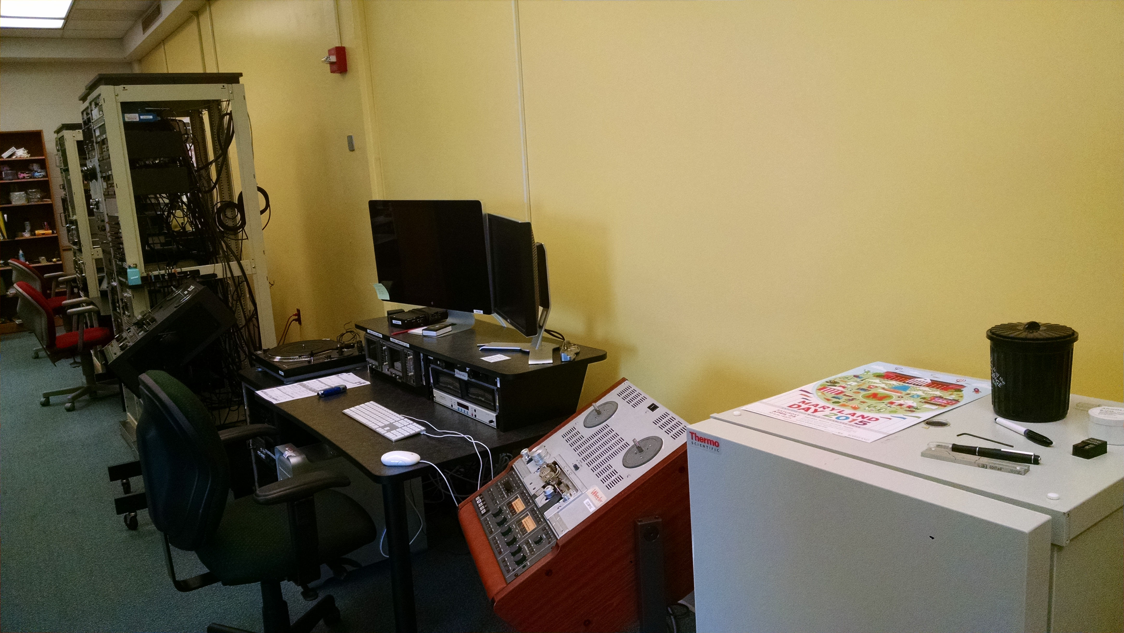
Production/Collection Growth
In-house
  Requests
    Patrons
    Staff (exhibits, classes, etc.)
  Small projects
    Second/third tier workflow
Vendor
  Large projects
    Special projects
  Requests of specialized formats

Slide 6
Digitization Vendors
KEY: grouping “like” formats together for better rates
Lyrasis Digitization Collaborative
  Internet Archive
Rationale
  One overarching vendor agreement
  Discounted rates (from normal vendors’ rates)
  Set SOW, with some modifications
  Spend more time on projects, not contracts
Ad hoc vendors
  Specialized work
  Deadlines

Slide 7
Selection Process
Access need
  Patron/staff requests
  Formats are barrier to unmediated access
Preservation need
  Assessments
Institutional priorities

Slide 8
Digitization Initiatives Committee (DIC)
In lieu of budget line
Scalable process
Cross-divisional expertise/interests

Slide 9
DIC Criteria
Area | Considerations | Weight | Score
Relation to Teaching and Research Priorities | Intellectual value, collection assessment score (if available), previous use of material, etc. | 1 | High=3 Moderate=2 Low=1 None=0
Relation to Library Administration Priorities | Political, space (disposition or sending to offsite storage), development, public relations, etc. | 1 | High=3 Moderate=2 Low=1 None=0
Department/Unit Prioritization | When a department/unit submits more than one project, DIC will contact you to request prioritization information. | 2 | High=3 Moderate=2 Low=1 None=0
Continuation from Previous FY | Multi-year proposal. | 2 | Yes=1 No=0
Preservation Need | Preservation assessment score; consult with Preservation & Conservation. | 2 | High=3 Moderate=2 Low=1 None=0
Project Readiness | Available description for metadata; status of preservation work; material selection; other resources needed; plans for prep work or prep work completed. People should have spoken to MSD or P&C and prep work should be on work plans. | 2 | High=3 Moderate=2 Low=1 None=0
Available Funding | Gifts, endowments, donors, partners, grants, etc. | 2 | Full=2 Some=1 None=0
Partnerships | Campus, grants, CIC, etc. Relationships or funding. | 3 | Yes=1 No=0
Copyright status | On-campus access only will not be a limiting factor to digitization. | 4 | Public=2 On-campus=1 Dark archive=0

Slide 10
Funding Projects
Digitization Initiatives Committee
  Operations (state line)
  Gifts
  Endowments
  Foundation
  Fundraising
Grants

Slide 11
How We’re Tracking Usage
Better representation across collection areas
Google Analytics
Web scraper used for Internet Archive
Asking for statistics from Chronicling America

Slide 12
Usage Trends 2013-2015
Region
  70-80% Non-Metro
  80-90% Non-College Park
60-80% New Users (though each College Park public computer session is tracked as new)
Languages of highest use
  English (US), Japanese, European languages (various)
3-4 pages visited, on average
As social media referrals increase
  60-70% Leave after arriving on initial page
  Average session decreasing from 3-4 minutes to 2-3 minutes
Pageview trends ranking by semester: Fall, Spring, Summer, Winter
Increasing mobile users

Slide 13
Content Trends 2013-2015
Most frequent landing page is “digital collections home page”
Users follow search-result-search pattern
Popular digital exhibits/collection landing pages
  Appear to be consistent interest among semesters, inferring classes, though not necessarily from UMDCP
Most popular:
  Baroness Elsa von Fretag-Loringhoven Digital Library (Dada movement, poems and papers)
  Films at UM (educational licensed film content)
  University AlbUM (UMD photos from various collections)
  Prange Collection (censored publications from US Occupation of Japan)
  Jim Henson Collection (licensed videos)

Slide 14
Plans for Data Use
Integrate into DIC prioritization rubric
Outreach to collection areas
  Project planning
Fundraising/grants for collection areas
Repository development
  Access restrictions due to copyright
  Need to be more friendly for mobile users (Zoomify image viewer uses flash)

