Slide 1
USMAI data warehouse initiative:
Overview of application design and ETL process development
Tiffany Schoneboom & Joseph Koivisto
(University of Maryland)

Slide 2


Overview
ILS reporting clunky, inaccessible
Requires sys representative to pull custom reports or generate custom code for automated reports
Users need easier user-driven, on-demand reporting functionality
Data warehouse would support transfer of ILS data to independent application server with graphic interface reporting dashboard
Promote data visibility, unique data reuse & assessment
Reduce wait time, sysadmin dependency

Slide 3
Project overview
Resource Acquisitions & Licensing Subgroup proposed data warehouse application
Task group produced findings & recommendations (December 2016)
Objectives, deliverables developed as part of initiation plan authored by consortial leadership & consortial applications support team (October 2017)
Data architecture consultant hired (March 2018 - February 2019)
System reporting & data source analysis
General requirements
High level architecture definition
February 2019 to Present
Implementation of requirements for Historical Load and Incremental Load ETL

Slide 4
Data warehouse overview
DW application server
(Jasperreports)
Extract, transform, and load procedures
Bibliographic, user, and circulation data
DW data
(PostGRES)

Slide 5
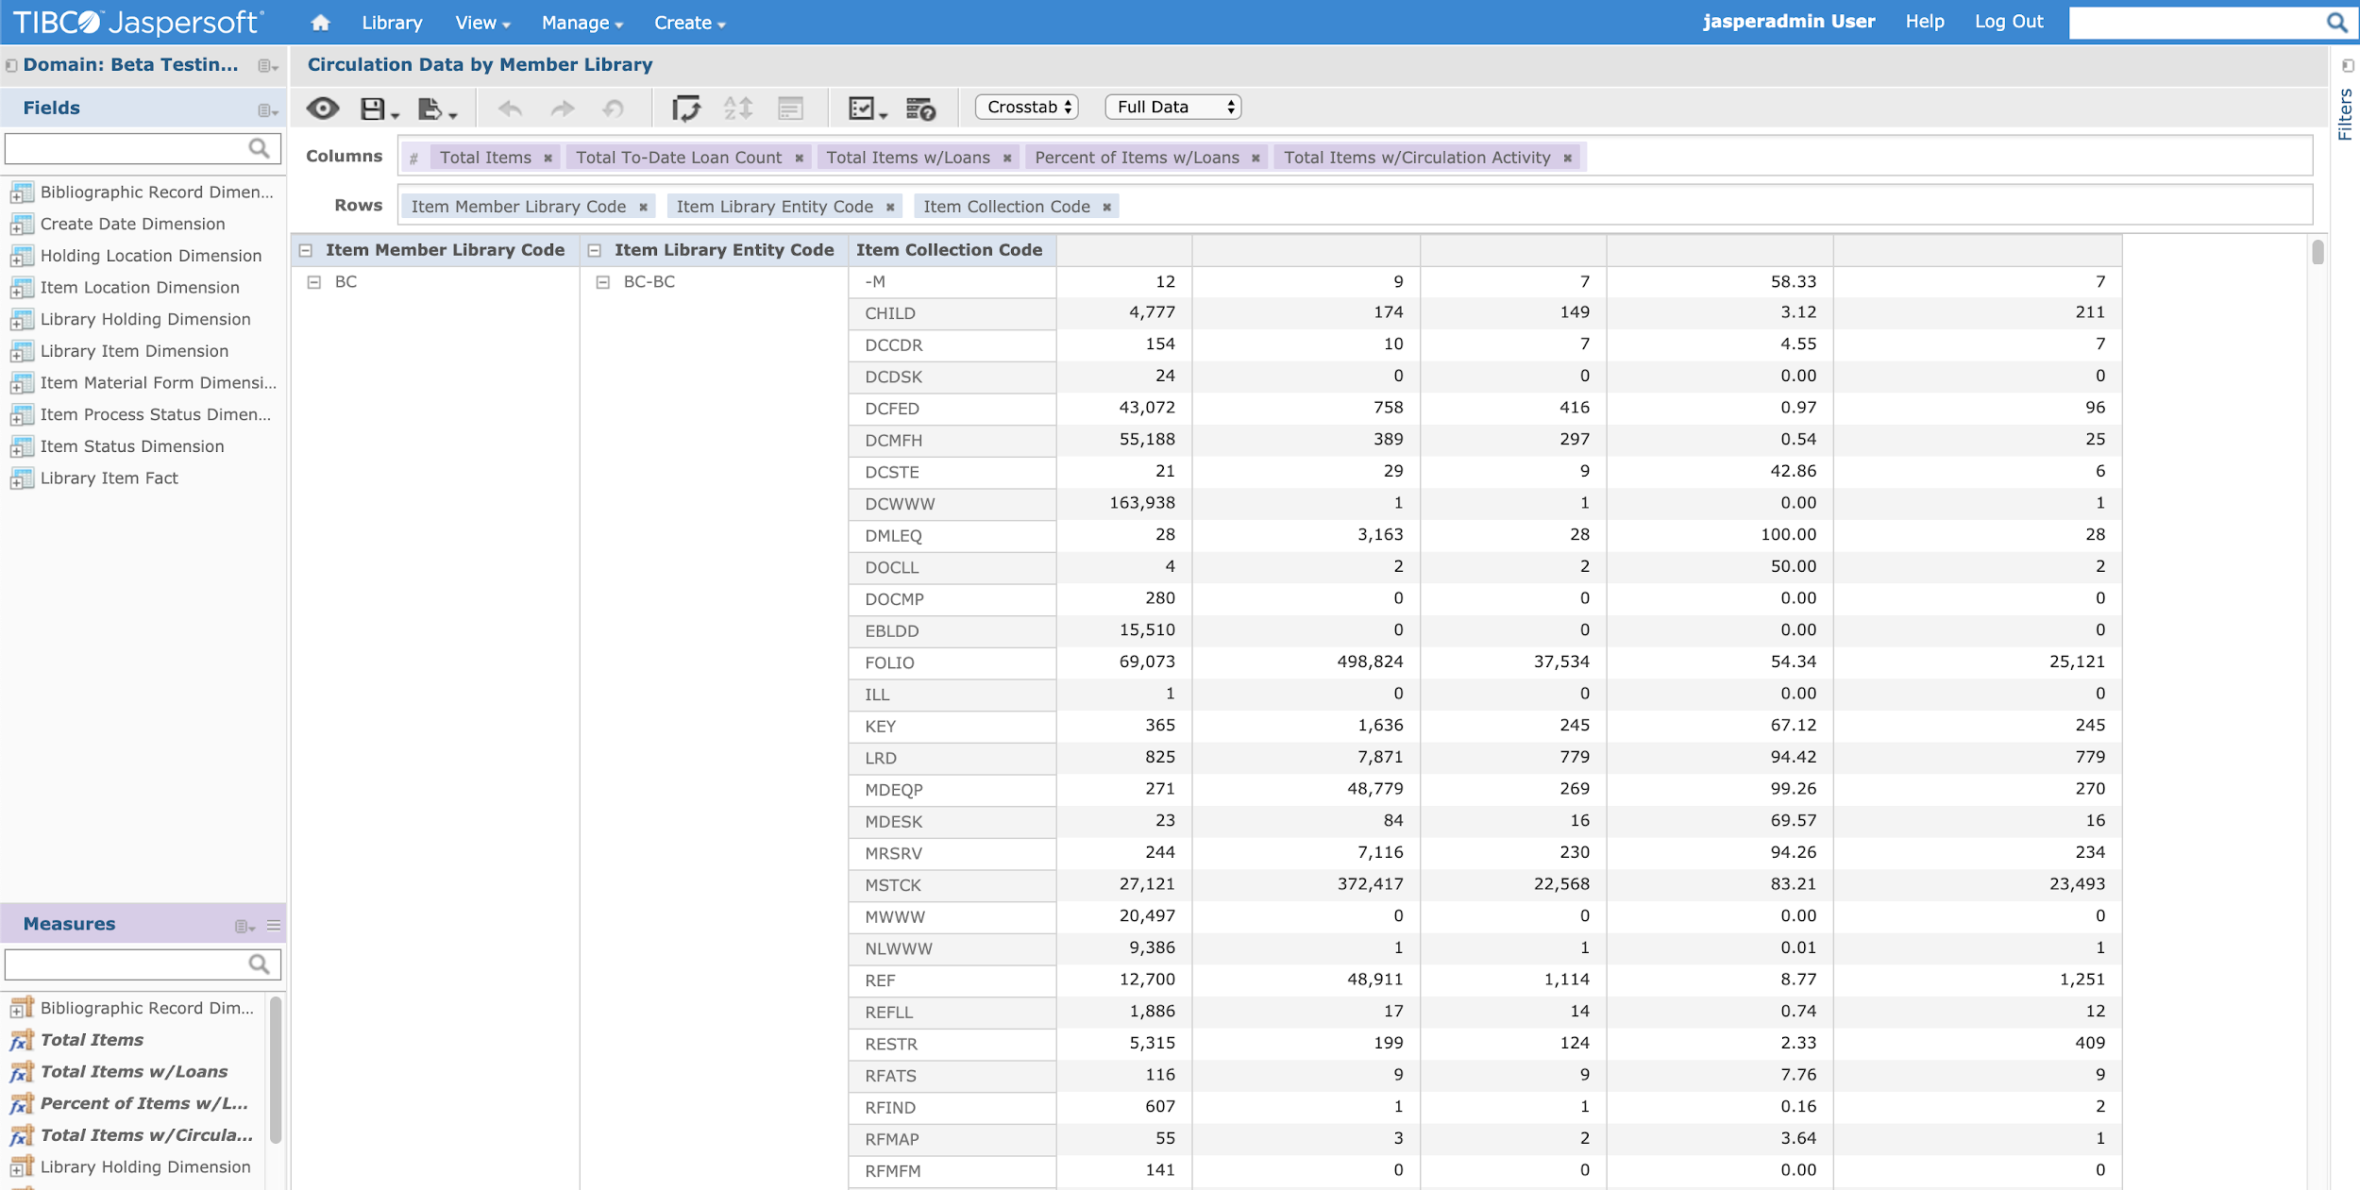
Jasperreports
Notes:
Here’s a preview of what the GUI for Jasperreports looks like.
Drag and drop
Users can create reports as they want them, and filter data

Slide 6
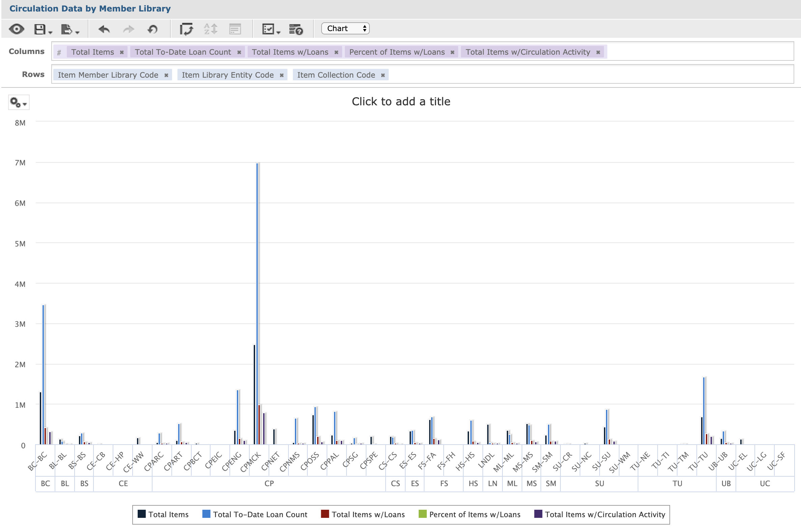
Notes:
Also, has charts and graphs and “picture-perfect” reports which are made for printing.

Slide 7
Data warehouse overview
DW application server
(Jaspersoft)
Extract, transform, and load procedures
Bibliographic, user, and circulation data
DW data
(PostGRES)

Slide 8
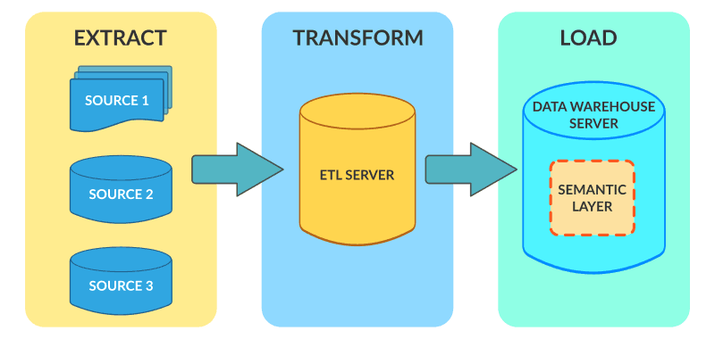
What is ETL?
Extract
Get data from the source database, Aleph’s database.
Transform
Clean, data-quality check, and transform data. Verify that the transformation is correct.
Load
Load the transformed data into the DW
Notes:
You are probably wondering, what exactly is ETL?
E stands for Extract, which in this case is reading the data from the Aleph database. The data in Aleph is notoriously complicated, and there are many different sources of data in a few diff formats. - the datawarehouse must be kept up to date with the aleph db, so regular extracts are needed. We do them every night.
T stands for Transform.
This is where the data is cleaned, and converted into the right form needed for the data warehouse. Transformations can require using Lookup tables, or combining data from multiple sources. This step takes various sources and implements the new organization of the data into dimensions for the data warehouse, which are at a different granularity than the original extract format.
The last step Load, is getting the data into the target data warehouse database.

Slide 9
From ETL tool to hand-coded ETL
Alex, our DW consultant put together complex documentation and requirements for 1 year, and also began a historical data ETL load in Pentaho Data Integration.
Historical load was refined in three months by David Dahl and is currently accessible in our Jasperreports reporting server
Learning Pentaho Data Integration was not easy.

Slide 10
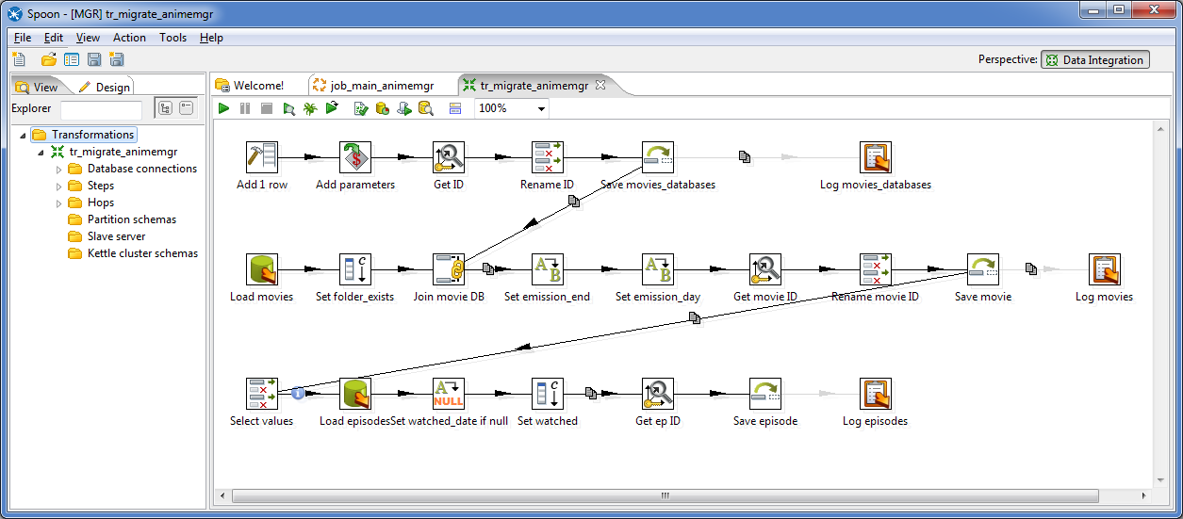
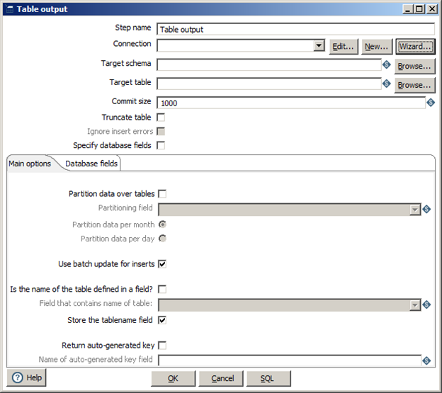
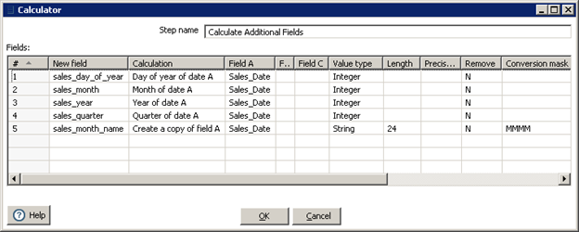
Pentaho Data Integration
Notes:
Here I’ll show you why Pentaho was so hard to learn.
While reading an entire book on using Pentaho, and doing the tutorials in the book, I grew very frustrated with the drag and drop coding, and complicated menus of the interface. From the start, I had some issues reading data, and doing basic transformation logic, and the program did not have great error messages to give me hints on where something was wrong. This made development difficult.
I also researched using Python to build the ETL process, since I heard it was a common language of choice for data pipelines and I am most familiar with Python.
There are many examples of projects that used plain python or python with other libraries to accomplish etl pipelines.

Slide 11
Benefits of hand-coding the ETL process in Python
Complete and transparent control over the ETL process.
No need for me or future CLAS developers to beat the Pentaho learning curve.
Avoid vendor dependency on the Pentaho company
Maintainability and sustainability given CLAS and SSDR developer skill sets.
Ability to not repeat processes unnecessarily: DRY
Building skills in software development which will be more useful for CLAS in the long run than proprietary drag and drop coding skills.
Notes:
Complete and transparent control over the ETL process.
No need me or future developers to beat the Pentaho learning curve.
No vendor dependency on the Pentaho company
Maintainability given CLAS and SSDR developer skill sets.
Building skills in software development which will be more useful for CLAS in the long run than proprietary drag and drop coding skills.
Now that you know some of the benefits if hand-coding, I want to talk about the challenges that have come up and how they have been dealt with so far.

Slide 12
Note on DW ETL complexity
Data sources:
14 TSV files: some extracted from Aleph tables and others manually created
126 fields need to be transformed with unique requirements
Data Targets:
9 Dimension tables, and 1 Fact table to be written to.
149 fields in the end
Alex’s requirements include three intermediate tables in between the TSV and the final tables.
Process status table, Error message table

Slide 13
Simple example of what happens to one field: z30_rec_key
Starting value | ‘ 009000616000010 ‘
Pre-processing value Trim leading and trailing white-spaces | ‘009000616000010’
Data-quality checks: No missing values? Valid length? Is it numeric? | ‘009000616000010’ ‘009000616000010’ ‘009000616000010’
Transformation 1 Move As-Is to Target Column: LBRY_ITEM_SOURCE_SYSTEM_ID | ‘009000616000010’
Transformation 2 Substring index 0 through 9 Target Column: LBRY_ITEM_ADM_NO | ‘009000616’
Transformation 3 Substring index 9 through 15 Target Column: LBRY_ITEM_SEQ_NO | ‘000010’
Notes:
Managing the particular flow of steps that need to happen to each field in the DW ETL is difficult, because each field has unique requirements.
Here is a simplified example of what happens to one field, z30_record_key, the key of the library item dimension in the data warehouse.
This field’s value is preprocessed: or trimmed of leading and trailing white spaces.
Then the result of the Preprocessing is checked for data-quality problems such as: no missing values, is the length valid, is the value numeric. If the value passes the checks, then the value is passed on to the next data quality check.
For some fields the process of DQ checks is more complicated, if a field’s value fails certain DQ check, then a replacement value is substituted in place of the original value. These fields cannot be null or contain invalid values. The replacement values are to make sure the values in the DW are not missing or invalid.
Then this field has three different “Transformations”. The first is an as-is move. The second involves a substring of the first 8 characters, and the third involves a substring of the last six characters.
Other fields have unique transformations as well requiring their own specific transform functions.

Slide 14
Problem:
Managing configuration of transformations for each field using Google Sheets
Example of table data TSV
Source to Target Mapping Google sheet
Solution: I wrote a python script to convert the google sheet information into a JSON representation of each field and its transformations and data-quality checks.
Notes:
Look at - how many fields there are in the source, and how many ther eare in the target
This spreadsheet lays out all the steps that need to happen to a field
Another sheet exists for DQ transformations
Other sheets exist for replacement values needed for DQ checks
Problem: How do I represent the transformation and data-quality check logic in my program without using a google spreadsheet? How do I cleanly associate special transform functions with field names?
Solution: Convert the Google Sheet into JSON structure using a script. Associate any specific functions needed with the fields with special transformation or data-quality needs in a column. Create a transformation “engine” that will use JSON data as instructions for dealing with various fields.

Slide 15

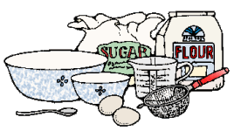

ETL design is like baking efficiently:
Data and tools to process the data
Source-to-target Instructions in JSON form.
Final product:
Data Warehouse Dimensions
Notes:
My design decision to generate JSON dimension table configuration files using the google sheets is like using standardized recipe cards to bake different desserts.
However, desserts use a lot of the same ingredients, and these Data dimensions are made up of all different fields.
So using the Google sheet in JSON form, like recipe cards, gives us a standardized format that allows me to chain together the ingredients for a transformation with the instructions with what needs to happen. The transformations and checks become metadata driven.
The Google sheet is more user friendly for viewing and editing than JSON, but JSON is easier for my program to work with and it is version controllable.

Slide 16
Technical Challenges with hand-coding the ETL
I am a team of one developer. 2nd developer position has been empty since last October.
Joseph has been able to help with testing, but both of us are new to it.
Making sense of complex requirements as one person and architecting the design alone.
Dealing with complexity of the requirements that Alex has created and trying to find simplicity in them.
Finding flaws in the ETL design along the way.

Slide 17
Ongoing Challenge: Ensuring Accuracy of the ETL
I want to have full test coverage of the entire ETL process so that we can be confident that everything is working expected and is ACCURATE.
Unit testing of individual functions. Joseph has made a ton of progress on this.
End-to-end testing how pieces are working together from start to finish
Functional testing to ensure requirements are being met

Slide 18
Data Warehouse ETL Lessons learned
Be prepared to hire an expert - Data Warehousing is an entire field of specialists
GUI ETL tools are complicated. There are some developers who specialize in only these tools, but does it make sense for libraries to hire them?
Sustainability of the ETL process. What happens when your specialists leave?
Start with the basic functionality and add the specifics later.
At least two developers are better than one.

